Slide 1
Project Title
Name: S. S. Dharshini
Register number:922525243038
Student performance prediction using machine learning

Slide 2
Abstract
This project predicts student academic performance using Machine Learning techniques. The system analyzes attendance, internal marks, assignment scores, and academic records to identify students who may require additional support.

Slide 3
Objectives
Predict student performance
Identify at-risk students
Analyze academic data
Generate reports

Slide 4
Frontend Details
HTML, CSS, Bootstrap, JavaScript
Pages: Login, Dashboard, Student Entry, Prediction, Reports

Slide 5
Backend Details
Python Flask, Scikit-Learn, MySQL
Modules: Authentication, Data Management, ML Prediction, Reports

Slide 6
System Architecture
Frontend -> Flask Backend -> ML Model -> MySQL Database

Slide 7
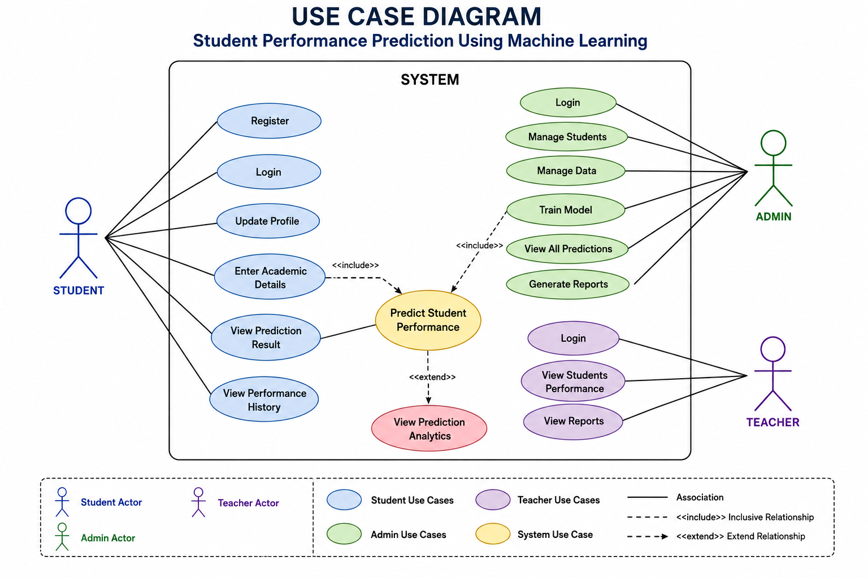
Use Case Diagram
Admin: Login, Manage Data, Generate Reports
Student: Login, View Predictions

Slide 8
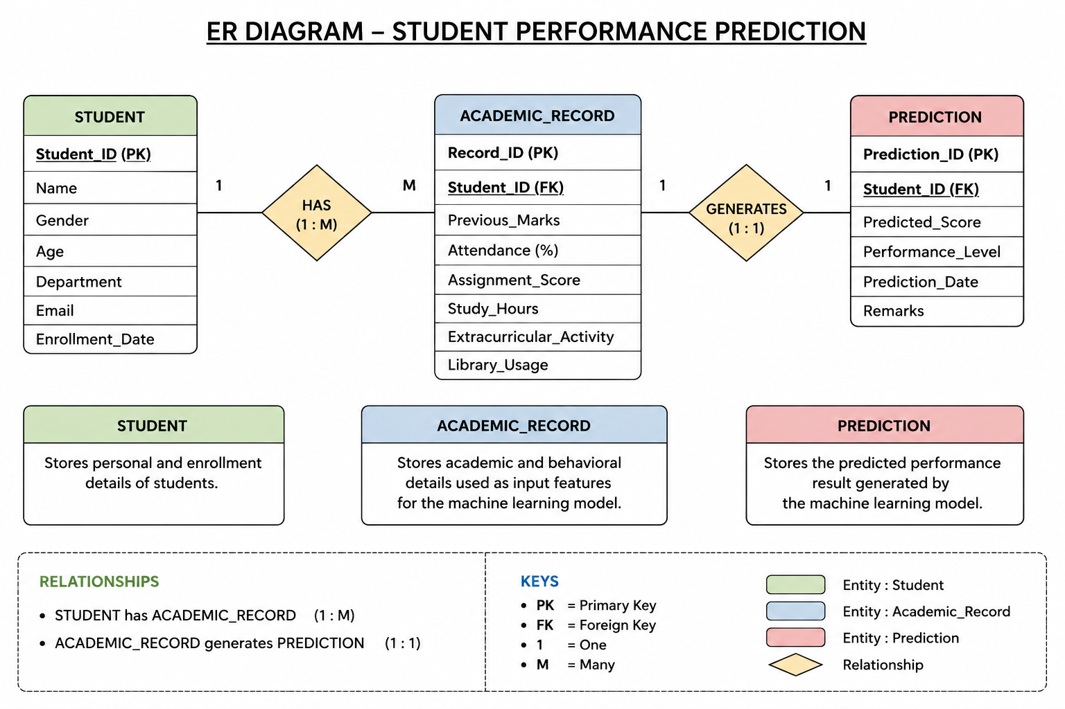
ER Diagram
Student -> Academic_Record -> Prediction
Admin manages system

Slide 9
Database Tables
Student
Academic_Record
Prediction
Admin

Slide 10
Conclusion
AI-based system for predicting student performance and identifying students needing academic support.

