Slide 1
Digital Speech Processing Homework 3
May 09 2018
黃淞楓

Slide 2
To complete this homework, you need to…
Build a character-based language model with toolkit SRILM.
Decode the ZhuYin-mixed sequence.

Slide 3
Outline
Introduction
Flowchart
SRILM
Step by Step
Submission and Grading

Slide 4
Introduction
讓 他 十分 ㄏ怕
只 ㄒ望 ㄗ己 明ㄋ 度 別 再 這ㄇ ㄎ命 了
演ㄧ ㄩ樂 產ㄧ ㄐ入 積ㄐ ㄓ型 提ㄕ 競爭ㄌ
HW3：注音文修正
讓 他 十分 害怕
只 希望 自己 明年 度 別 再 這麼 苦命 了
演藝 娛樂 產業 加入 積極 轉型 提升 競爭ㄌ

Slide 5
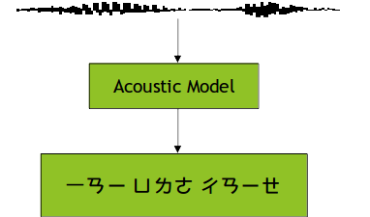
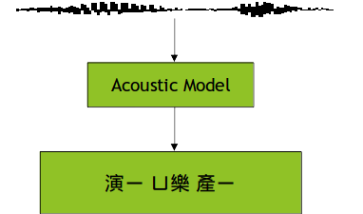
Introduction (cont’d)
Imperfect acoustic models with phoneme loss.
The finals of some characters are lost.

Slide 6
Introduction (cont’d)
Proposed methods:
Reconstruct the sentence by language model.

Slide 7
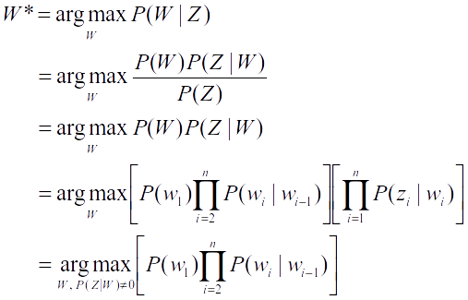
Introduction (cont’d)
For example, let Z = 演ㄧ ㄩ樂 產ㄧ
P(Z) is independent of W
W=w₁w₂w₃w₄...w_{n} , Z=z₁z₂z₃z₄...z_{n}
Bigram language model

Slide 8
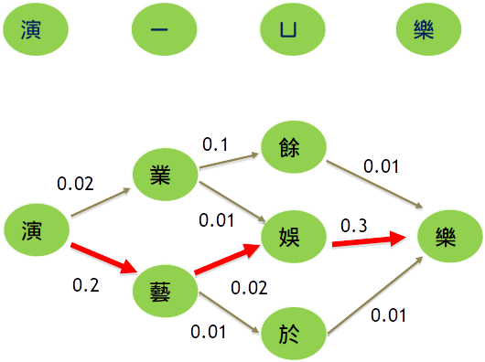
Flowchart
Big5-ZhuYin.map
ZhuYin-Big5.map
corpus.txt
lm.cnt
bigram.lm

Slide 9
SRILM
SRI Language Model toolkit
http://www.speech.sri.com/projects/srilm/
A toolkit for building and applying various statistical language models
Useful C++ classes
Using/Reproducing some of SRILM

Slide 10
SRILM (cont’d)
Build it from source code (Provided on course website)
Allows you to use SRILM library
Or download the executable from the course website to finish the first part of HW3
Different platform:
i686 for 32-bit GNU/Linux
i686-m64 for 64-bit GNU/Linux (CSIE workstation)
Cygwin for 32-bit Windows with cygwin environment

Slide 11
SRILM (cont’d)
You are strongly recommended to read FAQ on the course website
Possibly useful codes in SRILM
$SRIPATH/misc/src/File.cc (.h)
$SRIPATH/lm/src/Vocab.cc (.h)
$SRIPATH/lm/src/ngram.cc (.h)
$SRIPATH/lm/src/testError.cc (.h)

Slide 12
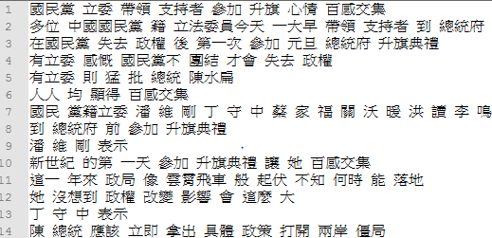
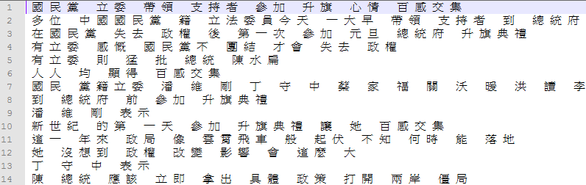
SRILM (cont’d)
Big5 Chinese Character separator written in perl:
perl separator_big5.pl corpus.txt > corpus_seg.txt
Why we need to separate it? (Use char or word?)

Slide 13
SRILM (cont’d)
./ngram-count -text corpus_seg.txt -write lm.cnt -order 2
-text: input text filename
-write: output count filename
-order: order of ngram language model
./ngram-count -read lm.cnt -lm bigram.lm -unk -order 2
-read: input count filename
-lm: output language model name
-unk: view OOV as <unk>. Without this, all the OOV will be removed

Slide 14
Example
corpus_seg.txt
在 國 民 黨 失 去 政 權 後 第 一 次 參 加 元 旦 總 統 府 升 旗 典 禮
有 立 委 感 慨 國 民 黨 不 團 結 才 會 失 去 政 權
有 立 委 則 猛 批 總 統 陳 水 扁
人 人 均 顯 得 百 感 交 集
bigram.lm
\data\
ngram 1=6868
ngram 2=1696830
\1-grams:
-1.178429 </s>
-99 <s> -2.738217
-1.993207 一 -1.614897
-4.651746 乙 -1.370091
......
lm.cnt
夏 11210
俸 267
鴣 7
衹 1
微 11421
檎 27
......
(log probability)
(backoff weight)

Slide 15
SRILM (cont’d)
./disambig -text testdata/xx.txt -map ZhuYin-Big5.map -lm bigram.lm -order 2 > $output
-text: input filename, xx = 1, 2, …, 10
-lm: input language model
-map: a mapping from (注音/國字) to (國字)
You should generate this mapping by yourself from the given Big5-ZhuYin.map.
Do not directly copy this command, please replace xx.txt with 1.txt~10.txt.

Slide 16
Generate Map
Big5-ZhuYin.map
一 ㄧˊ/ㄧˋ/ㄧ_
乙 ㄧˇ
丁 ㄉㄧㄥ_
柒 ㄑㄧ_
乃 ㄋㄞˇ
玖 ㄐㄧㄡˇ
…
…
長 ㄔㄤˊ/ㄓㄤˇ
行 ㄒㄧㄥˊ/ㄏㄤˊ
…
ZhuYin-Big5.map
ㄅ 八 匕 卜 不 卞 巴 比 丙 包 …
八 八
匕 匕
卜 卜
…
…
ㄆ 仆 匹 片 丕 叵 平 扒 扑 疋 …
仆 仆
匹 匹
…
…

Slide 17
Generate Map (cont’d)
Be aware of polyphones(破音字)
There could be arbitrary spaces between all characters.
Key - value pairs
Can be random permutation

Slide 18
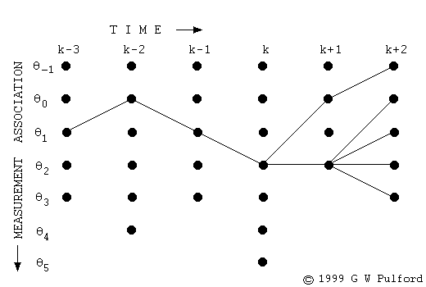
My Disambig
Implement your version of disambig.
Use dynamic programming (Viterbi).
The vertical axes are candidate characters.

Slide 19
Step by Step
Segment corpus and all test data into characters
./separator_big5.pl corpus.txt > corpus_seg.txt
./separator_big5.pl testdata/xx.txt > testdata/seg_xx.txt
You should rename the segmented testdata as testdata/1.txt, testdata/2.txt… and use them in the following task.
Train character-based bigram LM
Get counts:
./ngram-count -text corpus_seg.txt -write lm.cnt -order 2
Compute probability:
./ngram-count -read lm.cnt -lm bigram.lm -unk -order 2

Slide 20
Step by Step (cont’d)
Generate ZhuYin-Big5.map from Big5-ZhuYin.map
See FAQ 4
Using disambig to decode testdata/xx.txt
./disambig -text testdata/xx.txt -map ZhuYin-Big5.map -lm bigram.lm -order 2 > $output
Using mydisambig to decode testdata/xx.txt

Slide 21
Tips
C++ is Required
Speed
SRILM compatibility and utility
You must provide Makefile for execution (See. Grading Procedure for details)
Dual OS or VirtualBox with Ubuntu strongly recommended
Your output format should be consistent with SRILM
<s> 這 是 一 個 範 例 格 式 </s>
There are an <s> at the beginning of a sentence, a </s> at the end, and whitespaces in between all characters.
Zero credit if your format is incorrect

Slide 22
How to deal with Chinese char?
Chinese character: You should use Big5 encoding
All testing files are encoded in Big5
A Chinese character in Big5 is always 2 bytes, namely, char[2] in C++

Slide 23
Submission Example: student ID: r04922167
r04922167/ (see submit_files_template/ in dsp_hw3.zip)
result1/1.txt~10.txt (generated from SRILM disambig with your LM by yourself)
your codes
Makefile
report.pdf
Compress the folder to a zip file and upload it to Ceiba.
20% of the final score will be taken off for wrong format.

Slide 24
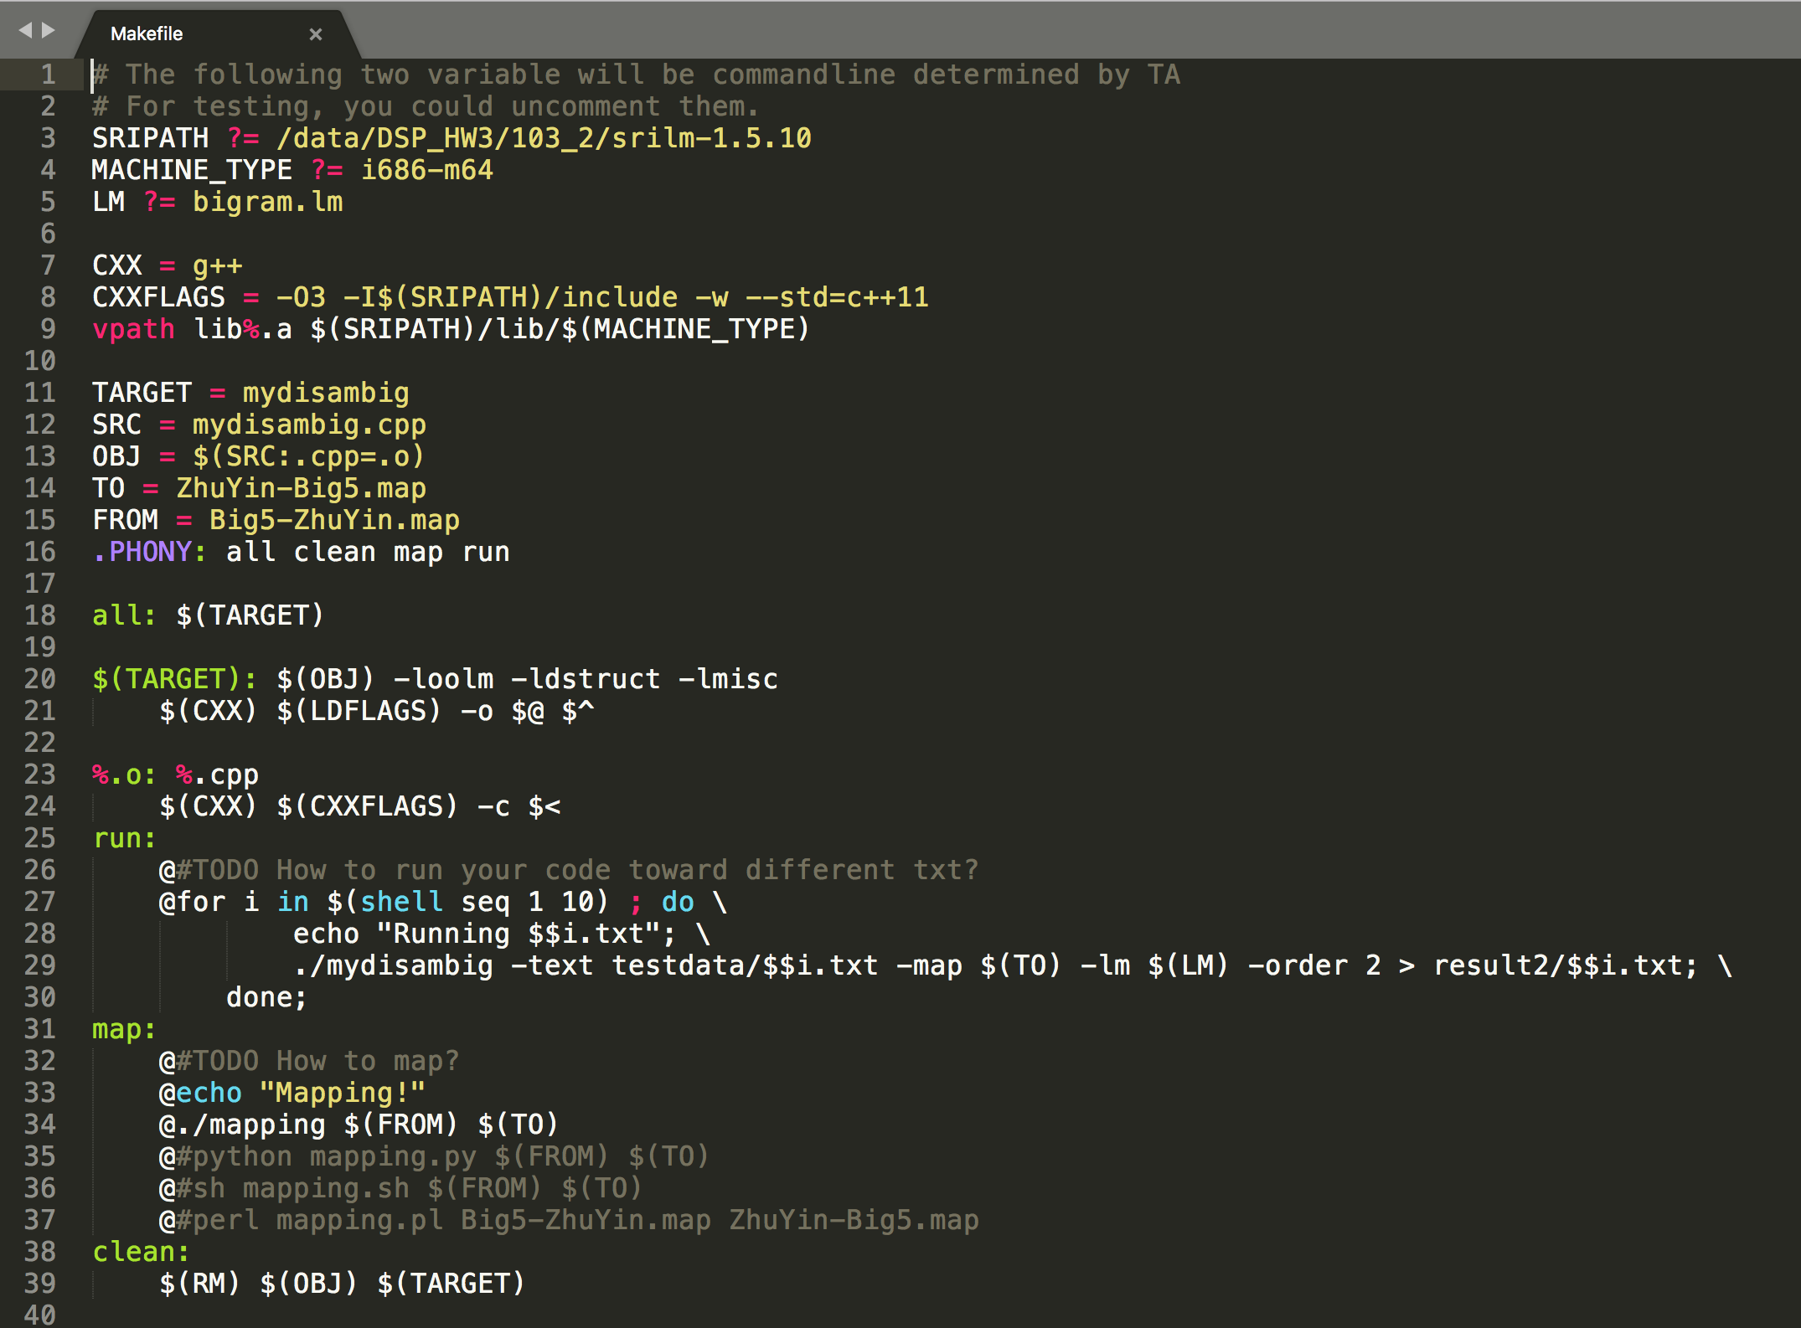
Makefile

Slide 25
Report
Your report should include:
Your environment (CSIE workstation, Cygwin, …)
How to “compile” your program
How to “execute” your program
Not familiar with makefile is fine, tell me how to execute your program
However, you should also strictly follow the spec (regulations about filenames, input files and output files)
ex: ./program –a xxx –b yyy
What you have done
NO more than two A4 pages.

Slide 26
Grading Procedure
There are some files provided by TA but you shouldn’t upload them
Big5-ZhuYin.map, bigram.lm, testdata…
Strictly follow regulations about format
However, you can utilize the files in makefile
test_env/ in dsp_hw3.zip shows locations of files during evaluation
In the following slides, this color specify makefile commands of evaluation scripts

Slide 27
Grading Procedure (cont’d)
(20%) You strictly follow format regulation
Initialization
make clean
copy ta’s bigram.lm, Big5-ZhuYin.map, testdata to your directory
(10%) Your code can be successfully compiled
make MACHINE_TYPE=i686-m64 SRIPATH=/home/ta/srilm-1.5.10 all
i686-m64 is TA’s platform
Your code should be machine-independent(system(“pause”) is invalid in my system) and the user can easily specify the platform and SRILM path

Slide 28
Grading Procedure (cont’d)
(10%) Correctly generate ZhuYin-Big5.map
make map (it should generate r04922167/ZhuYin-Big5.map)
check if r04922167/ZhuYin-Big5.map is correct
(You have to write your own makefile to achieve it. Generation must be based on r04922167/Big5-ZhuYin.map)
(Your output in this step should be r04922167/ZhuYin-Big5.map )
(python/perl/C/C++/bash/awk permitted)
(20%) Correctly use SRILM disambig to decode ZhuYin-mixed sequence
Check if result1/1.txt~10.txt is the same as expected

Slide 29
Grading Procedure (cont’d)
(10%) mydisambig program can run with no errors and crashes
make MACHINE_TYPE=i686-m64 SRIPATH=/home/ta/srilm-1.5.10 LM=bigram.lm run
(it should run based on bigram.lm and generate result2/1.txt~10.txt)
(20%) Your results decoded by your own program are the same as expected
check result2/1.txt~10.txt
TA’s testdata will be segmented testdata, not the given raw testdata. DO NOT use “perl separator_big5.pl” in your makefile to separate testing data again.

Slide 30
Grading Procedure (cont’d)
(10%) Your report contains required information
(10% bonus!) Your program can support trigram language models with speed pruning.
Write down how to execute your trigram code in your report.

Slide 31
If there are runtime errors during TA’s testing
Like compilation error, crash…
TA will ask you to demo your program only with the files you uploaded.
If you can prove that you followed the rules correctly, you will get your credits.

Slide 32
Late Penalty
10% each 24 hours, according to the announced deadline instead of the deadline on Ceiba
100 -> 90 -> 80, not 100 -> 90 -> 81

Slide 33
Notes
Follow the spec!!!!
All of your program should finish the tasks assigned below 10 minutes
Totally checking the correctness with good documents is YOUR JOB
Only the latest files you uploaded to Ceiba will be evaluate (All of your previous uploaded version will be ignored)

Slide 34
Reminders and Suggestions
Read the spec carefully
Finish the first part (SRILM disambig) as early as possible
If everything goes well, you should finish the first part in an hour
Fix the issue of dependencies early
Big5 encoding issue, iconv not recommended
Be sure that you prepare the correct Makefile
Grading procedure is in part automatically done by scripts. You can see the details in the previous slides
See the FAQ in the website

Slide 35
Reminders and Suggestions
Contact TA if needed
email：ntudigitalspeechprocessingta@gmail.com title: [HW3] bxxxxxxxx (your student number)
Check email-FAQ!
TA will not help you debug your program

