Slide 1
DSP HW2-1 HMM Training and Testing
教授：李琳山 助教：陳冠宇

Slide 2
Outline
Introduction
Hidden Markov Model Toolkit (HTK)
Homework Problems
Submission Requirements

Slide 3
Introduction
Construct a digit recognizer - monophone ling | yi | er | san | si | wu | liu | qi | ba | jiu
Free tools of HMM: Hidden Markov Toolkit (HTK) http://htk.eng.cam.ac.uk/
Training data, testing data, scripts, and other resources all are available on http://speech.ee.ntu.edu.tw/DSP2017Autumn/

Slide 4
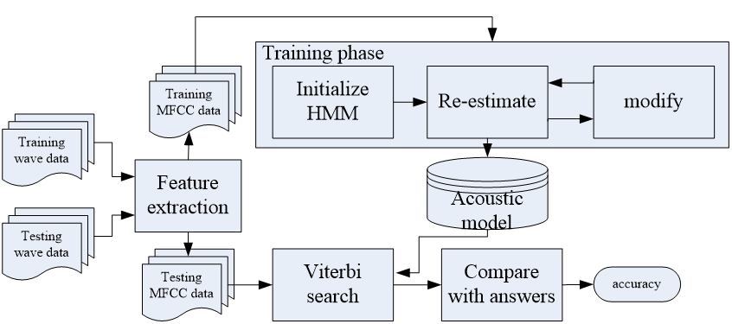
Flowchart

Slide 5
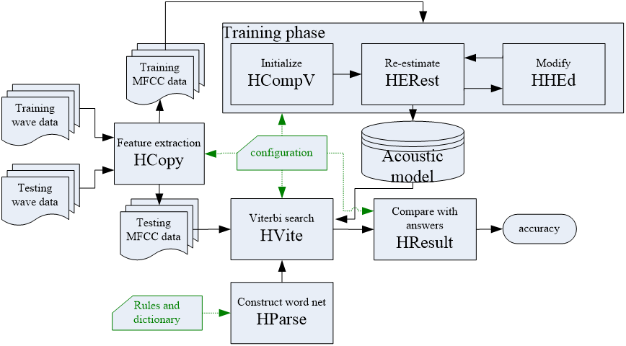
Hidden Markov Model Toolkit (HTK)

Slide 6
Feature Extraction

Slide 7

Feature Extraction - HCopy
Convert wave to 39 dimension MFCC. -C lib/hcopy.cfg ● input and output format ● parameters of feature extraction ● Chapter 7 - Speech Signals and Front-end Processing -S scripts/training_hcopy.scp ● a mapping from Input file name to output file name
speechdata/training/ N110022.wav
MFCC/training/ N110022.mfc

Slide 8
Training Flowchart

Slide 9
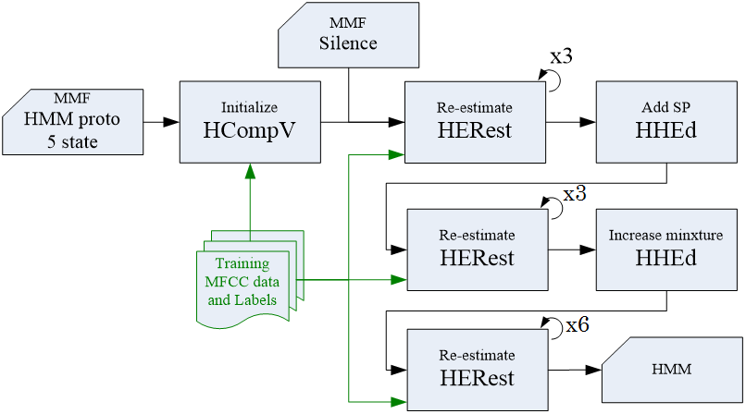
Training Flowchart

Slide 10

Initialize model - HCompV
Compute global mean and variance of features -C lib/config.cfg ● set format of input feature (MFCC_Z_E_D_A) -o hmmdef -M hmm ● set output name: hmm/hmmdef -S scripts/training.scp ● a list of training data lib/proto ● a description of a HMM model, HTK MMF format
⇨ you can modify the Model Format here (# states) !

Slide 11
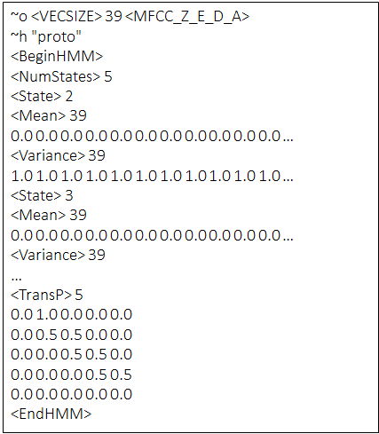
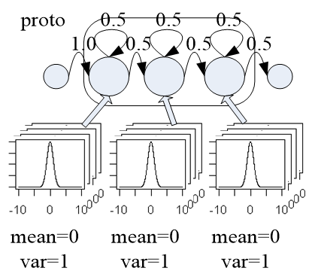
Initial MMF Prototype
MMF: HTKBook chapter 7

Slide 12
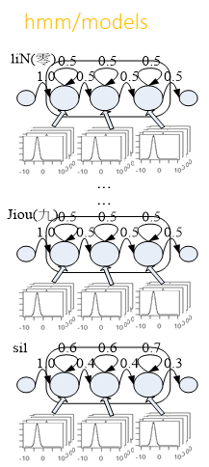
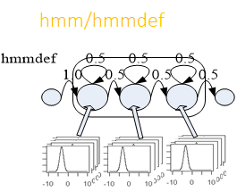
Initial HMM
hmm/models
bin/macro Produce MMF contains vFloor
bin/models_1mixsil add silence HMM
hmm/hmmdef

Slide 13
Training Flowchart

Slide 14
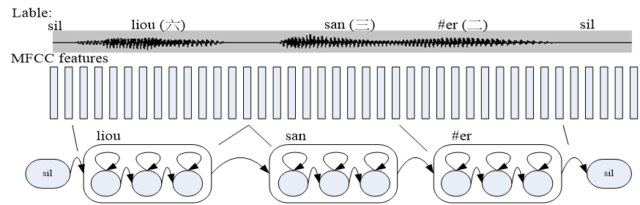
Adjust HMMs - HERest
Basic problem 3 for HMM ● Given O and an initial model λ=(A,B, π), adjust λ to maximize P(O|λ)

Slide 15

Adjust HMMs - HERest
Adjust parameters λ to maximize P(O|λ) ● one iteration of EM algorithm ● run this command three times => three iterations –I labels/Clean08TR.mlf ● set label file to “labels/Clean08TR.mlf” -o lib/models.lst ● a list of word models (liN (零), #i (一), #er (二),… jiou (九), sil)

Slide 16

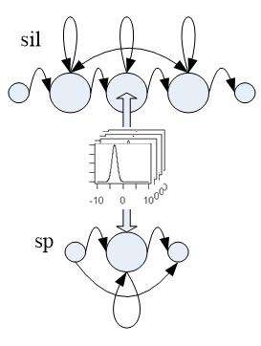
Add SP Model
Add ”sp”(short pause) HMM definition to MMF file “hmm/hmmdef”

Slide 17

Modify HMMs - HHEd
lib/sil1.hed ● a list of command to modify HMM definitions lib/models_sp.lst ● a new list of model (liN (零), #i (一), #er (二),… jiou (九), sil, sp)

Slide 18
Training Flowchart

Slide 19

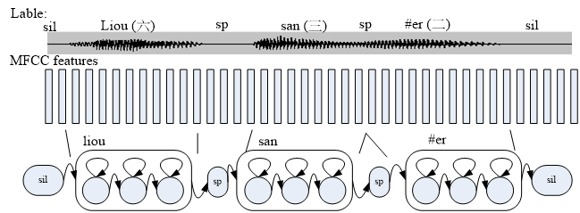
Adjust HMMs Again - HERest

Slide 20

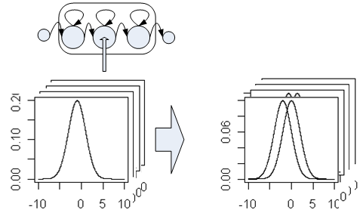
Increase Number of Mixtures - HHEd

Slide 21
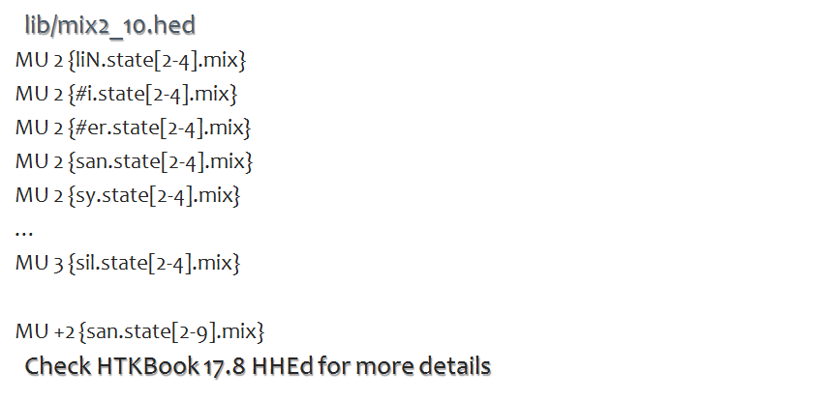
Modification of Models
You can modify # of Gaussian mixture here.
This value tells HTK to change the mixture number from state 2 to state 4. If you want to change # state, check lib/proto.
You can increase # Gaussian mixture here.

Slide 22
Adjust HMMs Again - HERest

Slide 23
Training Flowchart
Hint：Increase mixtures little by little !

Slide 24
Testing Flowchart

Slide 25
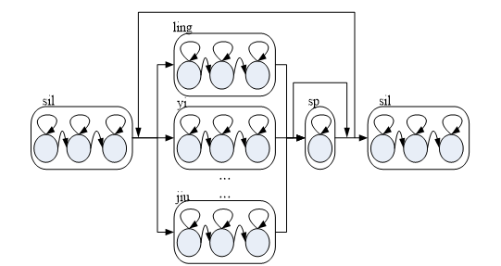
Construct Word Net - HParse
lib/grammar_sp ● regular expression ● easy for user to construct lib/wdnet_sp ● output word net ● the format that HTK understand

Slide 26
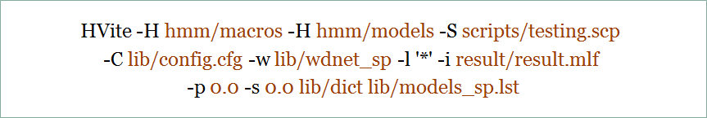

Viterbi Search - HVite
-w lib/wdnet_sp ● input word net -i result/result.mlf ● output MLF file lib/dict ● dictionary: a mapping from word to phone sequences ling -> liN, er -> #er, … . 一 -> sic_i i, 七-> chi_i i

Slide 27
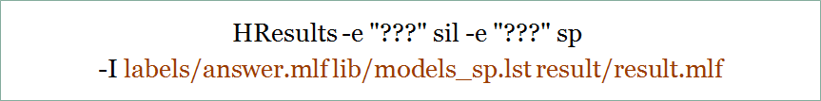
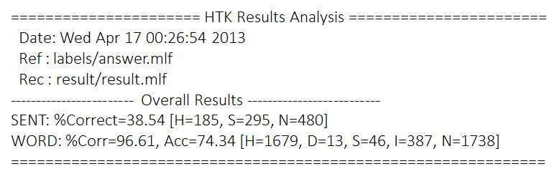
Compared With Answer - HResults
Longest Common Subsequence (LCS) Ref：See HTK book 3.2.2 (p. 33)

Slide 28
Report - Part 1 (40%) - Run Baseline
Download HTK tools and homework package
Set PATH for HTK tools：set_htk_path.sh
Execute (bash shell script) 01_run_HCopy.sh 02_run_HCompV.sh 03_training.sh 04_testing.sh
You can find accuracy in “result/accuracy” the baseline accuracy is 74.34%
Put the screenshot of your result on the report.

Slide 29
Useful tips
To unzip files unzip XXXX.zip tar -zxvf XXXX.tar.gz
To set path in “set_htk_path.sh” PATH=$PATH:“~/XXXX/XXXX”
In case shell script is not permitted to run… chmod 744 XXXX.sh

Slide 30
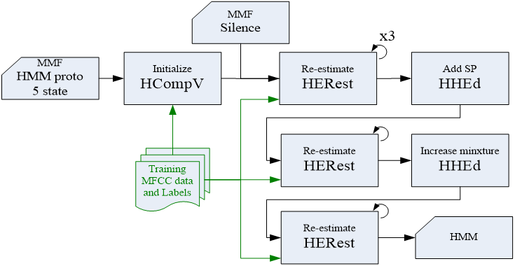
Report - Part 2 (40%) - Improve Accuracy
Acc > 95% for full credit ; 90~95% for partial credit and put the screenshot of your result on the report.
proto
03_training.sh, mix2_10.hed...

Slide 31
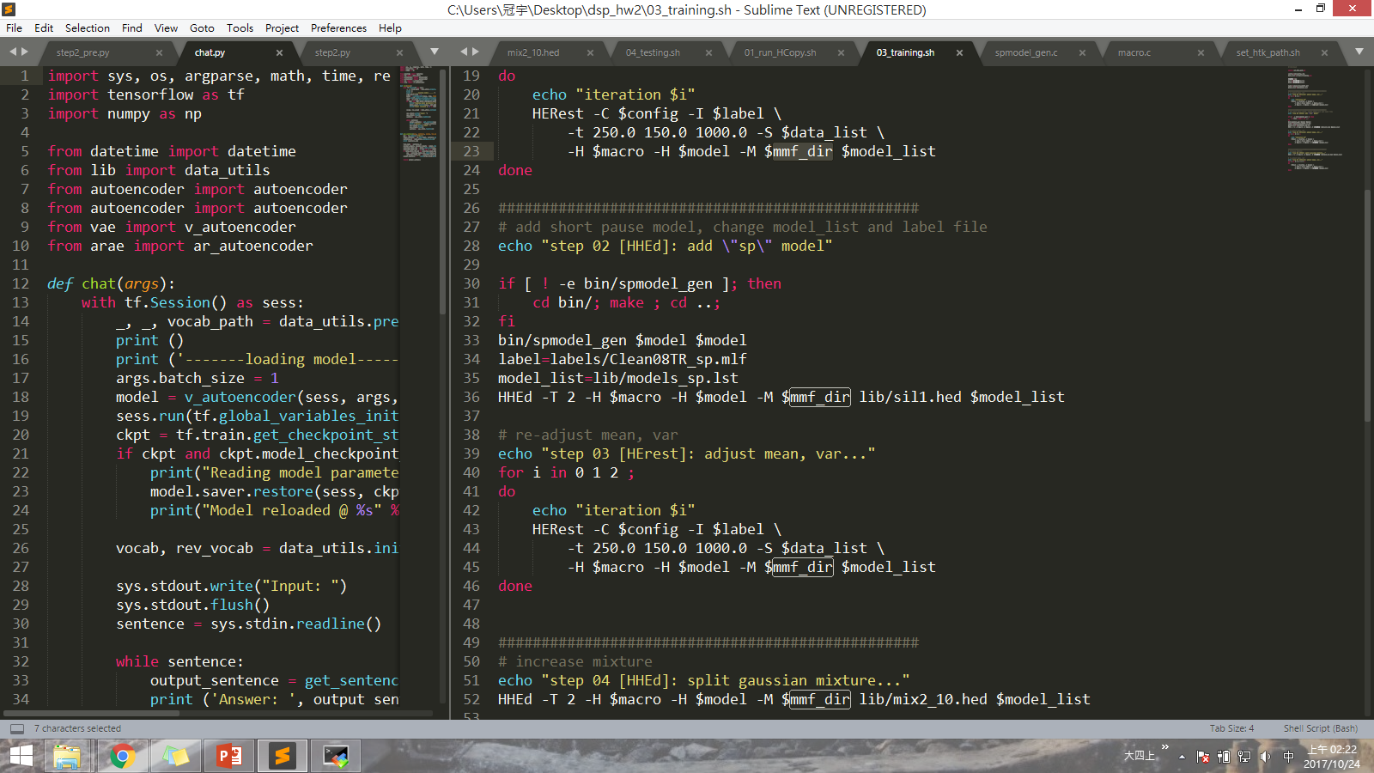
Part 2 - Attention 1
Executing 03_training.sh twice is different from doubling the number of training iterations. To increase the number of training iterations, please modify the script, rather than run it many times.

Slide 32
Part 2 - Attention 2
Every time you modified any parameter or file, you should run 00_clean_all.sh to remove all the files that were produced before, and restart all the procedures. If not, the new settings will be performed on the previous files, and hence you will be not able to analyze the new results. (Of course, you should record your current results before starting the next experiment.)

Slide 33
Report - Part 3 (30%)
Write a report describing your training process and accuracy. Number of states, Gaussian mixtures, iterations, … How some changes effect the performance Other interesting discoveries
Well-written report may get +10% bonus.

Slide 34
Submission Requirements
4 shell scripts your modified 01~04_XXXX.sh
1 accuracy file with only your best accuracy (The baseline result is not needed.)
proto, mix2_10.hed your modified hmm prototype and file which specifies the number of GMMs of each state
1 report (in PDF format) the filename should be hw2-1_bXXXXXXXX.pdf (your student ID)
Put above 8 files in a folder (named after your student ID), and compress into 1 zip file and upload it to Ceiba.

Slide 35
If you have any problem…
Check for hints in the linux and shell scripts. ex 鳥哥
Check the HTK book.
Ask friends who are familiar with Linux commands or Cygwin. (link：how to HTK on Cygwin)
Contact the TA : email：ntudigitalspeechprocessingta@gmail.com title: [HW2-1] bxxxxxxxx (your student number)

