Slide 1
Advanced Graphics in R
Guest Lecture
Stephen Sefick

Slide 2
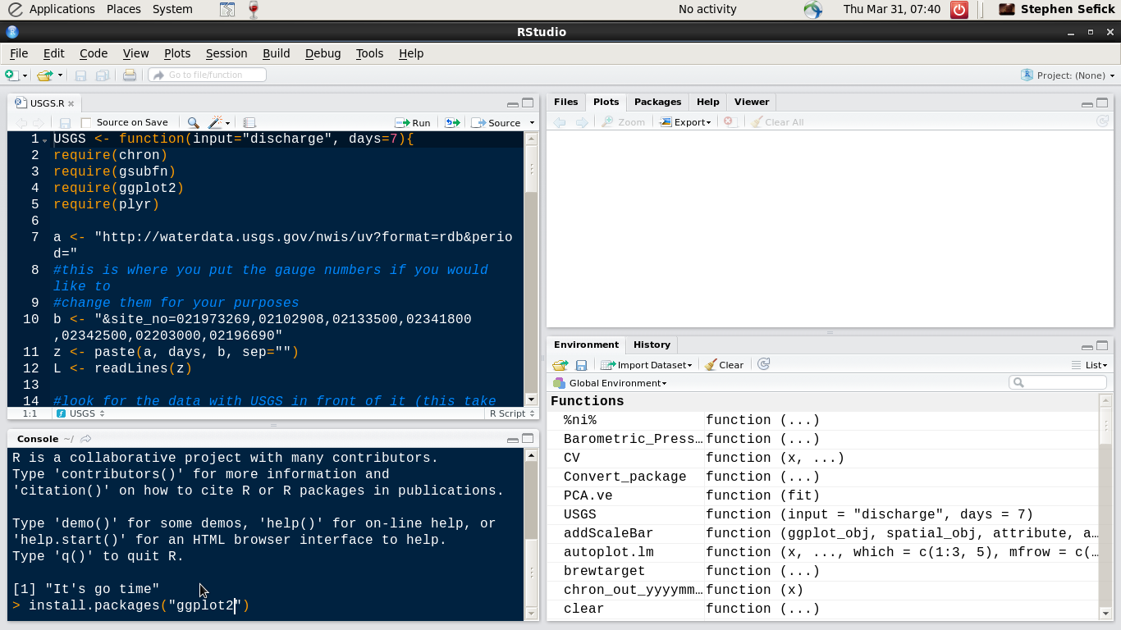

Slide 3
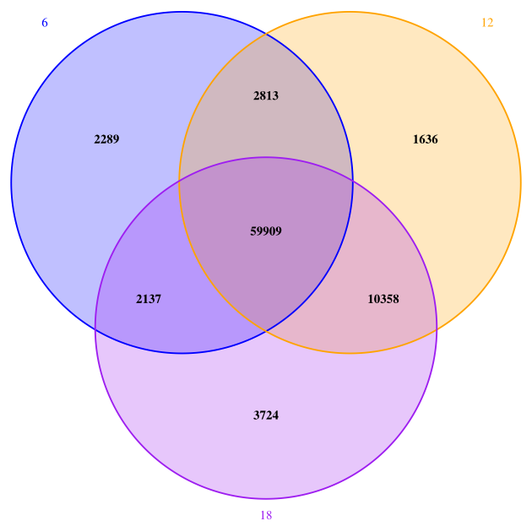
Venn diagrams
vcf-compare output
$ vcf-compare(r940) rep7gen06.recode.vcf.gz rep7gen12.recode.vcf.gz rep7gen18.recode.vcf.gz
VennDiagram

Slide 4
Manhattan Plot
Represent genome wide association studies (GWAS)
qqman
Argument chrlabs vector – c(1:22, “X”)
Sequence 1-22 and the X chromosome

Slide 5
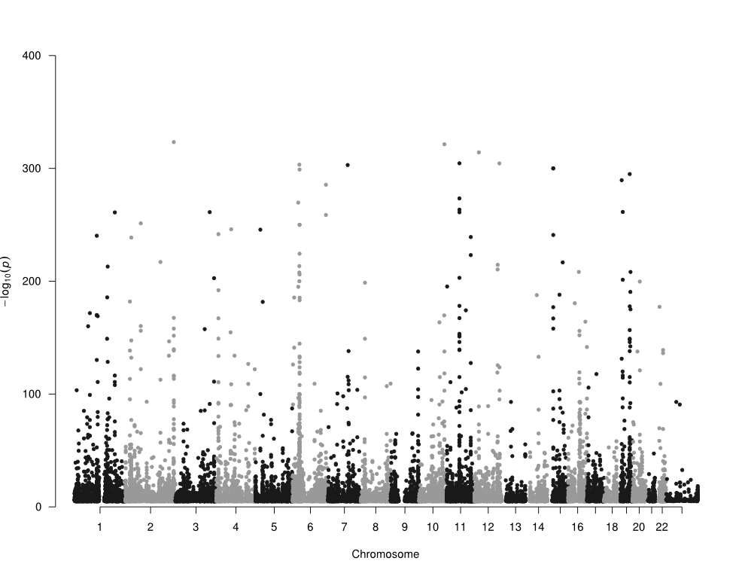
What is wrong with this plot?

Slide 6
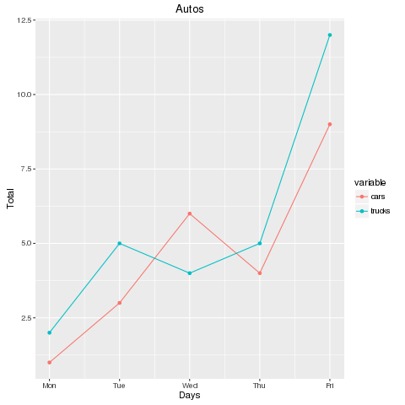
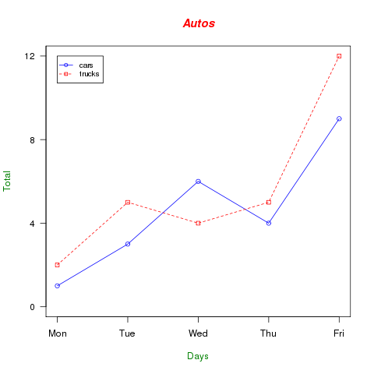
ggplot2
#data
cars <- c(1, 3, 6, 4, 9)
trucks <- c(2, 5, 4, 5, 12)
g_range <- range(0, cars, trucks)
#plot
plot(cars, type="o", col="blue", ylim=g_range,
axes=FALSE, ann=FALSE)
axis(1, at=1:5, lab=c("Mon","Tue","Wed","Thu","Fri"))
axis(2, las=1, at=4*0:g_range[2])
box()
lines(trucks, type="o", pch=22, lty=2, col="red")
title(main="Autos", col.main="red", font.main=4)
title(xlab="Days", col.lab=rgb(0,0.5,0))
title(ylab="Total", col.lab=rgb(0,0.5,0))
legend(1, g_range[2], c("cars","trucks"), cex=0.8,
col=c("blue","red"), pch=21:22, lty=1:2);
#data
library(ggplot2)
library(reshape2)
ct <- data.frame(cars = c(1, 3, 6, 4, 9), trucks = c(2, 5, 4, 5, 12), day=c(1:5))
ct.melt <- melt(ct, id.var="day")
#ggplot2
p <- qplot(day, value, data=ct.melt, col=variable)
p <- p+geom_line()
p <- p+scale_x_continuous(labels=c("Mon", "Tue", "Wed", "Thu", "Fri"))
p <- p+xlab("Days")
p <- p+ylab("Total")
p <- p+ggtitle("Autos")
p

Slide 7
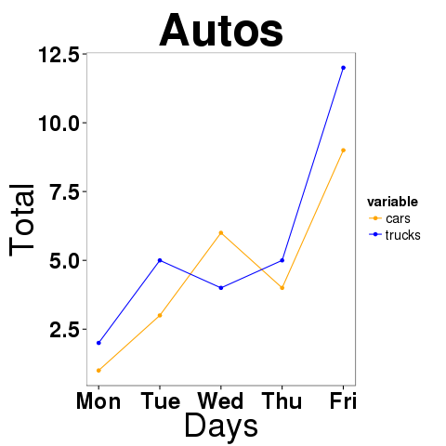
p <- p + publication() p <- p+scale_color_manual(values=c("orange", "blue"))
Provided in the zip file

Slide 8
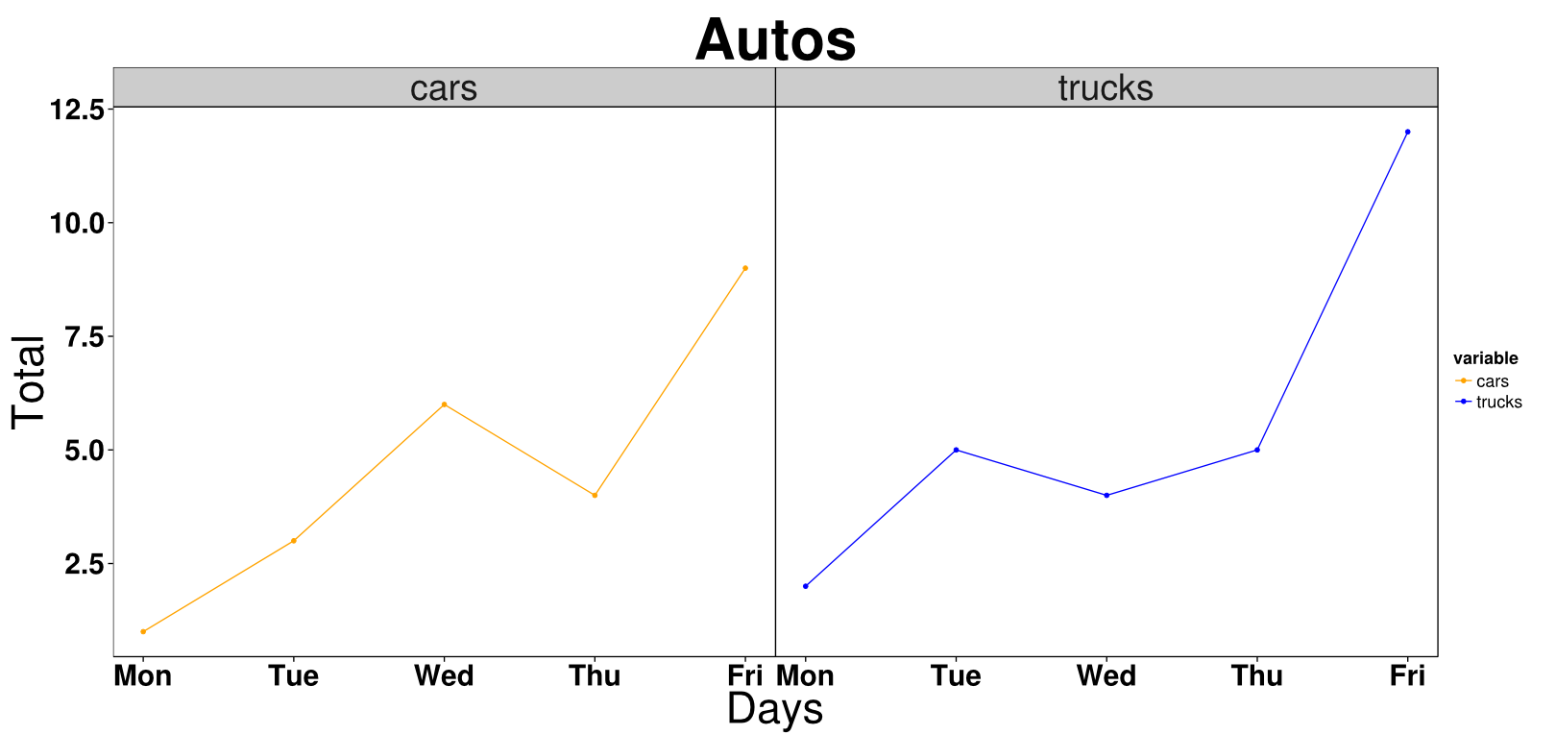
p + facet_wrap(~variable)+theme(strip.text.x = element_text(size = 30))

