Slide 1




AU BioInformatics Bootcamp 2015
S.R. santos, L.R. Goertzen & K.M. Halanych
Department of Biological Sciences

Slide 2
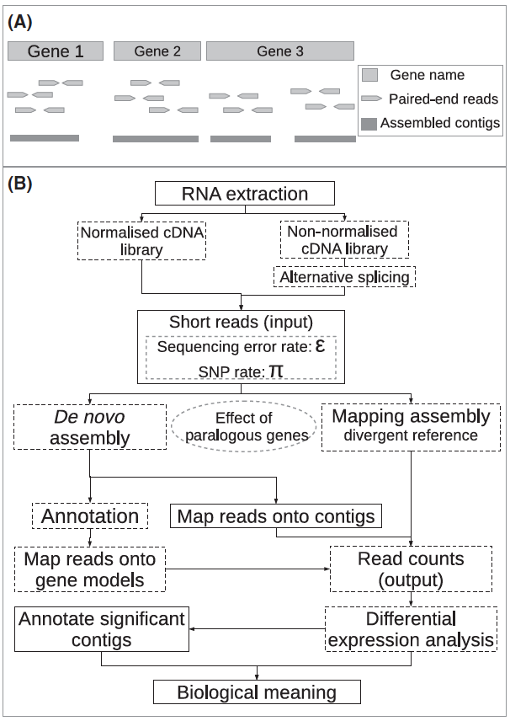
Where we have been
and
where we are
Vijay et al. (2013) Molecular Ecology 22:620

Slide 3
Basic Bash scripting
A script
Def: the written text of a play
Utilized by interpreted computer languages
Instruction set executed at run-time by program
Shell (i.e., Bash), Lua, Perl, Python, R, Ruby
Human-readable
Allows one to dissect the “action”

Slide 4
Basic Bash scripting
A script
Def: the written text of a play
Utilized by interpreted computer languages
Instruction set executed at run-time by program
Shells (i.e., Bash), Lua, Perl, Python, R, Ruby
Human-readable
Allows one to dissect the “action”

Slide 5
Basic Bash scripting
A script
Def: the written text of a play, movie
Utilized by interpreted computer languages
Instruction set executed at run-time by program
Shells (i.e., Bash), Lua, Perl, Python, R, Ruby
Human-readable
Allows one to dissect the “action”

Slide 6
Anatomy of a script

Slide 7
Anatomy of a script
Execution in top->bottom, left->right fashion

Slide 8
Anatomy of a script
1 #!/bin/bash

Slide 9
Anatomy of a script
1 #!/bin/bash
“she-bang” line:
tells the shell the absolute
path to the interpreted language binary
that should be utilized to read the script
and execute its actions

Slide 10
Anatomy of a script
#!/bin/bash
VARIABLE=blah
Declare variable(s) early since you want them
set prior to being calling, same for other
essential commands
(i.e., module load XXXXX)

Slide 11
Examples of variables
Environmental variables
Named object containing data used by one or more applications
$HOME, $PATH, $SHELL, etc.
User-set variables
Can be anything, but best to not use names associated with env variables
Convention is typically use UPPER CASE letters

Slide 12
Examples of variables
Environmental variables
Named object containing data used by one or more applications
$HOME, $PATH, $SHELL, etc.
User-set variables
Can be anything, but best to not use names associated with env variables
Convention is to typically use UPPER CASE letters

Slide 13
Creating a variable
Set directly (i.e., hardcoded)
WK_DIR=/blah/blah/blah
cd $WK_DIR
Set dynamically
MTHYR=`date | awk '{print ($2$6)}'`
filename_${MTHYR}.tab

Slide 14
Creating a variable
Set directly (i.e., hardcoded)
WK_DIR=/blah/blah/blah
cd $WK_DIR
Dynamically set
MTHYR=`date | awk '{print ($2$6)}'`
filename_${MTHYR}.tab

Slide 15
Creating a variable
Set directly (i.e., hardcoded)
WK_DIR=/blah/blah/blah
cd $WK_DIR
Dynamically set
MTHYR=`date | awk '{print ($2$6)}'`
filename_${MTHYR}.tab

Slide 16
Anatomy of a script
#!/bin/bash
VARIABLE=blah
3 - ∞
Sequential command calls to be executed:
nearly anything you’ve been running line-by-line
can be added as-is

Slide 17
Anatomy of a script
#!/bin/bash
VARIABLE=blah
3 - ∞
4 # comments to someone reading the script

Slide 18
Example script - time.sh
#!/bin/bash
TIME=`date | awk '{print $4}'`
3 printf “The time is ${TIME}. Bye.\n”
4 ## prepare to be blown away by my script since its
## so awesome and cool and gnarly… `80s rule!!

Slide 19
Example script - time.sh
#!/bin/bash
TIME=`date | awk '{print $4}’`
3 printf “The time is ${TIME}. Bye.\n”
4 ## prepare to be blown away by my script since its
## so awesome and cool and gnarly… `80s rule!!
Save script, chmod +x the script and execute with:
./script_name.sh

Slide 20
Bracket, ticks and quote use in scripts
TIME=`date | awk '{print $4}'`
${TIME} returns literal interpretation of above
Above is a dynamic example since it will change at runtime. In contrast, below is static (at least until installation of Trinity changes):
TRINITY_HOME=/usr/local/genome/trinityrnaseq

Slide 21
Bracket, ticks and quote use in scripts
TIME=`date | awk '{print $4}'`
${TIME} returns literal interpretation of above
Above is a dynamic example since it will change at runtime. In contrast, below is static (at least until installation of Trinity changes):
TRINITY_HOME=/usr/local/genome/trinityrnaseq
Are dynamic or static variables “better”?

Slide 22
Bracket, ticks and quote use in scripts
printf “some text to screen”
printf ‘some text to screen’
Either double OR single quote behave the same in the above context, but that’s not always the case…

Slide 23
Bracket, ticks and quote use in scripts
printf “some text to screen”
printf ‘some text to screen’
Either double OR single quote behave the same in the above context, but that’s not always the case…

Slide 24
Example script - time.sh
#!/bin/bash
TIME=`date | awk '{print $4}’`
3 printf “The time is ${TIME}. Bye.\n”
4 ## prepare to be blown away by my script since its
## so awesome and cool and gnarly… `80s rule!!

Slide 25
Example script - time.sh
#!/bin/bash
TIME=`date | awk '{print $4}’`
3 printf “The time is ${TIME}. Bye.\n”
4 ## prepare to be blown away by my script since its
## so awesome and cool and gnarly… `80s rule!!
5 printf 'The time is ${TIME}. Bye.\n'
Now add this 5th line to your script;
NOTE: the line is nearly the same as
the 3rd line EXCEPT double quotes are
now SINGLE QUOTES

Slide 26
Example script - time.sh
#!/bin/bash
TIME=`date | awk '{print $4}’`
3 printf “The time is ${TIME}. Bye.\n”
4 ## prepare to be blown away by my script since its
## so awesome and cool and gnarly… `80s rule!!
5 printf 'The time is ${TIME}. Bye.\n'
Save script and execute with:
./script_name.sh
What’s the big difference between “ and ‘?

Slide 27
Bracket, ticks and quote use in scripts
printf “some text to screen”
Preserves the literal value of all characters
EXCEPTIONS: $, `, \
printf ‘some text to screen’
Preserves the literal value of all characters
LITERALLY

Slide 28
Bracket, ticks and quote use in scripts
printf “some text to screen”
Preserves the literal value of all characters
EXCEPTIONS: $, `, \
printf ‘some text to screen’
Preserves the literal value of all characters
LITERALLY

Slide 29
Bracket, ticks and quote use in scripts
printf “some text to screen”
Preserves the literal value of all characters
EXCEPTIONS: $, `, \
printf ‘some text to screen’
Preserves the literal value of all characters
LITERALLY

Slide 30
Scripting good practices
Map out your script before coding it
Where you are -> where you want to go
Remember to add comments & good names
Gives a “play-by-play” of what script is doing
Use comments like notebook/data management
Shorter rather than longer scripts
Easier to dissect, especially troubleshooting
Modular; link together with another script
LEGOS

Slide 31
Scripting good practices
Map out your script before coding it
Where you are -> where you want to go
Remember to add comments & good names
Gives a “play-by-play” of what script is doing
Use comments like notebook/data management
Shorter rather than longer scripts
Easier to dissect, especially troubleshooting
Modular; link together with another script
LEGOS

Slide 32
Scripting good practices
Map out your script before coding it
Where you are -> where you want to go
Remember to add comments/use good names
Gives a “play-by-play” of what script is doing
Use comments like notebook/data management
Shorter rather than longer scripts
Easier to dissect, especially troubleshooting
Modular; link together with another script
LEGOS

Slide 33
Scripting good practices
Map out your script before coding it
Where you are -> where you want to go
Remember to add comments/use good names
Gives a “play-by-play” of what script is doing
Use comments like notebook/data management
Shorter rather than longer scripts
Easier to dissect, especially when troubleshooting
Modular; link together with another script
LEGOS

Slide 34
Scripting good practices
Google is your friend….
Lots of scripts already out there
BUT:
READ/UNDERSTAND HOW THEY WORK BEFORE EXECUTING THEM!!!!! (Why?)
Use your biologist training when scripting
Modify -> test -> modify -> test
Change only a single variable at a time

Slide 35
Scripting good practices
Google is your friend….
Lots of scripts already out there
BUT:
READ/UNDERSTAND HOW THEY WORK BEFORE EXECUTING THEM!!!!! (Why?)
Use your biologist training when scripting
Modify -> test -> modify -> test
Change only a single variable at a time

Slide 36
Scripting good practices
Use built-in Bash “set” in development
set -o errexit – script exit on failed command
set -o xtrace – follow what’s being executed
Keep script as “portable” as possible
Use variables whenever possible
#!/usr/bin/env BINARY is better than #!/usr/bin/BINARY

Slide 37
Scripting good practices
Use built-in Bash “set” in development
set -o errexit – script exit on failed command
set -o xtrace – follow what’s being executed
Keep script as “portable” as possible
Use variables whenever possible
#!/usr/bin/env BINARY is better than #!/usr/bin/BINARY

Slide 38
For – do – done (a versatile and essential tool)
#!/bin/bash
for XXXXXXX in XXXXXXX
3 do
4 COMMANDS
5 done

Slide 39
For – do – done (a versatile and essential tool)
#!/bin/bash
for XXXXXXX in XXXXXXX
3 do
4 COMMANDS
5 done
Example of a loop construct
(think of this like cycling in PCR)

Slide 40
For – do – done (a versatile and essential tool)
#!/bin/bash
for FILENAME in ./*.fasta
3 do
4 get_fasta_stats.pl -T -g $FILENAME
5 done

Slide 41
For – do – done (a versatile and essential tool)
#!/bin/bash
for FILENAME in ./*.fasta
3 do
4 get_fasta_stats.pl -T -g $FILENAME
5 done
See what I mean?

Slide 42
Remember:
frustration -> gratification + productivity
once you become comfortable with scripting

Slide 43
Remember:
frustration -> gratification + productivity
once you become comfortable with scripting

