Slide 1

AI-Based Prediction of Student
Trajectory Abandonment in Higher Education
Tuncer Güngören | Samsung Innovation Campus AI Course | June 2026

Slide 2

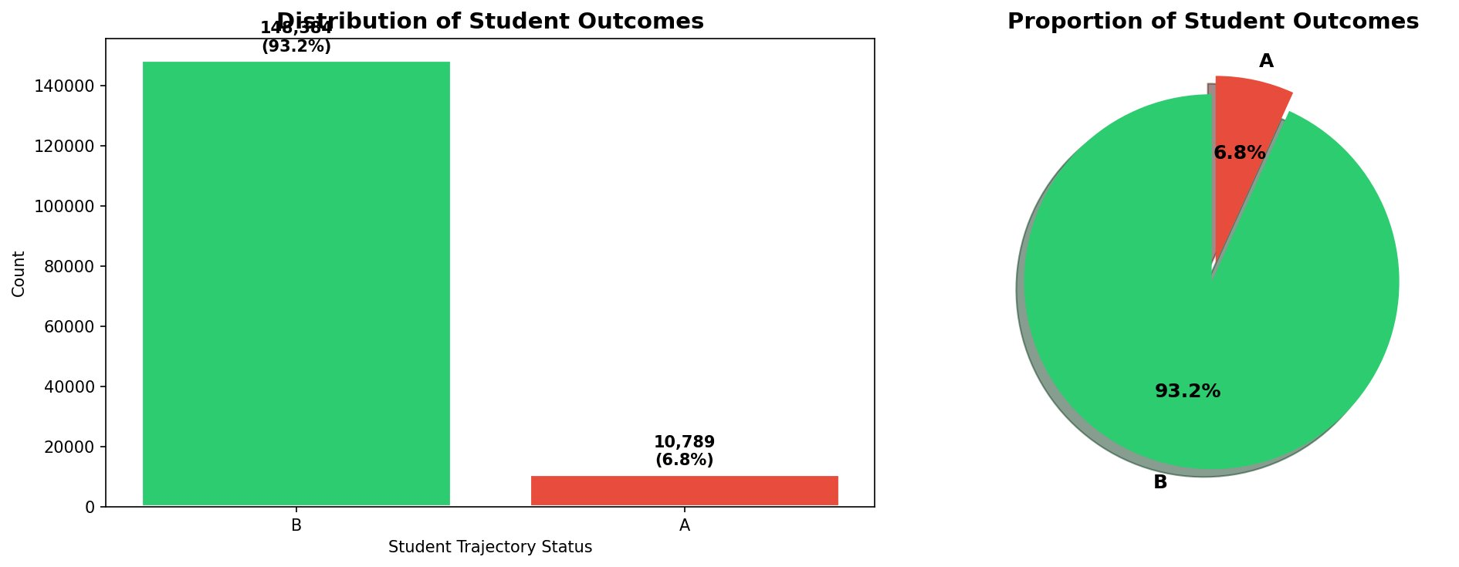

Background
PROJECT OVERVIEW
Predicting student dropout (class A: abandoned vs. B: continuing) using ML on the UPV Longitudinal Dataset (Zenodo 2025).
DATASET AT A GLANCE
159,173 enrollment records across 20,427 unique students, 169 features.
Anonymized: no age/gender. Key features include tuition payment status, displaced status, semester credits, and course grades.
Class imbalance: 93.2% continuing (B) vs. 6.8% abandoned (A).
PROBLEM IMPORTANCE
Early dropout detection enables timely academic interventions, directly supporting equitable access to quality higher education.
Empirical evidence: unpaid tuition fees and low first-semester performance are the strongest dropout risk signals.

Slide 3
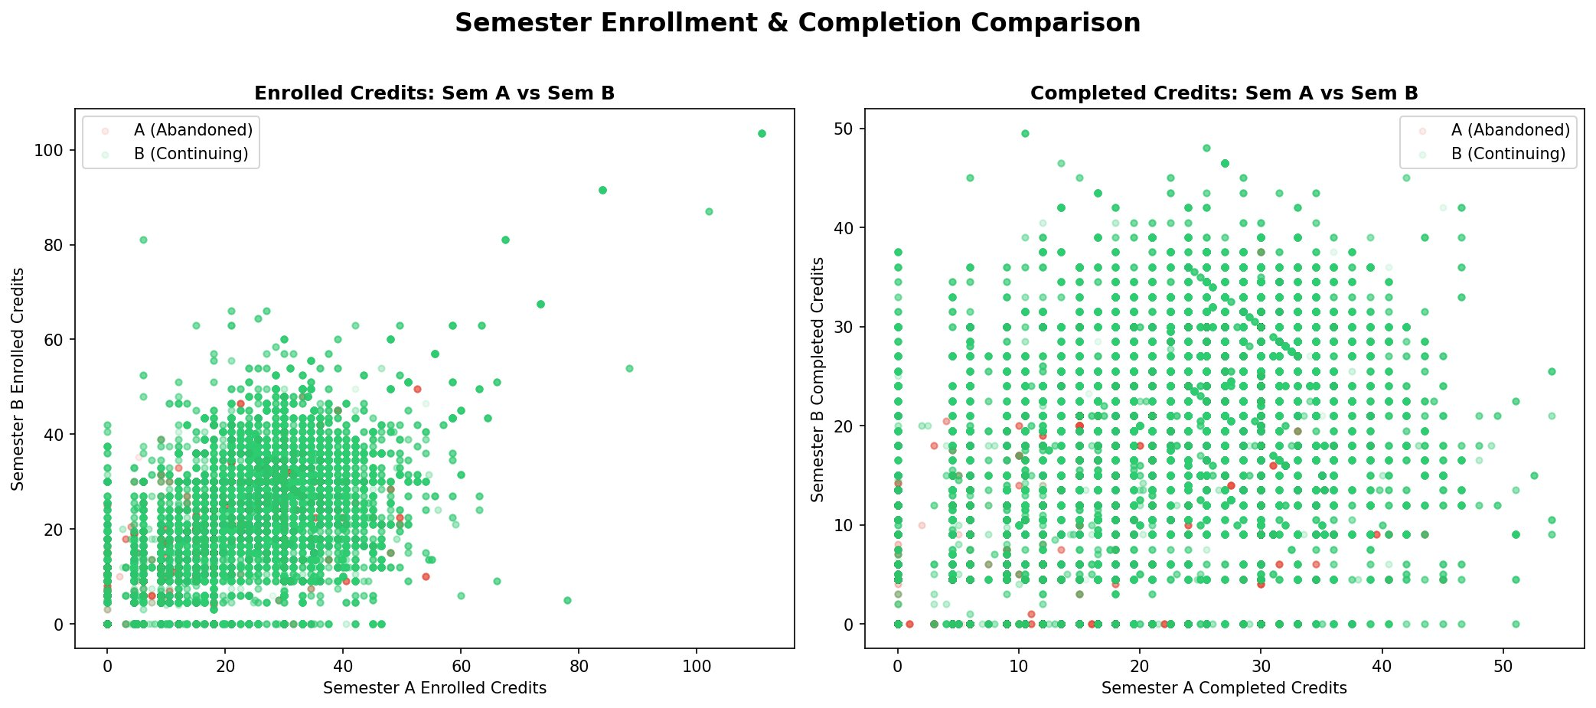
Objectives
PRIMARY GOAL
Build a leakage-free, production-ready ML system to predict student trajectory abandonment (class A) vs. continuation (class B) from enrollment data.
ML OBJECTIVES
Train and compare four classifiers: Logistic Regression, Random Forest, HistGradientBoosting (HGB), and MLP Neural Network.
Apply proper student-level group split (GroupShuffleSplit) and in-fold SMOTE via imblearn Pipeline.
Tune hyperparameters using 5-fold StratifiedGroupKFold cross-validation.
Build a Voting Ensemble combining tuned RF, HGB, and MLP for best generalization.
DEPLOYMENT OBJECTIVE
Serialize the best model into a FastAPI microservice (GET /health, POST /predict) ready for integration into university student dashboards.

Slide 4
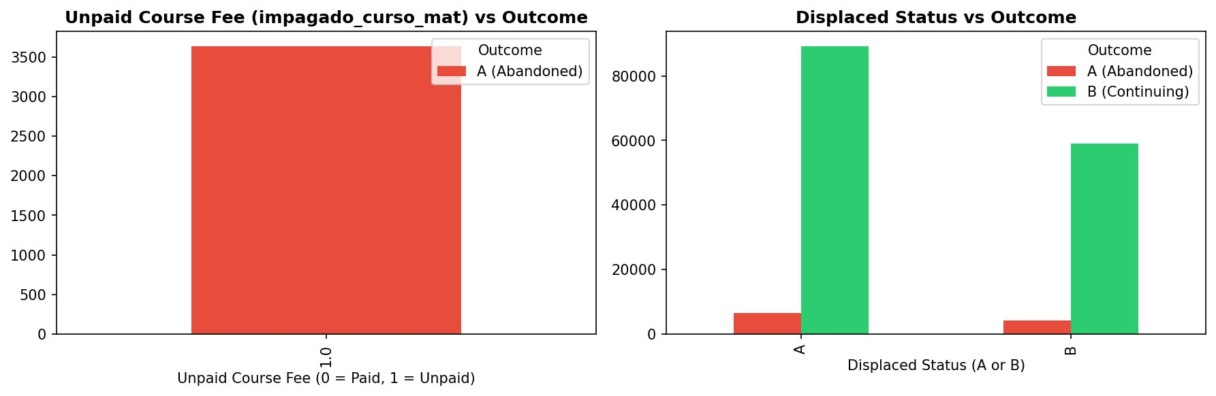
SDG Relation
SDG 4: QUALITY EDUCATION
This project directly supports UN SDG 4 (“Ensure inclusive and equitable quality education”) by enabling early academic intervention.
An AI-powered early warning system flags at-risk students before the end of their first semester, when intervention is most impactful.
KEY SOCIOECONOMIC DIMENSION
Tuition Payment Status: Students with unpaid course fees drop out at a disproportionately high rate — a critical financial vulnerability signal.
Parental Education (Ablation): Removing studies_p_hash and studies_m_hash dropped RF Macro F1 by -0.85%, confirming socioeconomic factors carry statistically significant predictive power.
REAL-WORLD IMPACT
When integrated into university software, advisors receive proactive alerts in the first semesters — the highest-risk window for dropout.
Target beneficiaries: 20,427+ students in the UPV dataset; scalable to any institution adopting the FastAPI deployment bundle.

Slide 5
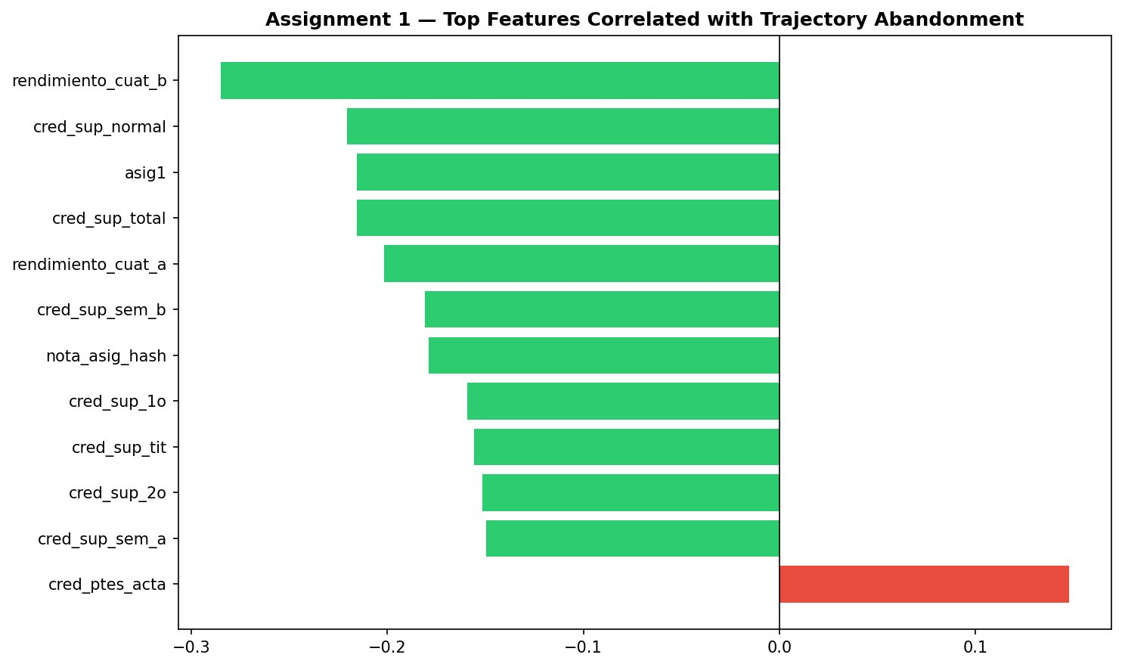
Data
DATASET: UPV LONGITUDINAL (ZENODO 2025)
Source: MDPI Data Journal / Zenodo 2025 — Universitat Politècnica de València (UPV) student records.
Scale: 159,173 enrollment records | 20,427 unique students | 169 raw features.
Target: abandono_hash — Class A (abandoned, 6.8%) vs. Class B (continuing, 93.2%).
PREPROCESSING STEPS
Target Leakage Drop: Removed columns that directly encode graduation or active enrollment status (e.g., matricula_activa, rendimiento_total).
Temporal Leakage Drop: Removed 88 monthly LMS event, Wi-Fi, and visit log columns (future-leaking variables).
Categorical Encoding: Non-numeric fields converted to integer indices. Missing values filled with column-median imputation.
TOP PREDICTIVE FEATURES (from RF importance)
cred_pend_sup_tit (0.123) | rendimiento_cuat_b (0.095) | cred_sup_tit (0.093) | cred_mat_normal (0.076) | nota_asig_hash (0.015).

Slide 6
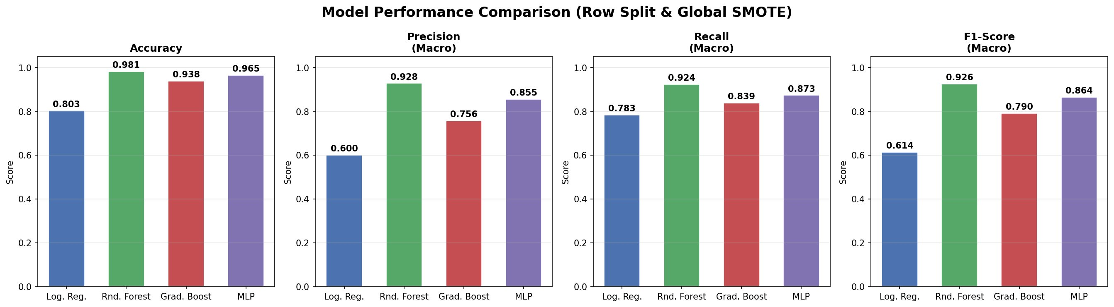
Model Selection and Training/Testing
ASSIGNMENT 2 — BASELINE (WITH LEAKAGE)
Row-level split + global pre-CV SMOTE caused student identity leakage, inflating CV F1 to 0.99 and test accuracy to 98%.
Models: Logistic Regression, Random Forest, Gradient Boosting, MLP.
ASSIGNMENT 3 — LEAKAGE-FREE REFINEMENT
GroupShuffleSplit on student ID (dni_hash): entirely disjoint student sets in train/test.
imblearn Pipeline: StandardScaler + SMOTE applied strictly inside each CV fold (no validation leakage).
5-fold StratifiedGroupKFold for tuning: prevents group and class skew across folds.
MODELS & HYPERPARAMETER TUNING
Random Forest — Grid: n_estimators [100,200], max_depth [10,20,None]. Best CV F1: 0.7351.
HistGradientBoosting (≈LightGBM) — Grid: lr [0.01–0.1], max_iter [100,200], l2_reg [0–10]. Best CV F1: 0.7474.
MLP Neural Network — Layers [(64,32),(32,16)], alpha [0.1–5.0]. Best CV F1: 0.7132.
Voting Ensemble — Soft-vote of tuned RF + HGB + MLP for maximum generalization.

Slide 7
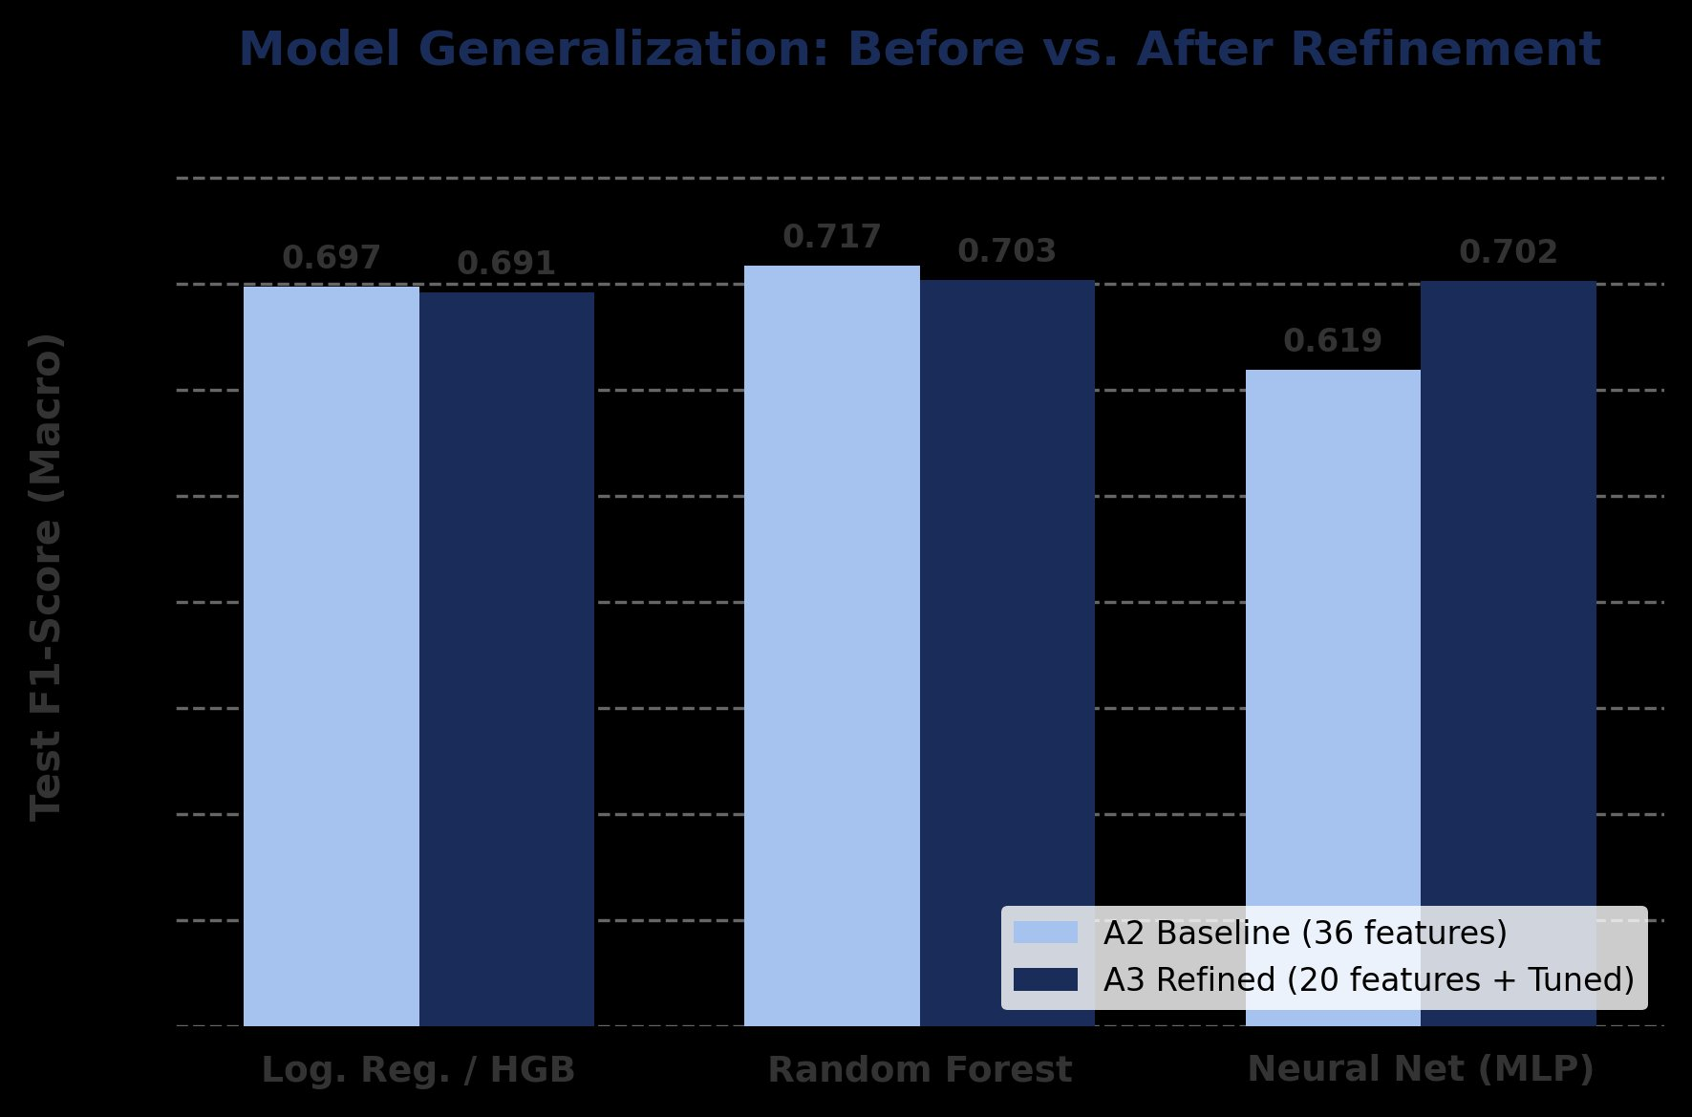
Evaluation Results
FINAL TEST RESULTS (LEAKAGE-FREE, 1,600 UNSEEN STUDENTS)
Model Accuracy Precision Recall Macro F1
Tuned Random Forest 93.36% 72.58% 80.16% 75.68%
Tuned HistGradientBoosting 94.02% 74.58% 80.39% 77.10%
Tuned MLP Neural Network 93.51% 72.63% 76.36% 74.32%
VOTING ENSEMBLE (BEST) 94.44% 76.07% 79.43% 77.62%
CROSS-VALIDATION STABILITY
5-fold StratifiedGroupKFold CV F1 scores align tightly with test scores (std ±0.002), confirming true generalization on unseen students.
LEAKAGE IMPACT COMPARISON
Assignment 2 (leaked): CV F1 ≈ 0.99, Test Accuracy ≈ 98% ← severely inflated.
Assignment 3 (clean): CV F1 ≈ 0.74, Test Accuracy ≈ 94% ← realistic generalization.
SOCIOECONOMIC ABLATION STUDY
Removing studies_p_hash + studies_m_hash: RF accuracy −0.33%, Macro F1 −0.85% — parental education carries significant, non-trivial signal.

Slide 8
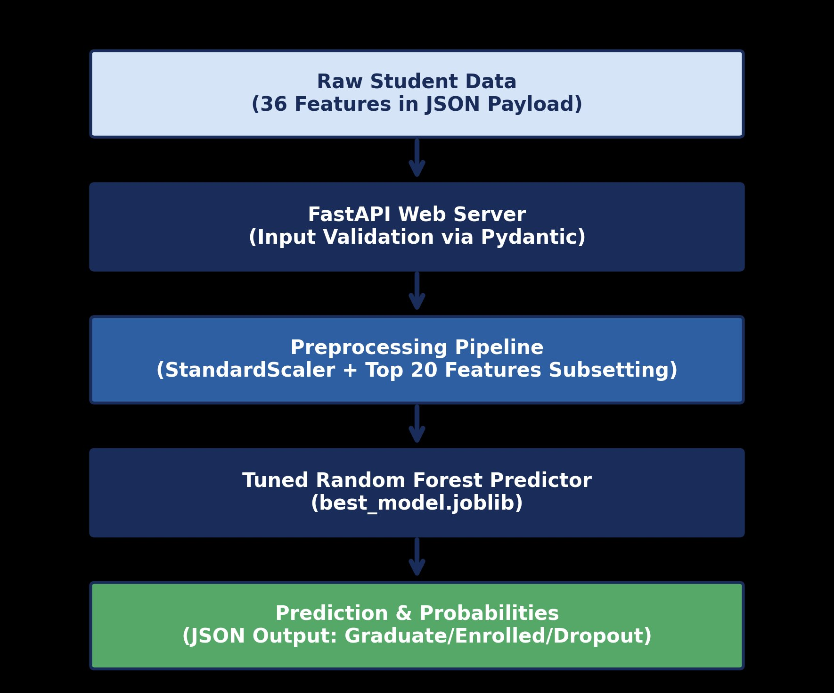
Deployment
MODEL SERIALIZATION
Trained Voting Ensemble serialized to best_model.joblib containing: classifier pipeline (with embedded StandardScaler), LabelEncoder, and top-20 feature list.
Scaler fit inside pipeline prevents training-serving skew at inference time.
FASTAPI SERVING ENDPOINTS
GET /health — Returns service status and loaded model details.
POST /predict — Accepts a JSON payload of 20 features; returns prediction (A/B), confidence score, and class probabilities.
Stack: FastAPI + Uvicorn ASGI server | Auto OpenAPI docs | Pydantic input validation.
SECURITY & MONITORING
HTTPS (TLS) for PII in transit | API Key authentication | Rate limiting against DoS.
Accuracy Drift monitoring via end-of-term record joins; Data Drift via KS-tests on feature distributions.
DEPLOYMENT VALIDATION
Inference tested on 12,575 held-out rows (1,600 unseen students). Prediction latency: sub-second per record via pipeline.predict().
Files: best_model.joblib | assignment3_refinement.py | assignment3_deployment.py

Slide 9
Thank You!

