Slide 1
Short Term Momentum Play
Santhya Selvakularanjan, Matthew Richards, and James Phalen

Slide 2
Goal
Use a machine learning algorithm to predict future portfolio price movements.
Portfolio stocks were determined via short-term momentum strategy and new investor execution style
A long-short-term-memory recursive neural network (LSTM-RNN) was used to predict stock prices

Slide 3
Questions/Hypotheses
Questions:
Can we build an algorithm (based on a trading strategy) to predict portfolio performance?
How would that model perform on out-of-sample data, specifically during March of 2020?
Hypothesis: We can train a model to predict portfolio performance, based on historical stock closing price changes.
Notes:
We wanted to incorporate class work with something that we could build upon moving forward.

Slide 4
Setting up the Experiment
Choosing a Strategy:
Keep it simple
Minimize Data Engineering
Can reasonably predict performance (ie is the timeframe appropriate?)
Notes:
Choosing a strategy
Looking for something with documentation, that may serve us in the future
Want it to be relevant
Want it to be relatively easy to interpret and write code for
Data Considerations
Strategy and data are interdependent
Don’t want to spend significant time engineering data
Want a strategy that will quickly tell us which stocks to analyze
Examples of different trading strategies:
Put/Call options to capitalize on short term volatility
Long-term Portfolio Plays
Short-term plays
Momentum Strategy

Slide 5
Setting up the Experiment: Choosing a Strat.
Momentum Strategy
Considered two types: Short Term or Mid Term strategies
Leveraged work performed during class hours – Luke’s code as a resource
Focused on a Short-Term Momentum Strategy
Notes:
Why:
We’ve been working on it in class hours
Quickly code-able
Minimal data engineering required
Momentum Strategy Basic Ideas
Good stocks continue to do well
Frequent rebalancing of a portfolio (using said strat) tends to have higher performance over time (see book)
We chose a short-term momentum strategy
Weekly rebalancing
1 month look-back period
The short term momentum-strategy allows us to apply a prediction out by one week.
Since the short term strategy is rebalanced each week, this timeframe will allow us
NEXT: we need to determine what machine learning model we’re gonna use

Slide 6
Setting Up the Experiment
Choosing the right ML Model
Prediction: Not quite a binary classification problem
Influenced by past performance
Want to understand tendencies of indicators
Notes:
We want to understand what the performance will be, not necessarily if it’s a buy or sell signal
We want to pull historic data and run the model to teach itself
Not best suited for an ANN, an RNN uses its feedback loop to determine fwd behavior
But we don’t want to forget past data too quickly

Slide 7
Setting Up the Experiment: Choosing a Model
Long-Short Term Memory Recursive Neural Network (LSTM-RNN)
Uses previous outputs as inputs
Ability to manipulate time weighting
LSTM-RNNs can capture long term dependencies
Jonathan helped with developing out-of-sample forward projection code
Notes:
We want to be able to adjust the behavior of the model in the future if we switch momentum strategies
Explain mid-term strategies will rely on longer-length data inputs

Slide 8
Setting up the Experiment
General Process Flow
Pull Stock Data
Generate Momentum Portfolio
Run LSTM Model
Generate Results Dashboard

Slide 9
Short Term Momentum Play
Investment Style: base a decision on recent trends given the market downturn
Robinhood style portfolio: 5 stocks to buy and hold for one week and then sell and buy new ones “rebalance” over a 2-week period
Universe will be SP500 stocks for familiarity
Invest $1,000 distributed equally among the stocks (20% each)

Slide 10
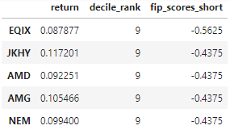

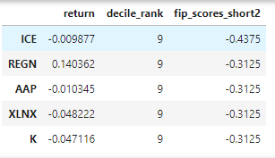
FIP Score Results
4 Week look back, excluding the latest week
Calculate the direction of the weekly cumulative returns
Multiply the by the percentage of negative days less the percentage of positive days
Lower is better
Week1 Picks:
Week2 Picks:

Slide 11
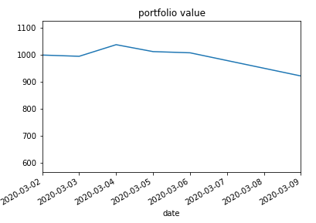
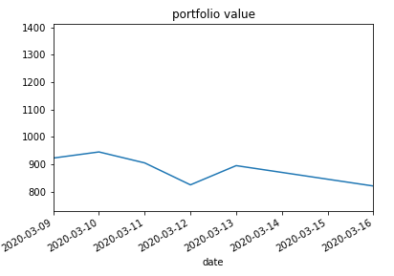
Results of Investments
Week 1:
Week 2:

Slide 12
Setting up the LSTM-RNN
Features Tested:
Closing performance from the portfolio based on an even weight
Daily Change of the portfolio value based on an even weight
Notes:
Our goal

Slide 13
The LSTM-RNN Model
Training…

Slide 14
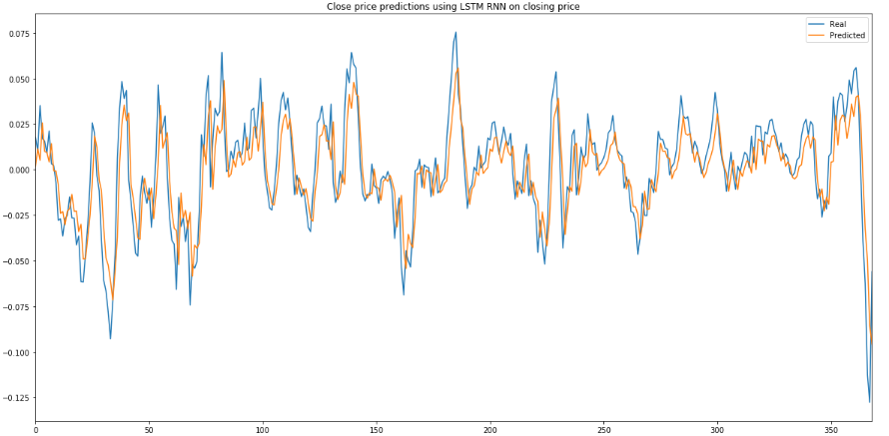
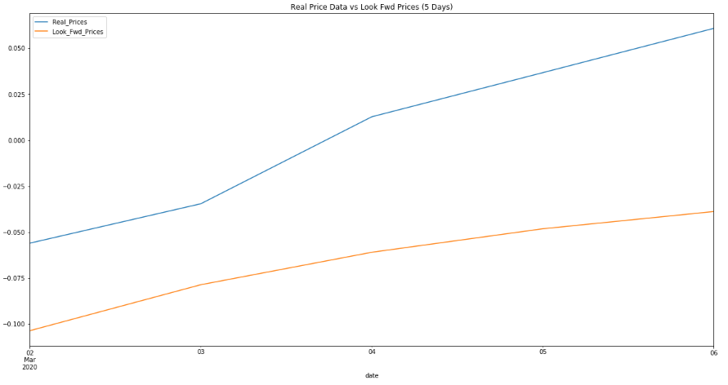
Week 1 – Mar-02(Mon) – Mar-06(Fri)
Training
Results versus Actual

Slide 15
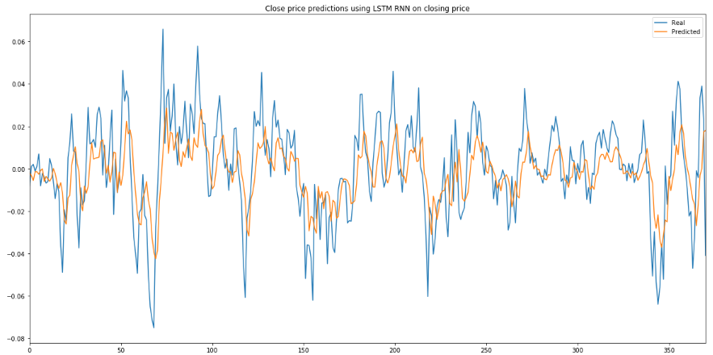
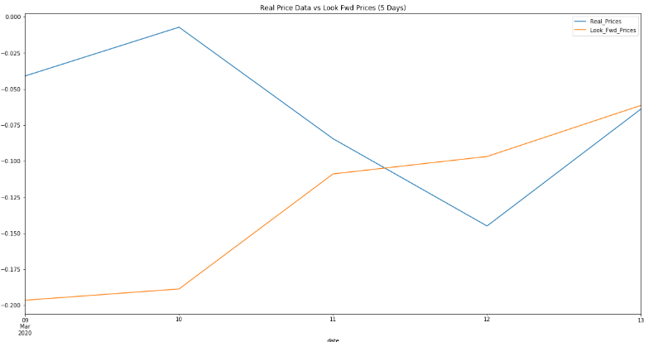
Week 2 – Mar-09(Mon) – Mar-13(Fri)
Training
Results versus Actual

Slide 17
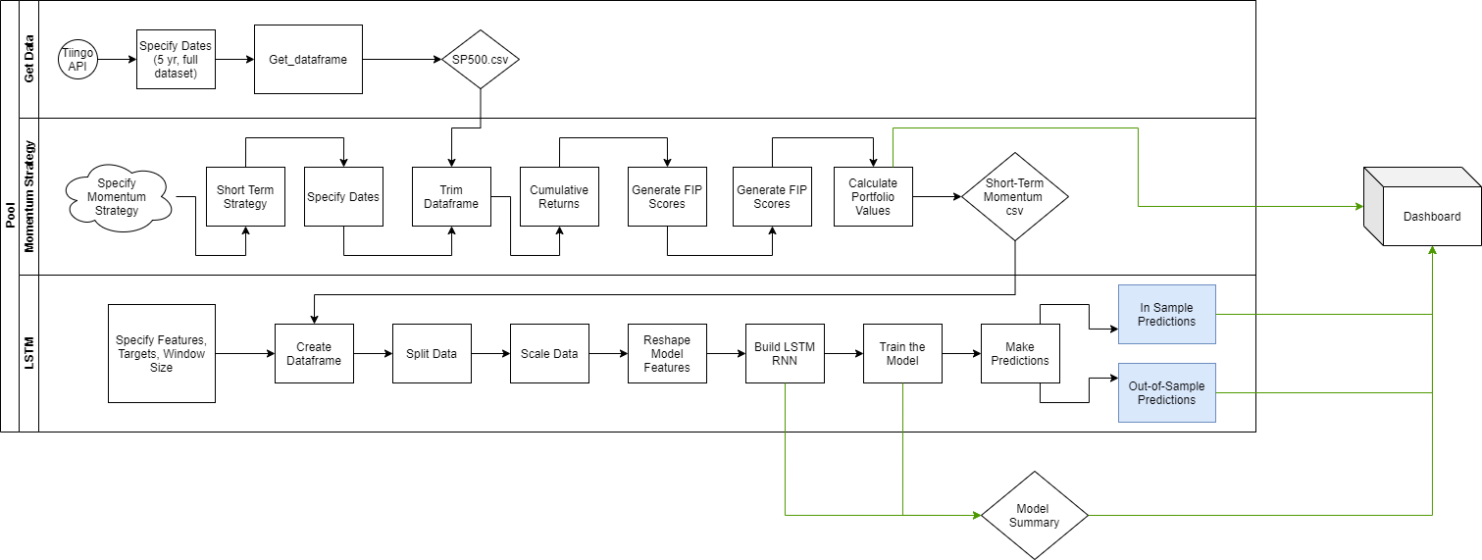

Slide 18
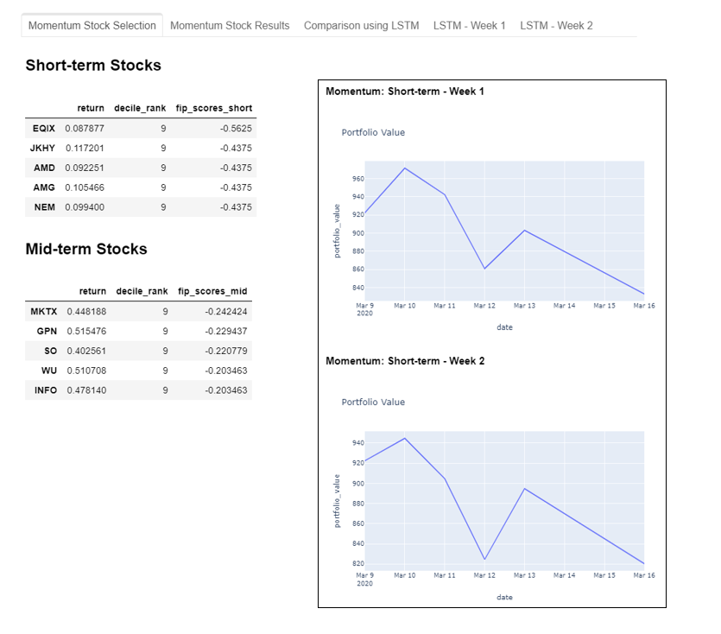
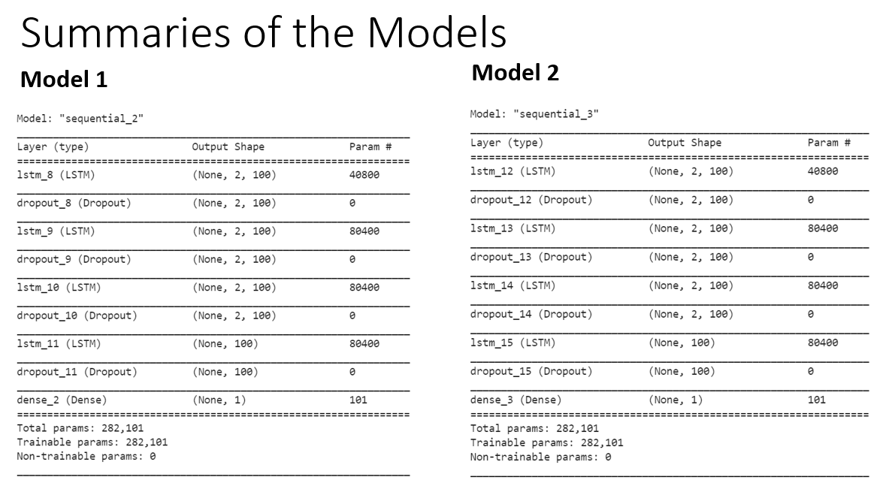
The Dashboard
Enhancing the user’s experience for quick decision making.
Demo

Slide 19
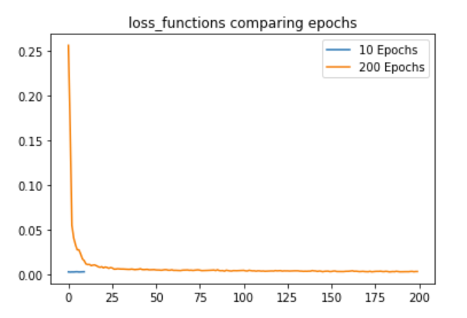
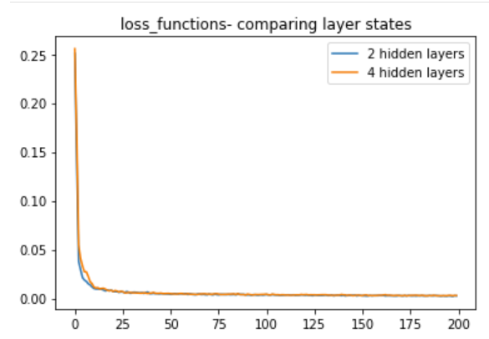
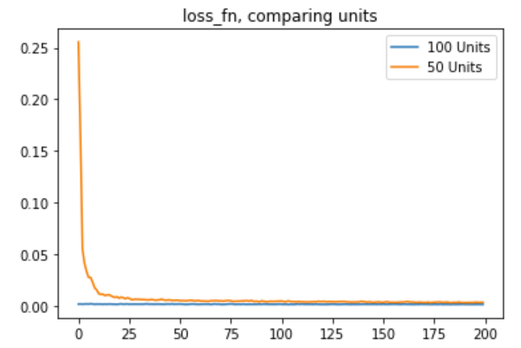
Appendix
Testing model parameters:

