Slide 1

Unit testing your java code

Slide 2
Overview of JUnit
JUnit belongs to the xUnit unit testing framework
Ported to Java by Kent Beck and Erich Gamma
Open source
Usually used by the developer
Allows devs to test small chunks of code by writing and executing repeatable tests

Slide 3
Why do we want to unit test our software?
Implementation: manual and\or automated.
Performed during the development phase of a software process model e.g. Agile sprint development phase i of n.
Objective is to isolate a section of code and verify its correctness.
Goal is to find bugs and programmer errors in each of those parts.
Repercussions of poor\no unit testing lead to system, integration, and acceptance testing overhead (time, cost, number of defects).
Identifying defects early on improves testing phase efficiency

Slide 4
Test-driven development with JUnit

Slide 5
JUnit is often used in test-driven development for Agile projects
Requirements are converted into test cases
Test cases are coded before any other code is developed
This makes developers understand and focus on the requirements
Code is written until the tests only just pass, ensuring that the minimum requirements have been met
Code can be refactored
Repeat the tests
Improves quality of code and testing phase efficiency, whilst conforming to requirements

Slide 6
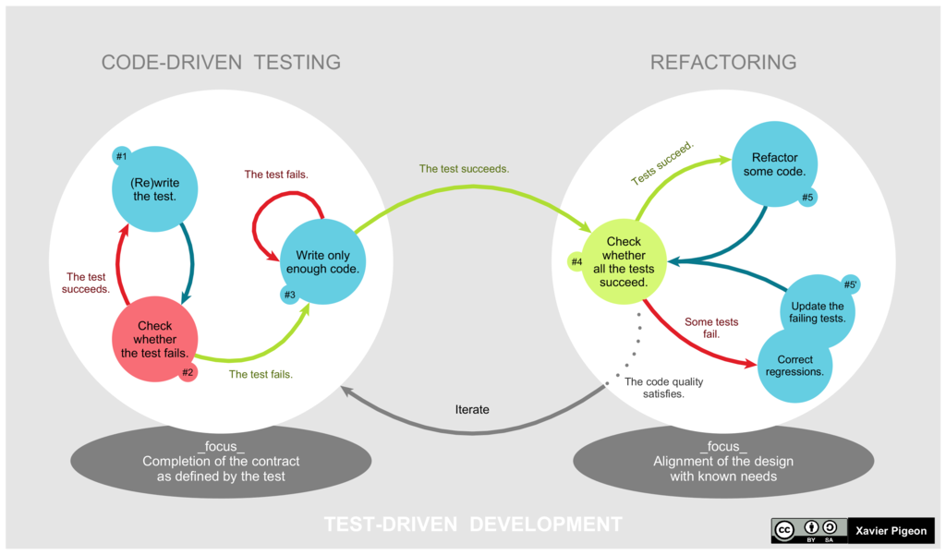
Test-driven development (TDD) cycle
Add a test
Run all tests and observe outcome
Write the code
Run tests
Refactor code
Repeat
By Xarawn - Own work, CC BY-SA 4.0, https://commons.wikimedia.org/w/index.php?curid=44782343

Slide 7
TDD cycle explained
Add a test
Each new feature begins with writing a test. Write a test that defines a function or improves an existing function. Use cases and user stories are used to cover the requirements and exception conditions.
Run all tests and observe the outcome of the newly added test
Write the code
Run tests
Refactor code
Repeat

Slide 8
TDD cycle explained
Add a test
Run all tests and observe the outcome of the newly added test
This validates that the test harness is working correctly, and shows that the new test does not pass without requiring new code because the required behavior already exists, and it rules out the possibility that the new test is flawed and will always pass. The new test should fail for the expected reason. This step increases the developer's confidence in the new test.
Write the code
Run tests
Refactor code
Repeat

Slide 9
TDD cycle explained
Add a test
Run all tests and observe the outcome of the newly added test
Write the code
The next step is to write some code that causes the test to pass. The new code written at this stage is not perfect and may, for example, pass the test in an inelegant way. That is acceptable because it will be improved and honed in Step 5. At this point, the only purpose of the written code is to pass the test. The programmer must not write code that is beyond the functionality that the test checks.
Run tests
Refactor code
Repeat

Slide 10
TDD cycle explained
Add a test
Run all tests and observe the outcome of the newly added test
Write the code
Run tests
If all test cases now pass, the programmer can be confident that the new code meets the test requirements, and does not break or degrade any existing features. If they do not pass, the new code must be adjusted until they do.
Refactor code
Repeat

Slide 11
TDD cycle explained
Add a test
Run all tests and observe the outcome of the newly added test
Write the code
Run tests
Refactor code
By continually re-running the test cases throughout each refactoring phase, the developer can be confident that the process is not altering any existing functionality. Ensure duplication is removed, and that naming conventions are followed properly. Ensure that there is good readability and maintainability for the newly added code.
Repeat

Slide 12
TDD cycle explained
Add a test
Run all tests and observe the outcome of the newly added test
Write the code
Run tests
Refactor code
Repeat
Starting with another new test, the cycle is then repeated to push forward the functionality. The size of the steps should always be small, with as few as 1 to 10 edits between each test run. If new code does not rapidly satisfy a new test, or other tests fail unexpectedly, the programmer should undo or revert in preference to excessive debugging.

Slide 13
Introduction to JUnit 5

Slide 14
What is JUnit 5?
JUnit 5 is composed of several different modules from three different sub-projects.
JUnit 5 = JUnit Platform + JUnit Jupiter + JUnit Vintage
The JUnit Platform serves as a foundation for launching testing frameworks on the JVM. It also defines the TestEngine API for developing a testing framework that runs on the platform.
JUnit Jupiter is the combination of the new programming model and extension model for writing tests and extensions in JUnit 5. The Jupiter sub-project provides a TestEngine for running Jupiter based tests on the platform.
JUnit Vintage provides a TestEngine for running JUnit 3 and JUnit 4 based tests on the platform.

Slide 15
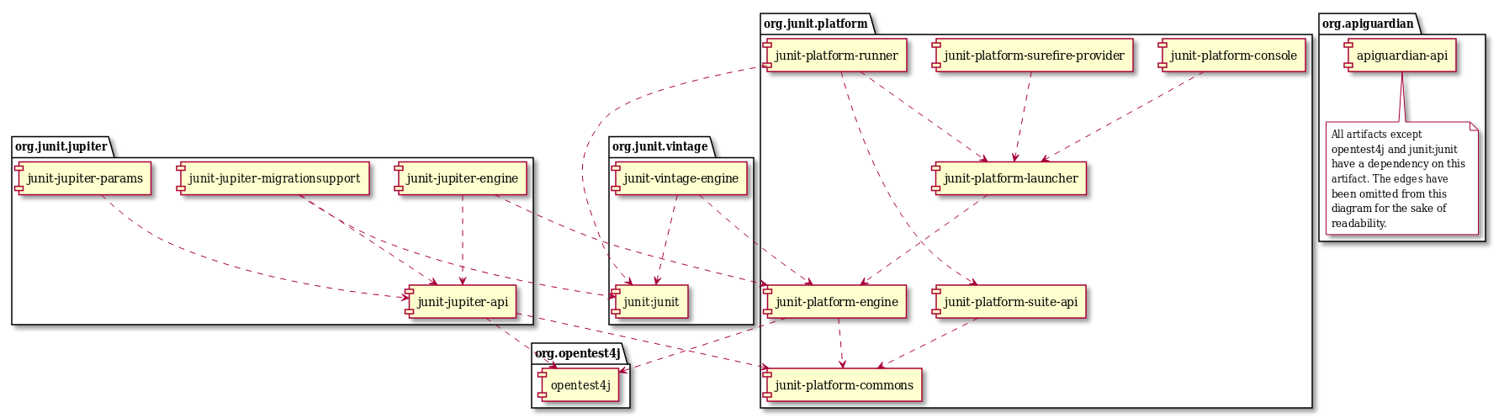
Dependency diagram

Slide 16
Supported Java versions for JUnit 5
JUnit 5 requires Java 8 (or higher) at runtime.
However, you can still test code that has been compiled with previous versions of the JDK.

Slide 17
Writing JUnit tests

Slide 18
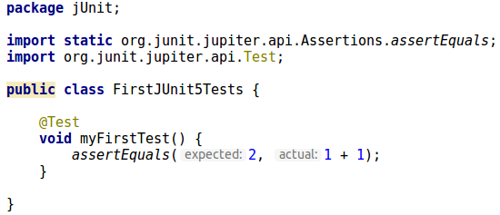
A first test case

Slide 19
Core Annotations in
org.junit.jupiter.api
for
configuring tests and extending the framework

Slide 20
JUnit Jupiter supports the following annotations for configuring tests and extending the framework.
All core annotations are located in the org.junit.jupiter.api package in the junit-jupiter-api module.
@Test
Denotes that a method is a test method. Such methods are inherited unless they are overridden.
@ParameterizedTest
@RepeatedTest
@TestFactory
@TestInstance

Slide 21
JUnit Jupiter supports the following annotations for configuring tests and extending the framework.
All core annotations are located in the org.junit.jupiter.api package in the junit-jupiter-api module.
@Test
@ParameterizedTest
Denotes that a method is a parameterized test. Such methods are inherited unless they are overridden.
@RepeatedTest
@TestFactory
@TestInstance

Slide 22
JUnit Jupiter supports the following annotations for configuring tests and extending the framework.
All core annotations are located in the org.junit.jupiter.api package in the junit-jupiter-api module.
@Test
@ParameterizedTest
@RepeatedTest
Denotes that a method is a test template for a repeated test. Such methods are inherited unless they are overridden.
@TestFactory
@TestInstance

Slide 23
JUnit Jupiter supports the following annotations for configuring tests and extending the framework.
All core annotations are located in the org.junit.jupiter.api package in the junit-jupiter-api module.
@Test
@ParameterizedTest
@RepeatedTest
@TestFactory
Denotes that a method is a test factory for dynamic tests. Such methods are inherited unless they are overridden.
@TestInstance

Slide 24
JUnit Jupiter supports the following annotations for configuring tests and extending the framework.
All core annotations are located in the org.junit.jupiter.api package in the junit-jupiter-api module.
@Test
@ParameterizedTest
@RepeatedTest
@TestFactory
@TestInstance
Used to configure the test instance lifecycle for the annotated test class. Such annotations are inherited.

Slide 25
JUnit Jupiter supports the following annotations for configuring tests and extending the framework.
All core annotations are located in the org.junit.jupiter.api package in the junit-jupiter-api module.
@TestTemplate
Denotes that a method is a template for test cases designed to be invoked multiple times depending on the number of invocation contexts returned by the registered providers. Such methods are inherited unless they are overridden.
@DisplayName
@BeforeEach
@AfterEach
@BeforeAll

Slide 26
JUnit Jupiter supports the following annotations for configuring tests and extending the framework.
All core annotations are located in the org.junit.jupiter.api package in the junit-jupiter-api module.
@TestTemplate
@DisplayName
Declares a custom display name for the test class or test method. Such annotations are not inherited.
@BeforeEach
@AfterEach
@BeforeAll

Slide 27
JUnit Jupiter supports the following annotations for configuring tests and extending the framework.
All core annotations are located in the org.junit.jupiter.api package in the junit-jupiter-api module.
@TestTemplate
@DisplayName
@BeforeEach
Denotes that the annotated method should be executed before each @Test, @RepeatedTest, @ParameterizedTest, or @TestFactory method in the current class; analogous to JUnit 4’s @Before. Such methods are inherited unless they are overridden.
@AfterEach
@BeforeAll

Slide 28
JUnit Jupiter supports the following annotations for configuring tests and extending the framework.
All core annotations are located in the org.junit.jupiter.api package in the junit-jupiter-api module.
@TestTemplate
@DisplayName
@BeforeEach
@AfterEach
Denotes that the annotated method should be executed after each @Test, @RepeatedTest, @ParameterizedTest, or @TestFactory method in the current class; analogous to JUnit 4’s @After. Such methods are inherited unless they are overridden.
@BeforeAll

Slide 29
JUnit Jupiter supports the following annotations for configuring tests and extending the framework.
All core annotations are located in the org.junit.jupiter.api package in the junit-jupiter-api module.
@TestTemplate
@DisplayName
@BeforeEach
@AfterEach
@BeforeAll
Denotes that the annotated method should be executed before all @Test, @RepeatedTest, @ParameterizedTest, and @TestFactory methods in the current class; analogous to JUnit 4’s @BeforeClass. Such methods are inherited (unless they are hidden or overridden) and must be static (unless the "per-class" test instance lifecycle is used).

Slide 30
JUnit Jupiter supports the following annotations for configuring tests and extending the framework.
All core annotations are located in the org.junit.jupiter.api package in the junit-jupiter-api module.
@AfterAll
Denotes that the annotated method should be executed after all @Test, @RepeatedTest, @ParameterizedTest, and @TestFactory methods in the current class; analogous to JUnit 4’s @AfterClass. Such methods are inherited (unless they are hidden or overridden) and must be static (unless the "per-class" test instance lifecycle is used).
@Nested
@Tag
@Disabled
@ExtendWith

Slide 31
JUnit Jupiter supports the following annotations for configuring tests and extending the framework.
All core annotations are located in the org.junit.jupiter.api package in the junit-jupiter-api module.
@AfterAll
@Nested
Denotes that the annotated class is a nested, non-static test class. @BeforeAll and @AfterAll methods cannot be used directly in a @Nested test class unless the "per-class" test instance lifecycle is used. Such annotations are not inherited.
@Tag
@Disabled
@ExtendWith

Slide 32
JUnit Jupiter supports the following annotations for configuring tests and extending the framework.
All core annotations are located in the org.junit.jupiter.api package in the junit-jupiter-api module.
@AfterAll
@Nested
@Tag
Used to declare tags for filtering tests, either at the class or method level; analogous to test groups in TestNG or Categories in JUnit 4. Such annotations are inherited at the class level but not at the method level.
@Disabled
@ExtendWith

Slide 33
JUnit Jupiter supports the following annotations for configuring tests and extending the framework.
All core annotations are located in the org.junit.jupiter.api package in the junit-jupiter-api module.
@AfterAll
@Nested
@Tag
@Disabled
Used to disable a test class or test method; analogous to JUnit 4’s @Ignore. Such annotations are not inherited.
@ExtendWith

Slide 34
JUnit Jupiter supports the following annotations for configuring tests and extending the framework.
All core annotations are located in the org.junit.jupiter.api package in the junit-jupiter-api module.
@AfterAll
@Nested
@Tag
@Disabled
@ExtendWith
Used to register custom extensions. Such annotations are inherited.

Slide 35

Methods annotated with @Test, @TestTemplate, @RepeatedTest, @BeforeAll, @AfterAll, @BeforeEach, or @AfterEach annotations must not return a value.

Slide 36
Meta-Annotations
and
Composed Annotations

Slide 37
Meta-Annotations and Composed Annotations
JUnit Jupiter annotations can be used as meta-annotations. That means that you can define your own composed annotation that will automatically inherit the semantics of its meta-annotations.
For example, instead of copying and pasting @Tag("fast") throughout your code base (see Tagging and Filtering), you can create a custom composed annotation named @Fast as follows. @Fast can then be used as a drop-in replacement for @Tag("fast").

Slide 38
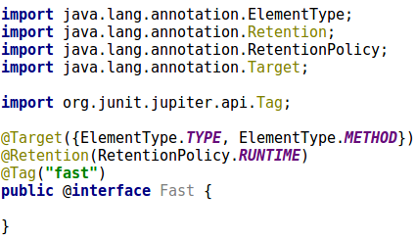
Meta-Annotations and Composed Annotations

Slide 39
Test classes
and
methods

Slide 40
Test classes and methods
A test method is any instance method that is directly or meta-annotated with @Test, @RepeatedTest, @ParameterizedTest, @TestFactory, or @TestTemplate.
A test class is any top level or static member class that contains at least one test method.

Slide 41
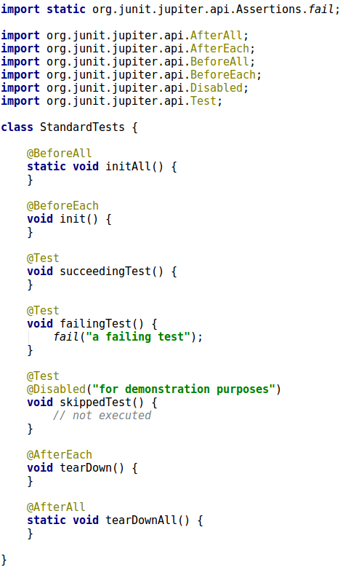
A standard test class
Neither test classes nor test methods need to be public. See method declarations with no public modifier.

Slide 42
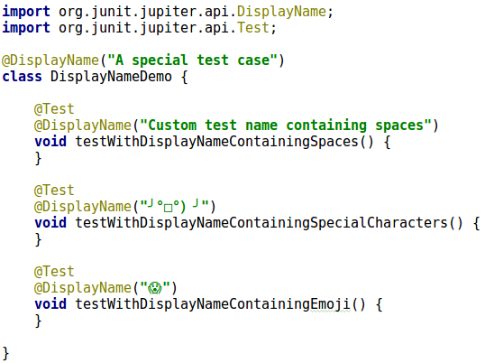
Custom display names
Test classes and test methods can declare custom display names — with spaces, special characters, and even emojis — that will be displayed by test runners and test reporting.

Slide 43
Assertions
See this example (and all others) on GitHub:
https://github.com/mathewr23/Java_Tutorials/tree/master/src/jUnit/AssertionsDemo.java
JUnit Jupiter comes with many of the assertion methods that JUnit 4 has and adds a few that lend themselves well to being used with Java 8 lambdas.
All JUnit Jupiter assertions are static methods in the org.junit.jupiter.api.Assertions class.

Slide 44
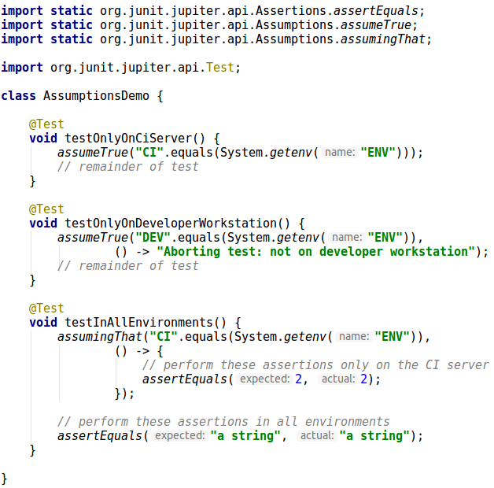
Assumptions
JUnit Jupiter comes with a subset of the assumption methods that JUnit 4 provides and adds a few that lend themselves well to being used with Java 8 lambdas.
All JUnit Jupiter assumptions are static methods in the org.junit.jupiter.api.Assumptions class.

Slide 45
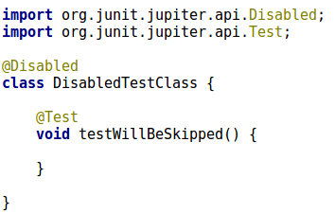
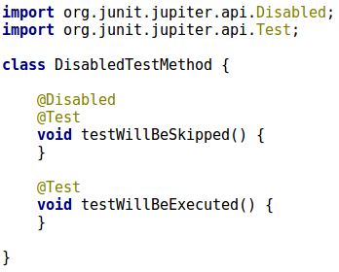
Disabling tests
Entire test classes or individual test methods may be disabled via the @Disabled annotation, via one of the annotations discussed in Conditional Test Execution, or via a custom ExecutionCondition.

