Slide 1
SHIFTVERIFY: AN USER STRING INSPECTOR WITH SHIFT-REDUCE PARSING TECHNIQUE
COURSE NAME: COMPILER DESIGN FOR LANCE
COURSE CODE:CSA1475 SLOT B TEAM MEMBERS: C.Nithin (192211397)
N.P.Sai Gowtham (192211337)
V.Jayanth Reddy (192211329)

Slide 2
ShiftVerify greatly increases parsing accuracy by using a shift-reduce technique to handle nested structures, confusing grammar, and unexpected changes.
ShiftVerify greatly increases parsing accuracy by using a shift-reduce technique to handle nested structures, confusing grammar, and unexpected changes.
ABSTRACT
SHIFTVERIFY, a novel tool for user string inspection based on the shift-reduce parsing technique
Aim to enhance the accuracy and efficiency of user string analysis compared to traditional methods.
SHIFTVERIFY greatly increases parsing accuracy by using a shift-reduce technique to handle nested structures.
Because of its effective parsing mechanism, it can handle data in real time, making it appropriate for interactive applications .

Slide 3

Section 1
INTRODUCTION
Overview of SHIFTVERIFY

Slide 4
What is SHIFTVERIFY ?
01
Inspection of user input :
A tool for examining and evaluating user input strings for particular structures or patterns is called SHIFTVERIFY.
02
Method of SHIFTREDUCE parsing:
It process and validates user provided data quickly and effectively by using the shift reduce parsing approach.
03
Improving String safety:
SHIFTREDUCE finds possible weakness and inconsistencies in input ,improving the string security.

Slide 5

Important of user string inspection:
Compliance: Certain industries or applications may have regulatory requirements regarding data validation and security.
Security:User input can be a significant security risk if not properly inspected. Malicious users may attempt to exploit vulnerabilities by injecting code, such as SQL injection or cross-site scripting (XSS), through input fields.
Performance: Properly validated input can improve application performance by reducing the likelihood of processing unnecessary or invalid data.

Slide 6



Features of Shift verify :
01
Pattern matching :
SHIFTVERIFY is able to recognize particular structures or patterns in input.
02
Custom rule definition:
Custom rules can be defined by user for string inspection.
03
Integration flexibility:
It can be included for thorough string analysis into variety of systems.

Slide 7

Section 2
An Understanding of Parse-Reduce

Slide 8


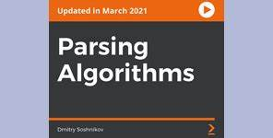
Exploring the Shift reduce parsing :
Parsing techniques overview :
A summary of parsing method that emphasizes shift-reduce parsing’s effectiveness.
Shift and reduce actions :
Recognizing the importance of shift and reduce operations in string analysis during the parsing process.
Parsing algorithm:
An overview of shift parsing reduce algorithm used for user string inspection.

Slide 9

Implementation of shift-Reduce parsing:
Initialize parser:
Create a parser object with a stack and initialize it with the start symbol of the grammar. Additionally, prepare an input buffer containing the tokens to be parsed.
Reduce Operation:
Check if any reduction can be applied based on the current stack configuration. If a reduction is possible, pop the appropriate symbols from the stack and replace them with the corresponding non-terminal symbol.
Error Handling:
Implement error handling to deal with syntax errors gracefully. This may involve error recovery strategies such as panic mode or error productions.

Slide 10
Code :
#include <stdio.h>
#include <string.h>
struct ProductionRule
{
char left[10];
char right[10];
};
int main()
{
char input[20], stack[50], temp[50], ch[2], *token1, *token2, *substring;
int i, j, stack_length, substring_length, stack_top, rule_count = 0;
struct ProductionRule rules[10];
stack[0] = '\0';
// User input for the number of production rules
printf("\nEnter the number of production rules: ");
scanf("%d", &rule_count);
// User input for each production rule in the form 'left->right'
printf("\nEnter the production rules (in the form 'left->right'): \n");
for (i = 0; i < rule_count; i++)
{
scanf("%s", temp);
token1 = strtok(temp, "->");
token2 = strtok(NULL, "->");
strcpy(rules[i].left, token1);
strcpy(rules[i].right, token2);
}
// User input for the input string
printf("\nEnter the input string: ");
scanf("%s", input);
i = 0;
while (1)
{
// If there are more characters in the input string, add the next character to the stack
if (i < strlen(input))
{
ch[0] = input[i];
ch[1] = '\0';
i++;
strcat(stack, ch);
printf("%s\t", stack);
for (int k = i; k < strlen(input); k++)
{
printf("%c", input[k]);
}
printf("\tShift %s\n", ch);
}
// Iterate through the production rules
for (j = 0; j < rule_count; j++)
{
// Check if the right-hand side of the production rule matches a substring in the stack
substring = strstr(stack, rules[j].right);
if (substring != NULL)
{
// Replace the matched substring with the left-hand side of the production rule
stack_length = strlen(stack);
substring_length = strlen(substring);
stack_top = stack_length - substring_length;
stack[stack_top] = '\0';
strcat(stack, rules[j].left);
printf("%s\t", stack);
for (int k = i; k < strlen(input); k++)
{
printf("%c", input[k]);
}
printf("\tReduce %s->%s\n", rules[j].left, rules[j].right);
j = -1; // Restart the loop to ensure immediate reduction of the newly derived production rule
}
}
// Check if the stack contains only the start symbol and if the entire input string has been processed
if (strcmp(stack, rules[0].left) == 0 && i == strlen(input))
{
printf("\nAccepted");
break;
}
// Check if the entire input string has been processed but the stack doesn't match the start symbol
if (i == strlen(input))
{
printf("\nNot Accepted");
break;
}
}
return 0;
}

Slide 11
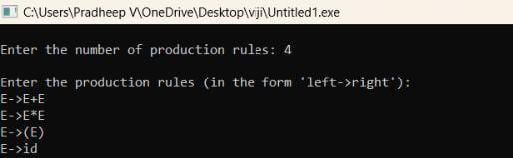
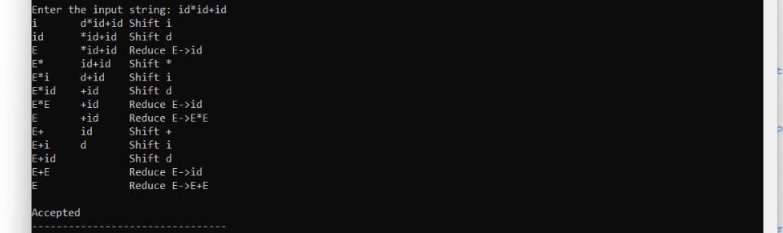
SHIFT-REDUCE :
INPUT:
OUTPUT:

Slide 12

Case Studies of Shift-Reduce parsing :
Language processing:
Syntax analysis in natural language processing frequently uses Shift-Reduce parsing.
Compiler Design :
It’s use in language syntax validation and analysis during compiler design .
Data Validation :
Shift-reduce parsing examples from real world that improves data validation and inspection procedures.
.

Slide 13
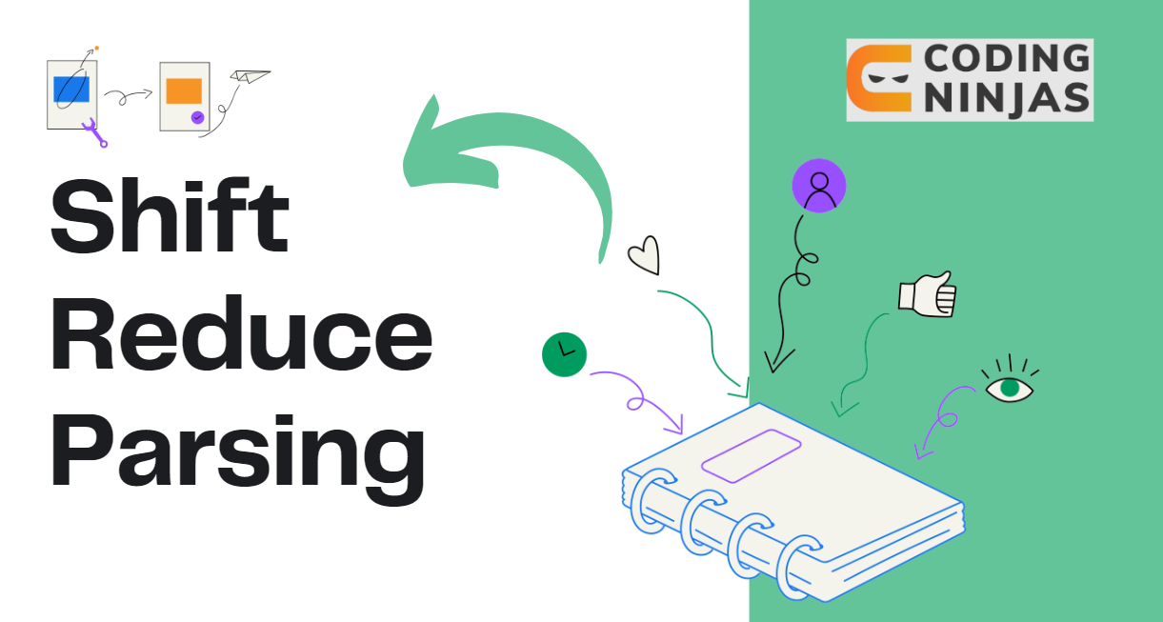
CONCLUSION
Shift Verify presents a promising approach to user string inspection, leveraging shift-reduce parsing techniques to enhance the security and reliability of software systems, particularly web applications.
Shift Verify represents a significant advancement in user string inspection, offering a promising solution to the ongoing challenge of ensuring the integrity and safety of user inputs in software systems.
Shift Verify has the potential to become a valuable tool for developers and security professionals in safeguarding against cyber threats and enhancing the resilience of web applications.

