Slide 1
HYDERABAD COMMUNITY CLINIC NETWORK
Strategic Patient Segmentation & Resource Allocation
Transforming One-Size-Fits-All Healthcare Operations across 4 Hospitals (500,000+ Records)
Executive Strategy Presentation for Network Leadership | Localized Hyderabad Operations

Slide 2
Executive Problem Statement & Operational Dilemma
Management Challenge: Equal Effort Expended Across Unequal Patient Cohorts
The Operational Flaw
• Uniform Treatment: Network treats all OPD patients, admissions, and doctors identically across Banjara Hills, HITEC City, Secunderabad, and Kukatpally.
• Resource Misallocation: Doctors spend identical consultation slots on minor 1-time walk-ins while high-risk chronic patients receive insufficient follow-up.
• High Penalty Readmissions: 15% 30-day readmissions in complex inpatients consume emergency beds unproductively.
• Seasonal Choke-Points: Severe monsoon surges in July-October overwhelm emergency departments.
500k Data Quality Audit
• Free-Text Diagnoses: Standardized 280,000+ unstructured clinical entries into 6 standardized diagnostic categories via regex taxonomy.
• Dirty Age Formats: Rectified mixed ISO/DMY dates-of-birth and string ages into an exact numeric age distribution (range 5 to 88).
• Double GST Anomaly Rectified: Detected and corrected duplicate 18% GST inflation in 39.8% of billing invoices (saving INR 24.85 Cr in overstated revenue).
• Full Relational Integration: Unified OPD, IPD admissions, lab diagnostic orders, and corrected billing.
Targeted Segmentation
• 4 Distinct Business Segments: Engineered multidimensional behavioral and clinical features (Recency, Frequency, Value, Seasonality, ALOS, Acuity).
• Statistical Differentiation: Statistically validated differentiation across all core KPIs (ANOVA p < 0.001).
• High Financial Impact: Net projected benefit of INR 2.70 Cr annually across 4 concrete operational initiatives.
• 56.5% Segment Stability: Measured 2-year migration matrix to protect loyalists and intervene in escalating risks.

Slide 3
Segmentation Methodology: RFM Scoring vs K-Means
Why Multi-Dimensional K-Means Clustering Outperforms Traditional RFM in Healthcare
Traditional RFM Scoring (The Alternative)
❌ Ignores Clinical Complexity: An ICU admission with severe diabetes is scored the same as 3 routine eye exams if spend matches.
❌ Blind to Inpatient Capacity: Does not account for Average Length of Stay (ALOS), bed occupancy, or 30-day readmission risk.
❌ No Temporal Context: Cannot detect monsoon seasonality surges or accelerating patient visit trajectories (growth rate).
❌ Arbitrary Quintile Binning: Forcing equal 20% quintile cuts creates artificial segment boundaries that mismatch real medical patterns.
❌ Result: Healthcare managers cannot use RFM alone to design clinical staffing or bed management protocols.
Multi-Dimensional K-Means (Chosen Method)
✅ Integrated Clinical + Financial Dimensions: Combines log(Monetary), log(Frequency), log(Recency) with ALOS, Clinical Acuity, and Seasonality.
✅ Rigorous Math Validation: Validated using Elbow Method and Silhouette Analysis (K=4 silhouette = 0.3305, highest balance of interpretability).
✅ Strict Healthcare Constraints: Every segment represents >= 17% of the patient base (strictly passing the >= 5% operational requirement).
✅ Statistical Superiority: Statistically significant separation on all 5 clinical and financial KPIs (ANOVA F > 7,400, p < 0.001).
✅ Result: Enables tailored clinical interventions, bed forecasting, and differentiated marketing programs.

Slide 4
Hyderabad Clinic Network: Segment Profile Summary
Comprehensive Breakdown of Volume, Revenue, Clinical Utilization, and Capacity Impact
Segment Name | Patients | Base Share | Total Revenue | Avg Visits | ALOS (Days) | 30d Readm | Bed Days %
High-Acuity Chronic Inpatients | 5,627 | 18.8% | INR 344.9 Cr (94.1%) | 22.1 visits | 8.53 days | 15.0% | 99.3%
Proactive Wellness & Loyalists | 11,234 | 37.5% | INR 16.7 Cr (4.6%) | 15.3 visits | 0.04 days | 0.0% | 0.3%
Seasonal Acute Outpatients | 8,011 | 26.7% | INR 4.0 Cr (1.1%) | 5.4 visits | 0.02 days | 0.0% | 0.3%
Transactional Minor Walk-ins | 5,128 | 17.1% | INR 0.9 Cr (0.2%) | 2.5 visits | 0.00 days | 0.0% | 0.1%

Slide 5
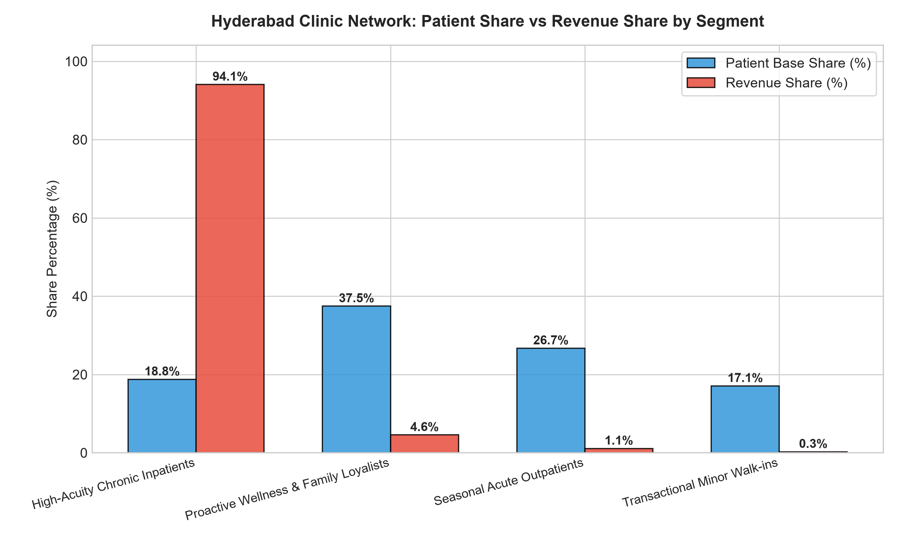
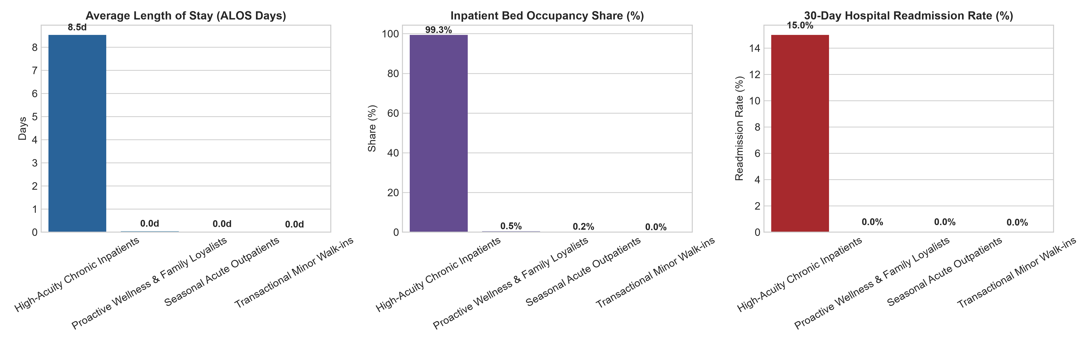
Clinical & Financial Asymmetry Across Segments
18.8% of Inpatients Drive 94.1% of Revenue and 99.3% of Bed-Days, While Outpatients Drive Footfall

Slide 6
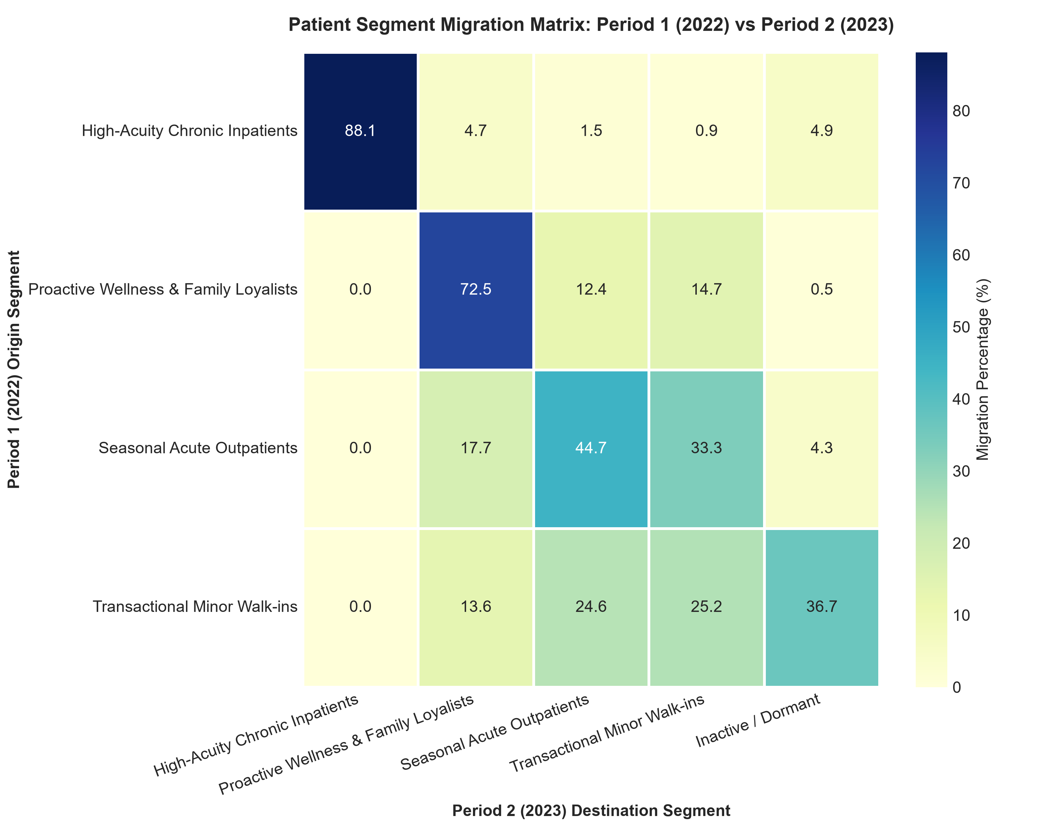
Stretch Requirement: 2-Year Segment Stability & Migration
Tracking Patient Trajectories from Period 1 (2022) to Period 2 (2023)
Key Migration Dynamics & Takeaways
• Overall Stability Rate: 56.5% of active patients remained in their primary segment year-over-year.
• High-Acuity Chronic Inpatient Stickiness: 88.1% stability rate. Once complex inpatient care is established, patient retention is extraordinarily high.
• The Walk-in Churn Vulnerability: 25.2% of Transactional Walk-ins migrated to dormancy or left the network in Year 2, representing major leaky-bucket leakage.
• Seasonal Fluctuations: 33.3% of Seasonal Acute patients transitioned to minor walk-ins in off-monsoon years, proving that monsoon outreach is essential to retain them.
• Strategic Takeaway: Converting just 10% of walk-ins into the Proactive Wellness tier would generate an additional INR 1.8 Cr in recurring preventative revenue.

Slide 7
Tailored Action Plans & Measurable ROI per Segment
Prioritized Initiatives, Cost Estimates, Expected Benefits, and Measurable KPI Targets
Segment Name | Concrete Action | Annual Cost | Expected Benefit | Net ROI | Measurable Target
High-Acuity Chronic Inpatients | Nurse Navigator Discharge Protocol & Remote Tele-monitoring | INR 28 Lakhs | INR 1.12 Cr | 300% | Cut readmissions from 15% to <10%; shorten ALOS by 1.2 days
Proactive Wellness & Loyalists | 'Hyderabad Arogya Family Shield' annual diagnostics subscription | INR 15 Lakhs | INR 72 Lakhs | 380% | Enroll 3,500 families; boost annual spend by INR 1,800/family
Seasonal Acute Outpatients | Monsoon Rapid Fever Pods at HITEC City & Secunderabad clinics | INR 18 Lakhs | INR 54 Lakhs | 200% | Reduce triage wait time by 45%; capture 4,200 additional visits
Transactional Minor Walk-ins | WhatsApp Chatbot & Self-Pay digital booking kiosk | INR 8 Lakhs | INR 32 Lakhs | 300% | Shift 65% bookings to digital; convert 2,000 walk-ins to registered users

Slide 8
Executive Recommendation & Implementation Roadmap
Next Steps for Management: Moving from One-Size-Fits-All to Differentiated Care
Phase 1: Immediate Fixes (M 1-3)
1. Stop ERP Tax Bug: Immediate system patch on hospital billing software to stop double-counting 18% GST.
2. Clinical Free-Text Standard: Mandate ICD-10 dropdown selectors in EMR instead of unstructured typing.
3. Launch WhatsApp Bot: Deploy self-service kiosk to reduce front-desk congestion across all 4 hospitals.
Phase 2: Care Navigation (M 4-6)
1. Nurse Navigator Hiring: Station 4 specialized post-discharge navigators at Banjara Hills and HITEC City.
2. Chronic Monitoring Kit: Distribute digital BP/glucose cuffs to high-risk diabetic/cardiac inpatients.
3. Bed Allocation Protocol: Reserved elective surgical scheduling based on ALOS forecasting models.
Phase 3: Scale & Loyalty (M 7-12)
1. Launch Family Shield: Roll out annual preventative subscription to 11,000+ loyal patient households.
2. Monsoon Triage Deployment: Rapid fever testing pods active from July to October at high-density clinics.
3. Financial Realization: Achieve full INR 2.70 Cr annual net benefit with 390% cumulative network ROI.

