Slide 1


IoT Data Cleaning and Visualisation
By
Richard Sserunjogi & Lillian Muyama
Department of Computer Science,Makerere University, Uganda
richard.sserunjogi@airqo.net & lillian@airqo.net

Slide 2
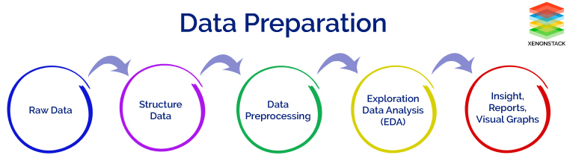
Data Preparation Process
Figure 1: Data preparation process. source:xenonstack.com

Slide 3

Data Cleaning
Data cleaning is the process of detecting and correcting (or removing) corrupt or inaccurate records from a data set. The incomplete, inaccurate or irrelevant parts of the data can be replaced, modified or deleted.

Slide 4
Why is it important?
GIGO Concept: How well you clean your data has a direct impact on the quality of your results.
What we are looking at:
Validity e.g. data types, range constraints etc.
Accuracy i.e. degree to which the data is close to the true values.
Completeness i.e. degree to which all required data is known.
Consistency i.e. the degree to which the data is consistent.
Uniformity i.e. the degree to which the data is specified using the same unit of measure.
Notes:
Data can be valid but not accurate.
Failure to transmit data,

Slide 5
The Cleaning Process
Inspect the data for inaccuracies, anomalies, inconsistencies and gaps.
With Python’s Pandas library, we can use functions such as dataframe.describe(), dataframe.info(), dataframe.shape, dataframe.isnull().sum() etc. Also visualisations
Clean the data.
Verify that the data has been cleaned using some of the methods in 1 and several additional methods dataframe.head(), dataframe.tail().
Always record what has been done to the data.

Slide 6
Cleaning IoT data - ex. AirQo
Dealing with datatypes
Dealing with null values
Dealing with outlier values
Dealing with units of measure
Dropping unwanted columns
The main columns we shall deal with are the 2 PM 2.5 columns, the 2 PM 10 columns and the latitude and longitude coordinates. Temperature and humidity will also feature at a later time.
Notes:
Units of measure: Having different types of sensors, some record in Fahrenheit while others in Celsius so this comes back to the point of uniformity made earlier

Slide 7
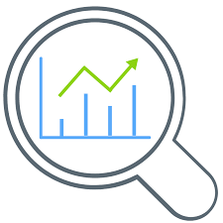
Data Visualisation
Process of interpreting data and presenting it in a pictorial or graphical format.
Notes:
Aims at understanding data by extracting and graphing information to show patterns and trends.

Slide 8
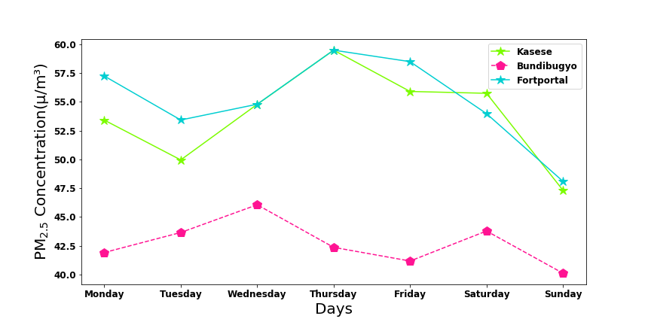
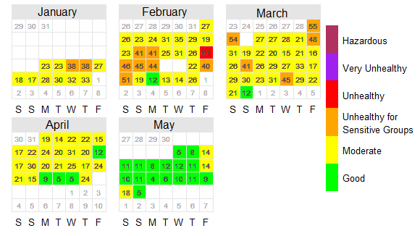
Examples(Air quality related visuals)
Figure 2. Average PM_{2.5} for each day of the week for three monitoring stations in Western Uganda
Figure 3: Daily average PM_{2.5} for a certain location Uganda from January to May 2019

Slide 9
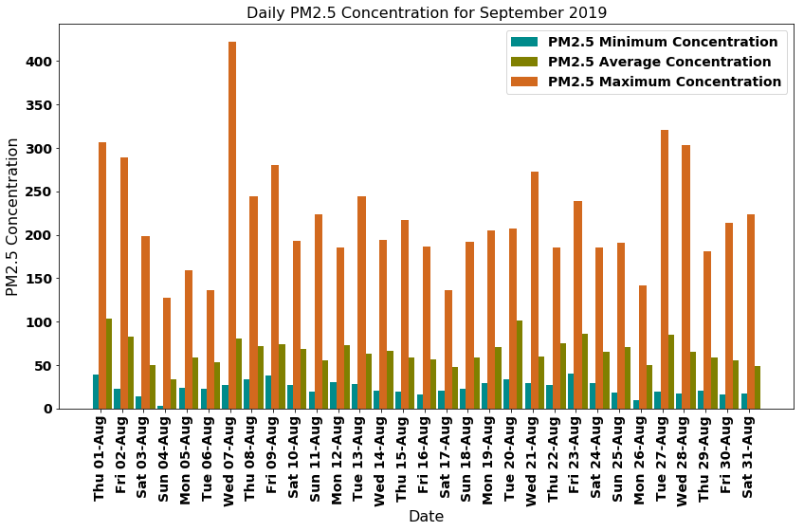
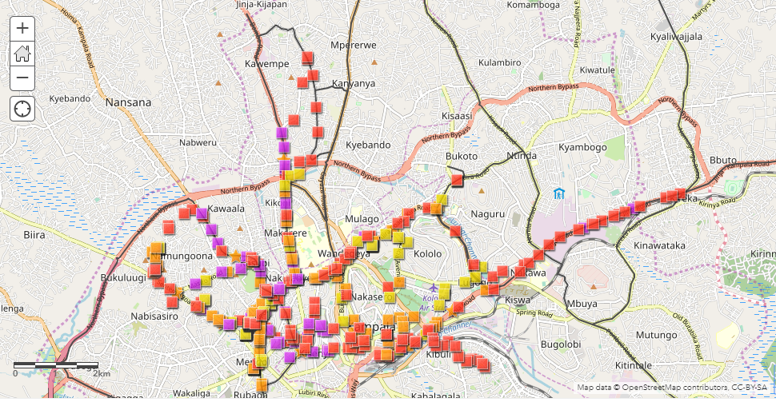
Examples cont..
Figure 4: Map showing PM_{2.5} concentrations for one of the mobile air quality monitoring units in Kampala on 23-Feb-2019
Figure 5: Daily average PM_{2.5} for a certain location Uganda from January to May 2019

Slide 10
Why is data visualisation important?
Easier trend & pattern visualisation within data sets
Simplifies data by giving a full picture of the scoped parameters leading to efficient decision making
Unifies interpretation through the use of graphics and charts
Notes:
Data visualisation provides easier approaches to identifying upcoming trends and patterns within data sets and hence enables businesses to make efficient decisions and prepare strategies in advance
Simplicity: It is impossible to make efficient decisions based on large amounts of raw data. Therefore, data visualisation gives the full picture of the scoped parameters and simplifies the data by enabling decision-makers to cherry pick the relevant data they need and dive into a detailed view wherever is needed
Unify interpretation :Data visualisations can produce charts and graphics that lead to the same Interpretations by all who use the extracted information for decision-making.

Slide 11

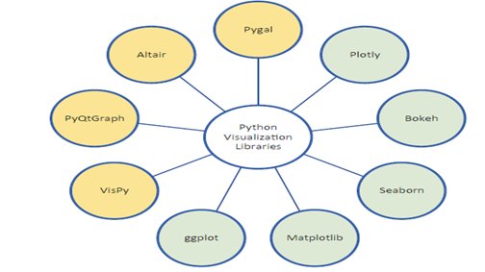






Common python visualisation packages
Figure 6: Libraries for python data visualisation (Src: Data Analysis and visualisation Using Python book)

Slide 12
Practical Session

Slide 13
Prerequisite
Knowledge of python programming language
Have anaconda/conda installed

Slide 14
Required Packages
Numpy
Pandas
Matplotlib
Seaborn

