Slide 1


EXIT FORMALITIES
Note – This same content can be viewed as video under International relocation page from Be. Cognizant

Slide 2

EXIT FORMALITIES
02 - 07
Exit Formalities while Departing the Host Country
Table of Contents
Exit and Deregistration Formalities
The End

Slide 3


EXIT FORMALITIES
05 - 07
Exit and Deregistration Formalities
Before leaving the host country, you must contact HR and Immigration teams to complete certain exit and deregistration formalities to be compliant. Please see below the key exit formalities .
If you are travelling on vacation or emergency, you must inform the Human Resources team.
If you have travelled with your dependents and you need to return to your home country prior to completion of nine months, then your manager must inform the Human Resources team and provide a business justification.
Your manager must update your payroll changes in ESA back to your home country payroll.
In case the Primary applicant is returning from the host country, it is also mandatory for accompanied dependents to return.
Dependents are not permitted to work individually in the absence of the Primary Applicant.
Associates must ensure to adhere to the clearance formalities such as submitting the company assets like laptop, handsets etc.
If you have any queries on the process or policy, contact your local Talent Manager.

Slide 4


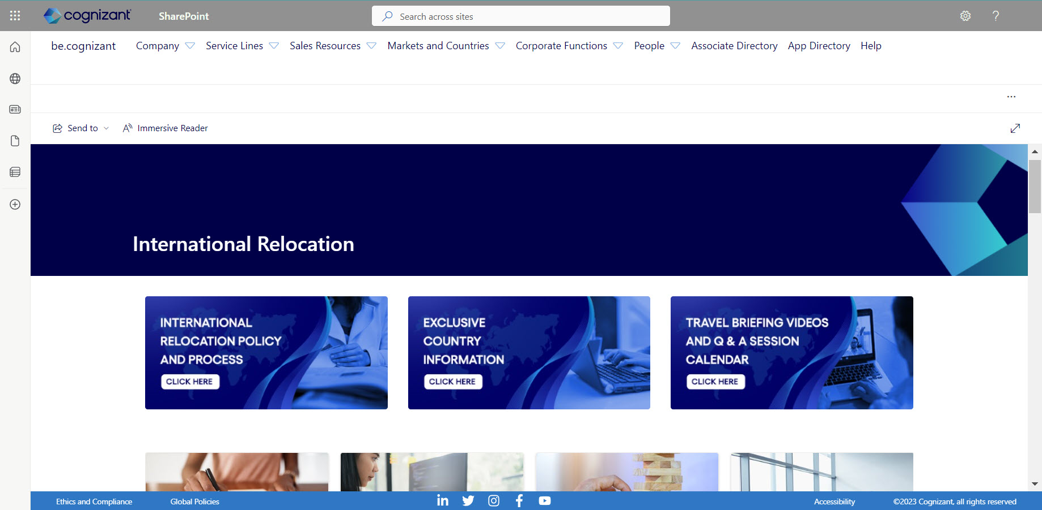
EXIT FORMALITIES
06 - 07
The End
With this section we have come to the end of the travel briefing.
To know more about relocation, please visit the International Relocation page and Canada Exclusive page in Be Cognizant Intranet site. Here, you can browse through a host of relocation policies, processes, FAQ’s and travel checklists.
Wishing you a safe and pleasant trip!

