Slide 1
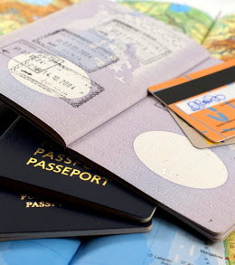

TRAVEL READINESS
Note – This same content can be viewed as video under International relocation page from Be. Cognizant

Slide 2

TRAVEL READINESS
02 - 12
Travel Readiness
Table of Contents
Check your flight timings.
Check weather conditions.
Check baggage allowance.
Check for any travel advisories sent by travel support team.
Verify the list of items prohibited during travel.
Carry Medicines in your Hand baggage along with the doctor’s prescription.
Carry all the required documents during travel.

Slide 3
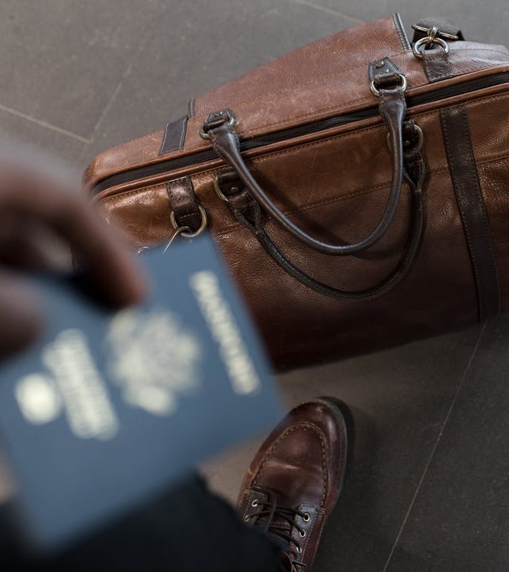

TRAVEL READINESS
05 - 12
Travel Readiness Checklist
Check your flight timings at the airlines website and ensure that you reach the airport at least three hours prior to your scheduled departure time.
Check the weather conditions of your destination country and plan your required clothing.
Check the baggage allowance in your ticket and pack your luggage accordingly.
Check for any travel advisories sent by the Travel Support Team
Carry medicines in your hand baggage along with the doctor’s prescription. Please check for any country specific restrictions or prohibitions on carrying medicines, even though the medicines are for personal use.

Slide 4


















TRAVEL READINESS
06 - 12
TRAVEL READINESS
07 - 12
Travel Readiness Checklist
Travel Readiness Checklist
Table of Contents
Verify the list of items prohibited during travel. You are not allowed to carry certain items during your travel to the Canada. We strongly recommend that you check the airlines website for detailed information on such items.
Verify travel checklist and make sure you are carrying all the required documents and other essentials during the entire duration of your travel.
Important Documents
Valid Passport
Valid Visa
Flight E-Tickets
Travel Insurance Document
Deputation letter
Initial accommodation
confirmation, address and
contact numbers.
Fresh fruits
& vegetables
Flowers
Plants
Seeds
Poppy seeds –
also known as
Khus Khus
Soil
Pets
Insects
Any kind of meat, sausages or
cold cuts
Biological
products

Slide 5


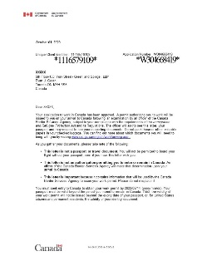

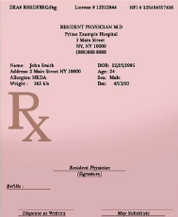


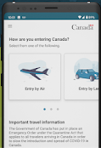
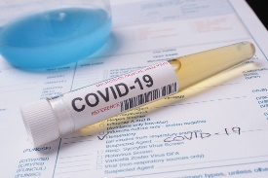
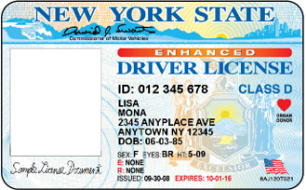
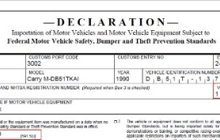
TRAVEL READINESS
08 - 12
TRAVEL READINESS
09 - 12
Travel Readiness Checklist
Work authorization/Correspondence letter
Medicals (Validity - One year). Your medicals should be valid at the time of entry into Canada). Associates travelling from India & APAC countries must undergo a medical test and submit their medical reports. Associates travelling from US & major European countries are exempted from medical tests. However, associates are advised to check with the Immigration team as the requirement could change.
Arrive CAN App update
PCR COVID 19 negative test result report (All air passengers to Canada five years of age or older must obtain a negative COVID-19 test taken within a 72-hour period prior to boarding the flight. The test must be a polymerase chain reaction (PCR) test)
US – Canada travelers must carry below documents
Drivers’ license and other relevant
licenses from US are valid in Canada.
Car ownership and registration
documents.
Important Documents
Corporate Amex Card
HDFC Forex Card
(India Outbound travelers)
Matrix SIM card
(India Outbound travelers)
Contact details of Onsite manager, Project manager & colleagues (Emergency contacts)
11. Birth, marriage, education, adoption certificates, health, documentation of vaccines, etc. of the associate and family.
12. Copies of recent Pay statements to show country of employment
13. 2 passport size photographs

Slide 6
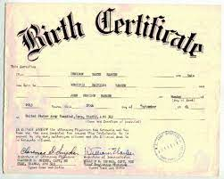
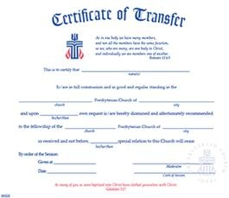
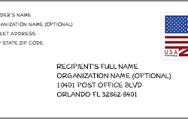
TRAVEL READINESS
10- 12
TRAVEL READINESS
11- 12
Dependents travel checklist
Dependents travel checklist
Table of Contents
Valid Passport (with a minimum validity of 6 months)
Valid Visa
Correspondence letter
E - Tickets
Medicals (Should be valid at the time of entry into Canada)
Copy of Primary applicant’s passport, Work permit, employment letter, recent pay slips.
Details of primary applicant’s residential and office address
Original Marriage certificate and birth certificate for child
School transfer certificate, report card, documentation of vaccines, etc. for kid(s)
Drivers’ license and other relevant licenses (Applicable only for US – Canada).
Arrive CAN App update
PCR COVID 19 negative test result report (All air passengers to Canada five years of age or older must obtain a negative COVID-19 test taken within a 72-hour period prior to boarding the flight. The test must be a polymerase chain reaction (PCR) test)
Please note – Your dependents would either receive an Open Work Permit, Visitors’ Record or Study Permit at the Port Of Entry (POE) depending upon the type of application that was filed for them. This document is important for enrolling the dependents for health benefits in Canada and also for obtaining admission into school for your kid(s). If your dependents are not issued any of these documents at the POE, please reach out to Global Mobility on priority.

Slide 7
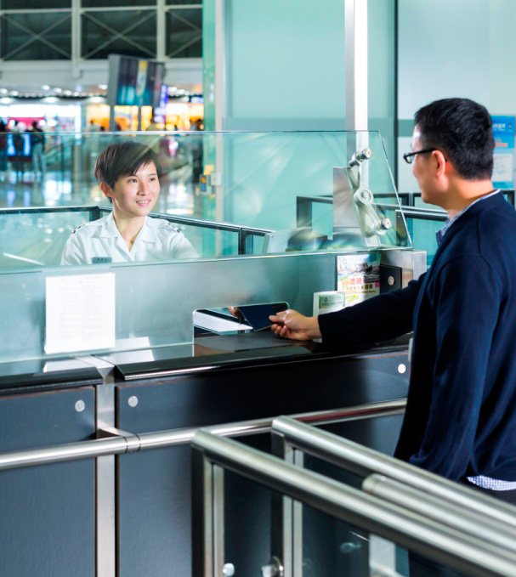
Click here for
YOUR TO-DOS POST TRAVEL

