Slide 1


TRAVEL BRIEFING – Canada
Note – This same content can be viewed as video under International relocation page from Be. Cognizant

Slide 2


YOUR MUST-KNOWS 03 - 23
Welcome to Canada Travel Briefing Session!
This session is intended for all associates relocating to Canada on a Payroll Transfer.

Slide 3


YOUR MUST-KNOWS
04 - 23
Travel Briefing - Canada
Table of Contents
Your Must – Knows
Your To – Dos before travel
Travel Readiness
Your To – Dos post travel
Know your Relocation Benefits & Services
Exit formalities while Departing the Country

Slide 4


YOUR MUST-KNOWS 07 - 23
Your Must – Knows
Table of Contents
Be Aware about Cognizant’s Relocation Policy Guidelines
Understand Cognizant’s Visa Compliance Guidelines
Understand Cognizant’s Modes of Security Assistance.
Know about Dependent Travel Procedures and Policies
Be Aware of the changes to your India Benefits when you relocate – Medical Insurance and Leaves
Know your Action items if there are Changes in your Travel plan

Slide 5
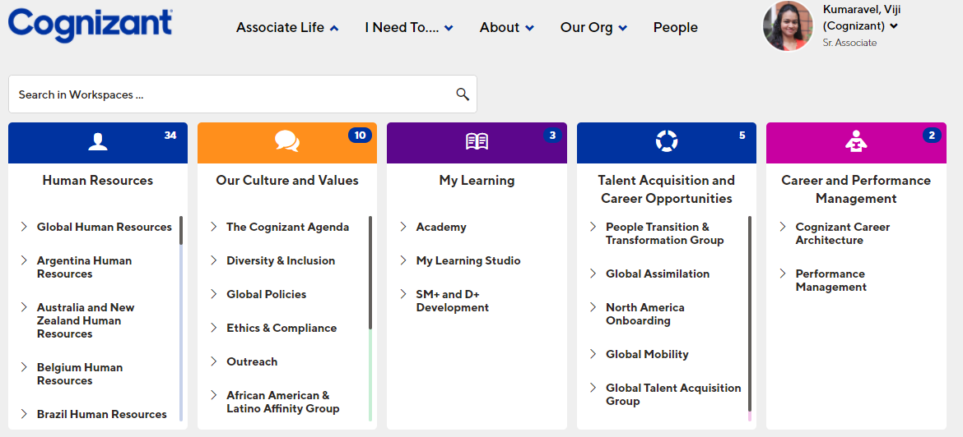

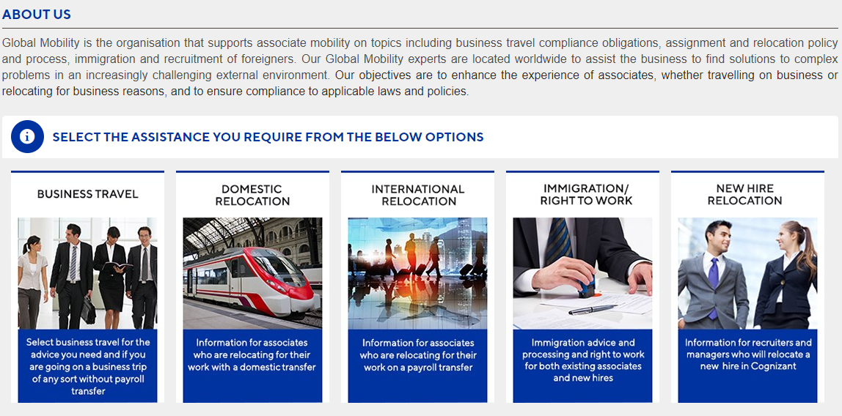
YOUR MUST-KNOWS
08 - 23
YOUR MUST-KNOWS 09 - 23
Be Aware about Cognizant’s Relocation Policy Guidelines
Before you travel, make yourself aware of Cognizant’s Relocation Policy guidelines by visiting Be.cognizant- Global Mobility site – International Relocation – Click on International Relocation policy.

Slide 6

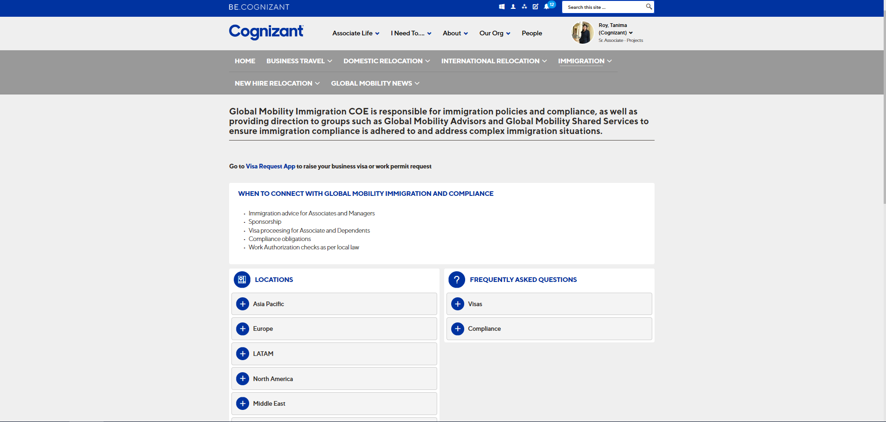

YOUR MUST-KNOWS
10 - 23
YOUR MUST-KNOWS 11 - 23
Understand Cognizant’s Visa Compliance Guidelines
Understand Cognizant’s Modes of Security Assistance
Associates should always follow the advice of our Immigration Team and abide by Cognizant’s Visa compliance guidelines. For more information, please refer the Be Cognizant – Global Mobility Immigration page.
Also, reach out to your respective destination country Immigration team for any queries.
At Cognizant, we give utmost importance to the safety and security of our associates. Please follow the security measures you need to take during your travel.
View the Travel Security Awareness video on the Corporate Security website.
Visit the Travel Security page of the Corporate Security website for travel security tips and up-to-date travel alerts.
If you require Security Assistance while traveling, or you become aware of a situation that is or has the potential of escalating into a crisis, you should contact Corporate Security. The Corporate Security Contact information is given below.
Table of Contents
Your Must – Knows
Your To – Dos before travel Travel Readiness
Your To – Dos post travel Know your Relocation Benefits
Exit formalities while Departing the Country
Information Corner
VNET: 56666 (Option -0) I US Toll Free: 1-866-822-2024 I
UK Toll Free: 0800-678-1616 I India Toll Free: 1800-2000-473
Email: corporatesecurity@cognizant.com
For any further assistance, please drop an email at Cstravelsecurity@cognizant.com

Slide 7


SCAM
ALERT!
YOUR MUST-KNOWS 13 - 23
Understand Cognizant’s Modes of Security Assistance
Please be aware of Immigration Scams during your stint in the host country and take the following necessary precautions to avoid them.
- Do not give money or personal information to strangers.
- Ignore any call or email communication from scammers.
How to Identify Scammers?
Scammers can call or email you: Stating problems with your records Demand money for resolving fabricated problems Threaten arrest or deportation Tell you that the call is being recorded or monitored by high officials Ask you not to talk to anyone else or use the Internet.
Note: Also, keep your dependents informed about scammers.​

Slide 8

YOUR MUST-KNOWS
14 - 23
Know about Dependent Travel Procedures and Policies
Your dependents can join you in your destination country provided that your immigration status is eligible for family reunification.
Let us look at the key policies under which Cognizant sponsors dependent travel:
As per Cognizant’s Global Travel and Expense Policy, the employee needs to be on assignment for more than 9 months for their dependents to be covered for relocation.
Dependents include legally married spouse of the associate and their children at the time of the associate’s relocation.
Dependents can travel either along with the associate or on a future date.
Dependents are eligible to travel to the associate’s principal work location only.
If an associate gets married or has a child during the assignment, at the assignment work country, the new family member will be entitled to one way travel when leaving the host jurisdiction on completion of assignment. If the associate gets married outside of the assignment work location, the company will not support travel for the new family from where the member is located to the associate host jurisdiction.
After the dependents arrive in the destination country, the associate must notify the respective NA Benefits (NABenefits@cognizant.com) to register them for Health insurance.
Associates are responsible to track their dependents’ status and ensuring they are valid at all times.

Slide 9
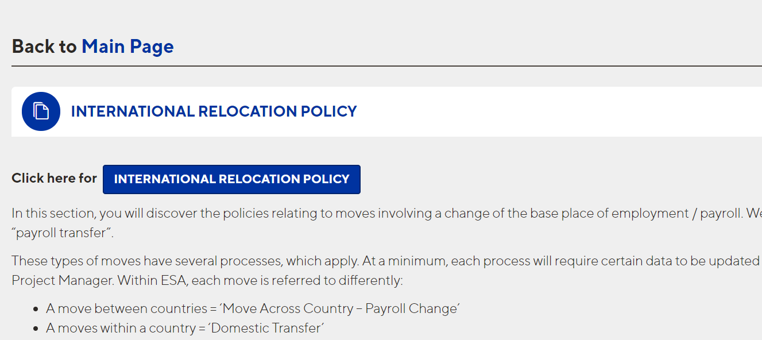
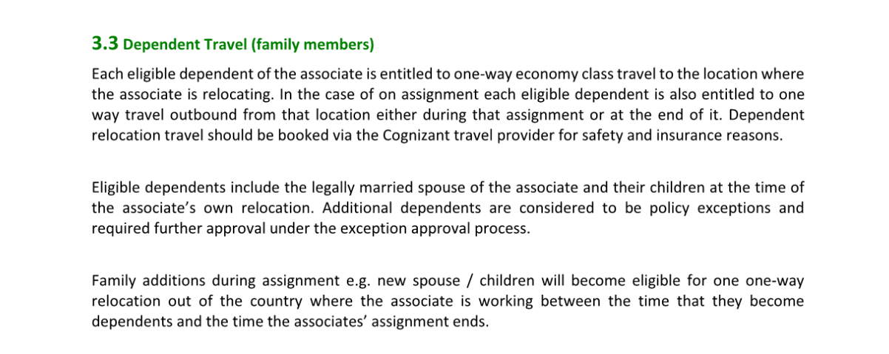
YOUR MUST-KNOWS
16 - 23
YOUR MUST-KNOWS 17 - 23
Know about Dependent Travel Procedures and Policies (Continued)
Know about Dependent Travel Procedures and Policies (Continued)
For more information on dependent travel, kindly visit section 3.3 of the international Relocation Policy available on the International Relocation page in Be Cognizant.
The status of the Open Work Permit (OWP) holder is linked to the primary applicant’s status and any change in the status of primary applicant will affect the spouse’s OWP status as well. OWP holders cannot enter Canada before the primary applicant or work in Canada in the absence of primary applicant.
Associates must procure a separate approval from the project manager for dependents travel if they are travelling later and the travel must be booked with the help of AMEX GBT (Cognizant travel provider)
If dependents citizenship requires temporary resident visas they must have one or be listed on the associates visa. They may have to meet other requirements. Please check www.cic.gc.ca for further details.
Your Must – Knows
Your To – Dos before travel Travel Readiness
Your To – Dos post travel Know your Relocation Benefits
Exit formalities while Departing the Country

Slide 10


YOUR MUST-KNOWS
18 - 23
YOUR MUST-KNOWS 19 - 23
Be aware of the changes to your India Benefits
when you relocate — Leaves
Be aware of the changes to your India Benefits
when you relocate — Medical Insurance
Your India leaves will be suspended effective from the start date of the International assignment and will be activated after you return to India post the assignment.
Medical Insurance for your Dependents Residing in India
  Dependents residing in India will not be automatically enrolled into India Medical Insurance post your payroll transfer.
  For dependents to be active in India Medical Insurance, you need to enroll your dependents and pay the premium amount for the ongoing policy period through MediBuddy portal.
  You will receive a Welcome mail from Medi assist within 2 weeks on your arrival at onshore.
  Go to Medi Buddy app in One Cognizant and enroll your dependents for Group Member Coverage or GMC.
  The enrolment window will remain open only for 14 days from the date of receipt of the Welcome Mail from Medi assist.
You can use all the available vacation, sick, and personal leaves before the International assignment start date or after you return to India and get transferred to India payroll provided your leaves have not lapsed.
To know more about India Leave Policy, please check the India leave policy document in the India HR Policy page in Be Cognizant
Note – Use only India Debit or Credit card to pay your premium as International Card transactions will not be successful.

Slide 11

YOUR MUST-KNOWS
20 - 23
YOUR MUST-KNOWS 21 - 23
Be aware of the changes to your India Benefits when you
relocate — Medical Insurance
Actions to be taken if there any changes in the Travel plan
Please ensure to contact the relevant stakeholders at the earliest to make modifications related to your travel date or hotel accommodation booking. This will help us to avoid huge cancellation charges.
The contact information of various teams that you might need are given below.
Medical Insurance for your Dependents Residing in India
MONTHLY ALLOWANCE
A flat average monthly allowance will be paid as part of your onsite payroll for enrolling your dependents into your Home Country Insurance
This Monthly Allowance is applicable to associate at all levels.
GM Travel Support team/ROW Travel Support team: Gmtravelsupport@cognizant.com / ROWTravelSupport@cognizant.com Contact AMEX GBT (Cognizant travel partner) - For flight tickets and hotel booking changes, India Outbound travellers – drop an email to in.Cognizant.travel@amexgbt.com or call at 18604191142 (Toll free number from within India only) / Rest of the world travellers – drop an email to in.Cognizant.relo@amexgbt.com or call at +91- 80-61550709 (from outside India).
Please refer to the Be. Cognizant - International relocation – India benefits page

Slide 12

YOUR MUST-KNOWS
22 - 23
Actions to be taken if there are any changes in the Travel plan
The contact information of various teams that you might need are given below.
Travel Insurance Provider: ICICI Lombard (India –based associates): Email ID - cognizant.travel@icicilombard.com Aetna (Global Travelers): Email ID - aiservice@aetna.com; Phone No – 18773015042; Website: Aetnainternational.com Chubb (Europe-based associates only): Email ID - Medicalassistance@chubb.com; Phone No – +44 (0) 207 895 3364; Website: http://www.chubbassistance.com/ Travel Expenses – TravelExpenseMgm@cognizant.com
Click here for
YOUR TO-DOS BEFORE TRAVEL

