Slide 1
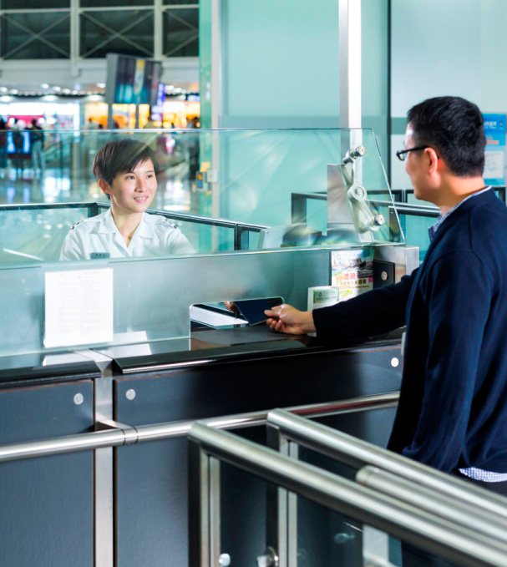

YOUR TO-DOS POST TRAVEL
Note – This same content can be viewed as video under International relocation page from Be. Cognizant

Slide 2

YOUR TO-DOS POST TRAVEL
02 - 13
Your To-Dos post travel
Table of Contents
Obtain Immigration clearance at the Port of Entry.
Apply for SIN Card (Social Insurance Number) and complete Work authorization check.
Complete Post arrival HR & Payroll formalities

Slide 3


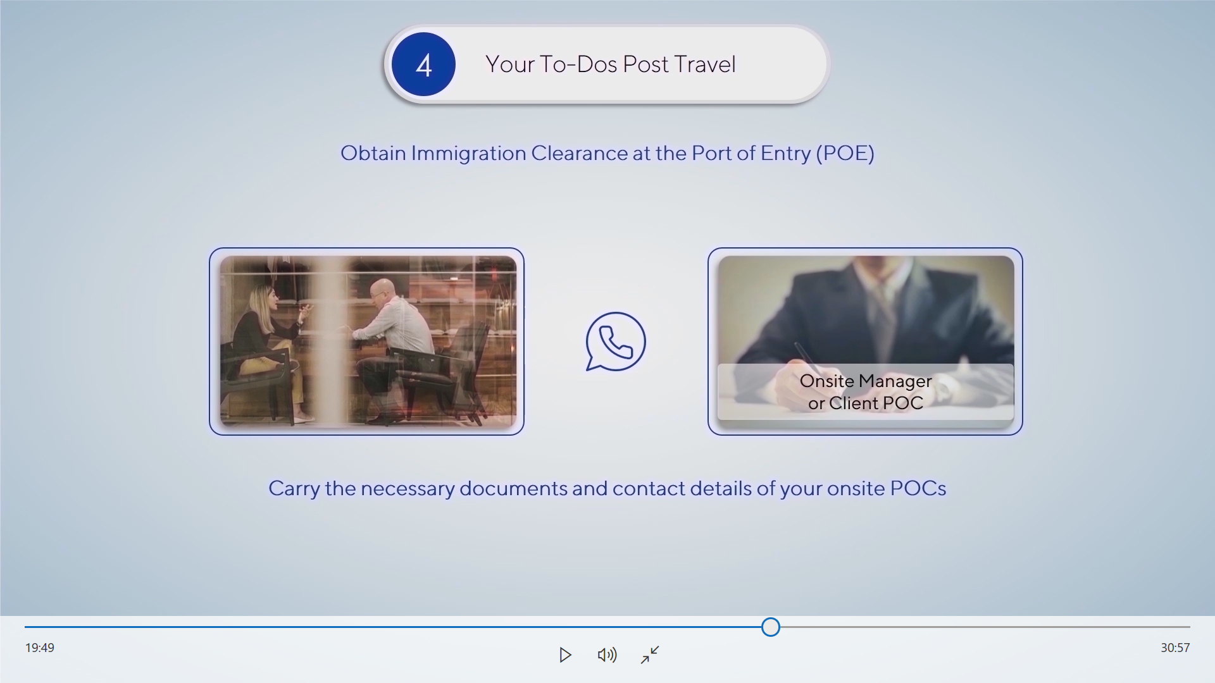
YOUR TO-DOS POST TRAVEL
04 - 13
YOUR TO-DOS POST TRAVEL
05 - 13
Obtain Immigration clearance at the Port of Entry
Obtain Immigration clearance at the Port of Entry
Table of Contents
Once you reach your destination country, you need to first obtain immigration clearance at the Port of Entry.
Immigration officer will ask you questions and check your documents before granting permission into the country.
They may call your Onsite Manager or Client POC to verify your statements. Thus, please ensure you carry the necessary documents and contact details of your onsite POC’s.
Note – Associates who travel from US to Canada after the expiry or denial of US Visa status, it is recommended to choose Air travel.
What questions can PoE officer
ask?
Your citizenship
Your trip
Items that you seek to
bring to the country
How to Behave with Immigration officer?
Be ready with your passport and have all papers ready for POE review.
Listen closely and provide only the information that is requested.
Be polite and respectful
Furnish accurate information
Note - Immigration officers have the legal authority to examine your baggage at the Port of Entry.

Slide 4


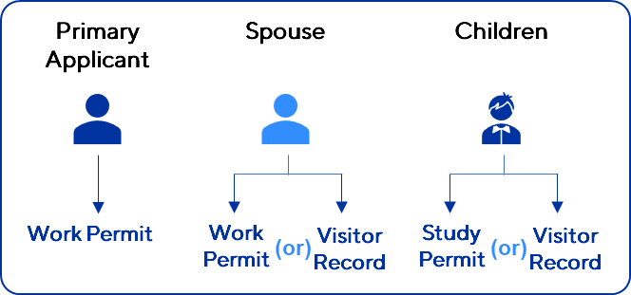
YOUR TO-DOS POST TRAVEL
06 - 13
YOUR TO-DOS POST TRAVEL
07 - 13
Obtain Immigration clearance at the Port of Entry
After performing the necessary checks, the POE Officer will issue a Work permit for the primary applicant and for spouse a work permit will be issued if an Open work permit was applied else a visitor record will be issued. And for children, a study permit will be issued if student permit is applied else a visitor record will be issued.
Please check for any typos on the document (has your passport details). If you find any discrepancies, please do highlight it to the Officer and request for an amendment before you leave the airport.
Though immigration officials are generally professional and courteous, it is important for you to know that our associates faced a few unfortunate encounters involving discriminatory and abuse remarks at the Port of Entry.
In such a case, we would want the associate to remain calm, professional and courteous, and after clearing the immigration formalities, report any such incidents to the Global Mobility team.
Immigration officers have full discretion over allowing entry, and having a valid Work permit does not guarantee entry to the destination country .
Always cooperate and follow the instructions of the PoE officer
Note - The associate must upload the copy of Work Permit in the Work authorization app or share the copy to CanadaWorkAuth@cognizant.com within 3 days of arrival.

Slide 5
YOUR TO-DOS POST TRAVEL
08 - 13
YOUR TO-DOS POST TRAVEL
09 - 13
Complete Immigration clearance and collect your Work permit from the POE officers
Complete Immigration clearance and collect your Work permit from the POE officers.
After performing the necessary checks, the POE Officer will issue a Work permit for the primary applicant and for dependents the officers will issue a Visitors record, study permit or Open work permit.
If your dependents are not issued Visitors record, study permit or Open work permit at the POE, please reach out to Global Mobility on priority.
Cognizant does not track the immigration or documentation related to the dependents of the associates. Hence, associates should ensure that the dependents maintain the legal status all the time.
The Work permit issued by the POE at the Canadian border is a mandatory document which contains the stay validity In Canada along with the employer name and location where work can be performed and it also enables the associate to obtain legal employment in Canada, Maintain legal status, Health insurance, Social insurance number (SIN) and availing school admission for children.
In case of any emergencies/challenges at the Port of entry, associates can reach out to the emergency contacts which is listed below (Please do not call for any general immigration enquires)
Immigration Emergency contacts
Vahe Mirzoyan (2138715) - 1 437-234-6465
A R, Hemalatha (185043) - +1 551 219 3186

Slide 6

YOUR TO-DOS POST TRAVEL
10 - 13
YOUR TO-DOS POST TRAVEL
11 - 13
Apply for SIN Card (Social Insurance Number) and complete Work authorization check
Complete Post Arrival HR & Payroll Formalities
Next, associates need to apply for a Social Insurance Card or SIN at the Toronto Airport – Service Office. However, considering the COVID scenario, associates will not be able to apply SIN at the airport as Service Canada is not accepting walk-ins currently. Instead, associates need to visit the nearest Service Canada office to apply for SIN once they complete 14 days of self-quarantine. Please note that associates need to book an appointment using the below link prior to their visit to the Service Canada office.
https://eservices.canada.ca/en/service/
In order to comply with Canadian Employment Insurance Regulations and by laws, associate must upload the copy of Work Permit in the Work authorization app or share the copy to CanadaWorkAuth@cognizant.com within 3 days of arrival.
After the receipt of SIN, Associates must upload the below documents in the Work authorization app or share the copy of below documents to the CanadaWorkAuth@cognizant.com. Failure to share/upload the documents or providing expired or invalid documents may result in revoking the Offer of Employment.
Associates whose SIN begins with “9”
  Passport
  Work permit.
  Associates whose SIN does not begin with “9”
  Canadian Passport
  Permanent Residency Card (or)
  Driving license.
Upon arrival, you shall receive a welcome mailer from the HR team with end-to-end instructions on the post-travel activities you need to complete.
Therefore, it is very important to read the mailer completely and take the necessary actions. If you have further queries, you can write an email to the HR team. You can refer the Be. Cognizant – Canada exclusive page to know your Canada HR and HRSS contacts.
Please see below the key action items (To be continued)

Slide 7

YOUR TO-DOS POST TRAVEL
08 - 13
Please see below the key action items
Ensure to update your SIN Number, current address, contact numbers and all other personal information in Peoplesoft HCM after your arrival.
Update your profile name in HCM according to the Passport.
Open a bank account and update the bank account details in Peoplesoft HCM for your salary to be processed.
Enroll self and dependents into the Host country Health insurance. Dependents will be covered only if they are present in the host country.
Ensure to attend the HR Induction program if you have received an invite.
Submit all your travel expenses, such as travel tickets, airport transfers, and excess baggage in the Expense Portal within 15 days of arrival into the host country.
Connect with your supervisor and set your goals.
Click here for
KNOW YOUR RELOCATION BENEFITS & SERVICES

