Slide 1

Crypto currencies

Slide 2
Introduction to Cryptocurrencies
A digital currency, or cryptocurrency, is an alternative payment method developed utilizing encryption methods.
By utilizing encryption technology, cryptocurrencies may act as both a medium of exchange and a virtual accounting system.
You need a cryptocurrency wallet in order to utilize cryptocurrencies.
The advantages of cryptocurrencies include cheaper and faster money transfers and decentralized systems that do not collapse at a single point of failure.

Slide 3

Traditional Currencies vs. Cryptocurrencies
Imagine a scenario in which you want to repay a friend who bought you lunch, by sending money online to his or her account. There are several ways in which this could go wrong, including:
1
The financial institution could have a technical issue, such as its systems are down or the machines aren’t working properly.
2
Your or your friend’s account could have been hacked—for example, there could be a denial-of-service attack or identity theft.
3
The transfer limits for your or your friend’s account could have been exceeded.
4
There is a central point of failure: the bank.
5
Now imagine a similar transaction between two people using the bitcoin app. A notification appears asking whether the person is sure he or she is ready to transfer bitcoins. If yes, processing takes place: The system authenticates the user’s identity, checks whether the user has the required balance to make that transaction, and so on. After that’s done, the payment is transferred and the money lands in the receiver’s account
6

Slide 4

5 main cryptocurrencies
Bitcoin
Ethereum
Ripple (XRP)
Bitcoin Cash
EOS

Slide 5
Bitcoin
Bitcoin (BTC) is a cryptocurrency, a virtual currency designed to act as money and a form of payment outside the control of any one person, group, or entity, thus removing the need for third-party involvement in financial transactions. It is rewarded to blockchain miners for verifying transactions and can be purchased on several exchanges.
Bitcoin was introduced to the public in 2009 by an anonymous developer or group of developers using the name Satoshi Nakamoto.1
It has since become the most well-known cryptocurrency in the world. Its popularity has inspired the development of many other cryptocurrencies. These competitors either attempt to replace it as a payment system or are used as utility or security tokens in other blockchains and emerging financial technologies.

Slide 6
KEY TAKEAWAYS BitcoiN
Launched in 2009, Bitcoin is the world's largest cryptocurrency by market capitalization.
Unlike fiat currency, Bitcoin is created, distributed, traded, and stored using a decentralized ledger system known as a blockchain
Bitcoin and its ledger are secured by proof-of-work (PoW) consensus, which also secures the system and verifies transactions.
Bitcoin can be purchased via various cryptocurrency exchanges.
Bitcoin's history as a store of value has been turbulent; it has undergone several boom and bust cycles over its relatively short lifespan.

Slide 7
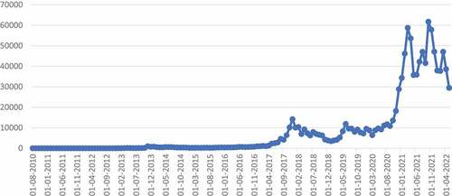
As of 31 August 2010, the price of Bitcoin was about $0.06, and since then, the price of Bitcoin has witnessed an unprecedented rise, reaching an all-time high of $68,000 in November 2021 and declining to $29,448 in May 2022. Figure 1 shows the trend of monthly Bitcoin market prices (in USD) from August 2010 to May 2022.
Dynamics of Bitcoin
Monthly Bitcoin market price (in USD), 31/08/2010–31/05/2022 source: Quandl.Com

Slide 8
Ethereum
Ever since the Ethereum network was launched in July 2015 by Vitalik Buterin, its associated currency – also called ethereum, or ether (ETH) – has proven hugely popular.
How is it different to bitcoin? If bitcoin is a digital payment system, Ethereum is all about utility. To appreciate its benefits, it’s worth understanding the Ethereum network. It is a decentralized, open-source, public-distributed computing platform that runs smart contracts: applications that run exactly as programmed without any possibility of downtime, censorship, fraud or third-party interference.
How does it work? In the Ethereum protocol and blockchain there is a price for each operation. Ether is simply the unit of cryptocurrency used on the Ethereum blockchain, and is used to pay for computer processing time and for transaction fees. It’s frequently compared to bitcoin, but it’s not actually a competing currency. However, Ethereum and ether wouldn’t have been possible without bitcoin, and there are many similarities between the two. For example, they’re both blockchain-based cryptocurrencies and can be mined by users around the world.
So when will all the ether be mined? While the annual supply of ether is limited to 18 million, Ethereum could theoretically continue to introduce new currency and make its supply unlimited. Conversely, bitcoin’s supply is capped at 21 million. Another key contrast with bitcoin is the processing speed; bitcoin transactions take around 10 minutes, whereas an ether transaction takes an average of 15 seconds.

Slide 9

Key Takeaways Ethereum
Data coordination. Ethereum’s decentralized architecture better allocates information and trust so that network participants do not have to rely on a central entity to manage the system and mediate transactions.
Rapid deployment. With an all-in-one SaaS platform enterprises can easily deploy and manage private blockchain networks instead of coding a blockchain implementation from scratch.
Private transactions. Enterprises can achieve granularity of privacy in Ethereum by forming private consortia with private transaction layers.
Scalability and performance. With Proof of Authority consensus and custom block time and gas limit, consortium networks built on Ethereum can outperform the public mainnet and scale up to hundreds of transactions per second or more depending on network configuration.
Tokenization. Businesses can tokenize any asset on Ethereum that has been registered in a digital format.

Slide 10
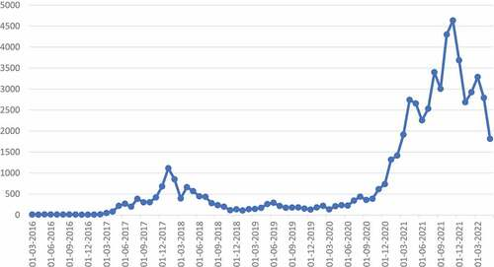
Dynamics of Ethereum
As of 31 August 2010, the price of Bitcoin was about $0.06, and since then, the price of Bitcoin has witnessed an unprecedented rise, reaching an all-time high of $68,000 in November 2021 and declining to $29,448 in May 2022. Figure 1 shows the trend of monthly Bitcoin market prices (in USD) from August 2010 to May 2022.
Monthly Ethereum market price (in USD), 31/03/2016–31/05/2022

Slide 11
Ripple (XRP)
XRP is three-letter name for a digital currency launched in 2013 by Ripple Labs – often (wrongly) just called “ripple”. Fast and green, the digital asset XRP was built to be the most practical cryptocurrency for applications across the financial services space.
Ripple Labs has three main products: xCurrent, xRapid and xVia. xCurrent is its flagship tool, which gives banks the ability to efficiently move money across borders and doesn’t utilize XRP (this is what most of its financial partners are using). xVia is similar to xCurrent, but targets non-financial institutions, such as corporations and payment providers, helping them to send money through banks (this also doesn’t use XRP). xRapid helps banks improve liquidity – when trading in emerging markets, for example – and does make use of XRP.
XRP tokens aren’t mined – unlike bitcoin and others. All the 100 billion original XRP tokens were created by Ripple Labs. They’re held in a special account and released in batches of varying size each month. Each transaction on Ripple’s network has a cost, which destroys a tiny fraction of an XRP token – to stop hackers overloading the system. This has the side effect of slowly making XRP more scarce, and hence helps support its value.

Slide 12
Key takeaways Ripple (XRP)
Trustworthy Network
With a network of 150 validators spread across the world, XRP operates on RippleNet, a platform that offers high reliability and stability. This feature has made it a preferred choice among leading financial institutions globally.
Low-Cost Transactions
The Ripple blockchain uses “drops” as a unit of measurement for XRP transactions, making them low-cost and easily accessible.
Scalable Infrastructure
Ripple can handle a large number of transactions per second, similar to popular payment processors like VISA, making it a suitable option for fintech companies that need a strong infrastructure and a quality crypto payment gateway.
Speedy Transactions
The Bitcoin network has a slow transaction time, causing many users to shy away from using it. The integration of blockchain technology can also lead to a poor user experience due to long wait times for transactions to be processed.

Slide 13
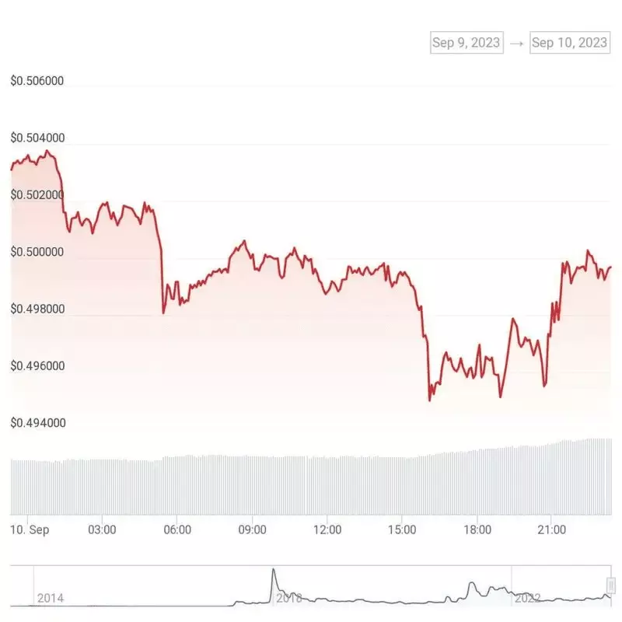
Dynamics of Ripple XRP
Ripple Sold 892M XRP in Q3 2023
Ripple, the blockchain company responsible for the XRP cryptocurrency, has recently unveiled its Q3 2023 report, revealing that it sold more than 892 million XRP tokens during the third quarter of the year. However, it’s worth noting that 41.3 billion XRP is currently locked away in escrow out of a total holding of 46.5 billion XRP.

Slide 14
Bitcoin Cash
Bitcoin Cash is a proof-of-work blockchain network and cryptocurrency that’s faster and cheaper to use than Bitcoin
The asset was created via a hard fork of the Bitcoin blockchain network and has since developed its own community. Like its predecessor, Bitcoin Cash is accepted at certain merchants, can be bought on PayPal and represents another way to transact value.
BCH was meant to solve many of Bitcoin’s long-standing issues — but such a solution caused a rift in the crypto community. While the two can easily coexist, many argue over which will be the asset of the future
BCH operates faster and has lower transaction fees than its predecessor, thanks to the larger block size. It’s much better suited for smaller transactions, such as buying a cup of coffee with cryptocurrency.

Slide 15

Key takeaways Bitcoin cash
High efficiency – more transactions are validated on the larger block size
Safe against possible wipeouts
Great exposure to the largest crypto exchanges
High liquidity
Larger blocks: Bitcoin Cash has a larger block capacity than Bitcoin, allowing it to process more transactions per second.
Lower fees: Due to the larger blocks, Bitcoin Cash has lower transaction fees compared to other cryptocurrencies.
Active community: Bitcoin Cash has an active community of developers and investors working on developing new solutions to improve the cryptocurrency

Slide 16
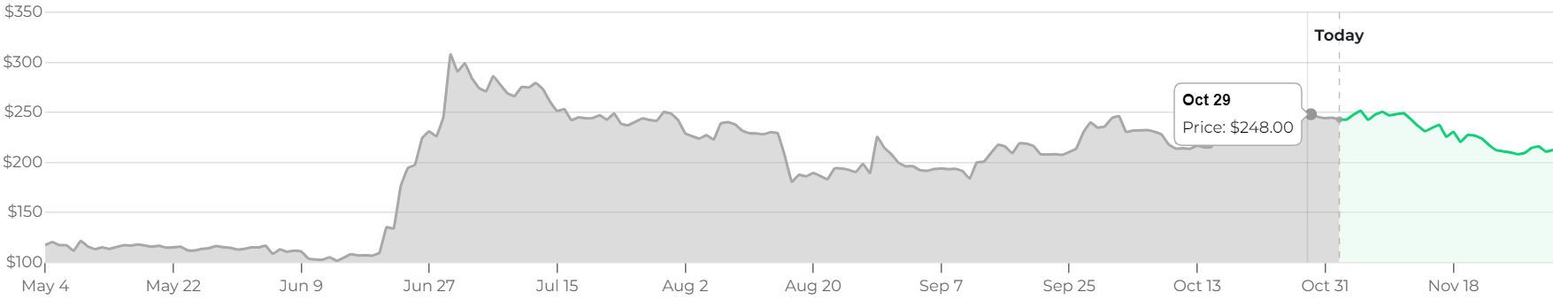
Dynamics of Bitcoin Cash
According to our Bitcoin Cash price prediction, BCH is forecasted to trade within a price range of $ 175.26 and $ 275.24 next year. Bitcoin Cash will increase by 11.82% and reach $ 275.24 if it reaches the higher value target for 2024

Slide 17

EOS
EOS is a blockchain-based, decentralized platform used to develop, host, and run business applications, or dApps.
EOS launched In June 2018 after an initial coin offering that raised $4.1 billion in crypto for Block.one, the company that developed the open-source software called EOS.IO that is used on the platform.
EOS supports core functionality that allows businesses and individuals to create blockchain-based applications in a way that is similar to web-based applications. EOS provides secure access and authentication, permissions, data hosting, usage management, and communication between dApps and the Internet.
EOS is supported by a web toolkit store that aims at hassle-free app development.

Slide 18

Takeaways EOS
EOS is a blockchain-based platform that enables the development of business applications, or DApps.
EOS supports secure access and authentication, permissioning, data hosting, usage management, and communication between the DApps and the Internet.
EOS.IO is the system architecture.
The EOS token is the network's cryptocurrency.
Its main competitor is the better-established Ethereum platform.

Slide 19
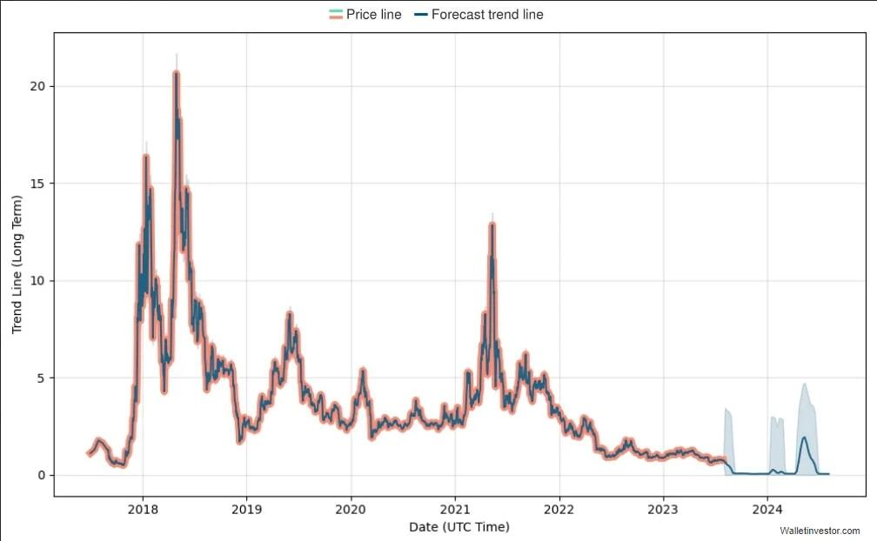
Dynamics of EOS
Back in 2017, EOS developers Brendan Blumer and Dan Larimer publicly released their whitepaper, and the first EOS initial coin offering (ICO) launched in June of the same year. It lasted an entire year and raised a whopping $4.1 billion – breaking all ICO records at the time.
The EOS price prediction 2023 provided by Wallet Investor is based on technical analysis and neural network EOS price prediction. According to their information, the price of EOS USD during 2023 may fall from $0.75 to $0.08.

Slide 20

How Empire Investment Biz monitoring the dynamics of cryptocurrency development
Empire Investment Biz allows you to copy all cryptocurrency investors that you think you can make profit from. You don’t need to have knowledge about cryptocurrencies or trading at all, with Empire Investment Biz, you can see the most successful traders, and copy them.
Empire Investment Biz is tracking everything: investors, smart contracts, tokens, and transactions. There will be no transaction done, no ICO announced that will be absent from the Empire Investment Biz database.
Empire Investment Biz monitoring the dynamics of cryptocurrency development through:
Social Trading
Badge system
ICO Trading
Investment signals

