Slide 1
A Unified Header Compression Framework for Low-Bandwidth Links
Jeremy Lilley • Jason Yang
Hari Balakrishnan • Srinivasan Seshan
MIT Laboratory for Computer Science
Networks and Mobile Systems Group
http://nms.lcs.mit.edu/

Slide 2
Motivation
Low bandwidth on many wireless links
Protocol headers are often large
Header compression is attractive and beneficial in many cases
But…
  Many, many protocols in practice-
  compressing them is where the real gains are
  Treating each as a separate problem: tedious!
Wanted: A general approach!
Notes:
Wirelss scarce andlikely to remain in many parts of the world
end-host bws on order 128kbps or less will be common

Slide 3
The Problem:
Painful Implementation Path
Standardization (packet format, RFCs)
Implementation hassles
  Requires detailed knowledge of kernel internals
  Needs understanding of link error characteristics
Each protocol treated as a new problem
Result: Header-compressed protocols lag way behind!
Notes:
Transition – real problem is impl path is painstaking..

Slide 4
Solution:
Unified approach to the problem
Protocol designer
writes
Toolkit runs
Source code implementation for different platforms
Code Generation
High-level protocol description
Goal: to make header compression absurdly simple
Notes:
Left to right, slower clearer
Emph: goal

Slide 5

Previous Work
1984 – Thinwire
1990 – V. Jacobson
  TCP/IP
1996 – Degermark
  UDP/TCP/IPv6
1999 – Casner
  RTP

Slide 6
Contributions
Unified header compression scheme
High-level description language
Header compression software toolkit
Error-tolerance analysis
Comparison to conventional header compression
Notes:
More punch. We have _unified_: any protocol: general, simple, way to do that.
Someone who knows nothing about ppp can do it

Slide 7
Compression Scheme: An Example
Ver
HLen
TOS
Length
ID
Flags
Fragment Offset
TTL
Protocol
Checksum
Source IP Address
Destination IP Address
Constant
Inferrable
Delta
Random
Notes:
Colors??
This Example!!
All designer does is categorize

Slide 8
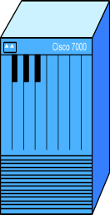
Unified Compression Scheme
Internet
Mobile Host
Base Station
Goal: To send original packets with minimal amount of bandwidth
Reference packets
  Send complete header
Compressed packets (common case)
  Send only changes
Notes:
Orange vs. red

Slide 9
Reference Packets
Fields sent unchanged
  Initializes decompressor state
  Keeps state synchronized
Contexts
  Want to allow many packet streams concurrently
  Provide different “contexts” for them
  Context ID to identify the stream
Notes:
Sender – driven

Slide 10
Compressed Headers
Delta flags
Delta values
Random
Compressed Packet Header
Which Deltas have changed?
Delta values
Random fields
Context ID
0 0 0 0 1 0 1 0
Δ
Δ
Payload
Context ID
0 0 0 0 1 0 1 0
XXXX
XXXX
XXXXX
Corresponding flag
and delta values
Only delta and random fields sent
Send only non-zero delta values
  Encoded in change bit-vector
Field ordering must be consistent
Notes:
Every protocol can be used,
All they need to do is figure out which fields are which
They need a spec language…

Slide 11
Specification Language
Set of header fields
  Size in bits
  Compression category (CONSTANT, INFERRED, DELTA, RANDOM)
  Category-specific parameters:
  inference formula, encoding method…
PField sourceIP, fsize=32, ptype=CONSTANT;
PField length, fsize=16, ptype=INFERRED,
formula=[framelength];
Notes:
Template at some point

Slide 12
Rules and Actions
Rules can:
  Bypass routines altogether
  PRule SendAsIP, ruletext=[protover]!=4;
  Force a reference packet to be sent
  PRule SendReference, ruletext=[curTime]<{expireTime};
Actions can keep state, write logs
{expiretime}=[curTime]+5*[tickspersecond]
Notes:
Is this too much detail? Should it be combined with the previous slide?
Or the heading changed or…
Ode different

Slide 13
Complete Sample Description
class IPcompressor {
NiceName IP_Compression_Protocol;
Compressed_ID 0x0081;
UnCompressed_ID 0x0083;
PField protover, fsize=4, ptype=NOCHANGE;
PField hdrlen, fsize=4, ptype=NOCHANGE;
PField tos, fsize=8, ptype=NOCHANGE;
PField totlen, fsize=16, ptype=INFERRED, formula=[length];
PField packetid, fsize=16, ptype=DELTA,
encoding=VARONETHREE, negatives=DISALLOWED;
PField fragments, fsize=16, ptype=NOCHANGE;
PField ttl, fsize=8, ptype=NOCHANGE;
PField protocol, fsize=8, ptype=NOCHANGE;
PField checksum, fsize= 16, ptype=RANDOM;
PField sourceIP, fsize=32, ptype=NOCHANGE;
PField destIP, fsize=32, ptype=NOCHANGE;
PRule SendAsIP, ruletext=[protover]!=4; # want IP version 4
}
Notes:
This really is complete. Error recovery = 2 line
“that’s the end of this… etc. there are other issues…”

Slide 14
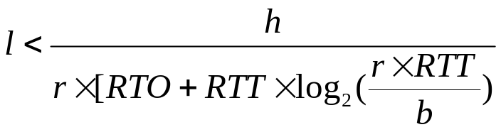
Errors
Internet
Mobile Host
Base Station
Errors desynchronize compressor and decompressor
  State changes missing, corrupted
  As errors increase, header compression can be a losing proposition
Need to keep synchronized, preferably with implicit semantics/in-band signaling
Compressor
Decompressor
Notes:
- NO explicit signalling

Slide 15
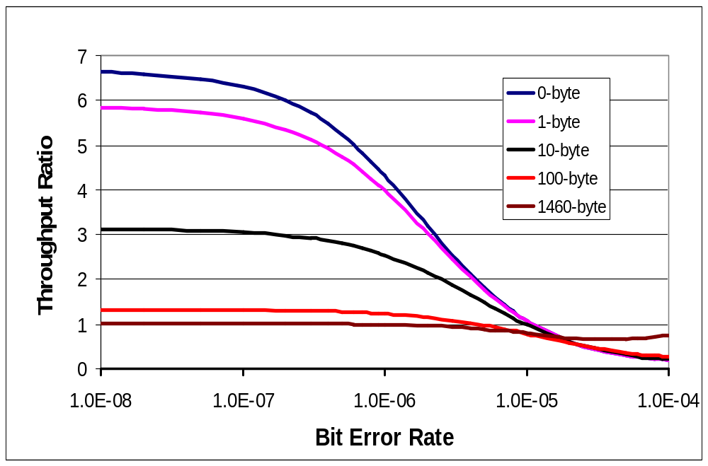
Impact of Link Errors
TCP/IP over a 28.8 kbps link
Break-even
at 1.0
Errors Decrease Effectiveness
Notes:
“the key message you should take is that errors are bad. You’ll get to some point where you’re better off not having compression at all”
Throughput ratio
- what throughput ratio means
- can be worse off
Show breakeven point here
- no out of band signalling

Slide 16
Error handling
Subject of ongoing research, we implement basic techniques
  Connection-oriented protocols: implicit signaling
  Connectionless protocols: periodic refresh
TCP effectiveness analysis in paper
Flexible framework enables other techniques to be incorporated
Notes:
practice
Describe why errors are bad and our general approach to them. don’t want to spend too much time here.
Tge Bullets don’t mean much. Dangling formula bad. Explain byllets,
divide into 2 slides. Describe problem clearly….
Intelligent implicit signalling driving sychronization
- NO explicit signalling

Slide 17
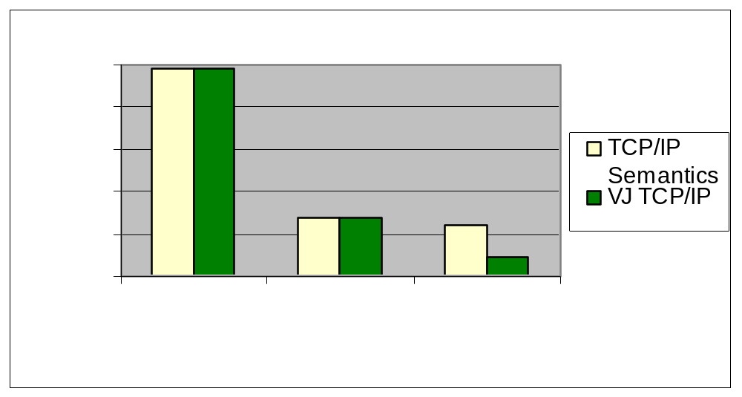
Compression Comparisons
Generated TCP/IP vs. VJ TCP/IP, based on original packet length
Notes:
Explain first
“particularities of TCP –for instance, he takes advantage of the fact that syn+urg+ack never happen together in real life”

Slide 18
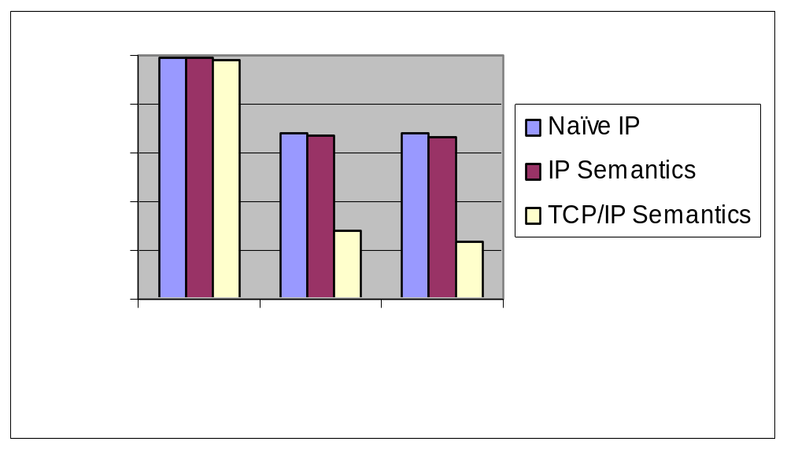
Compression vs. Specificity
How much does extra information help?
Notes:
Naïve ip vs. ip -----describe
Fields no semantics, fields w/ semantics, full
(naïve just diffs, ip semantics, tcp/ip semantics)

Slide 19
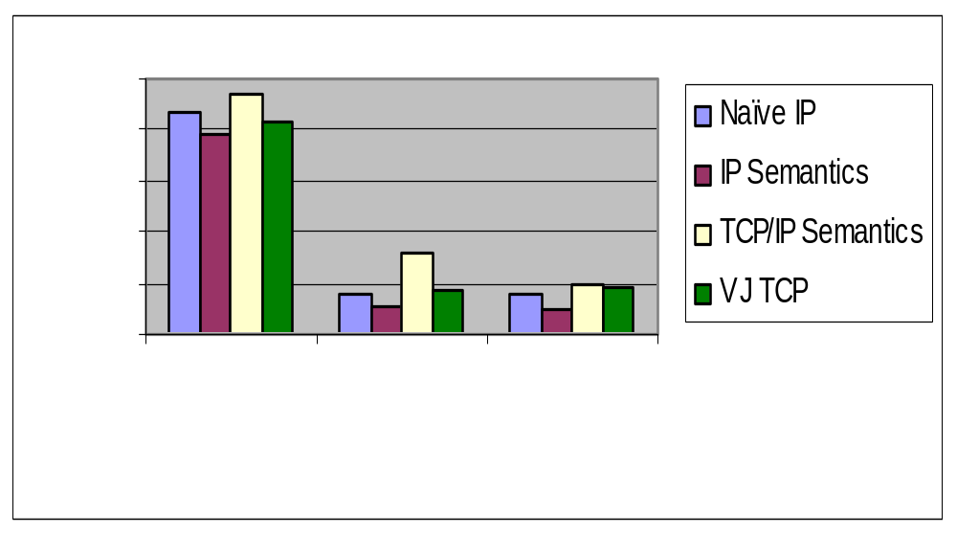
Low-overhead Implementation
CPU time for compressing outgoing packet
Notes:
Careful. Time vs. compression ratio.
Includes mem copy****
“entry to exit of routine”

Slide 20
Further Directions
String protocol compression
  E.g., HTTP transfers
Advanced error recovery
Handling IPSec
Fraction of
transfer as
http header
All | <250k | <50k | <10k
6.3% | 9.3% | 11.1% | 19.3%
Notes:
Should we say anything about http/ipsec/future work??

Slide 21
Conclusion
New approach to header compression
  Unified header compression scheme
  High-level description language
  Software toolkit: http://nms.lcs.mit.edu/software/
Performance comparable to hand-optimized algorithms for TCP
Eases implementation and deployment of header-compressed protocols
Notes:
The end.
-tailing off
-“real bandwidth”
-

