Slide 1
The Effects of Wide-Area Conditions on WWW Server Performance
Erich Nahum, Marcel Rosu,
Srini Seshan, Jussara Almeida
IBM T.J. Watson Research Center,
CMU, Univ. of Wisconsin
Notes:
Hi.
Thanks for being here, and hope you enjoy the talk!

Slide 2

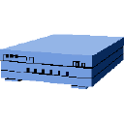

Motivation: Benchmarking Today
switch
server
clients
Problem: real Internet doesn’t work this way!
Notes:
The way people do benchmarking today: grab a 12-way SMP, add 12 gigabit Ethernet
interfaces, lots of clients, and blast away to get the best SpecWeb number possible.
IBM is no exception.

Slide 3


Motivation: Real Life
Internet
clients
server
Evaluate WWW server performance
under WAN conditions
Notes:
Unfortunately, vast majority of sites are connected over the actual Internet, or perhaps some corporate Intranet.
Clients have diversity, Internet has variability, fluctuations, etc. These are manifested as packet drops, delays,
Reorderings, duplications, etc.

Slide 4
Web Server Performance
Workload generators
  Webstone, SpecWeb, SURGE, s-client, etc.
  + Based on measured traffic behavior
  + Reproducible
  - WAN case is ignored: no drops, delays, etc.
Live server analysis
  California elections, 96 Olympics, WAWM
  + Capture real WAN conditions
  - But not reproducible
Want an environment that is *both*
realistic *and* reproducible
Notes:
Workload generators are derived from traces, reproducible, but ignore WAN case
Live servers are hard to do, and can be difficult to reproduce
What we want is the best of both worlds

Slide 5
Outline
Motivation and Background
The WASP Environment
  Hardware and software
  Workload generators
Results
  Effects on throughput, response time
  Effects on server capacity
Summary and Conclusions

Slide 6

Wide-Area Server Performance
What WASP is:
  Realistic: emulates the WAN environment
  Reproducible: allows iterative analysis
  Configurable: can vary many parameters
  Scalable: scales to very large workloads
What WASP is not:
  Doesn’t reproduce a specific web site
  Doesn’t reproduce a specific network topology
A testbed for server performance analysis
Notes:
Reproducing a specific web site is essentially impossible
Instead, we vary parameters over a range of `realistic’ values.
Operators can configure the system based on their own traffic measurements

Slide 7

Centralized Approach
100 Base-T
1 Gbps
Gigabit
Ethernet
switch
WAN
emulator
server
clients
WAN emulator used to drop & delay packets

Slide 8
WASP Approach
User App
drop
Socket
TCP
IP
DummyNet
client
Ethernet
delay
Each client acts as a ‘WAN emulator’
Use DummyNet to drop and delay packets

Slide 9
Scaling with Load
Single intermediary doesn’t scale

Slide 10
Packet Loss Model
loss event probability
Good
Bad
(1 - loss
event
probability)
conditional
loss
probability
(1 - conditional loss probability)
Two-state loss model based on work by
  Bolot 93, Paxson 97, Rubenstein et al. 2000
Packets forwarded in good state, dropped in bad
Transitions based on desired loss rate

Slide 11
Workload Generators
Responses
Requests
S-client (from Rice), SURGE (from BU)
WaspClient integrates the two
Notes:
Singleclient uses event-driven architecture to scale to large numbers of connections
SURGE captures all kinds of relevant characteristics
WaspClient combines the two

Slide 12
Putting it all together
Workload generator
(WaspClient)
Web server software
( Apache, Flash)
switch
Fast
Ethernet
Gigabit
Ethernet
server
200 MHz PowerPC w/AIX 4.3.3
clients
500 MHz P/3
w/ FreeBSD 3.3
& DummyNet

Slide 13
Experimental Methodology
Performance Metrics:
  Server throughput, utilization, response time, capacity
Sensitivity Analysis:
  Vary generated load in SURGE UE’s
  Vary loss rate from 0 to 9 %
  Vary RTT from 0 to 400 msec
  Parameters taken from Paxson97, Allman2000
Methodology:
  Average of 10 runs
  Each run lasts 10 minutes
  90 % confidence intervals

Slide 14
Outline
Motivation and Background
The WASP Environment
  Hardware and software
  Workload generators
Results
  Effects on throughput, response time
  Effects on server capacity
Summary and Conclusions

Slide 15
Throughput vs. Loss Rate
Throughputs fall with increasing loss

Slide 16
Utilization vs. Loss Rate
Utilization falls with increasing loss

Slide 17
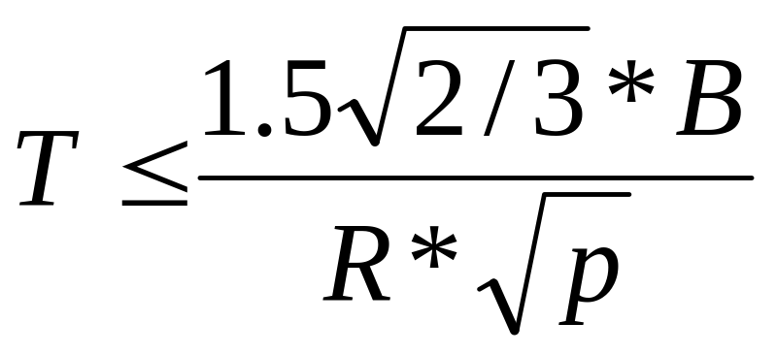
What’s going on?
Simple model for TCP throughput, where:
  B = max segment size (MSS),
  R = round-trip time, and
  p = loss rate.
More elaborate models available from:
  Padhye et al. (SigComm98),
  Cardwell et al. (Infocom2000)

Slide 18
Latency vs. Loss Rate
Latency increases with loss rate

Slide 19
Capacity vs. Loss Rate
Capacity falls with loss rate
Notes:
Non-overlapping columns

Slide 20
Outline
Motivation and Background
The WASP Environment
  Hardware and software
  Workload generators
Results
  Effects on throughput, response time
  Effects on server capacity
Summary and Conclusions

Slide 21
Throughput vs. RTT
Throughputs decrease with RTT
Notes:
Try to make produced gif transparent
Larger fonts on graphs

Slide 22
Utilization vs. RTT
Utilization falls with increasing RTT

Slide 23
Latency vs. RTT
Latency increases with larger RTT’s

Slide 24
Capacity vs. RTT
Capacity falls slightly with RTT

Slide 25
TCP Variants: Throughput
SACK, Reno reach same thpt

Slide 26
TCP Variants: Latency
SACK provides lower latency
Notes:
Not exposed by benchmarks such as SpecWeb99

Slide 27
Summary
Presented the WASP environment
  Emulates WAN conditions in a controlled setting
  Scalable, reproducible, configurable
Several results:
  Delays and losses affect performance
  Loss reduces capacity, increases latency
  Delays increase latency but not capacity
  SACK, New Reno can reduce response time,
  don’t affect capacity
Benchmarks must include WAN characteristics

Slide 28

Future Directions
HTTP 1.1
Linux
Bandwidth limitations
Dynamic content
Other workloads:
  Proxies
  Clients
  SSL
WASP provides a general environment
for performing all kinds of evaluations

Slide 29
Apache Capacity vs. Loss
Capacity decreases with loss rate

Slide 30
Apache Capacity vs. RTT
RTT doesn’t really affect capacity

