Slide 1
A Game-Theoretic Analysis of TCP
Aditya Akella, Srinivasan Seshan (CMU)
Richard Karp, Christos Papadimitriou,
Scott Shenker (ICSI/UC Berkeley)

Slide 2



1980s: Network Collapse
?
Internet
?
In the 80s’s, naïve behavior caused the network to collapse

Slide 3




Salvation!
Internet
Socially responsible congestion control implemented at end-points was given credit for saving the Internet

Slide 4




Salvation?
Internet
Can the network survive with greedy (but intelligent) behavior?

Slide 5
Why Bother?
If greed is bad, today’s Internet is stable because –
  End-points are consciously social and/or
  It is hard to modify end-hosts to be greedy
If not, we need no such mechanism
  Can rely on end-point behavior for efficient operation
We may need mechanisms to monitor, dissuade aggressive behavior

Slide 6
Outline
The TCP Game
Results for the TCP Game
Mechanisms for Nash Equilibrium

Slide 7
The TCP Game
TCP Game
  Flows attempt to maximize application throughput
    Flows modify their AIMD parameters (α, β)
    Must still provide reliability
What happens at Nash Equilibrium?
  No flow can gain in throughput by unilaterally changing its parameter choice

Slide 8
The TCP Game
Analyze a simplified version of this Game for…
  Parameters at the Nash Equilibrium
  Efficiency at the Nash Equilibrium
    Link Goodput and per-flow Loss rate
Study symmetric Nash Equilibria only
Notes:
Define goodput

Slide 9
Factors Affecting the Nash Equilibrium
(1) End-point’s loss recovery mechanism
  Reno vs. SACK (primitive vs. modern)
  Depends on TCP implementation
(2) Loss assignment at routers
  Bursty loss assignment vs. randomized uniform losses
(3) Congestion control parameters of the flows
  How flows are allowed to vary their parameters
  Under complete control of end-point
End-points show greed by adjusting factor (3) alone. Factors (1), (2) are part of the environment.

Slide 10
Outline
The TCP Game
Results for the TCP Game
Mechanisms for Nash Equilibrium

Slide 11
Results – Road-map
First, consider FIFO droptail buffers
  Most wide-spread in today’s Internet
  Efficiency at Nash Equilibrium for Tahoe, Reno, SACK-style loss recovery
Then, discuss RED buffers briefly
  As above
Put the results together

Slide 12
FIFO Droptail Buffering
Droptail buffers punish bursty behavior
  Unintentionally so
  Observed by designers of RED AQM
  Flows with bursty transmission incur losses proportional to their burstiness
    AIMD flows incur losses in bursts of size ~ α (AI parameter)

Slide 13
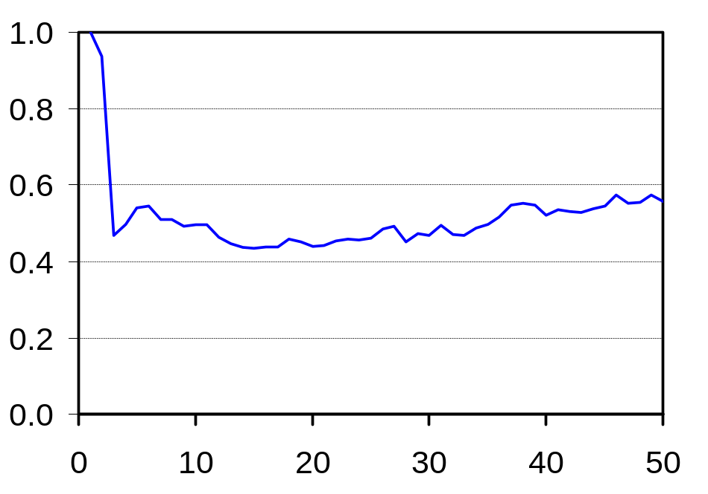
Results for FIFO Droptail Buffers –
A Sample
α₁...α_{n−1} = 1
Reno-style loss recovery
(flows vary α, keeping β=0.5)
Thruput of flow n (Mbps)
α_{E} | Link Goodput | Per-flow Loss rate
1 | 100% | 0.15%
α_{n} of flow n
Greedy flows don’t gain by using large α’s
  Flows observe burst losses
  Reno’s severe reaction (time-outs) kicks in

Slide 14
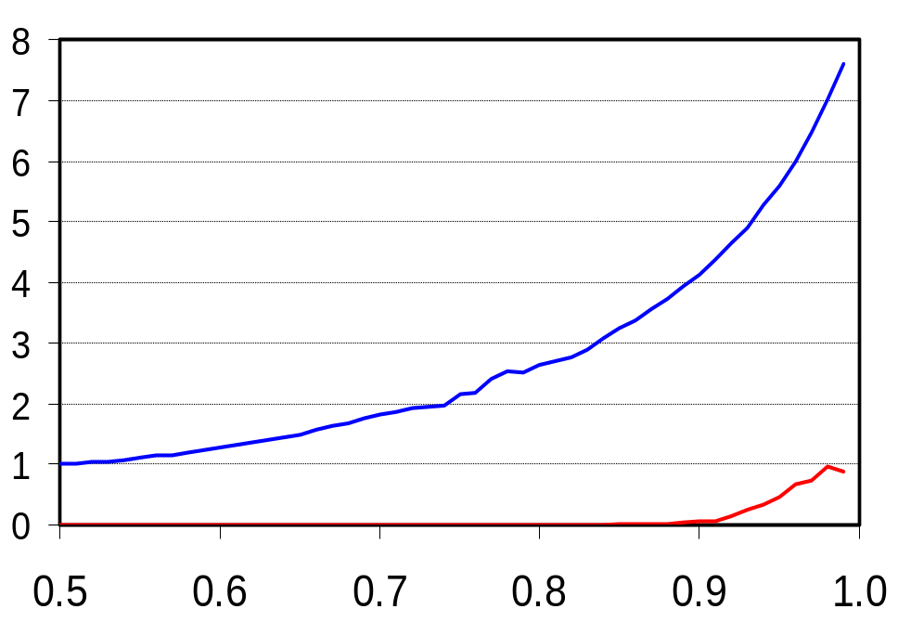
Results for FIFO Droptail Buffers –
A Sample
β₁...β_{n−1} = 0.5
β₁...β_{n−1} = 0.98
Thruput of flow n (Mbps)
Reno-style loss recovery
(flows vary β, keeping α=1)
β_{E} | Link Goodput | Per-flow Loss rate
0.98 | 100% | 1.5%
β_{n} of flow n
Greedy flows gain by using β→1
  No burst losses since α=1

Slide 15
Results for FIFO Droptail Buffers –
A Sample
Reno-style loss recovery
(flows vary α, β together)
(α_{E}, β_{E}) | Link Goodput | Per-flow Loss rate
(1, 0.98) | 100% | 1.5%
Nash Equilibrium is efficient!
  Goodput is high and loss rate is low
  Greedy behavior might work out
But unfair
  Since β→1 (AIAD)
Notes:
Unfair allocation of bw across flows

Slide 16
RED Buffering
RED buffers “spread” losses uniformly across flows
  Identical loss %-age across flows irrespective of parameters used
  Greater greed of a few flows causes a small increase in overall loss rate
  Bursty flows do not experience burst losses, unlike droptail buffers

Slide 17
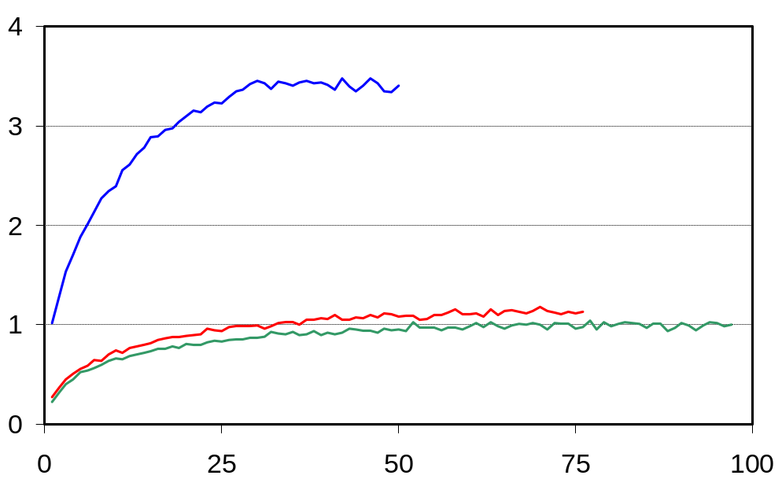
Results for RED Buffers –
A Sample
α₁...α_{n−1} = 1
c
α₁...α_{n−1} = 27
B
α₁...α_{n−1} = 48
A
SACK-style loss recovery
(flows vary α alone; β=0.5)
Thruput of flow n (Mbps)
α_{Ε} | Link Goodput | Per-flow Loss rate
48 | 96% | 5%
α_{n} of flow n
Aggression is always good
  TCP SACK ➔ high loss rate doesn’t affect goodput
  RED ➔ greater aggression will cause minor increase in overall loss rate

Slide 18
Results for RED Buffers –
A Sample
SACK-style loss recovery
Flows vary α,β together
(α_{Ε}, β_{Ε}) | Link Goodput | Per-flow Loss rate
(23, 0.98) | 96% | 5.70%
Nash Equilibrium is inefficient
  Parameter setting is very aggressive
    Loss rate is high
  Potential congestion collapse!

Slide 19
Results for the TCP Game –
A Summary
 | Droptail | RED
Tahoe | α_{Ε} → high, β_{Ε}→ 1, Inefficient | α_{Ε} → high, β_{Ε} → 1, Inefficient
Reno | α_{Ε} = 1, β_{Ε} → 1, Efficient, Unfair | α_{Ε} → high, β_{Ε} → 1, Inefficient
SACK | α_{Ε} → high, β_{Ε} → 1, Inefficient | α_{Ε} → high, β_{Ε} → 1, Inefficient

Slide 20
Discussion
Question: Does selfish congestion control endanger network efficiency?
Common Intuition: Yes, since flows would always gain from being more aggressive.
Our Answer: Not necessarily true!
  In the traditional setting (Reno end-points and droptail routers), network operates fine despite selfish behavior
  Selfish behavior very detrimental with modern loss recovery and queue management schemes

Slide 21
Outline
The TCP Game
Results for the TCP Game
Mechanisms for Nash Equilibrium

Slide 22
Mechanisms for Nash Equilibrium
We need mechanisms to explicitly counter aggressive behavior
Has been a hot topic in the past
  Fair Queuing discourages aggressive behavior
    But needs per-flow state
  RED-PD, AFD etc. explored lighter mechanisms
    Aim to ensure fair bandwidth allocation
Our requirement is less stringent:
How much preferential dropping is needed to ensure a reasonable Nash Equilibrium?

Slide 23
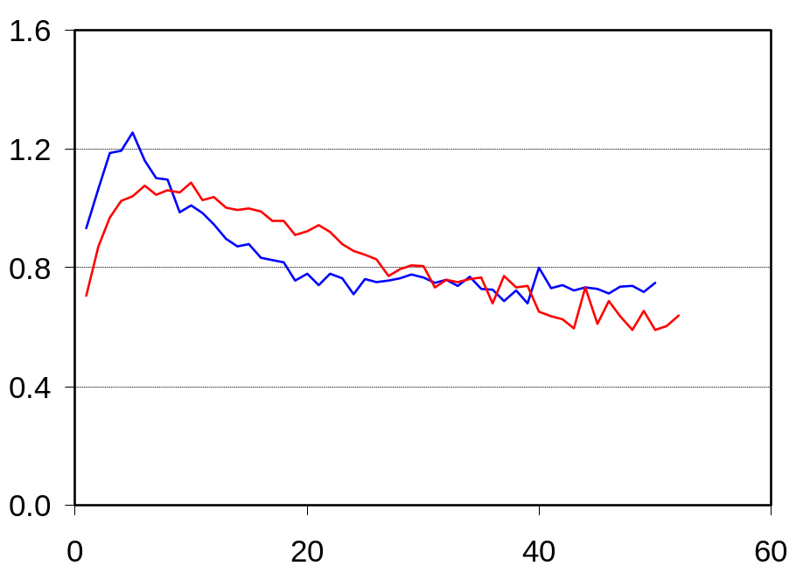
CHOKe+ -- A Simple, Stateless Scheme
A small modification to RED is enough
CHOKe+
  Simple, stateless
  Provides just the right amount of punishment to aggressive flows
  Makes marginal advantage from greed insignificant
  E.g. SACK flows varying α
α₁...α_{n−1} = 1
α₁...α_{n−1} = 3
Thruput of flow n (Mbps)
α_{n} of flow n
α_{Ε} | Goodput | Loss rate
3 | 97% | 2.74%

Slide 24
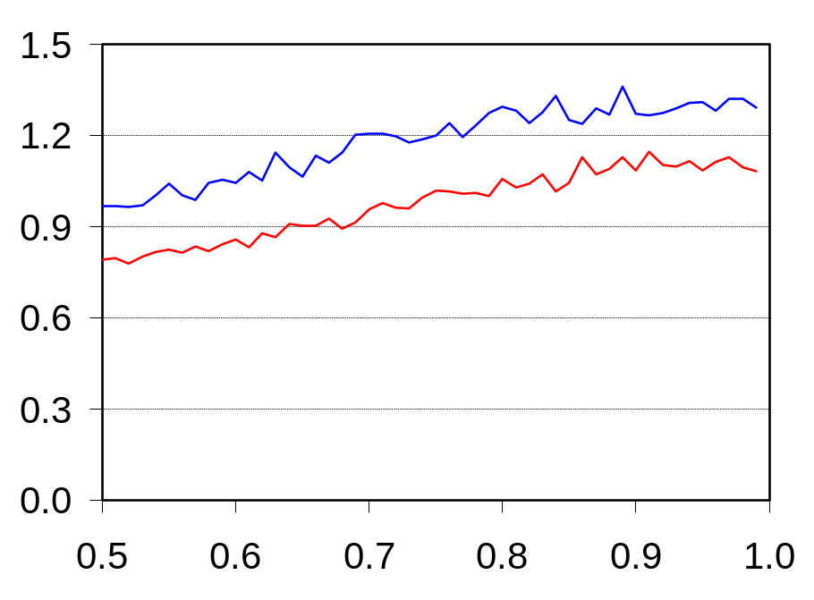
CHOKe+ (Cont.)
β→1 at Nash Equilibrium in all cases
  β < 1 impossible to ensure without Fair Queuing
But, CHOKe+ encourages β < 1
  Makes aggressive β a risky choice
  With SACK flows β=0.74 at Nash Equilibrium
β₁...β_{n−1} = 0.5
β₁...β_{n−1} = 0.74
Thruput of flow n (Mbps)
β_{n} of flow n
β_{Ε} | Goodput | Loss rate
0.74 | 100% | 2.42%

Slide 25
Summary
Greedy congestion control may not always lead to inefficient operation
  Traditional Reno host-droptail router setting
Unfortunately, greedy behavior is bad in most other situations
Fortunately, it is possible to ensure a desirable Nash Equilibrium via simple, stateless mechanisms

Slide 26
Back-up
Back-up
  Back-up
    Back-up

Slide 27
CHOKe+
CHOKe would have worked
  But, enforces too high a drop rate
  Underutilization at low levels of multi-plexing
  CHOKe+ fixes this problem

Slide 28
The CHOKe+ Algorithm
For each incoming packet P
  Pick k packets at random from queue
  Let m be #packets from the same flow as P
  Let 0 <= γ₂ < γ₁ <= 1 be constants
  If m > γ₁k, P and the m packets are dropped
  Else if γ₂k <= m < γ₁k, drop P and the m packets only if RED were to drop P
  Else just drop P according to RED

Slide 29
Motivation
TCP’s congestion control successful at avoiding congestion collapse
  For more than a decade now…
  “Social” or “Co-operative” congestion control
    End-points use conservative parameter settings
    Assumed crucial for Internet’s stability
Notes:
Highlight the difference between 80s behavior and smartness

Slide 30
Motivation
But, is social behavior necessary for efficiency?
  Naïve congestion behavior lead to congestion collapses
  What if end-points were greedy and smart?
    Would the outcome be different than what happened in the 80s?
    Would this endanger stability of the Internet?

