Slide 1
Improving Web Performance in Broadcast-Unicast Networks
Mukesh Agrawal, Amit Manjhi, Nikhil Bansal, Srinivasan Seshan

Slide 2
Satellite-Based Internet Service
High-speed Internet connectivity (45 Mbps)
Nationwide availability
Providers
  DirecPC (Hughes): ~100,000
  Starband (Echostar)

Slide 3
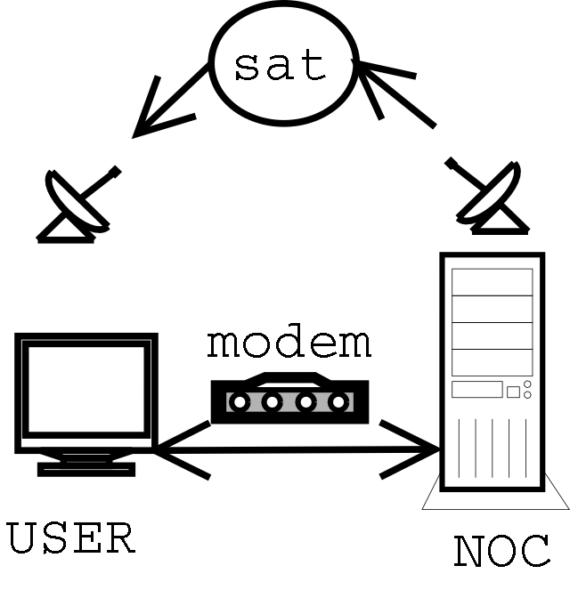
Satellite-Based Internet Service
One-way satellite channel
Two-way modem channel

Slide 4
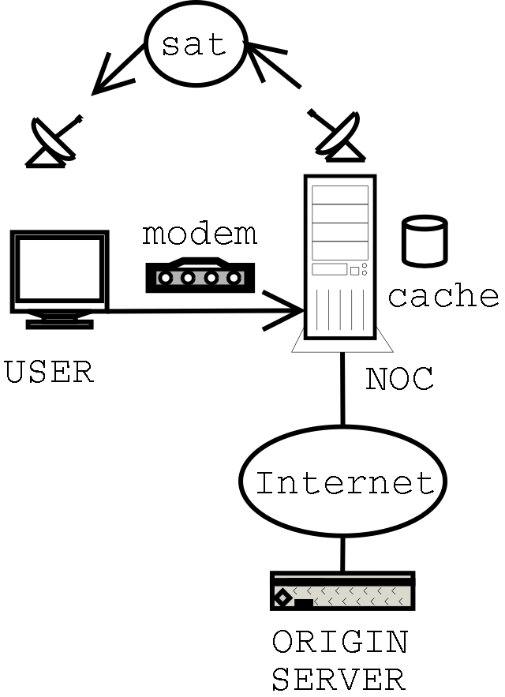
Web Access with Satellite-Based ISPs
Request via modem
NOC fetches content
NOC sends object to satellite
User receives object via satellite

Slide 5
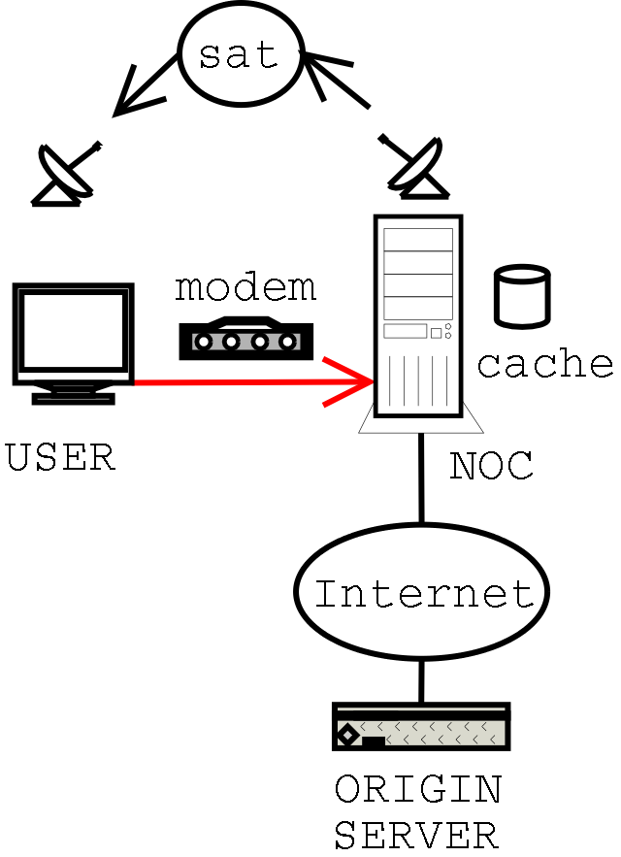
Web Access with Satellite-Based ISPs
Request via modem
NOC fetches content
NOC sends object to satellite
User receives object via satellite

Slide 6
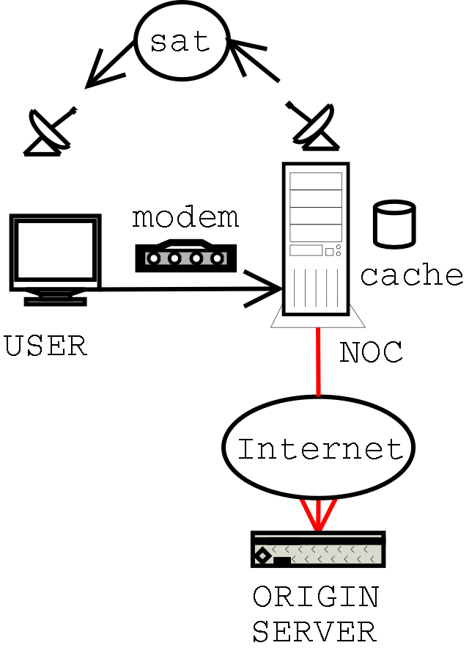
Web Access with Satellite-Based ISPs
Request via modem
NOC fetches content
NOC sends object to satellite
User receives object via satellite

Slide 7
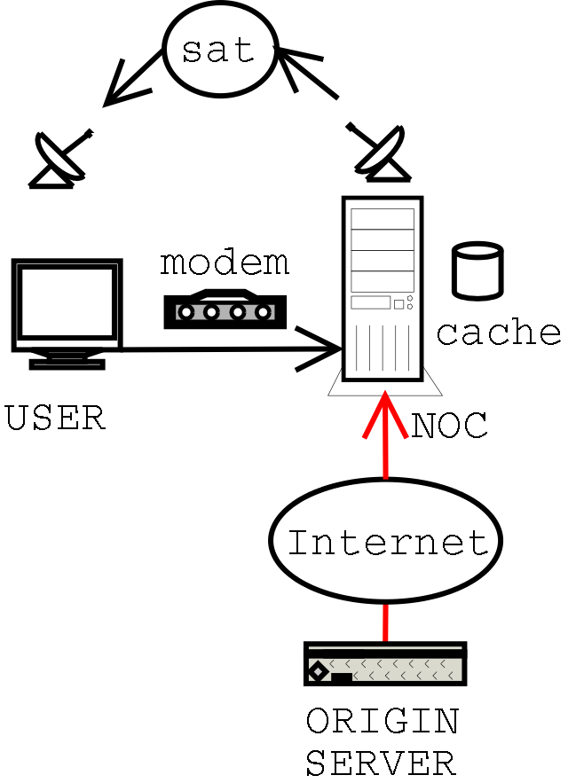
Web Access with Satellite-Based ISPs
Request via modem
NOC fetches content
NOC sends object to satellite
User receives object via satellite

Slide 8
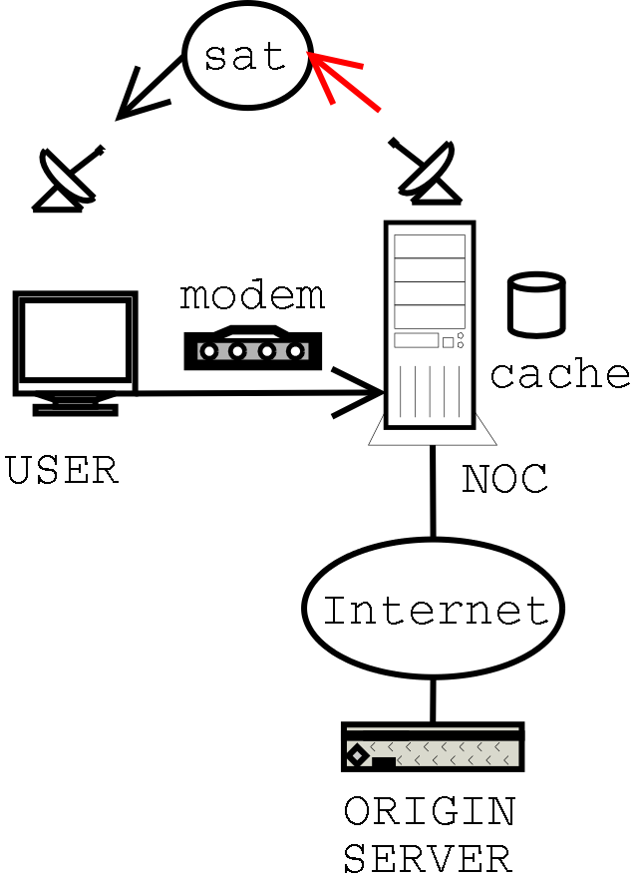
Web Access with Satellite-Based ISPs
Request via modem
NOC fetches content
NOC sends object to satellite
User receives object via satellite

Slide 9
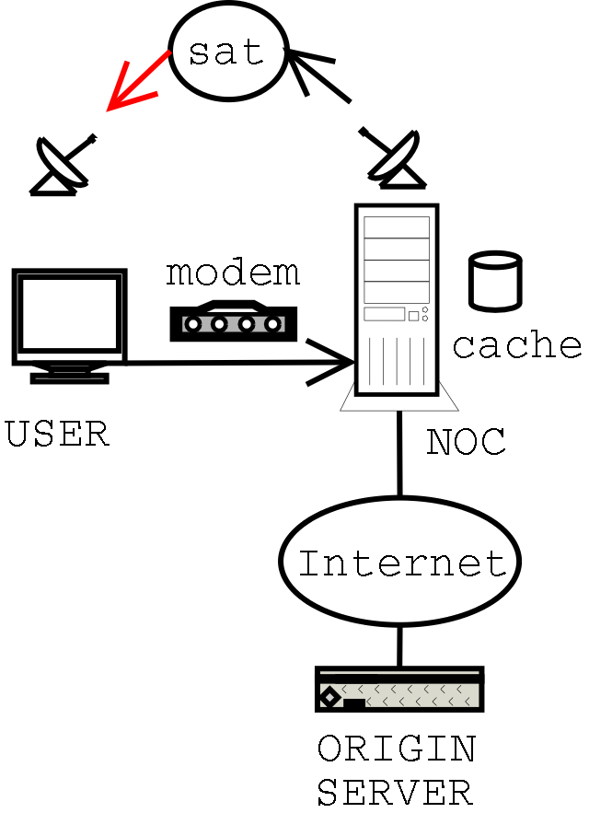
Web Access with Satellite-Based ISPs
Request via modem
NOC fetches content
NOC sends object to satellite
User receives object via satellite

Slide 10
Satellite-Based Internet Properties
Single broadcast channel
  High bandwidth
  High latency
  Shared
Many unicast channels
  Low bandwidth
  Dedicated
  Self-scaling
For DirecPC, ~12x capacity on unicast as broadcast

Slide 11
Goal and Approach
Improve web performance under high loads
Optimize performance by exploiting fundamental properties of different links
  Satellite
    High bandwidth, broadcast
    Good for popular objects and large objects
  Modem (downlink)
    Low bandwidth, dedicated
    Good for small, unpopular objects

Slide 12
Outline
System Modem and Methodology
Results
Related Work and Conclusions

Slide 13
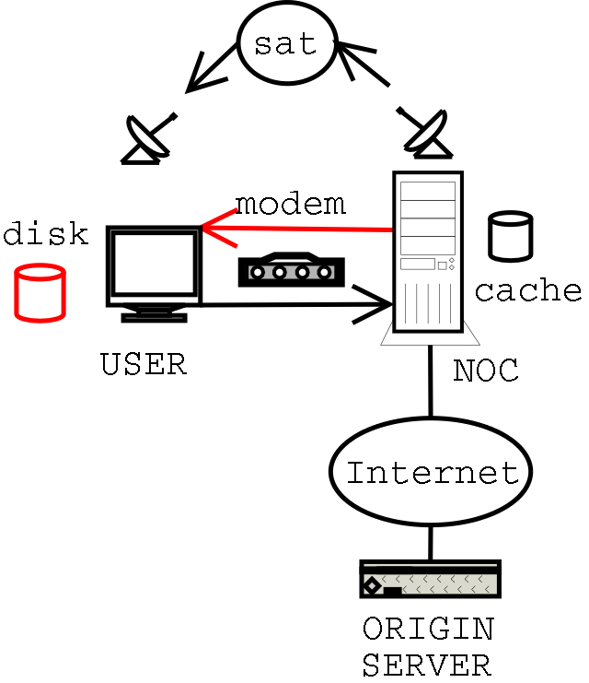
System Model
Modem
  56 Kbps, 50ms
  Bidirectional
Satellite
  2.25 Mbps, 125ms
  Receive only
User cache: 4GB
No server delays
1000 users

Slide 14
Methodology
Simulation with synthetic workloads
Simulator: ns-2
Proxy workload

Slide 15
Typical Workload
Parameter | Value
Simulation length | 8 hours
Warmup period | 4 hours
Mean request rate | 0.4/client/sec
Mean requested file size | 7 KB
Max requested file size | 2 MB
# of users | 1000

Slide 16
Outline
System Modem and Methodology
Results
  OpCaching
  Modem Downlink
  Large Object Performance
Related Work and Conclusions

Slide 17
OpCaching
Goal: reduce bandwidth required to serve requests
Technique: users cache replies to other users’ requests
Evaluation Metrics
  Bandwidth required to meet demand
  Response time

Slide 18
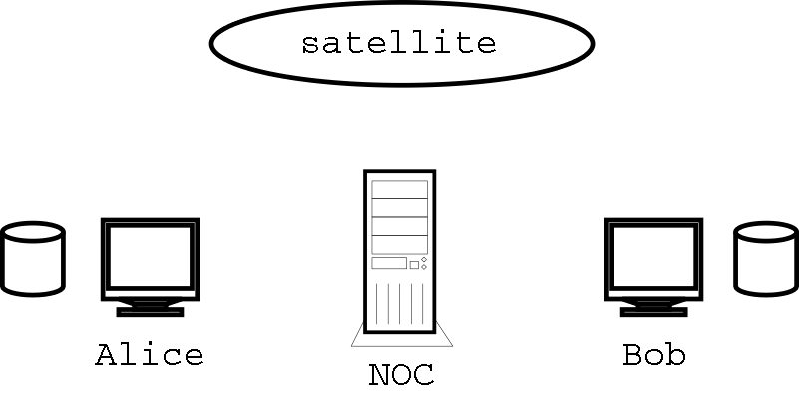
OpCaching

Slide 19
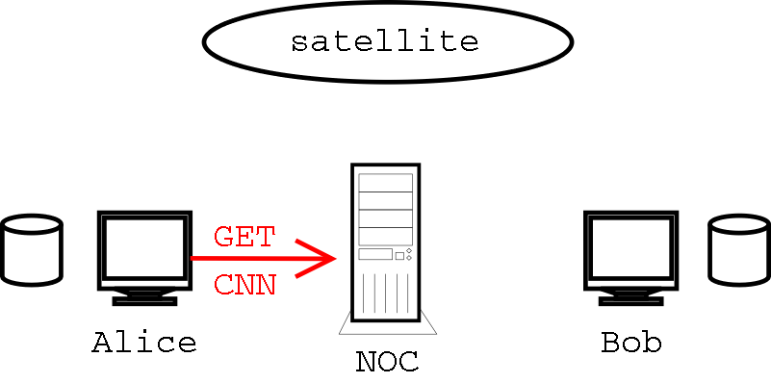
OpCaching

Slide 20
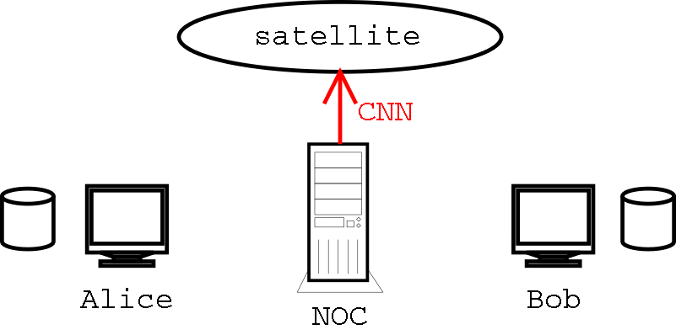
OpCaching

Slide 21
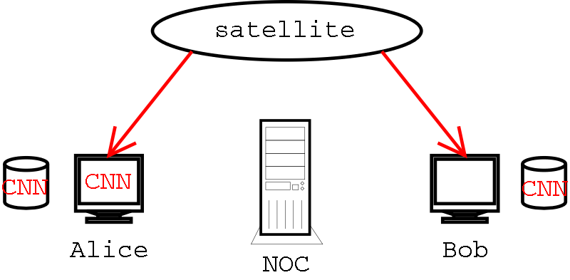
OpCaching

Slide 22
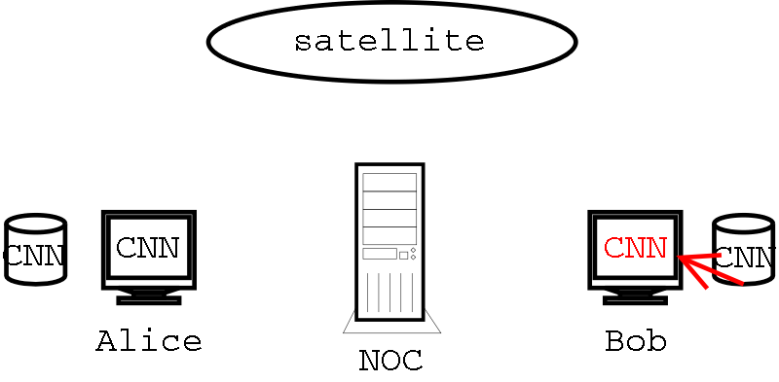
OpCaching

Slide 23
OpCaching Benefits
Cache | B/W (Mb/s) | Mean Resp (sec)
none | 21 | 0.95
12GB | 14 | 0.36
33% reduction in bandwidth
62% reduction in mean response time

Slide 24
OpCaching Benefits
Cache | B/W (Mb/s) | Mean Resp (sec)
none | 21 | 0.95
12GB | 14 | 0.36
33% reduction in bandwidth
62% reduction in mean response time

Slide 25
OpCaching Benefits
Cache | B/W (Mb/s) | Mean Resp (sec)
none | 21 | 0.95
12GB | 14 | 0.36
33% reduction in bandwidth
62% reduction in mean response time

Slide 26
Modem Downlink
Goal: reduce response time under high load
Technique: service some requests via modem
Evaluation metric: response time

Slide 27
Modem Downlink
Optimal scheduling is infeasible
Scheduling broadcast and unicast links is NP-hard
  Even in the offline case
  Even with same-sized objects
More results (including approximation algorithms) in the paper

Slide 28
Modem Downlink: Heuristic Schedulers
Greedy
Sorted
Greedy-Popular (“GPOP”)

Slide 29
Modem Downlink: Heuristic Schedulers
Greedy
  Estimate response time on both links
  Choose faster link
Sorted
Greedy-Popular (“GPOP”)

Slide 30
Modem Downlink: Heuristic Schedulers
Greedy
Sorted
Greedy-Popular (“GPOP”)

Slide 31
Modem Downlink: Heuristic Schedulers
Greedy
Sorted
  Exploit popularity
  Service all requests immediately via modem
  Periodically broadcast most popular objects
Greedy-Popular (“GPOP”)

Slide 32
Modem Downlink: Heuristic Schedulers
Greedy
Sorted
Greedy-Popular (“GPOP”)
  Combine greed and popularity
  Very popular objects sent via broadcast, if faster
  Unpopular objects sent via broadcast if much faster

Slide 33
Modem Downlink Methodology
Bandwidth constrained scenario (2.25 Mb/s)
Same ratio of users:bandwidth as deployed systems
Satellite bandwidth insufficient for load

Slide 34
Modem Downlink Results
Heurisitc | Mean Resp | Hit Rate | Modem Frac
Greedy | 1.72 | 0.36 | 0.52
Sorted | 2.29 | 0.47 | 0.53
GPOP | 1.33 | 0.45 | 0.42
Greedy: ignores popularity → low hit rate
Sorted: similar hit rate to GPOP, but first response always modem

Slide 35
Modem Downlink Results
Heurisitc | Mean Resp | Hit Rate | Modem Frac
Greedy | 1.72 | 0.36 | 0.52
Sorted | 2.29 | 0.47 | 0.53
GPOP | 1.33 | 0.45 | 0.42
Greedy: ignores popularity → low hit rate
Sorted: similar hit rate to GPOP, but first response always modem

Slide 36
Modem Downlink Results
Heurisitc | Mean Resp | Hit Rate | Modem Frac
Greedy | 1.72 | 0.36 | 0.52
Sorted | 2.29 | 0.47 | 0.53
GPOP | 1.33 | 0.45 | 0.42
Greedy: ignores popularity → low hit rate
Sorted: similar hit rate to GPOP, but first response always modem

Slide 37
Large Object Performance
In addition to fast web browsing, users want to download large files quickly
Goal: good performance for large objects
Technique: preferential scheduling
Evaluation Metrics
  Large object improvement
  Small object degradation

Slide 38
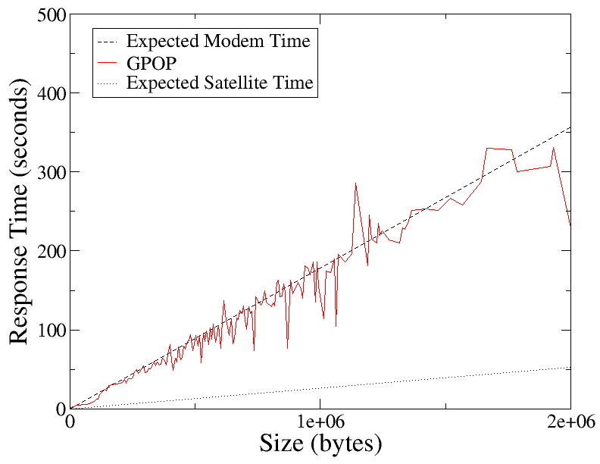
Large Object Performance

Slide 39
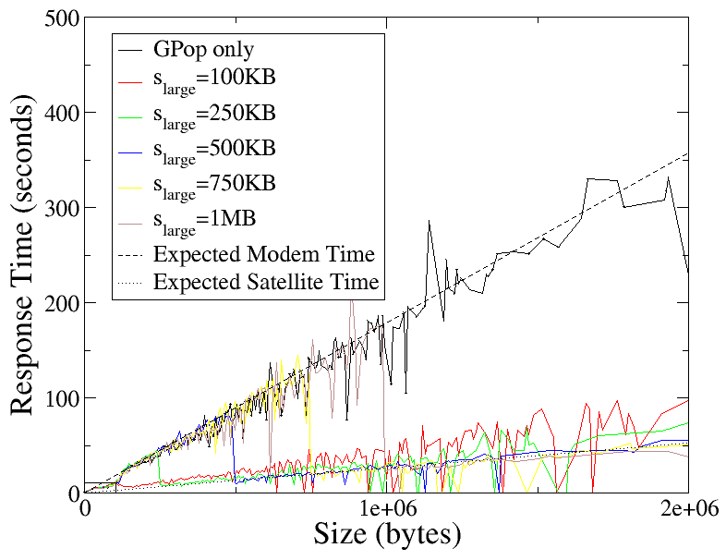
Large Object Performance

Slide 40
Large Object Performance

Slide 41
Large Object Performance

Slide 42
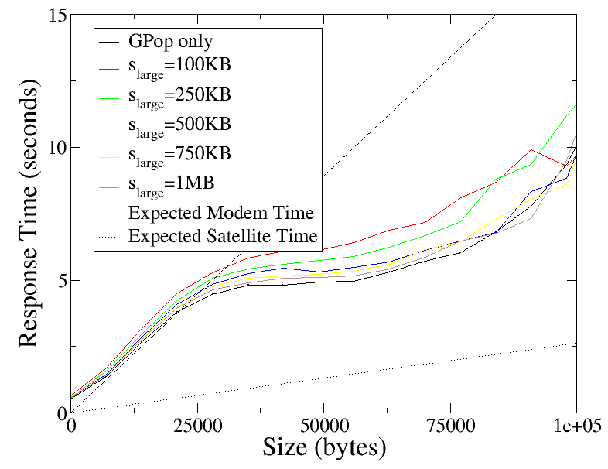
Large Object Performance

Slide 43
Outline
System Model and Methodology
Results
Related Work and Conclusions

Slide 44
Related Work
IP Multicast for web servers [Almeroth, Ammar, Fei]
  Multicast popular pages to reduce load on webserver
Broadcast disks [Acharya, Alonso, Franklin, Zdonik]
  Periodic broadcast of popular objects
DirecPC webcast [Hughes]

Slide 45
Conclusions and Future Work
OpCaching reduces b/w, improves resp. time
Scheduling improves resp. tme for high loads
Can accelerate large objects
Future work: consistency management
  Coordinate validation among clients
  Eliminate latency in common case

Slide 46
Backup
To do (on backup slide)
  Clean up formatting
  Fix graph fonts

Slide 47
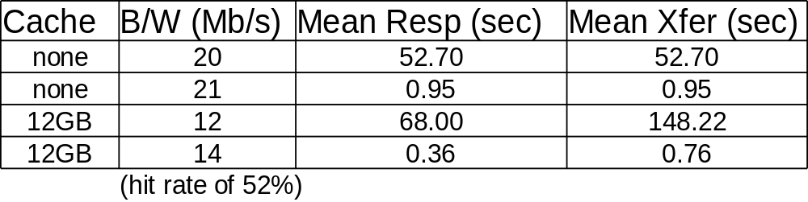
OpCaching Benefits
33% reduction in bandwidth
62% reduction in mean response time
Notes:
TODO: highlight the important lines, or eliminate the unimportant ones. Maybe make a backup slide with the full table.

Slide 48
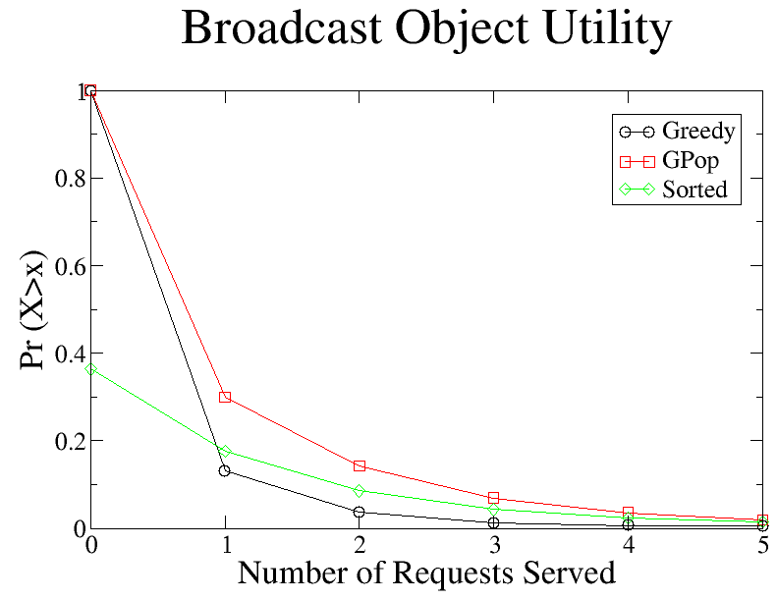
Modem Downlink: Sorted vs GPOP

Slide 49
System Capacity
Questions
  How does basic system perform as load increases?
  Can using modems help?
Method
  Open workload with bounded buffer
  Scale mean request rate

Slide 50
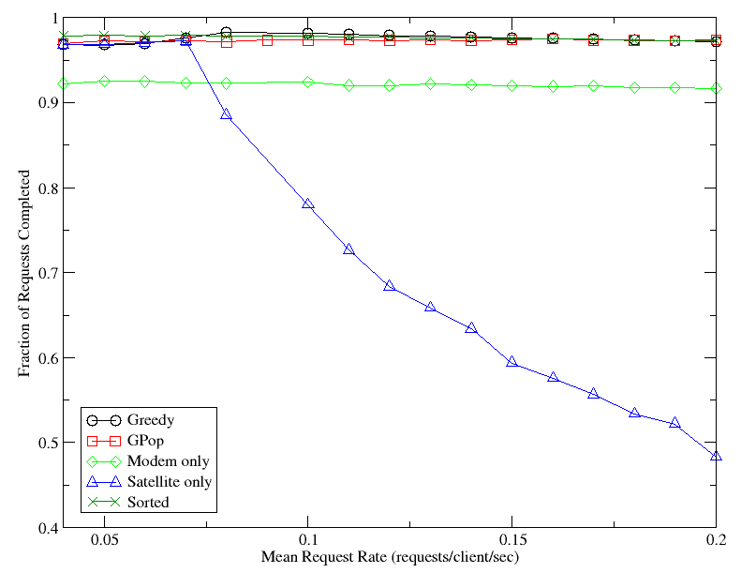
System Capacity
Base system capacity: 0.07 reqs/sec
Others maintain stable completion rate

Slide 51
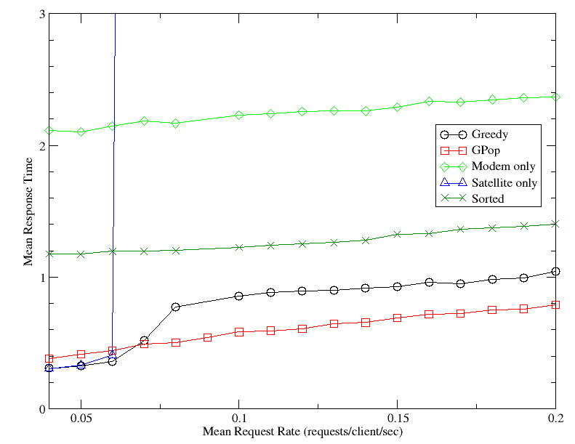
System Capacity
Base system unusable beyond 0.06 reqs/sec
Greedy, GPOP give best of satellite and modem

Slide 52
Workload Models
Cachability
Embedded objects
Simultaneous connections
Hot sets
Private objects

Slide 53
Related Work
Multicast Web Delivery (Ammar et. al., Georgia Tech)
  Very small scenarios (5 pages, single server)
  IP Multicast ― underlying medium not broadcast
  Single channel
  No caching

Slide 54
Related work
Wormhole caching (Chen et. Al.)
  Architecture for incorporating satellite systems in content distribution
  No evaluation of whole-system performance

