Slide 1
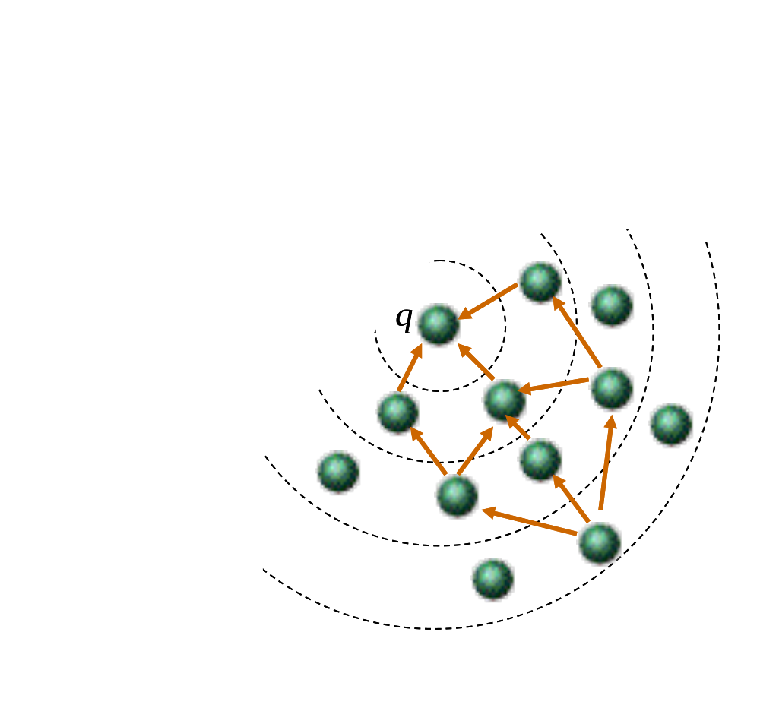
Synopsis Diffusion: A Robust Paradigm for Computing Aggregates in Sensor Networks
Suman Nath and Phillip B. Gibbons
Intel Research Pittsburgh and Carnegie Mellon University
Context and Goals
Existing Work and Problems
Ad-hoc wireless network of resource-constrained sensors
Task: Compute aggregates
  How many nodes are in the network?
  What is the maximum temperature?
Goals:
  Energy efficiency
  Robustness (nodes and links may fail often)
  Support for mobile nodes
Tree: Aggregate over a spanning tree
  + Energy efficient
  - Not robust against node and link failures
DAG: Split the intermediate results among multiple parents
  + Energy efficient
  Underestimates results on link failures
  Not robust against node failures
Gossip- and flooding-based protocols
  + Robust
  Not energy efficient
Synopsis Diffusion
Synopsis: small representation of data (e.g., histogram, bit-vector)
3 functions for synopses: Generation (SG), Fusion (SF), and Evaluation (SE)
  Each node: Generates local synopsis s = SG(local data), and broadcasts
  Each node: On receiving a synopsis s’ from a neighbor, updates local synopsis s = SF(s, s’), and broadcasts s if it is changed
  Querying node: on termination , the final answer is SE(s)
Query processing is orthogonal to the underlying aggregation topology
  Any robust topology can be used
Example topology: Rings
  A set of rings are constructed around the querying node q: a node is in ring i if it is i hops away from q
  Broadcasts from a node in ring j is received by all its neighbors at ring (j -1)
  Synopses propagate towards q
As energy-efficient as the tree topology but with far greater robustness
Challenge
Examples
Data can be aggregated along
multiple paths towards
the querying node
  For more robustness
Challenge: to support duplicate
sensitive queries (e.g. count, sum)
Solution: Devise SG and SF that are
  Duplicate insensitive, associative, and commutative
H_{e}: Exponentially decaying hash function
  Maps 1/2 the elements to 0, 1/4th to 1, 1/8th to 2 …
H_{u}: Uniformly random hash function
Distinct-count
SG(v) = H_{e} (v)
SF(s, s’) = max(s, s’)
SE(s) = 2^{s}
Uniform sample of size k
SG(set) = k elements in set with max H_{u}() value
SF(s, s’) = k elements in (s ∪ s’) with max H_{u}() value
SE(s) = s
Preliminary Results and Ongoing Research
Formalize the semantics of a query answer in a dynamic network
Provide framework to analyze error bounds for approximate answers
Robustness against outliers
Support for mobile sensors
Quantify robustness of the algorithms through simulations
Investigate performance through real deployment

