Slide 1
A Distributed
Filtering Architecture for Multimedia Sensors
Suman Nath, Yan Ke,
Phillip B. Gibbons, Brad Karp, Srinivasan Seshan
Intel Research Pittsburgh
Carnegie Mellon University

Slide 2
A World of Smart Sensors
Webcams & other smart sensors are everywhere, collecting vast amounts of data
Connected via wired or wireless networks
Opportunities for new sensor-based services
  Rich, high bit-rate data sources
  Rich expressive queries: range queries, aggregate queries, historical queries
  Internet-scale: view vast collection of widely distributed sensors as a single queriable unit

Slide 3
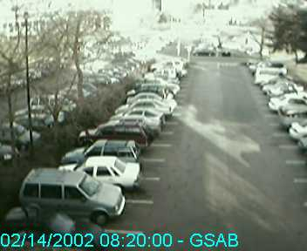
A Parking Space Finder
A distributed database maintains
  Dynamic data
    Spot availability
    Historical availability trend
  Static metadata
    address of parking spot
    Meter description
Query: Where is the cheapest empty parking spot near Intel Research Pittsburgh?
Returns driving directions to the best spot
One of many possible sensor services

Slide 4
Writing a Sensing Service
Collecting and Filtering rich data feeds
Storing and indexing sensor data
Query processing
Load balancing
Fault tolerance
…
A software infrastructure that implements all the generic functionalities
IrisNet: Internet-scale Resource-intensive Sensor Network services

Slide 5
Outline
Motivation
IrisNet
Scalable Data Collection
Evaluation

Slide 6
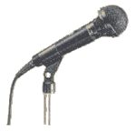





IrisNet (SigMod’02)
Parking Space
Finder OAs
OAs
Organize data
Process queries
Caching
Load balancing
Fault tolerance …
Sensing Agent
University
Downtown
Hill District
Organizing Agents
Internet
Sensing Agent
Sensing Agent
SA
Collects and filters sensor data
Amy-John
Kim-Steve
Tom-Zoe
Person Finder
OAs
Sensing Agent

Slide 7
Outline
Motivation
IrisNet
Scalable Data Collection
  Communication Scalability
  Processing Scalability
Evaluation

Slide 8

Communication Scalability
SA
OA
Filter data near the sensors
Challenge: provide a framework to customize filtering
  Senselets
  APIs to program, upload, control senselets
senselet
vs.
<car>
SA
OA

Slide 9
SA Architecture
SA
OA
senselet
Senselets are controlled via the SA daemon
<Empty>
<Bob, Alice>
SA
Daemon
Parking Space
Finder Senselet
Person Finder
Senselet
Sensor data is copied in a shared memory
Senselets use filtering libraries to process data
Sensor Data in Shared Memory
A unified framework for running filtering code

Slide 10
Processing Scalability
SA
OA
Multiple senselets overload SA
Soft real time behavior
  {period, slack}
  Needs to meet deadlines
Senselets miss deadlines in overloaded SA
senselet
slack
time
period
deadlines

Slide 11
Cross-Senselet Sharing
SA
OA
senselet
Observation: Senselets processing
same sensor feed perform common tasks
Idea: compute the common tasks once
Challenge: Storing and indexing the results
Subtract
background
Detect
edges
Detect
faces
Recognize
faces
<Bob>
Person Finder Senselet
Subtract
background
Detect
edges
Detect
cars
<empty spot>
Filtering DAG
Parking Space Finder

Slide 12
Storing Intermediate Results
SA
OA
Storing the results
  Stored in a shared memory
  All memory allocation is done in shared memory, pointers valid across senselet processes
  Senselet producing results have read/write permission, others have read access
senselet
Shared Memory
SA Daemon
Senselet 1
Senselet 2
Senselet 3

Slide 13
Indexing Results
SA
OA
senselet
Name intermediate results
  its path from the root
Published in TStore
  Stores (name, pointer)
  Supports insert, delete, lookup
frame1
a
b
c
d
frame1.a.b.c
e
Shared Memory
Insert
Delete
Lookup
name1
addr1
SA Daemon
Senselet 1
Senselet 2
name2
addr2
name3
addr3
Shared TStore

Slide 14
Transparency
SA
OA
senselet
IrisNet provides filtering library
  Wrapped version of the standard libraries
  Sharing transparent to programmers
1. name ← name of the result
2. result ← lookup(name)
3. if (result != null) return result
4. result = call original API
5. delete old results to get space
6. insert(result)
7. return result

Slide 15

Privacy and Security Issues
SA
OA
Use privacy filters
Flow control of the privacy filters
  Predict the rates of the untrusted senselets
  Run as fast as the fastest senselet
senselet
Trusted
Senselets
Untrusted
Senselets
SA
Daemon
Privacy Filter

Slide 16
Outline
Motivation
IrisNet
Scalable Data Collection
Evaluation

Slide 17
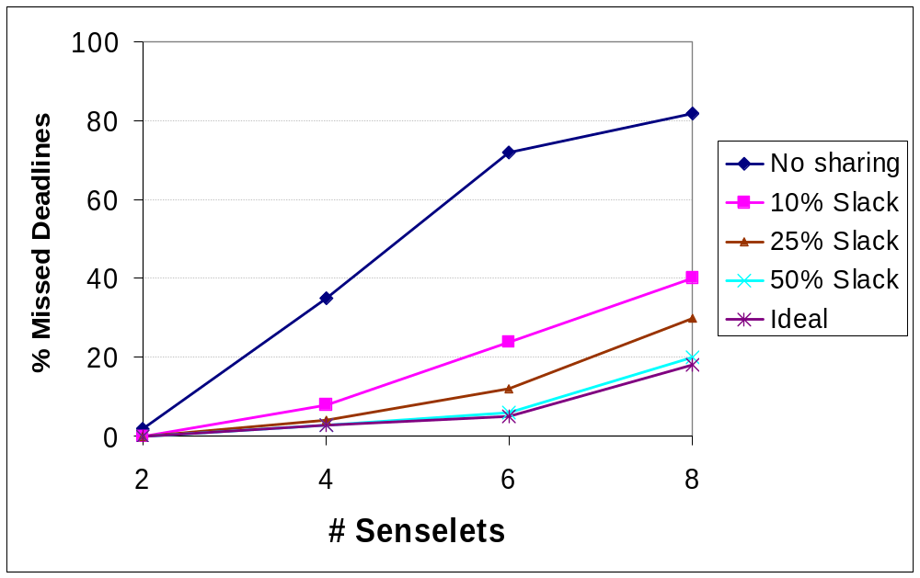
Missed Deadlines
Sharing reduces missed deadlines

Slide 18
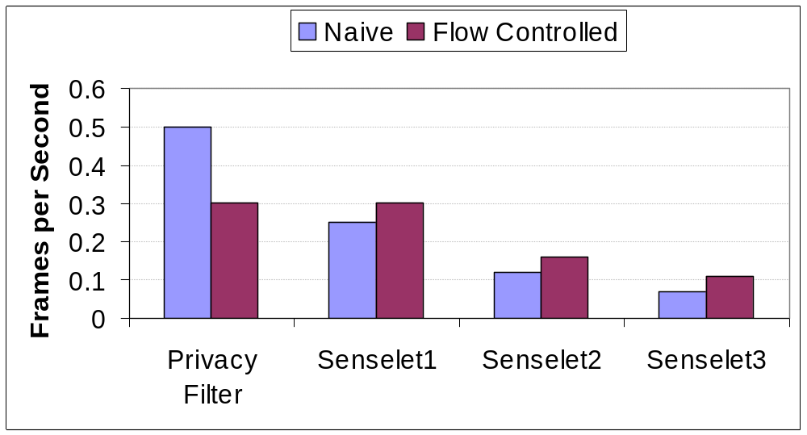
Flow Control
Flow control improves throughput

Slide 19
Conclusion
An architecture for specific filtering of multimedia sensors
Contributions
  Framework for application-specific filtering near sensors
  Computation sharing for scalable filtering
  Privacy filtering with flow control
  Evaluation in real system
More information in http://www.intel-iris.net

Slide 20
Evaluation
8 Senselets
  Description in the paper
Soft real time behavior
  Each senselet defines its {period, slack}
Ideally, meet each deadline and maximize sharing (i.e., minimize CPU load)
slack
time
period
deadlines

Slide 21
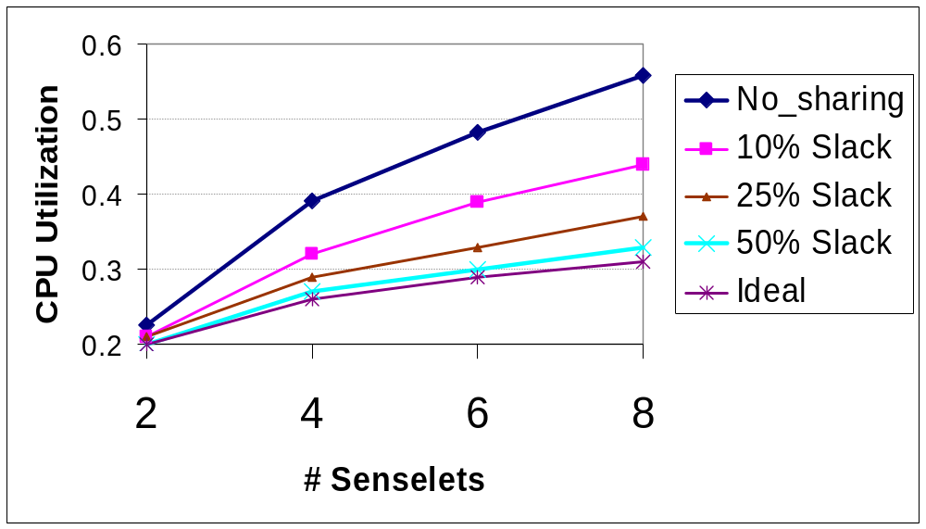
CPU Utilization

Slide 22
IrisNet Architecture
Sensing Agents (SA)
  PDA/PC-class processor, MBs–GBs storage,
  Linux
  Collect & process data from sensors
  Shared across services
Organizing Agents (OA)
  PC/Server-class processor, GBs storage, Linux
  Provide database & query facilities
  Group of OAs dedicated to one service
  Provide mechanisms for discovering relevant sensors, dealing with transient agents and balancing load across agents

Slide 23
Filtering DAG
Time=10
Time=11
Subtract background
Find contours
Detect car
Detect face
parking space
finder
Recognize face
person finder
Challenges of sharing
  Storing and indexing the results

Slide 24
Cross-Senselet Sharing
SA
OA
Basic idea: compute the common tasks once
Let senselets share each others’ computation
  Allows running more senselets, or more sophisticated senselets
Soft real-time behavior
Challenges of sharing
  Storing and indexing the results
senselet
slack
time
period
deadlines

Slide 25
Other IrisNet Research

