Slide 1
Availability, Usage, and Deployment Characteristics of the Domain Name System
Jeffrey Pang*, James Hendricks*, Aditya Akella*,
Roberto De Prisco†‡, Bruce Maggs*‡, Srinivasan Seshan*
*Carnegie Mellon University
†University of Salerno
‡Akamai Technologies
Notes:
Hi, I’m Jeff Pang and I’ll be presenting our study on the availability, usage, and deployment characteristics of the domain name system. This is joint work with James Hendricks, Aditya Akella, Roberto De Prisco of the University of Salerno, and Bruce Maggs and Srini Seshan.
TODO:
mention impact of results in questions + conclusions on federated infras.
fix contrast of grayed out servers so they are just lighter than the rest
axis on graphs

Slide 2
Why Characterize DNS?
Critical and Understudied
  Internet “stops working” when DNS goes down
  Example of federated deployment styles
  Much unknown and to be improved
  Proposed DNS Modifications: CoDoNS [Ramasubramanian04], CoDNS [Park04]
Guide to Future “Planetary-Scale” Services?
  Largest, most robust distributed system today
  PlanetLab, Overlays, DHTs, CDNs, and more!
Notes:
Why do we want to characterize DNS infrastructure? Well, although DNS has been deployed for several decades, there have only been limited attempts to characterize its properties as a distributed system. Moreover, we believe that a study of the basic characteristics of DNS infrastructure -- that is, the servers deployed to serve DNS requests -- is important not only for indicating where problems and improvements can be made to DNS today, but can also serve as a guide for future “planetary-scale” services.
Why is this? Almost all networked applications depend on DNS for operation, so the way it is deployed can serve as a rough model for future critical services. In addition, there are several different deployment models for DNS, and it is an example of a federated system in the sense that many different organizations deploy DNS servers in a cooperative manner.
Finally, we note that several recent proposals such as CoDoNS and CoDNS have advocated instrumenting DNS servers to be part of overlay networks to improve DNS performance and resiliance. Such schemes would benefit greatly from answers to question such as: how many users are behind each DNS server? How often are DNS servers unavailable? And how do different organizations deploy DNS servers to serve their clients?

Slide 3
The Domain Name System
...
Root Servers
gTLD Servers
Authoritative
DNS Servers
Local DNS Servers
Notes:
As all of you probably know, the domain name system is comprised of a hierarchy of authoritative DNS servers. During name resolution, clients first contact a root name server, then contact a top-level-domain or gTLD server, and then contact servers lower in the hierarchy. What is important to note is that while the top-levels of the hierarchy are generally centrally administered, beyond the gTLD servers, the system is completely federated.
Clients, however, generally do not access authoritative DNS servers directly, and instead send requests through a local DNS proxy, which caches results to improve performance. Each organization generally deploys their own local DNS servers to serve their clients.

Slide 4
Related Studies
Workload on the Root & gTLD servers [Brownlee01]
Lame-delegation, diminished server redundancy, and cyclic zone dependencies [Pappas04]
Bottleneck gateways [Ramasubramanian04]
Local DNS failures [Park04]
We focus on “raw” DNS server characteristics
Compare local vs. authoritative servers
Notes:
Several recent studies have reported on similar characteristics of the domain name system. For example, a study at sigcomm this year reported on the frequency of lame-delegations, lack of server redundancy, and cyclic zone dependencies in DNS. Another contained results showing that there are many gateways that serve as bottlenecks to name resolution. Finally, a study to appear in OSDI this year shows that failures of local DNS servers occur intermittently.
Our study instead focuses on “rawer” characteristics of DNS servers themselves like usage, availability, and deployment styles.

Slide 5
Overview
Methodology
  How to obtain representative samples of DNS servers?
Load
  How many users are serviced by DNS servers?
Availability
  How often are DNS servers unavailable?
Deployment Styles
  How do organizations deploy DNS servers?
Notes:
First we show how we obtained representative sample sets of name servers to measure. In particular we wanted to examine the differences between publisher driven deployments like auth dns servers and user-driven deployments like local dns servers.
then we will look at three questions we tried to answer in our study:
how is load distributed on dns servers? that is, how many users are behind each dns server
how available are dns servers? how often are they go offline and can not be accesssed?
how do different organizations deploy dns servers? what different styles of deployments exist?

Slide 6
Authoritative DNS (ADNS) Servers
...
Examples:
ns1.foo.com
ns.cs.cmu.edu
ns2.verizon.net
Authoritative
DNS Servers
Notes:
Since previous studies have looked at the root and top-level name servers already, we focus our measurement study on the large number of authoritative DNS servers lower in the hierarchy, which we will just call ADNS servers.
For example, ADNS servers might be the servers that know how to resolve a company’s webpage.

Slide 7
Sampling ADNS Servers
Servers for domain names in web cache logs (NLANR) (85,000)
Reverse name map of DNS hierarchy (87,000)
who owns 1.X.X.X?
who owns 1.1.X.X?
who owns 1.2.X.X?
Notes:
The first thing we tackle is how we obtain a sample of each of these type of DNS server we wish to study.
For ADNS servers, we used two techniques. First, we did a “reverse crawl” of the DNS hierarchy to obtain name servers responsible for different domains. Basically, we looked at the DNS reverse-name hierarchy which maps from IP addresses back to dns names and determined who is responsible for address blocks in the IP space to get a sample of DNS servers. We note that this was not a complete list, but we believe it is a representative sample of domains with reverse mappings. Second, we looked up the DNS servers responsible for the websites accessed by clients of the NLANR web caches.
For LDNS servers, we used the sample of servers that accessed Akamai’s DNS service over a week. Akamai serves the DNS for objects like images hosted many popular websites.

Slide 8
Local DNS (LDNS) Servers
Examples:
ns1.my-company.com
ns1.cs.somewhere.edu
ns2.big-isp.net
...
Local DNS Servers
Notes:
In addition, we want to study local DNS servers, which we will call LDNS servers for short. Examples of these include the name server your computer contacts when browsing the web, or quite probably, the name server your computer is contacting know if you are browsing the web.

Slide 9
Sampling LDNS Servers
Sample servers that access Akamai’s DNS
  Handles DNS for ~26 of top 100 websites
  274,000 LDNS servers in 49 different countries
Akamai DNS
LDNS Servers
Notes:
The first thing we tackle is how we obtain a sample of each of these type of DNS server we wish to study.
For ADNS servers, we used two techniques. First, we did a “reverse crawl” of the DNS hierarchy to obtain name servers responsible for different domains. Basically, we looked at the DNS reverse-name hierarchy which maps from IP addresses back to dns names and determined who is responsible for address blocks in the IP space to get a sample of DNS servers. We note that this was not a complete list, but we believe it is a representative sample of domains with reverse mappings. Second, we looked up the DNS servers responsible for the websites accessed by clients of the NLANR web caches.
For LDNS servers, we used the sample of servers that accessed Akamai’s DNS service over a week. Akamai serves the DNS for objects like images hosted many popular websites.

Slide 10
Overview
Methodology
Load
Availability
Deployment Styles
Notes:
now we turn to the question of load distribution over different dns servers. load can be indicative of where most clients are int the system and, for future systems, whether there might be imbalance in the number of requests that different servers submit to the system.
- questions on first slide only

Slide 11
Server Load
Goal: Estimate #Requests
Served by each LDNS and
ADNS Server
Notes:
The first characteristic we wanted to measure was server load -- which gives us a rough relative estimate of the number of clients using each DNS server. That is we wanted to know approximately how many requests each ADNS server served, and how many requests each LDNS server served or generated.

Slide 12
Estimating Relative Load
ADNS
  # HTTP reqs to websites served by DNS Server
  Coarse-grained relative estimator
  (1 week)
LDNS
  #DNS reqs sent to Akamai hosted websites
  Estimated 14% of all web reqs go to Akamai
  Akamai DNS records have low TTLs (20 sec)
  (1 week)
Notes:
Since trying to determine the number of clients using a particular DNS server is difficult, we instead tried to estimate the relative query load serviced by each DNS server. For ADNS servers, we estimated this by counting the number of web requests seen in the set of web cache logs and correlated them to the DNS server responsible for the websire. Obviously this is not completely accurate since not every web request results in a DNS request or vis versa, but we believe it is enough to serve as a course grained estimator.
For LDNS servers, we estimate the query load by counting the number of requests that a LDNS server sent to Akamai’s DNS service over the course of a week. Since we estimated that about 14% of all web requests are serviced by this particular Akamai service, this is likely to give a representative relative load estimate on average. Moreover, since Akamai DNS records have very low TTLs, we are likely to observe a DNS request from the LDNS server for each request it serviced from a client. (That is, assuming that they honor the TTL)

Slide 13
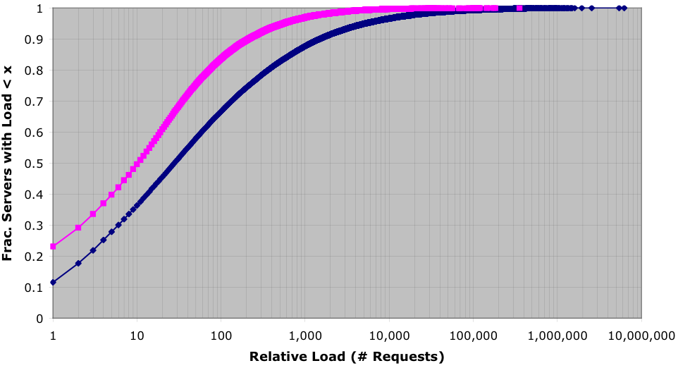
Relative Server Load: CDF
ADNS
LDNS
- Most servers are relatively lightly loaded.
Notes:
Here we show a CDF of the relative loads on LDNS and ADNS servers. The x-axis of both graphs indicate the number of requests we conted, and the y-axis shows the number of servers with at least tht many requests.
From these plots, we see that most servers are lightly loaded, relative to the rest. For example, if we look at the servers for which we saw less than 100 requets, they comprise 70% of the LDNS servers and 80% of the ADNS servers.

Slide 14
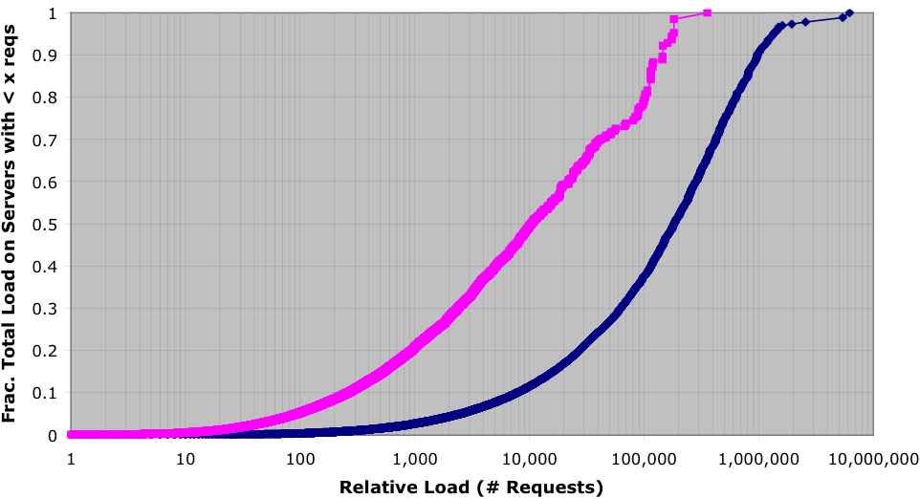
Total Load Distribution: CDF
ADNS
LDNS
Most Requests come from the highly loaded servers.
Not quite Zipfian: weight not all in tail
Notes:
Now we examine how the total query load in the system is distributed among these DNS servers. Here, on the x-axis we again have the relative number of requests seen at DNS servers, and on the y-axis we show the fraction of the total query load that was serviced by DNS servers having less than that many requests.
In the last graph we saw that most DNS servers served less than 100 requests. However, in this plot we see that those DNS servers make up less than 1% of the total query load in the case of LDNS servers and less than 5% in the case of ADNS servers. Hence most requests in the entire system come from the few highly loaded name servers.
+ contrary to zipfian (ght not in tail)

Slide 15
Overview
Methodology
Load
Availability
Deployment Styles
Notes:
now we turn to the question of dns server availability. in many proposed systems, such as dhts or overlays, churn, or the rate of server departure and arrival, can dramatically impact performance. in addition, this metric is important just for gauging the resiliance of the current dns infrastructure.

Slide 16
Server Availability
x
/
x
\
Goal: Estimate how often
servers can not serve requests,
and how long they are unavailable.
Notes:
Next we wanted to estimate server availability, or how often servers are unavailable to serve requests. We count both periods where the server is unavailable due to it being down, such as if the DNS server crashed or the site suffered a power outage, ... in addition to the case when the DNS server site’s network is unavailable. In both these cases, the server can not service requests to clients outside its immediate network.

Slide 17
Estimating Availability
x
Active Probes from one vantage point
  Poisson sampling with mean interval 1 hour
  Both DNS requests and ICMP pings
  estimates availability
  Took steps to avoid counting local failures
  (2 weeks)
# probe failures
# total probes
Notes:
To estimate server availability, we performed a series of active probes to our DNS server sample sets. The probes were spaced with exponentially distributed intervals with mean 1 hour, and included both DNS queries and ICMP pings. The ratio of probe failures over the total number of probes send to a DNS server estimates its availability. This experiment lasted for two weeks.

Slide 18
Non-Responsive Servers
x
Which Servers are Responsive?
  Sent “test” probe immediately after a server sent a DNS request to Akamai
  More likely server is “up” when initially probed
LDNS Server Responsiveness
  76% responded to either DNS or Ping
    35% respond to both
    21% only respond to Ping
    20% only respond to DNS
Notes:
Now I’ll outline two particular challenges we faced in this particular study that may be of interest.
First, we noticed that many of the LDNS servers were non-responsive to our probes. Although this is not suprising since properly LDNS servers should only service users within their organization, we found it interesting that 35% of servers did respond to both DNS and ping, while 21% only responded to ping, and 20% only responded to DNS.
Hence, it was important to only include responsive servers within our sample set. We tested the responsiveness of a LDNS server by sending it a probe immediately after it sent a request to the Akamai DNS service.

Slide 19
Distinguishing Dynamic IPs
x
Impact of Dynamic IPs
  6-8% of LDNS servers or more are probably on dynamic IPs (Surprising?)
  Incorrect estimate of availability
  Overestimate number of distinct DNS servers
We choose to be conservative
  Only analyzed servers on non-dynamic IPs
Identifying non-dynamic IPs (one technique)
  Conjectured that dynamic IP pools have similar host names:
  cust-0-1-2-3-3.isp.net (IP Address: 1.2.3.3)
  cust-0-1-2-3-4.isp.net (IP Address: 1.2.3.4)
  cust-0-1-2-3-5.isp.net (IP Address: 1.2.3.5)
  Example: for 1.2.3.3, compare with 1.2.3.2 and 1.2.3.4
  Correctly flags over 98% of a SPAM RBL dynamic IP list
Notes:
Secondly, we noticed that many of the LDNS servers were in fact using dynamic IP addresses. If we had included these LDNS servers in our study, we would have drastically underestimated their availability since a non-DNS server might take over its IP address when its DHCP lease expired.
Hence we chose to be conservative and only analyzed servers which we were reasonably sure were behind non-dynamic IPs.
We used several techniques to identify non-dynamic IPs, but I’ll just outline one of the more interesting ones here. We conjectured that most dynamic IPs look something like this... that is, that all the domain names assigned to a dynamic IP pool are likely to have very similar host names. Hence, we flagged IPs as potentially dynamic if their hostname was very similar to the IP immediately above and immediately below it. This turned out to correctly flag over 98% of the dynamic IPs in a real-time-blackhole list’s IP database.
why see these names (small bus + home users?)

Slide 20
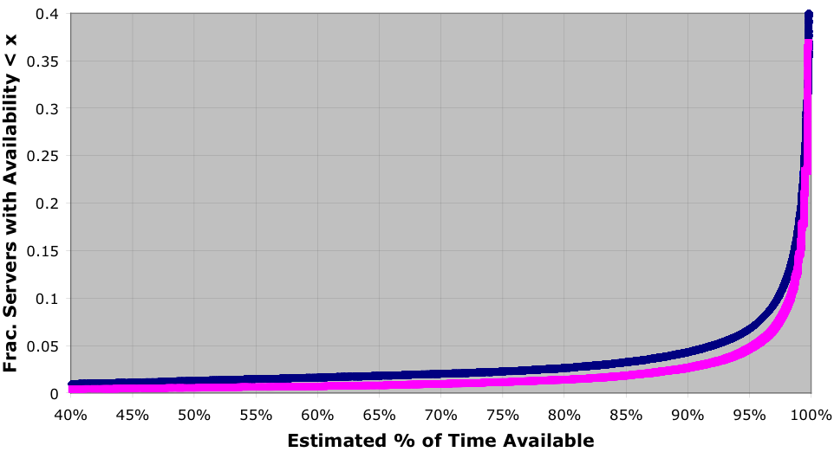
Server Availability: CDF
x
LDNS
ADNS
Perfect availability: 62% LDNS, 64% ADNS
Mean availability: LDNS 98%, ADNS 99%
Notes:
In this graph, we show the CDF of the server load among LDNS and ADNS severs. On the x-axis we show the fraction of time the server was available during our 2 week study and on the y-axis we show the fraction of servers that were available less than that often.
We found that over 60% of both LDNS and ADNS servers had “perfect” availability, while on average an LDNS server was available 98% of the time and an ADNS server was available 99% of the time.
Nonetheless, this plot shows that over 5% of the time, a server has less than 95% availability, so almost most servers have reasonably high availability, there are a fraction that do not.

Slide 21
Relative Load vs. Availability
x
ADNS
LDNS
Minor but non-trivial positive correlation
Sidenote: web cache ADNS sample set had ~1% higher
mean availability than “reverse crawl” sample set
Notes:
Another question we wanted to answer was whether there was any correlation between a server’s load, that is the number of users it serves, and its availability. In the scatter plot on the left, we plot the availability of ADNS servers against their relative loads. In the table on the right, we see that there is in fact a small positive correlation between the two. For example, an LDNS server having more than 100 thousand requests is 2% more likely to be available than an LDNS server with less than 100 requests.
As a sitenote, we note that the sample set of ADNS servers that came from our webcache results had about a 1% higher availability than the ADNS servers in our reverse-crawl sample set. This is consistent with these results since those ADNS servers only seen in the reverse-crawl are unlikely to have been used very often.
plot avg of pts
web dataset

Slide 22
Overview
Methodology
Load
Availability
Deployment Styles
Notes:
now we look at some deployment styles we observed with dns servers within organizations. this gives insight into how orgs split load between servers or how many subdepartments might exist within orgs. for future systems, this can indicate the degree of organizational locality that may exist.

Slide 23
Deployment Styles
vs.
Goal: Determine common “styles” of LDNS
deployment within different organizations.
Notes:
Finally, we took some initial steps to try to characterize certain deployment “styles” that are employed by different organizations in organizing LDNS servers. One such characteristic we looked at was how load was distributed among different LDNS servers within a single domain, due to load balancing or just multiple departments.
In this example, one organization might split their user population behind two LDNS servers, while another might use one to serve all its users.

Slide 24
Deployment Styles
Grouped LDNS servers by domain name
  Coarse-grained approximation of organizations
Characteristics examined:
  Load distribution within an organization
  Number of servers deployed [see paper]

Slide 25
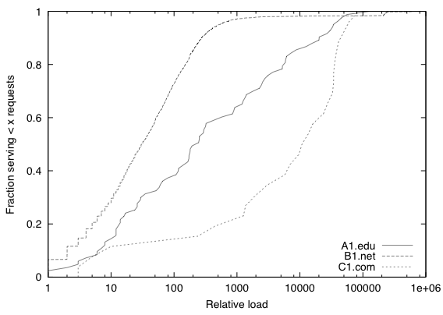
Deployment Styles:
LDNS Load Distribution CDF
Many sub-orgs
(e.g., ISP)
Departments
(e.g., .edu)
Centralized
(e.g., company)
We observed three common patterns in LDNS load
distribution among servers in a domain.

Slide 26
Summary
Load Distribution
  Many idle LDNS and ADNS servers
  But most requests come from/to a few busy ones
Availability
  Majority of servers are highly available
  Small positive correlation between load and availability
Deployment Styles
  Conjecture that there are 3 basic profiles for LDNS distribution in organizations
ADNS vs. LDNS
  ADNS slightly more available
  LDNS servers more diverse: dynamic IPs, etc.

Slide 27
Questions

Slide 28
Extra Slides

Slide 29
Limitations
Probing from single vantage point
  Limited impact of local connectivity issues [see paper]
  Rough estimate of failures related to network: 15%
Probing granularity
  Performed smaller 5-min granularity experiment
  Similar results
Accounting for “Middle-boxes”
  Probes may not actually be to actual DNS server
Sample Bias
  Web cache vs. Reverse-crawl ADNS sample sets show sampling method is important

Slide 30
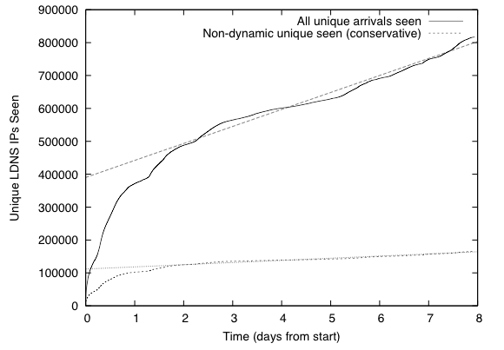
Dynamic LDNS Arrival Rate

Slide 31
Server Availability
x
/
Notes:
Now, we turn our attention to server availability, which you’ll recall we estimated with active probes to each DNS server site. We estimated the availability as the fraction of failed probes over the fraction of total probes.

Slide 32
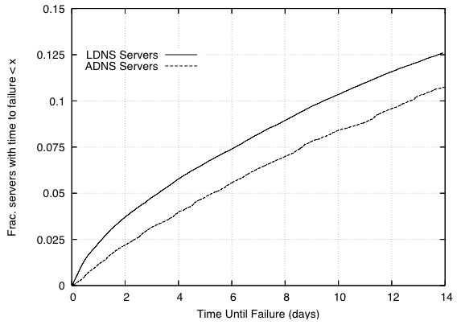
Time to Failure: CDF
x
Time to failure is likely to be on order of days,
weeks, or longer.
Notes:
remove these two

Slide 33
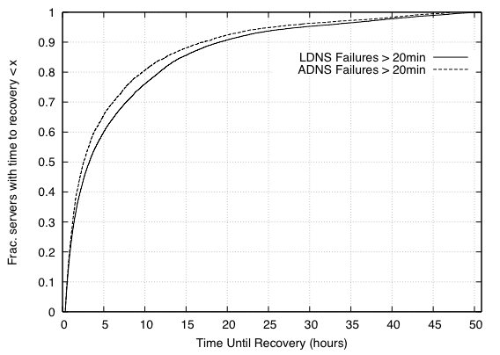
Time to Recovery: CDF
x
Time to recovery is likely to be on the order of hours.

Slide 34
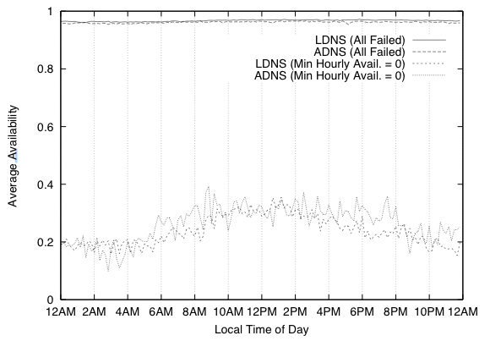
Time of Day Effects
x

Slide 35
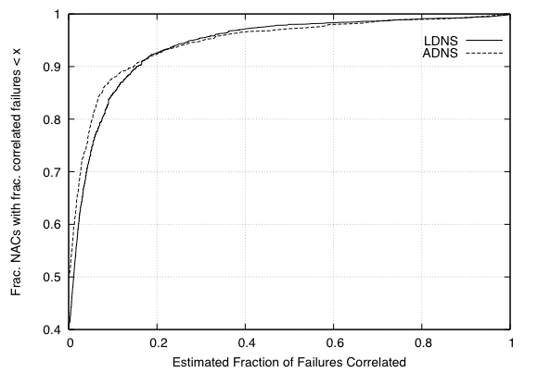
NAC Correlated Failures
x

Slide 36
Deployment Styles
vs.

Slide 37
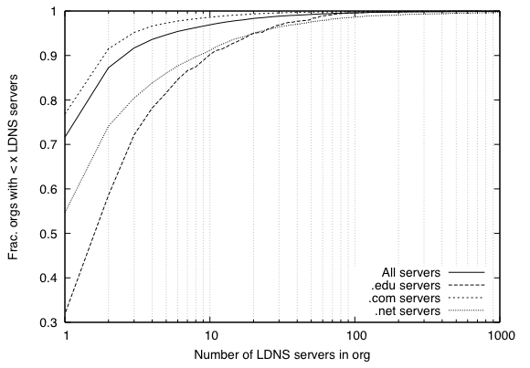
LDNS Server Count

Slide 38
Relative Server Load
Notes:
First, we will discuss some results related to relative server load, which if you recall, we estimated by counting the number of web requests for websites served by ADNS servers, and the number of requests sent to Akamai by LDNS servers.

