Slide 1
Self Management in Chaotic Wireless Networks
Aditya Akella, Glenn Judd,
Srini Seshan, Peter Steenkiste
Carnegie Mellon University
Notes:
GO SLOW, PAUSE, REHEARSE PAUSES

Slide 2
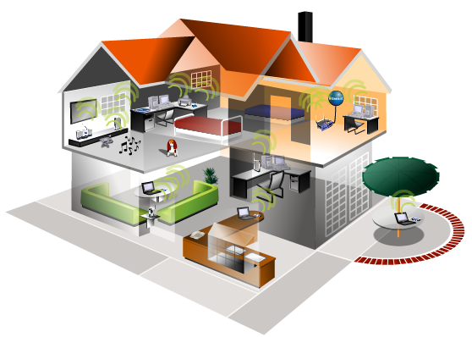

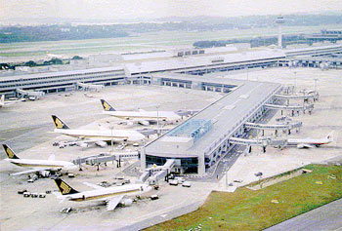
Wireless Proliferation
Sharp increase in deployment
  Airports, malls, coffee shops, homes…
  4.5 million APs sold in 3rd quarter of 2004!
Past dense deployments were planned campus-style deployments
Notes:
Sales will triple by 2009
However, if you looked 10 yrs into the past, wifi was limited to campus style deploye,ents where…

Slide 3
Chaotic Wireless Networks
Unplanned:
  Independent users set up APs
  Spontaneous
  Variable densities
  Other wireless devices
Unmanaged:
  Configuring is a pain
  ESSID, channel, placement, power
  Use default configuration
→ “Chaotic” Deployments
Notes:
In contrast, todays deployments…

Slide 4
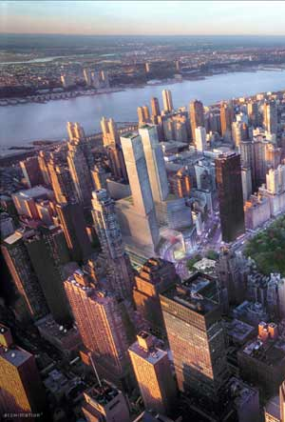
Implications of Dense Chaotic Networks
Benefits
  Great for ubiquitous connectivity, new applications
Challenges
  Serious contention
  Poor performance
  Access control, security
Notes:
The modern dense deployments are actually great, because…

Slide 5
Outline
Quantify deployment densities and other characteristics
Impact on end-user performance
Initial work on mitigating negative effects
Conclusion
Notes:
More visible
Link sections
Bring up summary slides/outline
So our goal in this work was to ….
Motivate the need for automatic management of these networks, for example, to reduce the potential negative impact.

Slide 6
Characterizing Current Deployments
Datasets
Place Lab: 28,000 APs
  MAC, ESSID, GPS
  Selected US cities
  www.placelab.org
Wifimaps: 300,000 APs
  MAC, ESSID, Channel, GPS (derived)
  wifimaps.com
Pittsburgh Wardrive: 667 APs
  MAC, ESSID, Channel, Supported Rates, GPS
Notes:
Caveats
Subset, old,
Relative strengths of each
Placelab: data collected as part of Intel’s placelab project, this is software that allows commodity hardware clients such as notebooks, PDAs to locate themselves by listening to radio beacons such as 802.11…
Wifimaps: provides a graphic visualization tool to map out access points in specific areas of the world. This under database is contributed by various war-drive efforts.
War-drive: small scale war drive of some dense areas of pittsburgh

Slide 7
AP Stats, Degrees: Placelab
  (Placelab: 28000 APs, MAC, ESSID, GPS)
#APs
Max.
degree
50 m
Portland | 8683 | 54
San Diego | 7934 | 76
San Francisco | 3037 | 85
Boston | 2551 | 39
1
2
1
Notes:
Data in placelab to understand how many APs in each city are in interference range of each other.
Figure on the right shows a distribution of the number on interfering neighboring APs in the various cities. More than 4…

Slide 8
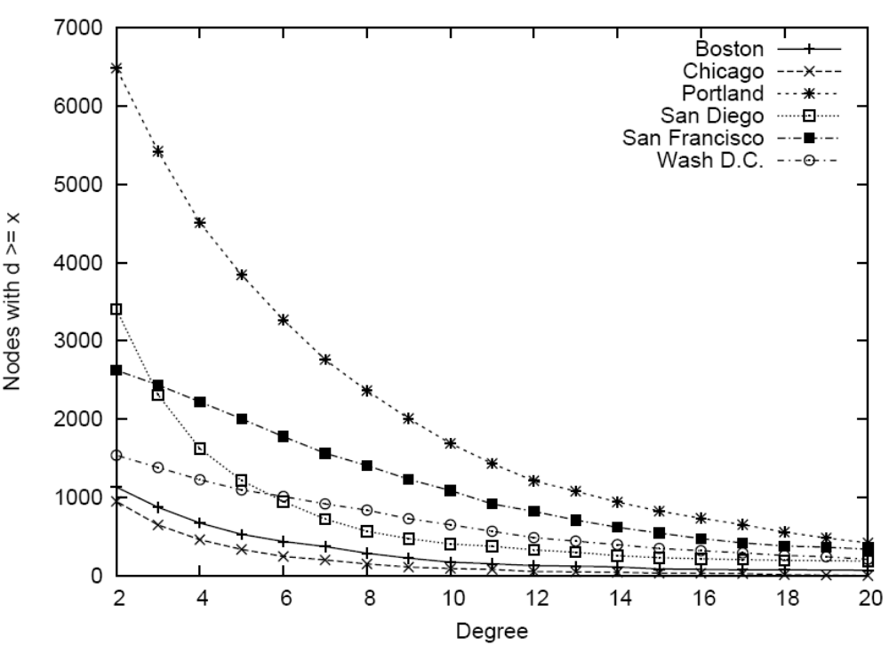
Degree Distribution: Place Lab
Notes:
Color
Don’t say graph coloring, channel selection
Search for “placelab”
Data in placelab to understand how many APs in each city are in interference range of each other.
Figure on the right shows a distribution of the number on interfering neighboring APs in the various cities. More than 4…

Slide 9
Unmanaged Devices
WifiMaps.com
(300,000 APs, MAC, ESSID, Channel)
Channel
%age
6 | 41.2
2 | 12.3
11 | 11.5
3 | 3.6
Most users don’t change default channel
Channel selection must be automated
Notes:
Change titles: as was done here…
Caveat
Mention autocell is used by new vendors, but solution is ?
Newer access points include
This is top 4 channels, number are unclassified
We computed several interesting statistics about deployment and usage. 6 – default on most APs, showing that users more often than not leave their def configs on. In the table on the right, I show the relatives levels of deployment a and g. We can determine this by looking at the supporting rates info for the APs… relatively recent standardization….

Slide 10
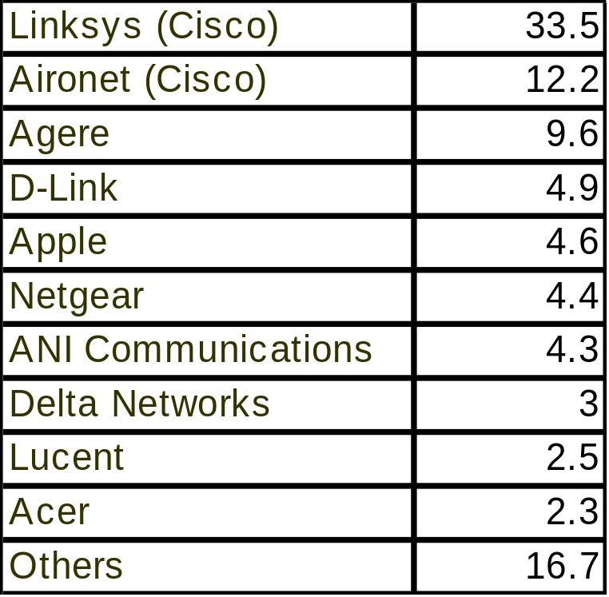
Opportunities for Change
  Wardrive
  (667 APs, MAC, ESSID, Channel, Rates, GPS)
Major vendors dominate
Incentive to reduce “vendor self interference”
Notes:
Opportunities for …
Chipset distribution is even more homogeneous
Drop if time needed

Slide 11
Outline
Quantify deployment densities and other characteristics
Impact on end-user performance
Initial work on mitigating negative effects
Conclusion
Notes:
More visible
Link sections
Bring up summary slides/outline
So our goal in this work was to ….
Motivate the need for automatic management of these networks, for example, to reduce the potential negative impact.

Slide 12
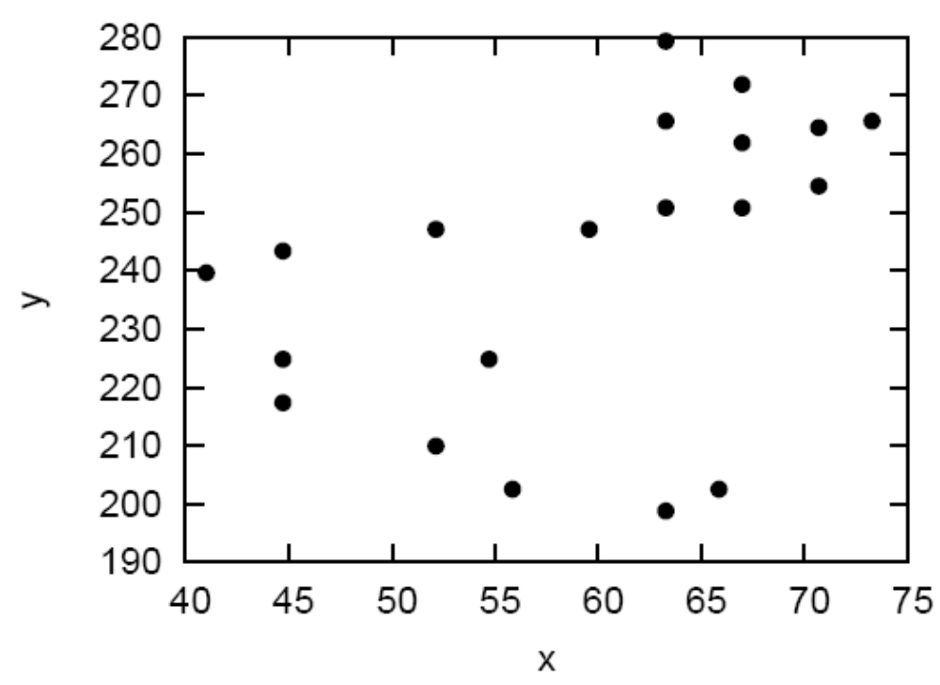
Impact on Performance
Glomosim trace-driven simulations
“D” clients per AP
Each client runs
HTTP/FTP
workloads
Vary stretch “s”
→ scaling factor for
inter-AP distances
Map Showing Portion of Pittsburgh Data
Notes:
Refer to picture as map
Justify workload, refer to roofnet
Next we conducted trace-driven simulations in glomosim to understand the impact of the dense deployements on end user performance. s=1, s=inf cases….

Slide 13
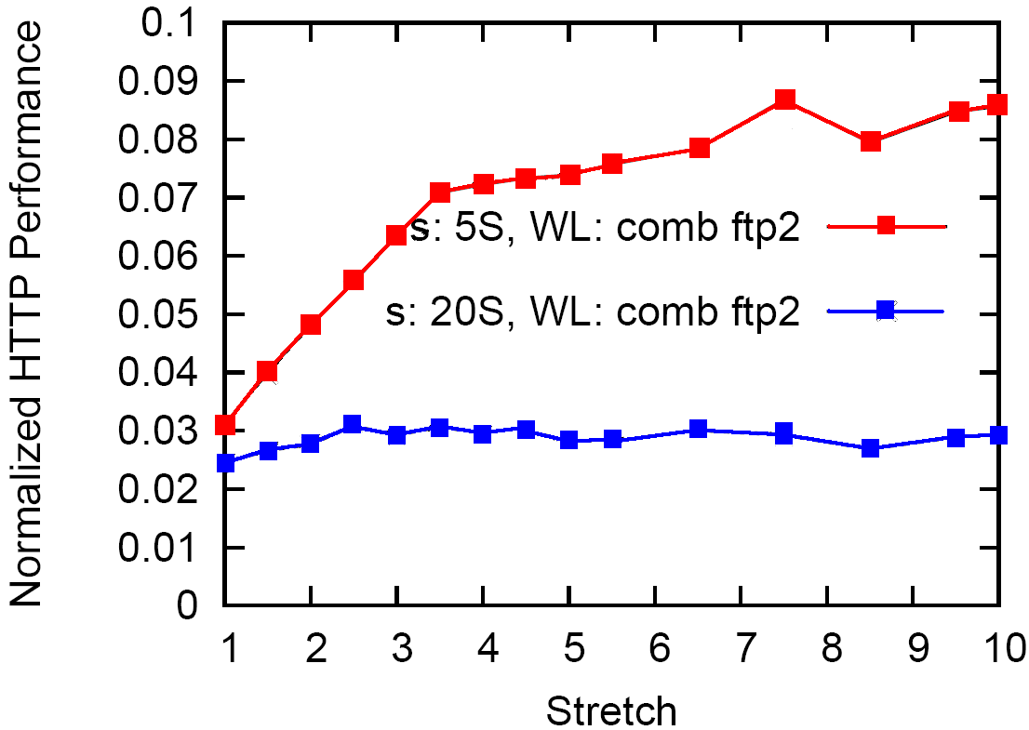
Impact on HTTP Performance
3 clients per AP. 2 clients run FTP sessions.
All others run HTTP.
300 seconds
Degradation
5s sleep time
20s sleep time
Max interference
No interference
Notes:
This graph isn’t consistent (http/ftp) switch to consistent and get rid of multiple
HTTP bytes for a
single session /
FTP bytes
(replace:
Metric for amount
Of work user gets done)
Add degradation line for second
Mention: y axis
Get rid of one of the ftp3 lines
Is ftp rate limited
Have vertical arrows showing degradation
Get rid of (a) HTTP from this and other graphs
Lets first look at the impact o http users. Top graph, each curve = 2 params. ..
One client per AP.
20% lower performance.
Increase clients per AP, impact is even more severe. Performance at s=1 is upto 3 times smallers… effect plays up even in the lighter workloads.
What is we increased the number of competing ftp flows? There is a definite effect, although the performance is impacted slightly…

Slide 14
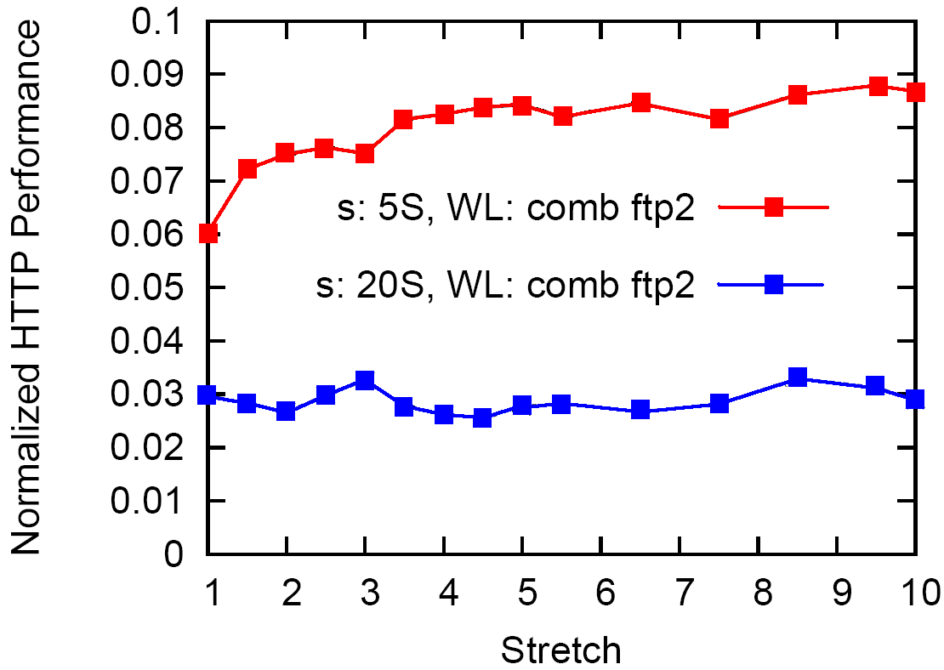
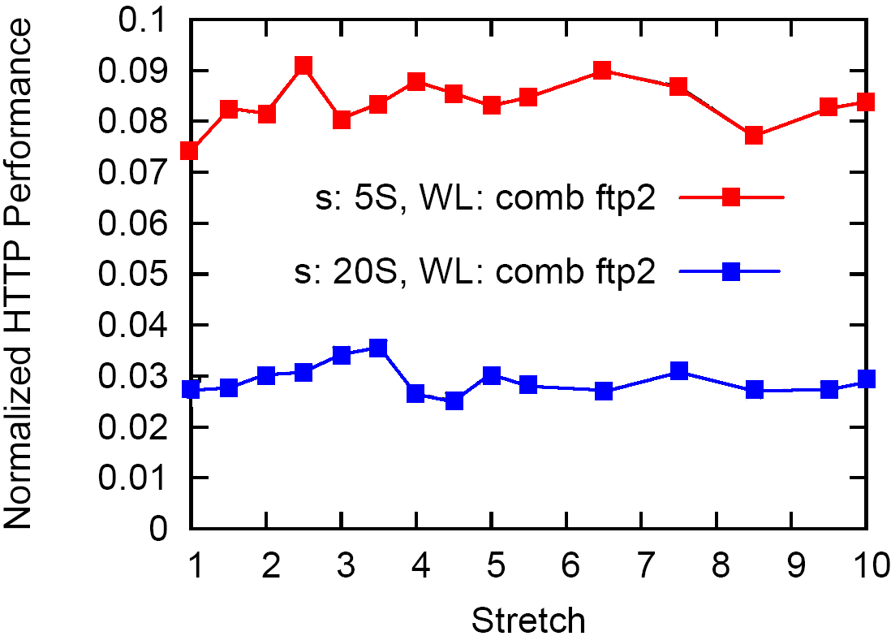
Optimal Channel Allocation vs.
Optimal Channel Allocation + Tx Power Control
Channel Only
Channel + Tx Power Control
Notes:
Describe channel selection
Power control done by cutting interference range is in half
Difference between stretch 1 and 10
Cut (a) HTTP performance

Slide 15
Incentives for Self-management
Clear incentives for automatically selecting different channels
  Disputes can arise when configured manually
Selfish users have no incentive to reduce transmit power
Power control implemented by vendors
  Vendors want dense deployments to work
Regulatory mandate could provide further incentive
  e.g. higher power limits for devices that implement intelligent power control
Notes:
Look up channel dispute lawsuit
Set up transition: what is the maximum density that 802.11 networks can support
What power levels do we need to support these densities
Look up Continental vs. airports

Slide 16
Impact of Joint Transmit Power and Rate Control
Objective: given <load, txPower, d_{client}> determine d_{min}
require: mediumUtilization <= 1
txPower determines range
d_{client}, txPower determines rate
d_{client}
APs
d_{min}

Slide 17
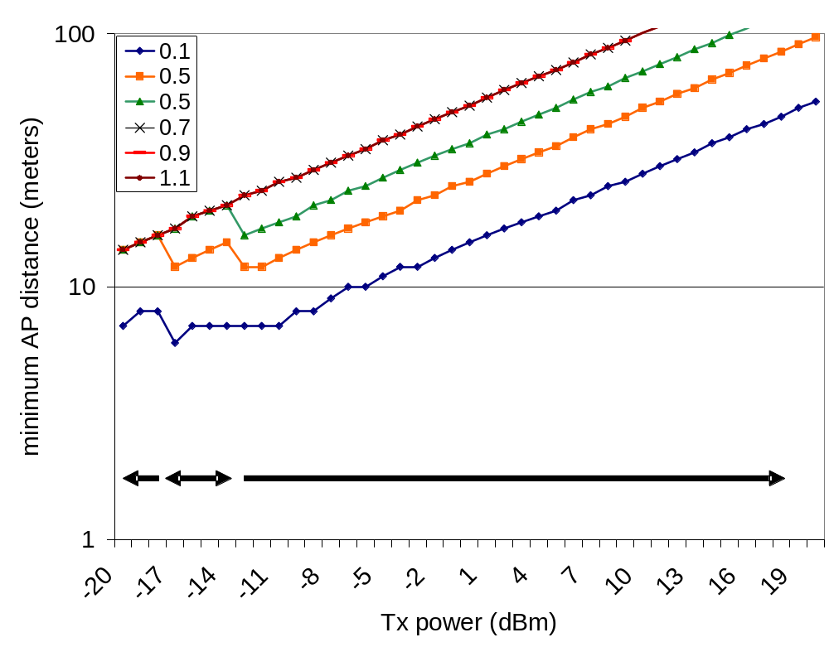
Impact of Transmit Power Control
Minimum distance decreases dramatically with transmit power
High AP densities and loads requires transmit power < 0 dBm
Highest densities require very low power → can’t use 11Mbps!
Notes:
Color
Think about overlapping series
Bigger graph

Slide 18
Outline
Quantify deployment densities and other characteristics
Impact on end-user performance
Initial work on mitigating negative effects
Conclusion
Notes:
More visible
Link sections
Bring up summary slides/outline
So our goal in this work was to ….
Motivate the need for automatic management of these networks, for example, to reduce the potential negative impact.

Slide 19
Power and Rate Selection Algorithms
Rate Selection
  Auto Rate Fallback: ARF
  Estimated Rate Fallback: ERF
Joint Power and Rate Selection
  Power Auto Rate Fallback: PARF
  Power Estimated Rate Fallback: PERF
  Conservative Algorithms
    Always attempt to achieve highest possible modulation rate
Implementation
  Modified HostAP Prism 2.5 driver
    Can’t control power on control and management frames

Slide 20
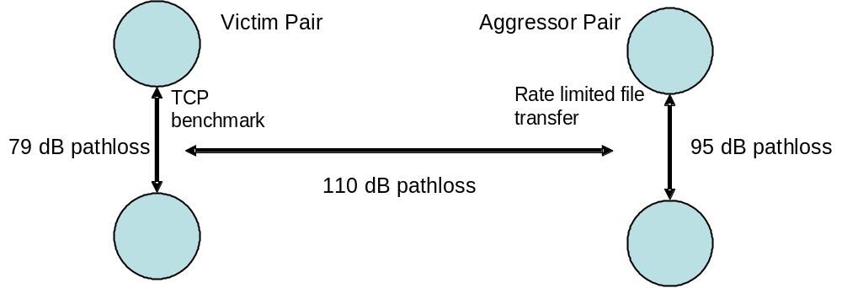
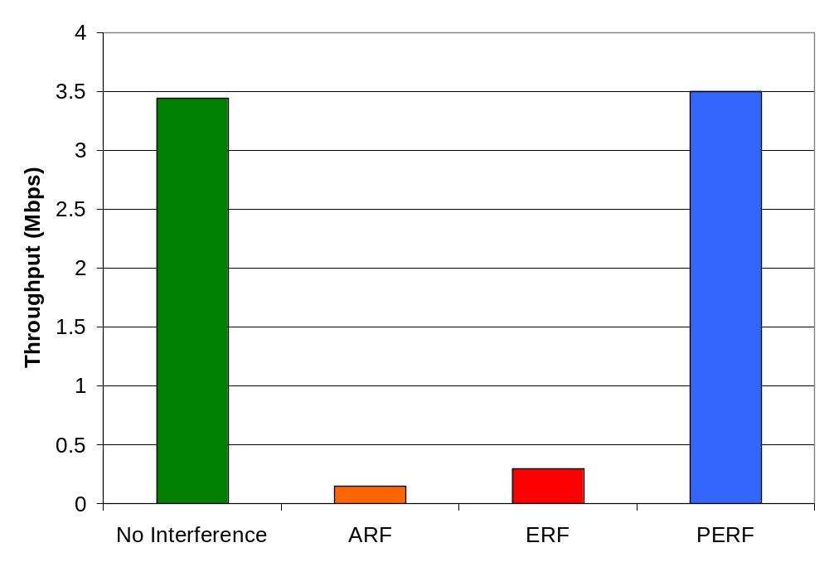
Lab Interference Test
Topology
Results
Notes:
Add power
Switch to rate limitation graph, leave this as extra slide, lab test, leave this for reference
Have lab-limited and home-limited side by side as this spare slide

Slide 21
Conclusion
Significant densities of APs in many metro areas
Many APs not managed
High densities could seriously affect performance
Static channel allocation alone does not solve the problem
Transmit power control effective at reducing impact

Slide 22
Extra Slides

Slide 23
Opportunities for Change
  Wardrive
  (667 APs, MAC, ESSID, Channel, Rates, GPS)
Total | 667
Classified | 472
802.11b | 379
802.11g | 93
802.11g standardized one year previous to this measurement
Relatively quick deployment by users
Notes:
Think about moving these slides to the end
Opportunity for quick deployment of self management
Another interesting observation
We computed several interesting statistics about deployment and usage. 6 – default on most APs, showing that users more often than not leave their def configs on. In the table on the right, I show the relatives levels of deployment a and g. We can determine this by looking at the supporting rates info for the APs… relatively recent standardization….

Slide 24
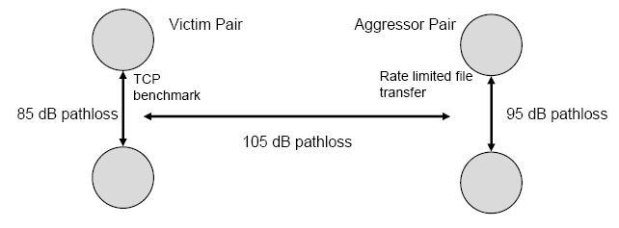
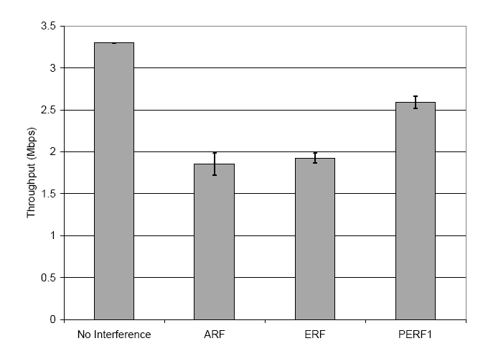
Home Interference Test
Results
Topology
Notes:
Add power
Switch to rate limitation graph, leave this as extra slide

Slide 25
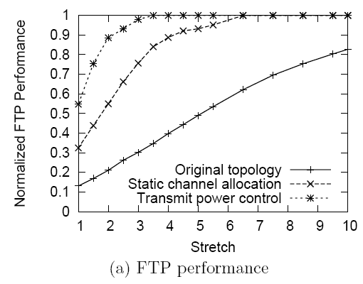
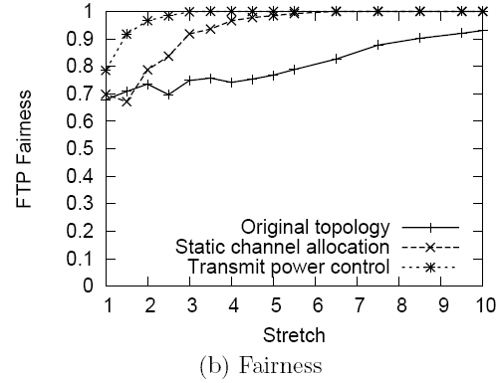
Network “Capacity” and Fairness
Set all transfers to FTP to measure “capacity” of the network.
Compare effects of channel allocation and power control
Notes:
Skip this slide?

Slide 26
LPERF
Tag all packets
  Tx Power
    Enables pathloss computation
  Utilization: Tx, Rx
    Enables computation of load on each node
      Fraction of non-idle time impacted by transmissions
Pick rate that satisfies local demand and yields least load on network

Slide 27
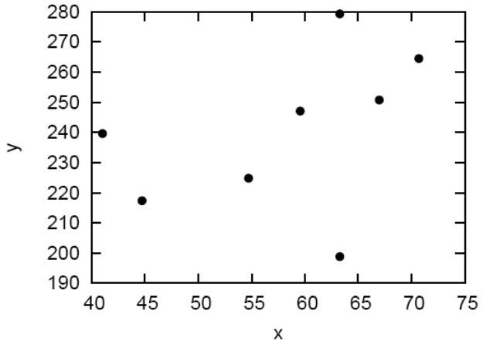
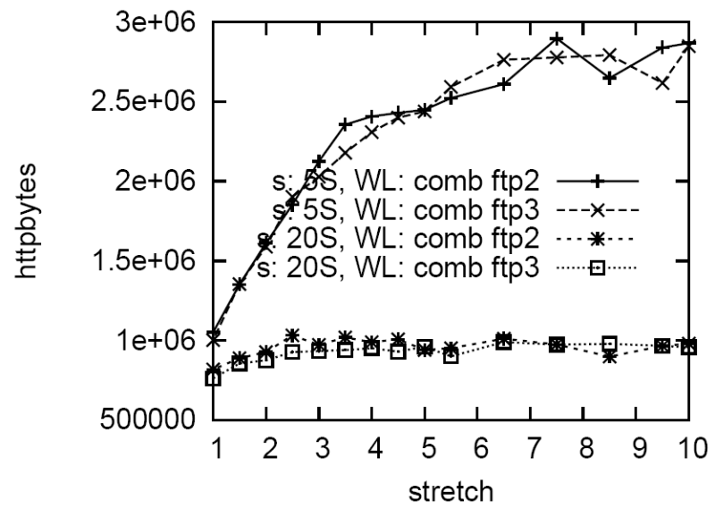
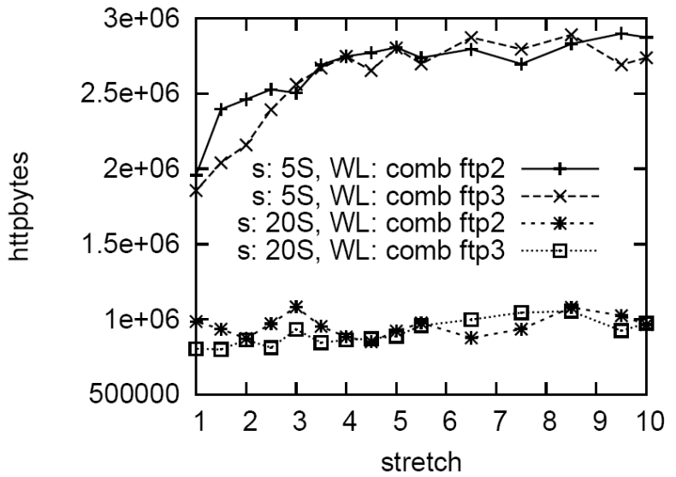
Static Channel Allocation
3-color
Notes:
So how do we reduce the negative impact of densities?
Well the first thing we can try is to assign APs to different channels. Of the 11 channels in 802.11b, three channels, 1, 6, and 11 are non-overlapping. Lets assume that we arrive at an optimal assignment os channels to these APs.
Does this really solve the problem… it does improve significantly, however, we still see that when APs are closely packed, there perf is about 33% worse. In fact, If the number of…

Slide 28
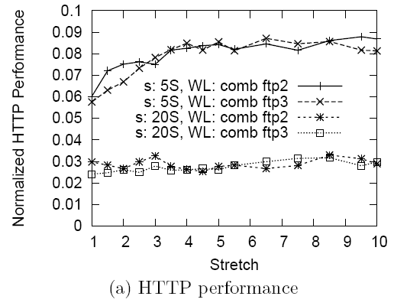
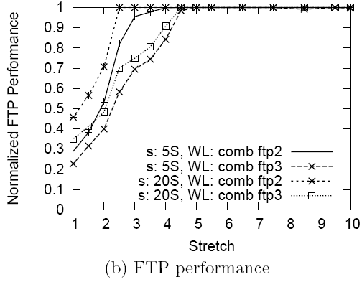
Static Channel

Slide 29
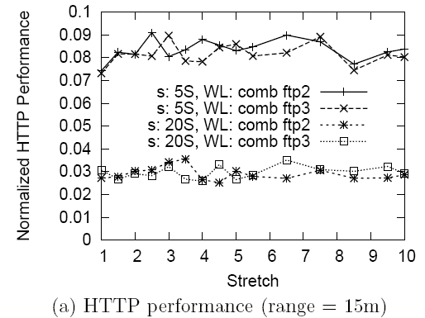
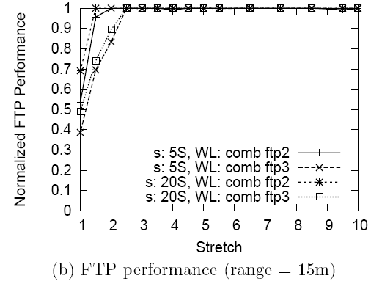
Static channel + Tx power

Slide 30
Ongoing Work
Joint power and multi-rate adaptation algorithms
  Extend to case where TxRate could be traded off for higher system throughput
Automatic channel selection
Field tests of these algorithms

