Slide 1
Understanding and Mitigating the Impact of RF Interference on 802.11 Networks
Ramki Gummadi (MIT), David Wetherall (UW)
Ben Greenstein (IRS), Srinivasan Seshan (CMU)
Notes:
Hello and good afternoon, everyone. Welcome to the first talk of the last session. My name is Ramki, and I’m going to be talking to you today about how we can better understand and mitigate the effects of RF interference on 802.11 networks. This is joint work with David Wetherall from UW, Ben Greenstein from IRS, which stands for Intel Research Seattle and not Internal Revenue Service, and Srini Seshan from CMU.

Slide 2
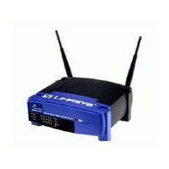
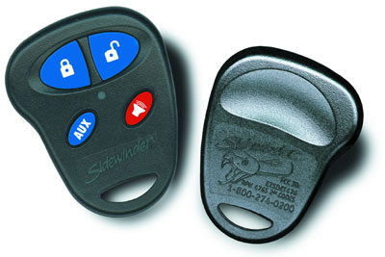

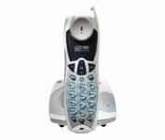
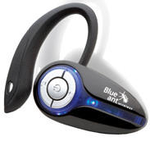
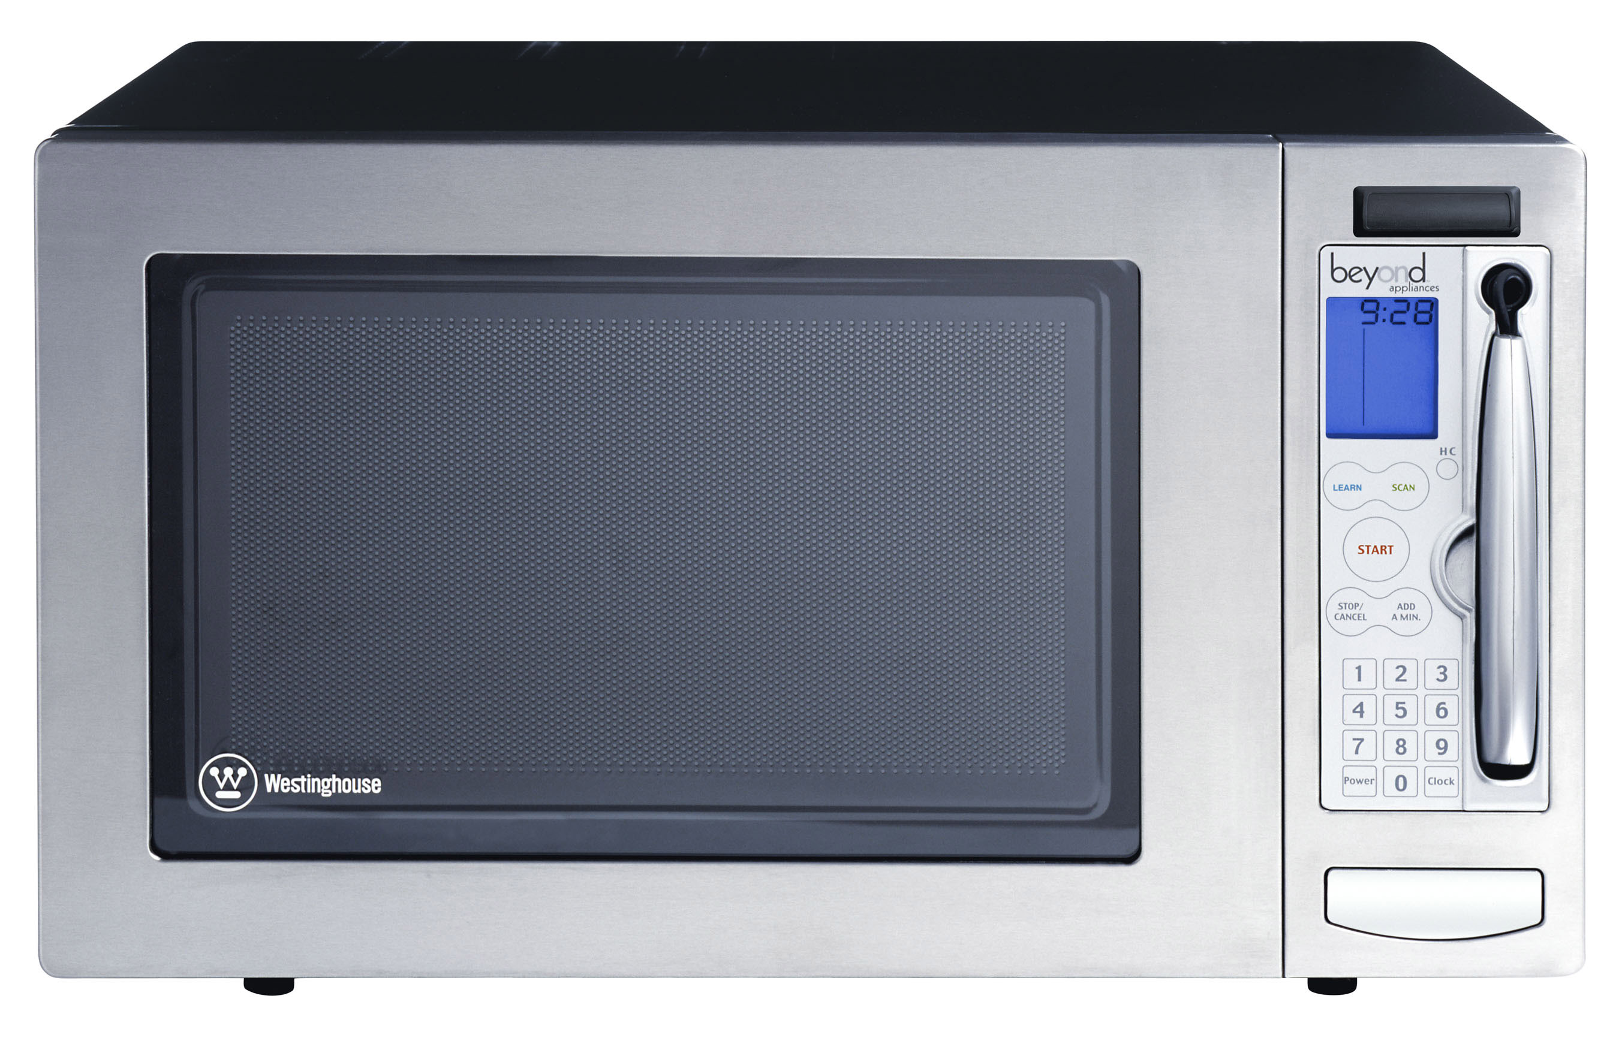
Growing interference in unlicensed bands
Anecdotal evidence of problems,
but how severe?
Characterize how 802.11 operates under interference in practice
Other 802.11
Notes:
The main problem we’re concerned with today is the impact of growing RF interference in unlicensed spectrum such as the 2.4GHz band used by 802.11. There has recently been a spate of anecdotal reports about the increasing severity of RF interference problems on the operation of wireless networks such as 802.11, but we don’t yet clearly know what the magnitude or the trend of the problem is. So, we would like to characterize how 802.11 performs under interference in reality.
Today, an 802.11 network has to contend with other 802.11 networks, as well as with other wireless devices that share the same spectrum, such as cordless phones, microwave ovens, car alarm systems, bluetooth, and a growing variety of other unlicensed band devices.

Slide 3
What do we expect?
Throughput to decrease linearly with interference
There to be lots of options for 802.11 devices to tolerate interference
  Bit-rate adaptation
  Power control
  FEC
  Packet size variation
  Spread-spectrum processing
  Transmission and reception diversity
Theory
Throughput (linear)
Interferer power
(log-scale)
Notes:
The standard SINR or (Signal to Interference and Noise Ratio) model predicts that throughput should decrease linearly with interferer power. The interferer power is on a log-scale. If this standard model holds in practice, then 802.11 devices have a variety of options at their disposal to tolerate interference gracefully. For example, they can change the bit rate at which they transmit, they can change the transmission power, they can use forward error correction, they can use smaller packets, and exploit various diversity techniques for transmission and reception, such as using multi-antenna systems.

Slide 4
Key questions for this talk
  How damaging can a low-power and/or narrow-band interferer be?
  How can today’s hardware tolerate interference well?
    What 802.11 options work well, and why?
Notes:
The key questions before us are whether 802.11 copes well with different types of low-power and/or narrow-band interferers, and which of the 802.11 options work well in practice, and why.

Slide 5
What we see
Effects of interference more severe in practice
Caused by hardware limitations of commodity cards, which theory doesn’t model
Theory
Throughput (linear)
Practice
Interferer power
(log-scale)
Notes:
The most interesting result we see is that the effects of interference are more severe in practice than theory would predict. There is a large gap between theory and practice at both low-end and high-end of the interference range. In fact, we find that the link throughput can drop to zero at medium to high end of the interference range. Such a rapid and severe degradation in performance is caused by several hardware limitations of commodity cards, which are not adequately modeled by theory.

Slide 6
Talk organization
Characterizing the impact of interference
Tolerating interference today

Slide 7
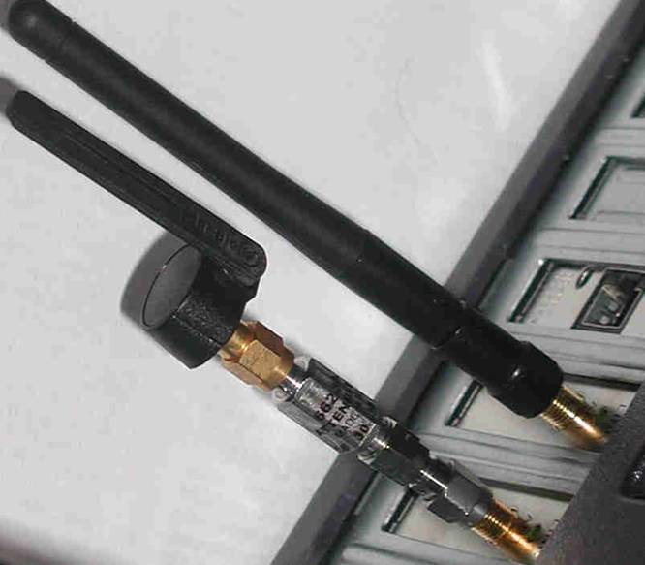
Experimental setup
Access
Point
UDP flow
802.11 Interferer
802.11
Client
Notes:
Our setup is a controlled testbed within an office building consisting of 802.11 transmitter and receiver that use different commodity cards. They exchange UDP flows. Interferers are various types of wireless devices such as an 802.11 interferer that can output arbitrary modulated 802.11 bit patterns, ZigBee sensor nodes, cordless phones, and camera jammers. They represent both worst-case natural and adversarial interferers arising in practice. The interferer varies in power as its physical distance to the 802.11 link changes. In order to simulate the effects of such an interferer in a controlled manner, we use hardware attenuators to vary the output power. The picture here shows such an attenuated 802.11 interferer.

Slide 8
802.11 receiver path
PHY
MAC
PHY
MAC
To RF Amplifiers
Amplifier control
RF
Signal
AGC
Analog
signal
ADC
Timing
Recovery
Barker
Correlator
Data
(includes beacons)
Demodulator
Descrambler
6-bit
samples
Preamble Detector/
Header CRC-16 Checker
Receiver
SYNC
SFD
CRC
Payload
PHY header
Extend SINR model (in paper) to capture these vulnerabilities
  Interested in worst-case natural or adversarial interference
Notes:
For example, when three consecutive beacons from the AP are lost by the MAC layer, the link is commonly assumed to be dead.

Slide 9
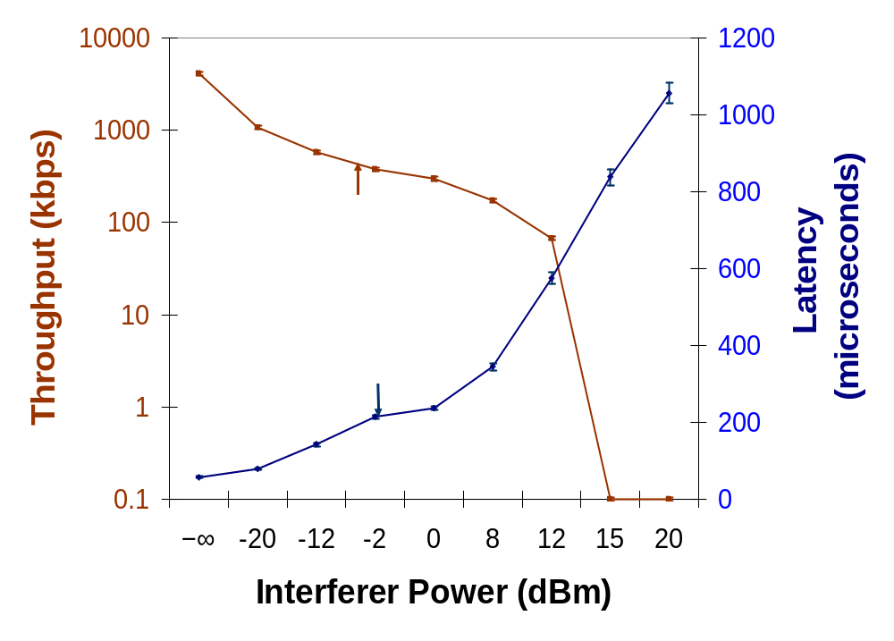
Timing recovery interference
Interferer sends continuous SYNC pattern
  Interferes with packet acquisition (PHY reception errors)
Weak interferer
Moderate
interferer
Log-scale
Notes:
We found an interferer that sends a continuous sync pattern

Slide 10
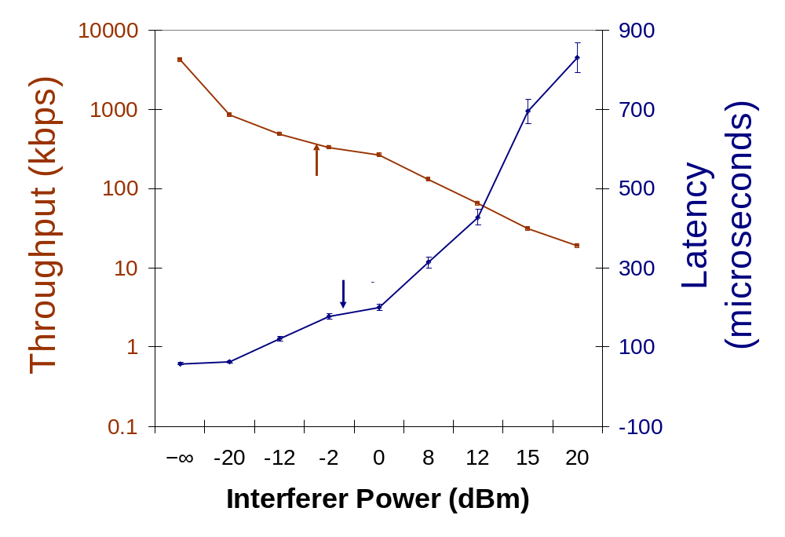
Dynamic range selection
Interferer sends on-off random patterns (5ms/1ms)
  AGC selects a low-gain amplifier that has high processing noise (packet CRC errors)
Narrow-band interferer
Notes:
udp
Drops preciptously for both narrowband and low power (e.g. -20dbm)

Slide 11
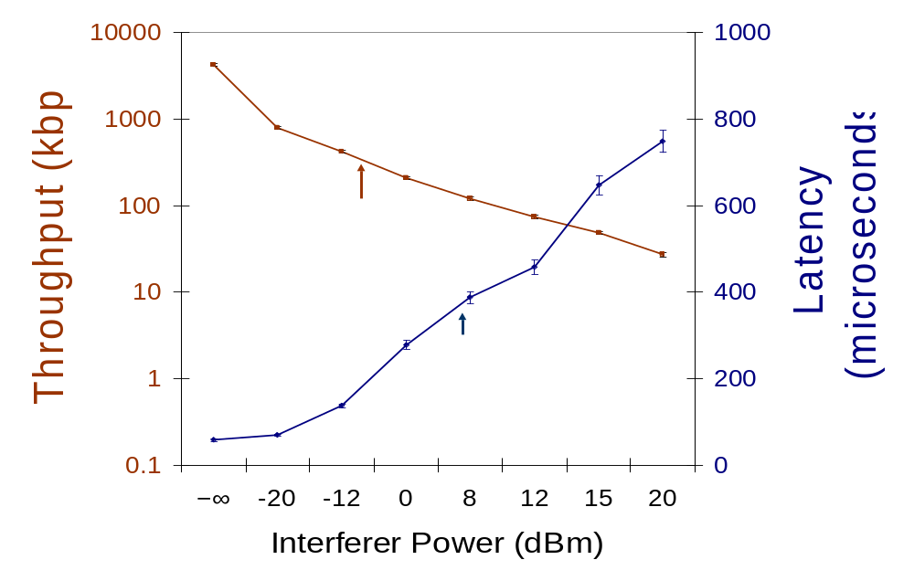
Header processing interference
Interferer sends continuous 16-bit Start Frame Delimiters
Affects PHY header processing (header CRC errors)
Unsynchronized interferer
Notes:
This interference pattern impacts the timing recovery module before the receiver has locked onto the packet, which means that typical packet processing improvements such as spread-spectrum gains or packet capture are ineffective.

Slide 12
Interference mitigation options
Lower the bit rate
Decrease the packet size
Choose a different modulation scheme
Leverage multipath (802.11n)
Move to a clear channel

Slide 13
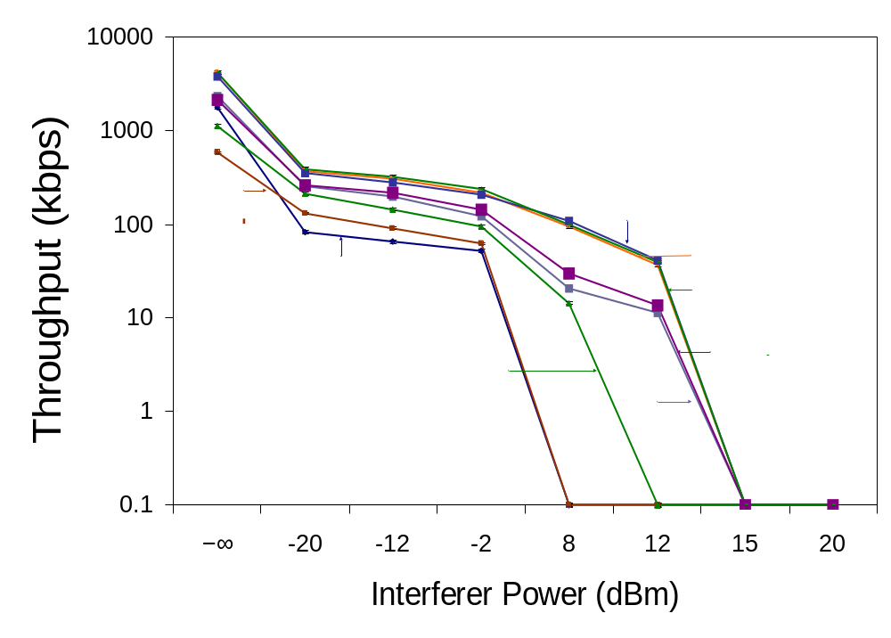
Impact of 802.11 parameters
Rate adaptation, packet sizes, FEC, and varying CCA parameters do not help
With and without FEC
Changing CCA mode
Rate adaptation
Changing packet size
Notes:
FEC doesn’t help because the additional coding gain of 4dB or so doesn’t offset the 30dB or more of loss caused by affecting the AGC. We next show bit-rate adaptation performance. The previous results showed performance of the lowest-rate (1Mbps) 802.11b, so using faster bit rates doesn’t help. CCA doesn’t help because the bad throughput is because of losses, not deferrals. Finally, changing the packet size only provides an SINR gain of at most 4dB or so, which isn’t enough to offset the losses caused by interfering with the AGC.

Slide 14
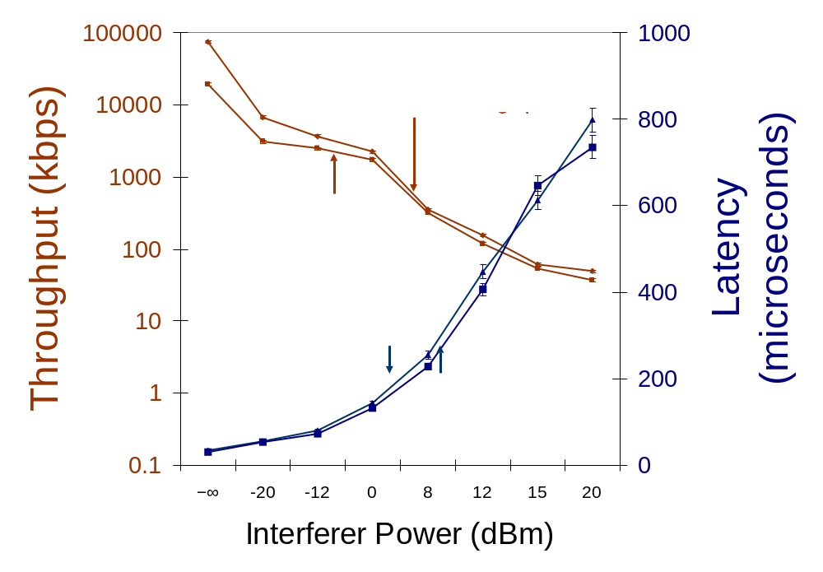
Impact of 802.11g/n
No significant performance improvement
High throughputs without interference
Significant drops with weak interferer

Slide 15
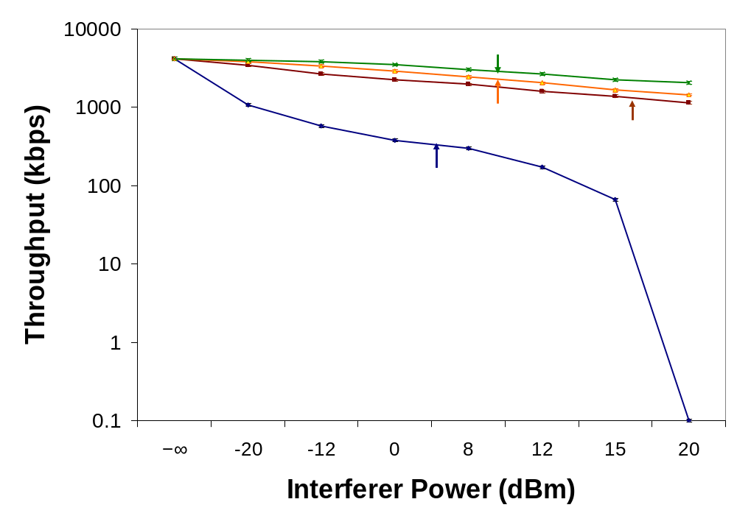
Impact of frequency separation
But, even small frequency separation (i.e., adjacent 802.11 channel) helps
  Channel hopping to mitigate interference?
5MHz separation
(good performance)
Notes:
Being slightly off channel can improve throughput significantly

Slide 16
Talk organization
Characterizing the impact of interference
Tolerating interference today

Slide 17
Rapid channel hopping
Use existing hardware
  Design dictated by radio PHY and MAC properties (synchronization, scanning, and switching latencies)
Design must accommodate adversarial and natural interference → channel hopping
  Test with an oracle-based adversary
Design overview
  Packet loss during switching + adversary’s search speed → 10ms dwell period
  Next hop is determined using a secure hash chain
  Triggered only when heavy packet loss is detected
Notes:
Guarding against observed interference, pick an idle channel. We want to design our system to withstand worst-case adversarial attack. This would be for someone to follow you.

Slide 18
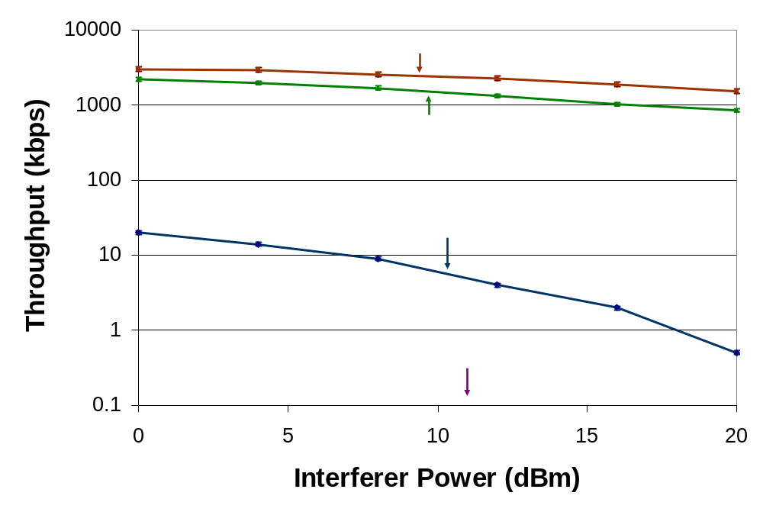
Evaluation of channel hopping
Good TCP & UDP performance, low loss rate
Weak interference,
17% degradation
Moderate interference,
1Mbps throughput

Slide 19
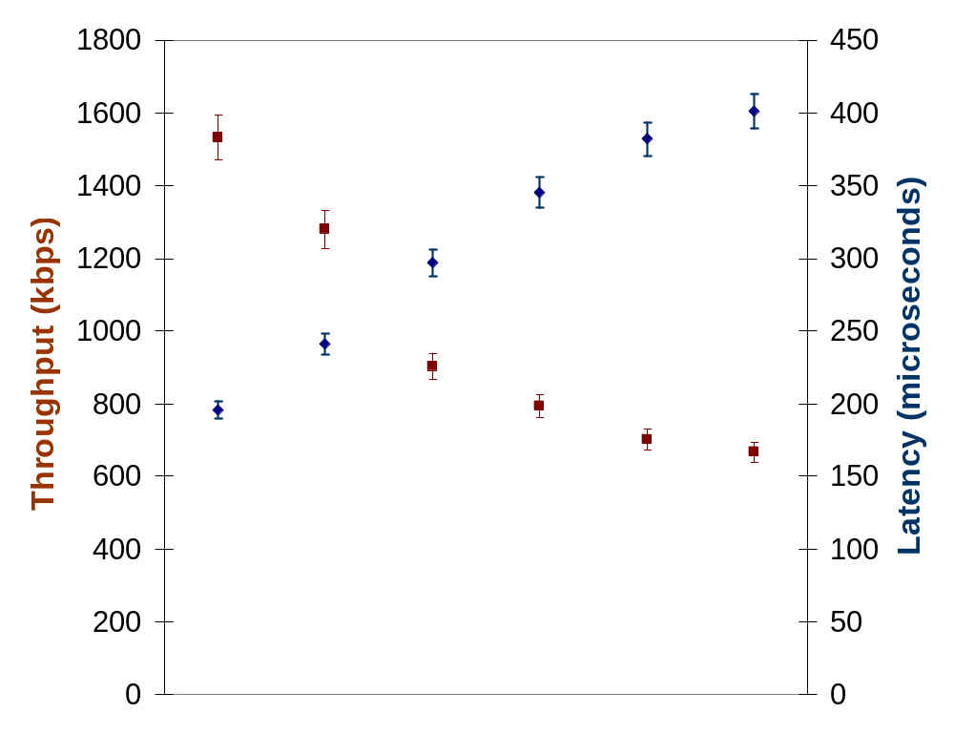


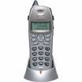
Evaluation of channel hopping
Acceptable throughput even with multiple interferers
Three orthogonal
802.11 interferers
Linear scale
Interferers

Slide 20
Conclusions
Lot of previous work on RF interference
  We show 802.11 NICs have additional PHY and MAC fragilities
Interference causes substantial degradation in commodity NICs
  Even weak and narrow-band interferers are surprisingly effective
Changing 802.11 parameters does not mitigate interference, but rapid channel hopping can

Slide 21
Thanks!
Questions? ramki@csail.mit.edu

Slide 22
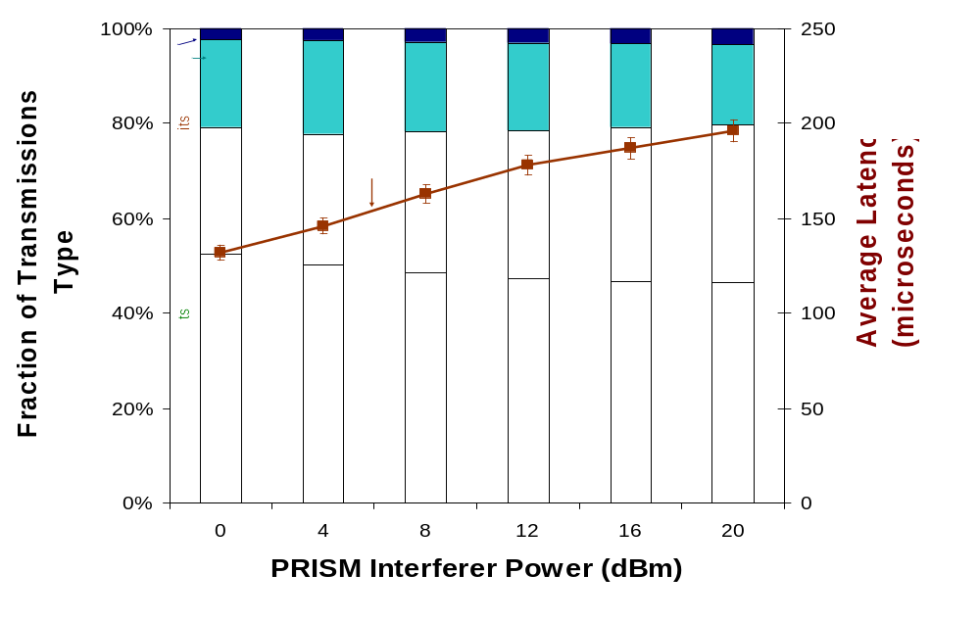
Channel hopping performance breakdown
Few losses, low multiple retransmits

Slide 23
Related work
RF interference and jamming (narrow-band jamming, demodulator interference)
  We expose additional vulnerabilities in receive path
802.11 DoS (e.g., CCA, association, and authentication attacks)
  We target PHY instead of MAC
Slow channel hopping (e.g., SSCH, MAXchop, 802.11 FH)
  Rapid channel hopping uses both direct-sequence and frequency hopping to tolerate agile adversaries

Slide 24

Evaluation Setup
CP
P3
C3
AP
Z
P2
C2
C1
J
P1

Slide 25
