Slide 1
Tryst: The Case for Confidential Service Discovery
Jeffrey Pang
CMU
Ben Greenstein
Intel Research
Damon McCoy
University of Colorado
Srinivasan Seshan
CMU
David Wetherall
University of Washington, Intel Research
Notes:
I’m Jeff Pang and today I’ll be discussing local service discovery. In particular, I will show why we want to make it confidential and how we can do so with a system we built called tryst. This is joint work with Ben Greenstein, Damon McCoy, my advisor Srini Seshan, and David Wetherall and was carried out while I was an intern at Intel Research in Seattle.

Slide 2
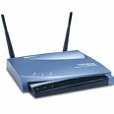



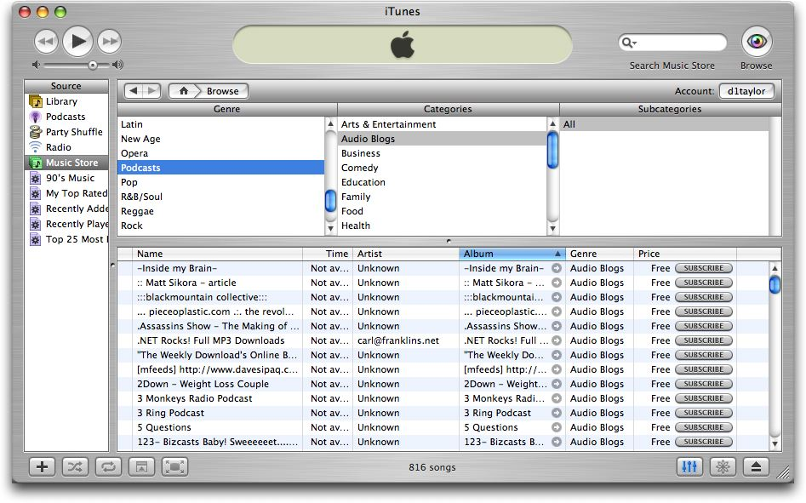




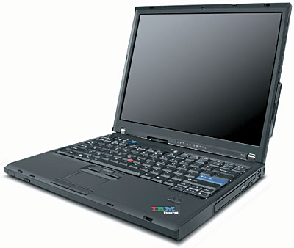
Local service discovery (SD)
Used to find:
802.11 networks
consumer electronics
local services
other applications
Notes:
Local service discovery is the process by which clients find services that are in close proximity. For example, when your laptop enters a new area, it probably wants to find online connectivity. To do so, it uses local service discovery to find a nearby wifi access point. But service discovery is used to discover many other types of local services as well. For example, it is used to discover local printers. Other consumer electronics nearby, such as portable game stations. And applications such as iTunes use service discovery to discover other instances of the application on nearby computers.
This discovery process most often proceeds automatically without user intervention so that connecting devices together does not require cumbersome configuration.

Slide 3

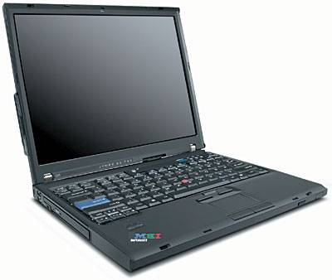



How SD is done today
iTunes “Bob” is here
Is iTunes “Bob” here?
Connect to “Bob”
“Bob” is here
Services send announcements and/or clients send probes
(typically via unencrypted broadcast)
Important properties:
Plug-and-play networking
  Can proceed automatically without user input
Disconnected operation
  Requires only communication medium between client and service

Slide 4

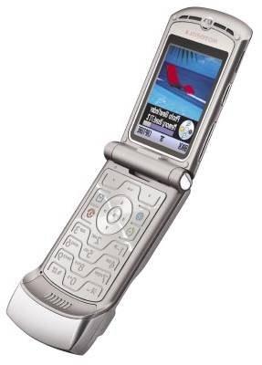
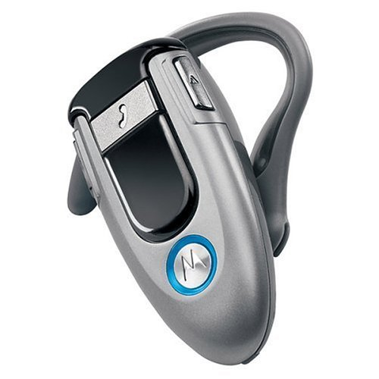

Problem 1: SD reveals inventory
Phone
here
The devices I have
  Problem: “Phone pirates in seek and steal mission”
  [Cambridge Evening News 2005]
The applications I am running
  Problem: “Apple Mac OS X mDNSResponder buffer overflow vulnerability” [CERT 2007]
iTunes here
exploit
Notes:
Announcements reveal information that can pose security and privacy concerns. First, devices that announce their existence reveal information about a person’s inventory. For example, it can reveal the devices present in a particular area. This can be problematic because we may not want to expose this information to everyone. For example, it has been reported that cell phone pirates have targeted cars with cell phones that announce their presence via bluetooth. But announcements not only reveal devices, but also the applications a device may be running. For example, if you were using iTunes or iChat, your device might announce that it is running those services. However, a buffer overflow was recently discovered in the service that performs these announcements. Thus, these announcements can allow hackers to target your machine.

Slide 5
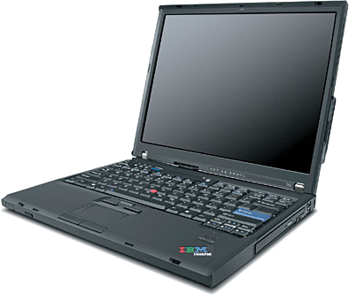
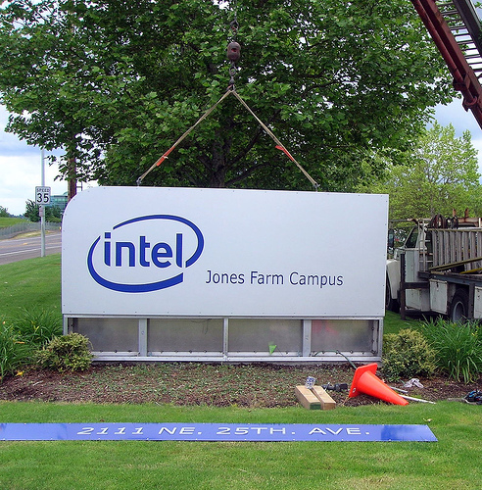

Problem 2: SD reveals identity
Announcements expose explicit identifiers
  Problem: Some services are private and want to be hidden
  Problem: Mobile “services” vulnerable to tracking
iTunes “Intel Bob” is here
iTunes “Intel Bob” is here
Why is Bob
over there?

Slide 6
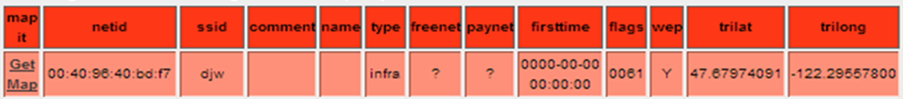
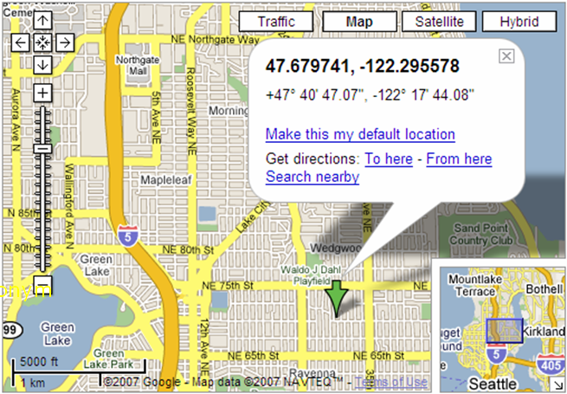


Problem 3: SD reveals history
Probes can reveal services you have used
  Problem: Network names can be correlated with location (e.g., using a wardriving database)
http://www.wigle.net
Is 802.11 network “djw” here?
Notes:
Probing can reveal information about your service history because your devices often send probes for services that you have used before. This information can be used to figure out where you have been before. For example, if you looked at the probes my laptop sent, you would observe that it probes for this particular network name, which happens to be my home network. If you look this name up in a war driving database, you would find that someone else has observed this name at another location. By looking at Google maps, we find that this location actually is where I used to live.

Slide 7


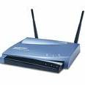


Problem 4: SD is not authenticated
Is “Alice’s Network” here?
“Alice’s Network” is here
Prove I am “Alice” (e.g., credential)
Associate
Prove I am “Alice’s Network”
Association denied
Association succeeded
Authentication occurs only after SD
  Problem: Anyone can elicit a response, even if they are not trusted to access the service

Slide 8


Solution requirements
inventory
identity
history
iTunes “Bob” is here
Is iTunes “Bob” here?
Connect to “Bob”
“Bob” is here
Desired properties:
Confidentiality
  Hide contents that reveals type
  Hide sender
  Hide intended recipients
Authenticity
  Offer proof of identity
Challenges:
  Exposing information only to trusted clients/services
  Clients and services may want to hide from third parties
  Plug-and-play networking, disconnected operation

Slide 9








A public key protocol
Based on [Abadi ’04]
Client
Service
Probe “Alice”
Check signature:
K_{Bob}
timestamp
Sign:
K⁻¹_{Bob}
K_{Alice}
K⁻¹_{Alice}
Key-private encryption
(e.g., ElGamal but not RSA)
Try to decrypt

Slide 10
Problems
Must obtain public keys for new services/clients
  May be disconnected during discovery
  Don’t want to involve extra user action
Must try to decrypt every message
  Public key decryption is slow (>100ms on typical AP)
  ⇒ adds jitter to relaying of other messages
  168x slower than 802.11 line-rate even on laptops
  ⇒ susceptible to low-rate denial-of-service attacks

Slide 11
Observations
Must obtain public keys for new services/clients
  Will have some relationship with those we trust
  Can trust new services/clients in trusted domains
Must try to decrypt every message

Slide 12


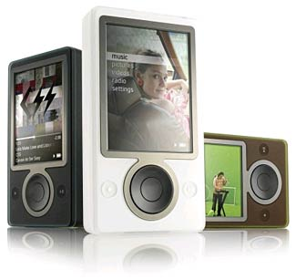




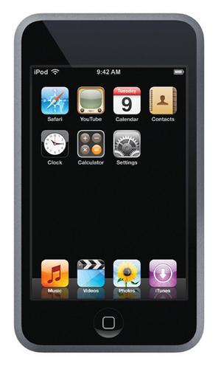


Tryst: key establishment
“bob@gmail.com/laptop”
“alice@mac.com/laptop”
“bob@gmail.com/psp”
Trusted
“alice@mac.com/ds”
“bob@gmail.com/zune”
Trusts:
alice@mac.com
Encrypt(public key=“alice@mac.com/ipod”, message)
Key provider
preloads devices
?
=
private key
Anonymous Identity Based Encryption

Slide 13
Observations
Must obtain public keys for new services/clients
  Will have some relationship with those we trust
  Can trust new services/clients in trusted domains
Must try to decrypt every message
  Common case is to rediscover known services
  Can negotiate a secret symmetric key the first time

Slide 14

Tryst: a symmetric key protocol
Client
Service
Check MAC:
K_{Shared}
Probe “Alice”
timestamp
MAC:
K_{Shared}
K_{Shared1}
K_{Shared2}
K_{Shared3}
…
K_{Shared}
Try to
decrypt
with each
shared key
Symmetric encryption
(e.g., AES)

Slide 15
Observations
Must obtain public keys for new services/clients
  Will have some relationship with those we trust
  Can trust new services/clients in trusted domains
Must try to decrypt every message
  Common case is to rediscover known services
  Can negotiate a secret symmetric key the first time
  Linkability at short timescales is usually OK
  Can use temporary unlinkable addresses

Slide 16
Tryst: a symmetric key protocol
Client
Service
Check MAC:
K_{Shared}
Probe “Alice”
timestamp
MAC:
K_{Shared}
K_{Shared1}
K_{Shared}
K_{Shared2}
K_{Shared3}
…
A_{T}
K_{Shared}
Try to
decrypt
with each
shared key
A_{T}
Lookup A_{T} in a
table to get K_{Shared}
Symmetric encryption
(e.g., AES)
K_{Shared}
K_{Shared}
…
…
A₀
A_{T-1}
Hash()
A_{T}
Hash()
A_{T+1}
secret

Slide 17
Conclusions
Ubiquitous clients and services may want privacy
Service discovery exposes inventory, identity, and history
Tryst helps enable confidential service discovery
Outstanding challenges
  Hiding other side channels (physical layer, message timing, size)
  Other mechanisms to automatically establish keys
  More efficient broadcast probes

Slide 18
Backup Slides

Slide 19
Other key establishment methods
Certificates (e.g., secure websites)
  Neither client nor service can offer certificate first!
Pairing (e.g., Bluetooth peripherals)
  Can not always physically identify service
  User must perform discovery before device does!
Discovery is also used to find unknown services
  We want to automatically expand the trust horizon
  Tryst mechanisms:
    New services in trusted domains
    New services trusted transitively

Slide 20
Anonymous identity based encryption
[Boneh & Franklin ’01]
PublicParams, MasterSecret = Setup ()
ciphertext = Encrypt (K_{AliceiPod}, PublicParams, plaintext)
plaintext = Decrypt (K⁻¹_{AliceiPod}, PublicParams, ciphertext)
publicly published
known only by key provider
=
“alice@mac.com/ipod”
=
Extract(“alice@mac.com/ipod”, MasterSecret)
Some assumptions over traditional public key crypto
  Alice and Bob trust key provider not to reveal secret keys to third parties
    Can instead trust that no t of n providers collude (use threshold crypto)
    May also be able act as their own key providers (anonymity unproven)
  Revoking my public key implies changing my identity since identity = key
    Can instead use temporary identities (“alice@mac.com/ipod.nov.2007”)
Only need to use protocol until first discovery

Slide 21


Tryst: key establishment
x
Trusted
x
?
x
To “alice”
Strawman Solution

Slide 22
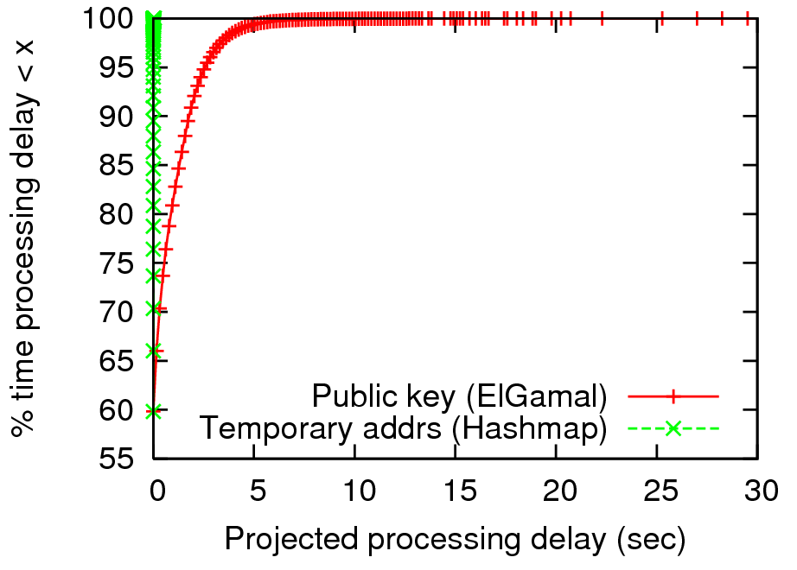
Projected probe processing delay
Rough simulation
based on:
SIGCOMM 2004
(wifi probes)
Soekris “AP”
(265Mhz Geode)
GnuPG crypto
(~150ms/pkt)

Slide 23
Protocol message volume
Each message encrypted for one recipient
⇒ As many messages as intended recipients
  Typically OK: E.G., 90% of WiFi clients probe for fewer than 12 unique network names [OSDI 2006 WiFi trace]
Future work:
  Efficient protocol to broadcast probes to many recipients

Slide 24
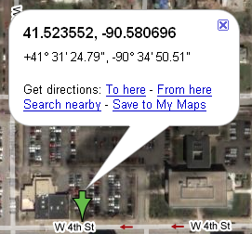
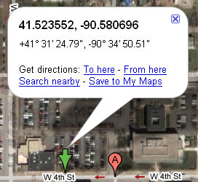

Key problem: messages can be linked
Consistent naming enable correlation of SD messages
Opaque names prevent some problems…
but not all:
  Example: location can be correlated with other databases
010294859
Is “Juvenile Detention Classroom” here?
Is “010294859” here?

Slide 25
Related work
SmokeScreen [Cox ‘07] – access control for discovering friends
  Similar to symmetric key protocol
  Uses online social network to exchange secret keys
SSDS [Czerwinski ‘00] – secure service discovery architecture
  Relies on trusted infrastructure
  Not necessarily confidential
Broadcast Encryption [Fiat ‘93] – encrypt message to many users
  Making this private is an open problem
JFK [Aiello ‘93] – efficient Internet key exchange
  No service privacy …
  … or not resilient to man-in-the-middle attacks

Slide 26
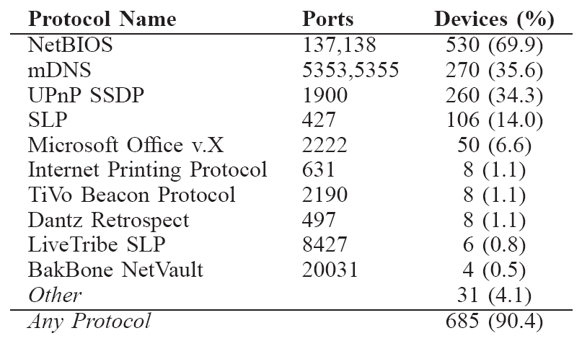
SD is widely used
Example 1:
Application
Protocols
(OSDI 2006)
Example 2: 85% devices send WiFi discovery probes
(SIGCOMM 2004)
Notes:
There are many discovery protocols, but the discovery mechanism itself is widely used. For example, …. In a second example, we observe….

Slide 27
Problem 3: SD reveals history
Probes can reveal services you have used
  Problem: Network names can be correlated with location (e.g., using a wardriving database)
23% of devices at SIGCOMM 2004 probed
for an name that WiGLE isolates to one city
All 4 known home networks located to
within 2 blocks
Notes:
We have evidence to suggest that you can use network names in probes to find out where many people have been before. For example, …

Slide 28
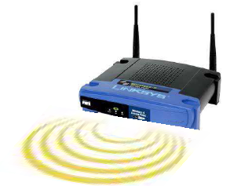
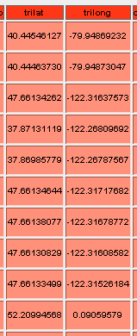
Problem 5: SD reveals location
The fact that my service is present
  Problem: Common practice to
  disable WiFi annoucements to
  (try to) hide access points
  [O’Reilly 802.11 Guide]
Where my service is located
  Problem: Knowledge of network
  name at one site can tell you
  where other sites are
  [WiGLE Wardriving Database]
x
IR_Guest
Pittsburgh
Seattle
Berkeley
Cambridge
Notes:
Announcements also reveal information about service location. Obviously, and announcement reveals that your service is “present” at a location but this is not always desirable because not all services are public. For example, your home network is probably not meant to be known by everyone. In fact, many people disable announcements on wireless access points to try to hide their networks and make them more difficult to attack.
In addition to service presence, announcements can help an adversary find an organization’s other locations. For example, if you went to the Intel Pittsburgh lab you would be able to see that their network name is IR_Guest. Thus, if you see this name announced elsewhere, you would be able to infer that Intel also has a lab there. In fact, you can just look this name up in a public wardriving database such as wigle, which lists locations where other people have observed network names before, and you will find the locations of all of Intel’s research labs. Although Intel’s locations are not private information, you can imagine that some organizations would rather keep their locations secret.

Slide 29
Problem 6: SD reveals social contacts
Emerging social devices also offer “services”
  Microsoft Zune: music sharing service
  PSP, Nintendo DS: multiplayer gaming service
Service discovery exposes social contacts
Notes:
We believe that these examples of privacy threats are only the tip of the iceberg because there are many uses of service discovery that are just emerging. For example…

Slide 30


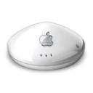
New services transitively trusted
Find networks
that Alice trusts
“Alice’s Home”
Transitive
Trust
Alice’s secret
Alice’s secret
Alice trusts
bob.laptop
Trust
Alice trusts
“Alice’s Home”
Attestation
Notes:
Another way we might want to automatically expand our trust horizon is by extending trust transitively. For example.

Slide 31
Old Slides

Slide 32
Tryst: key establishment
“bob.laptop”
“alice.laptop”
“bob.psp”
Trusted
“alice.ds”
“bob.zune”
Trusts:
alice@mac.com
params_{mac.com}
params_{mac.com}
params_{mac.com}
params_{mac.com}
Encrypt(params_{mac.com}, key=“alice.ipod”, message)
Provider mac.com
preloads devices
?
=
Anonymous Identity Based Encryption

Slide 33


Public Key Protocol
Existing theoretical public key protocol [Abadi ’04]
“Is Alice’s Laptop here?”
“Bob to Alice at time T”
Service Discovery
Message
K⁻¹_{Bob}
K_{Alice}
Digital signature with Bob’s private key (e.g., RSA, DSA)
Identity-hiding encryption with Alice’s public key (e.g., ElGamal)
Notes:
We note that there is existing theoretical work in a public key protocol that achieves what we want. To illustrate, consider what happens when bob’s laptop wants to discover alice’s laptop.

Slide 34
Public Key Protocol
Existing theoretical public key protocol [Abadi ’04]
???
K⁻¹_{Alice}
Decrypt with Alice’s private key
“Bob to Alice at time T”
Service Discovery
Message
K⁻¹_{Bob}
K_{Bob}
Verify with Bob’s public key

Slide 35
Symmetric Key Protocol
“Bob to Alice at time T”
Service Discovery
Message
K_{Shared}
K_{Shared}
Message authentication code with Alice and Bob’s shared key
(e.g., AES-CMAC)
Identity-hiding encryption Alice and Bob’s shared key (e.g., AES)

Slide 36
Symmetric Key Protocol
A_{T} = address at time T
“Bob to Alice at time T”
Service Discovery
Message
K_{Shared}
K_{Shared}
secret
K_{Shared}
K_{Shared}
…
…
A₀
A_{T-1}
Hash()
A_{T}
Hash()
A_{T+1}
Random hash function (e.g., HMAC-SHA1)

