Slide 1
802.11 User Fingerprinting
Jeffrey Pang¹ Ben Greenstein² Ramakrishna Gummadi³ Srinivasan Seshan¹ David Wetherall^{2,4}
¹CMU ²Intel Research Seattle ³USC,MIT ⁴University of Washington

Slide 2

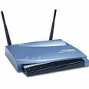
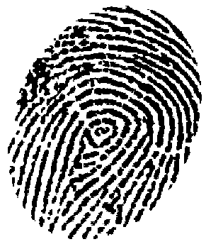
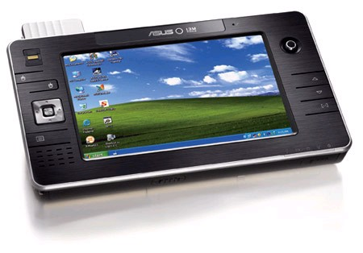
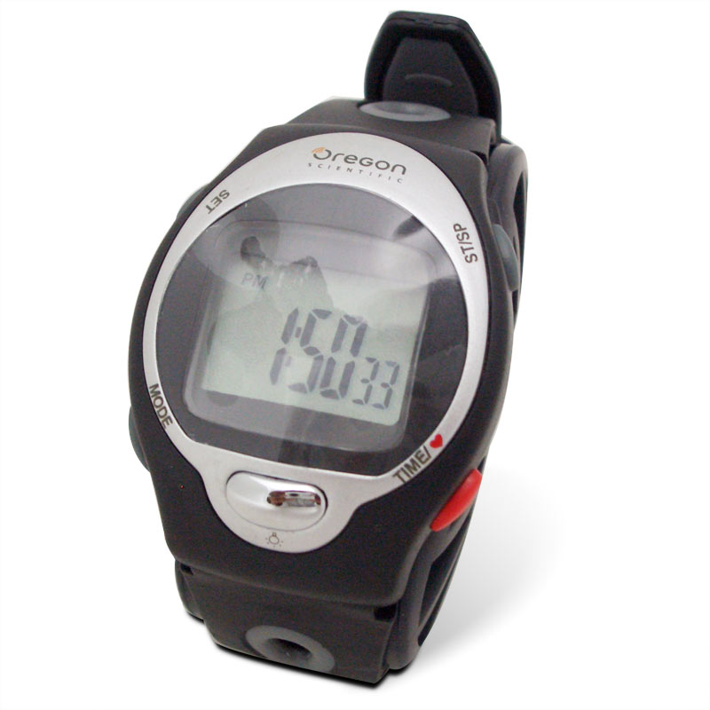
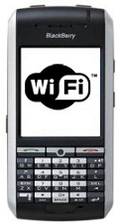
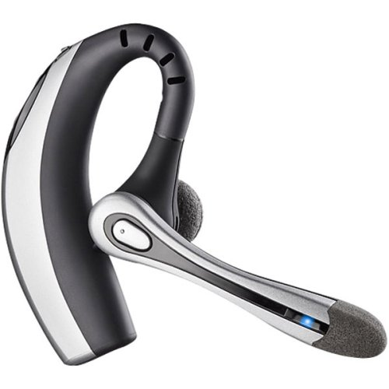
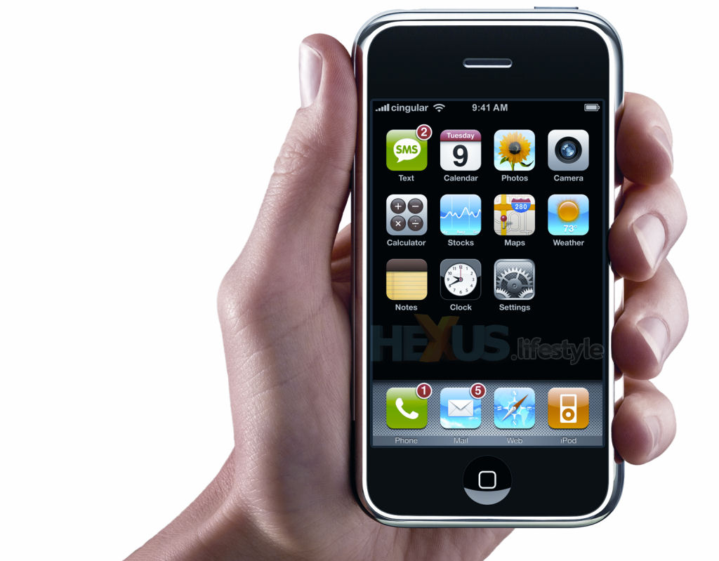

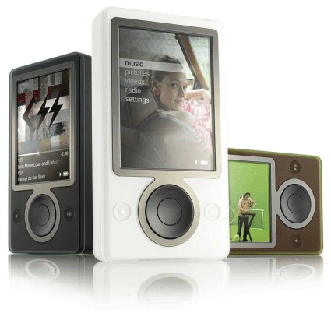
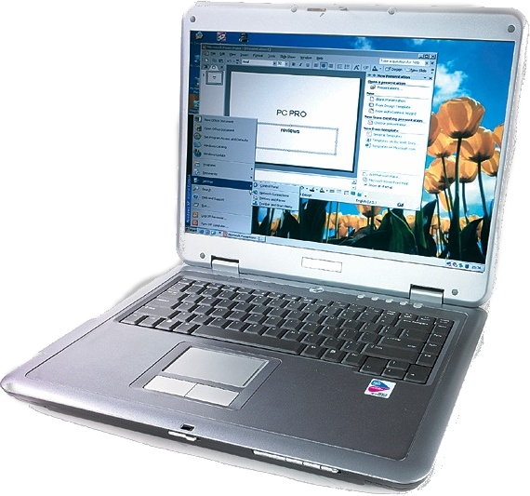
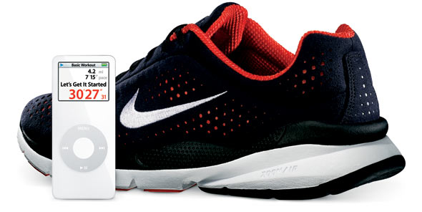
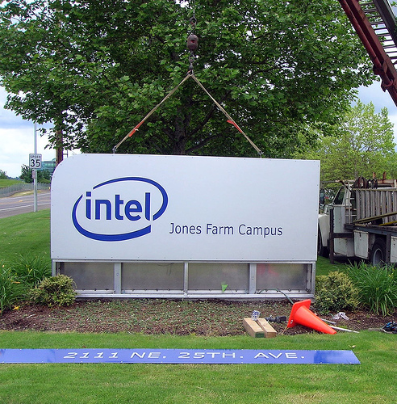
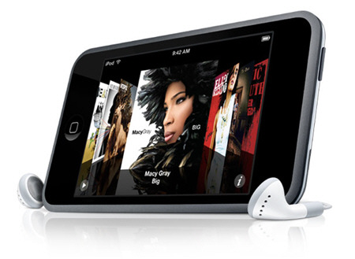

Motivation: The Mobile Wireless Landscape
“Bob@Intel”
“Bob@Intel”
Why is Bob
over there?
They leave “digital fingerprints” that reveal who we are
  And thus where we’ve been
Notes:
Say dependence on wireless is growing and information conveyed is more personal

Slide 3
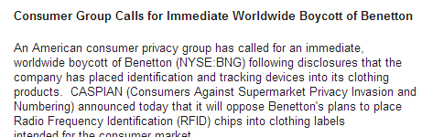
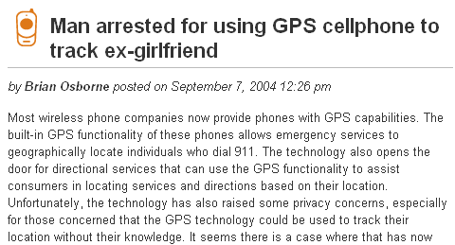
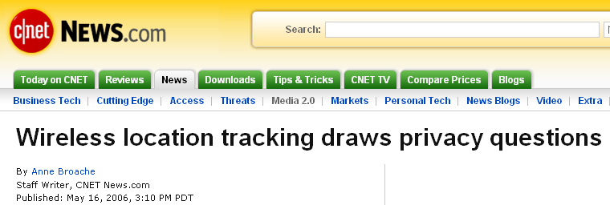

Motivation: The Mobile Wireless Landscape
Location privacy is growing concern
  Wireless Privacy Protection Act [U.S. House Bill ‘05]
  Geographic location/privacy working group [IETF]

Slide 4
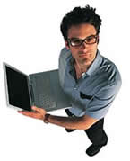
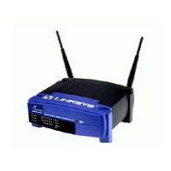
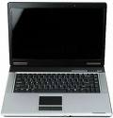
Motivation: The Mobile Wireless Landscape
A well known technical problem
  Devices have unique and consistent addresses
  e.g., 802.11 devices have MAC addresses
  ➔ fingerprinting them is trivial!
MAC address now:
00:0E:35:CE:1F:59
MAC address later:
00:0E:35:CE:1F:59
tcpdump
tcpdump
Adversary
time

Slide 5

Motivation: The Mobile Wireless Landscape
The widely proposed techical solution
  Pseudonyms: Change addresses over time
    802.11: Gruteser ’05, Hu ’06, Jiang ’07
    Bluetooth: Stajano ’05
    RFID: Juels ‘04
    GSM: already employed
MAC address now:
00:0E:35:CE:1F:59
MAC address later:
00:AA:BB:CC:DD:EE
?
tcpdump
tcpdump
time

Slide 6
Motivation: The Mobile Wireless Landscape
Our work shows: Pseudonyms are not enough
  Implicit identifiers: identifying characteristics of traffic
  E.G., most users identified with 90% accuracy in hotspots
Search: “Bob’s Home Net”
Packets ⇒ Intel Email Server
…
Search: “Bob’s Home Net”
Packets ⇒ Intel Email Server
…
00:0E:35:CE:1F:59
00:AA:BB:CC:DD:EE
tcpdump
tcpdump
time

Slide 7
Contributions
Four Novel 802.11 Implicit Identifiers
Automated Identification Procedure
Evaluating Implicit Identifier Accuracy

Slide 8
Contributions
Four Novel 802.11 Implicit Identifiers
Automated Identification Procedure
Evaluating Implicit Identifier Accuracy

Slide 9

Implicit Identifiers by Example
Consider one user at SIGCOMM 2004
  Transferred 512MB via BitTorrent
    Poor network etiquette?
  Seen in a “anonymized” wireless trace
    MAC addresses hashed, effectively a pseudonym
Can we identify the culprit using implicit identifiers?
?
tcpdump

Slide 10
Implicit Identifiers by Example
Implicit identifier: SSIDs in probes
  Set of SSIDs in 802.11 probe requests
  Many 802.11 drivers search for preferred networks
  Usually networks you have associated with before
SSID Probe:
“roofnet”
?
tcpdump
User of
“roofnet”

Slide 11
Implicit Identifiers by Example
Implicit identifier: SSIDs in probes
  Set of SSIDs in 802.11 probe requests
  Many 802.11 drivers search for preferred networks
  Usually networks you have associated with before
00:0E:35:CE:1F:59
00:AA:BB:CC:DD:EE
SSID Probe:
“roofnet”
Bittorrent
transfer
?
tcpdump
tcpdump
time

Slide 12
Implicit Identifiers by Example
Implicit identifier: network destinations
  IP <address, port> pairs in network traffic
  At SIGCOMM, each visited by 1.15 users on average
  Some nearly-unique destinations repeatedly visited
  (e.g., email server)
SSH/IMAP server:
159.16.40.45
SSH/IMAP server:
159.16.40.45
?
?
tcpdump
tcpdump
time
Notes:
Nearly-unique: or destinations visited by a very small number of people and thus distinguish them from others. For example, a school email server if you were the only person from that school at SIGCOMM

Slide 13
Implicit Identifiers by Example
Implicit identifier: broadcast packet sizes
  Set of 802.11 broadcast packet sizes in network traffic
  E.g., Windows machines NetBIOS naming advertisements; FileMaker and Microsoft Office advertise themselves
Broadcast pkt sizes:
239, 245, 257
Broadcast pkt sizes:
239, 245, 257
?
tcpdump
tcpdump
time

Slide 14
Implicit Identifiers by Example
Implicit identifier: MAC protocol fields
  Header bits (e.g., power management., order)
  Supported rates
  Offered authentication algorithms
Protocol Fields:
11,4,2,1Mbps, WEP
Protocol Fields:
11,4,2,1Mbps, WEP
?
tcpdump
tcpdump
time

Slide 15

Implicit Identifier Summary
802.11 Networks: | Public | Home | Enterprise
Network destinations
SSIDs in probes
Broadcast pkt sizes
MAC protocol fields
Identifying even
if devices have
identical drivers
Visible even with
WEP/WPA TKIP
encryption
More implicit identifiers exist
  ➔ Results we present establish a lower bound

Slide 16
Fixing Implicit Identifiers is not Simple
Encryption does not prevent traffic analysis
  Cover traffic?
  Challenge: Shared medium ⇒ large performance hit
Service discovery is done in the clear
  Don’t probe?
  Challenge: Beaconing is often undesirable also
Implementation and configuration variation
  Standardize?
  Challenge: Ambiguity of specifications

Slide 17
Contributions
Four Novel 802.11 Implicit Identifiers
Automated Identification Procedure
Evaluating Implicit Identifier Accuracy

Slide 18
Tracking 802.11 Users
Many potential tracking applications:
  Was user X here today?
  Where was user X today?
  What traffic is from user X?
  When was user X here?
  Etc.
Notes:
Verbiage: to show that these implicit identifiers can be used to track not just this “roofnet” user, we developed an automated method to track any user using implicit identifiers. Any adversary that wishes to track a target user X can use this method.

Slide 19





Tracking 802.11 Users
Tracking scenario:
  Every users changes pseudonyms every hour
  Adversary monitors some locations
  One hourly traffic sample from each user in each location
.....
?
?
?
?
tcpdump
?
?
tcpdump
Build a profile from training samples:
First collect some traffic known to be
from user X and from random others
Traffic at 2-3PM
Then classify
observation samples
Traffic at 2-3PM
Traffic at 2-3PM
Traffic at 3-4PM
Traffic at 3-4PM
Traffic at 3-4PM
Traffic at 4-5PM
Traffic at 4-5PM
Traffic at 4-5PM

Slide 20
Sample Classification Algorithm
Core question:
  Did traffic sample s come from user X?
A simple approach: naïve Bayes classifier
  Derive probabilistic model from training samples
  Given s with features F, answer “yes” if:
  Pr[ s from user X | s has features F ] > T
  for a selected threshold T.
  F = feature set derived from implicit identifiers
Notes:
Verbiage: In our paper, we show that an adversary can pick an appropriate threshold T using training samples. I omit this now for brevity.

Slide 21
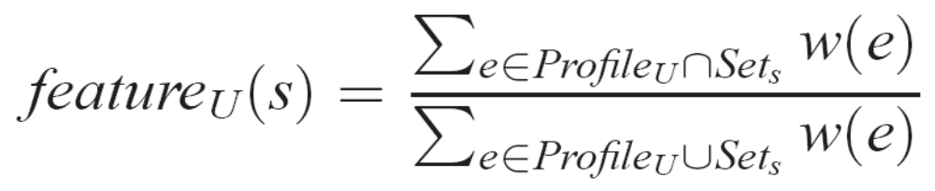
Sample Classification Algorithm
Deriving features F from implicit identifiers
  Set similarity (Jaccard Index), weighted by frequency:
Rare
djw
w(e) = high
linksys
IR_Guest
SIGCOMM_1
Common
w(e) = low
PROFILE FROM
TRAINING
SAMPLE FROM
OBSERVATION
Notes:
Note that this feature is a real-valued ratio (and thus is continuous). Therefore, we estimate its probability distributions from the training data using standard density estimation.

Slide 22
Contributions
Four Novel 802.11 Implicit Identifiers
Automated Identification Procedure
Evaluating Implicit Identifier Accuracy

Slide 23
Evaluating Classification Effectiveness
Simulate tracking scenario with wireless traces:
  Split each trace into training and observation phases
  Simulate pseudonym changes for each user X
 | Duration | Profiled Users | Total Users
SIGCOMM conf. (2004) | 4 days | 377 | 465
UCSD office building (2006) | 1 day | 153 | 615
Apartment building (2006) | 14 days | 39 | 196

Slide 24
Evaluating Classification Effectiveness
Question: Is observation sample s from user X?
Evaluation metrics:
  True positive rate (TPR)
  Fraction of user X’s samples classified correctly
  False positive rate (FPR)
  Fraction of other samples classified incorrectly
= ???
Measure TPR
= 0.01
Fix T for FPR
(See paper)
Pr[ s from user X | s has features F ] > T
Notes:
Verbiage: we note that ad adversary can lower the FPR by increasing the classification threshold at the cost of TPR. E.G., this graph shows the tradeoff for the MAC protocol fields feature. We assume that the adversary wants a low FPR (= 1%) and show the TPR that they can achieve.

Slide 25
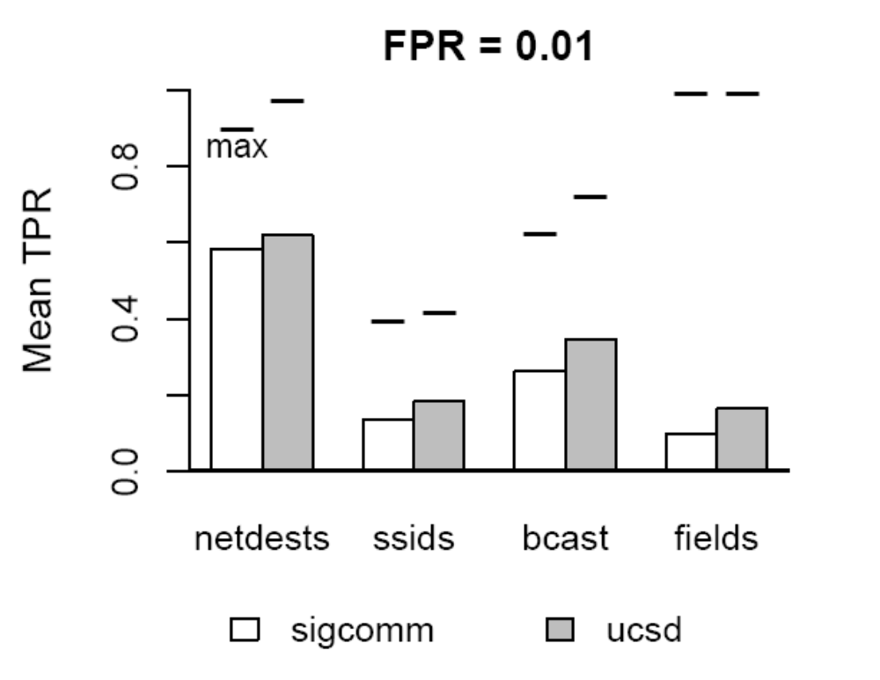
Results: Individual Feature Accuracy
1.0
TPR ≈ 60%
TPR ≈ 30%
Individual implicit identifiers give evidence of identity

Slide 26
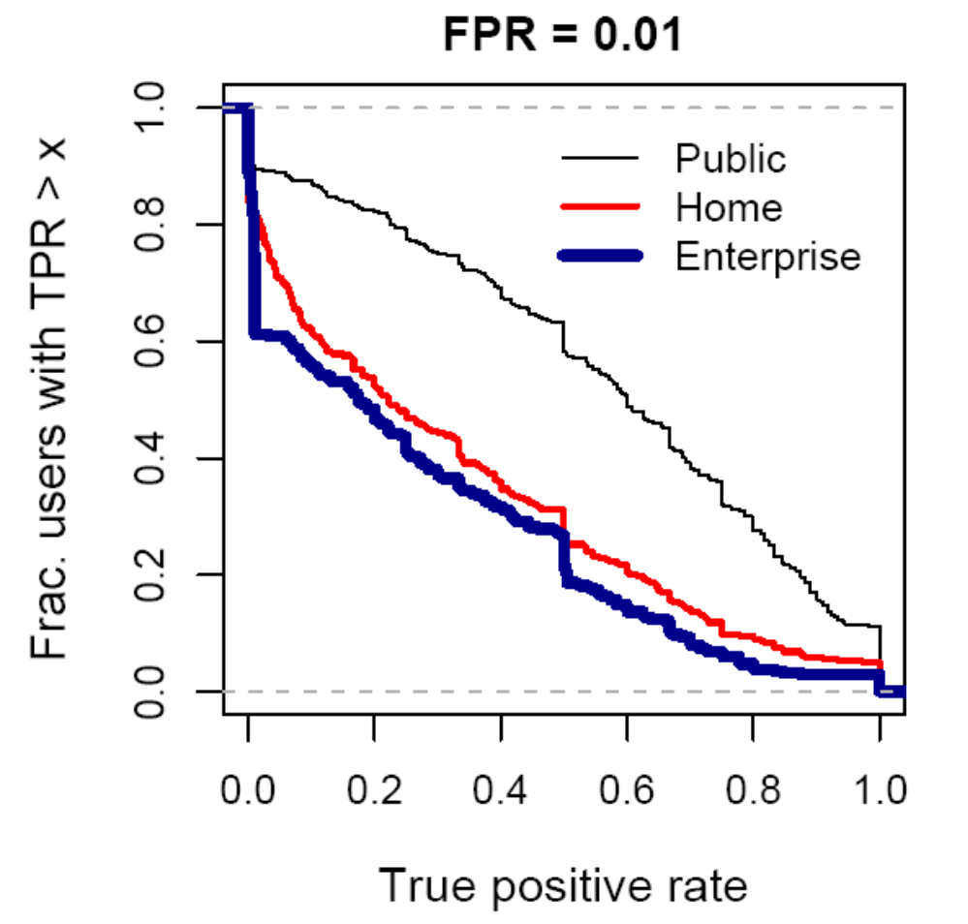
Results: Multiple Feature Accuracy
Users with TPR >50%:
Public: 63%
Home: 31%
Enterprise: 27%
 | Public | Home | Enterprise
netdests
ssids
bcast
fields
  We can identify many users in all environments

Slide 27
Results: Multiple Feature Accuracy
Public networks:
~20% users identified
>90% of the time
 | Public | Home | Enterprise
netdests
ssids
bcast
fields
  Some users much more distinguishable than others

Slide 28
One Application
Question: Was user X here today?
More difficult to answer:
  Suppose N users present each hour
  Over an 8 hour day, 8N opportunities to misclassify
  Decide user X is here only if multiple samples are classified as his
Revised: Was user X here today for a few hours?

Slide 29
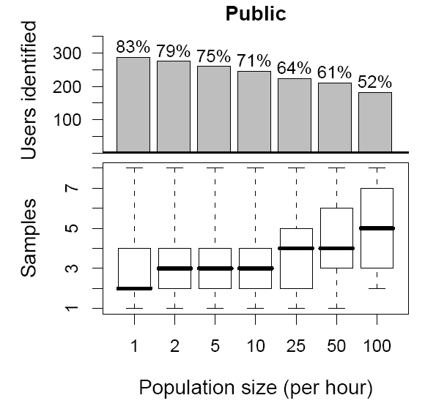

Results: Tracking with 90% Accuracy
Of 268 users (71%):
75% identified with ≤4 samples
50% identified with ≤3 samples
25% identified with ≤2 samples
  Majority of users can be identified if active long enough
Notes:
Xxx: need some example point text and animate graph (multiple steps) so it is easier to understand. Some conclusion at bottom of slide

Slide 30
Conclusions
Implicit identifiers can accurately identify users
  Individual implicit identifiers give evidence of identity
  We can identify many users in all environments
  Some users much more distinguishable than others
Understanding implicit identifiers is important
  Pseudonyms are not enough
  We establish a lower bound on their accuracy
Eliminating them poses research challenges
  Current work: Confidential service discovery
  Current work: Traffic analysis resistant MAC

Slide 31
Extra Slides

Slide 32
Related Work
Other Implicit Identifiers
  Device driver fingerprints [Franklin ’06]
  Clock-skew fingerprints [Kohno ’05]
  Click-prints [Padmanabhan ’06]
  RF antenna fingerprints [Hall ’04]
Our work:
  802.11 fingerprints for individual users
  Tracking with only commodity hardware/software
  Better coverage than some previous work
  Procedure to combine implicit identifiers

Slide 33
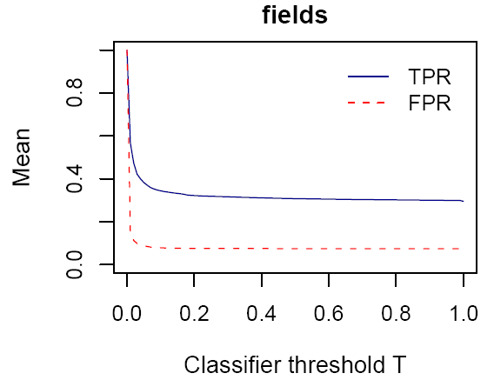
Evaluating Classification Effectiveness
Notes:
Verbiage: we note that ad adversary can lower the FPR by increasing the classification threshold at the cost of TPR. E.G., this graph shows the tradeoff for the MAC protocol fields feature. We assume that the adversary wants a low FPR (= 1%) and show the TPR that they can achieve.

Slide 34
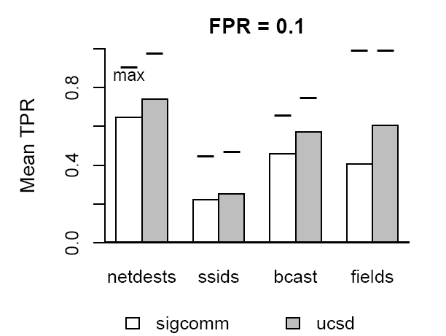
Results: Individual Feature Accuracy
TPR ≈ 50%
Individual implicit identifiers give evidence of identity
Other implicit identifiers distinguish groups of users

Slide 35
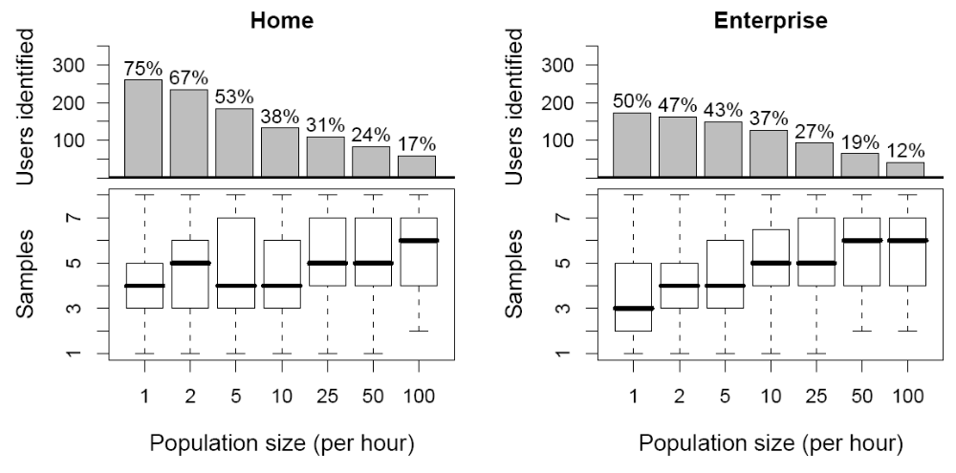
Results: Tracking with 90% Accuracy
  Many users can be identified in all environments

Slide 36
Old Slides

Slide 37
Answers to Common Questions
Is tracking accuracy good enough to track an entire city/how does it vary with population size?
  Our accuracy results aren’t good enough to allow fine-grained tracking of most users in environments with more than 100s of users because the adversary will simply obtain too many samples and have too many opportunities for false positives. However, we note that by modifying the question a little, such as “was this person here for x hours, where x is reasonably large, such as a couple days” or “was this person here in this specific area with smaller population in the sub-100s”, we can answer it fairly accurately.
Your traces were only over a couple days, why would one expect fingerprints to remain identifying over longer periods of time?
  You are correct and we can’t say anything empirical for longer term tracking. However, we suspect that the implicit identifiers would remain identifying because they are mostly caused by automatic behavior of drivers and applications and thus wouldn’t change due to human behavior or location. In the paper we show that ssids are stable over weeks at least for example.
Do you think people really care about location privacy?
  I think that people don’t care until they realize that they have a problem and then they do (e.g., the article about a guy tracking his ex-girlfriend). One magnifying factor is that because of the low cost of 802.11 radios and the ubiquity of 802.11 in devices, almost anyone can easily monitor some locations and track users of interest.
Don’t you think people could modify their behavior in order not to be as identifying when they want to be private?
  Sure; if they had the technical knowledge to do so, they could easily modify their behavior to “look different” and leave a different implicit fingerprint. However, I would argue that this is undesirable because it means that privacy concerns have a chilling effect on the types of act ivies we are willing to do thus limiting the wireless applications. I think the protocols themselves should protect us enough so that we don’t have to worry about these things.
What about wireless protocols other than 802.11?
  I believe many of the implicit identifiers still exist, for the reason that the fundamental reasons behind their existence remain: you can still do traffic analysis even with encryption, all wireless protocols have some form of service discovery, and there is implementation variation.

Slide 38
Outline
Problem
  People are worried about tracking, 802.11 is especially worrisome
  Pseudonyms proposed, not enough
Bittorrent Example
  Use to explain each identifier
  Summarize implicit identifiers
How to train as an example
  Points to bring up and jx:
    1 hour sample size
    How to select the classifier threshold
    How adversary could obtain training samples
  Learning process
Q1 results
Q2 results
  An attacker can use multiple features and multiple samples, so ask question…

Slide 39

Implicit Identifiers by Example
Implicit identifier: network destinations
  IP <address, port> pairs in network traffic
  At SIGCOMM, each visited by 1.15 users on average
  Some nearly-unique destinations repeatedly visited
  (e.g., email server)
XXXXX
SSH/IMAP server:
159.16.40.45
tcpdump
WPA TKIP
encryption
Notes:
- Nearly-unique needs verbal definition, example

Slide 40
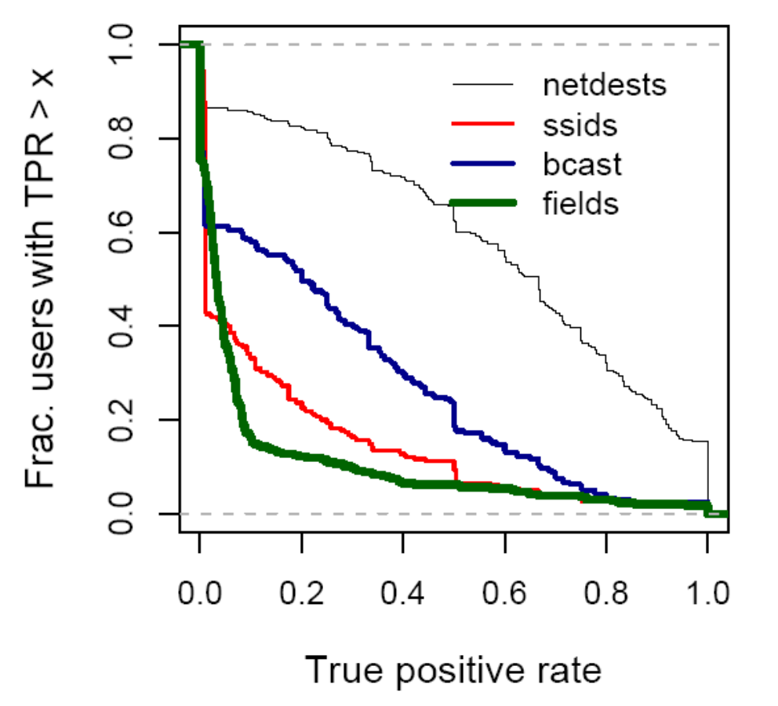
Results: Individual Feature Accuracy
netdests:
~60% users identified
>50% of the time
~20% users identified
>90% of the time
  Some users more distinguishable than others

