Slide 1



Practical, Real-time Centralized Control for CDN-based Live Video Delivery
Matt Mukerjee, David Naylor, Junchen Jiang, Dongsu Han,
Srini Seshan, Hui Zhang

Slide 2
Live Video is Becoming Wildly Popular
Commercial sports streams
User-generated streams

Slide 3
Live Video is Becoming Wildly Popular
Commercial sports streams
Single World Cup stream = 40% global Internet traffic
User-generated streams (e.g., Twitch)
Users watch 150b min of live video per month
Amazon buys Twitch for ~$1Billion

Slide 4

Our Contributions
We design a video delivery network (VDN) to efficiently manage quality and cost, with high responsiveness
Central
Optimization
Distributed
Control
Hybrid Control
Quality and cost management
Responsiveness to joins and failures
Notes:
Challenges of hybrid control — i.e., two loops etc.

Slide 5

Outline
Centralized
Control
Problems with Live Video Today
Hybrid Control
Putting it all Together
Distributed
Control

Slide 6



CDN Live Video Delivery Background
◀︎ Data
Control ▶︎
Legend
Video Sources
Requests:
A
B
Video 1
Video 2
HTTP RESPONSE
Responses:
Video 1
Reflector Clusters
Video 2
C
D
HTTP GET
Edge Clusters
E
F
G
Video Requests

Slide 7


CDN Live Video Delivery Background
◀︎ Data
Control ▶︎
Video Sources
A
B
120
100
100
3K
1K
2K
Link Cost
Reflector Clusters
C
D
Link Capacity
25
15
DNS
200
20
15
300
Edge Clusters
750
2K
E
F
G
0
1
10
1
500
300
750
700
Clients
H
I
J

Slide 8
CDN Live Video Delivery Background
◀︎ Data
Control ▶︎
Video Sources
A
B
120
100
100
Objective:
Maximize service quality &
Minimize delivery cost
3K
1K
2K
Link Cost
Reflector Clusters
C
D
Link Capacity
25
15
DNS
200
20
15
300
Edge Clusters
750
2K
E
F
G
0
1
10
1
500
300
750
700
Clients
H
I
J

Slide 9
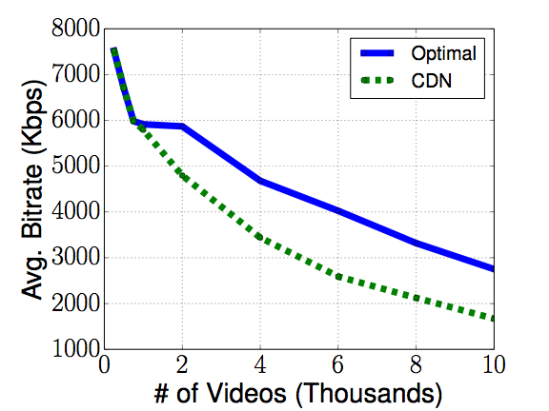
Problems with CDNs Today
Service Quality
Delivery Cost
(per request)
CDN
2.0x
OPTIMAL
1.0x
Simulation using Conviva traces,
modeling user-generated content
Simulation using Conviva traces,
modeling large sports events
Notes:
point back more to the first slide

Slide 10
Problems with CDNs Today
Service Quality
Not Fine-Grained
Videos aggregated into large groups
Delivery Cost
Slow DNS Updates
CDN
OPTIMAL
Can’t push updates
DNS entries get cached
2.0x
1.0x
QUANTITATIVE
QUALITATIVE
Notes:
*pause*
“the end conclusion is that there’s a lot of room for improvement”

Slide 11
Goals
Service Quality
Fine-Grained Control
Per-video Control
Delivery Cost
Real-time Response
CDN
OPTIMAL
Sub-second response to failures and joins
2.0x
1.0x
Room for improvement, but Internet latency / loss
QUANTITATIVE
QUALITATIVE

Slide 12
Goals
Service Quality
Fine-Grained Control
Per-video Control
Centralization!
[Liu, Xi et. al. A Case for a Coordinated Video Control Plane. SIGCOMM 2012]
Delivery Cost
Real-time Response
CDN
OPTIMAL
Sub-second response to failures and joins
2.0x
1.0x
Room for improvement, but Internet latency / loss
QUANTITATIVE
QUALITATIVE
Notes:
Prior work points towards room for improvement through centralization, but assumes that the CDN internals are un-changable. In this work we focus on the gains available through the lens of CDN management.

Slide 13
Outline
Centralized
Control
Problems with Live Video Today
Hybrid Control
Putting it all Together
Distributed
Control

Slide 14




Motivating Centralized Optimization
◀︎ Data
Control ▶︎
Video Sources
300
200
A
B
3K
1K
2K
Reflector Clusters
Link Capacity
C
D
DNS
200
750
2K
300
Edge Clusters
E
F
G
500
300
750
700
Clients
H
I
J

Slide 15
Motivating Centralized Optimization
◀︎ Data
Control ▶︎
Video Sources
300
200
A
B
3K
1K
2K
Reflector Clusters
Link Capacity
C
D
Congestion!
DNS
200
750
2K
300
Edge Clusters
E
F
G
500
300
750
700
Clients
300
H
I
J

Slide 16
Motivating Centralized Optimization
◀︎ Data
Control ▶︎
Video Sources
300
200
A
B
3K
1K
2K
Reflector Clusters
Link Capacity
C
D
DNS
200
750
2K
300
Edge Clusters
E
F
G
500
300
750
700
Clients
300
200
H
I
J

Slide 17
Motivating Centralized Optimization
◀︎ Data
Control ▶︎
Video Sources
300
200
A
B
3K
1K
2K
Needs global view to coordinate videos and network resources
Reflector Clusters
Link Capacity
C
D
DNS
200
750
2K
300
Edge Clusters
E
F
G
500
300
750
700
Clients
300
200
H
I
J

Slide 18
Motivating Centralized Optimization
◀︎ Data
Control ▶︎
Video Sources
300
200
A
B
3K
1K
2K
Reflector Clusters
Link Capacity
C
D
DNS
200
750
2K
300
Edge Clusters
E
F
G
500
300
750
700
Clients
300
200
H
I
J

Slide 19
Motivating Centralized Optimization
◀︎ Data
Control ▶︎
Video Sources
300
200
A
B
3K
1K
2K
Reflector Clusters
Link Capacity
C
D
Central
Controller
200
750
2K
300
Edge Clusters
E
F
G
500
300
750
700
Clients
300
200
H
I
J

Slide 20
Solving Centralized Optimization
MAXIMIZE
SERVICE QUALITY
MINIMIZE
DELIVERY COST
SUBJECT TO
DON’T EXCEED LINK CAPACITY
SENDER MUST HAVE RECEIVED VIDEO

Slide 21
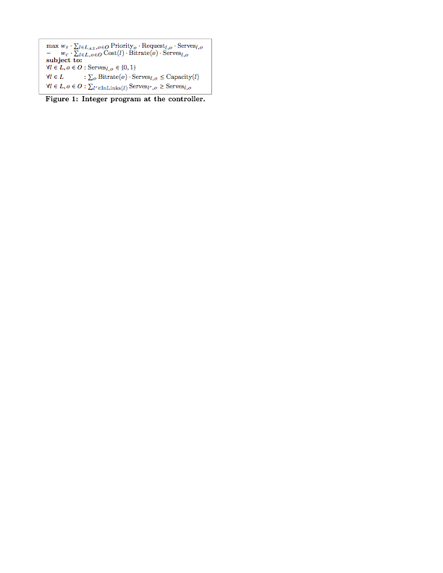
Solving Centralized Optimization
SERVICE QUALITY
DELIVERY COST
DON’T EXCEED LINK CAPACITY
SENDER MUST HAVE RECEIVED VIDEO

Slide 22
Flexibility of Centralized Optimization
◀︎ Data
Control ▶︎
Video Sources
800
A
B
1
1
1
2K
2K
2K
Link Cost
Reflector Clusters
?
C
D
Link Capacity
1
1
Central
Controller
2K
1
1
2K
Edge Clusters
2K
1K
E
F
G
1
1
10
1
1K
800
1K
800
Clients
800
800
H
I
J

Slide 23
Flexibility of Centralized Optimization
◀︎ Data
Control ▶︎
Video Sources
1
800
900
100
A
B
1
1
1
2K
2K
2K
Link Cost
Reflector Clusters
C
D
Link Capacity
1
1
Central
Controller
2K
1
1
2K
Video Priority
Edge Clusters
2K
1K
E
F
G
1
1
10
1
1K
800
1K
800
Clients
800
800
H
I
J
900

Slide 24
Centralized Optimization
Service Quality
Delivery Cost
(per request)
CDN
2.0x
OPTIMAL
1.0x
Simulation using Conviva traces,
modeling user-generated content
Simulation using Conviva traces,
modeling large sports events

Slide 25
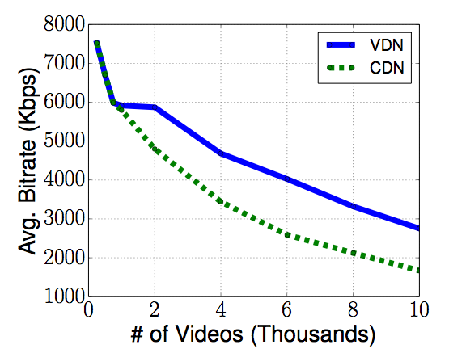
Centralized Optimization
Service Quality
Delivery Cost
(per request)
CDN
2.0x
VDN
1.0x
Simulation using Conviva traces,
modeling user-generated content
Simulation using Conviva traces,
modeling large sports events

Slide 26
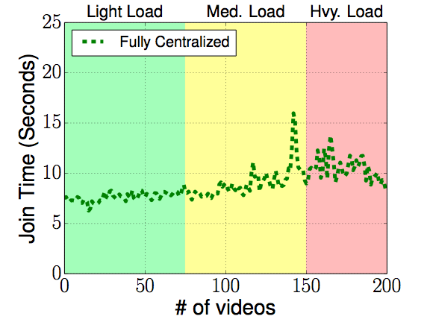
Unfortunately… No Free Lunch
Slow join times!
Experiments on EC2 nodes with a
centralized controller at CMU across the Internet

Slide 27

Problems with Centralization
◀︎ Data
Control ▶︎
Legend
Video Sources
800
Data Requests:
A
B
HIGH LATENCY
Video 1
Control Traffic:
Video 1
Reflector Clusters
C
D
Central
Controller
HIGH LATENCY
Edge Clusters
E
F
G
The Internet
Clients
H
I
J

Slide 28
Outline
Slow join times
Centralized
Control
Problems with Live Video Today
Hybrid Control
Putting it all Together
Distributed
Control

Slide 29
Alternate Approach: Distributed
◀︎ Data
Control ▶︎
Legend
Video Sources
800
Data Requests:
A
B
Video 1
3K
1K
1K
2K
Responses:
Video 1
Reflector Clusters
Link Capacity
C
D
Central
Controller
200
2K
800
800
Edge Clusters
?
E
F
G
500
300
750
700
Clients
H
I
J
800

Slide 30
Alternate Approach: Distributed
◀︎ Data
Control ▶︎
Legend
Video Sources
800
Data Requests:
A
B
Video 1
3K
1K
1K
2K
Responses:
Build “distance-to-video” tables
at each cluster, for each video
Video 1
Reflector Clusters
Link Capacity
C
D
Central
Controller
200
2K
2K
800
Edge Clusters
?
E
F
G
500
300
750
700
Clients
H
I
J
800

Slide 31
Alternate Approach: Distributed
◀︎ Data
Control ▶︎
Legend
Video Sources
800
Data Requests:
A
B
Video 1
3K
1K
1K
2K
Responses:
Video 1
1;
(B, 2K)
Reflector Clusters
Link Capacity
C
D
Central
Controller
200
2K
800
800
Edge Clusters
?
DISTANCE AT CLUSTER F
E
F
G
VIDEO 1:
500
300
750
700
Clients
H
I
J
800

Slide 32
Alternate Approach: Distributed
◀︎ Data
Control ▶︎
Legend
Video Sources
800
Data Requests:
A
B
Video 1
3K
1K
1K
2K
Responses:
Video 1
1;
(B, 2K)
Reflector Clusters
Link Capacity
C
D
Central
Controller
200
2K
800
800
Edge Clusters
?
DISTANCE AT CLUSTER F
E
F
G
VIDEO 1:
VIA C:
2;
(B, 1K)
500
300
750
700
Clients
PATH BOTTLENECK
H
I
J
800
# OF HOPS TO VIDEO
Notes:
emphasize the differences to distance vector

Slide 33
Alternate Approach: Distributed
◀︎ Data
Control ▶︎
Legend
Video Sources
800
Data Requests:
A
B
Video 1
3K
1K
1K
2K
Responses:
Video 1
1;
(B, 2K)
Reflector Clusters
Link Capacity
C
D
Central
Controller
200
2K
800
800
Edge Clusters
?
DISTANCE AT CLUSTER F
E
F
G
VIDEO 1:
VIA C:
2;
(B, 1K)
500
300
750
700
VIA D:
1;
(D, 800)
Clients
H
I
J
800
Notes:
emphasize the differences to distance vector

Slide 34
Alternate Approach: Distributed
◀︎ Data
Control ▶︎
Legend
Video Sources
800
Data Requests:
A
B
Video 1
3K
1K
1K
2K
Responses:
Video 1
1;
(B, 2K)
Reflector Clusters
Link Capacity
C
D
Central
Controller
200
2K
800
800
Edge Clusters
?
DISTANCE AT CLUSTER F
E
F
G
VIDEO 1:
VIA C:
2;
(B, 1K)
500
300
750
700
VIA D:
1;
(D, 800)
Clients
H
I
J
PICK SHORTEST PATH
WITH ENOUGH
CAPACITY
800
Notes:
emphasize the differences to distance vector

Slide 35
Alternate Approach: Distributed
◀︎ Data
Control ▶︎
Legend
Video Sources
800
Data Requests:
A
B
Video 1
3K
1K
1K
2K
Responses:
Video 1
Reflector Clusters
Link Capacity
C
D
Central
Controller
200
2K
800
800
Edge Clusters
DISTANCE AT CLUSTER F
E
F
G
VIDEO 1:
VIA C:
2;
(B, 1K)
500
300
750
700
VIA D:
1;
(D, 800)
Clients
H
I
J
PICK SHORTEST PATH
WITH ENOUGH
CAPACITY
800
800

Slide 36
Alternate Approach: Distributed
◀︎ Data
Control ▶︎
Legend
Video Sources
800
Data Requests:
A
B
Video 1
3K
1K
1K
2K
Responses:
Distributed decisions fast (ms)
but sub-optimal
Video 1
Reflector Clusters
Link Capacity
C
D
Central
Controller
200
2K
800
800
Edge Clusters
DISTANCE AT CLUSTER F
E
F
G
VIDEO 1:
VIA C:
2;
(B, 1K)
500
300
750
700
VIA D:
1;
(D, 800)
Clients
H
I
J
PICK SHORTEST PATH
WITH ENOUGH
CAPACITY
800
800

Slide 37
Alternate Approach: Distributed
◀︎ Data
Control ▶︎
Legend
Video Sources
800
Data Requests:
A
B
Video 1
3K
1K
1K
2K
Responses:
Combine approaches?
“Hybrid Control”
Video 1
Reflector Clusters
Link Capacity
C
D
Central
Controller
200
2K
800
800
Edge Clusters
DISTANCE AT CLUSTER F
E
F
G
VIDEO 1:
VIA C:
2;
(B, 1K)
500
300
750
700
VIA D:
1;
(D, 800)
Clients
H
I
J
PICK SHORTEST PATH
WITH ENOUGH
CAPACITY
800
800

Slide 38
Outline
Slow join times
Centralized
Control
Problems with Live Video Today
Hybrid Control
Putting it all Together
Low bitrate
Distributed
Control

Slide 39
Hybrid Control
Central
Optimization
Distributed
Control
Hybrid Control
Quality and cost management
(minutes)
Responsiveness to joins and failures
(milliseconds)

Slide 40
Challenges of Hybrid Control
Forwarding loops
Always forward requests upwards
State transitions
Versioning and “shadow FIBS”
Avoid bad control loop interactions
TRIVIAL
PRIOR WORK
CHALLENGING

Slide 41
Combining Approaches: Hybrid
◀︎ Data
Control ▶︎
Legend
Video Sources
800
Data Requests:
A
B
HIGH LATENCY
Video 1
3K
1K
1K
2K
Responses:
Video 1
Reflector Clusters
C
D
Central
Controller
200
2K
800
800
HIGH LATENCY
Edge Clusters
?
E
F
G
500
300
750
700
Clients
The Internet
H
I
J
800

Slide 42
Combining Approaches: Hybrid
◀︎ Data
Control ▶︎
Legend
Video Sources
800
Data Requests:
A
B
HIGH LATENCY
Video 1
3K
1K
1K
2K
Responses:
Video 1
Reflector Clusters
C
D
Central
Controller
200
2K
800
800
HIGH LATENCY
Edge Clusters
E
F
G
500
300
750
700
Clients
The Internet
H
I
J
800
800

Slide 43
Combining Approaches: Hybrid
◀︎ Data
Control ▶︎
Legend
Video Sources
800
Data Requests:
A
B
HIGH LATENCY
Video 1
3K
1K
1K
2K
Responses:
Video 1
Control Traffic:
Reflector Clusters
Video 1
C
D
Central
Controller
200
2K
800
800
HIGH LATENCY
Edge Clusters
E
F
G
500
300
750
700
Clients
The Internet
H
I
J
800
800

Slide 44
Challenges of Hybrid Control
Forwarding loops
Always forward requests upwards
State transitions
Versioning and “shadow FIBS”
TRIVIAL
PRIOR WORK
Avoid bad control loop interactions
CHALLENGING
Centralized decision has priority
Distributed uses shortest available path
distributed never
forces clusters from
centralized decision
changes don’t
propagate

Slide 45
Challenges of Hybrid Control
Forwarding loops
Always forward requests upwards
State transitions
Versioning and “shadow FIBS”
TRIVIAL
PRIOR WORK
Avoid bad control loop interactions
CHALLENGING
Centralized decision has priority
Distributed uses residual after centralized
Distributed has no impact on current/future centralized decisions
Distributed’s changes don’t propagate

Slide 46
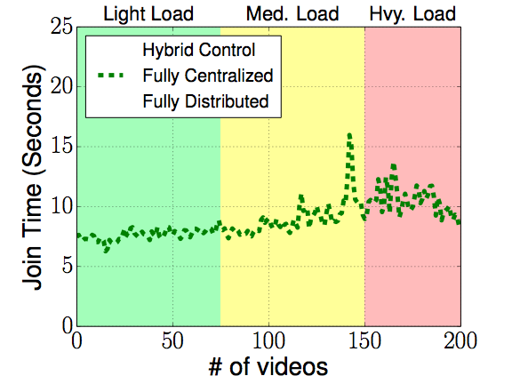
Hybrid Control and Responsiveness
Slow join times!
Experiments on EC2 nodes with a
centralized controller at CMU across the Internet

Slide 47
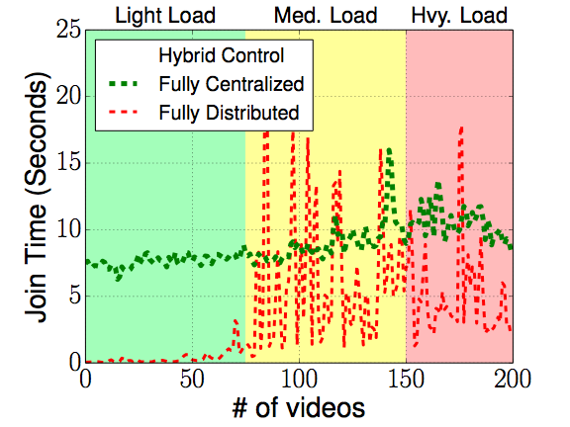
Hybrid Control and Responsiveness
Not stable
Slow join times!
Experiments on EC2 nodes with a
centralized controller at CMU across the Internet

Slide 48
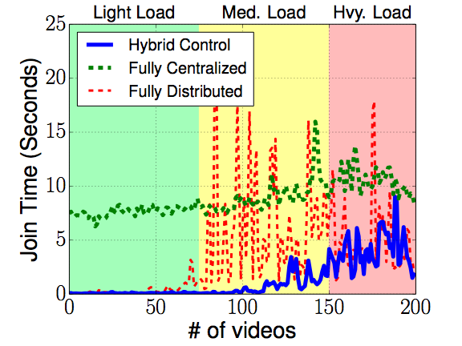
Hybrid Control and Responsiveness
Not stable
Slow join times!
Great join times and more stable
Experiments on EC2 nodes with a
centralized controller at CMU across the Internet
Notes:
better than both

Slide 49
Outline
Slow join times
Centralized
Control
“Better than both”
Problems with Live Video Today
Hybrid Control
Putting it all Together
Low bitrate
Distributed
Control

Slide 50
Putting it all Together
◀︎ Data
Control ▶︎
Video Sources
“Local Agent” per cluster
A
B
Reflector Clusters
C
D
Logically centralized controller
Edge Clusters
E
F
G
Clients
H
I
J

Slide 51
Putting it all Together
DISCOVERY
CONTROL
CENTRAL CONTROLLER
TOPOLOGY AND
VIDEO INFO
DISCOVERY
CONTROL
DISTRIBUTION
TREES
DISCOVERY
CONTROL
DISCOVERY
CONTROL
LOCAL AGENT
HYBRID CONTROL
HTTP Server
CENTRALIZED
HTTP Server
HTTP Server
DISTRIBUTED
DATA PLANE

Slide 52
Key Results
Trace-driven eval - centralized optimization
High quality & low delivery cost? 1.7x / 2x
Scalable / fine grain? 10K videos; 2K clusters
End-to-end eval - hybrid control
Responsive? 200ms
More results in paper
Operator Control? Failures? Partitions?

Slide 53
Conclusion
VDN presents a new approach for CDN-based live video delivery
Central
Optimization
Distributed
Control
Hybrid Control
Quality and cost management
Responsiveness to joins and failures

Slide 54
Practical, Real-time Centralized Control for CDN-based Live Video Delivery
Matt Mukerjee, David Naylor, Junchen Jiang, Dongsu Han,
Srini Seshan, Hui Zhang
Notes:
Why not use Calendaring Packing-Cover?
- This seems like an interesting approach although it focuses on meeting deadlines for long-lived flows while remaining responsive to short-lived high-priority flows. It’s unclear how to apply this to the live video context, where flows initially are high-priority (i.e., to decrease join time) but then transition to being long-lived, but may terminate based on user input. We build our system assuming a live video-specific setting (e.g., specific topologies, etc) Calendaring may provide an interesting approach to the problem, but the details to apply this to the remain unclear— let’s take this discussion offline.
Why not use Randomized Rounding?
- That’s a good idea. I assume you mean, why not use randomized rounding to make centralized control fast enough to run without needing distributed. The difficulty would come from the high churn of users entering/exiting the system. We’d need to run the randomized rounding LP after each new client request in order for the client to join (since we can’t rely on distributed control). This would become computationally intensive with millions of clients and high churn. Additionally, completely relying on a centralized controller makes solving partitioning from the controller harder. With hybrid control, we can get around partitioning by using distributed control.
Isn’t this just Multi-Commodity Flow (MCF)?
- At the high level they are similar problems. There are a couple of things that make live video a slightly different flavor than traditional MCF. For example, each commodity has a set of discrete bitrates, and as we’ve seen we provide additional flexibility to operators through video priority. More fundamentally traditional formulations of min cost MCF assumes that the system is admissible to all current requests, which might not be the case, so our formulation is made specific to live video.
What about other objectives (e.g., QoE)?
- The nice thing about our system is that we can change the optimization at the centralized controller to handle different objects (e.g., QoE). You’d only need to make a change at the centralized controller, so this is pretty simple.
What happens when you’re at capacity?
- If you’re at link capacity connections will be diverted to other servers that have path capacity. If the system is entirely at capacity, clients for lower priority videos will be dropped, to try to provide good service to the higher priority video clients. However, this is based on the optimization function I showed in the talk. If this isn’t the behavior that an operator wants, the optimization function could be modified to provide other behavior.

Slide 55
Backup slides…

Slide 56
Problems with Traffic Engineering
◀︎ Data
Control ▶︎
Video Sources
300
200
A
B
1.5K
1.5K
3K
1K
2K
Even Split (1K)
Reflector Clusters
Link Capacity
C
D
200
750
2K
300
Edge Clusters
E
F
G
500
300
750
700
Clients
300
200
H
I
J

Slide 57
Problems with Traffic Engineering
◀︎ Data
Control ▶︎
Video Sources
300
200
A
B
1.5K
1.5K
3K
1K
2K
Uneven Split
(1.5K / 500)
Reflector Clusters
Link Capacity
C
D
200
750
2K
300
Edge Clusters
E
F
G
500
300
750
700
Clients
1.5K
200
H
I
J

Slide 58
Distributed: Example of Sub-optimal
◀︎ Data
Control ▶︎
Legend
Video Sources
800
Data Requests:
A
B
Video 1
3K
1K
1K
2K
Wasting bandwidth
Responses:
Video 1
Reflector Clusters
Link Capacity
C
D
200
2K
2K
800
Edge Clusters
E
F
G
500
300
750
700
Clients
H
I
J
800
800

Slide 59
Distributed: Example of Sub-optimal
◀︎ Data
Control ▶︎
Legend
Video Sources
800
Data Requests:
A
B
Video 1
3K
1K
1K
2K
Responses:
Video 1
Reflector Clusters
Link Capacity
C
D
Coordination difficult without centralization
200
2K
2K
800
Edge Clusters
E
F
G
500
300
750
700
Clients
H
I
J
800
800

Slide 60
Trace-Driven Eval
3 Traces
Avg Day: raw trace of music video provider
Large Event: synthesized basketball game
Heavy Tail: synthesized twitch/ustream like workload
4 Systems
Everything Everywhere: all vids to all servers
Overlay Multicast: globally optimal; no coordination
CDN: greedy distribution scheme w/ DNS
VDN: our system

Slide 61
Trace-Driven Eval

Slide 62
Existing Solutions
Traffic Engineering (SWAN, B4, …)
Works on aggregates at coarse timescales
Overlay Multicast (Overcast, Bullet, …)
Not designed for coordinating across streams
Modern CDNs
Previous work shows a centralized system could greatly improve user experience but would be difficult to design over Internet

