Slide 1


The Impact of False Sharing on
Shared Congestion Management
Aditya Akella
with Srinivasan Seshan and Hari Balakrishnan
ICNP 2003

Slide 2

Web Traffic
The Web -- Lots of concurrent flows, multiple slow starts
No shared probing of network – aggressive behavior
Internet
Burst losses
&
Inefficiency

Slide 3
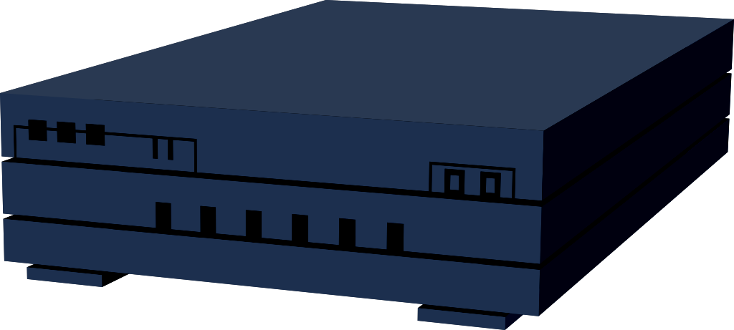
Shared Congestion Management
Assuming same (source, destination) ⇒ identical path, identical bottlenecks…
Share congestion state, learn from each other
→ No more independent probes
→ Fewer network losses
→ Better ensemble behavior
React to losses and delays on other flows
Internet
Macroflow

Slide 4
False Sharing
✗
Same source, destination → identical path, identical bottlenecks
Flows may not share all bottlenecks → False Sharing
False sharing: Two or more flows in a macroflow
may not share all bottlenecks
E.g., QoS-enhanced networks, Multipath routing, NATs
In such cases, should not share congestion state!
Multipath Routing
or NATs
QoS-enhanced
Networks
False sharing affects flow performance…
Internet
React to slower flow – reduce speed
Prioritize audio over video
React to faster flow –
increase speed
Flows may traverse different paths

Slide 5
In This Paper
How does false sharing affect flow performance?
  Compromise congestion control? Or lower throughput?
How can an end-system detect false sharing?
How should end-systems respond upon detection?

Slide 6
Outline of the Talk
Impact
Detection
Response
Summary

Slide 7
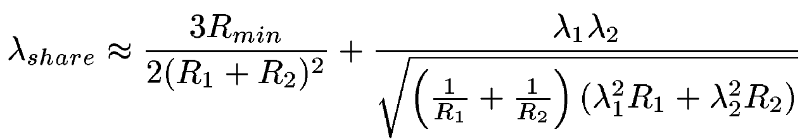
Impact: Back-of-the-Envelop Analysis
Flow 1 (RTT = R₁)
Src
Say Flows 1, 2
share macroflow.
What is their new
throughput?
Throughput: λ₁
λ_{share}< min(λ₁,λ₂)
  Slower sender doesn’t overwhelm its bottleneck
  But faster sender could suffer badly
Extensive simulation support
  Details in paper
Analysis assumes long-flows
  Results similar for short-flows
  False sharing does not compromise end-to-end congestion control
Dst
Flow 2 (RTT = R₂)
Throughput: λ₂
λ₁ = λ₂ = λ_{share}

Slide 8
Outline of the Talk
Impact
Detection
Response
Summary

Slide 9
Detection Tests: Intuition
Flows undergoing false-sharing traverse different paths
→ Packets in these flows experience different base RTT, queuing and losses

Slide 10
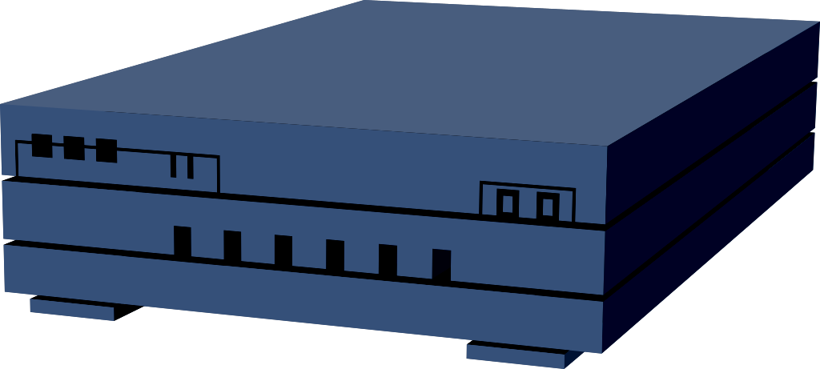
Detection: Out-of-Order Test
Flows experience different RTT or delays on paths
Packets on different flows, sent back-to-back, will arrive out-of-order!
Out-of-Order test: Look for consistent re-ordering at receiver
Increasing sequence numbers to packets in a macroflow
Reordering by more than 3 packets → flag flows in macroflow
If (#flags > 10), identify false-sharing
Flow 1 – somewhat congested bottleneck
Unshared
Bottlenecks
2
S
D
1
Flow 2 – highly congested bottleneck

Slide 11
Detection: Delay-Correlation Test
Assume sender and receiver time-stamp packets.
Receiver computes Δ(time-stamp) → packet delay
1. Delay auto-correlation: correlation between delays of
consecutive packets of a flow
2. Delay cross-correlation: correlation between delays
of consecutive packets from
different flows
Auto-correlation > Cross-correlation ⇨False-sharing!
[Rubenstein00]

Slide 12
Detection: Loss-Correlation Test
1. Loss auto-correlation = conditional loss
probability for packet
on a flow following a
loss on the flow
2. Loss cross-correlation = conditional loss
probability for packet
on a flow following a
loss on the flow
Auto-correlation > Cross-correlation ⇨ False-sharing!

Slide 13
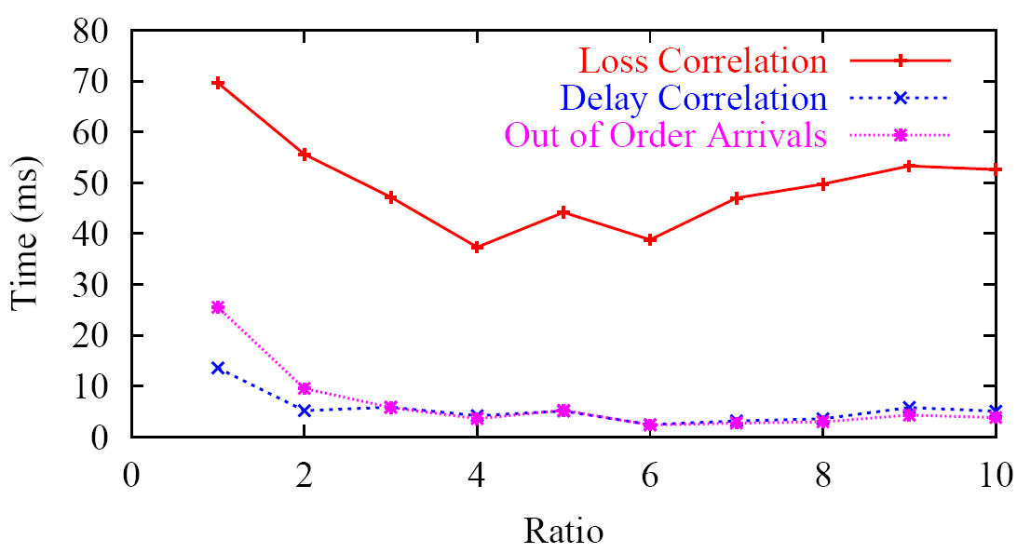
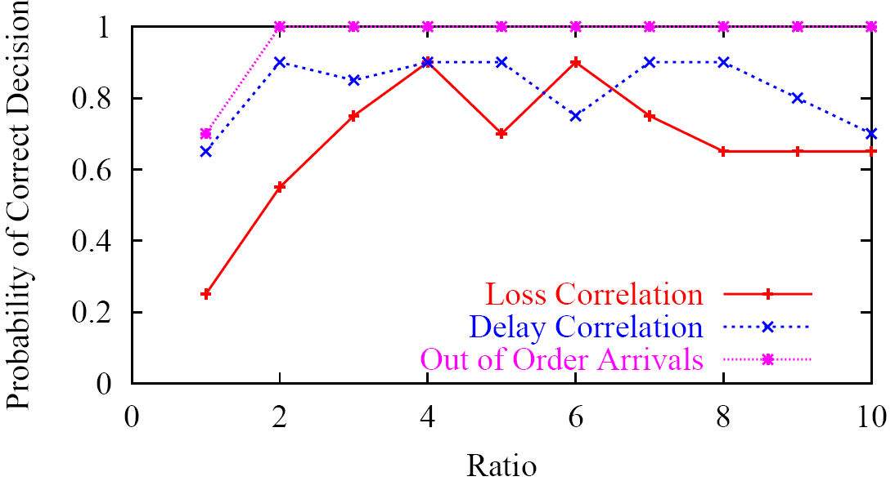
Detection Tests: Performance
Unshared
Bottlenecks
Correct output::
“Don’t Share”’
Detection accuracy
  Loss test has poor accuracy
  Delay test is better
  Order test is the best!
Detection speed
  Loss test slowest
  Delay and order test fastest
S
D
Detection Accuracy
Detection Speed

Slide 14
Detection Tests: Performance
Fully shared
Bottlenecks
Output from loss, delay tests:
“Share”
Correct output:
“Don’t Share”
Output from order test:
“Don’t Share”
High RTT
S
D
Low RTT
Detection speed
  Order test is very fast: <5s on average
Detection accuracy
  Order test: “Don’t share” > 90% of occasions
  Loss, delay test: “Share” > 70% of the occasions
Summary: Out-of-order test works best
  Very accurate, very fast

Slide 15
Outline of the Talk
Impact
Detection
Response
Summary

Slide 16
Response to False Sharing: Design
Which is the better default? “Share” or “Don’t Share”
  “Share” is a better default than “Don’t Share”
    Detecting false sharing much easier
      Statistically, easier to tell two things are different than to tell they are similar
    Scheduler ensures packet interleaving
    → detection tests will work well
    Out-of-order test will not work when
    default is “Don’t Share”

Slide 17
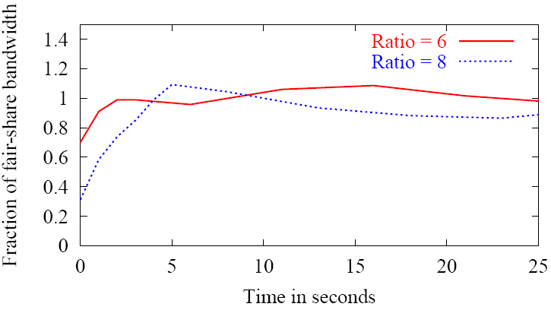
Response to False Sharing
What after detection?
  Stop sharing between
  flows!
    Put flows in different
    macroflows
Performance of
detection and
response
  Throughput
  of faster flow
  restored in <5s
Unshared
Bottlenecks
S
D

Slide 18
Summary
Impact of false sharing: faster senders’ throughput could drop by a lot
  Slower senders don’t overwhelm the bottlenecks on their paths
Detection: loss, delay and order based statistics can be employed
  Delay statistics have better accuracy and speed than loss
  Order-based tests are very fast and accurate
Response: default behavior should be to share
False-sharing is no longer a potential deployment concern…hopefully…

Slide 19
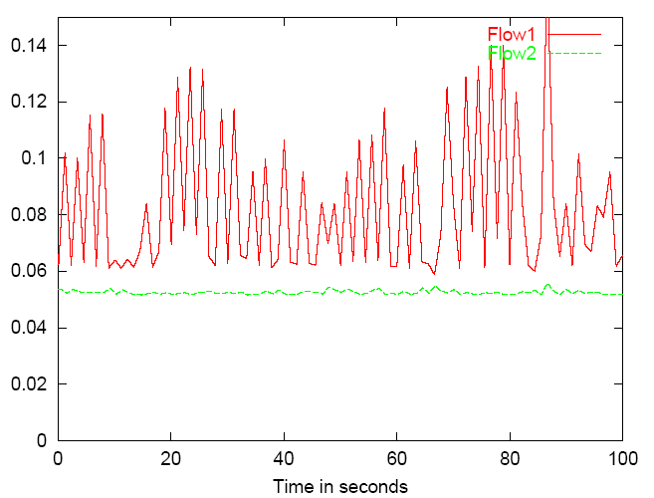
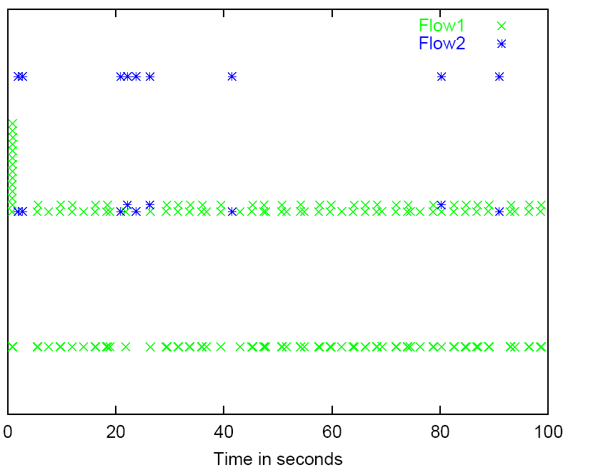

Shared Bottlenecks: Losses and Delays
Flow 1 – somewhat congested bottleneck
Unshared
Bottlenecks
S
D
(same RTT)
Flow 2 – highly congested bottleneck
Say flows 1, 2 share macroflow. What do their pkt losses and delay look like?
Correlation in losses/delays
(or lack of it) → useful to detect false sharing!
Packet delays
Packet losses

Slide 20
Detection: Delay-Correlation Test
Assume sender and receiver time-stamp packets.
Receiver computes Δ(time-stamp) → packet delay
1. Delay auto-correlation: correlation between delays of
consecutive packets of a flow
2. Delay cross-correlation: correlation between delays
of consecutive packets from
different flows
Auto-correlation > Cross-correlation ⇨False-sharing!
[Rubenstein00]
Unsynchronized clocks? Not an issue → computation of correlations eliminates constant differences.

Slide 21
Fully-Shared Bottlenecks
High RTT
Fully shared
Bottlenecks
S
D
Low RTT
Flows face the same bottleneck
→ Delay and loss correlation will return genuine sharing – Wrong!
Need a new test for such situations
Idea: packets sent back-to-back will reach out-of-order
Look for consistent back-to-back arrivals at receiver:
Out-of-Order test

Slide 22
Detection Tests: Summary
Loss-based test
  Inaccurate, very slow
Delay-based test
  Quite accurate, but still somewhat slow
Out-of-order test
  Very accurate and very fast
False sharing vs. genuine sharing
  Markedly easier to detect false sharing
  Detecting genuine sharing takes more than twice as long
Notes:
.

Slide 23
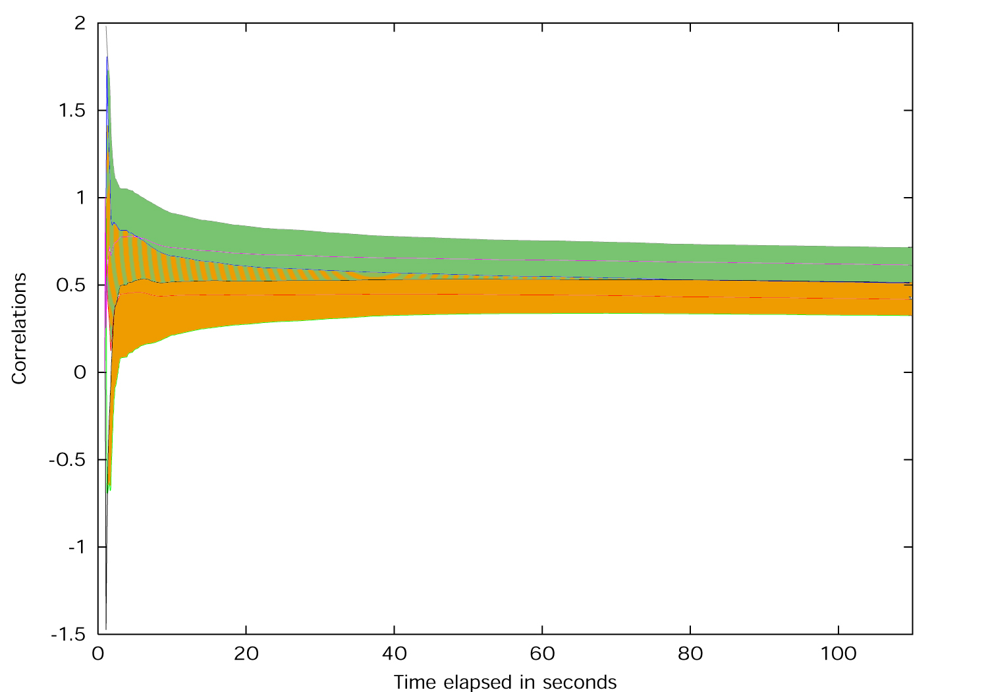
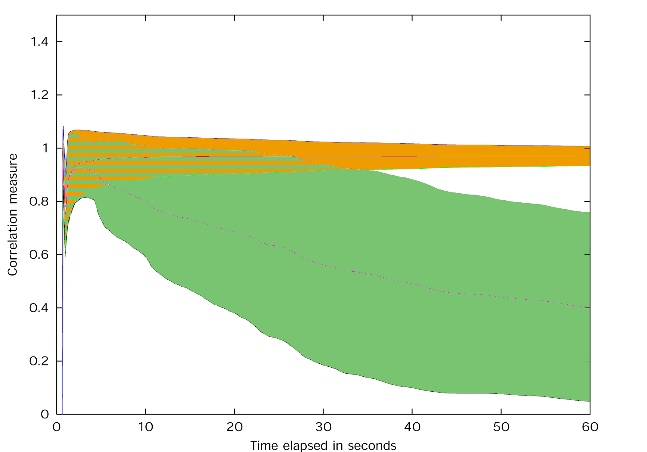
Delay and Loss Correlation: Practice
Use 90% confidence intervals around the correlation metrics as they evolve → higher confidence
Flows Share a Bottleneck
Flows Share no Bottlenecks
Cross Correlation
Cross Correlation
Auto Correlation
Auto Correlation
Correlation measure
Correlation measure
Time in seconds
Time in seconds
90% intervals don’t overlap anymore → quit and output result
Detecting false sharing easier (35s) than genuine sharing (100s)

Slide 24
Detection: Out-of-Order Test
Flows experience different RTT or delays on paths
Packets on different flows, sent back-to-back, will arrive out-of-order!
Out-of-Order test: Look for consistent re-ordering at receiver
Increasing sequence numbers to packets in a macroflow
Reordering by more than 3 packets → flag flows in macroflow
If (#flags > 10), identify false-sharing
Flow 1 – somewhat congested bottleneck
2
Unshared
Bottlenecks
2
S
D
1
1
Flow 2 – highly congested bottleneck

