Slide 1
Scaling Properties of the Internet Graph
Aditya Akella, CMU
With Shuchi Chawla, Arvind Kannan and Srinivasan Seshan
PODC 2003

Slide 2
Internet Evolution
AS-level graph
Grows with time…

Slide 3
Internet Evolution
Say, network doubles in size
Key:
Where to add capacity?

Slide 4
Internet Evolution
Uniformly scale all capacities?
Moore’s-law like scaling sufficient?
If so, good scaling!

Slide 5
Internet Evolution
Scale some links faster?
Moore’s-law like scaling insufficient?

Slide 6
Internet Evolution
Scale some links faster?
Congested hot-spots
If so, poor scaling!!

Slide 7
Key Questions
How does the worst congestion grow?
  O(n)? O(n²)?
How much of this is due to…
  Topology?
    Power-law structure
    Other distributions
  Routing algorithm?
    BGP-Policy routing
  Traffic demand matrix?
    Uniform vs. non-uniform
What can be done?
  Redesign the network?
  Change routing?

Slide 8
Outline
Analysis Overview – key result
Results from simulation
Discussion of results, network design
Conclusion

Slide 9
Analysis in One Minute
Simple evolutionary model
  Preferential Connectivity
    Known to yield power-law graphs
    #nodes v with d_{v} ≥ d is proportional to d^{-α}
  Unit traffic between all node-pairs
    Routed along the shortest path
    Prefer paths through higher-degree nodes
How does maximum congestion depend on n, the number of vertices?
  Congestion on an edge == number of shortest path routes using the edge
  Consider congestion on the edge between two highest degree nodes

Slide 10
Key Result
Theorem: The expected maximum edge congestion is Ω(n^{1+1/α}) (shortest path routing, any-2-any).
➔ Ω(n^{1.8}) or worse for the Internet (α=1.2)
Bad Scaling!

Slide 11
Outline
Analysis Overview
Results from simulation
Discussion of results, network design
Conclusion

Slide 12
Methodology: Outline
Topology
  Power-law
    #nodes v with d_{v} ≥ d is proportional to d^{-α}
    Real AS-level topologies
    Inet-3.0 generated synthetic
  Exponential
    #nodes v with d_{v} ≥ d is proportional to e^{-βd}
    Inet-3.0 generated
      Density same as power-law graphs of same size
  Tree-like
    Grown from the preferential connectivity model

Slide 13
Methodology: Outline
Routing algorithm
  Shortest-path
    Prefer paths through high degree nodes
  BGP routing
    Policy-based
      Peers only provide transit to traffic to/from customers
      Customers don’t provide transit for providers and peers
    Real graphs: past work on classifying edges
    Synthetic graphs: heuristically classify edges before imposing policy routing
      Accurate maximum congestion

Slide 14
Methodology: Outline
Traffic matrix
  Uniform demands: Any-2-any
    Between all pairs
  Non-uniform: Clout model
    Between “stubs”
    Traffic depends on “popularity”
      Popularity of node u depends on degree (d_{u}) and avg degree of neighbors (A_{u})
      Traffic (u→v) is proportional to popularity(u)

Slide 15
Methodology: Outline
Given → Topology X Routing X Traffic matrix
We seek → Max edge congestion as a function of n

Slide 16
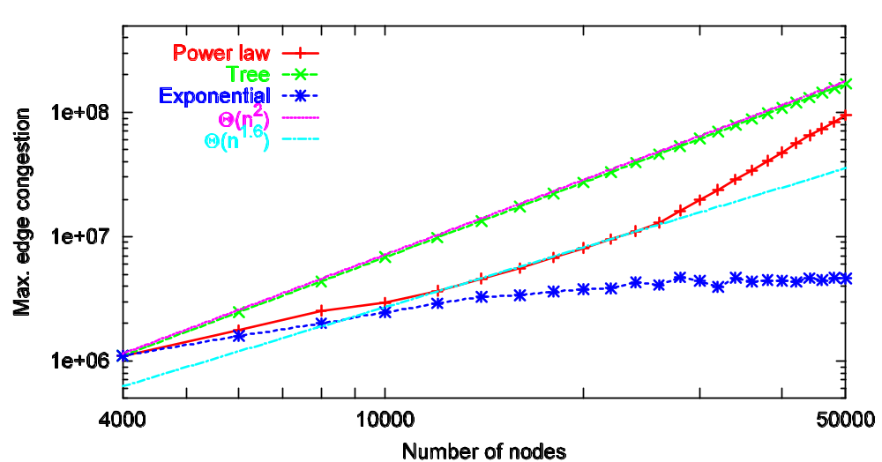
Shortest-Path Routing (Any-2-any)
Exponential >> Power law graphs > Power-law trees

Slide 17
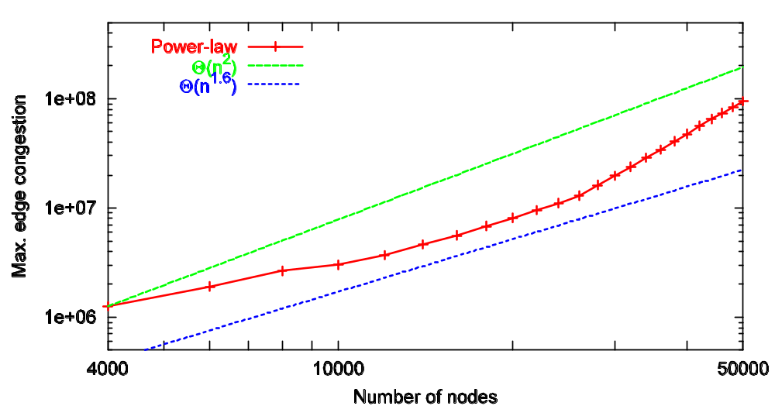
Policy Routing (Any-2-Any)
Poor scaling just like shortest path

Slide 18
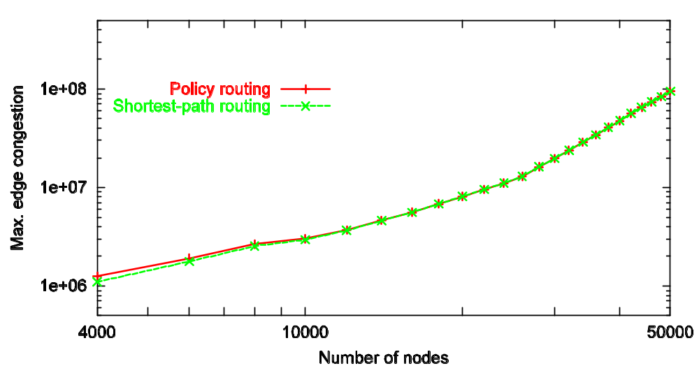
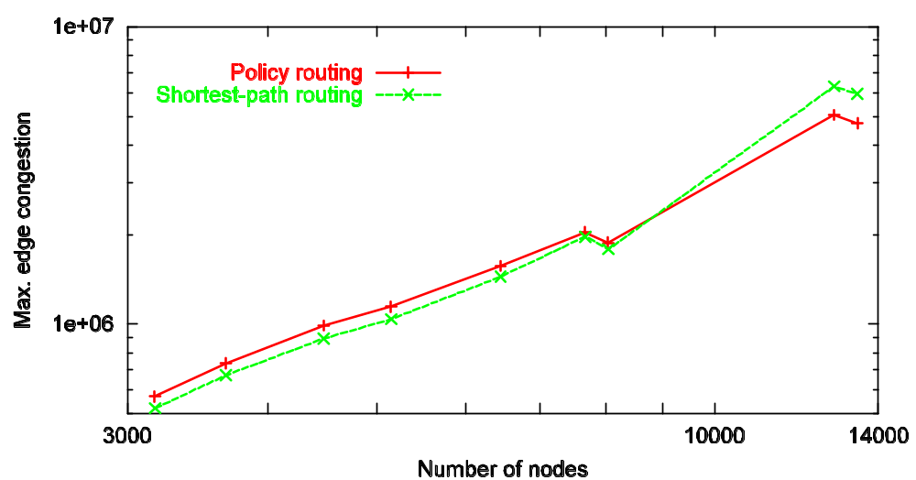
Policy Routing vs. Shortest Path
Any-2-Any
Synthetic Graphs
Real Graphs
Policy routing is never worse!

Slide 19
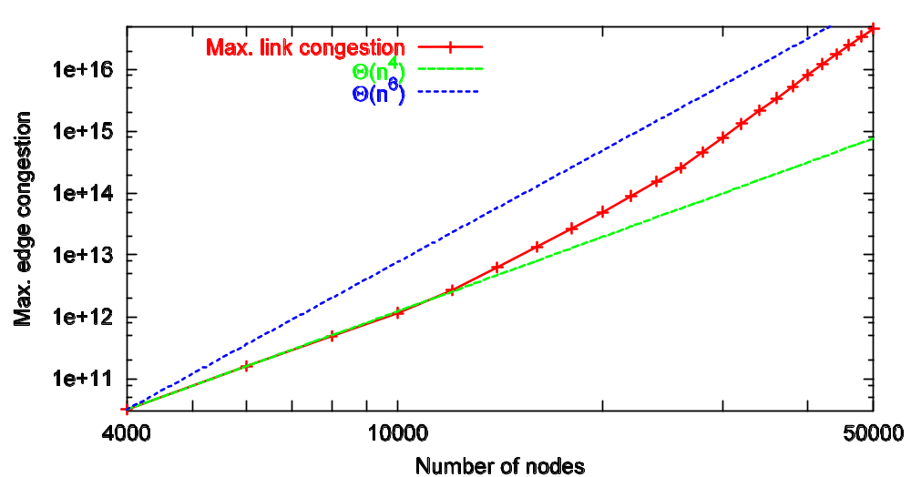
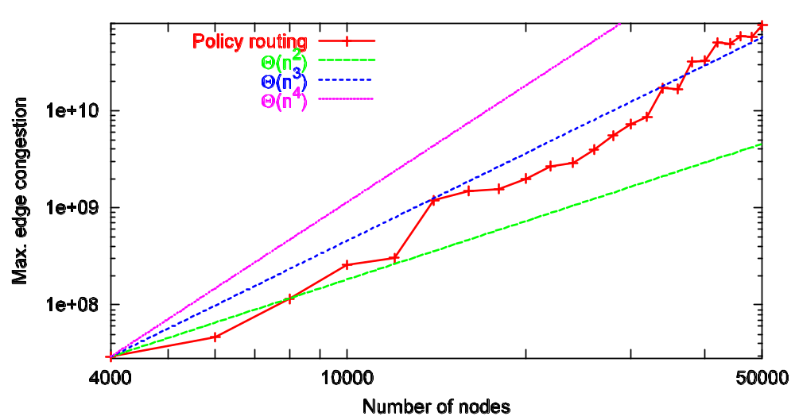
The Clout Model
Shortest-path routing
Scaling is even worse than uniform
Policy routing
Same true for policy
Policy routing better than shortest path!

Slide 20
Outline
Analysis overview
Results from simulation
Discussion of results, network design
Conclusion

Slide 21
Discussion
Scaling according to Moore’s law insufficient
  Congested hot-spots in the “core”
  Policy routing has minimal impact
May have to change the network
  Routing: diffuse demand in a centralized manner
  Structure: add additional edges to the graph

Slide 22
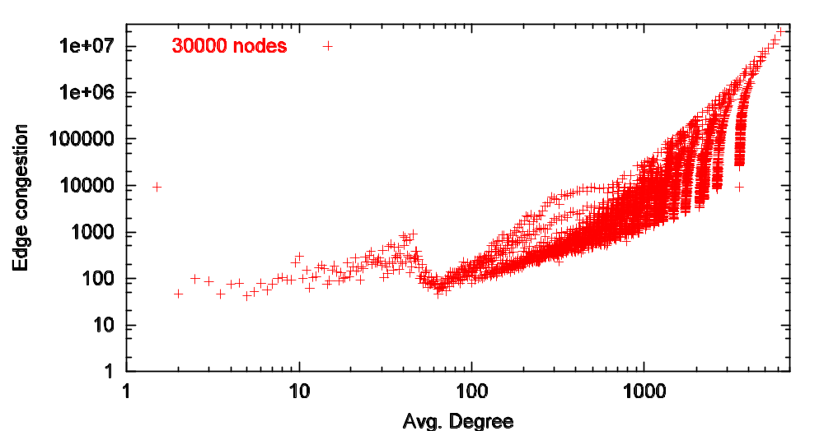
Adding Parallel Links
Intuition: Congestion higher on edges with higher average degree

Slide 23
Adding Parallel Links
#parallel links is dependant on degrees of nodes at the ends of the edge
Candidate functions
  Minimum, Maximum, Sum and Product of degrees
Shortest path routing, any-2-any
New edge congestion = edge congestion/#parallel links

Slide 24
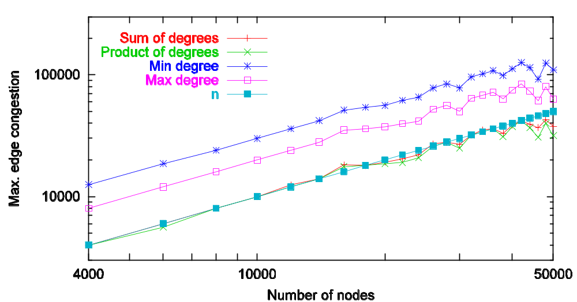
Parallel Links (Shortest path, Any2Any)
Even min yields Θ(n) scaling!
➔Desirable extent of AS-AS peering

Slide 25
Related Work
“Power law graphs have good congestion properties” [Mihail03]
  Allow routing with O(nlog²n) congestion
  Incorrectly extend to shortest path routing
  Also find policy routing to be worse
    Over smaller real graphs

Slide 26
Conclusion
Congestion scales poorly in Internet-like graphs
Policy-routing does not worsen the congestion
Alleviation possible via simple, straight-forward mechanisms

Slide 27
Key Observations (I)
e* -- edge between the top two degree nodes s₁ and s₂.
Observation 1: A significant fraction of single-source shortest path trees (Ω(n) trees) in the graph contain e*.
e* occurs in both trees
S₁
S₁
e*
e*
S₂
S₂

Slide 28
Key Observations (II)
Observation 2: In at least a constant fraction of the Ω(n) shortest path trees, s₁ and s₂ retain at least a constant fraction of their degrees.
S₁ ,S₂ retain most of their degrees
5/5
4/5
S₁
S₁
e*
e*
S₂
S₂
3/4
4/4

Slide 29
Key Observations (III)
Observation 3: The degrees of s₁ and s₂ are Ω(n^{1/α}).
And
In each tree that e* belongs to, congestion on
e* ≥ min{deg_{tree}(s1), deg_{tree}(s2)}.
S₁
Congestion(e*) ≥ 3
e*
S₂
So…

