Slide 1
Mercury: Scalable Routing for Range Queries
Ashwin R. Bharambe
Carnegie Mellon University
With Mukesh Agrawal, Srinivasan Seshan

Slide 2


Motivation
Lookup data in a distributed data store
  Scalable, efficient routing, load balance, etc.
State-of-the-art: DHTs
  Problem: exact match queries only
More expressive queries?
  Often rely on flooding or centralization!
  Trade-off between expressivity and scalability
What can we achieve in a scalable manner?
Notes:
The high-level problem is that, we want to lookup data spread over a large number of nodes in a p2p system in a scalable, efficient manner without having hot spots in the system. In the past 3-4 years, various DHTs have been designed which provide exactly such guarantees. A DHT offers a hash-table like interface to the application where the application can insert and lookup “keys” in the distributed system. However, the problem is that such an interface only allows for exact match queries.
It is clear that a richer set of queries are needed by many applications today. For example, location-aware computing applications require finding nodes which are present in some region of the space. Databases, in general, require much richer SQL-like queries. However, as of now, all we can do for richer queries is answer them using a central server or rely on sending the query to all nodes in the network.
So, it appears that there is a tradeoff in the expressivity of a query and the scalability with which it can be implemented. In this paper, we try to push the envelope a little further – i.e., we want to see how rich a query we can implement in a distributed system without sacrificing scalability…

Slide 3
Outline
Single attribute range queries
Performance evaluation
Multi-attribute range queries
Discussion and summary
Notes:
In this paper, we show that range queries can be implemented in a scalable manner providing all the guarantees I mentioned earlier. First, I am going to present the design of the Mercury system for range queries consisting of a single attribute.

Slide 4
Distributed Hash Tables (DHT)
x = 1
0xf0
0xe0
hash
0x00
0xd0
0xb2
0x10
0xc0
0x20
0xb0
0x30
0xa0
Finger pointer
0x90
0x40
0x80
O(log n) hops
0x50
0x60
0x70
Notes:
Although we have seen that DHTs can only perform exact match queries, their structure forms the basis of the design of Mercury. so we will briefly review the design of a standard DHT. As shown in this figure, in a DHT, nodes are arranged along a circular overlay of identifiers, with each node responsible for maintaining a range of such identifiers. In addition to immediate nbrs on the circle, each node has connections to distant nodes in the circle -- log(n) exponentially spaced “finger pointers” – for guaranteeing efficient O(log n) hop routing. The critical point to note here is that each routing step cuts the search space (in terms of #nodes) at least by half.
In the paper, we have used Symphony as the base DHT, however, the arguments are valid for any DHT with a “ring” topology. So, to simplify things, I will just assume we are working with Chord. Routing: each step effectively cuts the ID or value space in half => also node space in half.

Slide 5
Using DHTs for Range Queries
No cryptographic hashing for key → identifier
Query: 6 ≤ x ≤ 13
key = 6 ➔ 0xab
key = 7 ➔ 0xd3
…
key = 13 ➔ 0x12
0xf0
0xe0
0x00
0xd0
0x10
0xc0
Query: 6 ≤ x ≤ 13
0x20
0xb0
0x30
0xa0
0x40
0x90
0x50
0x80
0x60
0x70
Notes:
So, let us consider using a standard DHT for performing range queries; the first problem one encounters is that hashing destroys data contiguity and so answering range queries becomes very expensive. Explain the example. So a critical design choice we make is to eliminate cryptographic hashing. Now, keys are stored contiguously and range queries can be answered by reaching the first data-item in the query and following the circle. Explain a little bit. So, we see that routing can be efficiently accomplished just like in a standard DHT.. By the way, whenever I reference the term naïve DHT here on, what I mean is a DHT without the ‘H’ and which does load balancing.
So, it appears that the system just works! But this system has a serious flaw. Let’s look at what happens when we insert a few data-items into this overlay.

Slide 6
Using DHTs for Range Queries
Nodes in popular regions can be overloaded
Load imbalance!

Slide 7
DHTs with Load Balancing
Mercury load balancing strategy
  Re-adjust responsibilities
Range ownerships are skewed!
Notes:
A natural load balancing strategy which Mercury here is to repartition the ranges in the system. Pick some of the slackers and move them to the heavily loaded region of the space. Now, how these nodes figure out where and whether to move is an important question, by itself and I will discuss it later. For now, even assuming that such a load balancing algorithm works, there’s a second problem that has arisen namely, range ownerships are now no longer uniform! Some nodes may hold a large portion of the unpopular space while a node in the popular region will hold a very small range of values.

Slide 8
DHTs with Load Balancing
0xf0
0xe0
0x00
0xd0
Popular
Region
0xb0
Finger pointers
get skewed!
0x30
0xa0
Each routing hop may not reduce node-space by half!
➔ no log(n) hop guarantee
0x90
0x80
Notes:
So, the range ownerships were skewed; as you see in this figure now, this results in the finger pointers of a node getting skewed! Ok, so what is the problem here? Remember that a DHT lookup, at a high level, performs a binary search of the node-space reducing the search space in reaching the destination by half at each hop. This is what guarantees the DHT a log(n) hop guarantee.
Animate at this point…
But in our case, the finger pointers are no longer exponentially spaced over the “space of nodes”… instead they are just exponentially spaced over the “space of identifiers or values”. This implies that every hop may not decrease the routing distance by a factor of 2, and so the log(n) hops guarantee vanishes.

Slide 9
Ideal Link Structure
0xf0
0xe0
0x00
0xd0
Popular
Region
0xb0
0x30
0xa0
0x90
0x80
Notes:
Thus, you would like to connect to nodes which are 1,2, 4, 8 hops away from you along the circle. The challenge is actually finding these nodes.

Slide 10
Mercury
Need to establish links based on node-distance
Values
v₄
v₈
4
8
Nodes
If we had the above information…
For finger i
  Estimate value v for which 2^{i} th node is responsible
Notes:
But suppose that we knew where every node in the system was located; that is the range that it is responsible for. Given this information, it would be easy to establish the correct set of links. For example, if you wanted to establish a link to the 8th node after you along the circle, you could find out the range that it is responsible for and route a join-message towards this node. Thus, you could create appropriately spaced finger pointers.

Slide 11
Mercury
Need to establish links based on node-distance
v₄
Values
Node-density
v₈
4
8
Nodes
Values
Piece-wise linear approximation
Histogram
Notes:
Since maintaining such fine-grained information is not scalable, each node in Mercury just keeps a piece-wise linear approximation to this data. This can also be viewed as maintaining a histogram of node-counts. i.e., how many nodes are present in a particular part of the entire value-space.

Slide 12
Histogram Maintenance
Measure node-density locally
Gossip about it!
0xf0
0xe0
0x00
0xd0
(Range, density)
(Range, density)
(Range, density)
0xb0
Request sample
0x30
0xa0
0x90
Node-density
0x80
0x70
Values
Notes:
After finishing the slide:
So every node obtains a sampled histogram and constructs proper links based on the mapping algorithm described in the last few slides. Ok, so we have solved the skewed finger pointers problem now – but I haven’t told you how to solve the second problem, namely load balancing.

Slide 13
Load Balancing
Load histogram
Load
0
10
20
25
35
45
60
65
70
75
85
Basic idea – leave-join
  “light” nodes leave
  Re-join near “heavy” nodes; split the range of the heavier node
Notes:
Each bar represents load on a node in the system; the horizontal axis shows the ranges that each of these nodes is responsible for.

Slide 14
Load Balancing
Heavy
Load histogram
Load
Average
Light
0
10
15
20
25
35
45
60
65
70
72.5
75
85
Basic idea: leave-rejoin
Steps
  Find average, check if heavy or light
  Light nodes perform a leave and rejoin
Notes:
Heavy if load ≥ α * Average

Slide 15
Outline
Single-attribute range queries
Performance evaluation
Multi-attribute range queries
Discussion and summary

Slide 16


Evaluation
0xf0
Workload
  Several item insertions
  Data chosen according to Zipfian distribution
  Values near 0x00 most popular
Key questions:
  Are the histograms accurate?
  Are the routes efficient?
0x00
Popular
Unpopular
Notes:
See how this affects #routing hops

Slide 17
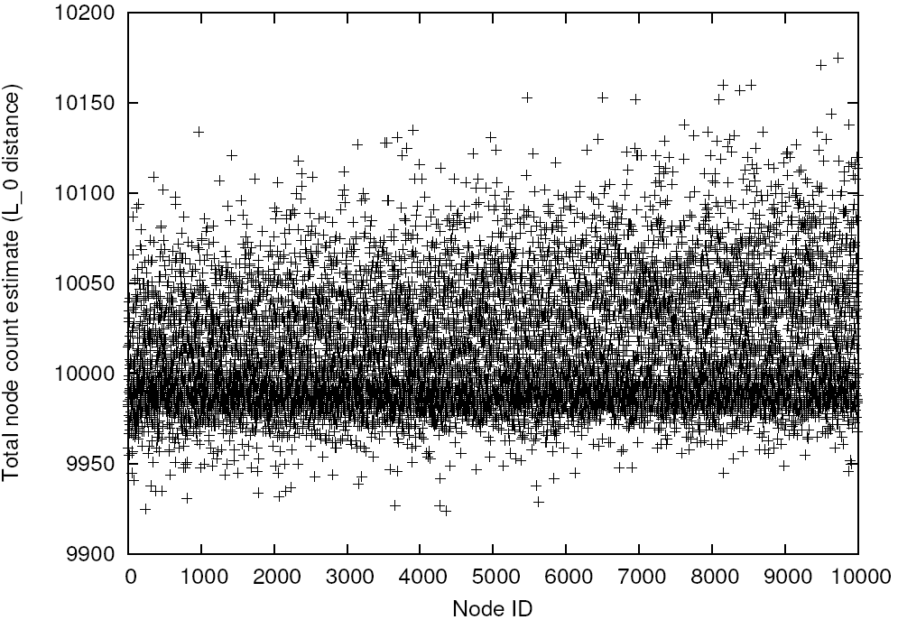
Sampling Accuracy
+1%
Node-count estimate
(L₀ error)
Correct
value
-1%
Node ID
Estimate of total node count by each participant
  10000 nodes, Zipf-skewed distribution with load-balancing

Slide 18
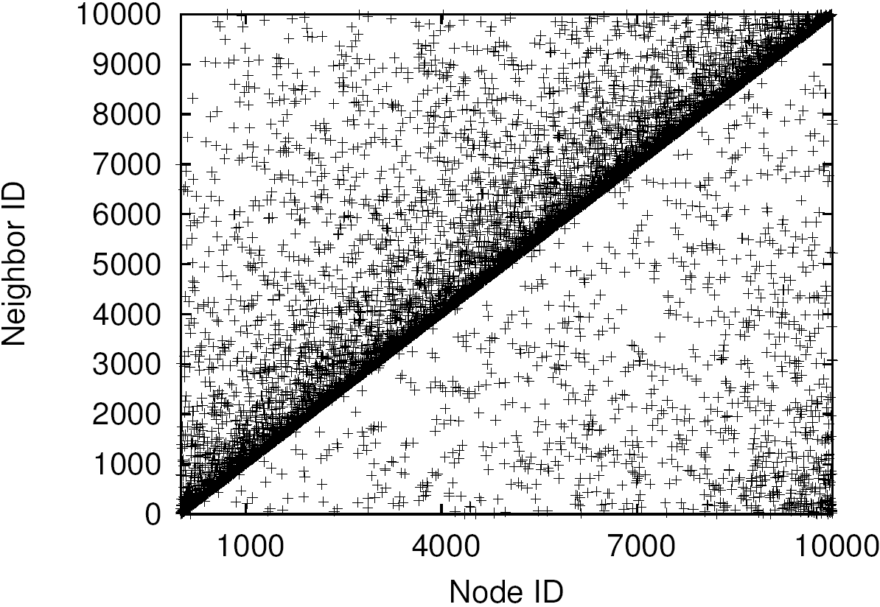
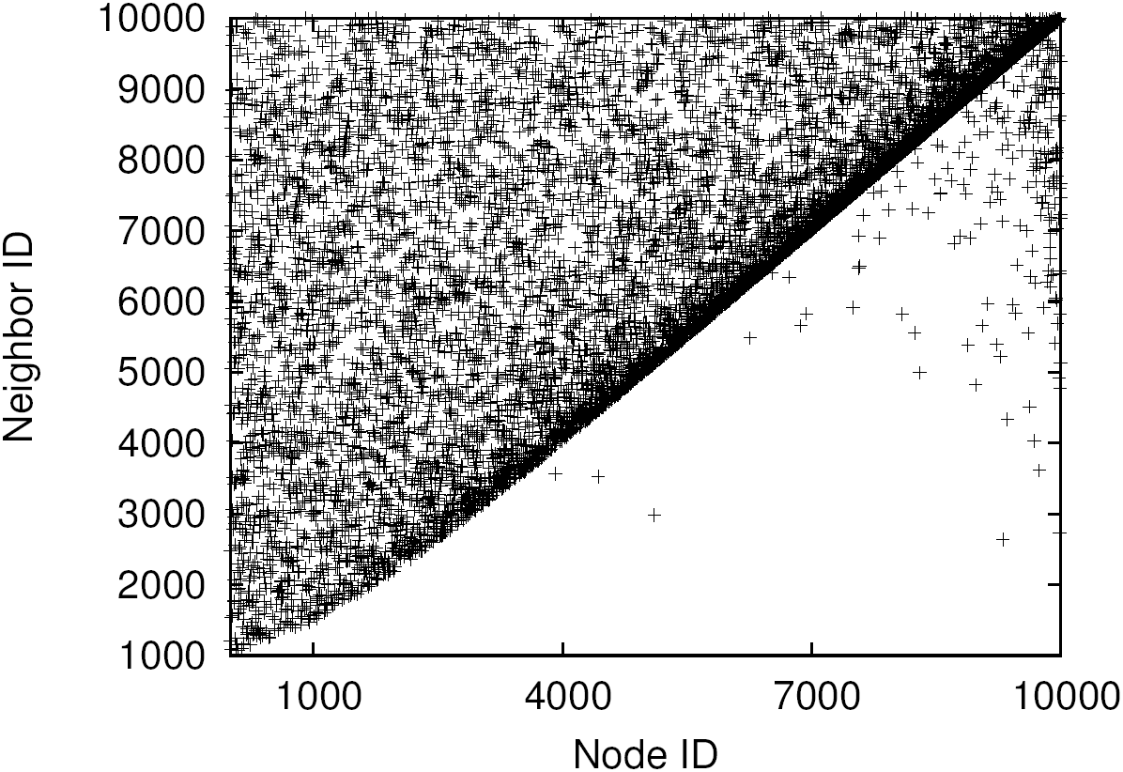
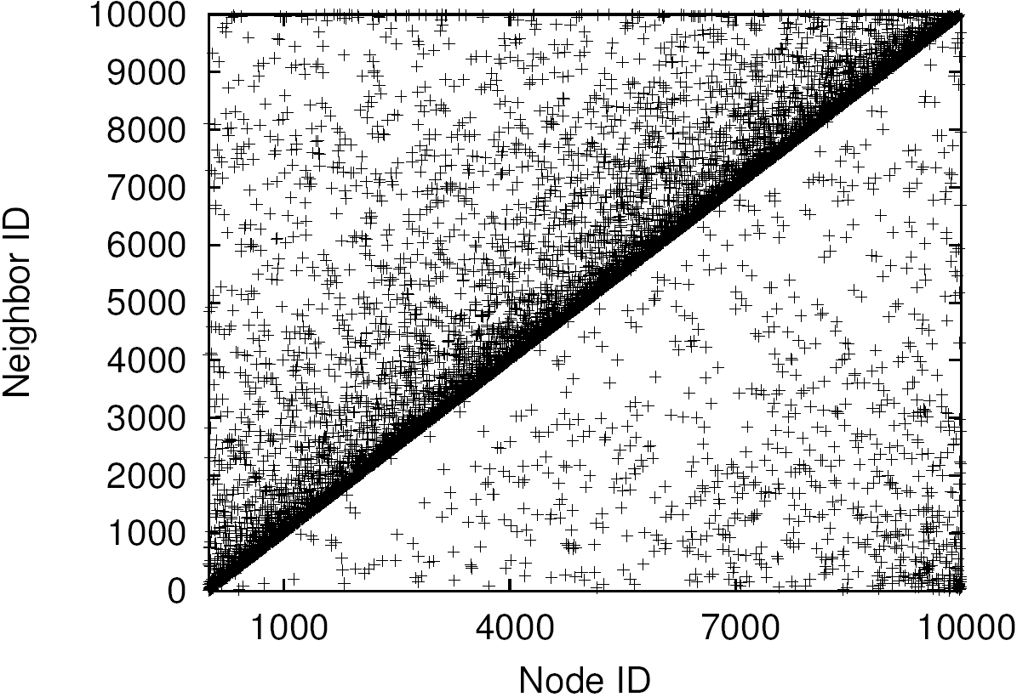
Overlay Structure
Neighbor ID
Node ID
Node ID
Node ID
Chord/Symphony
Ideal
Mercury
Finger pointers created by different schemes
  Nodes should pick greater number of neighbors near them and few long links
Notes:
What do we want the overlay to look like? Remember that each node should have exponentially spaced finger pointers… i.e., it should pick a bunch of neighbors near itself and a few links far from itself at a decaying rate. So, if nodes along the circle are numbered consecutively, we should see that a node 50 has links to 51, 52, 54, etc.. And a few links among the very far nodes. The plot here shows the ideal overlay that should be constructed. X-axis is the node ID, Y-axis is the neighbor ID… so, we should see a thick band just above the y = x line… now, let’s see what happens with a naïve DHT without hashing and load balancing and Mercury… we see blah.

Slide 19
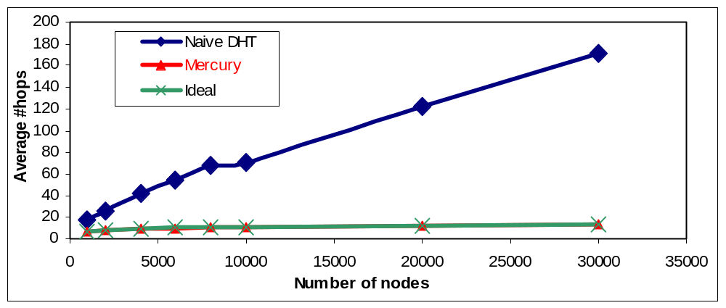
Routing Performance
Notes:
What is cached here?

Slide 20

Outline
Single-attribute range queries
Performance evaluation
Multi-attribute range queries
Discussion and summary

Slide 21

Multi-attribute Range Queries
Send data to all rings
Send query to only ring
Query
[240, 320)
50 ≤ x ≤ 150
150 ≤ y ≤ 250
[0, 105)
[160, 240)
R_{x}
[0, 80)
R_{y}
Data item
x = 100
y = 200
[210, 320)
[80, 160)
[105, 210)
Notes:
Explain how histograms can aid in selectivity estimation; how sending a query to only one attribute can make this optimization possible.
We are aiming at really reducing query load here; if we think queries are infrequent, one can turn this around.

Slide 22
Design Rationale
Send data-items to all rings??
Send queries to all rings??
vs.
Queries span multiple nodes; one ring restricts propagation
  0 < x < 1000 && 0 < y < 1000
Use histograms for selectivity estimation
  0 < x < 100 && y = *

Slide 23
Outline
Single-attribute range queries
Performance evaluation
Multi-attribute range queries
Discussion and summary

Slide 24
Alternate Designs
Virtual servers [Stoica02]
  #virtual servers ∝ skew
  Data-item distribution can have large skews
    Many virtual servers ⇒ high overhead
SkipNet [Harvey03]
  Load balancing OR range queries
Load balanced skip graphs [Karger04, Aspnes04]
  More complex to maintain
  Need random sampling
Notes:
Multiple instances of same physical node; Handles skews in randomizing hash functions
Supports constrained load balancing onlyv
Alternative designs
- a few other systems perform range queries
+ skipnet
+ skip graph based load balancing work?
- load balancing of data-items

Slide 25
Conclusions
Lesson: a little knowledge about a distributed system helps a lot!
Sampling and histogram maintenance
  Useful for efficient routing
  Load balancing
  Selectivity estimation
Routing for range queries in P2P networks
  Efficient in the face of skewed node ranges
  Explicit load balancing
  Multiple attributes

Slide 26
Thank You!

Slide 27
Backup slides

Slide 28
Dynamics
Node join
  Join one or more hubs – join some rep in a hub
    Init routing table from the representative
  Start sampling for obtaining new histogram
    Make new long-distance links
    Obtain new cross-hub neighbors
Node leave
  Maintain successor lists
  Repair succ-pred pointers
  Repair long-distance links only when number of nodes changes by a factor of 2

Slide 29
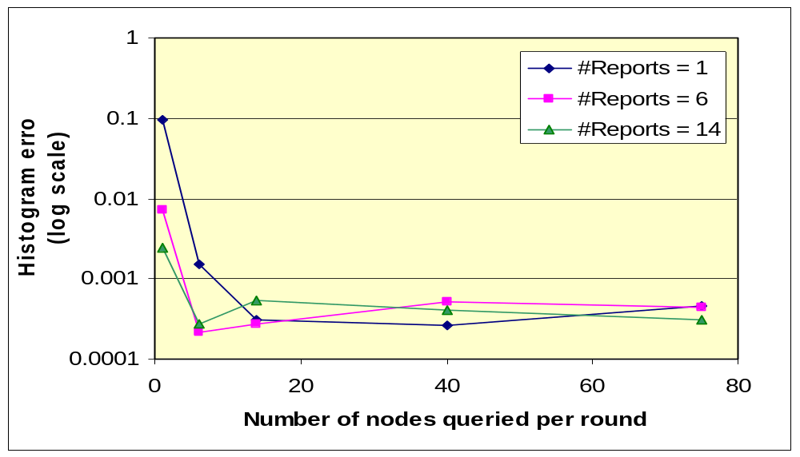
Histogram accuracy

Slide 30
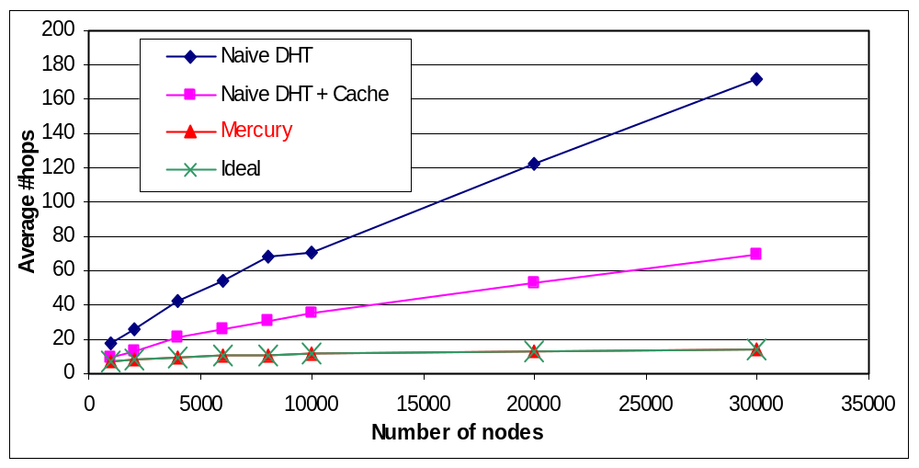
Routing Performance
Notes:
What is cached here?

Slide 31
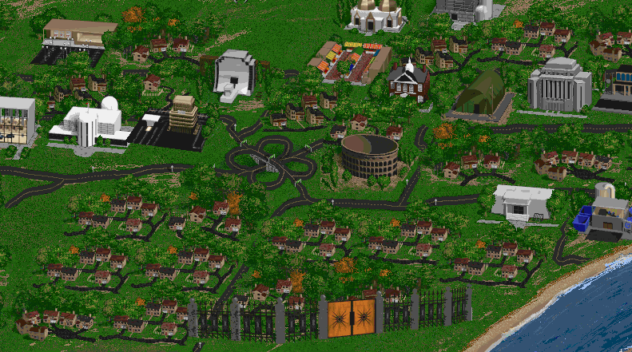
Multiplayer Games
Large shared world
  Composed of map information, textures, etc
  Populated by active entities: user avatars, AI bots, etc
Only parts of world relevant to particular user/player
Game World
Player 1
Player 2

Slide 32
Gaming with Mercury
Key challenge: provide every player with relevant updates without central server
Use Mercury for performing distributed object discovery
Each player “registers” a range predicate
  Bounding box region surrounding itself
  Periodically updated
Player movements are “matched” against the queries

Slide 33
Attribute Rings
Age+weight
Age
x
name
x
name
Intra-ring
links
y
y
Cross-ring
links
Hub = routing ring
Rings in the system
One hub for each attribute
  Linearization to support multiple attributes within a ring
Single node may participate in multiple rings
Notes:
Not good for a large number of attributes
Each node in a hub holds a contiguous range of attribute values

