Slide 1


RouterFarm: Towards a Dynamic, Manageable Network Edge
Mukesh Agrawal, Bobbi Bailey, Zihui Ge, Albert Greenberg, Kobus van der Merwe, Jorge Pastor, Panagiotis Sebos, Srinivasan Seshan, and Jennifer Yates
Internet Network Management Workshop 2006

Slide 2


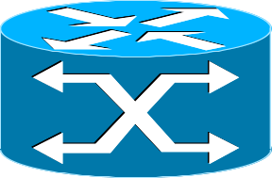
Today's IP Networks
Customers
ISP Backbone
Customers
Backbone Router
Edge Router
Customer Router
Notes:
Points:
we have three types of routes: customer, access, and backbone
We have redundancy in backbone routers

Slide 3
The Weakest Link
Customers
The network edge is a major source of customer downtime, due to...
software updates
OS crashes
CPU failures
line card failures
etc.
ISP Backbone
Customers

Slide 4
Edge vs. Backbone Routers
Customers
ISP Backbone
 | Backbone | Edge
Network Layer | IP, OSPF, MPLS | IP, OSPF, MPLS, BGP, EIGRP, VPN, ACLs
Link Protocols | POS, Ethernet | POS, Ethernet, ATM, Frame Relay, DS3, DSL, …
Redundancy | High | Low/None
Scale (# interfaces) | Low 1,000s | High 10,000s
Customers
Notes:
Points:
Edge routers have more diversity (hence complexity) => hard to get reliability (can’t get good testing coverage, e.g.)
We can’t make edge redundant (too expensive, due to scale)
We can’t make edge homogenous, unlike backbone

Slide 5
The State of the Art
Customers
Vendors have proposed a collection of ad-hoc solutions...
hitless updates
1:1 redundant CPUs with fail-over
1:1 redundant line cards
ISP Backbone
These solutions
are costly
introduce complexity
tie ISPs to vendor priorities/schedules
each requires new testing
Customers
Notes:
Emphasize cost of 1:1 redundancy
Costly: redundant hardware. And the hardware is specialized (non-commodity), hence expensive
testing: APS has seen field failures, e.g.

Slide 6
A Better Way?
Customers
Let routers fail, but make service restoration fast and easy
(like RAID and server farms)
Share resources to minimize cost
ISP Backbone
Customers
Develop one technique that works across a variety of scenarios

Slide 7
The RouterFarm Way
Manage routers as a “Router Farm”, dynamically moving customers as necessary
Notes:
Basic idea behind routerfarm: customers can be moved between a cluster of routers

Slide 8



RouterFarm in Action
(Planned Maintenance)
BGP
Extract customer configuration from initial router
Install customer configuration on to target router
Reconfigure transport (layer 2) connectivity
Wait for network to converge
Perform maintenance
Notes:
Explain context (refer to icon)
transport network:
Already in use today
Give examples of such networks (e.g. metro network, wide-area transport)
circuit-switched network => more reliable than IP
Copying config is specific to our realization of RF architecture (alternatively, could put functionality into provisioning system)

Slide 9
RouterFarm Viability
Customer 2
IP /MPLS network
IP /MPLS network
Remote Edge
Transport
Network
Target
Initial
Router Farm
Server
Traffic
Generator
Cross-Connect
Customer 1
Questions
How long does it take to re-home a customer?
What contributes to that time?
How does time scale with number of customer routes?
Notes:
See paper details, but…
Transport and IP
Real routers (7200s and 12000s)
Real links (POS)

Slide 10
RouterFarm Benefits
(Planned Maintenance)
Today
Outage: 10-15 min
RouterFarm
Outage: 2x 1 min
Notes:
Make clear that 10-15 minutes isn’t our measurement
Potential side-benefits:
if maintenance doesn’t have as much time-pressure, maybe it can be done more slowly/carefully
if maintenance were less painful (down to single digit seconds), maybe it could be done more often

Slide 11
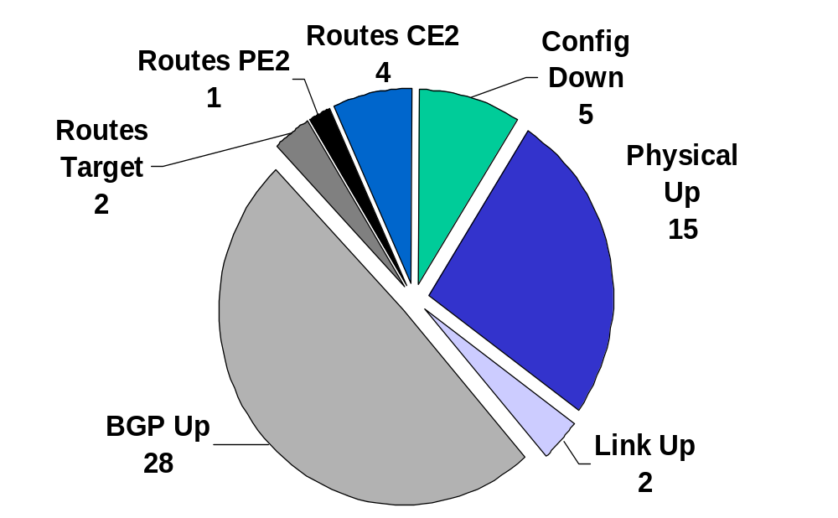
Time Breakdown
Total outage: 57 seconds
Notes:
Points:
Most of outage is caused by timers
These timers default high due to unimportance (today) of service establishment time
Could fix this with vendor help

Slide 12
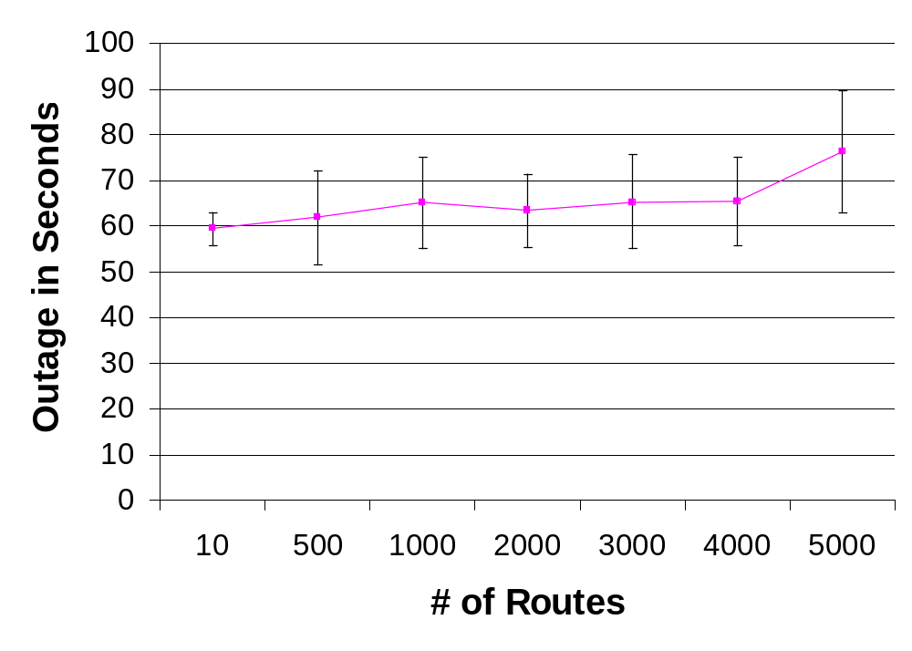
Scaling in Customer Routes
(mean and 95% confidence interval from 10 runs)
Notes:
May need to explain what was measured here
May need to argue for usefulness of single customer measure

Slide 13
RouterFarm Questions
How can we reduce outage times further?
How do outage times scale with number of customers?
Can we manage configuration in heterogeneous networks?
How do we keep up with an evolving network?
Notes:
Diversity (“death by a thousand cuts”): link layer (Ethernet vs. POS, channelized vs. unchannelized, CRC length, scrambling), network layer (static vs. BGP routing, VPN, multicast, class of service), hardware (tunneling support, ACL support on subifs, etc.)
Evoloving network: new link technologies and services

Slide 14
Challenge: Extracting
Configuration
ip vrf VPN1 …
controller T1 1/0 …
router bgp 65535
neighbor 192.168.10.2
network 10.1.0.0/16
interface Serial 1/0/1
ip address 192.168.10.5/30
ppp XXX
interface Ethernet 2/0
ip address 192.168.10.1/30
vrf forwarding VPN1 …
interface ATM3/0/1
ip address 192.168.10.9/30
ppp XXX
interface Multilink 1000
ip route 10.1.1.0/24 Serial1/0/1
ip route 10.1.2.0/24 ATM3/0/1
Notes:
Based on cisco syntax, but modified to fit your screen ☺

Slide 15
Challenge: Extracting
Configuration
ip vrf VPN1 …
controller T1 1/0 …
router bgp 65535
neighbor 192.168.10.2
network 10.1.0.0/16
interface Serial 1/0/1
ip address 192.168.10.5/30
ppp XXX
interface Ethernet 2/0
ip address 192.168.10.1/30
vrf forwarding VPN1 …
interface ATM3/0/1
ip address 192.168.10.9/30
ppp XXX
interface Multilink 1000
ip route 10.1.1.0/24 Serial1/0/1
ip route 10.1.2.0/24 ATM3/0/1
?

Slide 16
Challenge: Extracting
Configuration
ip vrf VPN1 …
controller T1 1/0 …
router bgp 65535
neighbor 192.168.10.2
network 10.1.0.0/16
interface Serial 1/0/1
ip address 192.168.10.5/30
ppp XXX
interface Ethernet 2/0
ip address 192.168.10.1/30
vrf forwarding VPN1 …
interface ATM3/0/1
ip address 192.168.10.9/30
ppp XXX
interface Multilink 1000
ip route 10.1.1.0/24 Serial1/0/1
ip route 10.1.2.0/24 ATM3/0/1
Extraction varies with interface and service
Configuration idioms can make some of this easier
Tools which infer relationships may help further
Notes:
Configuration idioms: tagging static routes by customer, using ppp chap hostname on mlppp
Inferring relationships: based on object type (e.g. IP address, access-list name), and reference modes (explicit by equal name, implict by containment of ip prefix)

Slide 17
Challenge: Integrating
Configuration
Customer configuration depends on “global” configuration options
What if configuration differs between routers?
  Configuration difficult to reason about, but heuristics might help…
  Observation: some things should differ, others should not
  Idea: use frequency with which an differs across network to estimate probability of error
Notes:
Difference that might be okay… something topology-sensitive (e.g. bgp router-id)
In fact, some things probably _ought_ to differ
Example global config: router-filters, packet-filters, bgp fast-external-fallover default

Slide 18
Conclusion
RouterFarm provides a solution to many edge-router reliability problems
RouterFarm improves outage times for planned maintenance
Configuration potentially an obstacle; need new tools and techniques to minimize risk
Performance at scale, and evolving with the network require further investigation

Slide 19
Thank you

Slide 21
Backup

Slide 22
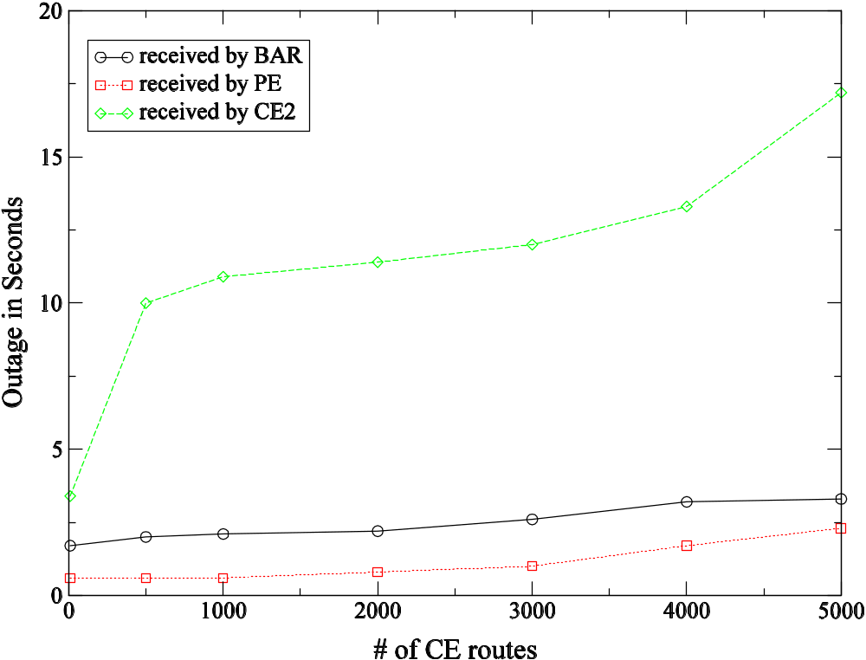
Lab Experiments

Slide 23
Testing Goals
Good coverage over customer configs
Limited hardware requirements
Automated
Fast (hopefully, run every night)

Slide 24

Testing Design
Initial router
A
A
B
A
B
A
B
A
A
A
B
A
A
B
B
target router
=?

Slide 25
Batched Route Transfer
Target Router
PE
CE2
Customer
Routes
BGP Established
Partial Customer Routes
Partial Customer Routes
IBGP MinAdver Timer (5 sec)
EBGP
MinAdver
Timer (30 sec)
Remaining Customer Routes
Remaining Customer
Routes

Slide 26
Clipboard

Slide 27
The RouterFarm Way
Notes:
Basic idea behind routerfarm: customers can be moved between a cluster of routers

Slide 28



Migration Challenges
Transport layer capacity
(IP vs. transport, bandwidth, duration, distance)
Inconsistent/noisy data
(circuit IDs, transport routing, configuration errors)
Scale
(# routes, # customers)
Network diversity
(DS1 vs. ATM, BGP vs. static, VPNs, CoS)

Slide 29
Feasibility: Goals
Demonstrate feasibility using “off-the-shelf” commercial routers
Establish that we reduce outage time over existing practice (especially for planned maintenance)
Quantify variability in re-homing times
Determine scaling of outage time in number of routes

Slide 30



Slide 31


Ongoing Work
?

Slide 32
Challenges
Scale: can we move all customers to a new router
  without overwhelming the new router?
  without overwhelming the network?
Diversity: moving customers requires configuration of numerous network layers, protocols, and parameters. In a network with 1000s of customers,
  how do we develop dynamic reconfiguration tools?
  how do we test these tools, without elaborate (and expensive) testbeds?
Notes:
we've only just begun!

Slide 33
Router Configuration Complications
So many configuration options!!!
Complicated dependencies: how to extract relevant configuration? (need to understand network services)
Inconsistent defaults
(e.g. CRC length, POS scrambling)
Channelized vs. unchannelized line cards
(“clock source” irrelevant for channelized interfaces)

Slide 35
The RouterFarm Way

