Slide 1
Analyzing Stability in Wide-Area Network Performance
Hari Balakrishnan
Mark Stemm
Randy H. Katz
Srinivasan Seshan
Computer Science Division
University of California at Berkeley
IBM T.J. Watson Research Labs
Hawthorne, NY

Slide 2
Background
Had access to IBM’s 1996 Olympic WWW server
  Hundreds of thousands of clients
  Tens of millions of hits per day
What can we learn about real-world network performance from packet-level traces from this busy WWW server?

Slide 3
Goals
If we model the throughput to Internet hosts as a random variable:
  Characterize throughput: what is the distribution of the random variable?
  Geographic stability: do nearby clients have the same distribution?
  Temporal stability: how does a host’s distribution change at different times?

Slide 4
Roadmap
Description of WWW server and dataset
Metrics and statistical methodology
Characterizing distributions
Geographic stability
Temporal stability
Conclusions, future work

Slide 5
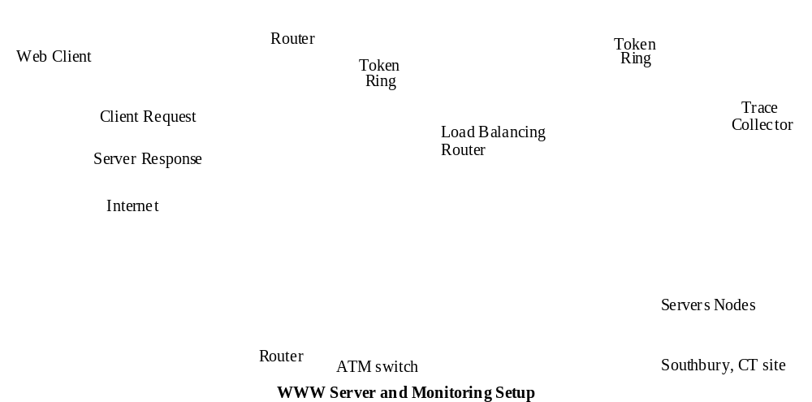
Web Server Setup

Slide 6
Data Collection Methodology
Data collection machine running tcpdump, capturing TCP acks on http port
Modified network stack on WWW servers to send out retransmission notifications
Post-processed ack traces to find client throughput samples
After Olympics, ran traceroute to every host who visited the WWW site

Slide 7
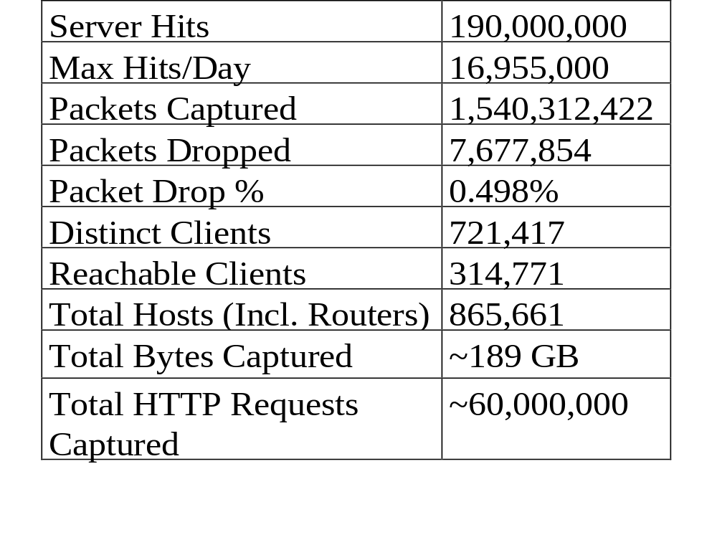
Trace Summary

Slide 8
Our Metric: Throughput
Throughput: (session bytes)/(session time)
  Session is measured across parallel TCP connections
  Excludes periods when all connections experience coarse timeouts
    Allows to remove randomness from TCP’s deficiencies, focus on what would happen if TCP were more ideal
Take log of throughput to reduce effect of outliers

Slide 9
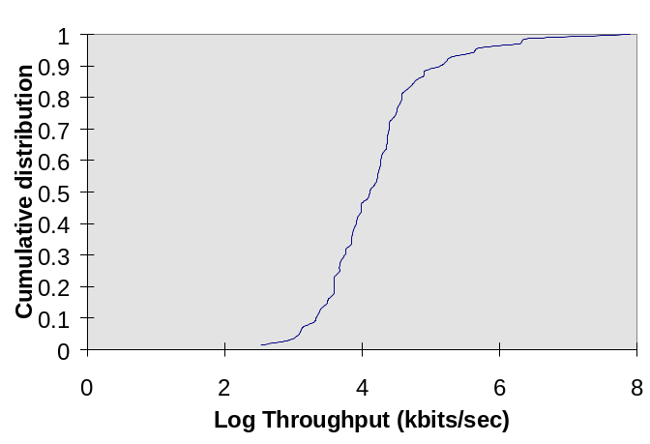
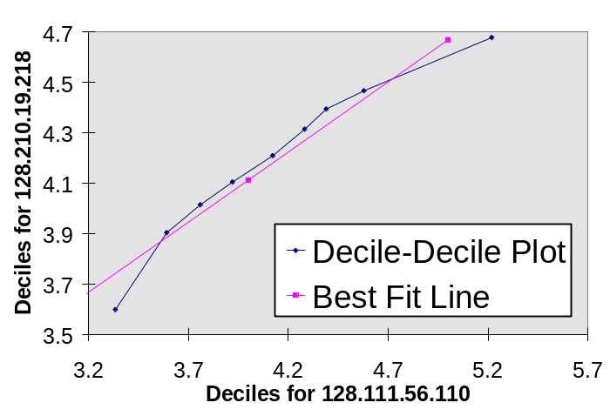
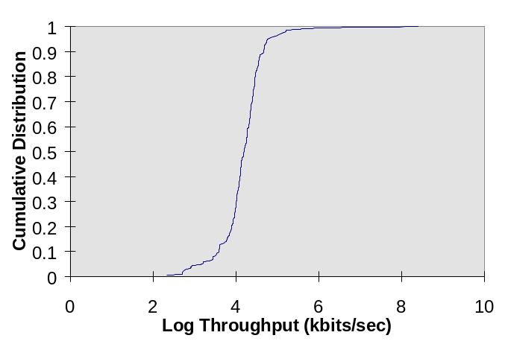
Statistical Methodology
Basic Tool: Quantile-Quantile Plot
Low mean-squared error
have same distribution
Slope close to 1
have same distribution &
same parameters

Slide 10
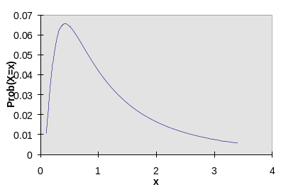
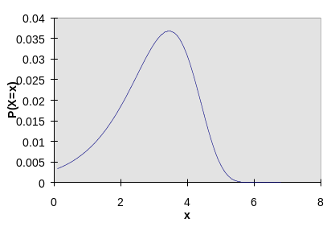
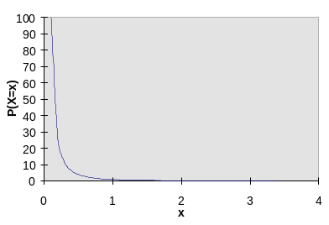
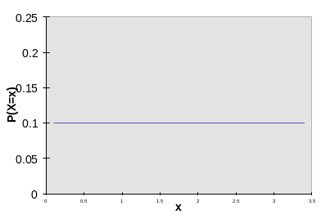
Characterizing Host Throughput
Compare log(throughput) with 4 analytical distributions:
  Normal: becomes Log-Normal
  Extreme: becomes Log-Extreme
  Exponential: becomes Pareto, parameter 2
  Uniform:

Slide 11
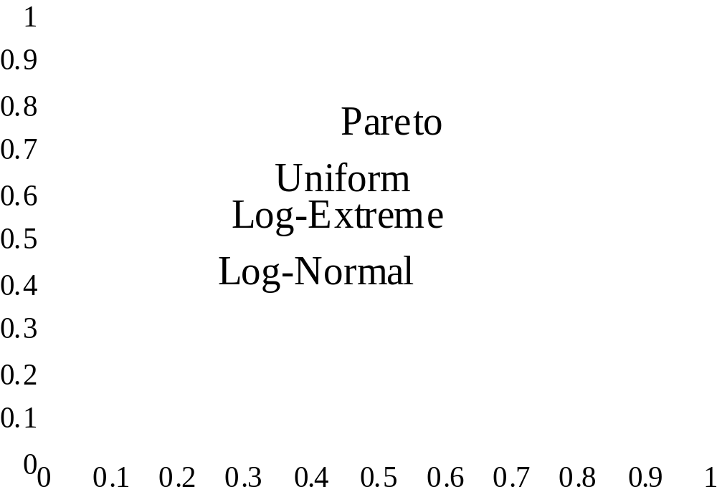
Characterizing Throughput (Cont.)
Probability
R²

Slide 12
Geographic Stability
Terminology: A cluster of size k is a collection of hosts who have a common router k/2 hops away.
A cluster of hosts have similar performance if more than half of the pairs of hosts have similar performance.
Calculated number of clusters that had similar performance for sizes k=2, 4, 6
Also compared cluster of size 2 against a cluster of randomly selected hosts

Slide 13
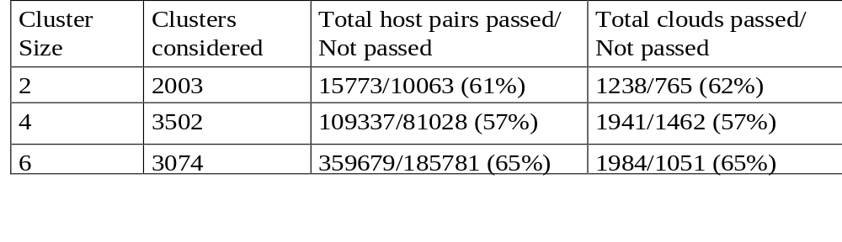
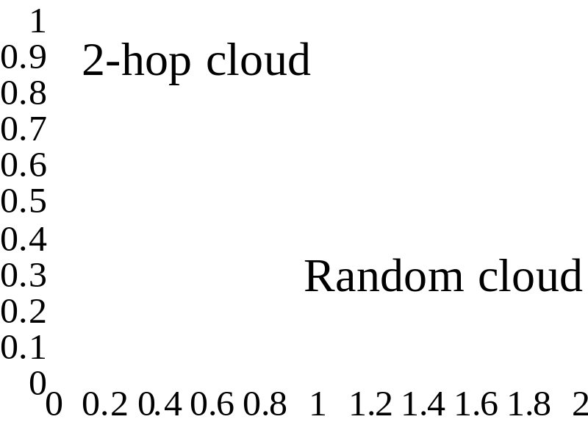
Geographic Stability (Cont.)
Probability
Slope of Best Fit Line

Slide 14
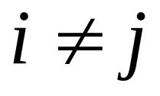
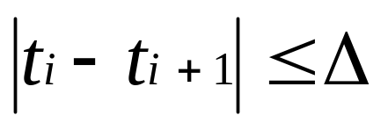
Temporal Stability
Let t₁..t_{n} be throughput measurements at discrete times 1…n.
Two components: stationarity and persistence
stationarity: E(t_{i})=E(t_{j}) for
persistence:
stationarity captures long-term changes, persistence captures short-term variation

Slide 15
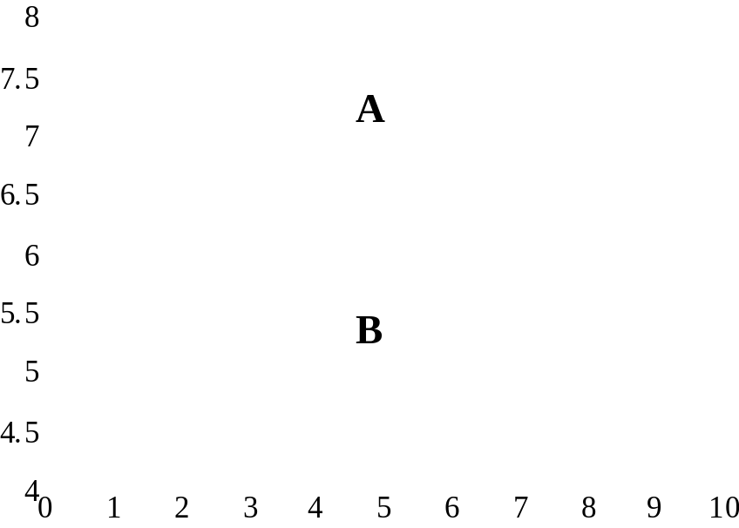
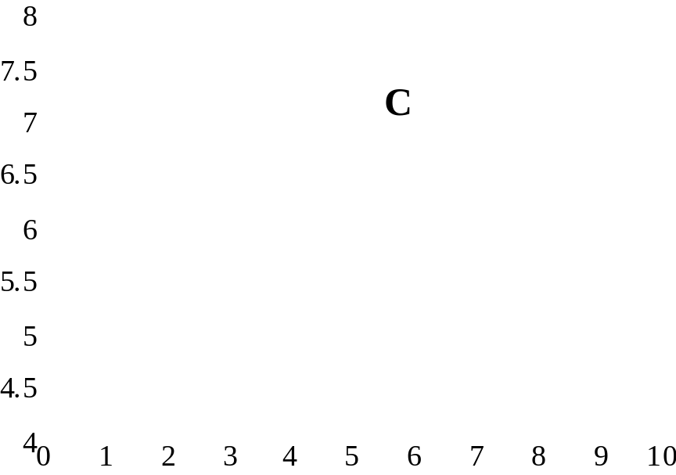
Temporal Stationarity
Log₂ Throughput
Log₂ Throughput
Time (seconds * 10³)
Time (seconds * 10³)
A and B are “stable” hosts
C is “unstable” host

Slide 16
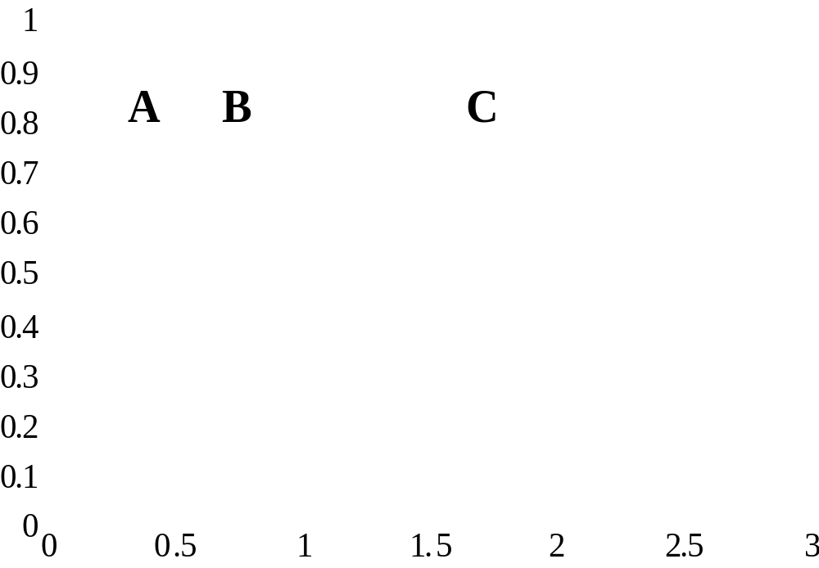
Temporal Persistence
Cumulative Probability
Relative Change Between
Successive Samples (Log₂ Kbits/sec)

Slide 17
Conclusions
Throughputs to individual hosts can be modeled using a log-normal distribution
Nearby hosts often have identical throughput distributions
For some hosts, throughputs vary by less than a factor of two for minutes

Slide 18
Future Work
Automate temporal analysis
TCP-specific analysis and improvements
  Effectiveness of loss recovery mechanisms
  Effect of multiple TCP connections on “fairness”
Build system that caches performance numbers and shares network performance information with nearby hosts

Slide 19
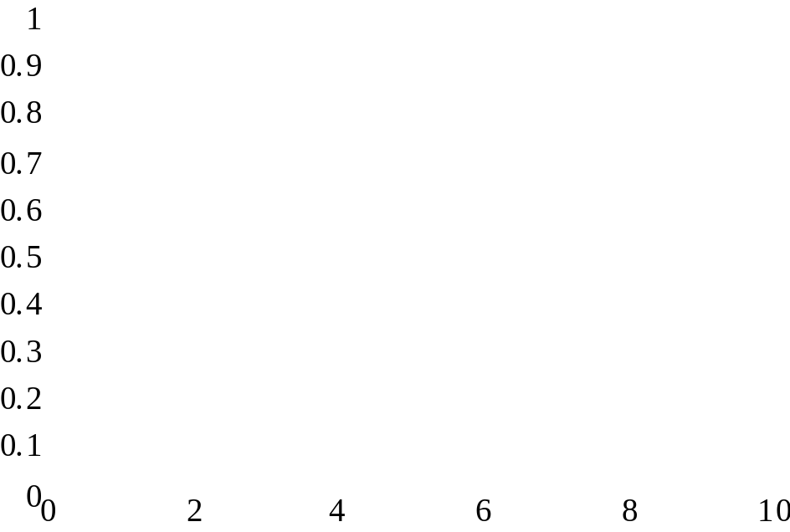
Client Heterogeneity
1
0.9
0.8
0.7
0.6
Probability
0.5
Probability
0.4
0.3
0.2
0.1
0
0
10000
20000
30000
40000
50000
60000
70000
Avg. Throughput (Kbps, log₂ scale)
Receiver window size (bytes)

