Slide 1
SPAND: Shared PAssive Network performance Discovery
Mark Stemm
Randy H. Katz
Srinivasan Seshan
Computer Science Division
University of California at Berkeley
IBM T.J. Watson Research Labs
Hawthorne, NY

Slide 2
Motivation
Determine in advance the network performance (available bandwidth, packet loss probability) to distant network sites
Apps that could use this
  Apps that choose between mirror sites
    (Harvest, Mirrored FTP/Web sites)
  Apps that have a choice of content fidelity
    (CMU Odyssey, UCB TranSend, Low graphics WWW sites, Streaming multimedia)
  Apps that present user feedback as to state of network

Slide 3
Outline
Other Solutions
Design of SPAND
  Sharing Performance Information
  Passive Measurements
Current Implementation Status/Future Work

Slide 4
Other Solutions: Probing Algorithms
Back-to-back packets (packet pair, bprobes)
  Packets get spaced out at bottleneck link, spacing is preserved at other faster links
  If network implements fair queuing, spacing determines “fair share” of bottleneck link bandwidth
  Without fair queuing, spacing provides little information (min is probably close to raw link bandwidth)

Slide 5
Probing Algorithms (Contd.)
Pathchar
  Combines traceroute and packet pair to find hop-by-hop latency and link bandwidth
Cprobes
  Sends small group of echo packets as a simulated connection (w/o flow or congestion control)
Common problem
  Rely on Active Probing, which introduces unnecessary traffic into network

Slide 6
Other Solutions: Server Selection Systems
Boston University: cprobes, bprobes
Harvest: round trip time
Harvard WWW Caching: geographic location
IPV6 Anycast
HOPS/IDMaps: routing metrics or probes
Common problems
  Use Wrong Metrics for server selection
  Rely on measurements from a Single Host

Slide 7
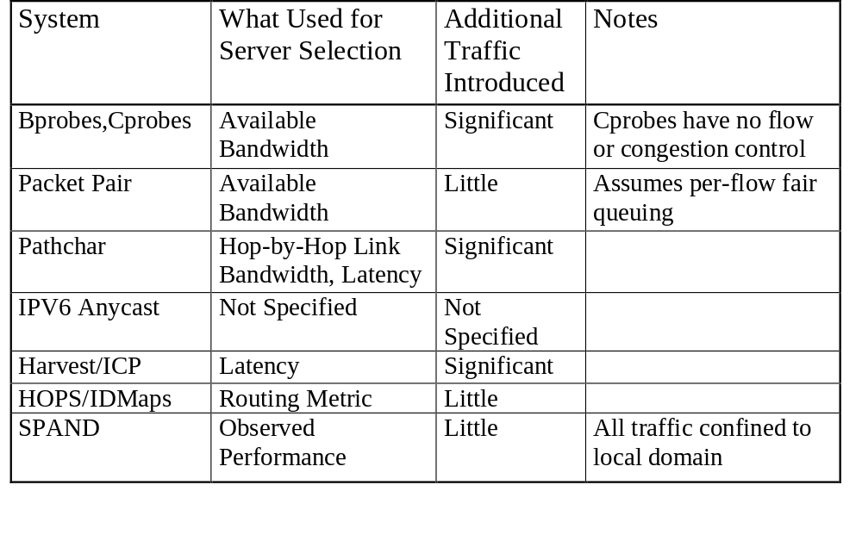
Summary of Previous Work

Slide 8
Outline
Other Solutions
Design of SPAND
  Sharing Performance Information
  Passive Measurements
Current Implementation Status/Future Work

Slide 9
Design Principles
Share measurements from many hosts
  Nearby hosts are likely to observe the same performance to distant hosts
  Eliminates redundant probes
Use passive measurements of network traffic
Use the right metrics: observed end-to-end performance

Slide 10
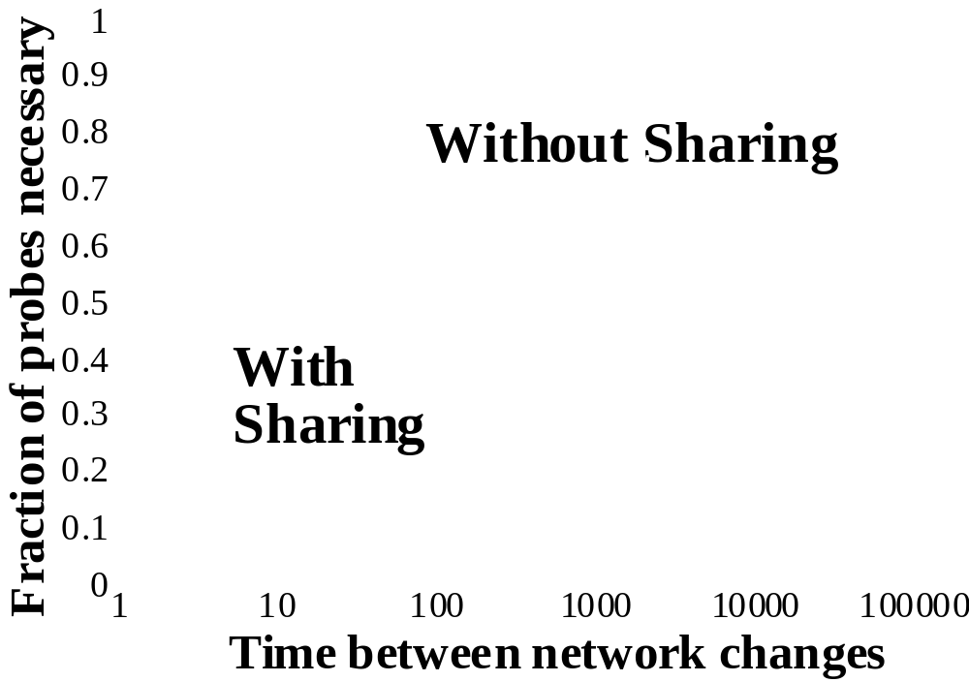
Benefits of Sharing

Slide 11
Benefits of Passive Measurements
Active probing introduces unnecessary traffic
Can quickly become a significant amount of the traffic handled by a busy web server
Illustrative example:
  Consider mirrored site with k mirrors
  A client must probe all the mirrors before selecting one
  As number of mirrors increases, fraction of probe traffic increases, and requests per second that each mirror can handle decreases

Slide 12


Design of SPAND
Internet
Client
Packet
Capture Host
= Data
= Perf. Reports
= Perf Query
Performance
Server
Client

Slide 13
Design of SPAND
Clients: have modified network stacks that transmit performance reports to performance servers
Performance Servers: receive reports from clients, aggregate/post-process reports, and serve them out to requesting clients
Packet Capture Host: snoops on local traffic, sends performance reports to perf. server

Slide 14
Outline
Other Solutions
Design of SPAND
  Sharing Performance Information
  Passive Measurements
Current Implementation Status/Future Work

Slide 15
Current Status
C++, Java toolkits implement API
Packet Capture Host, Performance Server implemented
Performance Server currently has simple aggregation policy
Demo applications:
  Overview of a local sites connectivity
  WWW user feedback via modified HTML

Slide 16
Prediction Performance
1
With
out
App
Heuristics
0.8
With
A
pp
Heuristics
0.6
Cumulative Probability
0.4
0.2
0
1/64
1/16
1/4
1
4
16
64
Ratio of Expected to Actual Throughput

Slide 17
Transparent Content Negotiation
Adapting content to available bandwidth
Server side
  Serving lower quality content during peak loads
  Modified Apache server
  Measurements show dependence on presence of “compressible” content
Client side
  Identifying slow transfers
  Requesting lower quality for slow transfers
  Analysis shows promise

Slide 18
Client Side Content Negotiation
1
0.9
0.8
0.7
0.6
0.5
Fraction of Requests
0.4
0.3
Fast transfers
0.2
Slow transfers
0.1
Slow transfers with content-negotiation
0
0
20
40
60
80
100
Response Time (seconds)

Slide 19
Server Side Content Negotiation
45
40
35
90% Negotiable
30
60% Negotiable
25
Not Negotiable
Throughput (connections/second)
20
15
10
5
0
0
1
2
3
4
5
6
7
8
9
Time (seconds)

Slide 20
Future Work
Deploy at gateway to large group of users
Smart aggregation of performance reports
  Aging algorithm to remove old reports
  Separating classes of users within a domain (i.e. modem pool users vs. LAN users)
  Aggregating distant sites that exhibit similar connectivity (i.e. all of Europe is probably the same)

Slide 21
Benefits of Sharing
Examined client-side (~100 clients) WWW trace
  Counted the number of necessary network probes
  First arrival time requires 1 probe (compulsory probe)
  Assume time between significant network changes is Δ:
    time_between_probes>Δ, a new probe is necessary (staleness probe)
    time_between_probes<Δ, no probe is necessary
Counted number of probes with and without sharing
Sharing reduces number of necessary probes from ~50% to ~15%

Slide 22
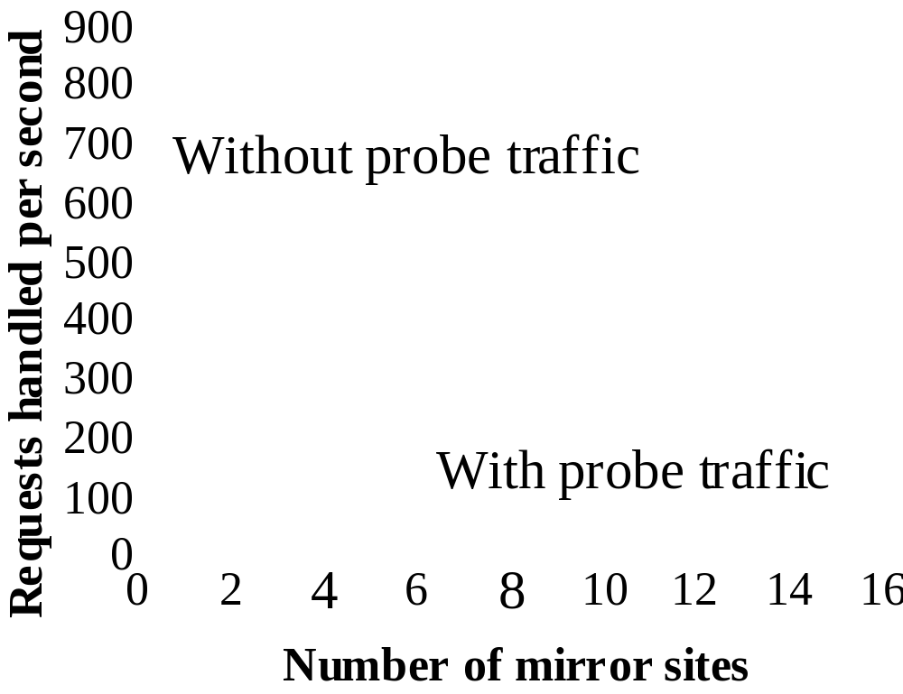
Benefits of Passive Measurements
Transfer Size: 100 kbytes
Probe Size: 6 kbytes
Each mirror has bottleneck T3 link

