Slide 1
TCP Behavior of a Busy Web Server:
Analysis and Improvements
Hari Balakrishnan
Venkata Padmanabhan
Mark Stemm
Randy H. Katz
Srinivasan Seshan
Computer Science Division
University of California at Berkeley
IBM T.J. Watson Research Labs
Hawthorne, NY

Slide 2
Motivation
Understand TCP behavior and performance in the Internet today, in the context of HTTP
  Identify problems and shortcomings in TCP
  Identify any possible protocol improvements
  Focus primarily on sender-side changes to TCP, to enable easy deployment
Testbed: IBM’s 1996 Olympic WWW server
  Hundreds of thousands of clients
  Tens of millions of hits per day
Notes:
1

Slide 3
Outline
Description of WWW server and dataset
Analysis
  Individual connections
  Concurrent connections
Improvements
  Loss recovery
  TCP-INT
Conclusions
Notes:
1

Slide 4
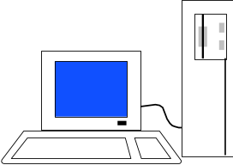

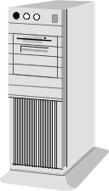
Web Server Setup
Trace Collector
Token
Ring
Load
Balancing
Router
Web Client
Router
Token
Ring
Client Request
Server Response
Internet
ATM
Switch
Server Nodes
HTTP Request,
TCP acks
TCP data packets
Southbury, CT site

Slide 5
Data Collection Methodology
Had access only to incoming traffic, i.e., all HTTP request packets and TCP acks but not data sent
Data collection machine running tcpdump, capturing TCP packets on http port
Modified Web servers to announce when TCP performed a retransmission
TCP emulation engine reconstructs precise sender behavior and evolution of TCP state variables
Notes:
2

Slide 6
Outline
Description of WWW server and dataset
Analysis
  Individual connections
  Concurrent connections
Improvements
  Loss recovery
  TCP-INT
Conclusions
Notes:
1

Slide 7
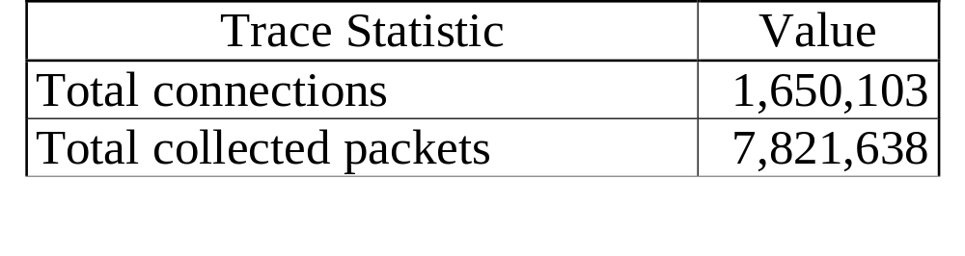
Analysis
Determine how well TCP recovers from losses
Determine how aggressive the use of concurrent connections is

Slide 8
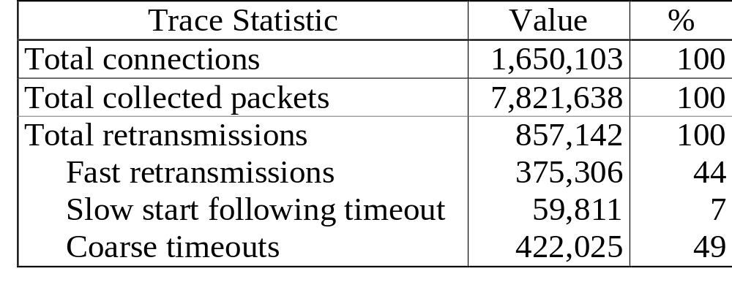
Analysis of Individual Connections
Most retransmissions occur as a result of timeouts

Slide 9
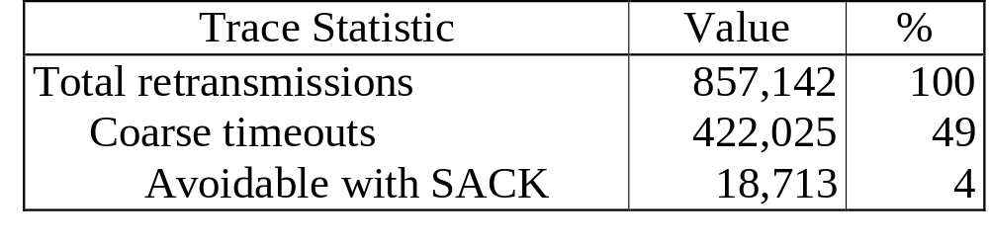
Analysis of Individual Connections
Sources of coarse timeouts
  Small window sizes
  Multiple losses in a window
SACK leads to only small additional improvement

Slide 10
Analysis of Concurrent Connections
Congestion window size
Network capacity
independent
connections
worsen
congestion
Backoff factor: 0.6-0.75
(IBM Olympics ‘96 server traces)
Time
On average, half the concurrent connections see a loss within roughly one round-trip time
Concurrent connections window behavior is more aggressive than standard TCP Reno

Slide 11
Outline
Description of WWW server and dataset
Analysis
  Individual connections
  Concurrent connections
Improvements
  Loss recovery
  TCP-INT
Conclusions
Notes:
1

Slide 12
Enhanced TCP Loss Recovery
Problem: need 3 duplicate acks to distinguish loss from reordered packets
Solution: send a new packet when first or second duplicate ack arrives
If these packets reach the receiver, additional duplicate acks will be generated, otherwise, timeout
Enables better data-driven loss recovery
Notes:
4

Slide 13
Enhanced TCP Loss Recovery
4
6
5
Router
Data Packets
Acknowledgments
Router
3
3
8
Router
7
Server
Client

Slide 14
Enhanced TCP Loss Recovery
Data Packets
Router
Acknowledgments
3
3
2
Router
Server
Client

Slide 15
Simulation: Enhanced TCP Loss Recovery
Router
Server
Client
Simulated performance of TCP when outstanding windows are not large enough to invoke fast retransmissions

Slide 16
Results: Enhanced Recovery
350
300
250
200
Packet sequence number
150
100
50
0
0
1
2
3
4
5
6
7
8
9
10
Time (seconds)
Trace analysis of Web data shows that this scheme could avoid 25% of all coarse timeouts (compared to only 4% with basic SACKs).

Slide 17
TCP-INT: Integrated Congestion Control and Loss Recovery
Problem: poor congestion control and loss recovery by short, concurrent connections
Solution: integrated congestion control and loss recovery across multiple concurrent connections
  “Combined” congestion window halved upon loss
  Use acks on one connection to initiate data-driven loss recovery for other connections
Notes:
5

Slide 18
Integrated TCP
8
3
4
2
1
Router
7
Data Packets
Acknowledgments
Router
7
1
2
4
3
8
Router
6
4
5
Server
Client

Slide 19
Simulation: Integrated Congestion Control
A
1
Router
Router
3
2
B
C
Simulation of bottleneck link sharing behavior of TCP
Connection A from host 1 to 3 (starting at t=0)
Connections B and C from host 2 to 3 (B starts at t=0, C at t=15)

Slide 20
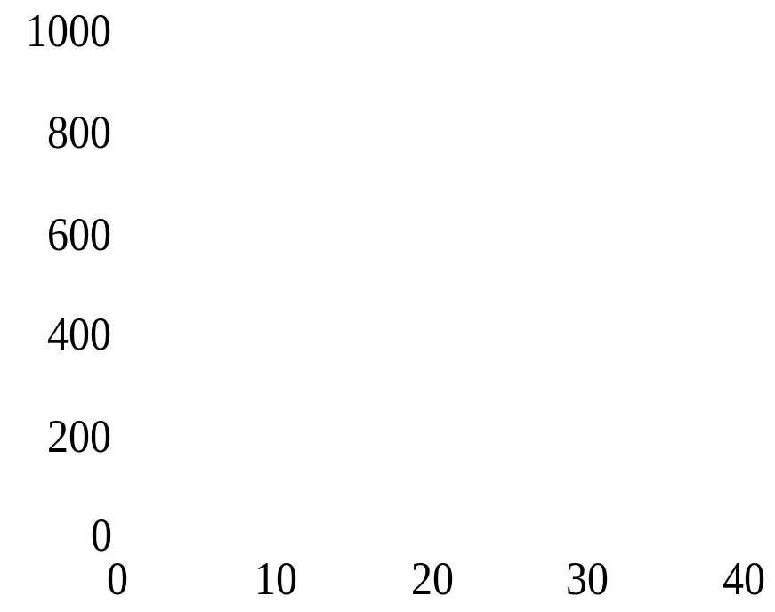
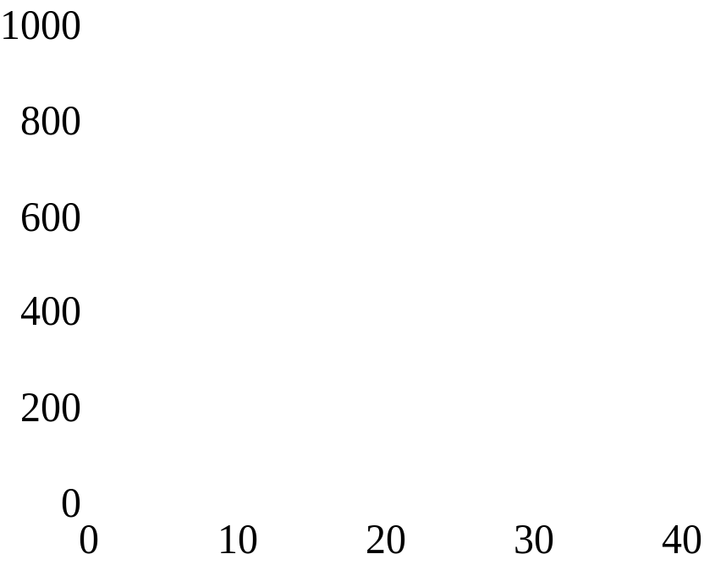
Results: Integrated Congestion Control
TCP-SACK
TCP-INT
Packet sequence number
B
A
B
Packet sequence number
A
C
C
Time (sec)
Time (sec)
TCP-SACK does per-connection congestion control, TCP-INT does per-host
TCP-INT connection C avoids performing slow-start

Slide 21
Advantages over Application Level Multiplexing
Integrate transfers initiated by separate applications
Loss of a packet from one logical stream will not stall other streams
Allow network stack to provide different service to different streams
Support for new applications

Slide 22
Outline
Description of WWW server and dataset
Analysis
  Individual connections
  Concurrent connections
Improvements
  Loss recovery
  TCP-INT
Conclusions
Notes:
1

Slide 23
Conclusions: Analysis
Over 55% of all retransmissions follow a timeout
SACK benefit is marginal (4%)
On average 50% of concurrent connections see a loss
Effective multiplicative decrease of concurrent connections is 0.6-0.75
Notes:
6

Slide 24
Conclusions: Improvements
Enhanced loss recovery scheme
Integrated congestion control and loss recovery
Sender-side modifications enable easy deployment
Notes:
6

Slide 25
Data Post-Processing
First post-processed tcpdump data to obtain one-line summary for each TCP connection
Wrote a TCP emulation engine to reconstruct precise sender behavior and evolution of TCP state variables
Used output of emulation engine to analyze characteristics of individual and concurrent connections
Notes:
2

Slide 26
Analysis of Individual Connections
Ack bandwidth = (outstanding window)/(time to ack wnd)
Data bandwidth = (outstanding window)/(time to send wnd)
Ack bandwidth ratio = (ack bw)/(median ack bw)
Ack compression factor = (data bw)/(ack bw)
Ack compression is a real, observed phenomenon
Ack compression factor easier to compute

Slide 27
Analysis of Individual Connections
0.35
Ack Compression Factor
0.3
Ack Bandwidth Ratio
0.25
Probability of loss in Subsequent window
0.2
0.15
0.1
0.05
0
14
0
2
4
6
8
10
12
Metric
Strong correlation between loss probability and ack bandwidth ratio up to a threshold
Ack compression factor also has strong correlation

Slide 28
Analysis of Concurrent Connections
6
5
4
Number with loss
3
2
1
0
0
1
2
3
4
5
6
7
8
9
Number of concurrent connections
On average, half the concurrent connections see a loss within roughly one round-trip time

Slide 29
Analysis of Concurrent Connections
1
0.8
Parallel Fast Recovery
0.6
Parallel Coarse Timeout
Effective multiplicative
decrease factor
0.4
Single Fast Recovery
0.2
Single Coarse Timeout
0
2
3
4
5
6
7
8
9
10
Number of concurrent connections
Concurrent connections window behavior is more aggressive than standard TCP Reno

Slide 30
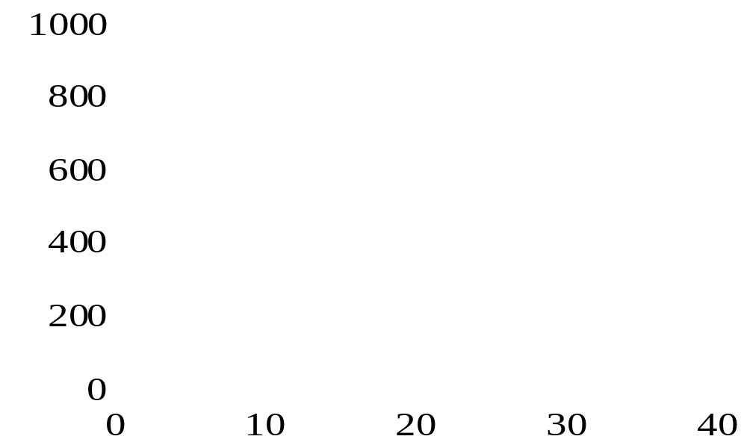
Results: Integrated Congestion Control
A
B
Packet sequence number
C
Time (sec)
TCP-INT can emulate per-connection congestion control
Maintains slow-start avoidance, better loss recovery advantages. Also provides more consistent and predictable performance.

Slide 31
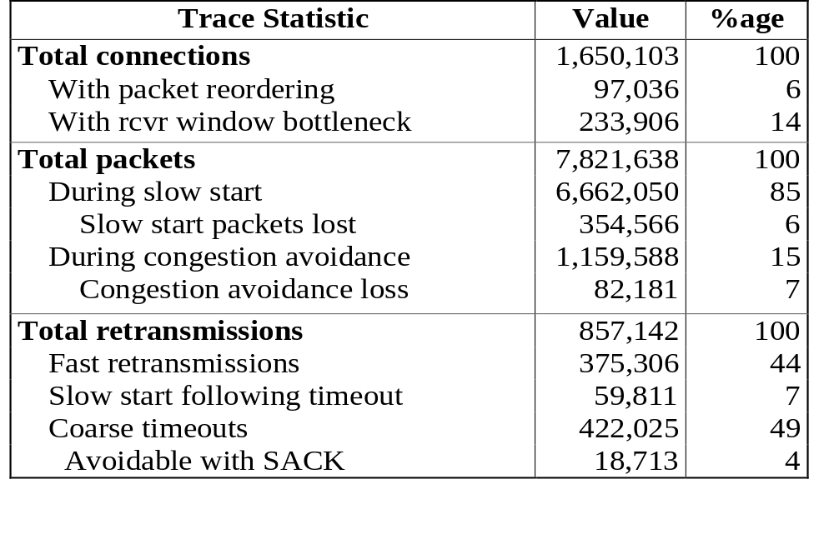
Analysis of Individual Connections

