Slide 1
An Integrated Congestion Management Architecture for Internet Hosts
Hari Balakrishnan
Hariharan Rahul
MIT LCS
Srinivasan Seshan
IBM T.J. Watson Research Center

Slide 2
Motivation
End-systems implement many functions
  Reliability
  In-order delivery
  Demultiplexing
  Message boundaries
  Connection abstraction
  Congestion control
Of these, congestion control MUST be done for all communications
Notes:
IP service model = best effort delivery
End-points do everything else… over time many functions have been implemented
Congestion control is unique…. Every endpoint must do this! This is necessary for overall efficiency of IP network

Slide 3
State of Congestion Control
“Multimedia Transmissions Drive Net Toward Gridlock”
Sara Robinson
New York Times
8/23/99
With some help from notable SIGCOMM members!
Notes:
What is state of congestion control today… not good if NY Times says “sky is falling… congestion collapse around the corner”
What drove NY Times to this conclusion? Mostly help from some notables… there are some real underlying issues

Slide 4
Concurrent Flows
f1
f2
Internet
Server
f(n)
Client
Compete for resources
  N “slow starts” = aggressive
  No shared learning = inefficient
Abstract all congestion-related
information into one location
Notes:
1st problem is wider use of concurrent flows… by web browsers, conferencing applications
N flows independantly probe network for resources -> aggressive use of network
Applications and flows do not share any info that they have found -> inefficient
Soln = store all congestion info in one location

Slide 5
Adapting to Network
?
f1
Internet
Server
Client
New applications may not use TCP
  Implement new protocol
  Often do not adapt to congestion
Need system that helps applications learn
and adapt to congestion
Notes:
Many new applications (such as multimedia or games) do not use TCP
Arduous task for applications to implement their own congestion control and do it correctly.
Most just ignore it.
Even ones that do, do not adapt application behaviour to congestion state
Need an easy to use interface for applications to learn and adapt to network state

Slide 6
State of Congestion Control
Increasing number of concurrent flows
Increasing number of non-TCP apps
Congestion Manager (CM): An end-system
architecture for congestion management
Notes:
So we can see why the state of congestion control is not so good
We need a new approach/architecture of congestion management which is why we developed the CM == congestion manager

Slide 7
The Big Picture
HTTP
Audio
Video1
Video2
Per-macroflow
statistics
(cwnd, rtt, etc.)
TCP1
TCP2
UDP
API
Congestion
Manager
IP
All congestion management tasks performed in CM
Applications learn and adapt using API
Notes:
View of a typical end-host…
Various applications transmit data through the transport protocol part of stack… and in turn through IP…
Some transports and some applications (sometimes both) monitor observed performance….
e.g. RTP receiver reports, TCP acks etc…
Sometimes they adapt to info…
each of these discoveries is done independently… we need a shared repository where this info can be stored
Anim 1…
CM stores info about the different dests that the end-host is communicating with
Anim 2
Applications report network information and read from the shared repository using a simple API…
Anim 3
As a result all congestion control is relegated to the CM and applications must use the API to interact with it

Slide 8
Problems
How does CM control when and whose transmissions occur?
  Keep application in control of what to send
How does CM discover network state?
  What information is shared?
  What is the granularity of sharing?
Key issues: API and information sharing

Slide 9
The CM Architecture
Applications
(TCP, conferencing app, etc)
API
Congestion
Controller
Scheduler
Congestion
Detector
CM
protocol
Responder
Prober
Sender
Receiver
Notes:
Requirements of api and probing sys result in following arch..
Cong ctl is repository of cong info… it gets info from the application hints as well as probing system… it implements
Cong ctl algorithms and decides when and how fast data should be sent
Once it decides data can be sent.. Control is passed to scheduler…. Sched decides which active application should be able to send.
Probing system interacts with receiver’s cong detector and responder to detect losses using cm protocol
Implemented in ns now and ongoing implementation in linux

Slide 10
Transmission API
Buffered send
  cm_send(data, length)
Request/callback-based send
App
cm_request( )
send( )
cmapp_send( )
CM
IP
cm_notify(nsent)
Notes:
The xmit api is cm’s method of control when data is sent
3forms of xmit api
Simplest is buffered send == socket send… data passed .. Buffered for some time… sent when cong ctl allows
Not great for apps that want to decide what to send at last moment… e.g. video capture.. Send latest frame not some old buffered one, even TCP must chose between new data and rxmit at last moment
Req/callback api for these apps…
Anim1
At some pt.. Cm_req
Anim2
Callback when cong ctl allows
Anim3
Send data

Slide 11
Transmission API (cont.)
Request API: asynchronous sources
  wait for (some_events) {
  get_data( );
  send( );
  }
Synchronous sources
  do_every_t_ms {
  get_data( );
  send( );
  }
Solution: cmapp_update(rate, srtt) callback
Notes:
Req/call great for async…what is async…event loop..add callback to events monitored
Many apps are sync.. What is sync… req/call not good for these… want info to set timer… soln

Slide 12
Feedback about Network State
Monitoring successes and losses
  Application hints
  Probing system
Notification API (application hints)
  Application calls cm_update(nsent, nrecd, congestion indicator, rtt)
Notes:
In order to act as a shared information repository, CM must learn about the current congestion state of the network
Does this the same way as TCP… monitors transmission and uses successful receptions, losses, and ECN to identify congestion.
CM uses the cm_notify call to keep track of transmissions. Whenever data is transmitted from a host, the IP output routine performs the cm_notify call and tells CM how much data was sent.
CM must also identify what data has reached its recipients. This is done primarily through interaction with the applications. At some point an application may identify that data has successfully arrived at its destination or lost enroute. E.g. TCP acks, RTCP reports etc. At this point the app should use cm update call. This call tells cm how much data was sent and how much of it arrived. Congestion indicator parameters indicates if congestion was detected on this xmit and how it was detected (transient, persist, and ECN). Rtt…
Probing system.. Mention for apps that don’t use cm_update
API provides a simple way to query info in repository… cm_query call allows app to ask what cm thinks is the appropriate rate and rtt estimate to use for a particular connection
Application could use repeated queries to adapt and decide when to xmit.. However this is very cumbersome and inefficient… we use an alternate style of API to control transmissions and the query interface for coarser grain adaptation of application behavior

Slide 13
Probing System
Receiver modifications necessary
  Support for separate CM header
  Uses sequence number to detect losses
  Sender can request count of packets received
Receiver modifications detected/negotiated via handshake
  Enables incremental deployment (TYPO in paper)
IP header
IP payload
CM header
IP payload
Notes:
Mention reordering?
Api so far requires tight coop between cm and apps… app must report about loss and cong for cm to learn about network state.. Not all… to support these apps we need receiver mods…

Slide 14
Congestion Controller
Responsible for deciding when to send a packet
Window-based AIMD with traffic shaping
Exponential aging when feedback low
  Halve window every RTT (minimum)
Plug in other algorithms
  Selected on a “macro-flow” granularity

Slide 15
Scheduler
Responsible for deciding who should send a packet
Hierarchical round robin
Hints from application or receiver
  Used to prioritize flows
Plug in other algorithms
  Selected on a “macro-flow” granularity
  Prioritization interface may be different

Slide 16
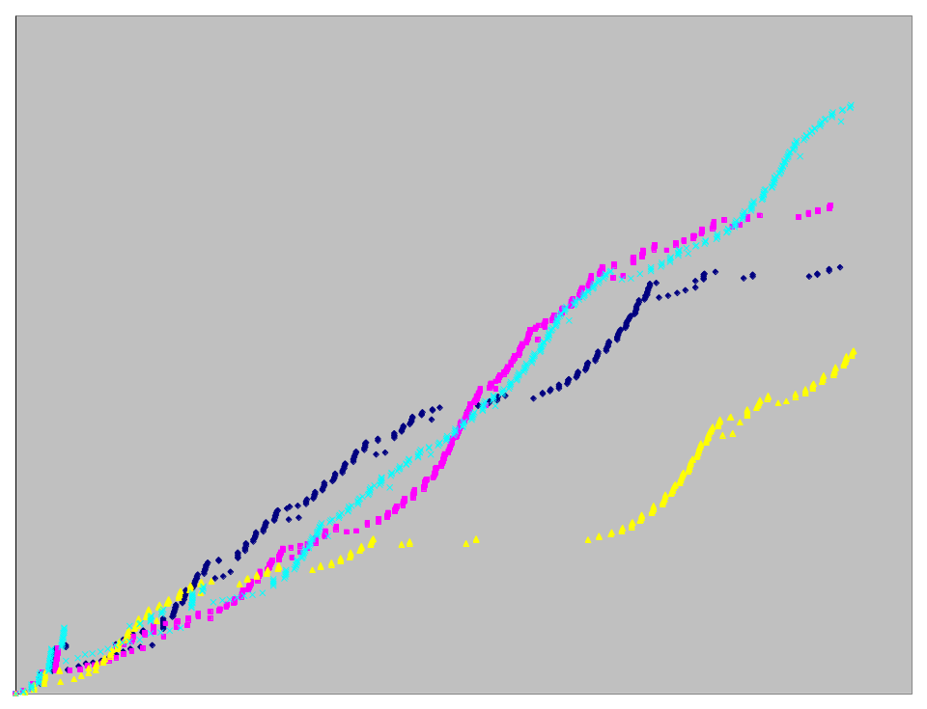
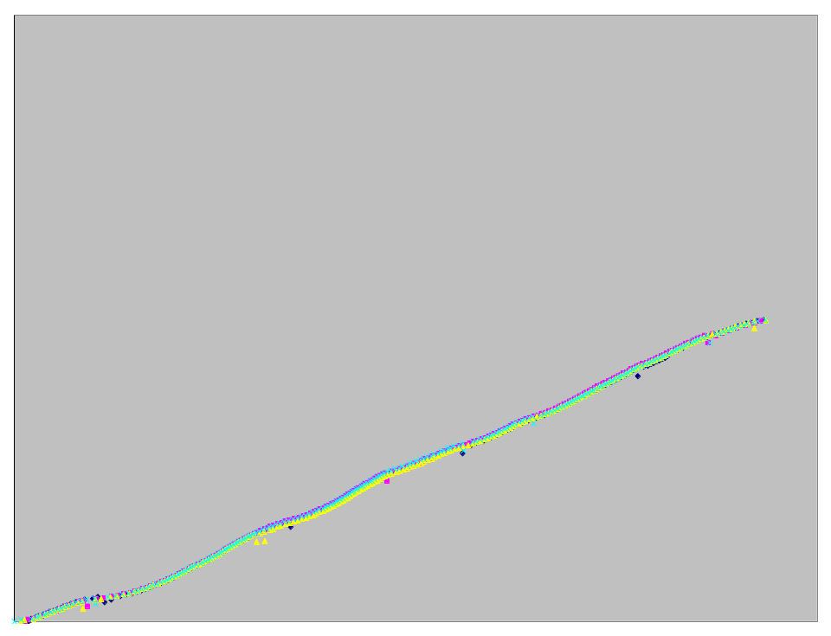
CM Web Performance
TCP Newreno
Sequence number
With CM
Time (s)
CM greatly improves
predictability
and consistency

Slide 17
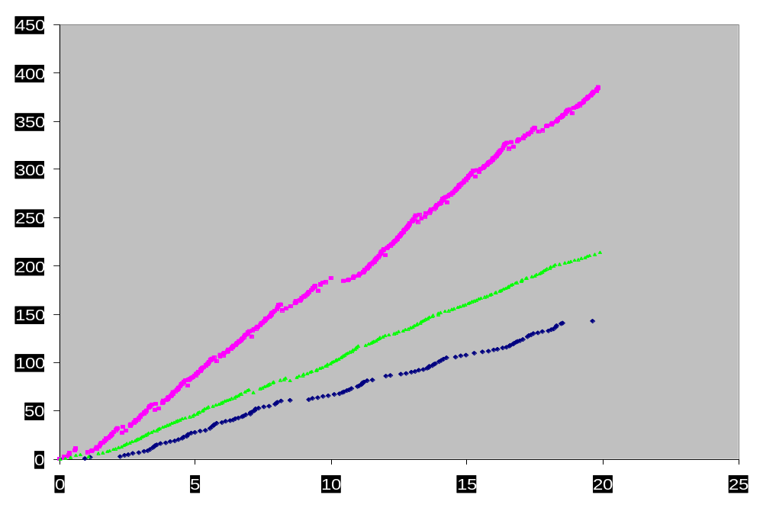
Layered Streaming Audio
Competing TCP
TCP/CM
Sequence number
Audio/CM
Time (s)
Audio adapts to available bandwidth
Combination of TCP & Audio compete equally with normal TCP

Slide 18
Summary
CM enables proper and stable congestion behavior
Simple API to enable application to learn and adapt to network state
Improves consistency and predictability of network transfers
CM provides benefit even when deployed at senders alone

Slide 19
Future Work
Implementation in progress (Linux)
Handling diff-serv
Aggregation: per-host, per-subnet,…
Feedback frequency analysis
Aging of congestion information
Write adaptive applications

Slide 20
CM API
State maintenance (open, close)
Notification
Querying (rate/rtt query)
Transmission
  Buffered style
  Callback style
  Synchronous style
Notes:
Open and close used whenever app opens/closes a new connection, used to inform CM of conn existence

Slide 21
Concurrent Flows
r1
r2
Put everyone on same
ordered byte stream
r3
Server
r-n
Client
Coupling between different streams
Application-specific (e.g., P-HTTP)

Slide 22
Better than Best-effort Networks
Future networks will not treat all flows equally
Per-host aggregation incorrect
Solution: flow segregation based on loss rates and delays
[Evaluation in-progress]

Slide 23
Unresponsive Flows
Is your Internet experience too slow?
Pesky TCP congestion control and those annoying timeouts
Speed up transfers by “adjusting” TCP’s congestion control!
Who cares if the Internet is stable or not?

Slide 24
How will they use it?
TCP
  Asynchronous API
Congestion controlled UDP
  Buffered API
Conferencing applications
  Synchronous API for real-time streams
  Combination of others for other streams

Slide 25
TCP
TCP
1. cm_open
6. cm_close
2. cm_request
4. cm_notify
3. cmapp_send
5. cm_update
CM
Steps 2,3,4 & 5 occur multiple times

