Slide 1
Enabling Conferencing Applications on the Internet using an
Overlay Multicast Architecture
Yang-hua Chu, Sanjay Rao,
Srini Seshan and Hui Zhang
Carnegie Mellon University

Slide 2
Supporting Multicast on the Internet
Application
?
At which layer should multicast be implemented?
IP
?
Network
Internet architecture

Slide 3
IP Multicast
MIT
Berkeley
UCSD
CMU
routers
end systems
multicast flow
Highly efficient
Good delay

Slide 4
End System Multicast
MIT1
MIT
Berkeley
MIT2
UCSD
CMU1
CMU
CMU2
Berkeley
MIT1
Overlay Tree
MIT2
UCSD
CMU1
CMU2

Slide 5
Potential Benefits over IP Multicast
Quick deployment
All multicast state in end systems
Computation at forwarding points simplifies support for higher level functionality
MIT1
MIT
Berkeley
MIT2
UCSD
CMU1
CMU
CMU2

Slide 6
Concerns with End System Multicast
Challenge to construct efficient overlay trees
Performance concerns compared to IP Multicast
  Increase in delay
  Bandwidth waste (packet duplication)
Berkeley
MIT1
Berkeley
MIT1
UCSD
MIT2
UCSD
MIT2
CMU1
CMU1
IP Multicast
CMU2
End System Multicast
CMU2

Slide 7
Past Work
Self-organizing protocols
  Yoid (ACIRI), Narada (CMU), Scattercast (Berkeley), Overcast (CISCO), Bayeux (Berkeley), …
  Construct overlay trees in distributed fashion
  Self-improve with more network info
Performance results showed promise, but…
  Evaluation conducted in simulation
  Did not consider impact of network dynamics on overlay performance

Slide 8
Focus of This Paper
Can End System Multicast support real-world applications on the Internet?
  Study in context of conferencing applications
  Show performance acceptable even in a dynamic and heterogeneous Internet environment
First detailed Internet evaluation to show the feasibility of End System Multicast

Slide 9
Why Conferencing?
Important and well-studied
  Early goal and use of multicast (vic, vat)
Stringent performance requirements
  High bandwidth, low latency
Representative of interactive apps
  E.g., distance learning, on-line games

Slide 10
Roadmap
Enhancing self-organizing protocols for conferencing applications
Evaluation methodology
Results from Internet experiments

Slide 11
Supporting Conferencing in ESM
Source rate
2 Mbps
2 Mbps
C
0.5 Mbps
Unicast congestion control
Transcoding
A
D
2 Mbps
(DSL)
B
Framework
  Unicast congestion control on each overlay link
  Adapt to the data rate using transcoding
Objective
  High bandwidth and low latency to all receivers along the overlay

Slide 12
Enhancements of Overlay Design
Two new issues addressed
  Dynamically adapt to changes in network conditions
  Optimize overlays for multiple metrics
    Latency and bandwidth
Study in the context of the Narada protocol (Sigmetrics 2000)
  Techniques presented apply to all self-organizing protocols

Slide 13
Adapt to Dynamic Metrics
Adapt overlay trees to changes in network condition
  Monitor bandwidth and latency of overlay links
Link measurements can be noisy
  Aggressive adaptation may cause overlay instability
transient:
do not react
persistent:
react
Capture the long term performance of a link
  Exponential smoothing, Metric discretization
raw estimate
bandwidth
smoothed estimate
discretized estimate
time

Slide 14
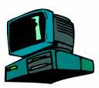
Optimize Overlays for Dual Metrics
Source rate
2 Mbps
60ms, 2Mbps
Receiver X
Source
30ms, 1Mbps
Prioritize bandwidth over latency
Break tie with shorter latency

Slide 15
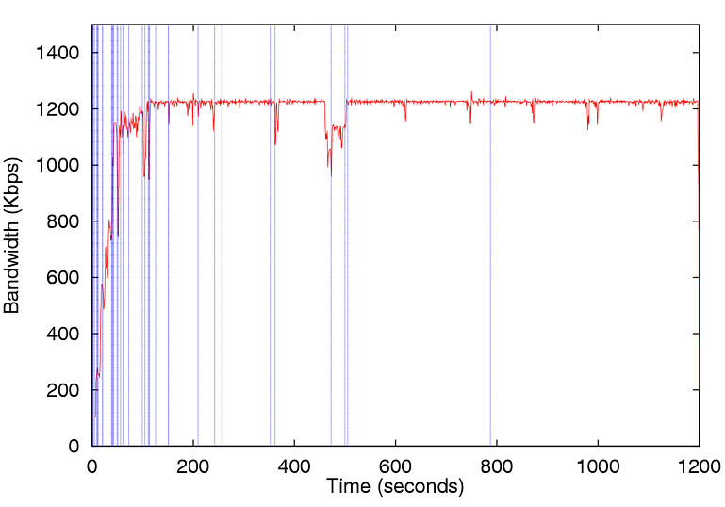
Example of Protocol Behavior
All members join at time 0
Single sender, CBR traffic
Mean Receiver Bandwidth
Reach a stable overlay
Acquire network info
Self-organization
Adapt to network congestion

Slide 16
Evaluation Goals
Can ESM provide application level performance comparable to IP Multicast?
What network metrics must be considered while constructing overlays?
What is the network cost and overhead?

Slide 17
Evaluation Overview
Compare performance of our scheme with
  Benchmark (IP Multicast)
  Other overlay schemes that consider fewer network metrics
Evaluate schemes in different scenarios
  Vary host set, source rate
Performance metrics
  Application perspective: latency, bandwidth
  Network perspective: resource usage, overhead

Slide 18
Benchmark Scheme
IP Multicast not deployed
Sequential Unicast: an approximation
  Bandwidth and latency of unicast path from source to each receiver
  Performance similar to IP Multicast with ubiquitous deployment
A
B
Source
C

Slide 19
Overlay Schemes
Overlay Scheme | Choice of Metrics
 | Bandwidth | Latency
Bandwidth-Latency
Bandwidth-Only
Latency-Only
Random

Slide 20
Experiment Methodology
Compare different schemes on the Internet
  Ideally: run different schemes concurrently
  Interleave experiments of schemes
  Repeat same experiments at different time of day
  Average results over 10 experiments
For each experiment
  All members join at the same time
  Single source, CBR traffic
  Each experiment lasts for 20 minutes

Slide 21
Application Level Metrics
Bandwidth (throughput) observed by each receiver
RTT between source and each receiver along overlay
Source
C
Data path
RTT measurement
A
D
B
These measurements include queueing and processing delays at end systems

Slide 22
Performance of Overlay Scheme
CMU
Exp1
CMU
Exp2
RTT
Exp1
Exp2
MIT
Harvard
32ms
30ms
Harvard
40ms
MIT
42ms
Rank
Different runs of the same scheme may
produce different but “similar quality” trees
1 2
Mean
Std. Dev.
“Quality” of overlay tree produced by a scheme
Sort (“rank”) receivers based on performance
Take mean and std. dev. on performance of same rank across multiple experiments
Std. dev. shows variability of tree quality

Slide 23
Factors Affecting Performance
Heterogeneity of host set
  Primary Set: 13 university hosts in U.S. and Canada
  Extended Set: 20 hosts, which includes hosts in Europe, Asia, and behind ADSL
Source rate
  Fewer Internet paths can sustain higher source rate
  More intelligence required in overlay constructions

Slide 24
Three Scenarios Considered
Primary Set
1.2 Mbps
Primary Set
1.2 Mbps
Primary Set
2.4 Mbps
Extended Set
2.4 Mbps
Does ESM work in different scenarios?
How do different schemes perform under various scenarios?
(lower) ← “stress” to overlay schemes → (higher)

Slide 25
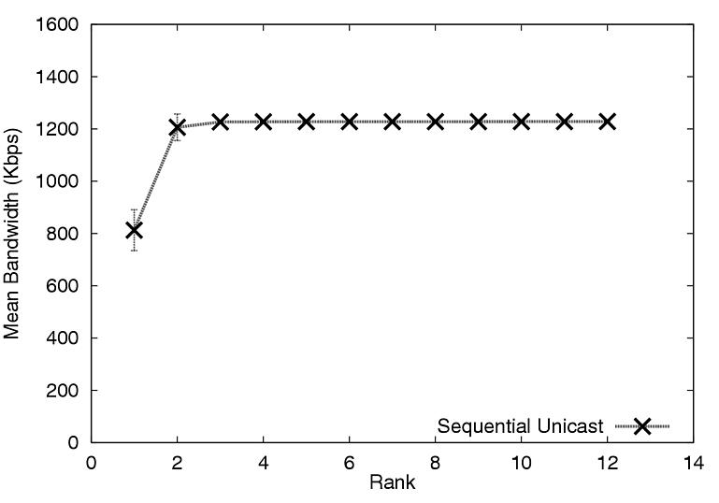
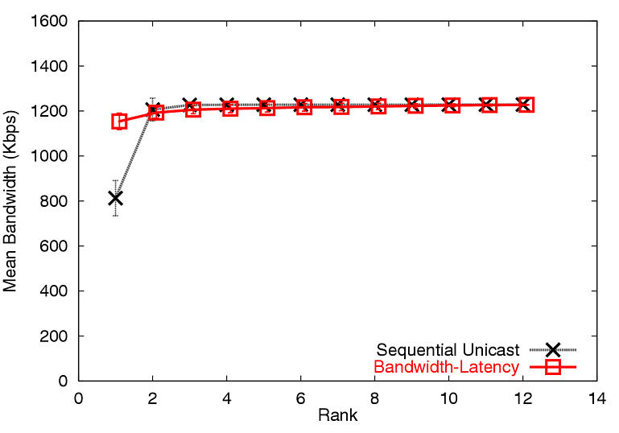
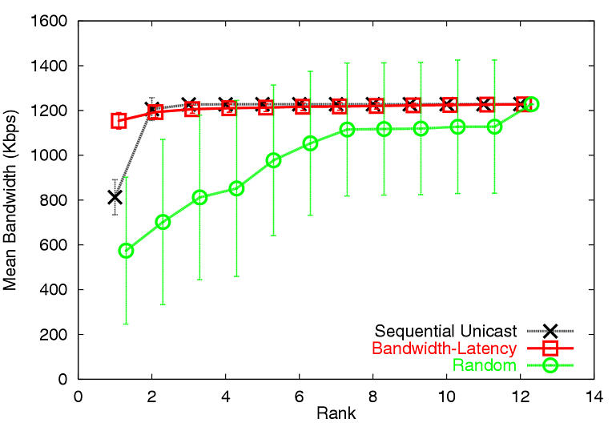
BW, Primary Set, 1.2 Mbps
Internet pathology
Naïve scheme performs poorly even in a less “stressful” scenario
RTT results show similar trend

Slide 26
Scenarios Considered
Primary Set
1.2 Mbps
Primary Set
2.4 Mbps
Extended Set
2.4 Mbps
(lower) ← “stress” to overlay schemes → (higher)
Does an overlay approach continue to work under a more “stressful” scenario?
Is it sufficient to consider just a single metric?
  Bandwidth-Only, Latency-Only

Slide 27
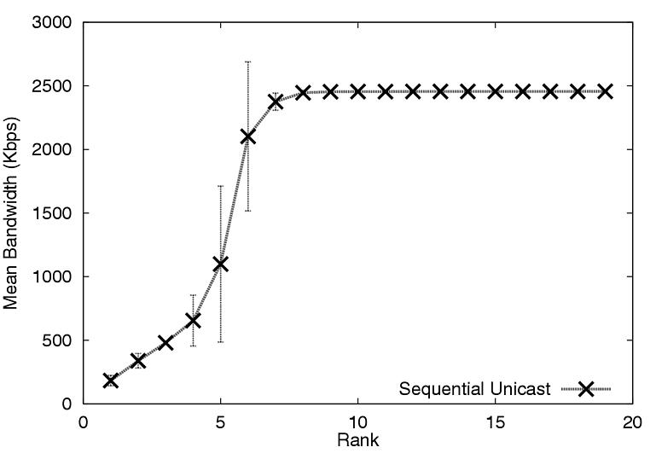
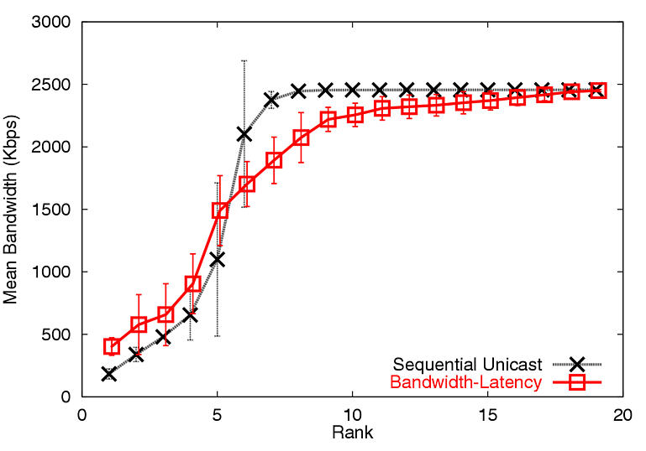
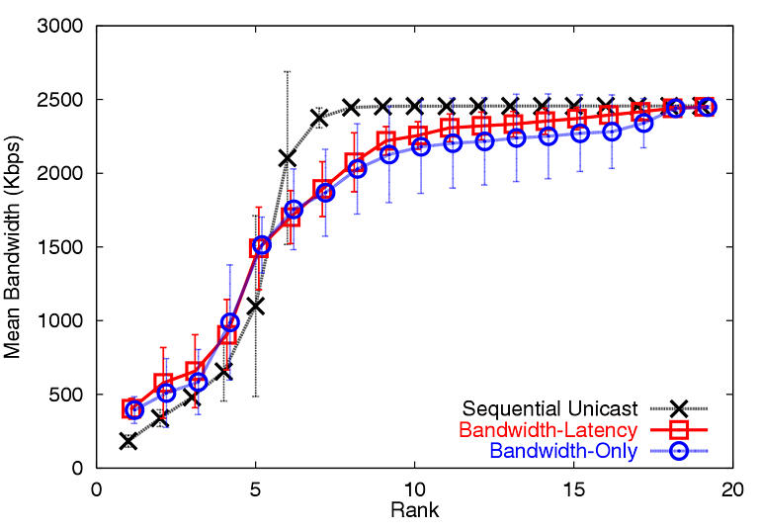
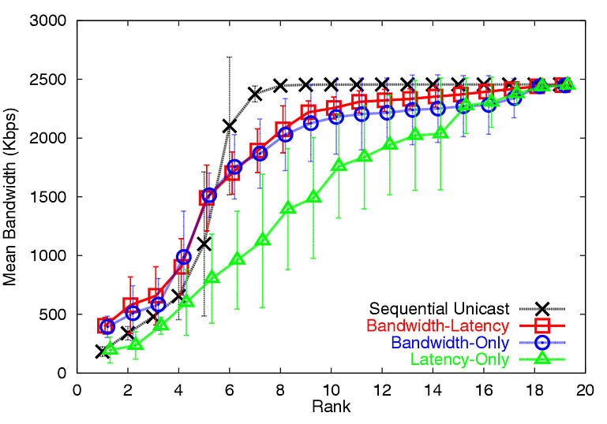
BW, Extended Set, 2.4 Mbps
no strong correlation between
latency and bandwidth
Optimizing only for latency has poor bandwidth performance

Slide 28
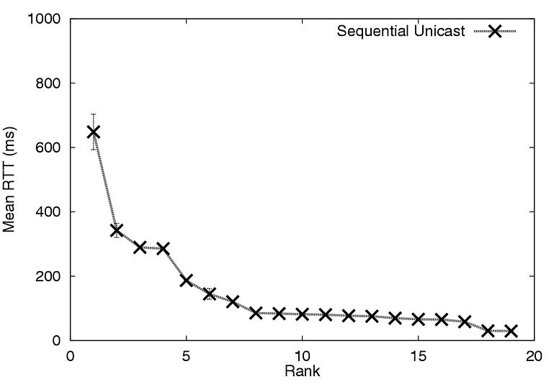
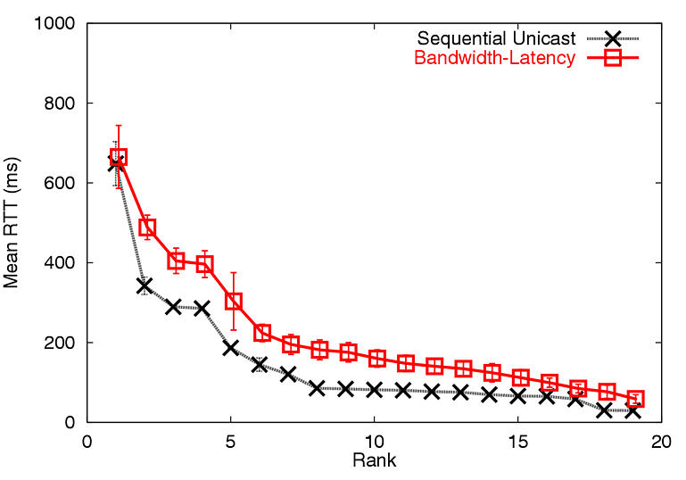
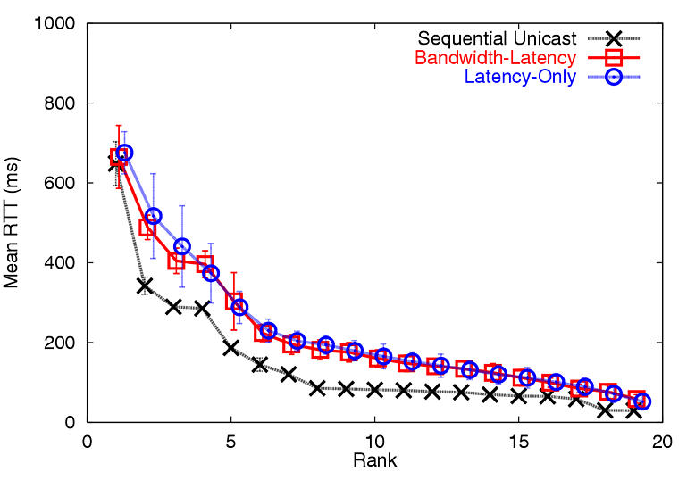
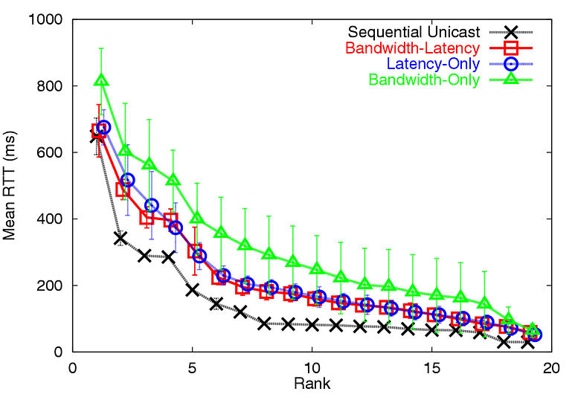
RTT, Extended Set, 2.4Mbps
Bandwidth-Only cannot avoid
poor latency links or long path length
Optimizing only for bandwidth has poor latency performance

Slide 29
Summary so far…
For best application performance: adapt dynamically to both latency and bandwidth metrics
Bandwidth-Latency performs comparably to IP Multicast (Sequential-Unicast)
What is the network cost and overhead?

Slide 30
Resource Usage (RU)
Captures consumption of network resource of overlay tree
Overlay link RU = propagation delay
Tree RU = sum of link RU
40ms
CMU
UCSD
2ms
U.Pitt
Scenario: Primary Set, 1.2 Mbps
(normalized to IP Multicast RU)
Efficient (RU = 42ms)
IP Multicast | 1.0
Bandwidth-Latency | 1.49
Random | 2.24
Naïve Unicast | 2.62
40ms
CMU
UCSD
40ms
U. Pitt
Inefficient (RU = 80ms)

Slide 31
Protocol Overhead
total non-data traffic (in bytes)
Protocol overhead =
total data traffic (in bytes)
Results: Primary Set, 1.2 Mbps
  Average overhead = 10.8%
  92.2% of overhead is due to bandwidth probe
Current scheme employs active probing for available bandwidth
  Simple heuristics to eliminate unnecessary probes
  Focus of our current research

Slide 32
Contribution
First detailed Internet evaluation to show the feasibility of End System Multicast architecture
  Study in context of a/v conferencing
  Performance comparable to IP Multicast
Impact of metrics on overlay performance
  For best performance: use both latency and bandwidth
More info: http://www.cs.cmu.edu/~narada

