Slide 1
MERCURY: A Scalable Publish-Subscribe System for Internet Games
Ashwin R. Bharambe,
Sanjay Rao &
Srinivasan Seshan
Carnegie Mellon University

Slide 2
Current game architectures
Distributed broadcast-based (e.g., DOOM )
  Every update sent to all participants
Advantages/disadvantages
  + No central server
  - Waste of bandwidth
  - Synchronized game state – difficult for players to join at arbitrary times
Does not scale beyond small LANs

Slide 3
Current game architectures (cont.)
Centralized client-server (e.g., Quake)
  Every update sent to server who maintains “true” state
Advantages/disadvantages
  + Reduces overall bandwidth requirements
  + State maintenance, cheat proofing much easier
  - Bottleneck for computation and bandwidth
  - Single point of failure
  “Most online games get stuck at about 6,000 players per server, and players on one server can't talk to those on another, reducing the appeal of an online-gaming community.” - www.redherring.com

Slide 4
Ideal architecture
Scalability
No hot-spot in the system in terms of:
  Number of packets routed or received
  Computational load
Most efficient use of available bandwidth
  Every player only receives “relevant” updates

Slide 5
Outline
Scalable game design
Publish-subscribe systems
Architecture of MERCURY – a distributed publish-subscribe system
Preliminary evaluation
  Scalability
  Performance
Future work

Slide 6
Bandwidth efficiency
Events happening in “arena”
  Need updates of visible or audible entities only
Other relevant game information
  Various scores
  Enemies, teammates
  Details about other terrain, etc.
(50,250)
(100,200)
Player
Arena
(150,150)
Virtual World

Slide 7
Modeling a first person shooting game
Events
(50,250)
x 100
y 200
(100,200)
Player
x ≥ 50
x ≤ 150
y ≥ 150
y ≤ 250
Arena
(150,150)
Interests
Virtual World
Notes:
The subscription would be a bounding box (3D) which would take visibility into account

Slide 8
Goal architecture
Centralized-server architecture
Ideal architecture
updates
updates
events
Intelligent Network
events & interests
Player
Player
Implicit filtering at the server
Messages explicitly filtered
Publish-Subscribe System

Slide 9




What is publish-subscribe ?
Publications
Subscription
Publishers produce events or publications
Subscribers register their interests via subscriptions
Network performs routing such that
  Publications “meet” subscriptions
  Publications delivered to appropriate subscribers

Slide 10
Critical components
Subscription language
  Subjects vs. attribute/values
  Exact matches vs. regular expressions?
Routing mechanism
  Where are subscriptions stored in the system?
  How are publications routed so that they “meet” subscriptions?

Slide 11
Related systems
Scribe, Herald
  Scalable, but –
  Restricted subscription language
Siena, Gryphon
  Flexible subscription language, but –
  Poor scalability due to message flooding
Delicate balance between expressiveness of
language and scalability of routing

Slide 12
MERCURY: subscription language
SQL-like
Type, attribute name, operator, value
  Example: int x ≤ 200
Attribute-values are sortable
Sufficient for modeling games –
  Game arenas
  Player statistics, etc.

Slide 13
MERCURY: routing protocol
Each node responsible for range of attribute values
For each attribute, nodes arranged into circle
Each node compares value in message to his range; and routes along the circle
Why not use hashing ?
[240, 320)
[0, 80)
[160, 240)
H_{x}
[80, 160)
Attribute Hub
Notes:
Similar to B-tree – distributed!

Slide 14
Why not use hashing ?
Hashing is good for exact matches
Want to support range queries
Possible approach
  Hash each value in the range
  Problems
    Can only be used for discrete-valued attributes
    Too many subscriptions
int x ≥ 1
int x ≤ 10
int x = 1
int x = 9
int x = 10

Slide 15

Routing illustrated
Send subscription to any one attribute hub
Send publications to all attribute hubs
Subscription
[240, 320)
50 ≤ x ≤ 150
150 ≤ y ≤ 250
[0, 105)
[160, 240)
H_{x}
[0, 80)
H_{y}
Publication
[105, 210)
x 100
y 200
[210, 320)
Rendezvous point
[80, 160)

Slide 16
Evaluation metrics
Scalability metric → load
  Number of publications routed by a node
  Averaged over time
Performance metric → publication delivery delay
  Time between sending of a publication and its receipt by all subscribers
  Averaged over all subscribers of a publication

Slide 17
Simulation workload
Modeling of a FPS game
  Virtual world = square
  Subscriptions = rectangles around current positions
Mobility models from ns-2 for modeling player movements

Slide 18
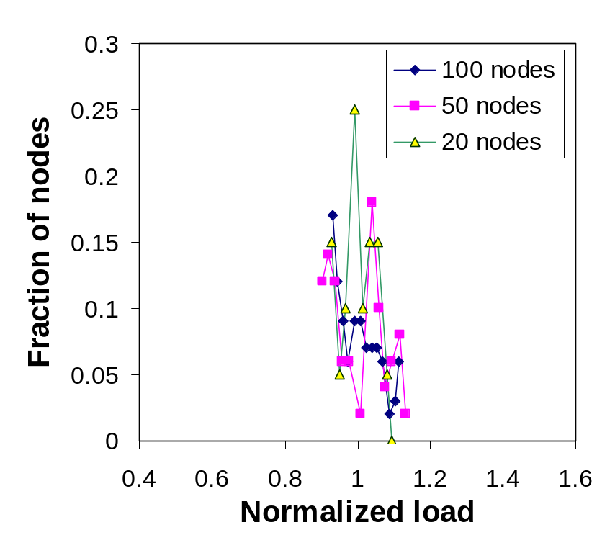
Results: scalability
Ideal case
  Every node routes approx. equal #msgs
  Normalized load is delta function at 1
Observations
  Small load fluctuations ( ± 12% ) → good load balancing

Slide 19
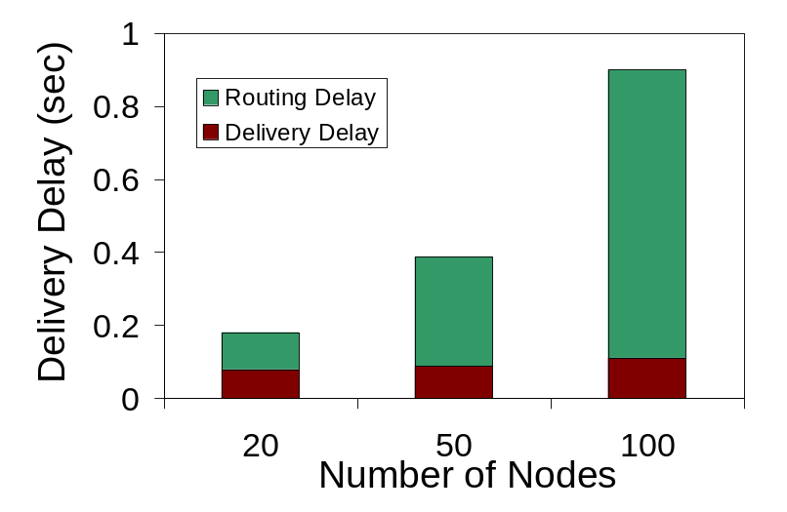
Results: performance
Publisher
Routing
delay
Linear Scaling, however, magnitude is high (~900ms)
  High number of Mercury level hops
  O(n) worst case!
Solution: maintain exponentially spaced pointers on the circle
  Can bring down delay to
  O(log n) hops
[0, 105)
H_{y}
[105, 210)
[210, 320)
Delivery
delay
Subscriber

Slide 20
Conclusions
Subscription language expressive enough for games
Completely decentralized architecture
Scalability
  Avoids flooding of subscriptions and publications – reduces network traffic
  Distributes publications and subscriptions throughout the network – prevents swamping

Slide 21
Future Work
Performance
  Simulation shows publication delivery delay scales linearly
  Need much better delay values (~300-400 ms) for real-time game play
  Cached pointers and network aware placement of nodes → delay competitive with centralized systems
Realistic workloads
  Current load balancing depends on workload
  Introduce BOTs into Quake → collect traces
Currently building a proof-of-concept system
  Quake-II+ prototype which uses MERCURY

Slide 22
State maintenance
Traditional pub-sub = filter
  No notion of an underlying persistent state
Game has associated state
Every publication
  Is matched against subscriptions and routed
  Acts as a write event on the underlying database
  Easily supported by Mercury by writing it at the rendezvous point(s)

