Slide 1


An Empirical Evaluation of Wide-Area Internet Bottlenecks
Aditya Akella
with Srinivasan Seshan and Anees Shaikh
IMC 2003

Slide 2






Internet Bottlenecks
Wide-Area Bottlenecks
As access technology improves…
Non-access or Wide-Area Bottlenecks?
Last-mile, slow access links limit transfer bandwidth
High-speed “core”
Big, fat
Pipe(s)
Slow, flaky
home connection
100Mbps home
connection
Most bottlenecks are last-mile

Slide 3
Outline
Wide-area bottlenecks: definition
Measurement methodology
Measurement results
Discussion of results and summary

Slide 4
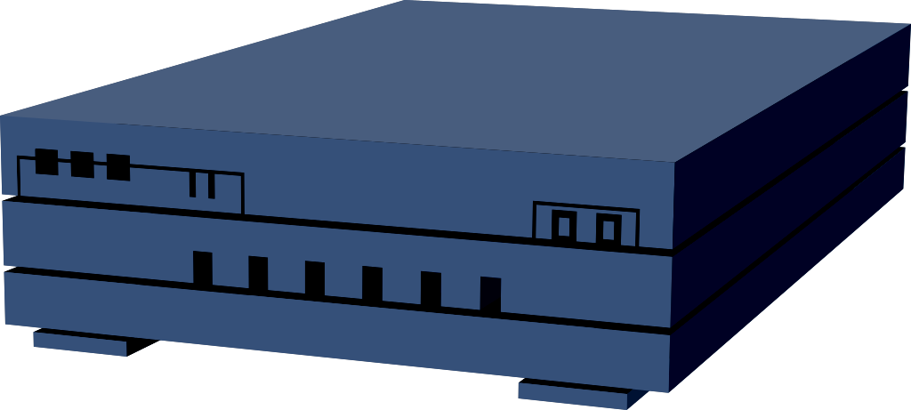
Wide-Area Bottlenecks
Wide-area bottleneck → where an unconstrained TCP flow sees
delays and losses
Not the “traditional” bottlenecks → may not be congested
Link with the least available bandwidth
Very Small ISP
Very Small ISP
Tiny ISP
Unconstrained
TCP flow
Wide-Area Internet/
High-speed “core”
Small
ISP
Small
ISP
Small
ISP
ATT
Very Small ISP
Sprint
UUNet
Small
ISP
Tiny ISP
Tiny ISP
Small
ISP

Slide 5
Characteristics of Wide-Area Bottlenecks
Location: Intra-ISP vs. Inter-ISP?
  Mostly peering links?
Available bandwidth: How congested?
  Bottleneck in large ISPs vs. small ISPs
Latency: Intra-POP vs. Inter-POP?
  Are long-haul links also congested?
Very Small ISP
Very Small ISP
Tiny ISP
Small
ISP
Small
ISP
Small
ISP
ATT
Very Small ISP
Sprint
UUNet
Small
ISP
Tiny ISP
Tiny ISP
Small
ISP

Slide 6
Outline
Wide-area bottlenecks: Questions
Measurement methodology
Measurement results
Discussion of results and summary

Slide 7
Measurement Methodology
Ideal goal: measure all wide-area paths,
identify bottlenecks
The real world:
  1. Choose small, representative set of paths
    Choosing appropriate sources
    Choosing appropriate destinations
    Goal: test many ISPs of various sizes
  2. Probe these paths → “send traffic, see where
  queues build”
    Goal: accurately identify bottlenecks, bottleneck properties

Slide 8
Internet AS Hierarchy
Can map size and “reach” of ISPs onto various levels of
a 4-tier hierarchy [Subramanian02]
Large regional providers
Small regional providers
tier-3
tier-3
tier-3
tier-3
tier-3
tier-3
tier-4
Large national providers
tier-4
tier-2
tier-2
tier-2
tier-3
tier-2
tier-2
tier-1
tier-4
tier-1
tier-4
tier-4
tier-1
tier-1
Very large international providers
tier-3
tier-3
tier-1
tier-1
tier-2
tier-2
tier-4
tier-4
tier-4
tier-4
tier-4
tier-2
tier-4
tier-3
tier-3
tier-4
tier-4

Slide 9

Choosing Sources
Sources: 1. Provider diversity
2. Geographic, diversity
3. High-speed connectivity
4. Ability to deploy our tools!
→ PlanetLab (26 nodes)
tier-3
tier-3
tier-3
Example: Provider diversity (26 planetlab sources)
tier-3
tier-3
tier-3
tier-4
tier-4
tier-2
tier-2
tier-2
tier-3
 | Tier-1 | Tier-2 | Tier-3 | Tier-4
Total #unique providers | 11 | 11 | 15 | 5
tier-2
tier-2
tier-1
tier-4
tier-1
tier-4
tier-4
tier-1
tier-1
tier-3
tier-3
tier-1
tier-1
tier-2
tier-2
tier-4
tier-4
tier-4
tier-4
tier-4
tier-2
tier-4
tier-3
tier-3
tier-4
tier-4

Slide 10

Choosing Destinations
Destinations: 1. Probe ISPs of various sizes
2. Keep measurements feasible!
Paths tested = 26 x 78
= 2028
tier-3
tier-3
tier-3
tier-3
tier-3
ISPs probed (78 in all)
tier-3
tier-4
tier-4
tier-2
tier-2
tier-2
tier-3
 | Tier-1 | Tier-2 | Tier-3 | Tier-4
Total #providers probes | 20 | 18 | 25 | 15
Total #providers in Internet | 20 | 129 | 897 | 971
tier-2
tier-2
tier-1
tier-4
tier-1
tier-4
tier-4
tier-1
tier-1
tier-3
tier-3
tier-1
tier-1
tier-2
tier-2
tier-4
tier-4
tier-4
tier-4
tier-4
tier-2
tier-4
tier-3
tier-3
tier-4
tier-4

Slide 11
Measurement Tool: BFind
But no control over destination
Emulate the whole process
from the source!
Ideally…
source
dest
Monitor queues, identify where queues build up
→ bottleneck

Slide 12
Measurement Tool: BFind
Round 1
Round 2
Round j
1Mbps
Flag #2, keep curent rate for round j+1→ force queueing
Rate for round 2:1+δ Mbps
Rate controlled
UDP stream
Rate for round 3: 1+2δ Mbps
Round j:
Queueing on #2!
Round 2:
No queueing!
Round 1:
No queueing!
source
dest
Rounds of
Traceroutes
If #2 flagged too many times → quit.
Identify #2 as bottleneck
Report to
UDP process
Monitor links for
queueing
BFind functions like TCP: gradually increase send rate until hits bottleneck
Can identify key properties of the bottleneck
  Location, latency, available bandwidth (== send rate of BFind before quitting)
  Single-ended control
Quits after 180s and before send rate hits 50Mbps
Bfind validation: wide-area experiments and simulations

Slide 13
Methodology: A Critique
Route changes, multipath routing
  Could interfere with bottleneck identification
  However, effect not prevalent in measurements
Router ICMP generation
  If high, could artificially inflate traceroute delays
  Govindan/Paxson show the delay is not high
Other issues:
  Identification of peering links may have some error
  Route asymmetry could affect delay measurements
  Results are an empirical snap-shot
    Trade-off long-term characterization for scale

Slide 14
Outline
Wide-area bottlenecks: Questions
Measurement methodology
Measurement results
Discussion of results and summary

Slide 15
Results
Found bottlenecks in 900 paths (out of 2028)
  ~45% of all paths
  >50% paths had >50Mbps capacity
    Bfind quit due to 180s limitation on 3% of paths

Slide 16
Results: Location
Intra-ISP links
Inter-ISP links
49%
51%
One of the two peering links with 50% chance
%bottlenecks %all links
%bottlenecks %all links
Peering Link
Probability of being the bottleneck = 0.25
Intra-ISP Link
Tier 4 | 3% | 1%
Tier 3 | 9% | 8%
Tier 2 | 12% | 13%
Tier 1 | 25% | 63%
Tier 4 – 4, 3, 2, 1 | 14% | 1%
Tier 3 – 3, 2, 1 | 17% | 3%
Tier 2 – 2, 1 | 12% | 4%
Tier 1 – 1 | 8% | 6%
Probability of being the bottleneck = 0.125
One of the four non-peering links with 50% chance

Slide 17
Results: Latency
Intra-ISP links
Inter-ISP links
%bottlenecks %all links
%bottlenecks %all links
High-latency | 9% | 10%
Med-Latency | 7% | 8%
Low-latency | 33% | 61%
High-Latency | 12% | 1%
Med-latency | 9% | 1%
Low-latency | 30% | 19%
Low latency: L< 5ms Medium Latency: 5 ≤ L< 15ms High Latency: L ≥ 15ms

Slide 18
Results: Available Bandwidth
Intra-ISP links
Inter-ISP links
Tier-1 ISPs are the
best
Tier-3 ISPs have slightly higher available bandwidth than tier-2
Tier-1 –1 peering is the best
Peering involving tiers-2,3 similar

Slide 19
Outline
Wide-area bottlenecks: Questions
Measurement methodology
Measurement results
Discussion of results and summary

Slide 20
Discussion
ISP Selection
  Assumption: tier1 → $$$, tier2 → $$, tier3 → $
  Tier-1 providers are best option, provided $$$
  Otherwise, probably better off buying connectivity from tier-3
ISP inter-domain traffic engineering
  ISPs can use information to select exit points into peer networks
  Also to decide where to deploy peering links and upgrade capacity
BGP route selection
  Use information about prevalence of bottlenecks → much more effective than shortest AS hop
Results useful to guide overlay node placement

Slide 21
Summary
A classification of wide-area bottlenecks
  Ownership, latency, available bandwidth
Quantify the likelihood of various wide-area links appearing as bottlenecks
Add weight to conventional wisdom, mostly
(e.g. tier-1 the best)
  A few surprises (e.g., 50-50 split between inter and intra-ISP links)
Results useful to understand relative performance of ISPs of the various tiers of AS hierarchy

Slide 22
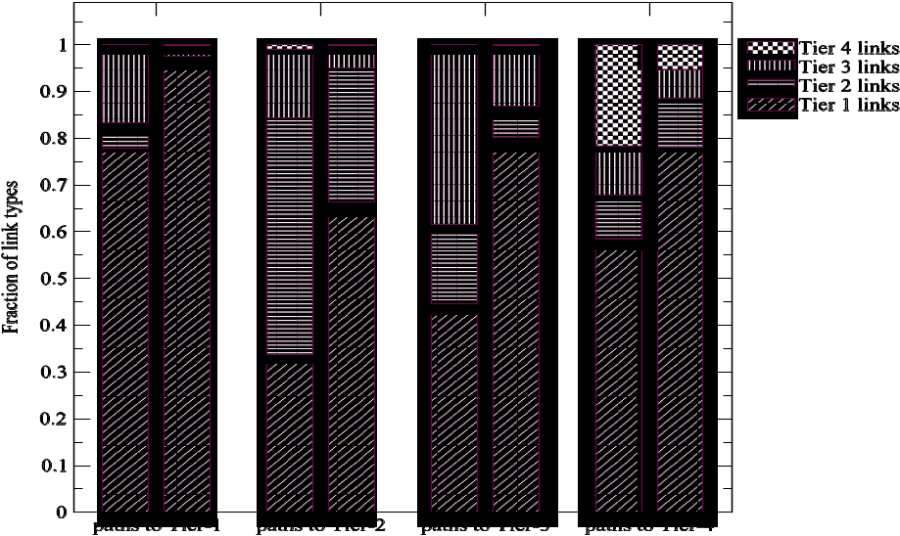
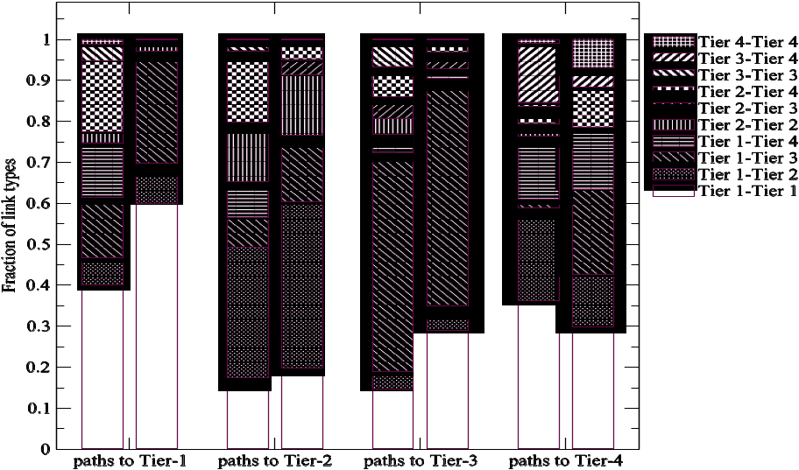
Read our paper…
But not in the proceedings ☹
  Figures are all messed up
Instead, go to…
http://www.cs.cmu.edu/~aditya/papers/widearea.pdf

Slide 23
Why is this Study Useful?
Good peering location?
Carrier ISPs (AT&T)
  Traffic engineering
    Inter-domain
ATT
End Networks (Yahoo!)
  ISP Selection
    Avoid “bad” ISPs
  Improve Performance
    Route control
Good
Bad
Bad
Good
Good

Slide 24
Wide-Area Bottlenecks: Related Work
Several studies tried to characterize typical flow performance
  Active measurements
    Path properties [Paxson], Detour [Savage]
    Look at factors that could impact typical performance
  Passive measurements
    Wide-area performance [Stemm], Origin of flow rates [Zhang]
    Focus on measuring typical performance
Important differences with past work
  Focus not on true end-to-end paths or typical end-hosts
    “Wide-area” or “non-access” bottlenecks
    Well-connected, unconstrained hosts
  Focus not on eventual end-to-end performance
    Reasons for poor performance
    Location and properties of the bottlenecks

