Slide 1



The Performance Benefits of Multihoming
Aditya Akella
CMU
With Bruce Maggs, Srini Seshan, Anees Shaikh and Ramesh Sitaraman

Slide 2


Multihoming
Announce address space to both providers
One announcement has longer AS path
  AS prepend;
  For backup
Primary motivation: reliability
Destination
Internet
AS 200
AS 300
4.0.0.0/19
AS-path:
101
4.0.0.0/19
AS-path:
101 101 101
AS 101
4.0.0.0/19

Slide 3
Multihoming
Announce address space to both providers
One announcement has longer AS path
  AS prepend;
  For backup
Primary motivation: reliability
Destination
Internet
AS 200
AS 300
AS-path:
101
AS-path:
101 101 101
AS 101

Slide 4
Multihoming
Announce address space to both providers
One announcement has longer AS path
  AS prepend;
  For backup
Primary motivation: reliability
Destination
Internet
AS 200
AS 300
AS-path:
101
AS-path:
101 101 101
AS 101

Slide 5

Multihoming for Performance
Destination
Intelligent “route control” products
  E.g., RouteScience
Observation: Performance varies with providers, time
  Help stubs extract performance from their ISPs
  →Multihoming no longer employed just for resilience
No quantitative analysis of performance benefits yet
Internet
ISP1
ISP2
Route-control
Use ISP1 or 2?

Slide 6
Our Goal
For an enterprise or a content provider in a
metro area…
Assuming perfect information, what is the maximum performance benefit from multihoming?
How can multihomed networks realize these benefits in practice?

Slide 7

Two Distinct Perspectives
Popular content providers
Web server
Enterprise
Active clients
Primarily data consumers
Goal: Optimize download performance
Primarily data sources
Goal: Optimize client-perceived download performance

Slide 8
Measurement Challenges
Enterprise Multihoming
In each metro area, need…
  Connections to multiple ISPs
Akamai infrastructure satisfies this
  Widespread presence
  Many servers singly homed to different ISPs
City | #Providers
Atlanta | 15
Boston | 10
Chicago | 23
Dallas | 21
Los Angeles | 32
New York | 39
San Francisco | 60
Seattle | 18
Washington DC | 29

Slide 9
Outline of the Talk
Enterprise performance benefits
Web server performance benefits
Practical schemes
Conclusion

Slide 10
Enterprise Performance
Popular content providers
Use Akamai’s servers and monitoring set-up to emulate multihomed enterprises
  Two distinct data sets:
    2-multihoming
    k-multihoming, k>2
Enterprise
Primarily data consumers Goal: Optimize download performance

Slide 11
Enterprise 2-Multihoming
selected content providers
Monitors download object every 6 mins from origins
  Logs stats per download
Four cities with two monitors
  Monitors attached to distinct, large ISPs
P₁
P₈₀
ISP 1
ISP 2
perf monitor
metro area

Slide 12
Enterprise 2-Multihoming
selected content providers
Monitors download object every 6 mins from origins
  Logs stats per download
Four cities with two monitors
  Monitors attached to distinct, large ISPs
  Stand-ins for 2-multihomed enterprise
P₁
P₈₀
ISP 1
ISP 2
perf monitor
Enterprise
metro area

Slide 13
Enterprise 2-Multihoming
selected content providers
Monitors download object every 6 mins from origins
  Logs stats per download
Four cities with two monitors
  Monitors attached to distinct, large ISPs
  Stand-ins for 2-multihomed enterprise
Look at top 80 customer content providers
  Log turn-around time
P₁
P₈₀
ISP 1
ISP 2
Enterprise
turnaround
Akamai node
(perf monitor)
metro area
REQ
RESP
origin server

Slide 14
Characterizing Performance Benefit
Compare single ISP performance to
2-multihoming
  Best one used at any instant
  Assume full knowledge of the best provider at any instance
Metric for ISP1 =
average_{downloads} turn-around time using ISP1
  High metric → ISP1 has poor performance
  Metric = 1 → ISP1 is always better than ISP2
average_{downloads}
turn-around time using best ISP

Slide 15
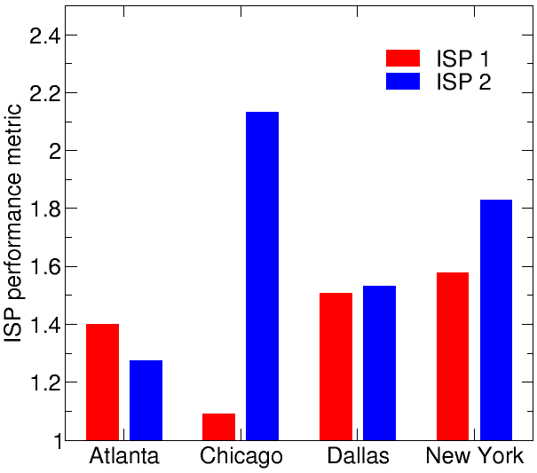
Enterprise 2-Multihoming: Results
Metric for each ISP
Definite benefits… but to varying degrees

Slide 16
2-Multihoming: Details
Analyze the benefit of using two given large providers together
  May not be the best choice, but…
  Reflective of typical route-control deployment
Still unanswered questions:
  What is the benefit from using the best providers?
    How to pick them?
  What is the benefit from using more providers?

Slide 17
Enterprise k-multihoming
New data set emulates a different form of multihoming
  Best ISP used each hour
  vs. 2-multihoming dataset → best ISP each transfer
  →Analysis of this data gives lower bound on actual benefits
Metric for k-multihoming:
turn-around time using best set of k ISPs
  Best ISP known beforehand
average_{hours}
turn-around time using all ISPs

Slide 18
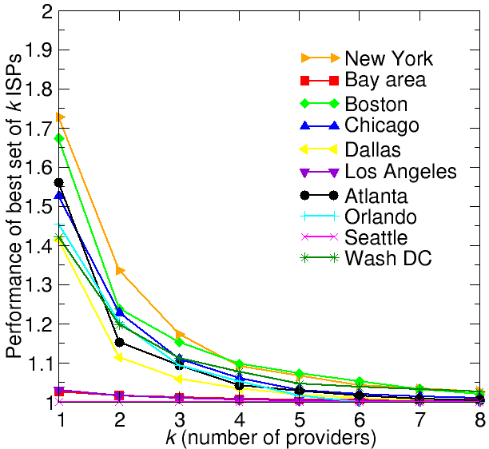
Enterprise k-Multihoming Performance
k-multihoming Performance
Beyond k=4, marginal benefit is minimal

Slide 19
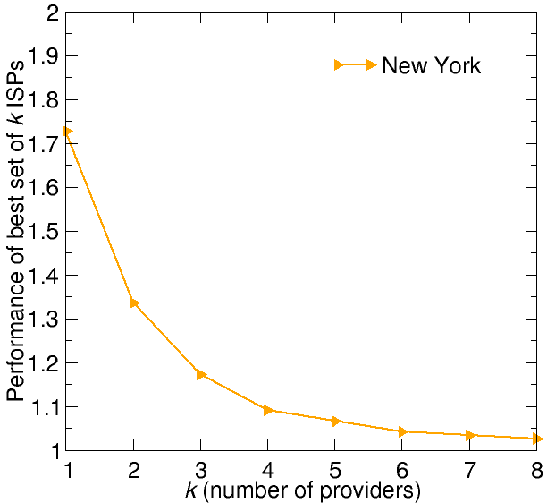
Enterprise k-Multihoming Performance
k-multihoming Performance
Best set of k vs. set of best k (NYC)
ISP | Individual Rank | 1-multi perf
ISP 1 | 1 | 1.72
ISP 2 | 2 | 1.93
ISP 3 | 9 | 2.61
ISP 4 | 3 | 2.05
ISP 5 | 4 | 2.29
ISP 6 | 19 | 3.16
ISP 7 | 17 | 3.03
ISP 8 | 13 | 2.93
Beyond k=4, marginal benefit is minimal
Cannot just pick top k individual performers

Slide 20
Outline of the Talk
Enterprise performance benefits
Web server performance benefits
Practical schemes
Conclusion

Slide 21
Web server k-Multihoming
Use Akamai servers to emulate multihomed data centers and their active clients
Web server
Active clients
Primarily data sources
Goal: Optimize client-perceived download performance

Slide 22
Web server Multihoming: Data
metro areas
In 5 metro areas, pick servers attached to unique ISPs
CDN servers

Slide 23
Web server Multihoming: Data
Web server
metro areas
In 5 metro areas, pick servers attached to unique ISPs
  Stand-ins for multihomed web server
CDN servers

Slide 24
Web server Multihoming: Data
Web server
metro areas
In 5 metro areas, pick servers attached to unique ISPs
  Stand-ins for multihomed web server
Select nodes in other cities
  Stand-ins for clients
CDN servers
For each metro area…
  The client stand-ins pull a 50K object from servers in the area
  Every 6 minutes
  Log turn around time
Metric for comparison: same as with enterprises

Slide 25
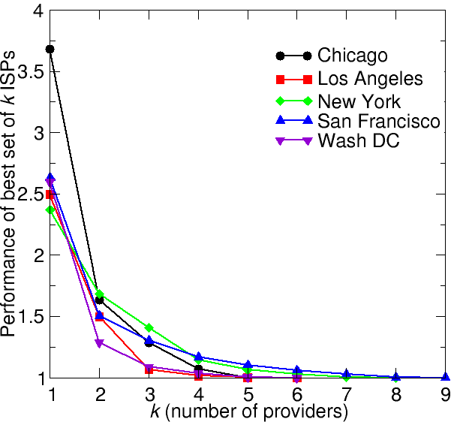
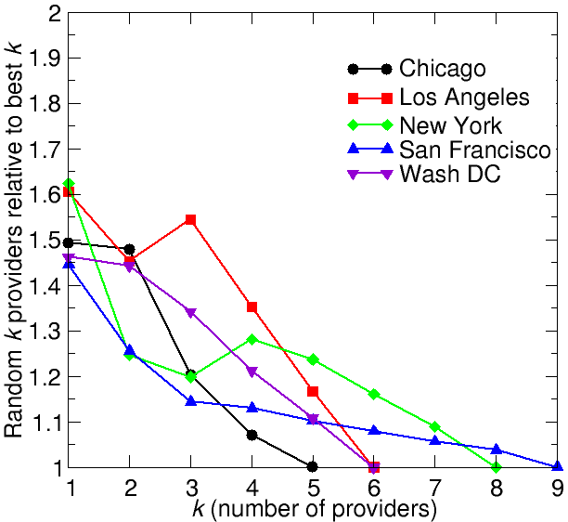
Web server k-Multihoming: Results
k-multihoming Performance
Average of Random Choice
Not much benefit beyond k=4 providers
Choice of providers must be made carefully

Slide 26
Outline of the Talk
Enterprise performance benefits
Web server performance benefits
Practical schemes
Conclusion

Slide 27
Simple Practical Solution
In practice, subscriber must use history and a reasonable time-scale to make decisions
  Monitor performance across all providers
    Keep EWMA(α) of performance to each destination across all ISPs
    Lower α → more weight to fresh samples
  Every T minutes, choose ISP with best EWMA
Evaluate effectiveness using Web server data
  Data still has 6-minute granularity

Slide 28
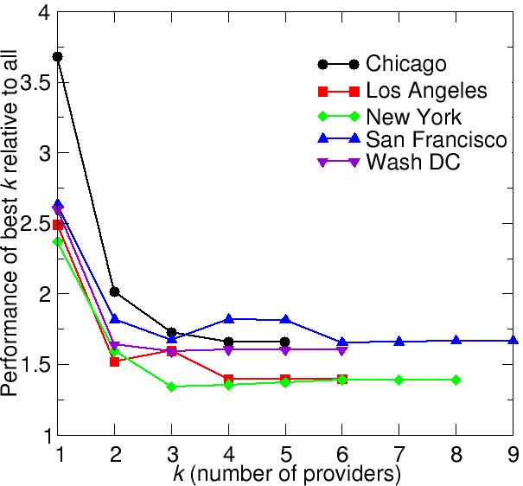
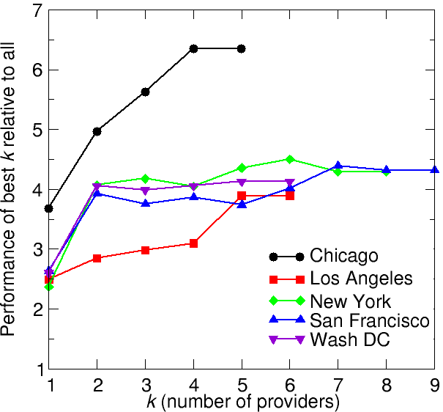
Web Server: Practical Solution
α=1, T=30 minutes
α=10, T=30 minutes
Need timely and accurate samples
Recent samples should get a lot of weight (lower α)

Slide 29
Conclusion
Multihoming helps, at least 20% improvement on average
  But not much beyond 4 providers
Careful choice necessary
  Cannot just pick top individual performers
  Performance can be hit by >50% for a poor choice
In practice, need accurate, timely samples
  Higher preference to fresh samples

Slide 30
Future Work
Reasons for observed performance benefit
Impact of ISP cost structure

Slide 31
Extra slides
Extra
  Extra
    Extra

Slide 32
Performance Benefits: Other Questions
Does performance improve with additional providers?
  Diminishing returns?
How carefully should a subscriber choose providers to multihome to?
  Top individual ISPs?
  Random vs. informed?

Slide 33
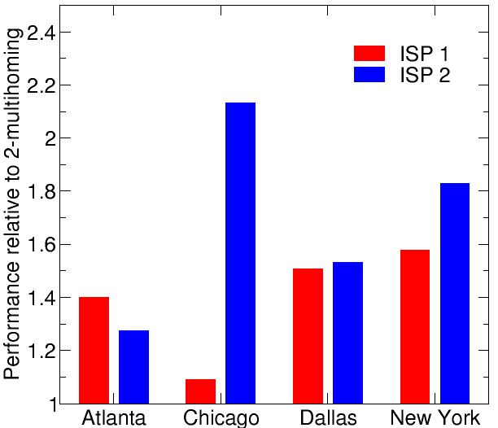
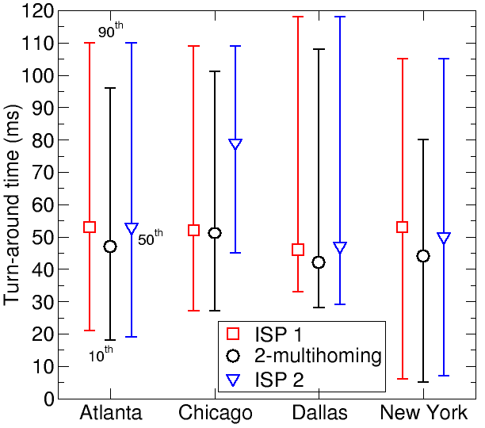
Enterprise 2-Multihoming: Results
Metric for each ISP
Performance from 2-multihoming
90th
50th
10th
Definite benefits… but to varying degrees
Longer turn-around times benefit more

Slide 34
Enterprise k-Multihoming, k > 2
all origin servers
Servers download objects from origins
  Cache misses
Log average turn-around times across all origins
  Averaged per hour
ISP 1
ISP 2
ISP 3
ISP K
metro area
CDN servers

Slide 35
Enterprise k-Multihoming, k > 2
all origin servers
Servers download objects from origins
  Cache misses
Log average turn-around times across all origins
  Averaged per hour
Servers in metro area → stand-in for k-multihomed enterprise
ISP 1
ISP 2
ISP 3
ISP K
metro area

Slide 36
Enterprise k-Multihoming, k > 2
all origin servers
Servers download objects from origins
  Cache misses
Log average turn-around times across all origins
  Averaged per hour
Servers in metro area → stand-in for k-multihomed enterprise
Form of multihoming where all traffic received via best upstream, per hour
Finer control (per destination, per flow) would perform better
→ Lower bound on actual benefits
ISP 1
ISP 2
ISP 3
ISP K
metro area

Slide 37
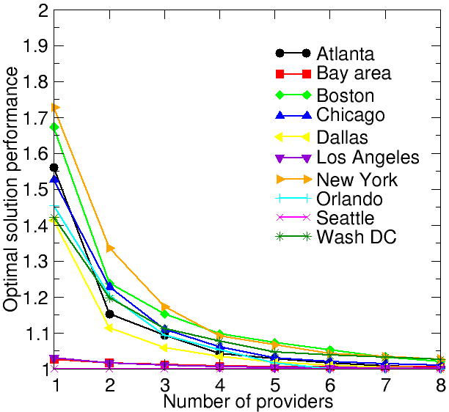
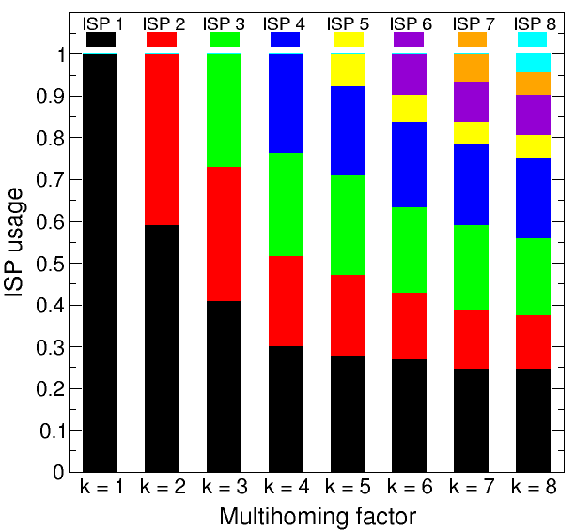
Enterprise k-Multihoming Performance
k-multihoming Performance
Relative usage of ISPs (New York)
Beyond k=4, marginal benefit is minimal
Contribution to overall benefit not always proportional to usage

Slide 38
Practical Multihoming Solution
So far…
  Assume accurate, timely knowledge
    Pick best provider link for each transfer
  Assume we can switch arbitrarily often
  Optimal, but not necessarily realizable
How do these limitations impact the practical implementation?
  How close to optimal can we get in practice?

