Slide 1
Multihoming Performance Benefits:
An Experimental Evaluation of
Practical Enterprise Strategies
Aditya Akella, CMU
Srinivasan Seshan, CMU
Anees Shaikh, IBM Research
USENIX 2004
Boston, MA

Slide 2

ISP Multihoming
Buy and use connections from multiple Internet Service Providers (ISPs)
Primary goal: high reliability or availability
  Use connections in primary-backup mode
Increasingly used for other goals
  Optimizing cost, performance, load balancing…
primary
Back up

Slide 3
“Route Control” Products
Several “route control” products in the market
  F5, Nortel, Radware, Stonesoft, Rainfinity, RouteScience, Sockeye
Use a host of proprietary mechanisms
Claim significant benefits
Select least cost
or
Best performming
Route
controller
What mechanisms should go into a route control system
and
what performance do they offer?

Slide 4
Multihoming Performance Evaluation
Our work in Sigcomm 2003 evaluates the “optimal” performance from ideal route control
  Best case performance benefits
  Upto 40% improvement when using 3 ISPs over a single default ISP
Perfect
knowledge of ISP performance;
Switch providers
instantaneously
How close to the optimal benefits can we get in practice?

Slide 5
Our Work
Discussion and design of simple, practical route control mechanisms for optimizing web performance
Experimental study of the performance and design tradeoffs
Focus on multihomed enterprises
  Primarily sink data from the Internet

Slide 6
Outline
Route Control components
Experimental Evaluation
Open issues
Conclusion
Notes:
Outline of the talk

Slide 7
Route Control Components
1. Regularly monitor
performance
over ISP links
By definition, must ensure all transfers traverse “good” ISP links
Three key components:
Monitoring ISP links
Selecting “good” ISPs
Directing traffic over
selected ISPs
ISP 3
ISP 1
ISP 2
3. Direct traffic
over ISP 3
2. Choose best
provider
e.g. ISP 3

Slide 8
Choosing the Best ISP per Transfer
Track the average performance of each ISP, per destination
  Smoothed averaging function such as EWMA
  α = 0 → no reliance on history
  α > 0 → some weight attached to historical samples
Select the provider with the best EWMA performance for a destination
  EWMA_{ti}(P,D) = (1-e^{-(t}i^{-t}i-1^{)/α} ) s_{ti} +
  e^{-(t}i^{-t}i-1^{)/α} EWMA_{ti-1}(P,D)

Slide 9
Directing Traffic over Chosen ISPs
Easy to select ISP for outbound traffic
Enforcing inbound control is important and harder
  Enterprise-initiated connections: direction of data transfers from servers
  Externally-initiated connections: direction of client requests
Client requests
Data from
webserver
Externally
-initiated
Enterprise
- initiated

Slide 10
Directing Traffic over Chosen ISPs
Source address → belonging to the best ISP at that time
Incoming packets will traverse the ISP
Enterprise-initiated:
use NAT to translate source addresses
Externally-initiated:
use DNS to return appropriate server IP to the client
Response sent
to 10.0.192.1
10.0.0.0/18
Network
owns
10.0.0.0/16
Split into
3 /18 blocks
10.0.64.0/18
10.0.192.0/18
PACKET
srcIP = 10.0.192.1

Slide 11
Monitoring ISP Links
Crucial step – determines how the “good” providers are chosen
Important components:
  What to monitor?
  How to monitor?
What: monitor just the top web servers
  Most traffic is to/from these
How: measure the performance, passively or actively
S₂
S₁₀₀
S₁
S₁₀₀₀
ISP 3
ISP 1
ISP 2

Slide 12
Passive Measurement
Static precomputed list
or track access counts
and use hard threshold
Measure “turn around” time of a few sampled web transfers
  Time between transmission of last byte of HTTP request and receipt of first byte of HTTP response
  Reflects the path RTT
Is destination
popular?
Yes
No
Is there an ISP P
such that
T–prev_sample(dest, P)
> Samp_Int?
Determines the
frequency of
measurements
Yes
No
Initiate connection
to destination with
SrcIP = IP[ISP_to_test]
Set
ISP_to_test=P
Wait for destination
to respond and
obtain performance sample
Contains EWMA
perf estimate
and current time
Update destination
hash entry
Relay connection
Initiate connection
to destination with
SrcIP = DefaultIP

Slide 13
Active Measurement
Initiate out-of-band
probes to obtain performance samples
Two mechanisms:
  FreqCounts: track access counts similar to passive measurement
  SlidingWindow: sample from a sliding window of recent transfers
SlidingWindow better at tracking temporal shifts in popularity.
FreqCounts is guaranteed to monitor the top destinations.
Active measurement
thread
Every Samp_int seconds:
1. Sample 0.03C elements
2. Probe unique destinations
Queue size > C?
Incoming
connection
If yes, Dequeue
Enqueue
destination

Slide 14
Active Probe Operation
Send three probes with different source addresses, corresponding to the three ISPs, per destination (for inbound control)
  Use TCP SYN+ACK to port 80 for active probing
Record performance per destination
  Use EWMA to update the performance
  No response → use a large positive value for update

Slide 15
Route Control Mechanisms: Summary
Monitoring provider links
  Monitor top destinations
  Passive measurement
  Active measurement: FrequencyCounts, SlidingWindow
  Parameter: sampling interval
Choosing best provider
  EWMA to track performance
  Parameter: weight assigned to historical samples
Directing traffic over chosen providers
  NAT for enterprise-initiated connection
  DNS for externally-initiated connections

Slide 16
Outline
Route Control components
Experimental Evaluation
Open issues
Conclusion

Slide 17
Experimental Set-up
10.1.1.1
10.1.1.2
10.1.1.100
Trace-based emulation of a “3-multihomed” enterprise network
  With 100 clients inside the network
  Accessing 100 wide-area web servers
  Access through a proxy that runs route control
  Optimize web response-time; monitor performance to the top 40 servers
Delay – (10.1.1.1, 10.1.3.1)
<time> <delay>
0 10ms
10 13ms
. .
. .
. .
24 9ms
S
Web server
D
Delay element
10.1.3.1
10.1.3.2
10.1.3.3
Traces obtained
from wide-area
measurements
P
Web proxy
Runs
route-control
C
Clients
Object sizes → pareto
Destination → Zipf
Tune the total request
rate
Client 1
Client 2
Client 100

Slide 18
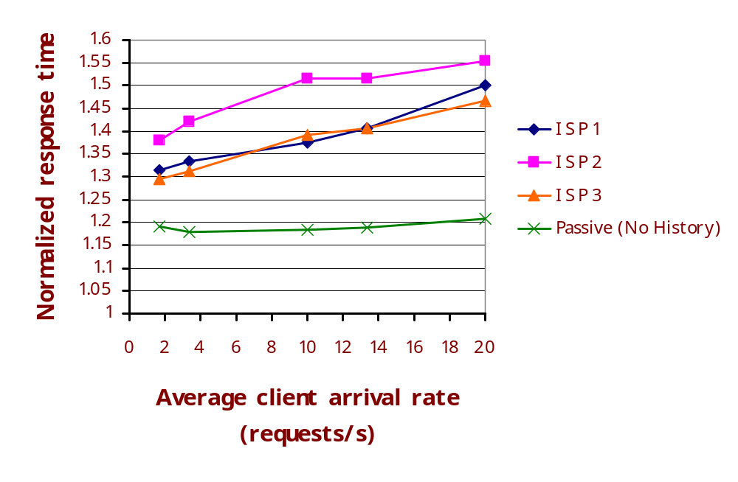
Route Control Performance Benefits
Performance
of scheme
relative to
optimal
route-control
Interval = 30s
The simple route control mechanisms can offer significant
improvement over using a single provider

Slide 19
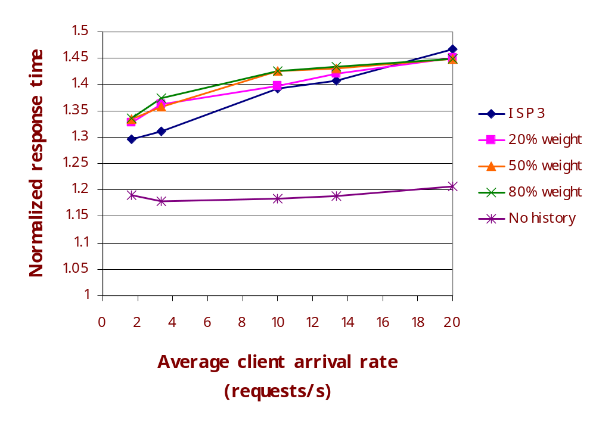
Employing History to Track Performance
Passive measurement,
Interval = 30s
Employing historical samples is not useful to track performance.
Best to use current sample as estimate of future performance

Slide 20
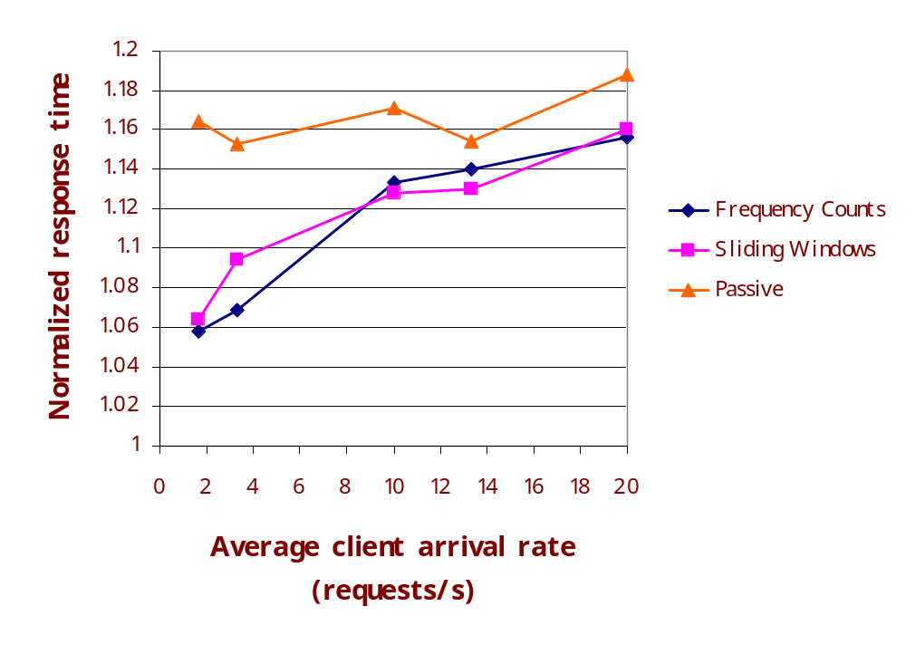
Active vs Passive Measurement
No history,
Interval = 60s
Active measurement offers slightly better performance

Slide 21
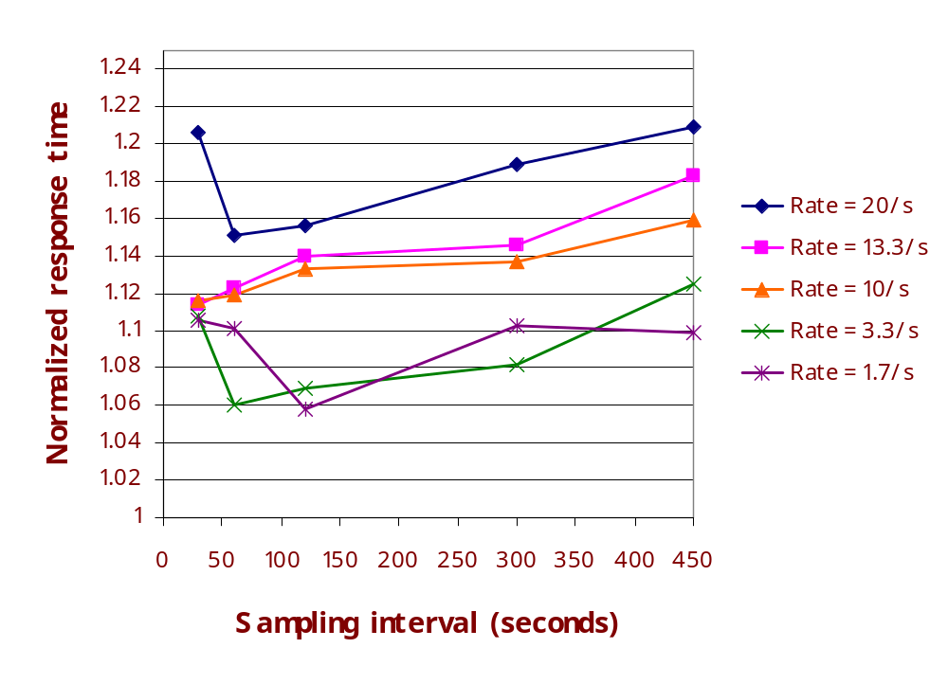
Frequency of Sampling
For SlidingWindow
Aggressive sampling could yield sub-optimal performance.
60-120s sampling intervals seem to work best.

Slide 22
Outline
Route Control components
Experimental Evaluation
Open issues
Conclusion

Slide 23
Some Unaddressed Issues
ISP pricing structures: Ignored in our analysis
  But, our evaluation of active vs passive measurement, and of history, central to more generic route control designs
Managing resilience: Long sampling intervals interact badly with resilience
  Pick a sufficiently small sampling interval
  Interval of 60s works well and gives 1 minute recovery times

Slide 24
Commercial Route Control Products
Products for large data centers and businesses that use BGP in multihoming
  Focus mainly on outbound control
  RouteScience, Sockeye
Network appliances for enterprises that don’t use BGP
  Radware, Nortel, F5, Rainfinity…
  Focus more on load balancing
  Use NAT and DNS based techniques for inbound control similar to ours
Our work applies to enterprises that may or may not employ BGP, looking to optimize performance

Slide 25
Summary
Designed and evaluated route control schemes in a multihomed enterprise context
Performance from active and passive measurement schemes is within 5-15% of optimal route control and 15-25% better performance than a single provider
Identify a few desired common practices (e.g., employing history, setting sampling intervals)

Slide 26
Backup Slides
Backup
  Backup
    Backup

Slide 27
Other Results
Overheads of route control
  Overhead from measurement and manipulating NAT tables are negligible.
  The performance penalty mainly from inaccuracies of measurement.
DNS for inbound control
  DNS is not effective since client may cache old A records much longer than the TTLs.

Slide 28
Overheads of Route Control
 | Passive | Active FreqCount | Active SlidingWin
Total performance penalty | 18% | 14% | 17%
Penalty from inaccurate estimation only | 16% | 12% | 14%
Penalty from measurement and NAT only | 2% | 2% | 3%

