Slide 1
Choosing Beacon Periods to Improve Response Times for Wireless HTTP Clients
Suman Nath
Zachary Anderson
Srinivasan Seshan
Carnegie Mellon University

Slide 2
Energy Consumption in a Mobile Device
Energy is an important resource in mobile systems
One of the big energy consumers: network interface card (NIC)
  Wireless network access can quickly drain a mobile device’s batteries
Energy-saving methods
  Turn off the network interface card when possible
  Trade-off performance for energy
  Example: the IEEE 802.11 Wireless LAN Power-Saving Mode (PSM)
ACM MobiWac'04

Slide 3
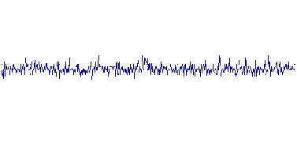
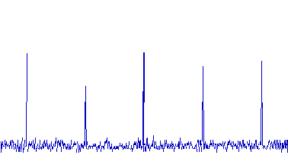
Power-Saving Mode
AWAKE: high power consumption, even if idle
SLEEP: low power, but can’t receive data
Basic PSM strategy: sleep to save energy, periodically wake to check for pending data
  PSM protocol: when to sleep and when to wake?
  802.11 PSM-static protocol: 100 ms period cycle
Enterasys Networks RoamAbout 802.11 NIC (Krashinsky, MobiCom’02 )
PSM off
PSM on
power
power
800mW
760mW
100ms
60mW
time
time
ACM MobiWac'04

Slide 4
Outline
Background
Problems of 802.11 PSM
Dynamic Beacon Period (DBP) Protocol
Practical Issues
Evaluation
Conclusions
ACM MobiWac'04

Slide 5



The 802.11 PSM Dilemma
The Internet
My laptop is sleeping too long, my data already arrived at the AP!!
RTT= 200 ms
100 ms period
RTT= 20 ms
My PDA is waking up too frequently; it is wasting too much energy!!
Too coarse-grained
Too fine-grained
Fundamental Tradeoff between energy and download time
A single beacon period can not be optimal for all
ACM MobiWac'04

Slide 6
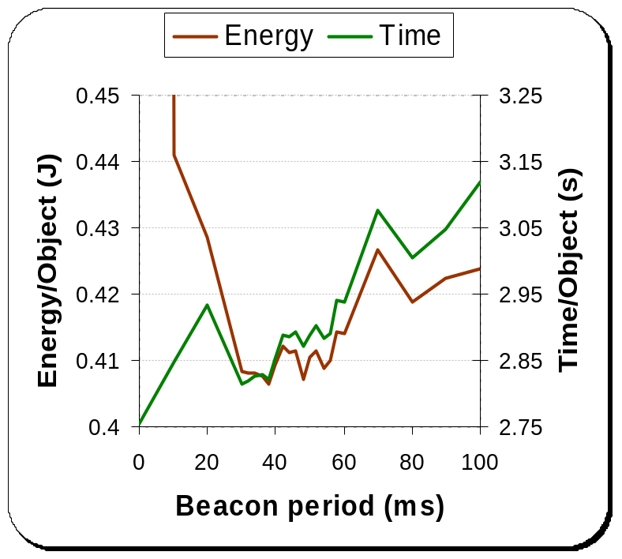
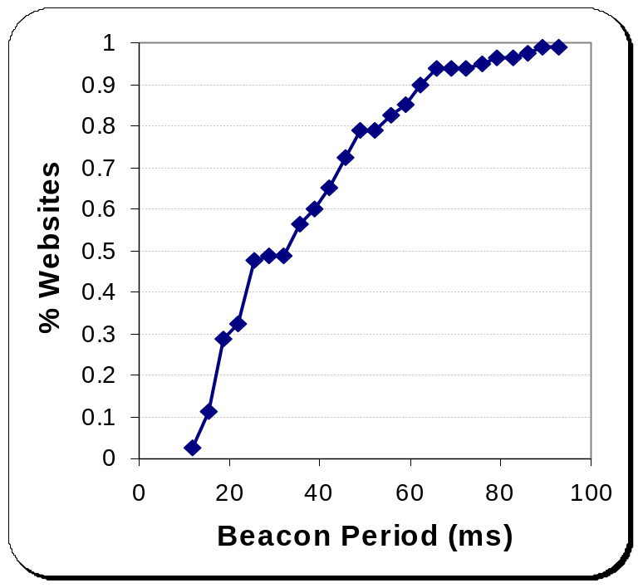
802.11 PSM in Practice
Q1. Is the default 100ms beacon period optimal?
Q2. Is there a single optimal beacon period?
NO
NO
Optimal
Downloading
superman.web.cs.cmu.edu
CDF of beacon periods optimizing
(delay x energy) for Alexa 100 sites
ACM MobiWac'04

Slide 7
Outline
Background
Problems of 802.11 PSM
Dynamic Beacon Period (DBP) Protocol
Practical Issues
Evaluation
Conclusions
ACM MobiWac'04

Slide 8
Dynamic Beacon Period Protocol
Key idea: the access point maintains separate beacon periods for separate clients
2. Receives and buffers data from web server
Bob
b1
Alice
b2
1. Guess a good beacon period b1 and notify AP
3. Wake up at period b1 to get data from AP
In 802.11 PSM, b1 = b2 = 100ms
ACM MobiWac'04

Slide 9
Practical Issues
How can a client choose a good beacon period?
Is the extra load on the access point manageable?
How can 802.11 PSM be enhanced to support the Dynamic Beacon Period (DBP) protocol?
ACM MobiWac'04

Slide 10
Choosing Beacon Periods
Heuristic: choose beacon period based on RTT of the connection
  Beacon period = α × RTT, α ≥ 1
    Results in the paper shows α=1.1 performs the best
  AP buffers data if prediction is inaccurate
RTT prediction based on experience
  RTT remains relatively stable over a download
  TCP style exponential average
  Cache estimated RTTs for future use
Concurrent connections
  Estimated RTT = smallest of the estimates
ACM MobiWac'04

Slide 11
Load on Access Points
Access point needs to maintain separate beacon periods for different clients
  Measurements at CMU campus, 50+ users/access-point at busy period
  Access points generally have a small number of concurrent connections
    Fewer than 10 clients registered for 90% time
  Therefore, overhead is not high
Optimizations for large population
  Coarser granularity of beacon periods
    Results in the paper shows 20ms granularity is good
  Temporarily fall back to the original 802.11 PSM
ACM MobiWac'04

Slide 12
Enhancing 802.11 to Support DBP
Make the default beacon period smaller
Use the existing ListenInterval feature
  A client can skip ListenInterval number of beacons
Clients dynamically change their ListenInterval values (existing feature)
Example:
  Default beacon period = 10ms
  Alice wants a beacon period of 38ms, Bob wants his to be 56ms
  Alice sets her ListenInterval=3, Bob sets his to be 5
ACM MobiWac'04

Slide 13
Outline
Background
Problems of 802.11 PSM
Dynamic Beacon Period (DBP) Protocol
Practical Issues
Evaluation
Conclusions
ACM MobiWac'04

Slide 14
Related Works
Client Centered Approach (CC, NOSSDAV’04)
  Client guesses next packet arrival and sleeps until then, does not use any access points
  DBP without the access point support
  A packet gets dropped if it arrives when the client is sleeping
Bounded Slowdown Protocol (BSD, MobiCom’02)
  Client dynamically changes sleep time to bound the slowdown of the download time
  DBP with different beacon period guessing algorithm
  Does not sleep in first few beacon periods, most HTTP transfers complete by then
ACM MobiWac'04

Slide 15
Evaluation
Algorithms compared: Client-Centered, Bounded Slowdown, 802.11 PSM, 802.11 no PSM, Optimal
Laboratory emulation:
  A kernel module emulates the access point
  Apache web server serves www.microsoft.com web page and all embedded objects (total size 168 KB)
  Normally distributed RTT, with variance of 5 ms
Real world experiments: top 100 web pages given by www.alexa.com, from CMU
ACM MobiWac'04

Slide 16
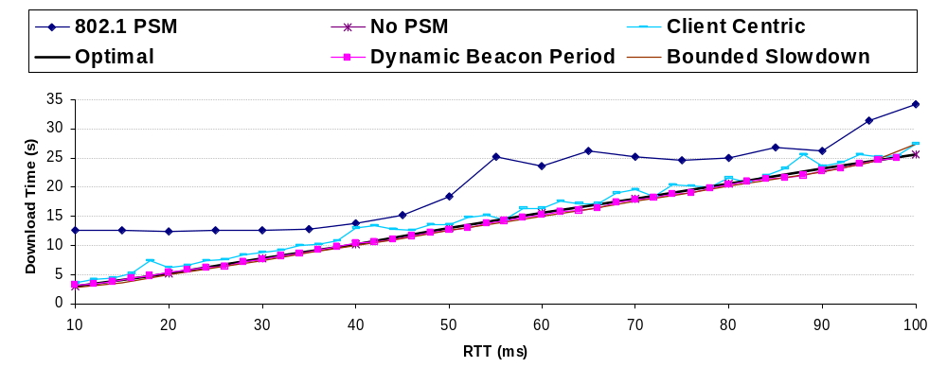
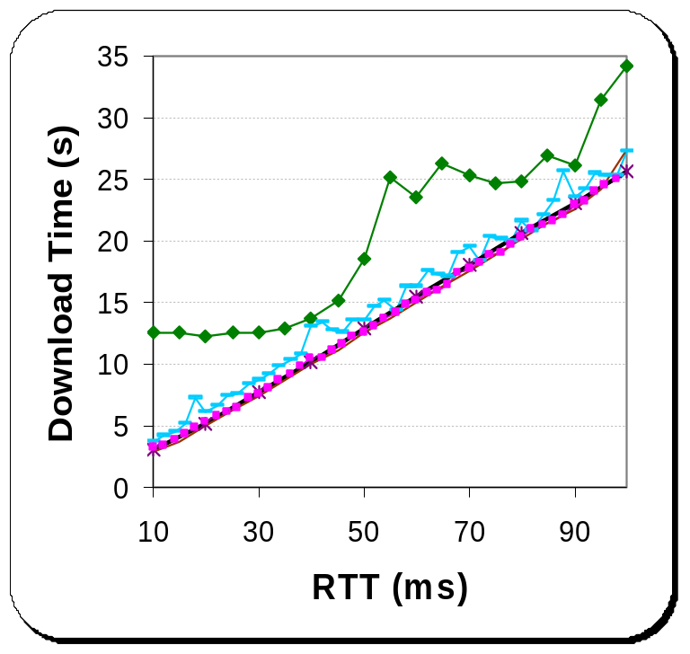
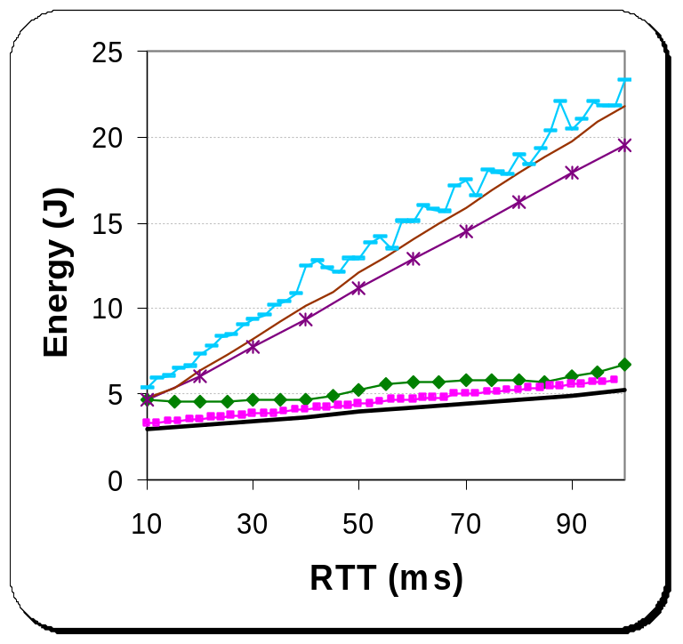
Emulation Results
DBP performs very close to the optimal
ACM MobiWac'04

Slide 17
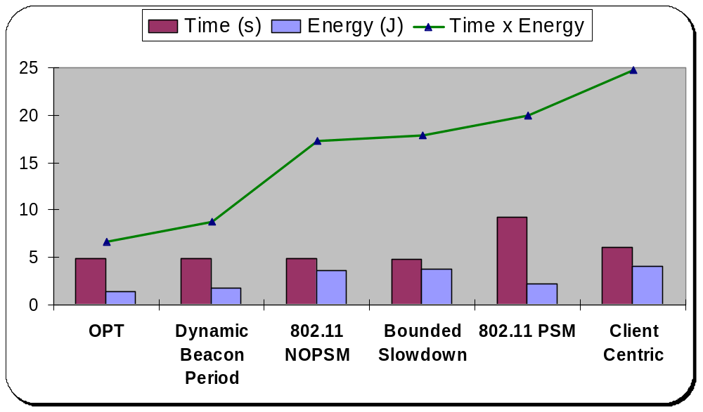
Real World Results
80th percentile of the download time and energy consumptions
DBP performs very close to the optimal
ACM MobiWac'04

Slide 18
Conclusions
Real world experiments show that 802.11 PSM performs poorly in practice
Using finer-grained beacons, controlled by each client, addresses shortcomings of 802.11 PSM
  Key challenges: beacon period estimation, scalability of access points, enhancing 802.11 PSM to support the extension
Emulation and real-world measurements show that key concerns can be addressed
ACM MobiWac'04

Slide 19
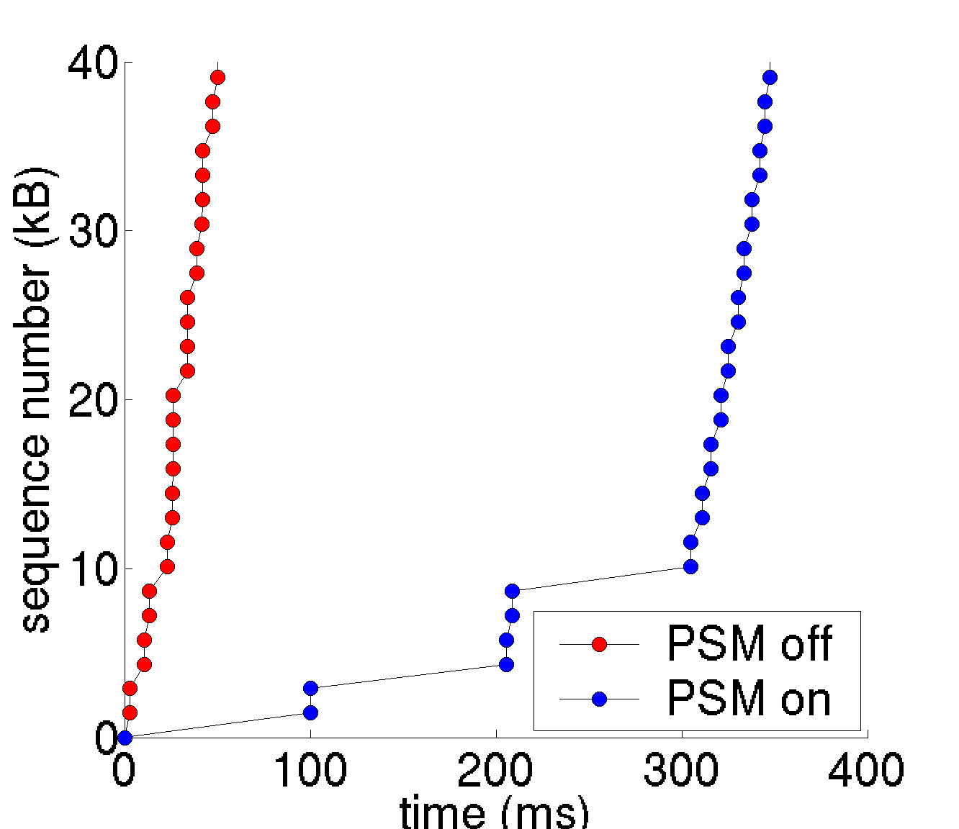
Impact of 802.11 PSM on
Web Browsing
Web browsing: typically small TCP data transfers
  Mostly finishes within the TCP slow-start period
PSM-static slows down initial RTTs to 100ms
For a server with RTT of 20ms, slowdown is 2.4x
Does not save enough energy either
  Longer transfer time
  Bursty workload
ACM MobiWac'04

