Slide 1
Adaptive Data Placement for Wide-area Sensing Services
Suman Nath
Phillip B. Gibbons
Srinivasan Seshan

Slide 2
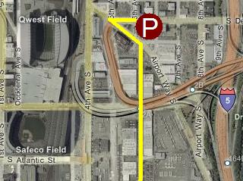
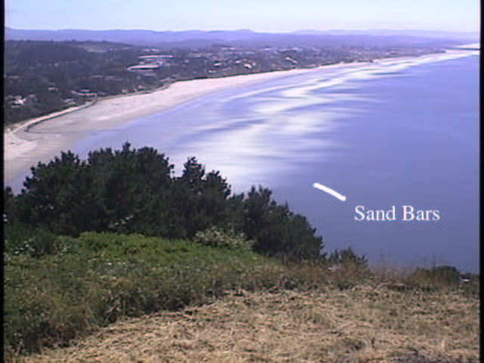
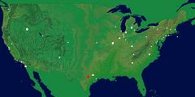
Context
Wide-area Sensing Service
  Live data from geographically dispersed sensors
  Queries from anywhere in the Internet
Parking Finder
Ocean Monitor
Network Monitor

Slide 3

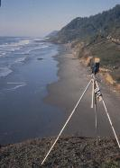



Sensing System
Distributed Query Processing
(Internet)
Distributed Storage
NetMon
IrisNet (SIGMOD’03)

Slide 4
Focus of This Talk
Distributed Query Processing
(Internet)
Distributed Storage
Distributed Storage
Partitioning
Replication
Placement
…
For robustness and performance
Goal: Automate these data-management tasks

Slide 5
Challenges
Unique data access pattern
  In-network processing in a hierarchy
Empty parking spot in Shadyside
City
…
Neighborhood
…
…
Street
Block

Slide 6
More Challenges
Dynamic workload
  Flash crowds
Write-intensive workload
Capacity constraints
  Processing and storage
Wide-area distribution

Slide 7
Problem Statement
Given
Hierarchical database
Machine capacity
Data
partitioning
Replication
factor
Data
placement
Determine
Cluster based on
access locality
Write-intensive
data => few
replicas
Near data and
query source
Optimize
Query
latency
Query
traffic
Update
traffic
NP-Complete Problem

Slide 8
Ideal Solution
Construct workload graph

Slide 9
Practical Solution

Slide 12
A Simple Run
Query
Query
1. Partitioning
Query
2. Replication +
Placement
Query
Query
Query
Query

Slide 13
Replica Selection
Random selection
  Fails to remove replicas after flash crowd
Proximity selection
  No effective in read-locality
Randomized response-time selection
  Selection probability = roughly inversely proportional to recent response time
    Nearby replica on similar load
    Lightly loaded replica on similar distances

Slide 14
Implementation in IrisNet
Stat-keeper module
  Real time monitoring of necessary statistics
Load adjusting module
  Executes the IDP algorithm
Discovery module
  Discovers target machines
  Centralized + distributed
Performance overhead < 1%

Slide 15
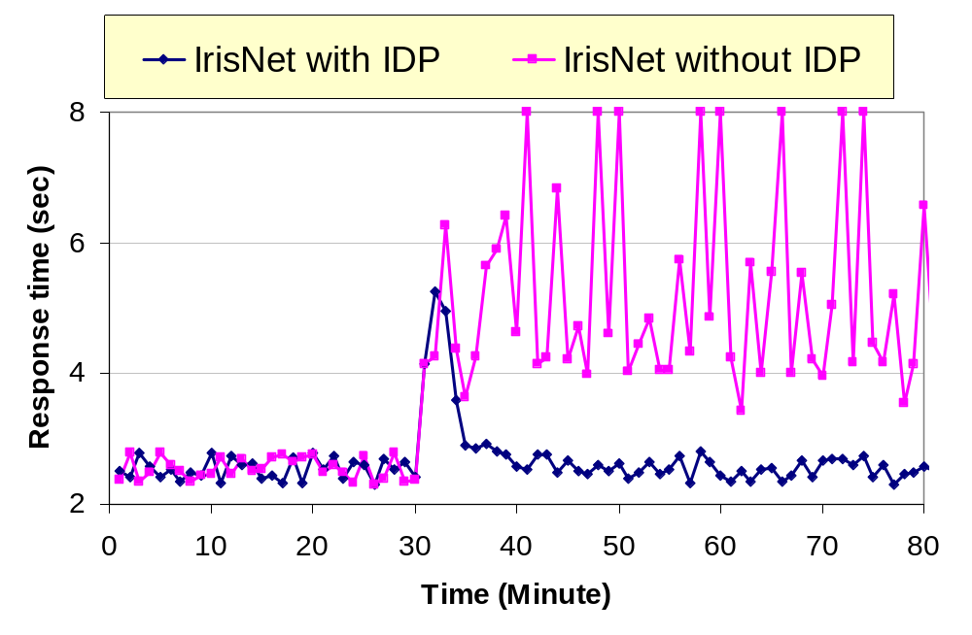
Overall Performance
Flash-crowd
Live PlanetLab deployment with synthetic workload

