Slide 1
Colyseus: A Distributed
Architecture for Online
Multiplayer Games
Ashwin Bharambe, Jeffrey Pang, Srini Seshan
Carnegie Mellon University
May 7, 2006 @ NSDI, San Jose

Slide 2
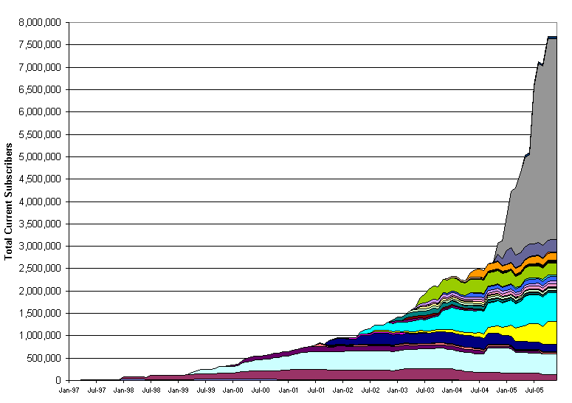
Online Games are Huge!
8 million
http://www.mmogchart.com/
7 million
World of Warcraft
6 million
5 million
Number of subscribers
4 million
3 million
Final Fantasy XI
2 million
Everquest
Ultima Online
1 million
1997
1998
1999
2000
2001
2002
2003
2004
2005
Notes:
Let me start by showing you a graph of the popularity of online games. The Y-axis here shows the number of subscribers for the most popular MMGs over the past 8-10 years. We see that these games have exploded in popularity and today, just WoW alone has over 4 million subscribers. The number of players playing at any point in time is lesser, but it is still over 150K for WoW…

Slide 3


Why MMORPGs Scale?
Slow-paced
  Players interact with the server relatively infrequently
Maintain multiple independent game-worlds
  Each hosted on different servers
Not true with other game genres
  First Person Shooters (e.g., Quake)
  Demand high interactivity
  Need a single game-world
Notes:
These games have centralized client-server architectures. and despite the numbers I just presented, I am going to claim that these games actually do not scale all that well. The reason is that these games make many changes to the game just to make the game scale to the current numbers. First, they slow down the pace of the game and reduce interactivity. More drastically, the game is actually divided into a set of parts called realms such that players in two realms cannot interact with each other. Essentially, the game is divided into multiple smaller games each of which is hosted on a single server. Even after all this, there are long wait-queues on some servers!
And it is not as if such games by their very nature have to be slow. new games like planetside have first-person shooter like interactivity. and they are popular. however due to the heavy load such games place on the server they scale even poorly.

Slide 4
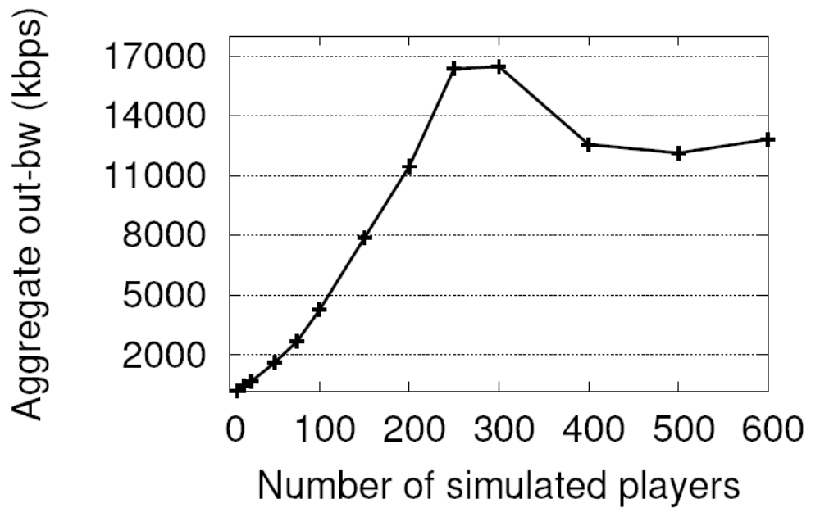
FPS Games Don’t Scale
Quake II server
Bandwidth (kbps)
Bandwidth and computation, both become bottlenecks
Notes:
These games have centralized client-server architectures. and despite the numbers I just presented, I am going to claim that these games actually do not scale all that well. The reason is that these games make many changes to the game just to make the game scale to the current numbers. First, they slow down the pace of the game and reduce interactivity. More drastically, the game is actually divided into a set of parts called realms such that players in two realms cannot interact with each other. Essentially, the game is divided into multiple smaller games each of which is hosted on a single server. Even after all this, there are long wait-queues on some servers!
And it is not as if such games by their very nature have to be slow. new games like planetside have first-person shooter like interactivity. and they are popular. however due to the heavy load such games place on the server they scale even poorly.

Slide 5

Goal: Cooperative Server Architecture
Focus on fast-paced FPS games
Notes:
The goal therefore is to build a cooperative or federated architecture which can utilize the resources of a number of PCs spread over a geographic area. Think of a number of server-like machines spread throughout the US (hosted by a company or contributed by players themselves), and one or more players connecting to these machines. When there is only player per machine, we can think of this as a P2P architecture.
The focus of this work is on fast-paced shooter type of games. We think these are one of the hardest to scale because of the tight latency demands they have. Players of such games are very sensitive to delay. Secondly, addressing cheating for such an architecture is clearly necessary. However, that is not the focus of this paper.

Slide 6
Talk Outline
Background
Colyseus Architecture
Evaluation
Conclusion
Notes:
As I describe the design decisions, I will discuss how they differ from previous work in this domain.
The rest of the talk is going to proceed like thus. I will start by describing the game model we use and how any generic distributed design for a game would look like. I will discuss the challenges that this brings and how related work does not address them adequately. Then I will prsent the architecture of our system concentrating on the main design principles. I will also discuss some important optimizations used in our architecture. After that I will present a brief evaluation of the system and then conclude with contributions and limitations.

Slide 7
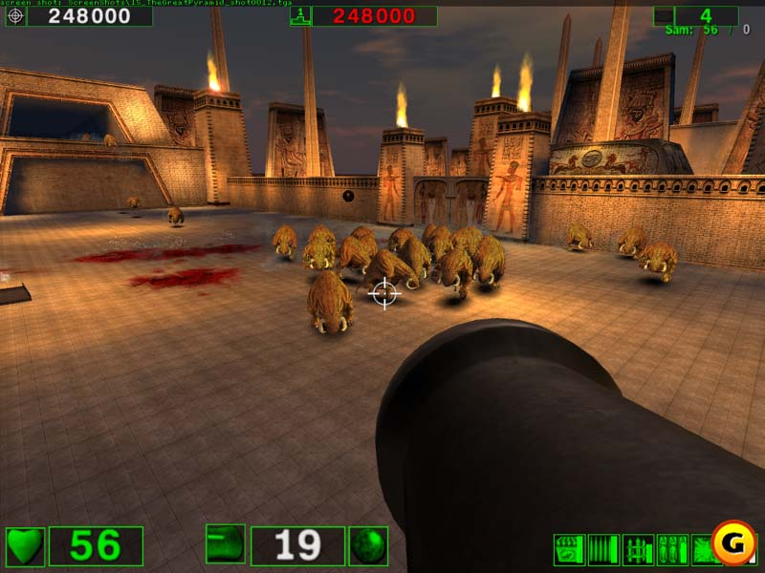
Game Model
Immutable
State
Mutable
State
Ammo
Interactive
3-D
environment
(maps,
models,
textures)
Monsters
Game
Status
Screenshot of Serious Sam
Player
Notes:
say something about object oriented architecture of the games.
What this picture shows is a screenshot of a typical game frm the perspective of a player. The game here is called Serious Sam. The state of the game can be divided into two parts. The first part is the immutable or static part which consists of the 3-d environment. the terrain also called the map, 3-d representations of objects, textures, etc. The other part is the mutable part which changes attributes responding to user events or game Artificial Intelligence.

Slide 8
Game Execution in Client-Server Model
void RunGameFrame() // every 50-100ms
{
// every object in the world
// thinks once every game frame
foreach (obj in mutable_objs) {
if (obj->think)
obj->think();
}
send_world_update_to_clients();
};

Slide 9
Talk Outline
Background
Colyseus Architecture
Evaluation
Conclusion
Notes:
As I describe the design decisions, I will discuss how they differ from previous work in this domain.
The rest of the talk is going to proceed like thus. I will start by describing the game model we use and how any generic distributed design for a game would look like. I will discuss the challenges that this brings and how related work does not address them adequately. Then I will prsent the architecture of our system concentrating on the main design principles. I will also discuss some important optimizations used in our architecture. After that I will present a brief evaluation of the system and then conclude with contributions and limitations.

Slide 10
Object Partitioning
Player
Monster

Slide 11
Distributed Game Execution
class CruzMissile {
// every object in the world
// thinks once every game frame
void think() {
update_pos();
if (dist_to_ground() < EPSILON)
explode();
}
void explode() {
foreach (p in get_nearby_objects())
{
if (p.type == “player”)
p.health -= 50;
}
}
};
Monster
Missile
Item
Item
Object Discovery
Replica Synchronization
Notes:
the objects needed for discovery should be present right then. otherwise you will end up stalling game execution.

Slide 12
Distributed Design Components
Object
Discovery
Create
Replicas
Object
Replica
Notes:
del

Slide 13
Primary-Backup Replication
Each object has a single primary copy
Replicas are read-only
  Writes to replicas are serialized at the primary
Primary responsible for executing think code
Replica trails from the primary by 0.5 RTT
  Weakly consistent
  Low latency is critical
Notes:
cut consistency… to just weakly consistent
latency is critical… vs. quorums, TACT etc…
cut mcast; primary responsible
what replicas should you create???h

Slide 14
Object Discovery
Find all objects with
obj.x ε [x₁, x₂]
obj.y ε [y₁, y₂]
obj.z ε [z₁, z₂]
Subscription
Matching
My position is
x=x₁, y=y₁, z=z₁
_{Located on 128.2.255.255}
Publication

Slide 15
Scalable Object Discovery
Mercury [SIGCOMM 04]
  Range-queriable structured overlay
  Contiguous data placement
  Provides O(log n)-hop lookup
    About 200ms for 225 nodes in our setup
Not good enough for FPS games
Colyseus uses three optimizations
  Pre-fetching objects
  Pro-active replication
  Soft-state subscriptions and publications

Slide 16
Prefetching
On-demand object discovery can cause stalls or render an incorrect view
Use game physics for prediction
  Predict which areas objects will move to
  Subscribe to object publications in those areas

Slide 17
Pro-active Replication
Standard object discovery and replica instantiation slow for short-lived objects
Piggyback object-creation messages to updates of other objects
  Replicate missile pro-actively wherever creator is replicated

Slide 18
Soft-state Storage
Objects need to tailor publication rate to speed
  Ammo or health-packs don’t move much
Add TTLs to subscriptions and publications
  Stored at the rendezvous node(s) Pubs act like triggers to incoming subs

Slide 19
Colyseus Components
server s1
Object Store
P1
P2
R3
R4
Object Location
Replica Management
Object Placement
Mercury
P3
P4
server s2

Slide 20
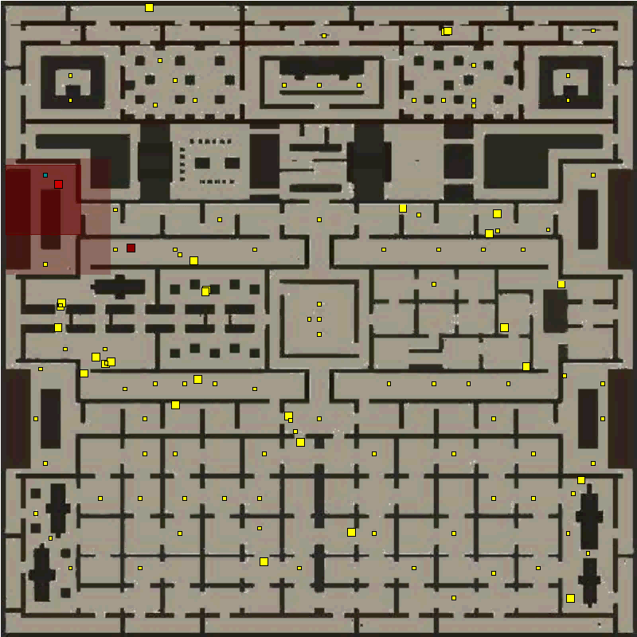
Putting It All Together
Notes:
displays a visualization of the game in progress. Quake game with our boring map.
perspective of my server.
big yellow dots are objects located on other nodes in the system. small yellow dots are items.
red dot is Jeff. Maroon dots covering the yellow dots represent replicas. Notice how yellow dots
get overlayed by maroon dots as Jeff moves through the maze.

Slide 21
Talk Outline
Background
Colyseus Architecture
Evaluation
Conclusion

Slide 22
Evaluation Goals
Bandwidth scalability
  Per-node bandwidth usage should scale with the number of nodes
View inconsistency due to object discovery latency should be small
Discovery latency
Prefetching overhead

Slide 23
Experimental Setup
Emulab-based evaluation
Synthetic game
  Workload based on Quake III traces
P2P scenario
  1 player per server
  Unlimited bandwidth
  Modeled end-to-end latencies
More results including a Quake II evaluation, in the paper

Slide 24
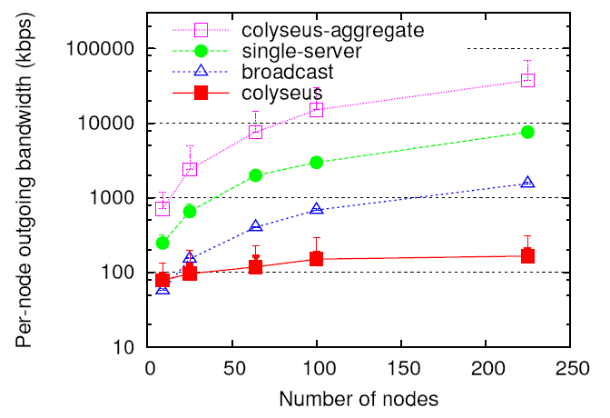
Per-node Bandwidth Scaling
Mean outgoing bandwidth (kbps)
Number of nodes

Slide 25
Per-node Bandwidth Scaling
Observations:
1. Colyseus bandwidth-costs scale well with #nodes
2. Feasible for P2P deployment
(compare single-server or broadcast)
3. In aggregate, Colyseus bandwidth costs are 4-5
times higher ➔ there is overhead

Slide 26
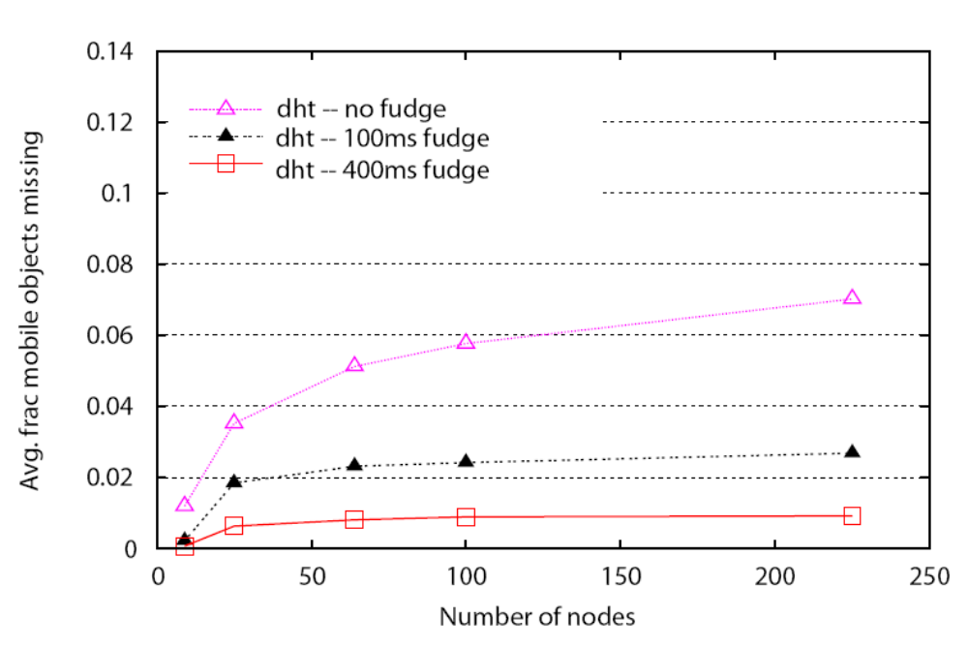
View Inconsistency
no delay
100 ms delay
400 ms delay
Avg. fraction of mobile objects missing
Number of nodes

Slide 27
View Inconsistency
no delay
100 ms delay
400 ms delay
Observations:
1. View inconsistency is small and gets repaired quickly
2. Missing objects on the periphery

Slide 28
Differences from Related Work
Avoid region-based object placement
  Frequent migration when objects move
  Load-imbalance due to skewed region popularity
1-hop update path between primaries and replicas
  Previous systems used IP or overlay multicast
Replication model with eventual consistency
  Some previous systems used parallel simulation

Slide 29
Conclusion
Demonstrated FPS games can scale
Colyseus enables low-latency game-play
  Keep primary-replica update path short
  Use structured overlays for scalable lookup
  Utilize predictability in the workload
Ongoing work
  Improved consistency model
  Robustness and cheating

Slide 30
Questions?

Slide 31
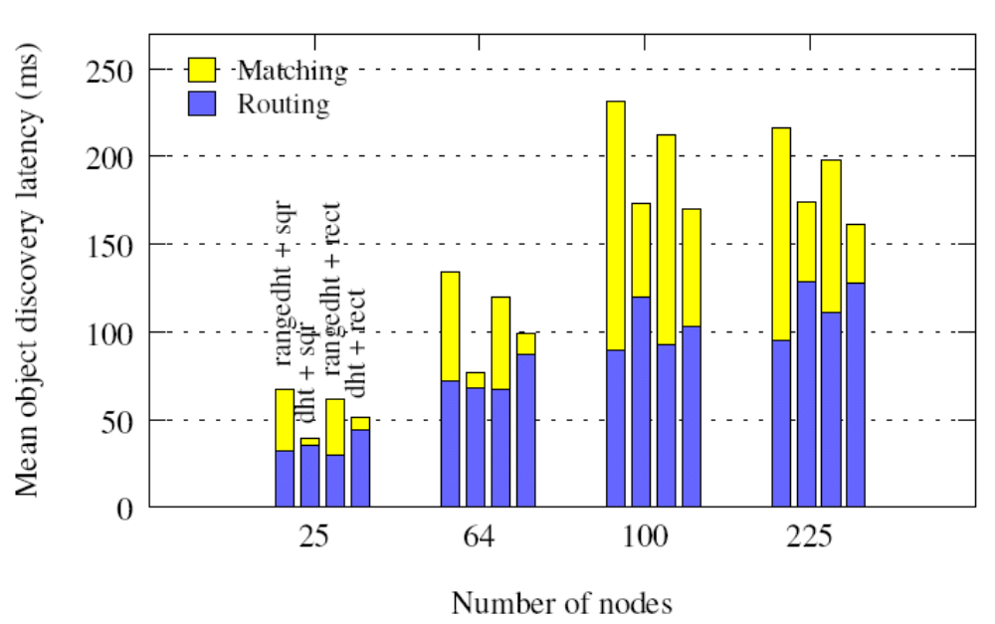
Object Discovery Latency
Mean object discovery latency (ms)
Number of nodes

Slide 32
Object Discovery Latency
Observations:
1. Routing delay scales similarly for both types of DHTs:
both exploit caching effectively.
Median hop-count = 3.
2. DHT gains a small advantage because it does not
have to “spread” subscriptions

Slide 33
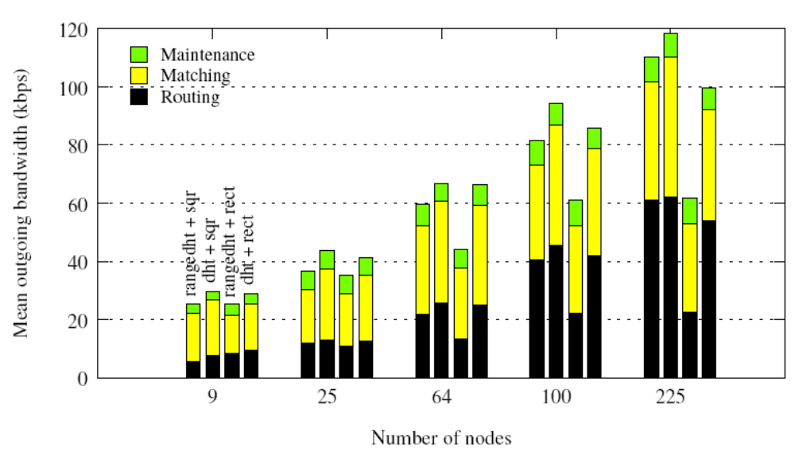
Bandwidth Breakdown
Mean outgoing bandwidth (kbps)
Number of nodes

Slide 34
Bandwidth Breakdown
Observations:
1. Object discovery forms a significant part of the total
bandwidth consumed
2. A range-queriable DHT scales better vs.
a normal DHT (with linearized maps)

Slide 35
Goals and Challenges
1. Relieve the computational bottleneck
  Challenge: partition code execution effectively
2. Relieve the bandwidth bottleneck
  Challenge: minimize bandwidth overhead due to object replication
3. Enable low-latency game-play
  Challenge: replicas should be updated as quickly as possible

Slide 36
Key Design Elements
Primary-backup replication model
  Read-only replicas
Flexible object placement
  Allow objects to be placed on any node
Scalable object lookup
  Use structured overlays for discovering objects

Slide 37
Flexible Object Placement
Object placement not tied to “regions”
Previous systems use region-based placement
  Disruptively frequent migration for fast games
  Regions in a game significantly vary in popularity
Permits use of clustering algorithms

Slide 38
View Consistency
Object discovery should succeed as quickly as possible
  Missing objects ➔ incorrect rendered view
Challenges
  O(log n) hops for the structured overlay
    Not enough for fast games
  Objects like missiles travel fast and short-lived

Slide 39
Distributed Architectures: Motivation
Server farms? $$$
  Significant barrier to entry
Motivating factors
  Most game publishers are small
  Games grow old very quickly
What if you are ~1000 university students wanting to host and play a large game? ☺
Notes:
And so, we would like to build a distributed architecture. But why? Couldn’t we use a big server farm like Amazon r Google? Except that would require loads of cash. Makes it a significant barrier to entry. Small game publishers are the norm in the industry and they lack such resources. Also, what if you are a large bunch of university students wanting to play? No one student will have the resources to support this group. Games become old very quickly and so the game you thought was cool will no longer be hosted!

Slide 40
Colyseus Components
server s1
Object Store
P1
P2
R3
R4
Object Location
Replica Management
Object Placement
1. Specify Predicted Interests:
(5 < X < 60 & 10 < y < 200) TTL 30sec
2. Locate Remote Objects: P3 on s2, P4 on s2
3. Register Replicas: R3 (to s2), R4 (to s2)
4. Synch Replicas: R3, R4
5. Optimize Placement: migrate P1 to server s2
Mercury
P3
P4
server s2

