Slide 1
Subtleties in
Tolerating Correlated Failures in Wide-area Storage Systems
Suman Nath |  | Microsoft Research
Haifeng Yu |  | Intel Research Pittsburgh
Phillip B. Gibbons |  | Intel Research Pittsburgh
Srinivasan Seshan |  | CMU

Slide 2
Motivation
Highly available distributed storage system
  Non-P2P wide-area systems (e.g., PlanetLab, Akamai)
Replication, erasure coding, etc.
  Most traditional studies assume failure independence
Failures are not independent in practice
  Correlated failures: Multiple machines fail simultaneously, regardless of root cause
    Causes: DoS attack, virus, human error, bugs, etc.

Slide 3
Correlated Failures
Example correlated failures
  Akamai: Victim of DDoS attacks in 2004-2005
  Planetlab: >20% nodes failed in 4 correlated failures in 2004-2005
Correlation hurts availability dramatically [Bakkaloglu’02] [Yalagandula’04]
Recent proposals
  Failure prediction [OceanStore, Weatherspoon’02]
  [Phoenix, Junqueira’05]
  Failure modeling [Glacier, Haeberlen’05]
  High storage redundancy [Glacier, Haeberlen’05]

Slide 4
Our Contributions
Study failure correlation in 3 Internet systems
Revisit existing techniques
  Existing prediction techniques give negligible benefits
    Can predict 99% failures, but no availability improvement
  Simple failure modeling has dramatic inaccuracies
    Miss target availability by 2 nines or use 240% more resources
  Redundancy does not improve availability after certain point
    Doubling/tripling redundancy gives negligible improvement
Derive design principles
Use the design principles in a real system

Slide 5
Outline
Motivation
Methodology
Revisiting existing techniques and
Deriving design principles
Experience of using the design principles

Slide 6
Methodology
Three failure traces
Name | Nodes | Measurement Period | Measurement Duration | Scheme
PL_Trace | ~ 300 Planetlab nodes | Every 15 mins | 16 months | All-pair ping
WS_Trace | ~ 130 public web servers | Every 5 mins | 3 months | HTTP Get
RON_Trace | ~ 30 RON nodes | Every 1 min | 20 months | All-pair ping
Notes:
heading

Slide 7
Methodology
Failure size =
# nodes failed
Measurement
period
Time in trace
Discussion with a read-only system
  Erasure(m,n) : m-out-of-n erasure coding system
  Results extend naturally to read-write system
Number of nines availability
  99.9% availability = three 9s
Notes:
No defn of number of nines
Cut down validation

Slide 8
Outline of Our Study
Investigate techniques to deal with correlated failures
Three classes of techniques
  Avoiding correlation
    Identifying correlation patterns
  Tolerating correlation
    Using model to determine parameters
    Using enough redundancy
  Ignoring correlation
    Choose design based on failure independence

Slide 9

Failure-pattern Prediction
1
Introspection [OceanStore, Phoenix]
  Predict failure pattern from history
  Place replica accordingly to improve availability
Can we predict failure patterns?
Yes. 99% failures follow historical patterns.
Does this improve availability?
Not really. We saw negligible improvement.

Slide 10
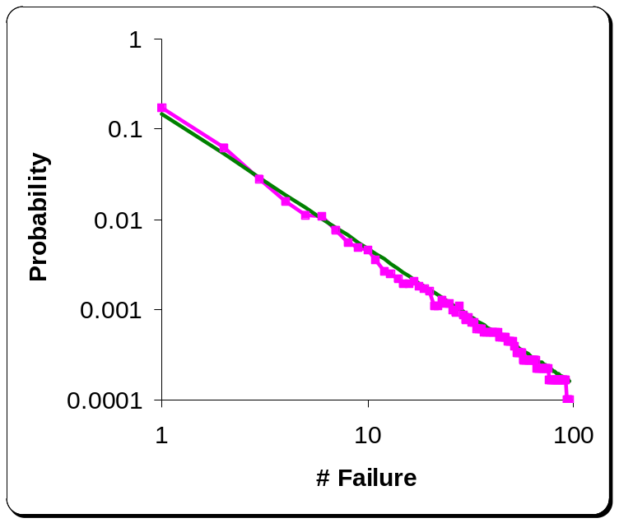
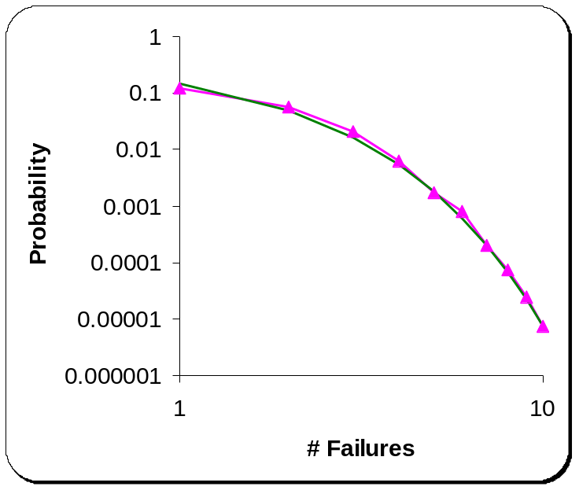
The Subtlety
99% failures are small (<= 15)
1% failures are big (>15)
WS Trace
WS Trace
y = 0.15x^{-1.5}
y = 0.44e^{-1.1x}
Pareto distribution ⇒ predictable
Exponential distr. ⇒ unpredictable
Negligible unavailability
High unavailability
High unavailability

Slide 11
The Design Principle
Should not rely on existing pattern prediction techniques
  Fail to detect patterns of large failures which are rare but have dominant effects on unavailability

Slide 12
Outline of Our Study
Investigate techniques to deal with correlated failures
Three classes of techniques
  Avoiding correlation
    Identifying correlation patterns
  Tolerating correlation
    Using model to determine parameters
    Using enough redundancy
  Ignoring correlation
    Choose design based on failure independence

Slide 13
Correlated Failure Model
2
Glacier model [Haeberlen, NSDI’05]
  Define the worst-case failure size
    Glacier(f), f fraction of nodes can fail together
  The system determines replication parameters to tolerate such failures
Is such simple modeling sufficient?
Notes:
No animation

Slide 14
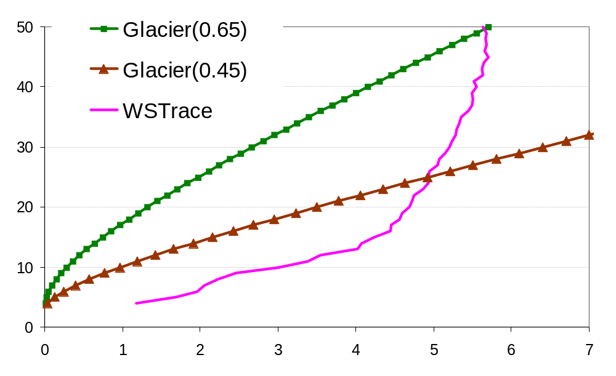
The Subtlety
Over-estimates
availability
Erasure(6, 31)
240% overhead
n in Erasure(6, n)
Erasure(6, 9)
Under-estimates
availability
#9s Availability
Dramatic inaccuracies in practice

Slide 15
Our Failure Model
Failure Size
Generator
k = Failure Event Size
3
5
2
Random k nodes fail
Discrete time model
Captures only temporal correlation
Notes:
Recovery gradually

Slide 16
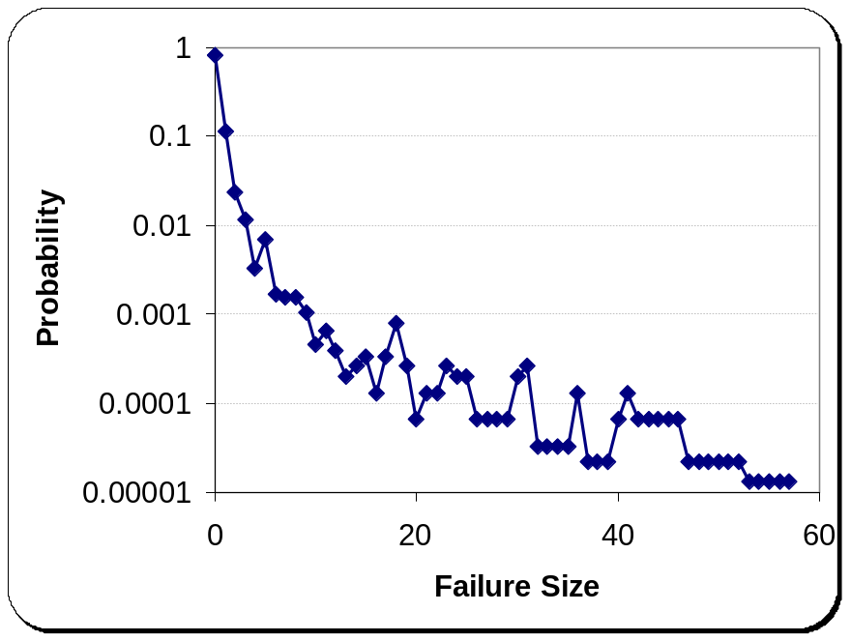
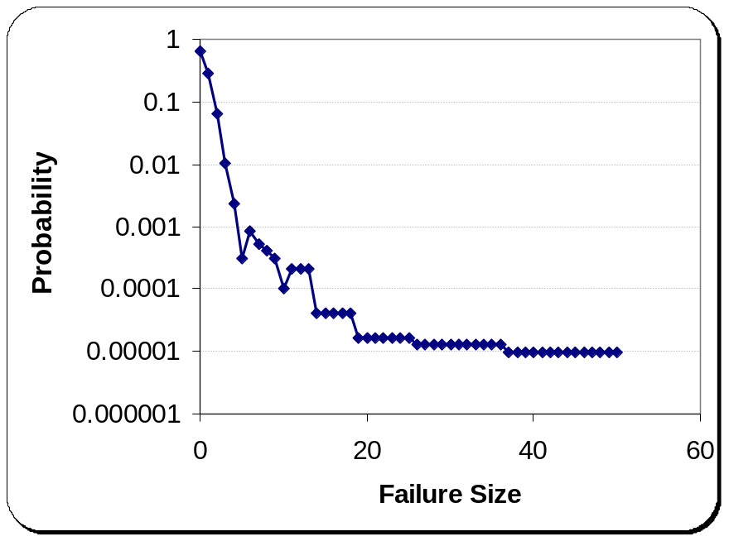
Failure Size Model
PlanetLab trace
WebServer trace
y = f(ρ₁, x) ∝ ρ₁^{x}
+
y = f(ρ₂, x) ∝ ρ₂^{x}
Bi-exponential Model
= (1-α) f(ρ₁, x) + α f(ρ₂, x)
= G(α, ρ₁, ρ₂)
Notes:
Proportion to
Bi-exponential
Exp1(small) + exp (large failures)

Slide 17
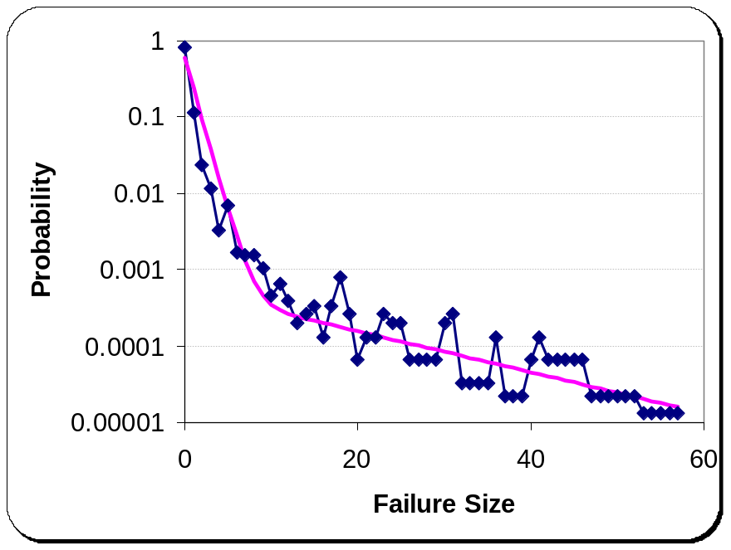
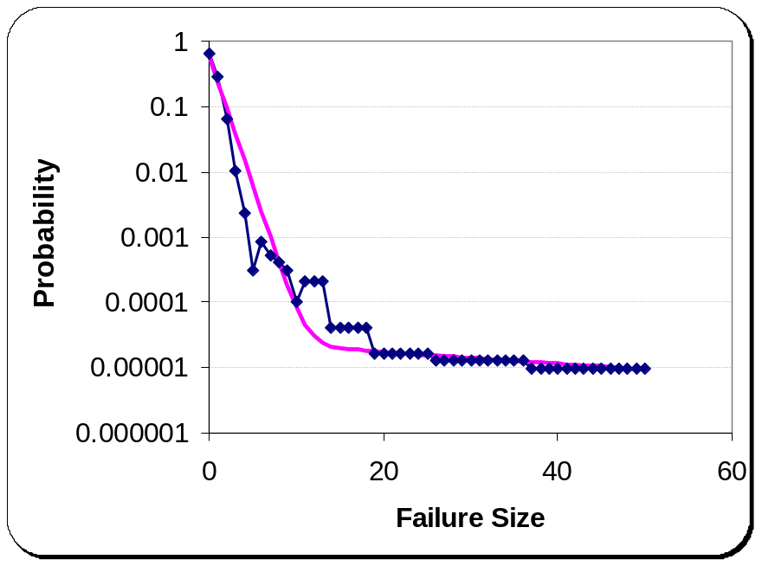
Failure Size Model
Bi-exponential Model
PlanetLab trace = G(0.009,0.4,0.95)
WS trace = G(0.0012,0.4,0.98)
Bi-exponential model fits the failure-size distribution well
Does this model gives good availability parameters?
Notes:
No shift

Slide 18
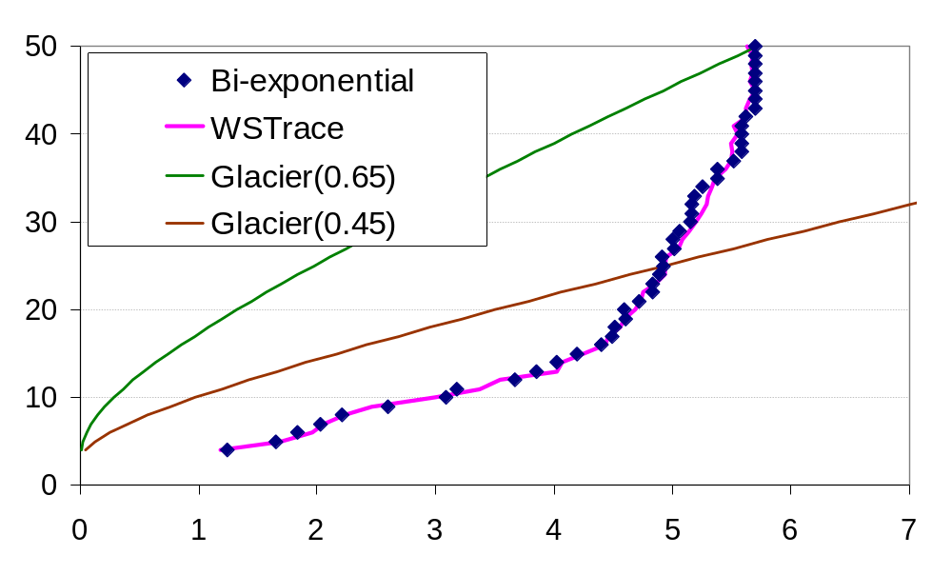
The Design Principle
n in Erasure(6, n)
#9s Availability
Failures should be modeled via a distribution, rather than a fixed size
Notes:
Highlight our model
G = Bi-exponential model

Slide 19
Outline of Our Study
Investigate techniques to deal with correlated failures
Three classes of techniques
  Avoiding correlation
    Identifying correlation patterns
  Tolerating correlation
    Using model to determine parameters
    Using enough redundancy
  Ignoring correlation
    Choose design based on failure independence

Slide 20
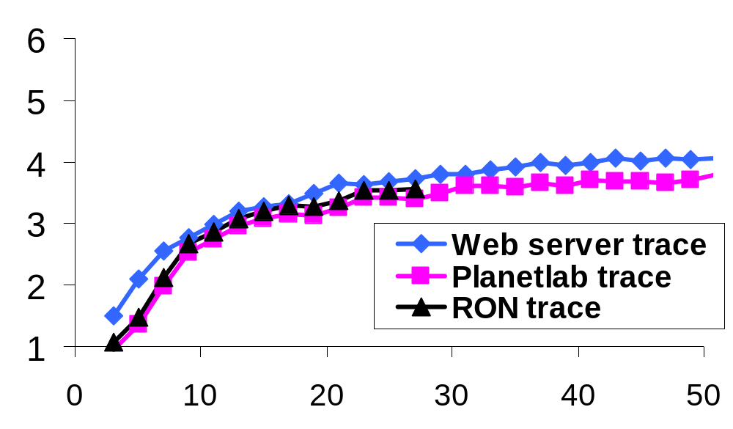
Additional Fragments
3
Independent failures
Diminishing return
Availability (#9s)
# Fragments n in Erasure(n/2, n) [CFS, OceanStore]
Are additional fragments helpful in practice?
Not always. Upper limit of availability.
Notes:
Say diff x axis
Clean up

Slide 21
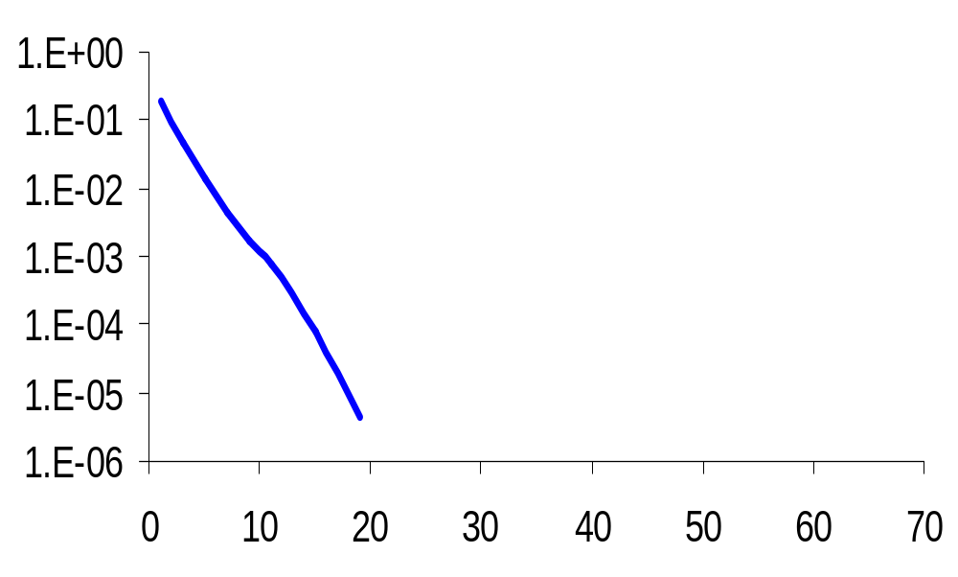
Real Cause of Diminishing Return
Reason behind the diminishing return
  Failure correlation? Not just that …
1
0.1
0.01
0.001
0.0001
0.00001
Various failure sizes
combined effects of
two failure sizes
Big failures
Unavailability
Unavailability
Large failures have
smaller probability
Small failures
# Fragments n in Erasure(n/2, n)
Notes:
Axis diff
Label axis
Large failure, small failure

Slide 22
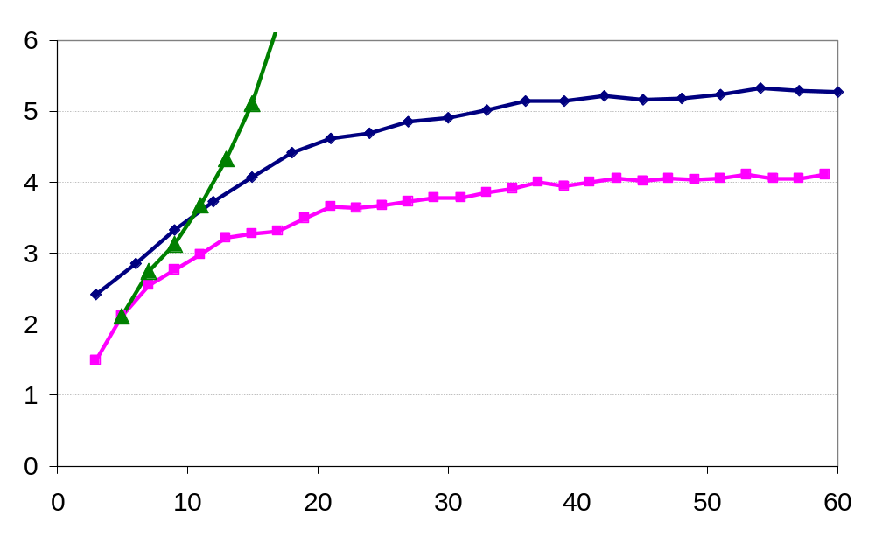
How to Avoid Diminishing Returns?
WS Trace
Erasure(4,n)
Availability (#9s)
Erasure(n/3,n)
Erasure(n/2,n)
# Fragments n
Design principle: Use smaller m in Erasure(m, n)
Notes:
Storage overhead, tradeoff

Slide 23
Outline of Our Study
Investigate techniques to deal with correlated failures
Three classes of techniques
  Avoiding correlation
    Identifying correlation patterns
  Tolerating correlation
    Using model to determine parameters
    Using enough redundancy
  Ignoring correlation
    Choose design based on failure independence

Slide 24
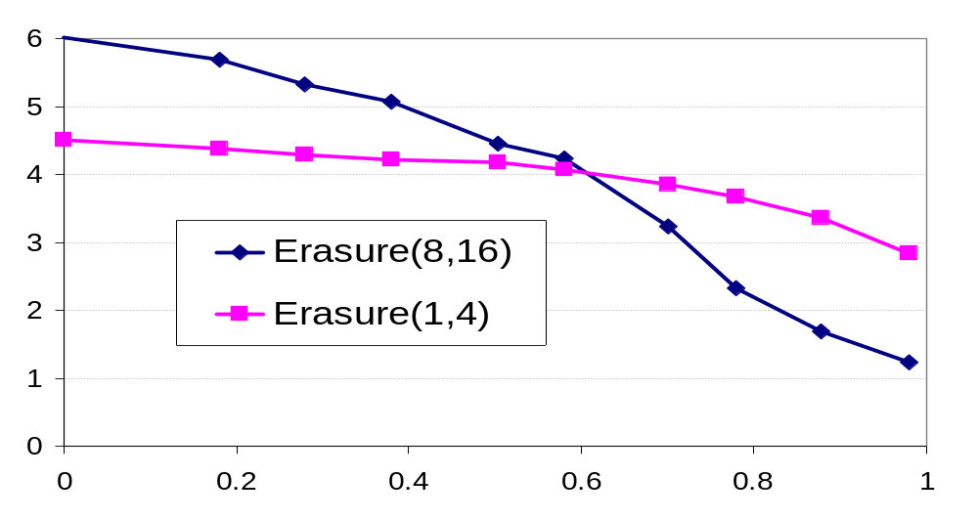
Choosing Design
4
#9s Availability
Independent
failures
WSTrace
ρ₂ in G(0.0012,0.4 ρ₂, ρ₂)
Design principle: Keep correlated failures in mind while evaluating and choosing designs

Slide 25
Outline
Motivation
Methodology
Revisiting existing techniques and
Deriving design principles
Experience of using the design principles

Slide 26
IrisStore
A distributed storage system
  Similar to recent systems (OceanStore, DHash) except availability design
Uses the lessons learnt, e.g.,
  Uses failure models for target deployment
Self-tune replication parameters for target availability
Uses consistent replica regeneration
  Useful optimizations of Paxos to be used in WAN
More details in the paper
Notes:
See paper

Slide 27
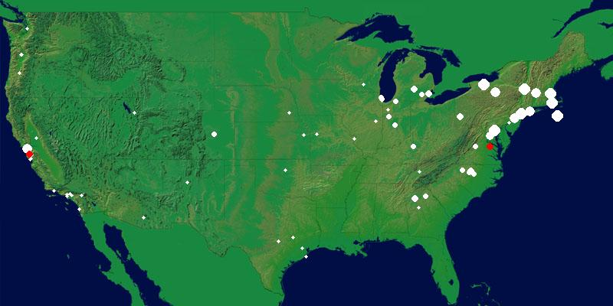
IrisLog – Example Application
  Wide-area network/node monitoring system deployed over PlanetLab
  IrisLog uses IrisStore for storing node usage info, statistics, etc.
Screenshot of IrisLog
-- open for public use for 8 months
Notes:
: http://www.intel-iris.net/irislog

Slide 28
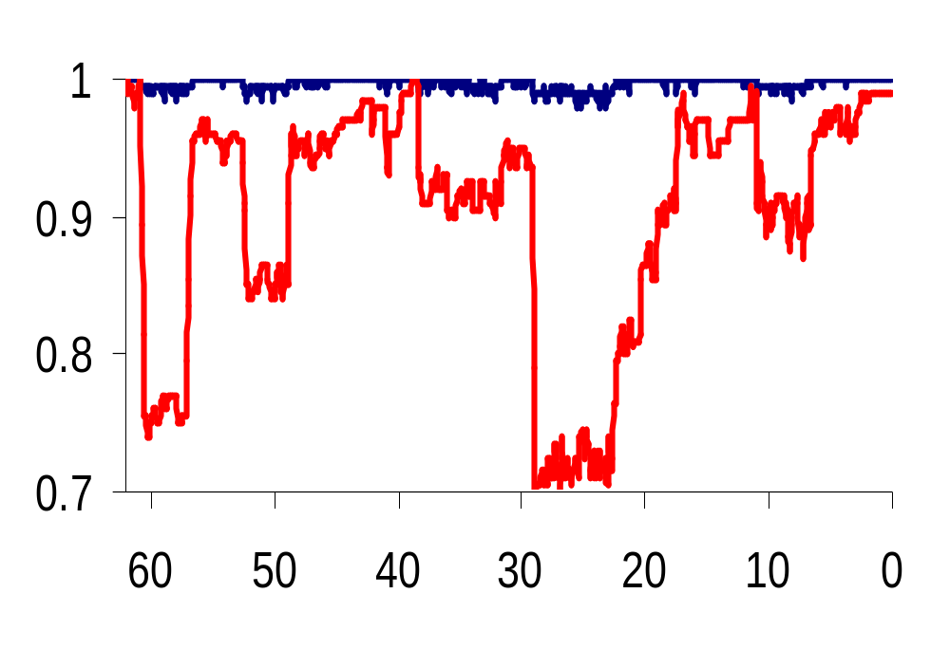
Availability Experience with IrisStore
Fraction of available data objects in IrisStore
7 replicas with quorum size = 2
Fraction of
available
PlanetLab
nodes
See paper for performance and other results
-
-
-
-
-
-
Hours before SOSP’05 deadline
Notes:
Say: planetlab is the most unstable before major systems conferences
Naming in IrisStore is done via DNS. IrisStore has about 3500 objects. Objects are grouped into ~300 groups that can be named. Individual objects cannot be named. This means about 300 DNS entries. We maintain two DNS servers locally at CMU. When doing the experiments, the DNS client is at CMU as well.
The results do capture naming failures. However, because the DNS server and client is always up, there were no naming failures during the experiment.

Slide 29
Conclusion
Patterns of small failures may be predicted, but that doesn’t help much
  Design to tolerate, not to avoid, correlated failures
Simple models have significant inaccuracies
  Use a distribution of failure size
Additional fragments have diminishing returns of availability
  Use smaller m in Erasure(m,n)
A better design under independent failure may not be better in real world
  Evaluate and choose designs based on correlated failures
Notes:
Extends to read-write

Slide 30
Conclusion
Study with three real-world traces show that
  Predicting large failures is necessary for high availability
    Existing history-based techniques does not help
  Simple failure models have significant inaccuracies
    We propose a new failure model
  Failure correlation causes diminishing return of availability
    Choose small m in Erasure(m,n)
    A better design under failure independence may not be better under failure correlation
Experience with a real system shows the effectiveness of the lessons learnt

Slide 31
Read-write Systems
Read-write systems
  Replication with voting/quorum systems
  m out of n replicas required to access an object
  Same as Erasure(m, n)
Results naturally holds
  Majority voting systems = Erasure(n/2, n)
  Signed quorum systems (SQS) [YU, PODC’04] with quorum size c = Erasure(c,n)
  SQS with smaller m can better tolerate correlated failures than Majority voting systems

Slide 32
Related Work
Availability research assuming failure independence
  TotalRecall [Bhagwan’04], Farsite [Bolosky’00], CFS [Cates’03], DHash++ [Dabek’04], Replica placement [Douceur’01]
Research on correlated failures in WAN
  OceanStore (UC Berkeley) [Weatherspoon’02]
  Phoenix Recovery Service [Junqueira’05]
  Failure correlation on Planetlab [Chun’03]
  Glacier (Rice Univ) [Haeberlen’05]

Slide 33
Methodology
Model-driven simulation for sensitivity study
Trace-driven simulation of a storage system
PlanetLab deployment for validation
Discussion with a read-only system
  Erasure(m,n) : m-out-of-n erasure coding system
  Results extend naturally to read-write system
Number of nines availability
  99.9% availability = three 9s
Notes:
No defn of number of nines
Cut down validation

Slide 34
Root Cause Analysis
Can we predict ALL the causes/patterns?
  Probably not
  Some failures are inherently unpredictable (DDoS attacks)
  Humans are not good in reasoning about rare events
  Rare but ignored patterns may cause unavailability
Selfish behavior?

Slide 39
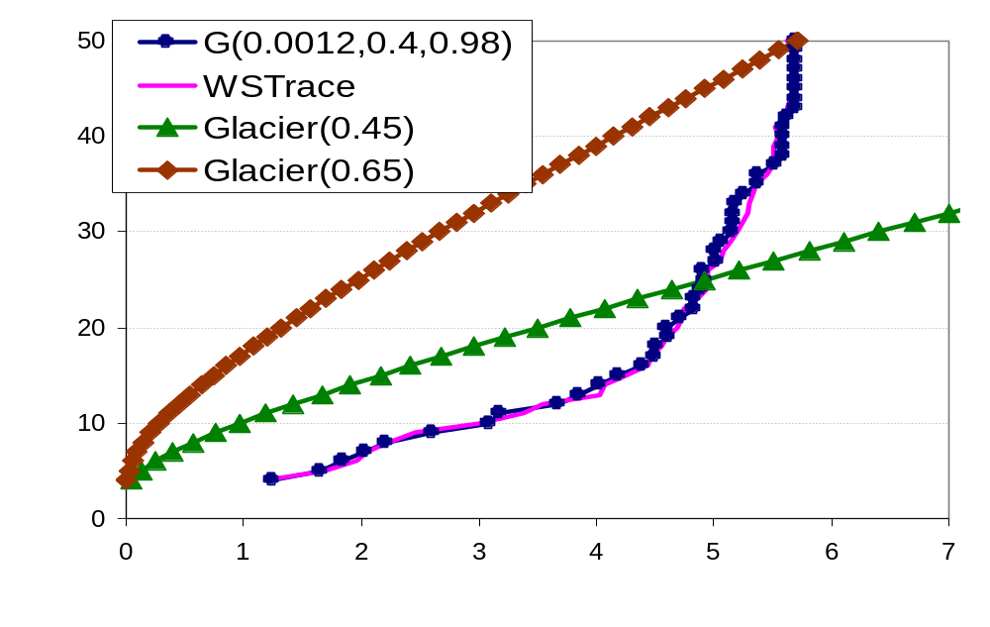
The Subtlety
Over-estimates
availability
Erasure(6, 31)
240% overhead
n in Erasure(6, n)
Erasure(6, 9)
Under-estimates
availability
#9s Availability
Dramatic inaccuracies in practice

Slide 40
Failure Model

Slide 41
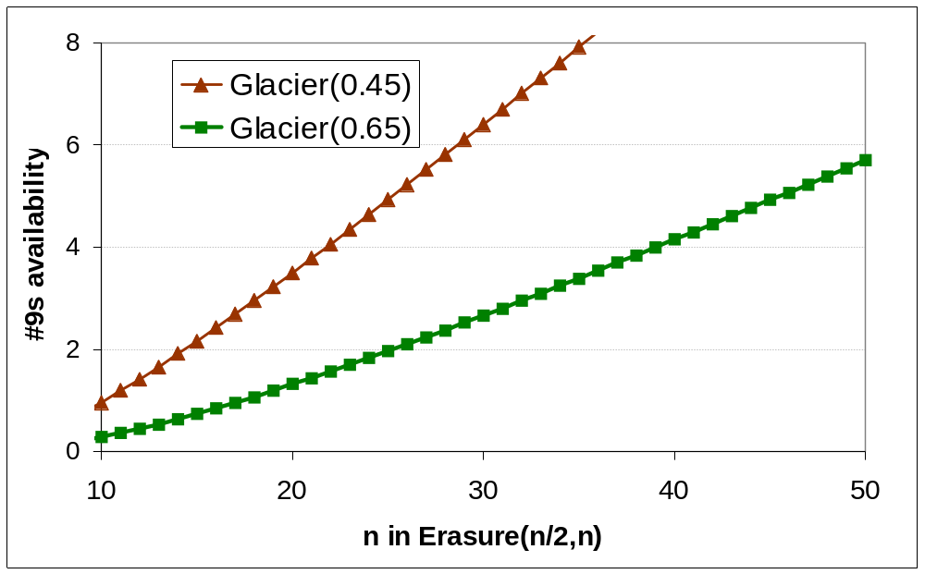
The Subtlety
Reason behind the diminishing return
  Failure correlation? Not really

Slide 42
The Design Principle
Large correlated failures
  Are rare
  Have dominant effects on unavailability
  Can not be predicted well by existing techniques
Root cause-based pattern prediction?
  May be effective in some cases. However,
    Many are unpredictable (e.g., DDoS attacks)
    Identifying ALL root causes not possible, the missed ones may have dominant effect
    See paper for more discussion

