Slide 1
Can Ferris Bueller Still Have His Day Off? Protecting Privacy in the Wireless Era
Ben Greenstein, Ramki Gummadi, Jeffrey Pang, Mike Chen, Yoshi Kohno, Srini Seshan, David Wetherall
HotOS XI
May 8, 2007

Slide 2
Warning: This talk is about privacy
Many of you will never care
  My job is not to convince you that you should
Rather, I want to design systems that provide it if you want it
  And that let you know how violated you’ve been

Slide 3

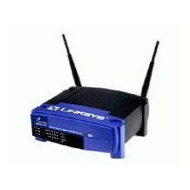

Wireless data privacy threat
Third party can see the contents of your messages, e.g., email, credit card numbers
  Addressed by encryption for confidentiality
xxxxx
email
xxxxx
(Mary)
email
(Mary)
Traditional threat, assumed solved (soon)

Slide 4
Wireless information privacy threat
Third party can identity specific users or kinds of devices near a given location
  Due to unique signatures, e.g., addresses
Hey, Mary’s next door!
xxxxx
(Mary)
xxxxx
(Mary)
Less well known, point of this talk
Notes:
Inventorying, presence, population, activity levels

Slide 5
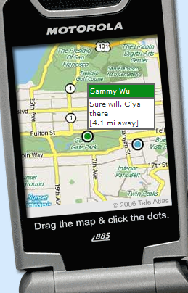
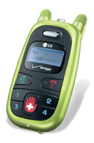
Traditional Context: Information threat of location systems well-appreciated
Concealing location information is well-studied
Solutions apply passivity, data confidentiality and policy
Or offer opt-in
service for
social network
tracking
Services prey
on kids, who
have limited
privacy rights
Verizon’s virtual
fence for kids
Loopt’s mobile
friend finder

Slide 6

Even devices without location systems are a threat
Anyone can use your transmissions to track you
  The problem scales
There’s no policy to help
  E.g., ISM is unlicensed and under-regulated
Hey, Mary’s next door!
xxxxx
(Mary)
X
xxxxx
(Mary)
Beth, Kim, Amy, and Jenny are home too!
Notes:
And managed by individuals with little accountability

Slide 7
Information privacy threat
Not just a glitch
  Persists even with best security practices
  Cuts across technologies (RFID, cellular, WiFi, WiMAX)
Potentially sensitive issue
  RFID tracking/inventorying
  Processor serial numbers
Trends will increase its importance
  Wireless becomes ubiquitous and personal
  Privacy awareness on the rise (identity theft, corporate policies)
Notes:
Processor serial numbers = synchronized cookies

Slide 8
Example: 802.11 clients
Q: What can we learn about users by observing their 802.11 transmissions?
  Who they are?
  Where they have been?
  Where they live?
A: In some cases, all of the above!

Slide 9
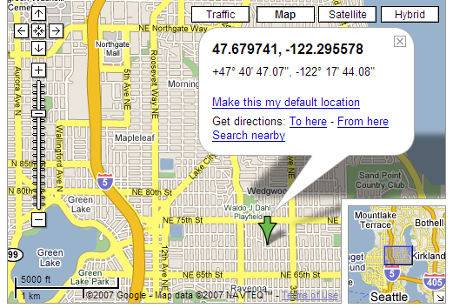
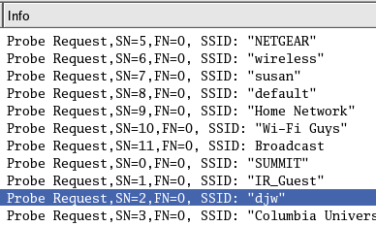
Laptops advertise preferred networks
To speed association, SSIDs sent in probes
  Sample data below from SIGCOMM 2004
Home
Set of SSIDs helps to identify user in terms of networks and places they’ve been
Cross-index with location databases (Wigle) for geographic information

Slide 10
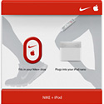
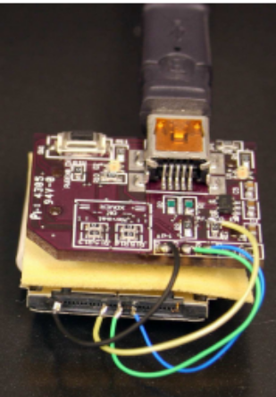
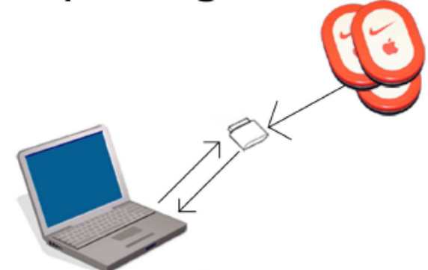
Example: Nike+iPod kit
Receiver can report all nearby transmitter names
  Can track joggers as they go by …
Nike+iPod
Tracker setup
Devices That Tell on You: Privacy Trends in Consumer Ubiquitous Computing, T.S. Saponas, J. Lester, C. Hartung, S. Agarwal, and T. Kohno, Usenix Security, August 6-10, 2007

Slide 11
There is increased opportunity to violate your privacy
This is true whether or not you care!
So, is privacy really that difficult to provide?

Slide 12
Fundamental problem: Naming
Need names to address, authenticate, bill
  But they give us away
  E.g., 802.11’s MAC address always transmitted in the clear
  Useful even without fe:02:2a:72:b9:48 = Mary a priori
  Can link multiple packets to a user
Send a packet to
fe:02:2a:72:b9:48
(a.k.a., Mary)
xxxxx
(Mary)
xxxxx
(Mary)

Slide 13
Fundamental problem: Resource discovery and binding
Reveals service provider and/or the client identities, and relationship
Only authorized clients of a service should be
capable of discovering it
Only client and service should know of their binding
Clients should be anonymous
Probing for djw. . .
Probing for Tom_AP. . .
Ah, Mary is here at Tom’s house, and she’s previously been to Wetherall’s house
Tom_AP here. . .
This is Mary. May I bind?
Tom_AP
Mary
Sure, no problem
Notes:
Note: Obscuring SSIDs in a simple way (hashing), still leaves consistent identifiers for offline profiling

Slide 14
Fundamental problem:
Implicit Information leakage
Can fingerprint sequence numbers, operating modes, advertised capabilities
  In 802.11, not protected by 802.11i (data payloads only)
Find implicit identifiers, measure strength
Then neutralize without performance hit
2
2
6
6
6
2
6
0-2312
4
Frame
Control
Duration/
ID
Address
1
Address
2
Address
3
Sequence
Control
Address
4
Frame
Body
CRC
Mac Header
Advertised rates, capabilities,
Authentication algorithms
Management
And Control
Payloads
Notes:
Even without explicit names
802.11w is a start (unicast mgmt payloads)

Slide 15
Researchers say: Use pseudonyms
Periodically change your MAC address [Gruteser, Hu]
  E.g., ifconfig eth1 hw ether fa:ca:de:00:00:01
But pseudonyms only attempt to address naming
And they’re easily linked together
  Across layers, e.g., ARP
  Across interfaces
  Via timing: Cessation, then addition, is suggestive
Send a packet to
fe:02:2a:72:b9:48
(a.k.a., Mary)
xxxxx
(Mary)
xxxxx
(Mary)
Hard to Fix
Notes:
Coordination is hard
Suggestive particularly if signal strength correlates

Slide 16
Strawman approach:
Encrypt everything!
Encrypt frame headers and all payloads
  With nonce so successive packets wouldn’t be identical
  With pairwise keys so authorized users can’t eavesdrop
Probe using an anonymous encryption scheme
  Client knows public keys of all its APs
  Client sends probe to each AP
    Using anonymous public key or identity based encryption scheme
    The probe includes a public key for the client
      AP could use this public key to encrypt the response

Slide 17
Challenges
Cryptographic Protocol Issues
  Encrypt protocol fields designed to be broadcast
  Conceal client identities from service providers
  Be robust to common attacks
  Bootstrap and manage state at autonomous clients
Backwards compatibility
Physical layer leaks
  Protocol timings, clock skew, RF fingerprints, RSSI correlation, packet lengths
  Requires padding, delays, Tx power randomization, more
Overhead
  Must be acceptable and scale with clients
Notes:
Designed to be broadcast to all users
E.g. the duration field used for reservations
Shared key over all users susceptible to insider attacks
Non-trivial computations on each encrypted frame
Thus wasted energy, DOS susceptibility
Particularly so in the face of message loss

Slide 18
So protecting privacy is hard
Where do we start?
How about by examining how bad the situation really is?

Slide 19
Initial investigation:
Find 802.11 user fingerprints
Goal:
  Assess how readily users can be identified from features of their 802.11 transmissions
  Assess whether pseudonym technique and confidentiality prevent users from being identified
Pseudonyms
  Temporary, slowly changing addresses (instead of fixed, unique MAC address)
  Widely used as part of GSM (cellular)

Slide 20

Experimental methodology
Gather trace from SIGCOMM 2004, with monitors (~500 users)
Split into training data and validation data, and traffic samples (1 hour)
Convert user identities to pseudonyms
Now train on features and try to identify users in validation data
Use user identities in trace for ground truth
“A busy conference/campus”

Slide 21
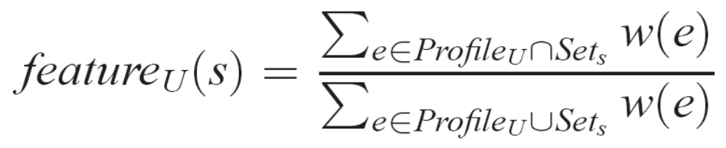
Step 1: Convert feature sets to metrics
See paper for details
Set similarity (Jaccard Index), weighted by frequency:
Rare
djw
linksys
IR_Guest
SIGCOMM_1
Common
PROFILE FROM
TRAINING
SAMPLE FOR
VALIDATION

Slide 22

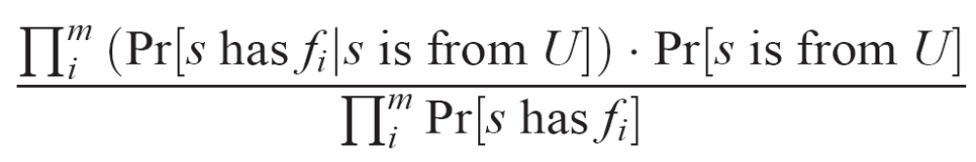
Step 2: Run a naïve Bayesian classifier
See the paper for details
We say sample s (with features f_{i}) is from user U if LHS > T
We vary T for different True Positive / False Positive Rates
=

Slide 23
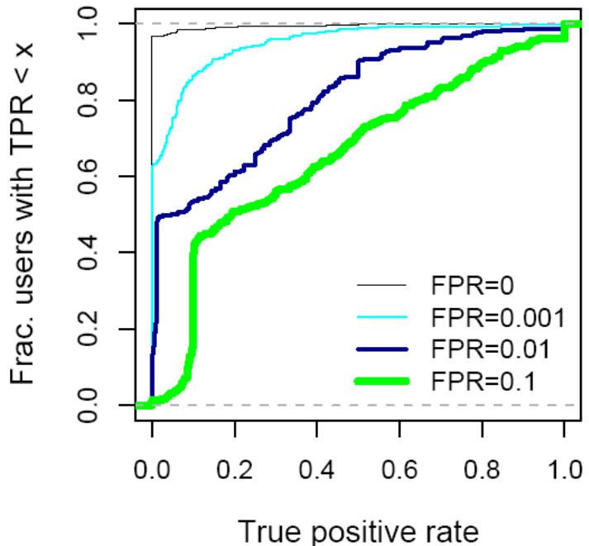
Fingerprinting result for set of 802.11 broadcast packet sizes
Some users stand out of the crowd
“Broadcast packet sizes” is one feature
Features combine to find more users
Cumulative distribution of True positive rate for users with given False positive rate (FPR)

Slide 24
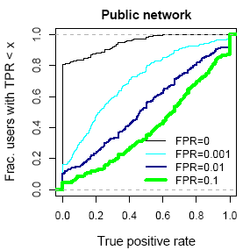
Combining features helps
In public networks, samples from 1 in 4 users are identified >50% of the time with 0.999 accuracy
Combined Features:
bcast
+ ssids
+ fields
+ netdests
Notes:
Lower to the left is better

Slide 25
802.11 Study and findings
Addresses not the only identifying feature
  Pseudonyms provide weak protection
Some users emit highly specific features
  Easily found in a crowd
802.11 User Fingerprinting, J. Pang, B. Greenstein, R. Gummadi, S. Seshan, and D. Wetherall, Technical Report, March 2007.

Slide 26
Conclusion
Information privacy is a threat for mobile, wireless devices
Future wireless protocols should preserve information privacy
Protocol designers must. . .
  Consider privacy at design time
  Understand the nature of the threat
    across a range of existing technologies (RFID, 802.11, WiMax)
  Design strategies to protect privacy
    Without sacrificing manageability and usability
    Balance with cost and performance
  Be proactive, and raise the bar
We must rethink all aspects of wireless communications, from addressing to resource discovery

Slide 27
