Slide 1
Defragmenting DHT-based Distributed File Systems
Jeffrey Pang, Srinivasan Seshan
Carnegie Mellon University
Phillip B. Gibbons, Michael Kaminsky
Intel Research Pittsburgh
Haifeng Yu
National University of Singapore

Slide 2

Traditional DHTs
Each node responsible for random key range
Objects are assigned random keys
324
987
160
150-210
211-400
401-513
800-999

Slide 3
Defragmented DHT (D2)
Related objects are assigned contiguous keys
320
321
322
150-210
211-400
401-513
800-999

Slide 4

Why Defragment DHTs?
Improves Task Locality
Task Success Rate
  Depend on fewer servers when accessing files
Task Performance
  Fewer DHT lookups when accessing files
Traditional DHT
D2
x
x
x
x
x
x
Fail!
Fail!
Fail!
Success
Success
Fail!
objects in two tasks:

Slide 5
Why Defragment DHTs?
Improves Task Locality
Task Success Rate
  Depend on fewer servers when accessing files
Task Performance
  Fewer DHT lookups when accessing files
Traditional DHT
D2
lookup
objects in two tasks:

Slide 6
Why Defragment DHTs?
Improves Task Locality
Task Success Rate
  Depend on fewer servers when accessing files
Task Performance
  Fewer DHT lookups when accessing files
Traditional DHT
D2
lookup
objects in two tasks:

Slide 7
D2 Contributions
Simple, effective locality techniques
Real defragmented DHT implementation
Evaluation with real file system workloads
Answers to three principle questions…

Slide 8
Questions
Can task locality be maintained simply?
Does locality outweigh parallelism?
Can load balance be maintained cheaply?
Notes:
First, it is unclear how much task locality can be maintained in practice because we need to predict the access patterns of future tasks. Thus, the question is, can we maintain sufficient task locality in a simple manner that improves availability and performance substantially?
Second, although locality reduces the number of dht lookups required to complete tasks, it also potentially reduces the amount of download parallelism. This is because if objects are stored on multiple machines, we may be able to download them all simultaneously. Hence, the question is, does locality outweigh parallelism in terms of improving performance?
Third, in order to maintain task locality we can no longer use consistent hashing to maintain load balance and instead must balance load dynamically by migrating data. So the question is, can load balance be maintained cheaply?

Slide 9
Questions
Can task locality be maintained simply?
Does locality outweigh parallelism?
Can load balance be maintained cheaply?

Slide 10
Technique #1:
Locality Preserving Keys
Preserve locality in DHT placement
  Assign related objects nearby keys
Group related objects
  Leverage namespace locality
  Preserve in-order traversal of file system
  E.G., files in same directory are related

Slide 11
Assigning Object Keys
6
Bill
userid
path encode
blockid
1
Docs
6
1
0
…
bid
1
6
1
1
…
bid
6
1
2
…
bid
2
7
Bob
570-600
601-660
661-700

Slide 12
Practical Concern
Key distribution is not uniformly random
  ⇒ Object placement is no longer uniform
  ⇒ Load imbalance if node IDs are random
Solution:
  Dynamically balance load
  (Discussed later in talk)

Slide 13
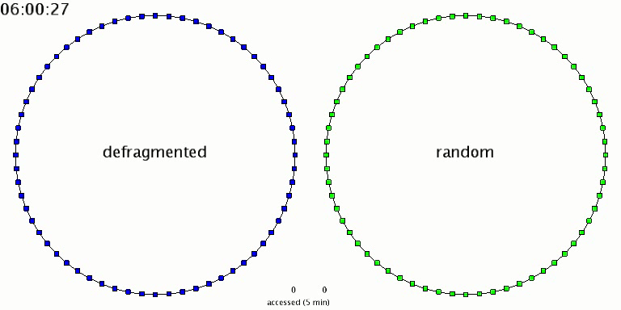
DHT Nodes Accessed

Slide 14
Task Availability Evaluation
How much does D2 reduce task failures?
Task = sequence of related accesses
  E.G., ‘ls -l’ accesses directory and files’ metadata
  Estimate tasks:
Evaluated infrastructure DHT scenario:
  Faultload: PlanetLab failure trace (247 nodes)
  Workload: Harvard NFS trace
< 1sec
< 1sec
access
time
Task

Slide 15
Systems Compared
8KB blocks
Traditional-File
(PAST)
Traditional
(CFS)
D2

Slide 16
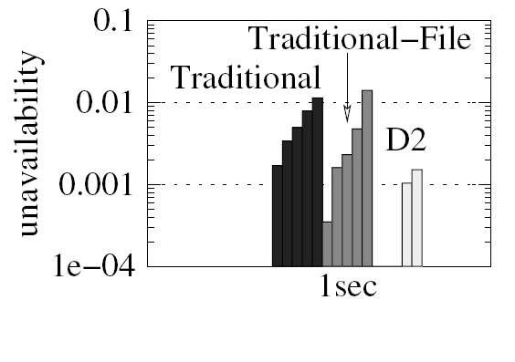
Task Unavailability
median
What fraction of tasks fail?

Slide 17
Questions
Can task locality be maintained simply?
Does locality outweigh parallelism?
Can load balance be maintained cheaply?

Slide 18
Technique #2:
Lookup Cache
Task locality ⇒ objects on a few nodes
  Cache lookup results to avoid future lookups
Client-side lookup cache
  Lookups give: IP Address ⇒ Key Range
  If key in a cached Key Range, avoid lookup

Slide 19
Performance Evaluation
How much faster are tasks in D2 than Traditional?
Deploy real implementation on Emulab
  Same infrastructure DHT scenario as before
  Emulate world-wide network topology
  All DHTs compared use lookup cache
Task replay modes:
  Sequential: accesses dependent on each other
    E.G., ‘make’
  Parallel: accesses not dependent on each other
    E.G., ‘cat *’

Slide 20
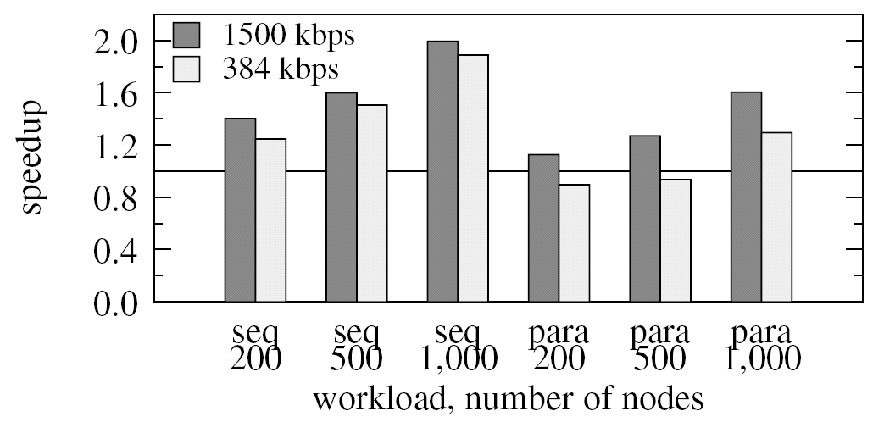
Performance Speedup
How much faster is D2 vs. Traditional?

Slide 21
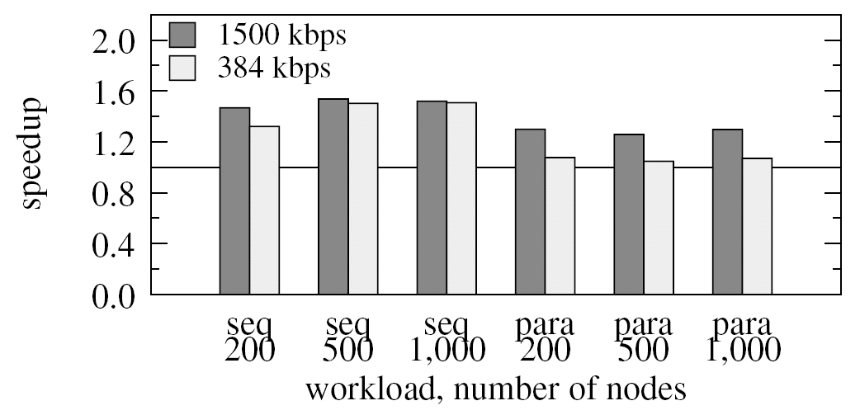
Performance Speedup
How much faster is D2 vs. Traditional-File?

Slide 22
Questions
Can task locality be maintained simply?
Does locality outweigh parallelism?
Can load balance be maintained cheaply?

Slide 23
Technique #3:
Dynamic Load Balancing
Why?
  Object placement is no longer uniform
  Random node IDs ⇒ imbalance
Simple dynamic load balancing
  Karger [IPTPS’04], Mercury [SIGCOMM’04]
  Fully distributed
  Converges to load balance quickly

Slide 24
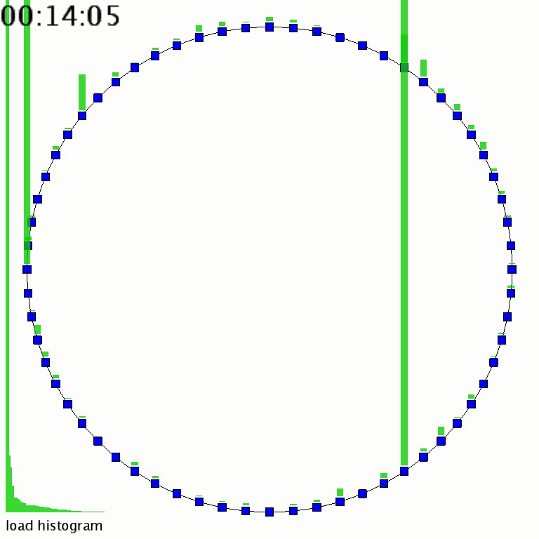
Dynamic Load Balancing
Notes:
In practice, since data might be moved multiple times during times of high churn, we first migrate only pointers to blocks and then migrate the blocks only after the position of pointers has stabilized.

Slide 25
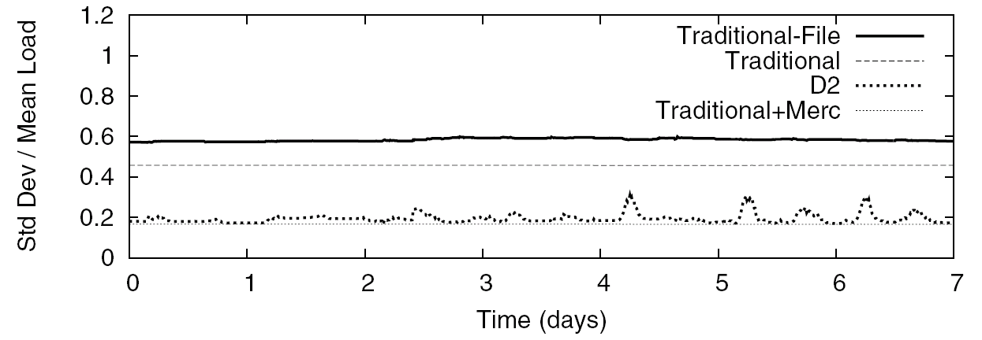
Load Balance
How balanced is storage load over time?
Notes:
Coefficient of variation

Slide 26
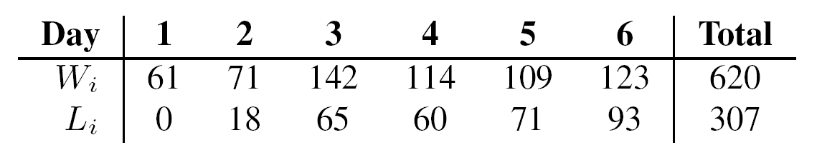
Load Balancing Overhead
Writes
MB/node
Load Balance
Load Balance
≈ 50% ≈ cost of 1 or 2 more replicas
Writes
How much data is transferred to balance load?

Slide 27
Conclusions
Can task locality be maintained simply?
  Yes: Namespace locality enough to improve availability by an order of magnitude
Does locality outweigh parallelism?
  Yes: Real workloads observe 30-100% speedup
Can load balance be maintained cheaply?
  Maintain Balance? Yes: better than traditional
  Cheaply? Maybe: 1 byte for every 2 bytes written
Defragmentation: a useful DHT technique

Slide 28
Thank You.

Slide 29
Backup Slides
Or, more graphs than anyone cares for…

Slide 30
Related Work
MOAT [Yu et al., NSDI ‘06]
  Only studied availability
  No mechanism for load balance
  No evaluation of file systems
SkipNet [Harvey et al., USITS ‘03]
  Provides administrative locality
  Can’t do both locality + global load balance
Mercury [Bharambe et al., SIGCOMM ‘04]
  Dynamic load balancing for range queries
  D2 uses Mercury as the routing substrate
  D2 has independent storage layer, load balancing optimizations (see paper)

Slide 31
Encoding Object Names
Traditional key encoding:
160 bits
data
SHA-1
Hash
SHA1(data)
D2 key encoding:
480 bits
depth: 12 width: 65k
petabytes
160 bits
16 bits
16 bits
16 bits
64 bits
64 bits
SHA1(pkey)
dir1
dir2
...
file
block no.
ver. hash
intel.pkey
/home/bob/Mail/INBOX
0000 . 0001 . 0004 . 0003 . 0000 . …
b-tree-like
8kb blocks
hash(data)
Example

Slide 32
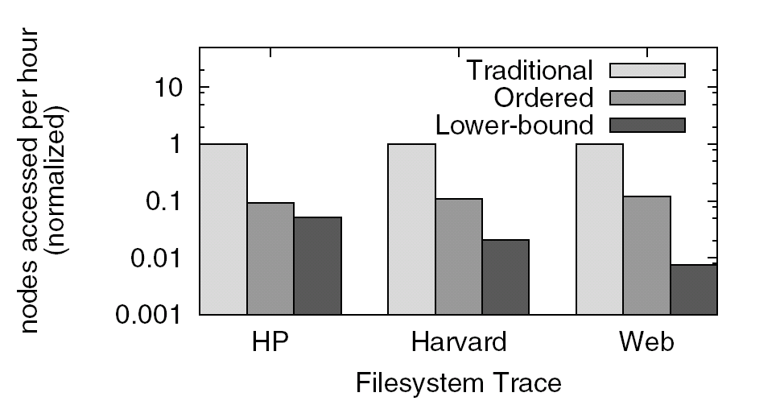
DHT Nodes Accessed
How many nodes does a user access?

Slide 33
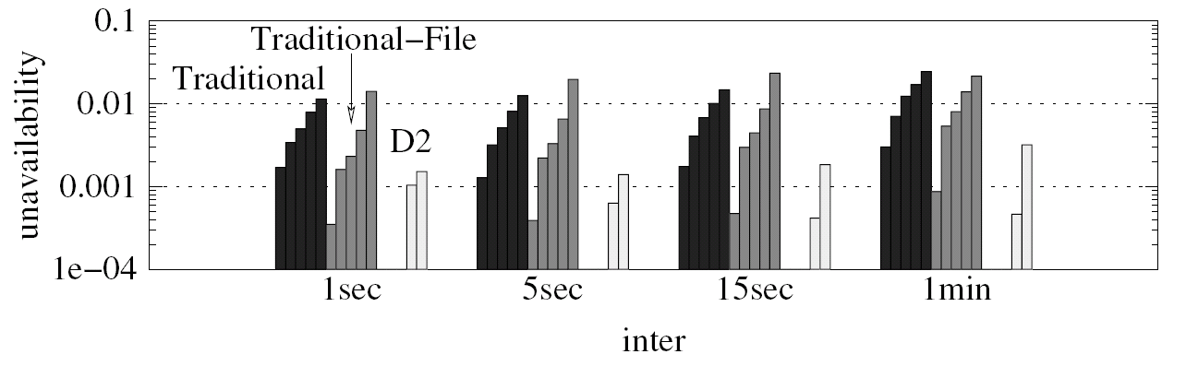
Task Unavailability
Application Tasks
Human Tasks
What fraction of tasks fail?

Slide 34
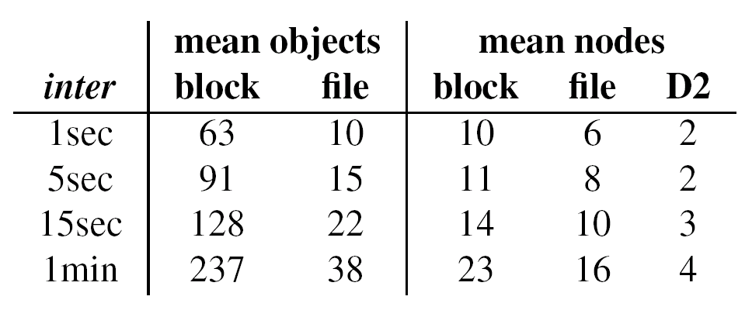
Task Unavailability
How many nodes are accessed per task?

Slide 35
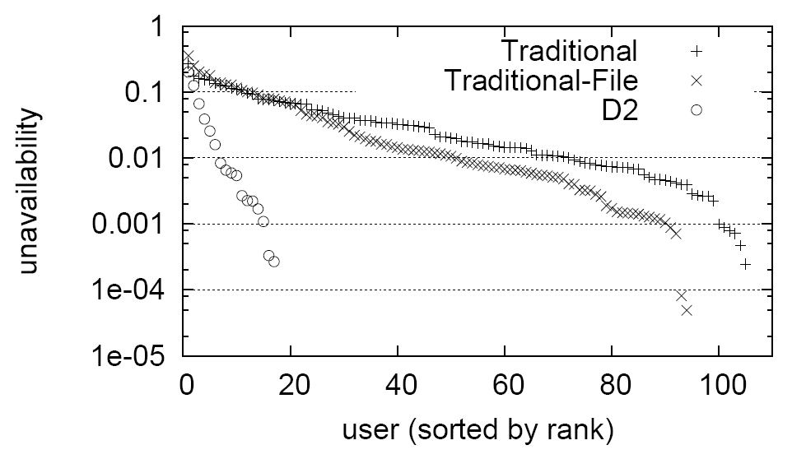
Task Unavailability (Per-User)
What fraction of each user’s tasks fail?

Slide 36
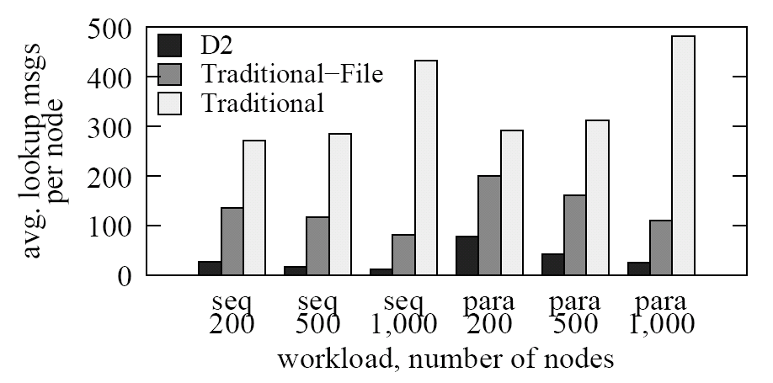
DHT Lookup Messages
How many lookup messages are used?

Slide 37
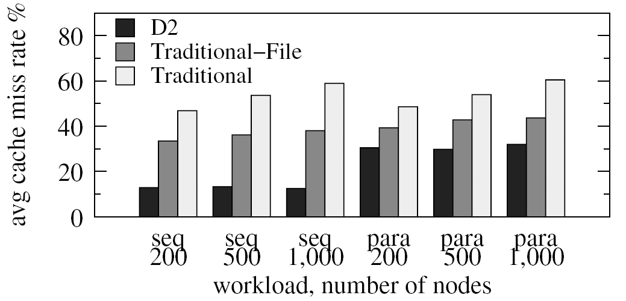
Lookup Cache Utilization
How many lookups miss the cache?

Slide 38
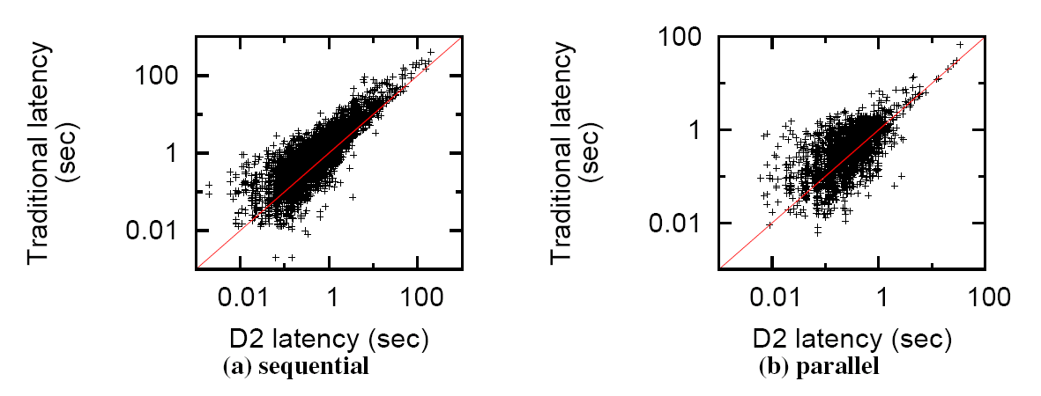
Performance Speedup (Per-Task)
How much faster is D2 vs. Traditional?

Slide 39
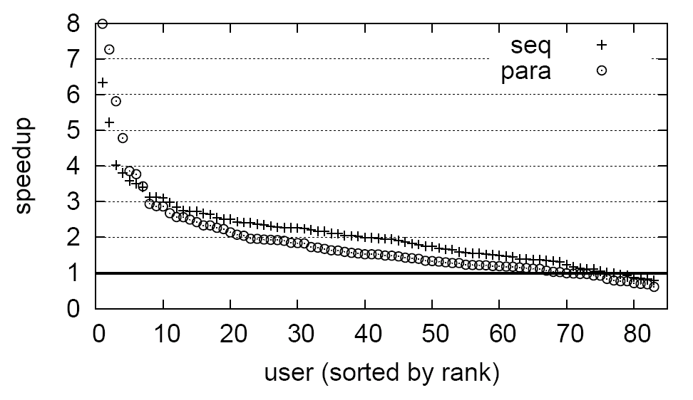
Performance Speedup (Per-User)
How much faster is D2 vs. Traditional?

Slide 40
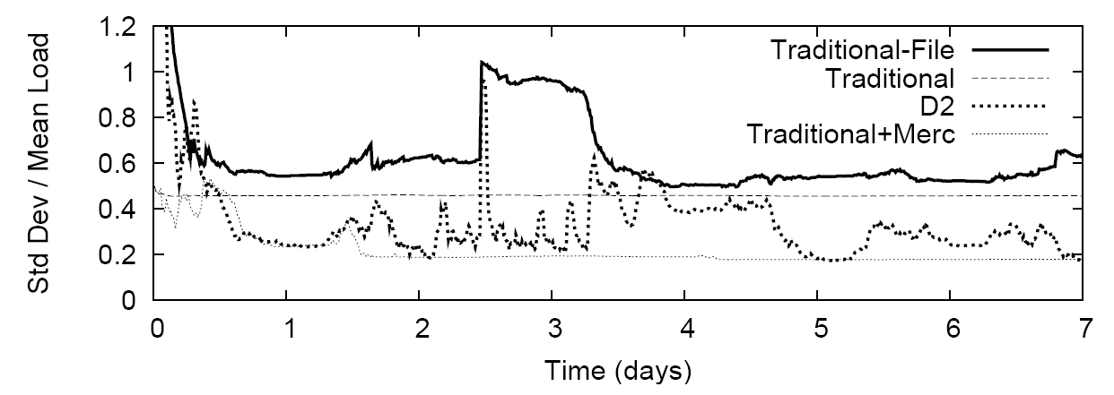
Load Balance (Webcache)
How balanced is storage load over time?

Slide 41
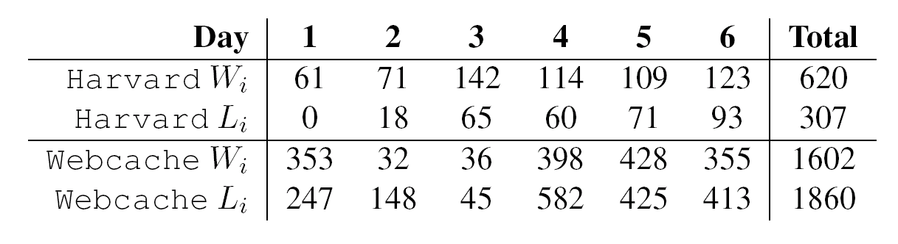
Load Balancing Overhead
How much data is transferred to balance load?

