Slide 1
Improving Wireless Privacy with an Identifier-Free Link Layer Protocol
Ben Greenstein, Damon McCoy, Jeffrey Pang, Tadayoshi Kohno, Srinivasan Seshan, and David Wetherall
Intel Research Seattle, University of Colorado, Carnegie Mellon University, University of Washington
Notes:
I’m Jeff Pang and I’ll be discussing how we can improve wireless privacy with an identifier-free link layer protocol. The main thing I’ll show is that we don’t have to expose any bits in link layer packets to achieve a functional and fast wireless protocol.

Slide 2

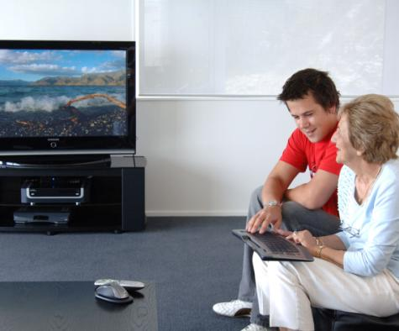


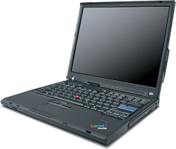

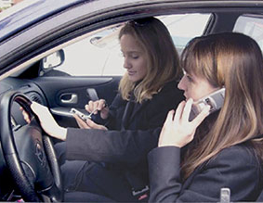











Our Wireless World
tcpdump
Link Layer Header
Blood pressure: high
Link Layer Header
PrivateVideo1.avi
Link Layer Header
PrivatePhoto1.jpg
Link Layer Header
Buddy list: Alice, Bob, …
Link Layer Header
Home location=(47.28,…
Notes:
More and more personal devices are being equipped with wireless capabilities like 802.11 and bluetooth. They include everything from media players and ipods to sensors on our clothing and our bodies.
Because of this trend, we now often carry wireless devices with us where ever we go, from our homes to our cars and even to places that we think should have more privacy.
Unfortunately, in this emerging wireless world, bad guys still exist. They can easily overhear any of our wireless transmissions, often with nothing more than a laptop computer. Thus, without protection, an eavesdropper can easily obtain private information.

Slide 3



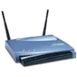




Best Security Practices
Bootstrap
Username: Alice
Key: 0x348190…
SSID: Bob’s Network
Key: 0x2384949…
Out-of-band (e.g., password, WiFi Protected Setup)
Discover
802.11 probe
Is Bob’s Network here?
802.11 beacon
Bob’s Network is here
Authenticate
and Bind
802.11 auth
Proof that I’m Alice
802.11 auth
Proof that I’m Bob
tcpdump
Send Data
802.11 header
Confidentiality
Authenticity
Integrity
802.11 header
3
Notes:
Protocols such as 802.11 try to protect against such threats with the following best practices.
Beforehand, Alice, a client such as a laptop, and Bob, a service such as an access point, exchange keys in a secure, out-of-band manner. For example, by passing a password on a post-it note.
Now, whenever Alice opens up her laptop, it tries to discover if Bob is present with probes or listening for Bob’s beacons.
If she discovers that Bob is present, then they use the bootstrapped key to exchange information that proves to each other they are who they think they are.
This process enables them to encrypt the data they send each other in a manner that is confidential, authentic, and maintains its data integrity.

Slide 4


Privacy Problems Remain
Bootstrap
Many exposed bits are (or can be used as) identifiers that are linked over time
SSID: Bob’s Network
Secret: 0x2384949…
Username: Alice
Secret: 0x348190…
Discover
802.11 probe
Is Bob’s Network here?
Is Bob’s Network here?
802.11 beacon
Bob’s Network is here
Bob’s Network is here
Authenticate
and Bind
802.11 auth
Proof that I’m Alice
802.11 auth
Proof that I’m Bob
tcpdump
Proof that I’m Bob
Send Data
802.11 header
Confidentiality
Authenticity
Integrity
MAC addr, seqno, …
MAC addr, seqno, …
802.11 header
Notes:
Unfortunately, in our pervasive wireless world, the information that remains exposed during this process poses additional privacy threats.
This is because many bits that remain exposed are, or can be used as, identifiers that are linked over time.

Slide 5



Problem: Long-Term Linking
802.11 beacon
Alice’s iPod is here
802.11 beacon
Alice’s iPod is here
MAC: 12:34:56:78:90:ab
MAC: 12:34:56:78:90:ab
tcpdump
Alice
Alice?
802.11 probe
Is Alice’s iPod here?
Alice’s friend?
Easy to identify and relate devices over time
Notes:
For example, this enables long-term linking. Identifiers such as MAC addresses and network names remain present in link layer headers and during the discovery process.
These identifiers are consistent over long periods of time, so it is relatively easy to track the movement of devices and infer their relationships.

Slide 6
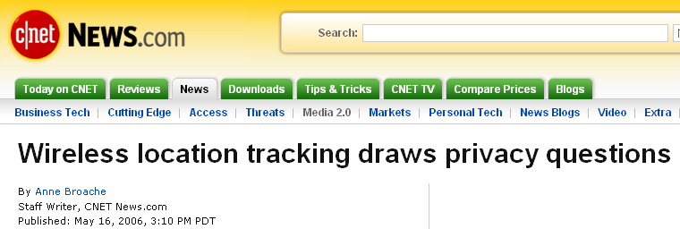

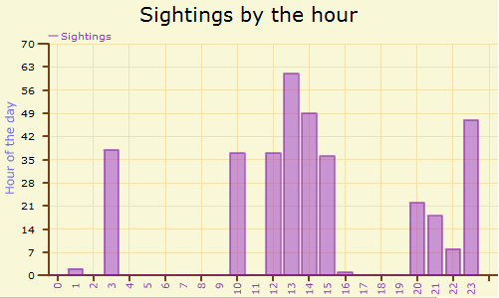
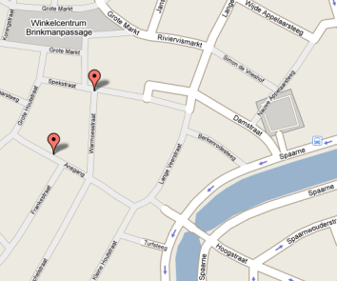


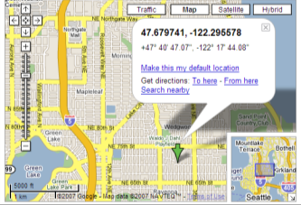
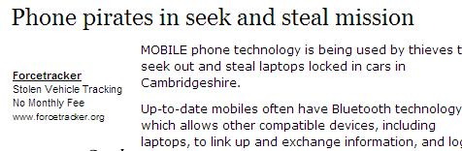



Problem: Long-Term Linking
Linking enables location tracking, user profiling, inventorying, relationship profiling, …
[Greenstein, HotOS ’07; Jiang, MobiSys ’07; Pang, MobiCom ’07, HotNets ’07]
www.bluetoothtracking.org
802.11 header
Is “djw” here?
“djw” is here
Home
www.wigle.net
Notes:
Long-term linking enables many attacks against our privacy such as location tracking, user profiling, and inventorying.
These attacks are just emerging but there are already real tracking networks, such as the bluetooth network in the netherlands listed on this slide. In addition, there are many concerns expressed in the popular media.

Slide 7


Problem: Short-Term Linking
12:34:56:78:90:ab, seqno: 1, …
3-9 data streams overlap
each 100 ms, on average (see paper)
12:34:56:78:90:ab
12:34:56:78:90:ab, seqno: 2, …
12:34:56:78:90:ab
00:00:99:99:11:11, seqno: 102, …
Alice -> AP
00:00:99:99:11:11
12:34:56:78:90:ab, seqno: 3, …
12:34:56:78:90:ab
00:00:99:99:11:11, seqno: 103, …
Alice -> AP
00:00:99:99:11:11
12:34:56:78:90:ab, seqno: 4, …
12:34:56:78:90:ab
00:00:99:99:11:11, seqno: 104, …
Alice -> AP
00:00:99:99:11:11
tcpdump
Easy to isolate distinct packet streams
Notes:
A second problem is short-term linking. Most of the time, an eavesdropper will overhear data streams from many devices. But identifiers in link-layer headers make it easy for eavesdroppers to isolate individual data streams. The obvious identifier that he can use is a MAC address, but in many cases, other bits of information, such as sequence numbers will work as well.

Slide 8

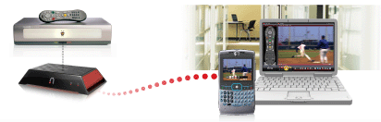
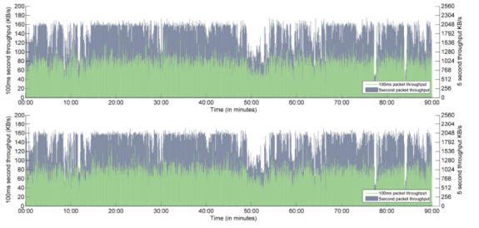
Problem: Short-Term Linking
Isolated data streams are more susceptible to side-channel analysis on packet sizes and timing
Exposes keystrokes, VoIP calls, webpages, movies, …
[Liberatore, CCS ‘06; Pang, MobiCom ’07; Saponas, Usenix Security ’07; Song, Usenix Security ‘01; Wright, IEEE S&P ‘08; Wright, Usenix Security ‘07]
Device
fingerprints
100
250
300
500
120
200
Video
compression signatures
transmission sizes
transmission sizes
DFT
Keystroke
timings
≈
Notes:
Short-term linking is problematic because isolated data streams are more susceptible to side-channel analysis. Recent research has shown that even when encrypted, the sequence of packet sizes and timings in a data stream can reveal its contents. This includes things like keys you type, words in your voice-over-IP calls, and webpages you visit.
Data packets have a wide interface so many more applications may inadvertently be vulnerable because they don’t add any additional protection before encapsulating data in them. Short-term linking helps enable them because they are less successful when multiple packet streams are mixed together.

Slide 9
Fundamental Problem
Bootstrap
Many exposed bits are (or can be used as) identifiers that are linked over time
SSID: Bob’s Network
Secret: 0x2384949…
Username: Alice
Secret: 0x348190…
Discover
802.11 probe
Is Bob’s Network here?
Is Bob’s Network here?
802.11 beacon
Bob’s Network is here
Bob’s Network is here
Authenticate
and Bind
802.11 auth
Proof that I’m Alice
802.11 auth
Proof that I’m Bob
tcpdump
Proof that I’m Bob
Send Data
802.11 header
MAC addr, seqno, …
MAC addr, seqno, …
802.11 header
Notes:
So fundamental problem in both long-term and short-term linking is that many exposed bits are, or can be used as identifiers that are linked over time.

Slide 10
Goal: Make All Bits Appear Random
Bootstrap
SSID: Bob’s Network
Key: 0x2384949…
Username: Alice
Key: 0x348190…
Discover
?
Authenticate
and Bind
tcpdump
Send Data
Notes:
Therefore, our goal in this talk is to develop a protocol that makes all bits appear random to third parties. This includes all the packets sent for discovery and authentication and all bits in link layer headers.

Slide 11
Challenge: Filtering without Identifiers
Which packets are mine?
Which packets are mine?
Notes:
Why is this hard to do? Since no longer have source or destination addresses in packets, filtering packets efficiently becomes much more challenging.

Slide 12
Talk Overview
Motivation and Goals
Design Requirements
Straw man: MAC Pseudonyms
Straw man: Encrypt Everything
Solution: SlyFi
Notes:
The remainder of this talk is organized as follows.
Now that I’ve frame our problem, I’ll describe the specific requirements we want of our protocol.
I will then describe the first two solutions we came up with in our design process that meet some of our requirements but not all.
Finally, I’ll describe how to build upon these straw men protocols to create a solution that meets all of the requirements, which we call SlyFi.

Slide 13

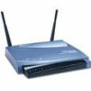

Goal: This Protocol
Bootstrap
SSID: Bob’s Network
Key: 0x2384949…
Username: Alice
Key: 0x348190…
Discover
Authenticate
and Bind
Send Data
Notes:
Recall that our goal is a protocol like this.

Slide 14
Design Requirements
When A generates Message to B, she sends: PrivateMessage = F(A, B, Message) where F has these properties:
Confidentiality: Only A and B can determine Message.
Authenticity: B can verify A created PrivateMessage.
Integrity: B can verify Message not modified.
Unlinkability: Only A and B can link PrivateMessages to same sender or receiver.
Efficiency: B can process PrivateMessages as fast as he can receive them.
A→B Header…
Unencrypted payload
Notes:
More specifically, what I mean…

Slide 15


Solution Summary
Confidentiality
Authenticity
Unlinkability
Integrity
Efficiency
Only
Data
Payload
Only
Data
Payload
Only
Data
Payload
802.11 WPA
MAC Pseudonyms
Public Key
Symmetric Key
SlyFi: Discovery/Binding
SlyFi: Data packets
Notes:
For example, …

Slide 16
Straw man: MAC Pseudonyms
Idea: change MAC address periodically
Per session or when idle [Gruteser ’05, Jiang ‘07]
Other fields remain (e.g., in discovery/binding)
No mechanism for data authentication/encryption
Doesn’t hide network names during discovery or credentials during authentication
Pseudonyms are linkable in the short-term
Same MAC must be used for each association
Data streams still vulnerable to side-channel leaks
Notes:
To try to get unlinkability, the first thing we might try is to remove the obviously identifying bits of information in packets, such as MAC addresses. For example, it has recently been proposed…

Slide 17
Solution Summary
Confidentiality
Authenticity
Unlinkability
Integrity
Efficiency
Only
Data
Payload
Only
Data
Payload
Only
Data
Payload
802.11 WPA
MAC Pseudonyms
Long Term
Public Key
Symmetric Key
SlyFi: Discovery/Binding
SlyFi: Data packets
Notes:
So MAC Pseudonyms by themselves do not give us…
It is also non-trivial to combine pseudonyms and WPA because WPA exposes identifiers in the discovery and binding process

Slide 18
Straw man: Encrypt Everything
Bootstrap
SSID: Bob’s Network
Key: 0x2384949…
Username: Alice
Key: 0x348190…
Idea: Use bootstrapped keys to encrypt everything
Discover
Authenticate
and Bind
Send Data
Notes:
To try to obtain the best of both worlds, we then may try to encrypt everything. After all, we already have…

Slide 19






Straw man: Public Key Protocol
Client
Service
Probe “Bob”
Check signature:
K_{Alice}
Sign:
K⁻¹_{Alice}
Slow! (>100ms)
K_{Bob}
K⁻¹_{Bob}
Key-private encryption (e.g., ElGamal)
Try to decrypt
Based on [Abadi ’04]
Notes:
One way we can do this is …

Slide 20

Straw man: Symmetric Key Protocol
Client
Service
Slow! (scales w/ # keys)
Check MAC:
K_{AB}
Probe “Bob”
Can’t identify the
decryption key in the packet or else it is linkable
MAC:
K_{AB}
K_{Shared1}
K_{Shared2}
K_{Shared3}
…
K_{AB}
Try to
decrypt
with each
shared key
Symmetric encryption (e.g., AES w/ random IV)
Different symmetric key per potential sender
Notes:
To address this problem, we might instead try to use symmetric key encryption, because it is much faster than public key encryption…

Slide 21
Solution Summary
Confidentiality
Authenticity
Unlinkability
Integrity
Efficiency
Only
Data
Payload
Only
Data
Payload
Only
Data
Payload
802.11 WPA
MAC Pseudonyms
Long
Term
Public Key Protocol
Symmetric Key Protocol
SlyFi: Discovery/Binding
SlyFi: Data packets
Notes:
So the encrypt everything approach

Slide 22
SlyFi
Symmetric key almost works, but tension between:
Unlinkability: can’t expose the identity of the key
Efficiency: need to identify the key to avoid trying all keys
Idea: Identify the key in an unlinkable way
Approach:
Sender A and receiver B agree on tokens: T₁ , T₂ , T₃ , …
A attaches T_{i} to encrypted packet for B
_{AB}
_{AB}
_{AB}
_{AB}
Notes:
To try to regain efficiency, we make the following observation: …
The key idea we leverage in our design of our solution slyfi is…

Slide 23
SlyFi
Required properties:
Third parties can not link T_{i} and T_{j} if i ≠ j
A doesn’t reuse T_{i}
A and B can compute T_{i} independently
Client
Service
_{AB}
_{AB}
Check MAC:
_{AB}
K_{AB}
Probe “Bob”
_{AB}
MAC:
K_{AB}
Main challenge:
Sender and receiver must synchronize i
K_{AB}
K_{AB}
_{AB}
T_{i}
_{AB}
Lookup T_{i} in a
table to get K_{AB}
Symmetric encryption
(e.g., AES w/ random IV)
_{AB}
_{AB}
T_{i} = AES_{K} (i)
T_{i} = AES_{K} (i)
_{AB}
_{AB}
Notes:
That is, SlyFi is basically the same as the symmetric key approach, but …

Slide 24
SlyFi: Data Transport
Data messages:
Only sent over established connections
⇒ Expect messages to be delivered
⇒ Use implicit transmission number to synchronize i
T_{i} = AES_{K} (i) where i = transmission #
_{AB}
_{AB}
On receipt of T_{i} , B computes next expected: T_{i+1}
Handling message loss:
On receipt of T_{i} save T_{i+1}, … , T_{i+k} in table
Tolerates k consecutive losses (k=50 is enough [Reis ‘06])
No loss ⇒ compute one token per reception
_{AB}
_{AB}
_{AB}
T_{i}
_{AB}
_{AB}
_{AB}
_{AB}
T_{i+1}
_{AB}
T_{i +2}
_{AB}
T_{i +3}
Notes:
For data messages we make the observation …

Slide 25
SlyFi: Discovery/Binding
Discovery & binding messages:
Often sent when other party is not present
⇒ Can’t expect most messages to be delivered
⇒ Can’t rely on transmission reception to synchronize i
_{AB}
Nope.
T_{i}
Is Bob’s Network here?
..
_{AB}
Is Bob’s Network here?
Nope.
T_{i +1}
..
_{AB}
Is Bob’s Network here?
Nope.
T_{i +2}
…...
i = ?
_{AB}
Is Bob’s Network here?
T_{i +3}
Notes:
We can not use the same approach for discovery and binding messages however, because discovery messages are often sent when the other party is not present. For example, Alice sends discovery probes whenever she opens up her laptop, even if bob is not present.

Slide 26
SlyFi: Discovery/Binding
Discovery & binding messages:
Infrequent: only sent when trying to associate
Narrow interface: single application, few side-channels
⇒ Linkability at short timescales is usually OK
⇒ Use loosely synchronized time to synchronize i
_{AB}
T_{i} = AES_{K} (i) where i = ⎣current time/5 min⎦
_{AB}
At the start of time interval i compute T_{i}
Handling clock skew:
Receiver B saves T_{i-s}, … , T_{i+s} in table
Tolerates clock skew of 5⋅s minutes
_{AB}
_{AB}
T_{i}
802.11 probe
_{BA}
T_{i}
802.11 beacon
_{AB}
_{AB}
_{AB}
T_{i}
802.11 auth
_{BA}
T_{i}
802.11 auth
Notes:
Instead, we make two observations…

Slide 27
SlyFi: Other Protocol Details
Broadcast
Higher-layer binding
Time synchronization
Roaming
Coexistence with 802.11
Link-layer ACKs
Preventing replay attacks
etc.
See paper
Notes:
So I’ve described how we can deliver messages in an unlinkable fashion in slyfi for data transport and discovery and binding….

Slide 28


Performance Evaluation
SlyFi implementation:
Linux kernel module using Click Modular Router
Run on Soekris devices (similar to APs, iPods, etc.)
Comparison protocols:
wifi-open: 802.11 with no security
wifi-wpa: 802.11 with WPA PSK/CCMP
public-key: straw man
symmetric-key: straw man
armknecht: previous header encryption proposal
Similar
Experiment:
AP with
500 accounts
50 associations
Background
traffic
Measure Alice’s connection to Bob
Notes:
We argued that SlyFi is faster than the encrypt everything approach because it doesn’t have to do any cryptographic operations to filter packets, only a table lookup. To evaluate how well SlyFi can perform in practice, …

Slide 29
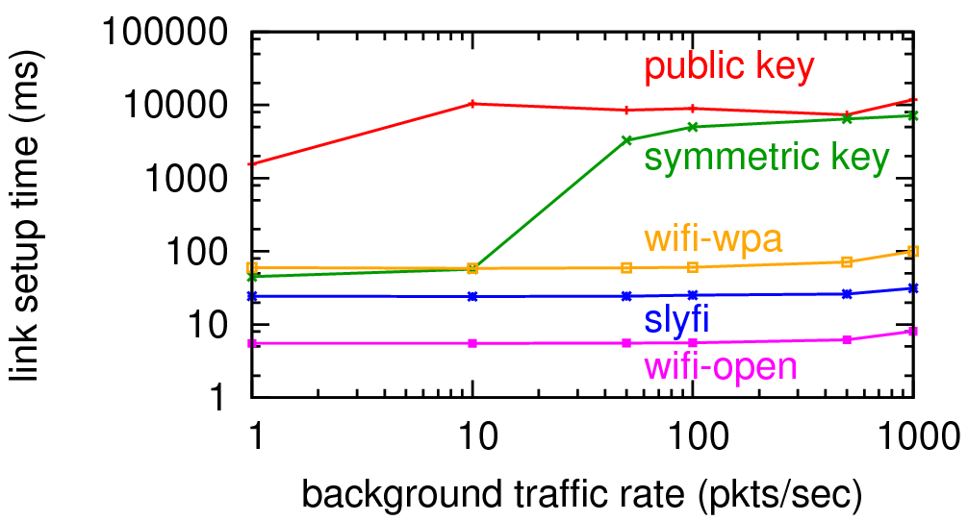
Discovery/Binding Time
Lower = Better
SlyFi link setup has less overhead than WPA
Notes:
We first look at discovery and binding time. That is, how long Alice must wait when she turns on her ipod before being able to send and receive useful data. Here we show the link setup time on the y axis as Charlie’s rate of backgroud traffic increases on the x-axis. Both axes are on a logarithmic scale….

Slide 30
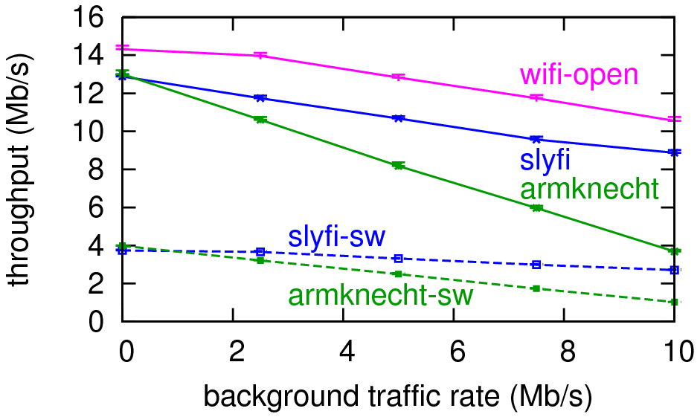
Data Throughput
Higher = Better
With simulated
AES hardware
Performs like
symmetric key
SlyFi data filtering is about as efficient as 802.11
Notes:
Next we look at data throughput. That is how fast can Alice send Bob traffic once the link has been established….
All lines decrease as the rate of bg traffic increases…
slyfi has a small overhead compared to wifi-open, which has no security, but both degrade in the same graceful manner.
This is in contrast to the other header encryption protocol in green that performs like the symmetric key protocol because it must try all keys to filter out a packet.
…

Slide 31
Solution Summary
Confidentiality
Authenticity
Unlinkability
Integrity
Efficiency
Only
Data
Payload
Only
Data
Payload
Only
Data
Payload
802.11 WPA
MAC Pseudonyms
Long
Term
Public Key
Symmetric Key
SlyFi: Discovery/Binding
Long
Term
SlyFi: Data packets
Notes:
Thus, we conclude that slyfi is efficient. For discovery and binding, it also provides …

Slide 32
Conclusion
Wireless devices are becoming personal and pervasive
Best practices don’t protect users from simple attacks
Long-term linking: tracking, profiling, inventorying
Short-term linking: side-channel attacks
SlyFi makes these attacks much more difficult to do
Removes all bits that are (or can be used as) identifiers
http://tw.seattle.intel-research.net
Notes:
In summary, wireless devices are becoming more personal and pervasive, heightening privacy threats that existing best practices do not protect against. These attacks include long-term and short-term linking attacks such as tracking and side-channel analysis.
SlyFi makes these attacks much more difficult to do because it removes all bits that are or can be used as identifiers.
As I mentioned before, we have a slyfi prototype which you can download from this link here.

Slide 33
====== CONTEXT ======

Slide 34
Related Work
Private discovery
Public key straw man [Abadi, ‘04]
Private discovery sketch [Pang ‘07]
Privately announce existence to friends [Cox ‘07]
Different application; uses hash chain
Encrypted data transport headers
Must try all keys to filter [Armknecht ‘07]
Targeted at WPANs and use hash chains [Singelee ‘06]
SlyFi is the first complete protocol and implementation

Slide 35


802.11w: Protected Management Frames
Confidentiality
Authenticity
Unlinkability
Integrity
Efficiency
802.11i (WPA)
Data
Payload
Data
Payload
Data
Payload
802.11i + 802.11w
Unicast
Frames
MAC Pseudonyms
Long
Term
Public Key
Symmetric Key
SlyFi: Discovery/Binding
Long
Term
SlyFi: Data packets

Slide 36
Why not GSM Pseudonyms?
GSM pseudonym properties
Provider must assign new pseudonym to client to change it
Only a single application used on GSM network
GSM pseudonyms not sufficient when
Both parties in discovery want to be private
May require using pseudonym when the provider is not present (e.g., during discovery)
Many applications with many side-channels
Must accommodate device heterogeneity, evolution

Slide 37






PHY Layer and Timing Signatures
PHY layer and timing signatures remain
These are not as accurate and can require uncommon or expensive hardware
Obscuring these signatures is future work
SlyFi raises the bar and is a necessary first step
Charlie -> AP
??? -> AP
Charlie -> AP
??? -> AP
Alice -> AP
??? -> AP
Charlie -> AP
??? -> AP
Charlie -> AP
??? -> AP
Charlie -> AP
??? -> AP

Slide 38
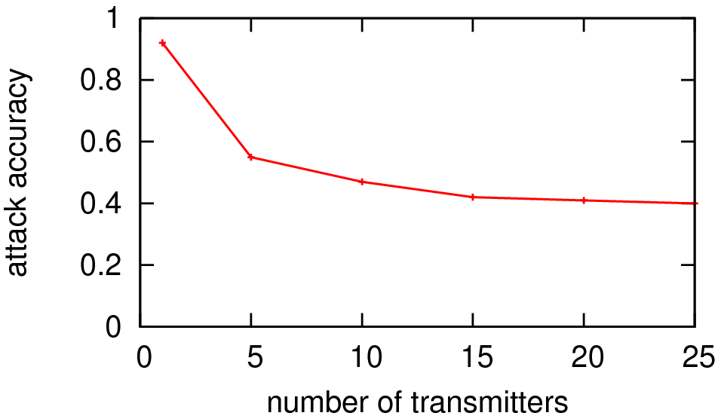
Linking with Signal Strength
Attack: website finger-printing using [Liberatore CCS ‘06]
Attacker has 5 nodes to record packets’ RSSIs
Attacker uses k-means clustering to determine which packets belong to each client. Set of RSSIs is the feature vector.
Experiment conservatively assumes that attacker knows k
Clustering accuracy > 75% for all experiments
Side-channel attack accuracy degrades significantly
even if attacker tries to use signal strength to link packets

Slide 39
Why not Time for Data Transport?
Data messages:
Frequent: sent often to deliver data
Wide interface: many applications, many side-channels
⇒ Linkability at short timescales is NOT usually OK
⇒ Can NOT use loosely synchronized time to synchronize i
_{AB}
T_{i}
=
_{AB}
T_{i}
=
_{AB}
T_{i}
=
_{AB}
T_{i}

Slide 40
Future Work
Private, automated bootstrapping [Greenstein, Pang]
Leverage transitive trust relationships
Leverage device reputation, measurable context
Measuring/defending against PHY layer linking [McCoy]
Leverage transmit power control, directional antennas
Masking remaining timing side-channels [Pang]
Perform intelligent packet padding/cover traffic

Slide 41

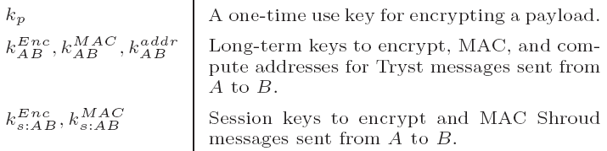
Packet Format
Token
Unencrypted Message
Tryst: Discovery/Binding
Shroud: Data Transport

Slide 42
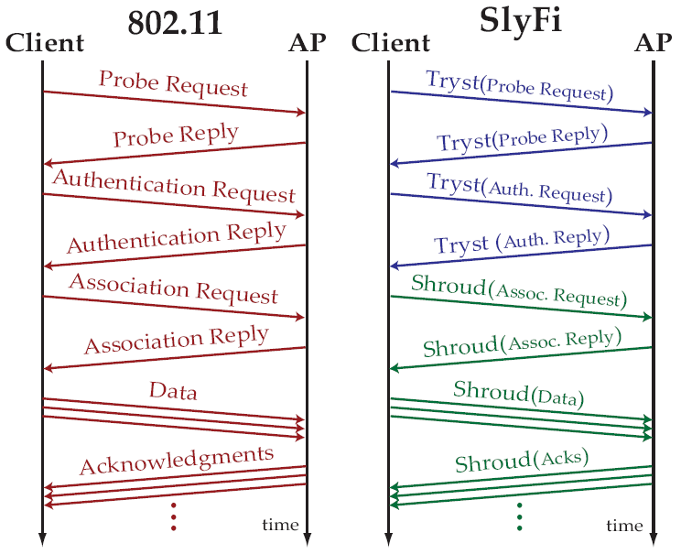
Protocol Timing Diagram
Discover
Authenticate
and Bind
Send Data

Slide 43
Other Protocol Details
Broadcast
All broadcast packets routed through the AP
Use same shared key for all the clients of the AP
Higher-layer binding
Clients report “pseudonym MAC address”-to-IP address bindings to AP
AP answers all ARP queries
Time synchronization and roaming
Use protected broadcast to transmit timestamps, same BSSID info
Coexistence with 802.11
Encapsulate SlyFi in “anonymous” 802.11 frame with unused FC code
Clients first search for SlyFi AP, then fall back to non-private AP search
Link-layer ACKs
If fast enough, just acknowledge last SlyFi token sent
Our software implementation uses windowed ACKs

Slide 44
====== TRYST EVAL ======

Slide 45
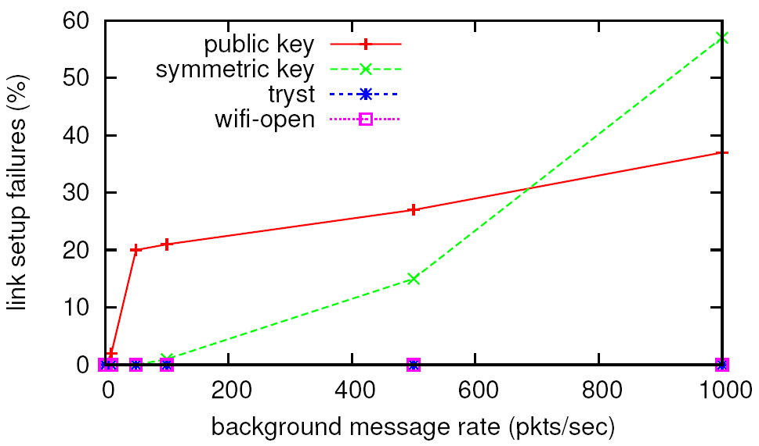
Link Setup Failures
“Encrypt everything” fails to setup many links

Slide 46
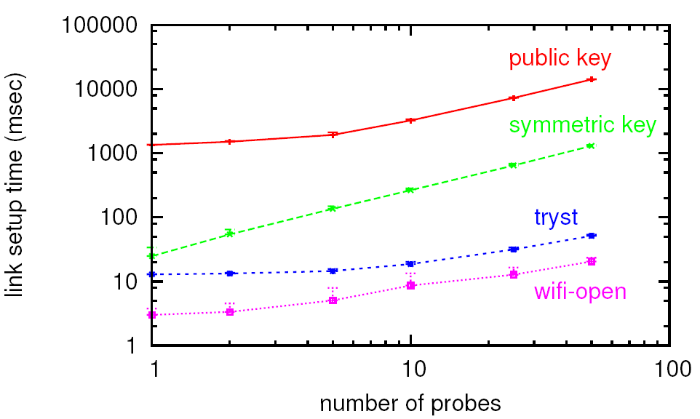
Link Setup Time vs. # Probes
(no background traffic)
SlyFi scales as gracefully as 802.11

Slide 47
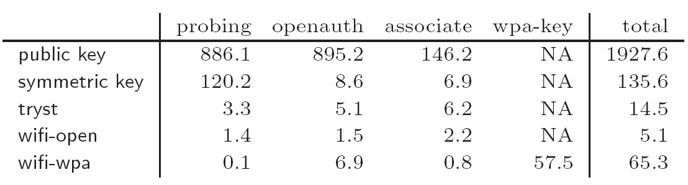
Link Setup Time Breakdown
(times are in msec, no background traffic)
Using software encryption on 256 Mhz Geode processor and 802.11a
“Try all keys” dominates symmetric key time

Slide 48
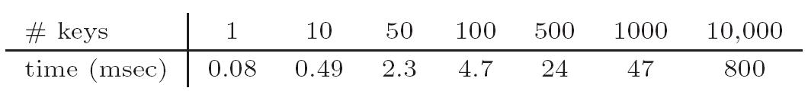
Token Computation Time
(Once every 5 minutes)
Using software AES, 256 Mhz Geode processor
Token computation time is negligible

Slide 49
====== SHROUD EVAL ======

Slide 50
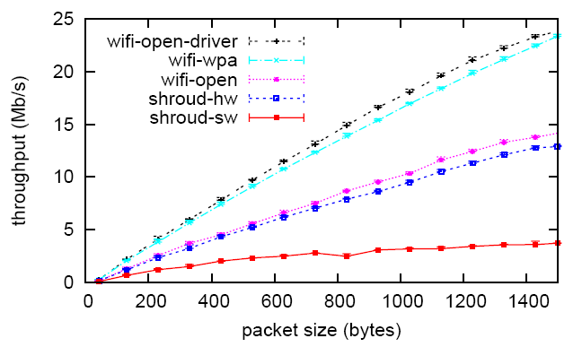
Data Throughput vs. Packet Size
SlyFi data transport overhead is similar to WPA

Slide 51
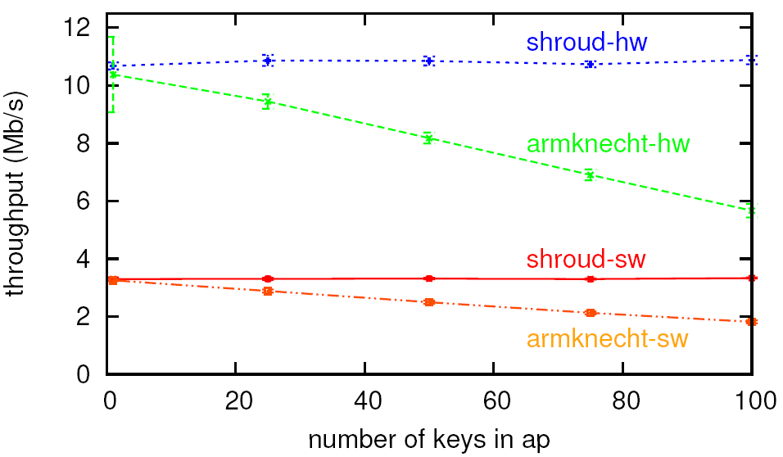
Data Throughput vs. # Associations
(no background traffic)
SlyFi throughput is independent of # associations

Slide 52
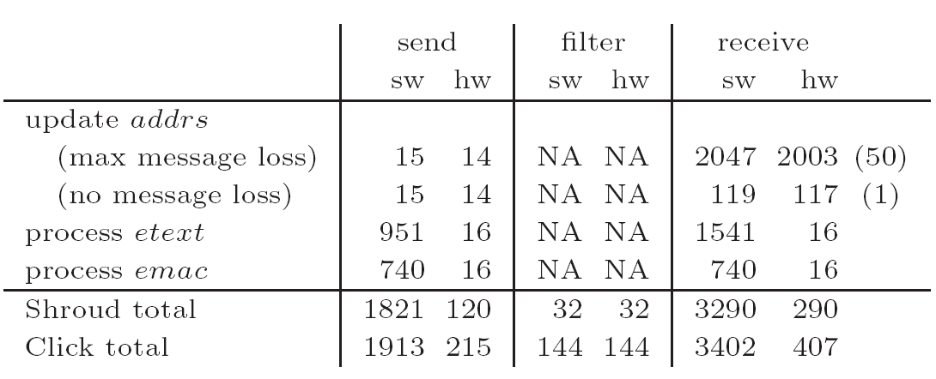
Data Transport Time Breakdown
(times are in usec)
256 Mhz Geode processor, hw times based on Atheros a/b/g 802.11 card
SlyFi can process messages at the line rate

Slide 53
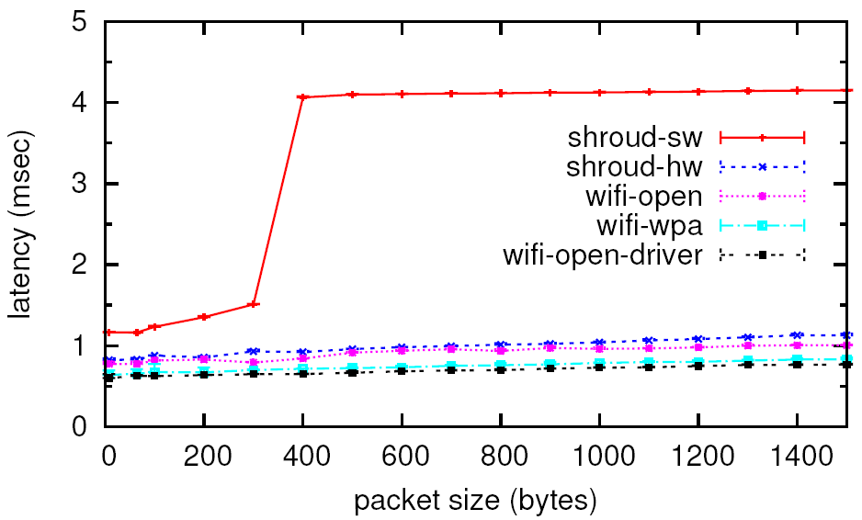
Latency vs. Packet Size
Click bug
SlyFi data transport overhead is similar to WPA

Slide 54
====== MEASUREMENTS ======

Slide 55
Empirical Stream Interleaving
Many streams interleaved even at short timescales

Slide 56
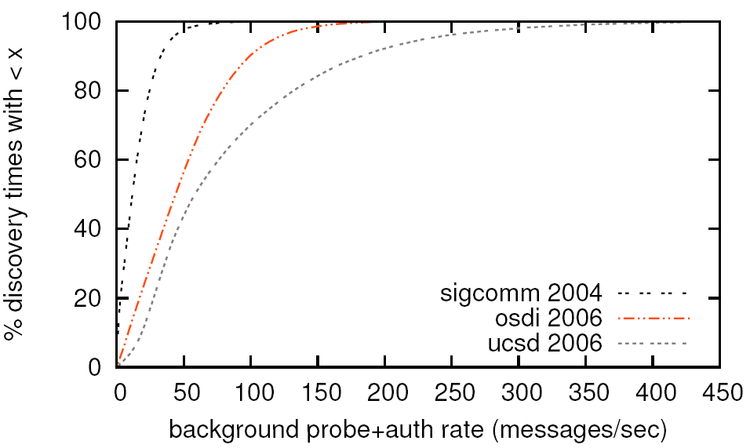
Empirical Background Probe Rate
Background probes are frequent in practice

Slide 57
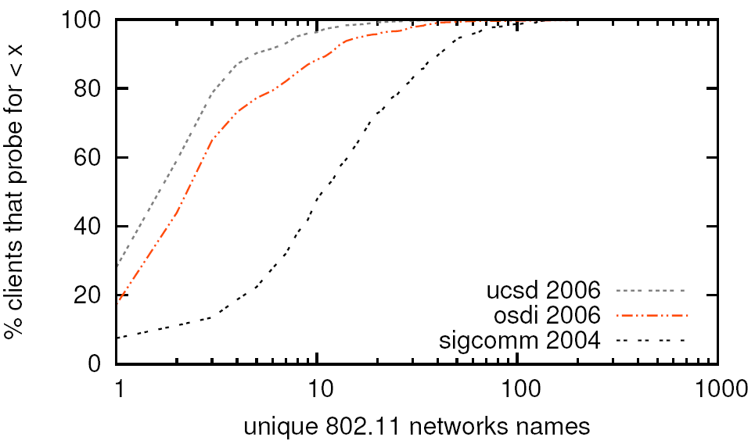
Empirical # Saved Network Names
Some clients probe for many network names

