Slide 1
Mark-and-Sweep: Getting the “Inside” Scoop on Neighborhood Networks
Dongsu Han* , Aditya Agarwala*, David Andersen*,
Michael Kaminsky †, Dina Papagiannaki †, Srinivasan Seshan*
*Carnegie Mellon University
† Intel Research Pittsburgh
Notes:
Hello, I’m dongsu Han and I would like to present Mark-and-Sweep, a measurement tool and its results on residential networks.
This is a joint work with Intel.

Slide 2
Characterizing the neighborhood networks
Internet
broadband
Types and bandwidth of the last-mile link
Overall coverage of wireless APs
Configuration of home networks
Notes:
Residential networks typically consist of broadband connection and wireless access points.
Our goal is to characterize this residential Internet connectivity and the environment in which home users connect to the Internet. Specifically we want to answer questions like,
What are the types, bandwidth of the last-mile links?
How much coverage do wireless APs provide in neighborhoods?
What the typical configuration of home networks?
Three types of approaches have been taken to characterize residential connectivity. First, Internet-based measurement probes residential link from a remote internet site, and has been the largest in scale. However, Internet-based study suffers from measurement noise and inaccuracy since they are performed far from the target links. User-driven studies like NETI@home, improve accuracy, but require significant user participation. In this work, we use wireless access point which allows us to focus on the neighborhood-level connectivity.

Slide 3
Approaches
Internet-based [IMC ’07]
Lack neighborhood level of details
User-driven [NETI@home]
Accurate, require significant user participation
Wireless access point based
Characterize wireless and broadband in neighborhood level
Problem: require time
Contributions
1. Efficient method
2. Measurement results

Slide 4
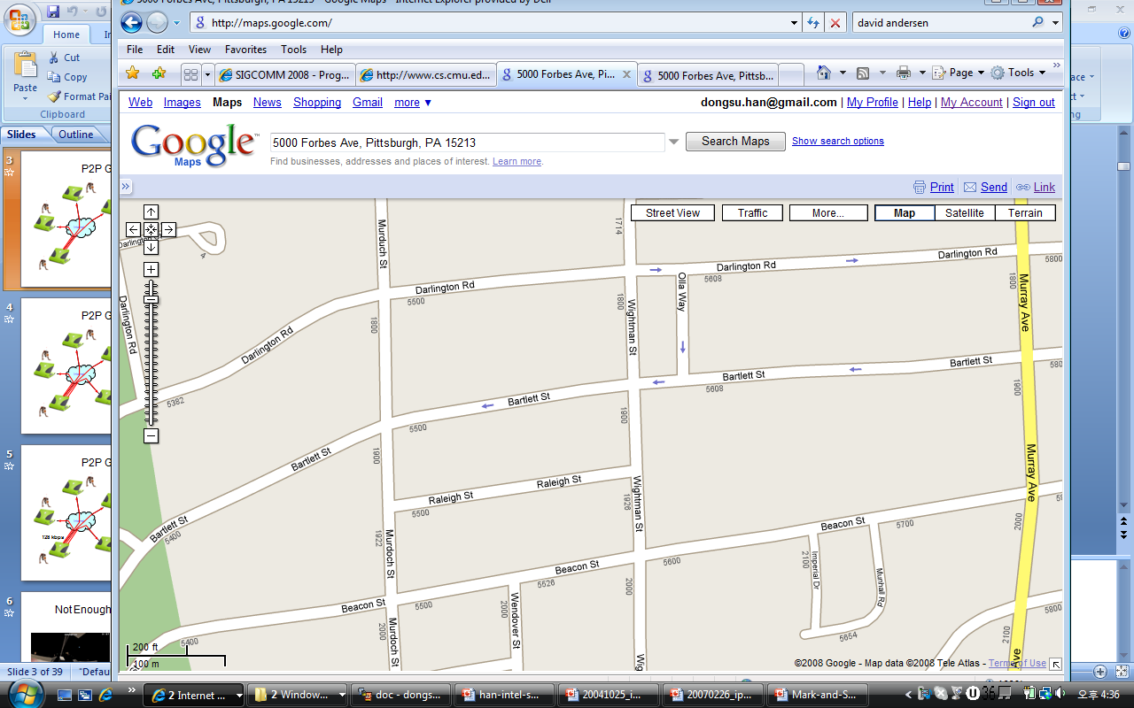
AP-based Measurement
Active measurements
Require time (1~2 min per AP)
Where to stop?
Stop when an AP is first
seen (Measure-First)
Stop at certain intervals
(Measure-Periodic)
Inefficient or inaccurate!
180kbps
Access Point
13Mbps
Notes:
Access point based measurement leverages open APs in the neighborhood. It would travel across the neighborhood to perform a set of active measurements for each AP. The active measurement takes time in order of minutes, so it has to be done in a stationary position.
So the question is where and how to make these stops to perform the measurement. One strategy would be to stop when an AP is first seen. we call this measure-first. Measure-first will perform the active measurements at the edge of coverage, where the connectivity can be easily lost. This makes the active measurement failure prone, and redoing the measurement when it fails can take more time. Even if it succeeds, throughput measurements will be much lower at the edge than the measurements at the core, so you will have inaccurate view of the broadband link.
Another strategy would be to stop at every certain interval and perform the measurement every time. However, if the stops are too infrequent, we will miss some APs. Frequent stops may provide accuracy, but would require significant amount of time because measurements are repeated.
So these approaches can be inaccurate or inefficient.
Our solution is to do two pass.

Slide 5
Mark-and-Sweep: Two Pass Method First Pass
APs send beacons every 100ms.
Passive measurement
Listen to all channels
Record signal strength for each packet, and the current GPS location
Collect bssid, essid, channel, encryption method for each AP
Encrypted AP
Encrypted AP
Unencrypted Access Point
Notes:
We propose mark-and-sweep, a two pass method.
In the first pass, we scan through the neighborhood without making a stop.
APs send out beacons every 100ms, which is less than a meter when you travel at 20mph.
We passively listen to all packets including these beacons at this stage. We record signal strength for each received packet and collect information for each AP. At the end, we basically have a signal map of the area.

Slide 6
Mark-and-Sweep: Two Pass Method Between Passes
Prune APs
Encrypted APs
APs with low signal strength (Max SNR<20dB)
Path planning
Perform active measurements where the signal was strongest
Map measurement locations using GPS navigation software
Encrypted AP
Encrypted AP
Unencrypted Access Point
Notes:
In between the two passes is where we do the planning. We prune secured APs that are using encryption, and prune the APs with low signal strength. In the study, we pruned APs whose maximum signal –to-noise-ratio was less than 20dB. The pruning helps us reduce the failure rate in the active measurement phase by avoiding APs with weak signal, which might be placed deep inside a building, or might even be located outside the target area.
We then do path planning for the remaining APs. We specify the measurement location to be the strongest signal point of each AP. We then map this to an open source navigation software to guide the driver.

Slide 7
Mark-and-Sweep: Two Pass Method Second Pass
Active measurement
Types of NATs
DNS
Traceroute
UDP throughput
Etc.
Notes:
In the second pass, we visit the specified locations and perform a set of active measurements. We first associated to the AP and acquire IP address via DHCP. We check available ports and types of nat used, perform traceroute and finally measure upload and download throughput.

Slide 8
Benefits of Mark-and-Sweep
Saves time spent in active measurement
Provides accuracy in throughput
Methods | Time spent in active measurement (Normalized) | # APs measured | Average xput
Measure-Periodic (75 ft) | 6 | 15 | 3.3Mbps
Measure-First | 2.7 | 15 | 1.3Mbps
Measure-Periodic (Thresh) | 1.7 | 10 | 3.6Mbps
Mark-and-Sweep | 1 (active) | 11 | 3.4Mbps
Fast and accurate!
+ 0.3 (pass1)
Notes:
There are a number of benefits to Mark-and-Sweep.
First it tells you, where to stop and perform measurement.
It also saves time while insuring accuracy.
To quantify these benefits we ran a small study.
Measure-periodic reports the best throughput value for each AP.
Measure-periodic-thresh applies the pruning of weak APs to measure-periodic.
Active measurement time for Mark-and-Sweep is 6 times faster than measure-all, and 2.7 times faster than measure-first. And Mark-and-Sweep’s throughput measurements are as accurate as measure-periodic.
Meaure-Periodic(thresh) offers a more fair comparison, but misses APs while spending more time.
Mark-and-sweep pruned 4 APs that were measured by measure-periodic because of low signal strength. But it turns out that most of them were located outside the test area. Mark-and-sweep’s first pass takes about 30% of the active measurement time when you scan the neighborhood twice.

Slide 9
Mark-and-Sweep Measurement Result
Area (Suburban Pittsburgh)
Squirrel Hill(SQ) 1.3 km²
Ross and McCandless Township(RMT) 3 km²
Statistics
 | SQ | RMT
Total APs | 1200 | 965
Unencrypted APs | 354 (30%) | 302 (31%)
2nd Pass APs | 173 | 184
Associated | 156 | 178
DHCP succeeded | 89 | 126
Internet Available (Open) | 80 | 115
Notes:
Using mark-and-sweep, we measured two suburban neighborhoods of Pittsburgh, Squirrel Hill and Ross and McCandless Township. Both neighborhoods are mainly residential, but Squirrel Hill is more densely populated. We denote SQ as SQ. Ross and MaCandless Township as RMT.
Both area features a large number of APs. We identified 80 Internet available APs in SQ and 115 in RMT.

Slide 10
Summary of results
ISP diversity/coverage in neighborhoods
Security and DNS configurations
NAT types
Broadband throughput (DSL and Cable)
Proximity to primary and alternative ISPs
Penetration rates of 802.11n devices
Provide detailed view of various components
of residential networks
Notes:
This is a list of results that mark-and-sweep provides.
Mark-and-Sweep provides detailed view of various components including broadband, wireless, and configuration aspects in neighborhood networks. Other approaches such as Internet based measurements do not provide such diverse views in neighborhood level of details.
Also studies on wireless APs, broadband properties, and types of NATs used have been done in separately. But our approach allows us to cover all these aspects.
We present the first few and refer you to the paper for the rest.

Slide 11
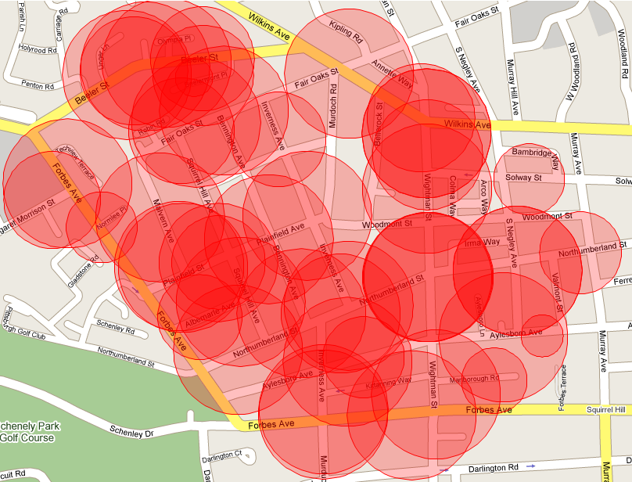
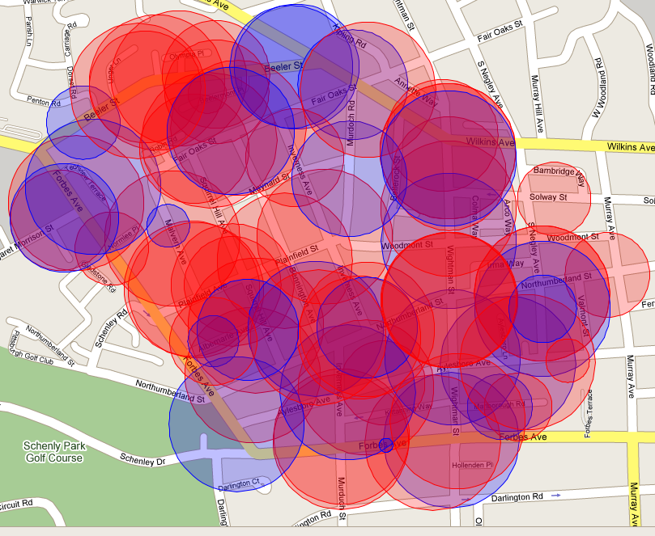
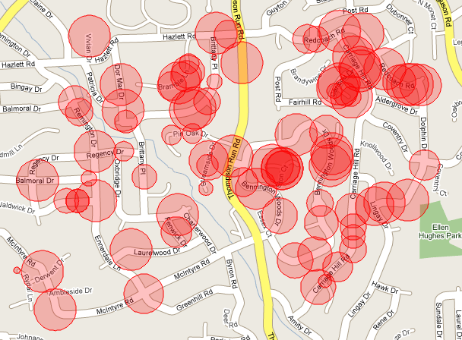
Connectivity: ISP diversity/Coverage
SQ
RMT
Other
Comcast
17%
10%
30%
Verizon DSL
Verizon Fiber-optic
61%
83%
ISP Break-down of Open APs
ISP Break-down of Open APs
95% coverage
40% coverage
98 % coverage
48 % coverage
Major ISPs can provide significant coverage.
Notes:
Using domain names, we identified ISPs and the types of technology they use.
Comcast and Verizon were the dominant ISPs in both neighborhoods. In RMT, 17% of open APs were subscribed to Verizon FiOS .
As a whole, the open APs offer diverse access to the dominant ISPs.
In SQ, open APs covered 98% of the area and RMT 48%.
Note that these are just a fraction of all APs.
Fraction of deployed APs cover significant area if not all.
This suggest that major ISPs potentially have this capability to cover the whole neighborhood through their customer’s AP.

Slide 12
Configuration: Home Networks Security
About 70% of APs are encrypted.
Top 7 Vendors | # of APs | % encrypted
Linksys | 977 | 65
Actiontec Electronics | 383 | 98
Netgear | 264 | 76
AboCom Systems | 249 | 78
D-Link | 232 | 55
Apple | 161 | 71
Belkin | 112 | 68
Vendor/ISP partnerships influence security settings.
Notes:
In both neighbors, 30% of APs were unencrypted.
When we break down the APs with security setting by vendors using the MAC address, we see that 60~70% of APs are encrypted regardless of the vendor with one exception.
APs from Actiontec Electronics were almost always encrypted. This fact was intriguing because other vendors such as Apple, also ships with encryption by default, but do not achieve the same fraction when deployed. The key difference is that Actiontec partners with Verizon and installs pre-configured APs to their customers.
This suggests that ISP driven deployments can influence home network settings.

Slide 13
Configuration: Home Network DNS
Most home users do not change DNS settings.
53% of DHCP servers supply remote, public DNS. (Vendor dependent)
99% of remote DNS are provided by the ISP.
98% of remote DNS are located in Pittsburgh, NJ, VA.
Content distribution networks (e.g., Akamai) would work well for residential users.
Notes:
We also looked at the DNS that home users use going through the DHCP lease information. We found evidence that most home users do not change the DNS setting. 53% of DHCP servers advertise a remote DNS, and 47% advertise local DNS in private address space. It had strong correlation with vendors. 99% of remote DNS are provided by their upstream ISP. We further studied the location of DNS and found that 97.5% of them were either collocated or located in neighboring states.

Slide 14
Summary
Mark-and-Sweep measures residential wireless and broadband network properties.
Mark-and-Sweep is efficient and accurate.
Measurements produced interesting insights, such as vendor/ISP influence on neighborhood networks, coverage provided by open APs and DNS settings in home networks.
Data and the tool available at http://cs.cmu.edu/~dongsuh/Mark-and-Sweep

Slide 16
Summary of results
ISP diversity in neighborhoods
Coverage of ISPs
Security and DNS configurations
Types of NATs used in home networks
Throughput comparison between DSL and Cable
Proximity to primary and alternative ISPs in neighborhoods
Penetration rates of 802.11n devices
Notes:
Mark-and-Sweep provides detailed view of various components including broadband, wireless, and configuration aspects in neighborhood networks. Internet based measurements do not provide such diverse views in neighborhood level of details.
Also studies on wireless APs, broadband properties, and types of NAT have been done in separately. But our approach allows us to cover all these aspects.

Slide 17
Characterizing the neighborhood networks
Characterizing the residential network connectivity
Previous approaches
- Internet-based study [IMC ’07]
- User-driven study [NETI@home]
- Wireless access point based
Internet
Types and bandwidth of the
last-mile link
Coverage of wireless APs
Configuration of home networks
broadband
Notes:
Residential networks typically consist of broadband connection and wireless access points.
Our goal is to characterize this residential Internet connectivity and the environment in which home users connect to the Internet. Specifically we want to answer questions like,
What are the types, bandwidth of the last-mile links?
How much coverage do wireless APs provide in neighborhoods?
What the typical configuration of home networks?
Three types of approaches have been taken to characterize residential connectivity. First, Internet-based measurement probes residential link from a remote internet site, and has been the largest in scale. However, Internet-based study suffers from measurement noise and inaccuracy since they are performed far from the target links. User-driven studies like NETI@home, improve accuracy, but require significant user participation. In this work, we use wireless access point which allows us to focus on the neighborhood-level connectivity.

