Slide 1
TCP Throughput Collapse in
Cluster-based Storage Systems
Amar Phanishayee
Elie Krevat, Vijay Vasudevan,
David Andersen, Greg Ganger,
Garth Gibson, Srini Seshan
Carnegie Mellon University

Slide 2


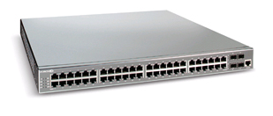
Cluster-based Storage Systems
Data Block
Synchronized Read
1
R
R
R
R
2
Client
Switch
3
1
2
3
4
Server
Request Unit
(SRU)
Client now sends
next batch of requests
4
Storage Servers
Notes:
Cluster-based storage systems are becoming increasingly popular. (both in research and in the industry)
Data is striped across multiple servers for reliability (coding/replication) and performance. Also aids in incremental scalability.
Client separated from servers by a hierarchy of switches – one here for simplicity
- high b/w, low latency network
- high b/w (1 Gbps), low latency (10s to 100 micro seconds)
Synchronized reads !
- describe block, SRU
- mention that this setting is simplistic
- could have multiple clients, multiple outstanding blocks,

Slide 3
TCP Throughput Collapse: Setup
Test on an Ethernet-based storage cluster
Client performs synchronized reads
Increase # of servers involved in transfer
  SRU size is fixed
TCP used as the data transfer protocol

Slide 4
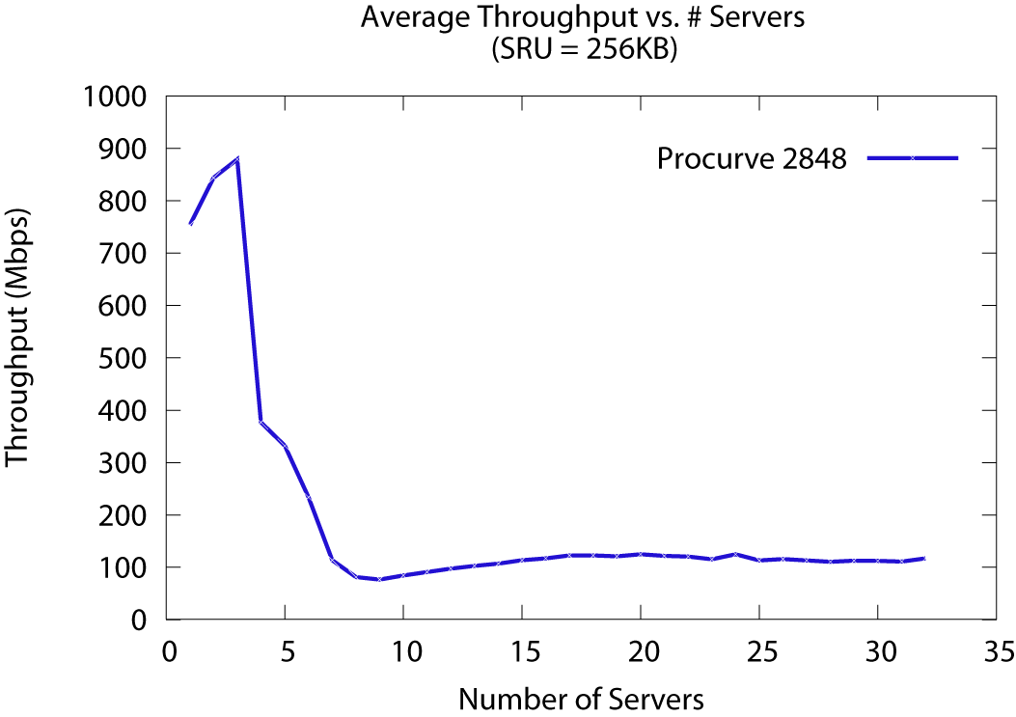
TCP Throughput Collapse: Incast
Collapse!
[Nagle04] called this Incast
Cause of throughput collapse: TCP timeouts
Notes:
Setup:
client---HP---server
SRU size = 256K
increase number of servers
X axis - # servers
Y axis – Goodput (throughput as seen by the application)
Order of magnitude drop for as low as 7 servers
Initially reported in a paper by Nagle et al. (Panasas) – called this Incast
Also observed before in research systems (NASD)
Cause – TCP timeouts (due to limited buffer space) + synchronized reads
With the popularity of iSCSI devices and companies selling cluster based storage file-systems, this throughput collapse is not a good thing.
If we want to play the blame game: if you wear the systems had you can easily say “Hey, this is the networks fault – networking guys fix it!”. If you wear the networking hat you would say “Well, TCP has been tried and tested over time in the wide area, and was designed to perform well and saturate the available bandwidth in settings like this one – so you must not be doing the right thing, like you might want to fine tune your TCP stack for performance”
Infact, Problem shows up only in synchronized read settings
- Nagle et al. ran netperf and showed that the problem did not show-up
In this paper, we perform an in-depth analysis of the effectiveness of possible “network-level” solutions.

Slide 5
Hurdle for Ethernet Networks
FibreChannel, InfiniBand
  Specialized high throughput networks
  Expensive
Commodity Ethernet networks
  10 Gbps rolling out, 100Gbps being drafted
  Low cost
  Shared routing infrastructure (LAN, SAN, HPC)
  TCP throughput collapse (with synchronized reads)
Notes:
FibreChannel, Inifiniband
High throughput (10 to 100Gbps), High performance
RDMA support for direct memory-memory data transfer without interrupting the CPU
Flow Control
But costly
Ethernet networks
shared network infrastructure can be used by both storage and compute clusters
10Gbit rolling out, 40/100Gbit being drafted
existing protocols designed for the wide area can be used
With all its advantages commodity ethernet networks seem to be the way to go
- but one of the major hurdles to cross the TCP throughput collapse observed in these networks
We are going to consider Ethernet for the rest of this talk

Slide 6
Our Contributions
Study network conditions that cause TCP throughput collapse
Analyse the effectiveness of various network-level solutions to mitigate this collapse.
Notes:
FibreChannel, Inifiniband
High throughput (10 to 100Gbps), High performance
RDMA support for direct memory-memory data transfer without interrupting the CPU
Flow Control
But costly
Ethernet networks
shared network infrastructure can be used by both storage and compute clusters
10Gbit rolling out, 40/100Gbit being drafted
existing protocols designed for the wide area can be used
With all its advantages commodity ethernet networks seem to be the way to go
- but one of the major hurdles to cross the TCP throughput collapse observed in these networks
We are going to consider Ethernet for the rest of this talk

Slide 7
Outline
Motivation : TCP throughput collapse
High-level overview of TCP
Characterizing Incast
Conclusion and ongoing work

Slide 8
TCP overview
Reliable, in-order byte stream
  Sequence numbers and cumulative acknowledgements (ACKs)
  Retransmission of lost packets
Adaptive
  Discover and utilize available link bandwidth
  Assumes loss is an indication of congestion
    Slow down sending rate
Notes:
TCP provides a reliable, in-order delivery of data. Fairness among flows (with same RTT)
So applications using TCP need not bother about losses in the network – TCP will take care of retransmissions, etc.
Bottleneck link bandwidth is shared by all flows. Congestion control is an adaptive mechanism – adapts to changing # of flows and varying network settings
Slow Start – For init or after timeout, until ss_thresh threshold, doubles CWND for every RTT (exponential growth to quickly discover link capacity)
Congestion Avoidance – Additive Increase – increase CWND by 1 for every RTT
-----
Congestion control
Adaptive mechanism
Slow start
Additive Increase, Multiplicative Decrease (AIMD)
Loss is an indication of congestion
Slow down sending rate

Slide 9
TCP: data-driven loss recovery
Seq #
1
2
Ack 1
3
4
Ack 1
5
Ack 1
Ack 1
3 duplicate ACKs for 1
(packet 2 is probably lost)
Retransmit packet 2
immediately
In SANs
recovery in usecs
after loss.
2
Ack 5
Sender
Receiver
Notes:
The sender waits for 3 duplicate ACKs because
- it thinks that packets might have been reordered in the network and that the receiver might have received pkt 2 after 3 and 4
- but it can’t wait forever (hence a limit – 3 duplicate ACKs)

Slide 10
TCP: timeout-driven loss recovery
Seq #
1
Timeouts are
expensive
(msecs to recover
after loss)
2
3
4
5
Retransmission
Timeout
(RTO)
1
Ack 1
Sender
Receiver
Notes:
Timeouts are expensive because
- you have to wait for 1 RTO before realizing that a retransmission is required
- RTO is estimated based on the round trip time
- estimating RTO – tricky (timely response vs premature timeouts)
- minRTO value in ms (orders of magnitude greater than the )

Slide 11
TCP: Loss recovery comparison
Timeout driven recovery is
slow (ms)
Data-driven recovery is
super fast (us) in SANs
Seq #
Seq #
1
1
Ack 1
2
2
3
Ack 1
4
3
5
Ack 1
Ack 1
4
5
Retransmit
2
Ack 5
Retransmission
Timeout
(RTO)
Sender
Receiver
Ack 1
1
Sender
Receiver
Notes:
The sender waits for 3 duplicate ACKs because
- it thinks that packets might have been reordered in the network and that the receiver might have received pkt 2 after 3 and 4
- but it can’t wait forever (hence a limit – 3 duplicate ACKs)

Slide 12
Outline
Motivation : TCP throughput collapse
High-level overview of TCP
Characterizing Incast
  Comparing real-world and simulation results
  Analysis of possible solutions
Conclusion and ongoing work

Slide 13
Link idle time due to timeouts
Synchronized Read
1
R
R
R
R
2
4
Client
Switch
3
1
2
3
4
Server
Request Unit
(SRU)
4
Link is idle until server experiences a timeout
Notes:
Given this background of TCP timeouts, let us revisit the synchronized reads scenario to understand why timeouts cause link idle time (and hence throughput collapse).
Setting: SRU contains only one packet worth of information.
If 4 is dropped, when server 4 is timing out, the link is idle – no one is utilizing the available bandwidth.

Slide 14
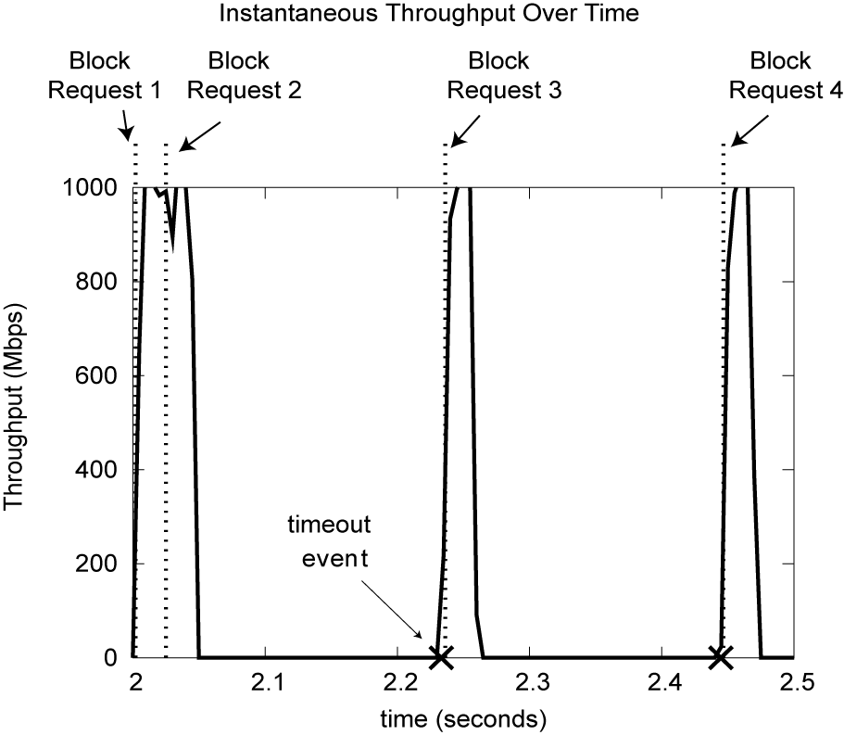
Client Link Utilization

Slide 15
Characterizing Incast
Incast on storage clusters
Simulation in a network simulator (ns-2)
  Can easily vary
    Number of servers
    Switch buffer size
    SRU size
    TCP parameters
    TCP implementations

Slide 16
Incast on a storage testbed
~32KB output buffer per port
Storage nodes run Linux 2.6.18 SMP kernel
Notes:
SRU = 256KB

Slide 17
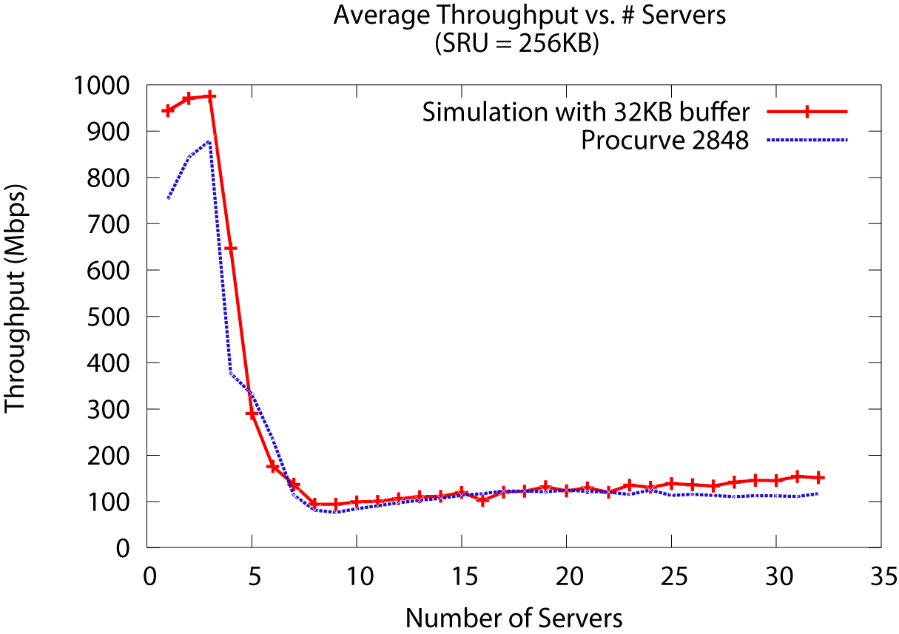
Simulating Incast: comparison
Simulation closely matches real-world result
Notes:
The slight difference between the two curve can be explained by the following reasons
- some non-determinism in the real world – servers in the real world can be slower in pumping data into the network that in simulation (simulated computers are infinitely fast)
- we do not know the exact buffer size on the Procurves (thought we believe it is close to 32KB)
SRU = 256KB

Slide 18
Outline
Motivation : TCP throughput collapse
High-level overview of TCP
Characterizing Incast
  Comparing real-world and simulation results
  Analysis of possible solutions
    Varying system parameters
      Increasing switch buffer size
      Increasing SRU size
    TCP-level solutions
    Ethernet flow control
Conclusion and ongoing work

Slide 19
Increasing switch buffer size
  Timeouts occur due to losses
    Loss due to limited switch buffer space
Hypothesis: Increasing switch buffer size delays throughput collapse
  How effective is increasing the buffer size in mitigating throughput collapse?
Notes:
Larger buffer size (output buffer per-port) → Fewer losses → fewer timeouts

Slide 20
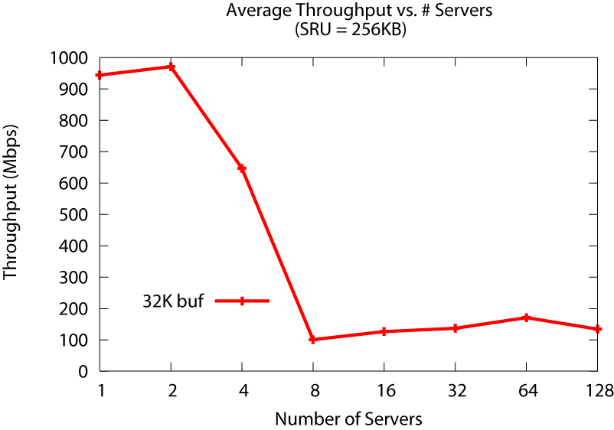
Increasing switch buffer size: results
per-port
output buffer
Notes:
First time a graph with x axis in log scale is being shown – explain it.
Note this is the same line that was shown before – but it looks different because of the log scale on the x-axis
SRU = 256KB

Slide 21
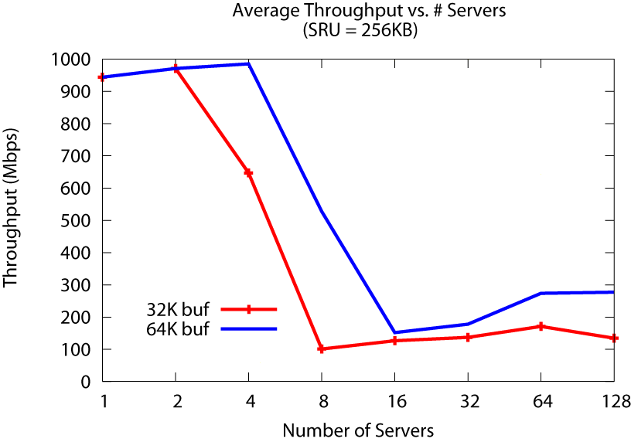
Increasing switch buffer size: results
per-port
output buffer

Slide 22
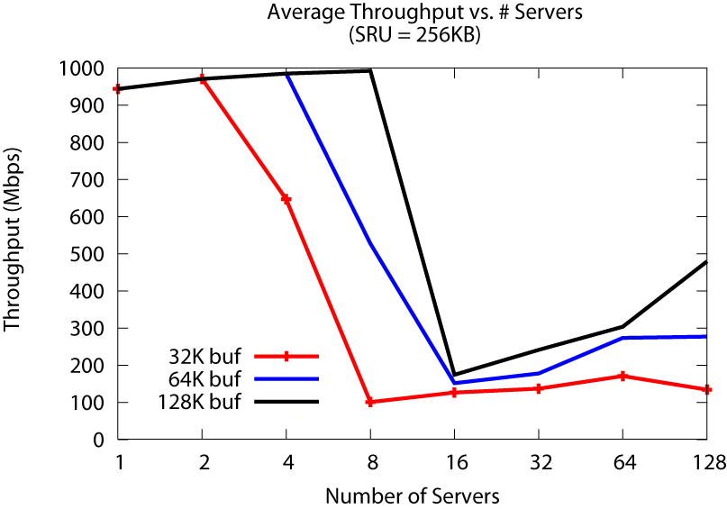
Increasing switch buffer size: results
per-port
output buffer
More servers supported before collapse
Fast (SRAM) buffers are expensive
Notes:
Very high capacity switches are vastly more expensive
When we tried this experiment on a switch that had a large per-port output buffer size (> 1MB), we were not able to notice a throughput collapse for as high as 87 servers.
But the cost of the switch was $0.5M !!!
A commodity Dell switch costs $1100
Force 10 S50 → 600+ ports, 1 to 5 MB per port (~ $1000/port)
HP Procurve – 24 port switch (~ $100/port)

Slide 23
Increasing SRU size
No throughput collapse using netperf
  Used to measure network throughput and latency
  netperf does not perform synchronized reads
Hypothesis: Larger SRU size → less idle time
  Servers have more data to send per data block
  One server waits (timeout), others continue to send
Notes:
Remind people about SRU – Server Request Unit
Larger SRU size → lesser link idle time
this is because when one of the serevrs is waiting for a timeout event to trigger, other servers can utilize the available link bandwidth

Slide 24
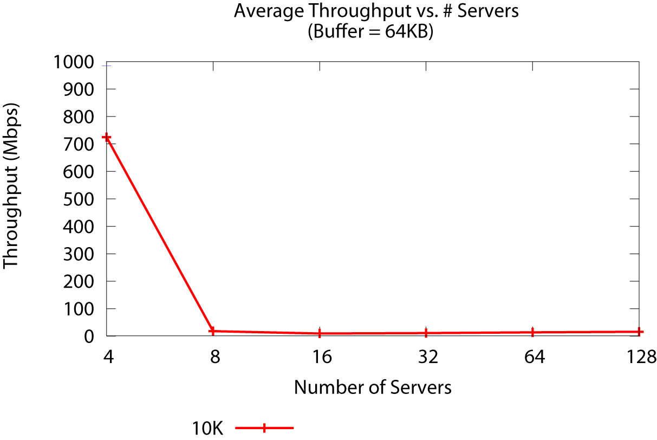
Increasing SRU size: results
SRU = 10KB
Notes:
Remind people about SRU
Buffer space = 64KB output buffer per port

Slide 25
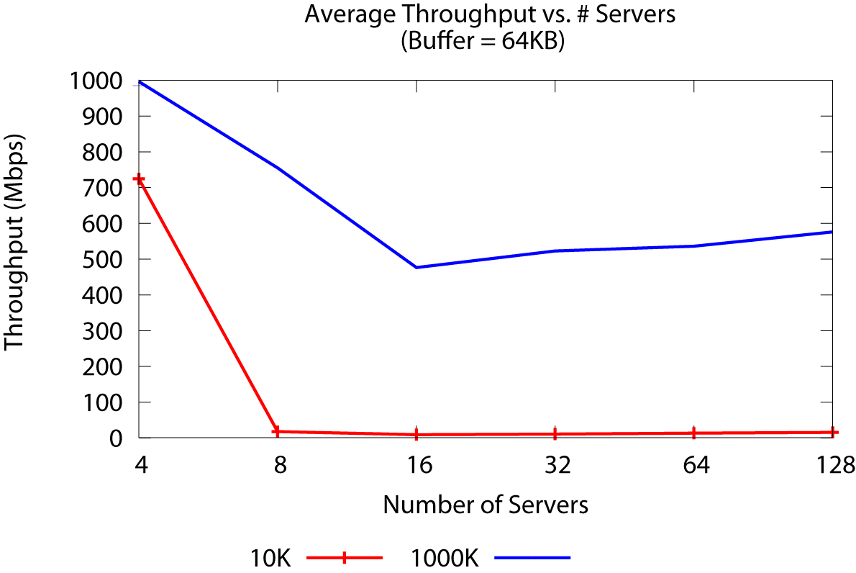
Increasing SRU size: results
SRU = 1MB
SRU = 10KB
Notes:
Buffer space = 64KB output buffer per port

Slide 26
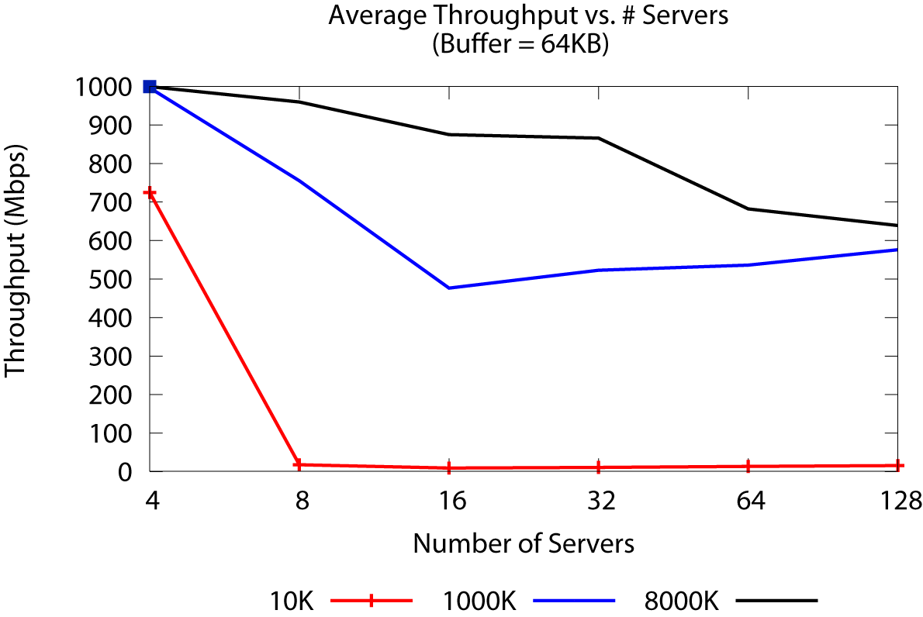
Increasing SRU size: results
SRU = 8MB
SRU = 1MB
SRU = 10KB
Significant reduction in throughput collapse
More pre-fetching, kernel memory
Notes:
More pinned space in client kernel leads to failures – Ric thinks this is not an issue, Garth and Panasas think this is! :-)
Buffer space = 64KB output buffer per port

Slide 27
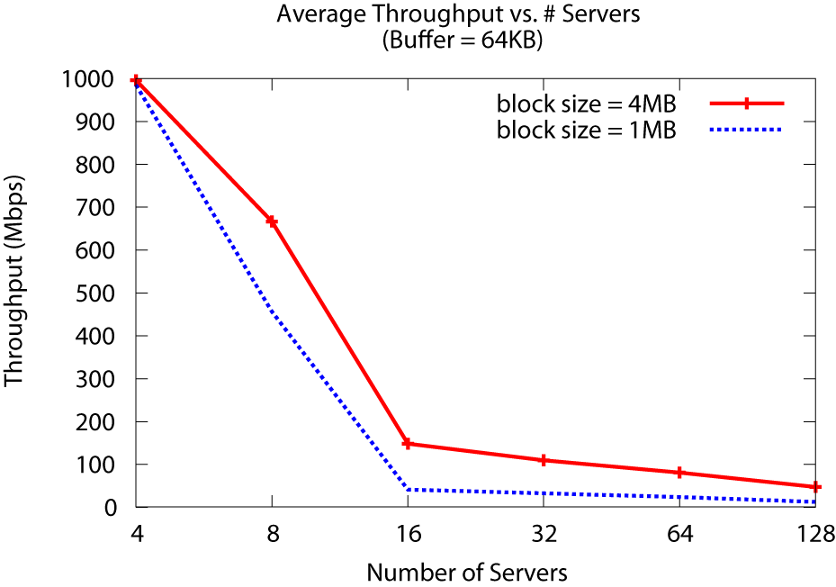
Fixed Block Size
Notes:
Buffer space = 64KB output buffer per port

Slide 28
Outline
Motivation : TCP throughput collapse
High-level overview of TCP
Characterizing Incast
  Comparing real-world and simulation results
  Analysis of possible solutions
    Varying system parameters
    TCP-level solutions
      Avoiding timeouts
        Alternative TCP implementations
        Aggressive data-driven recovery
      Reducing the penalty of a timeout
    Ethernet flow control

Slide 29
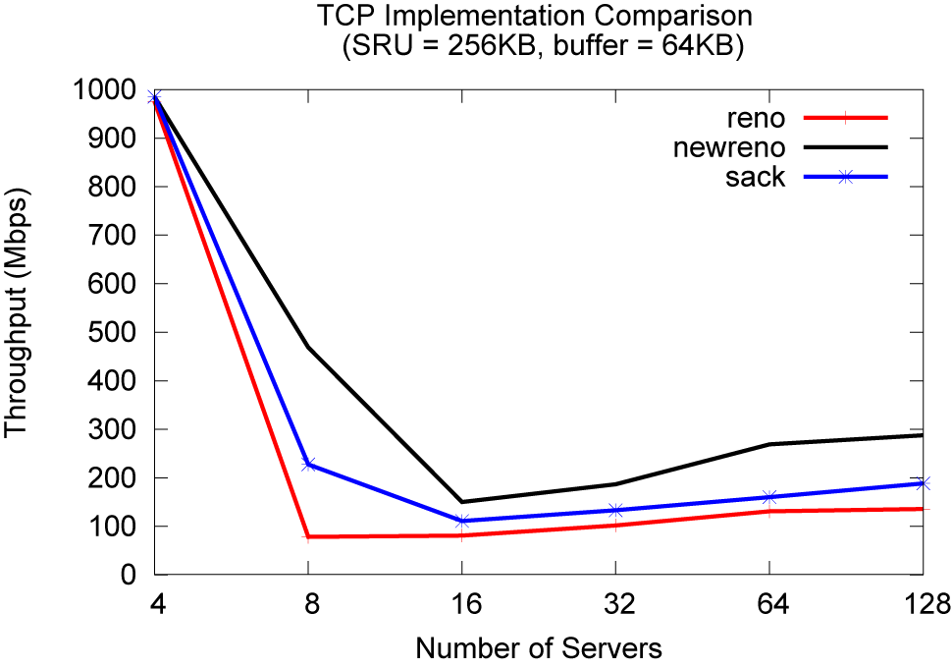
Avoiding Timeouts: Alternative TCP impl.
NewReno better than Reno, SACK (8 servers)
Throughput collapse inevitable
Notes:
SRU = 256KB
Buffer = 64KB

Slide 30
Timeouts are inevitable
1
2
Ack 1
1
1
3
2
2
4
3
3
5
Ack 1
4
4
5
5
1 dup-ACK
2
Ack 2
Retransmission
Timeout (RTO)
Retransmission
Timeout (RTO)
1
Ack 1
1
Sender
Receiver
Aggressive data-driven recovery does not help.
Sender
Receiver
Sender
Receiver
  Complete window of data is lost
  (most cases)
  Retransmitted packets are lost
Notes:
Why are timeouts still occurring when NewReno and SACK were specifically designed to reduce the number of timeouts
- timeout categorization showed that some timeouts occur even when there was limited feedback (<3 duplicate ACKs)
- reducing this to 1 is safe as there is no reordering in storage networks
Aggressive data-driven recovery did not help either
This was perplexing. So we categorized timeouts to find that all the timeouts occurring were inevitable

Slide 31
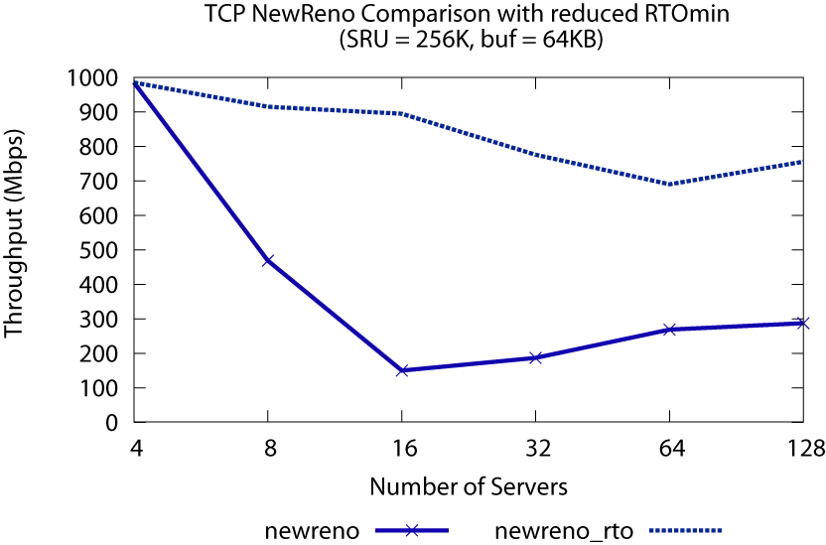
Reducing the penalty of timeouts
Reduce penalty by reducing Retransmission TimeOut period (RTO)
RTOmin = 200us
NewReno with
RTOmin = 200ms
Reduced RTOmin helps
But still shows 30% decrease for 64 servers
Notes:
Estimating RTO is tricky because if you are too aggressive, you will end-up retransmitting packets that might have been received by the destination (the ACK might be on its way back)
If you timeout and retransmit early (spurious retransmission + slow start)
On the other hand, being overestimating the RTO can hurt timely response to losses – can’t wait for too long.
RTOmin to guard against premature timeout
Default = 200ms – this made sense in the wide area where the RTT variation due to buffering in routers could be in ms.
3 orders of magnitude greater than RTT in SANs (100 us)
We reduce RTOmin in simulation

Slide 32
Issues with Reduced RTOmin
Implementation Hurdle
  Requires fine grained OS timers (us)
    Very high interrupt rate
    Current OS timers → ms granularity
    Soft timers not available for all platforms
Unsafe
  Servers talk to other clients over wide area
  Overhead: Unnecessary timeouts, retransmissions
Notes:
To reduce RTOmin to 200 us we need a TCP clock granularity of 100us. Linux TCP uses a TCP clock granularity of 10ms. BSD provides 2 coarse grained timers (200ms and 500ms) that are used to handle internal per-connection timers.
Allman et al. show that

Slide 33
Outline
Motivation : TCP throughput collapse
High-level overview of TCP
Characterizing Incast
  Comparing real-world and simulation results
  Analysis of possible solutions
    Varying system parameters
    TCP-level solutions
    Ethernet flow control
Conclusion and ongoing work

Slide 34
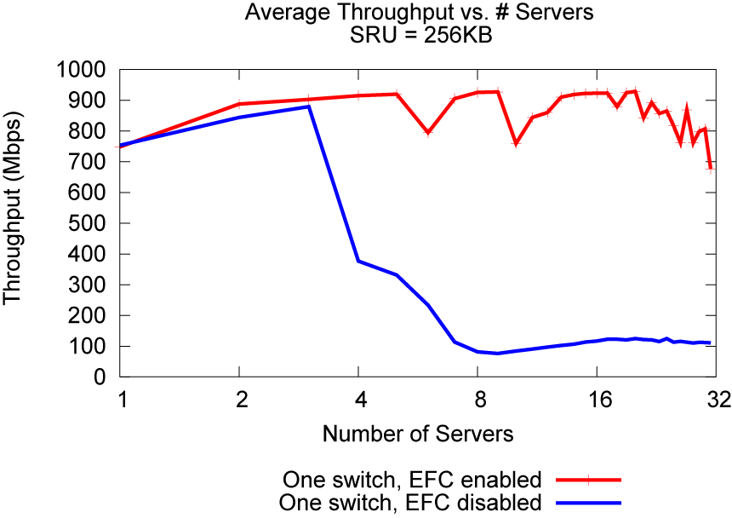
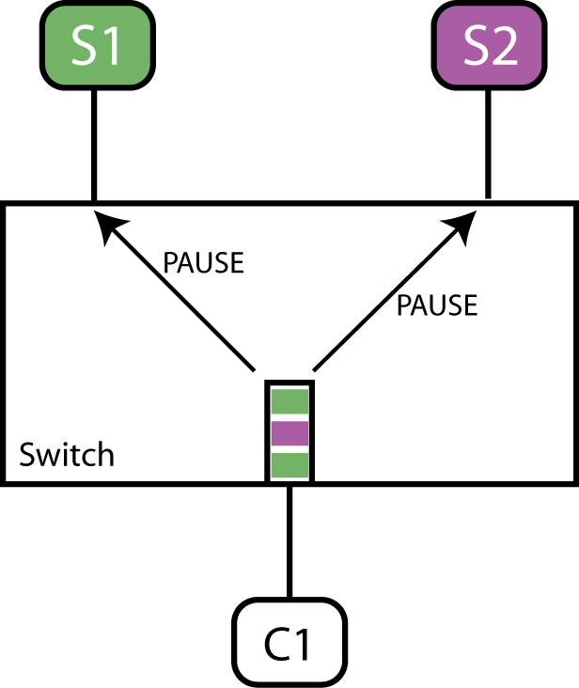
Ethernet Flow Control
Flow control at the link level
  Overloaded port sends “pause” frames to all senders (interfaces)
EFC enabled
EFC disabled
Notes:
We ran these tests on a storage cluster
Client and servers were separated by a single switch
SRU = 256 KB

Slide 35
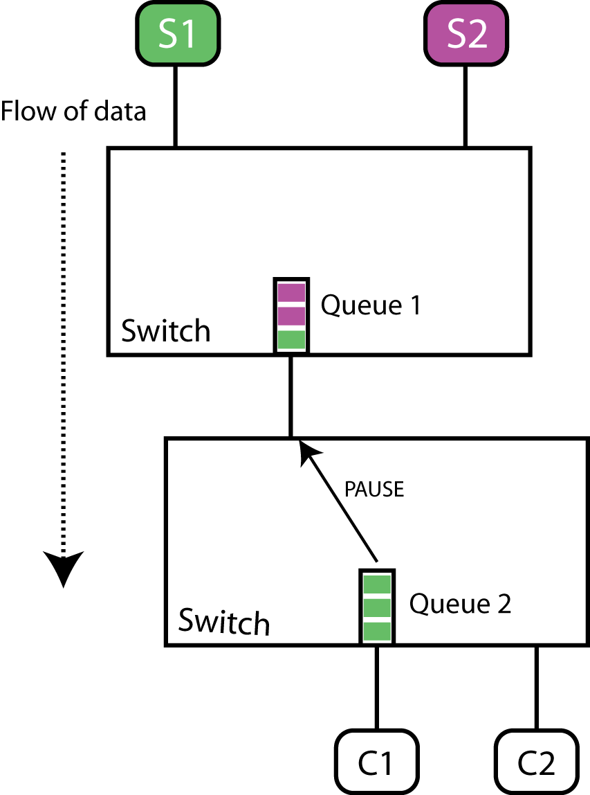
Issues with Ethernet Flow Control
Can result in head-of-line blocking
Pause frames not forwarded across switch hierarchy
Switch implementations are inconsistent
Flow agnostic
  e.g. all flows asked to halt irrespective of send-rate
Notes:
New standards of Ethernet Flow Control (Datacenter Ethernet) are trying to solve these problems, but it is unclear when these new standards will be implemented in switches
-

Slide 36
Summary
Synchronized Reads and TCP timeouts cause TCP Throughput Collapse
No single convincing network-level solution
Current Options
  Increase buffer size (costly)
  Reduce RTOmin (unsafe)
  Use Ethernet Flow Control (limited applicability)
Notes:
In conclusion …
Most solutions we have considered have drawbacks
Reducing the RTO_min value and EFC for single switches seem to be the most effective solutions.
Datacenter Ethernet (enhanced EFC)
Ongoing work: Application level solutions
Limit number of servers or throttle transfers
Globally schedule data transfers

Slide 37


Slide 38
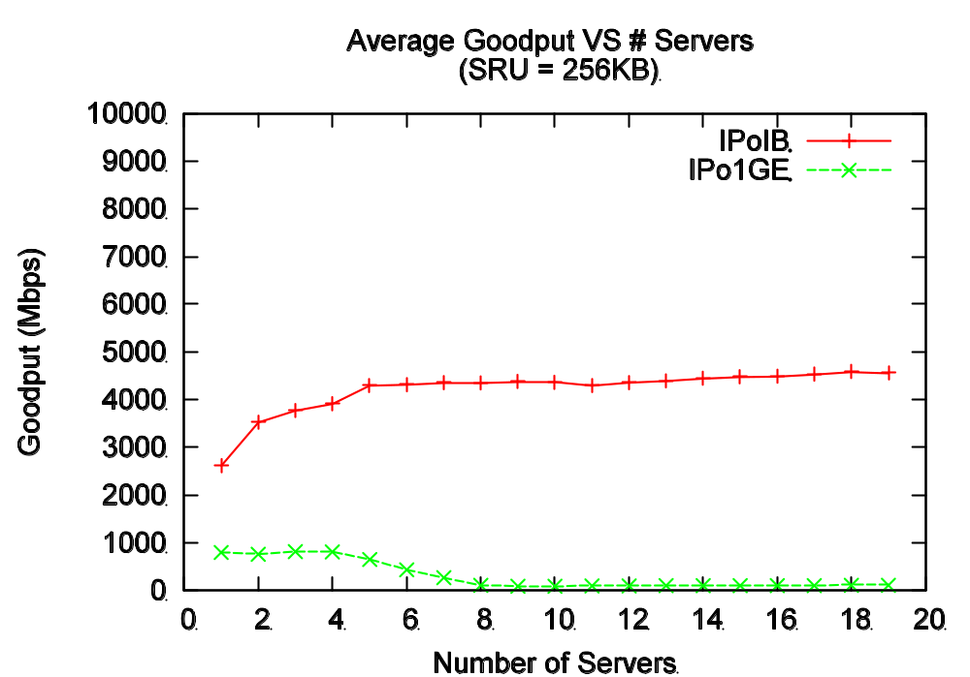

No throughput collapse in InfiniBand
Number of servers
Results obtained from Wittawat Tantisiriroj

Slide 39
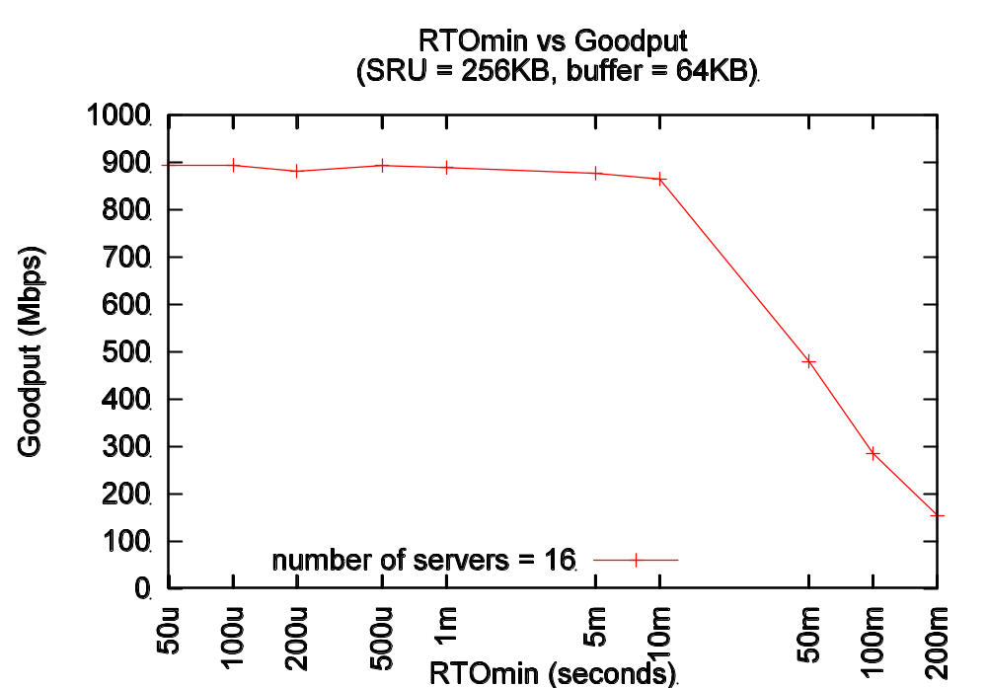

Varying RTOmin
RTOmin (seconds)

